Slide 1
Business Analystics Nanodegree
-
Project 3

Slide 2
Total Number of Sales by Each Sales Agent
We have Peacock Jane (EmployeeId 3) has the agent with the highest number of sales; Johnson Steve has the least.
The Number of sales by each agent are however close
Notes:
-- 1}. We are interested in knowing the total sales made by each sales agents. Provide a query that shows total sales made by each sales agent.--
SELECT e.*, count(i.invoiceid) as 'Total Number of Sales'
FROM employee as e
JOIN customer as c on e.employeeid = c.supportrepid
JOIN invoice as i on i.customerid = c.customerid
GROUP BY e.employeeid

Slide 3
Total Customers of Each Sales Agents
Peacock Jane has the most in the number of customers while Johnson Steve has the least
Notes:
-- 2}. Provide a query that shows the number of customers assigned to each sales agent.--
SELECT e.*, count(c.customerid) as 'TotalCustomers'
FROM employee as e
JOIN customer as c on e.employeeid = c.supportrepid
GROUP BY e.employeeid

Slide 4
Highest Spending Customers in Each Country
The diagram presents the highest spending customer in each country (Top 10 returned.
Helena from Czech Republic is the highest spending customer; this is followed by Richard from USA
Country | TotalSpent | FirstName
Czech Republic | 49.62 | Helena
USA | 47.62 | Richard
Chile | 46.62 | Luis
Hungary | 45.62 | Ladislav
Ireland | 45.62 | Hugh
Germany | 43.62 | Fynn
Austria | 42.62 | Astrid
Finland | 41.62 | Terhi
France | 40.62 | Isabelle
Netherlands | 40.62 | Johannes
Notes:
--3}. Write a query that determines the customer that has spent the most on music for each country. Write a query that returns the country along with the top customer and how much they spent. --
WITH t1 AS
(SELECT c.Country, SUM(i.Total) TotalSpent, c.FirstName, c.LastName, c.CustomerId
FROM Customer c
JOIN Invoice i ON c.CustomerId = i.CustomerId
GROUP BY c.CustomerId
)SELECT t1.*
FROM t1
JOIN(
SELECT Country, MAX(TotalSpent) AS MaxTotalSpent, FirstName, LastName, CustomerId
FROM t1
GROUP BY Country
)t2
ON t1.Country = t2.Country
WHERE t1.TotalSpent = t2.MaxTotalSpent
ORDER BY "TotalSpent" DESC;

Slide 5
Number of Customers in Each Country
We can see the USA has the highest number of customers.
Sweden, Spain, Poland, Norway, Netherlands, Italy, Ireland, Hungary, Finland, Denmark, Chile, Belgium, Austria, Australia and Argentina have the least number of customers (1 each).
Notes:
--4}. Use the Invoice table to determine the countries that have the most invoices. Provide a table of BillingCountry and Invoices ordered by the number of invoices for each country. The country with the most invoices should appear first.
SELECT Country, Count(*) as "Number of Customers"
FROM Customer
GROUP BY Country
ORDER BY count(*) DESC;

Slide 6
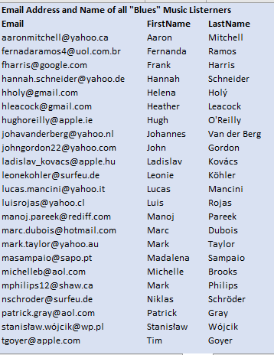
Email Address and Names of all Blues Music Listeners
The table presents the email address and names of all “Blues” Music Listeners
The list is ordered alphabetically by email address
Notes:
-- 5}. Provide a query to return the distinct email, first name, last name, and Genre of all Blues Music listeners.
-- Return your list ordered alphabetically by email address
SELECT DISTINCT Email, FirstName, LastName
FROM Customer C JOIN Invoice I
ON C.CustomerId = I.CustomerId JOIN InvoiceLine IL
ON I.InvoiceId = IL.InvoiceId JOIN Track T
ON IL.TrackId = T.TrackId JOIN Genre G
ON T.GenreId = G.GenreId
WHERE G.Name = "Blues"
ORDER BY C.Email

