Slide 1
Youtube-Analysis
File created on: 8/28/2022 5:03:31 PM

Slide 2
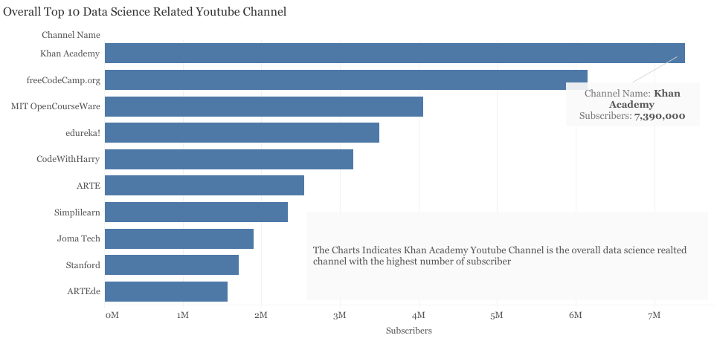

Slide 3
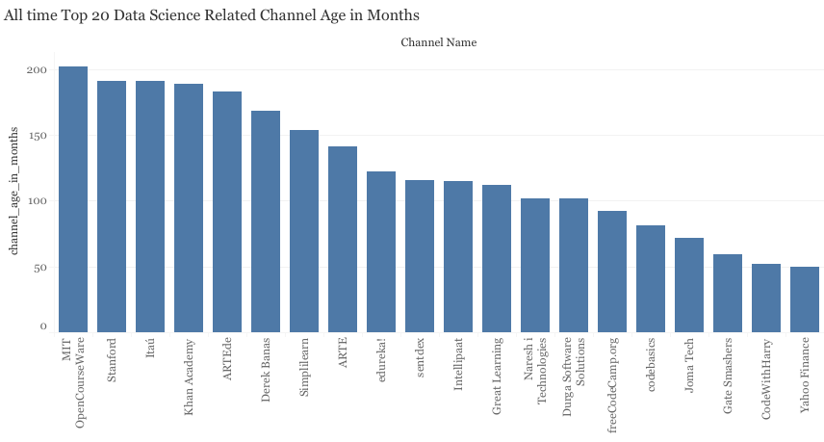

Slide 4
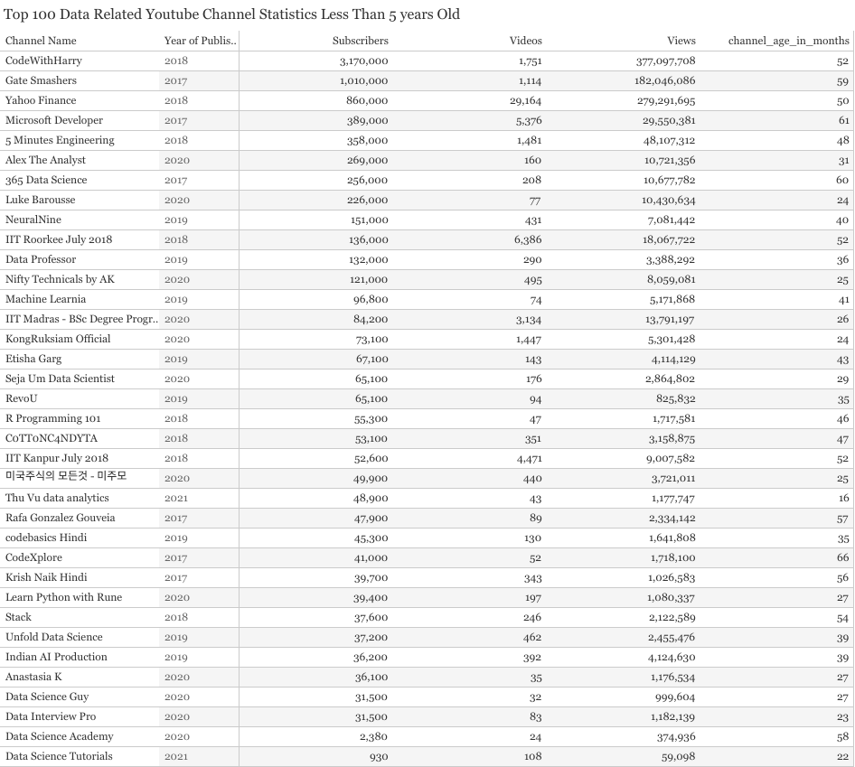

Slide 5


Slide 6
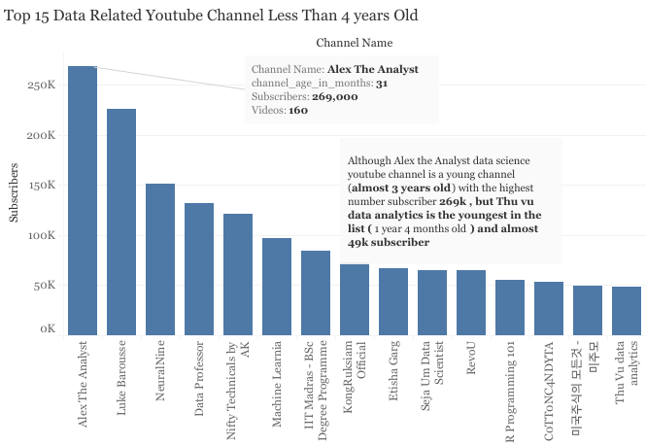

Slide 7
