Slide 1
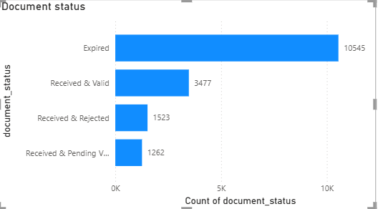
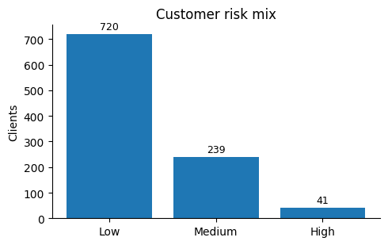
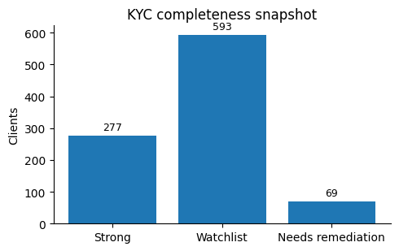
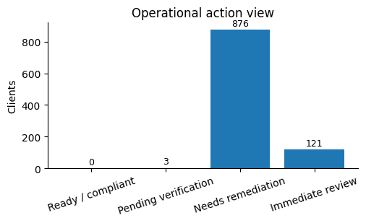
KYC Analytics Dashboard
for Banking Compliance
We have identified the risks and spotted documentation gaps. We thus need to prioritize remediation and support audit readiness.
1,000
16,807
41
clients reviewed
documents tracked
high-risk clients
Tools: Power BI, DAX, Excel
Dataset: synthetic corporate-banking KYC records
Ayodeji Jolaoso | KYC Analytics Portfolio

Slide 2
What is business question?
The problem
The workflow
Why we care
We cannot onboard or retain our clients safely if we cannot quickly see who is high risk, which files are incomplete and where review work is piling up.
1. Segment
customer risk
2. Check
document health
3. Prioritise
remediation
4. Improve
audit readiness
What message is being conveyed
The simple action: who needs review now, which files need remediation and what should happen next.
Why it matters
Shows the importance of KYC risk scoring, document review and remediation work flow to aid daily operational decisions.
Ayodeji Jolaoso | KYC Analytics Portfolio

Slide 3
The Question: How healthy is the book overall
92.1%
720
239
41
99
593
69
average completeness
low-risk clients
medium-risk clients
high-risk clients
PEP-linked
watchlist files
need remediation
The takeaway
Most clients are low risk, but a small high-risk segment still deserves close monitoring because those cases can carry disproportionate regulatory exposure.
What we need to do
Use the risk mix to assess resources, then use completeness status to decide which files can move forward and which need remediation first.
Ayodeji Jolaoso | KYC Analytics Portfolio

Slide 4
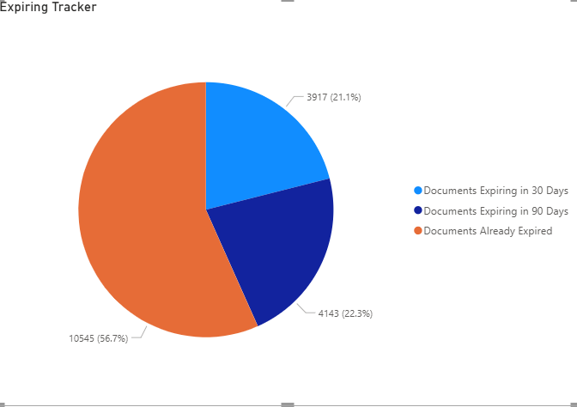
The main bottleneck is document gap
Once risk is understood, the next question is whether the supporting documentation is usable.
9,575
5,709
1,523
10,545
verified docs
pending verification
failed verification
expired docs
The takeaway
The bigger issue is not just missing documents. A large share of the documents book is expired or still waiting for verification, which slows onboarding and periodic review.
Operational meaning
This explains the backlogs and where we need process improvement, refreshes, follow-ups and review quality.
Ayodeji Jolaoso | KYC Analytics Portfolio

Slide 5
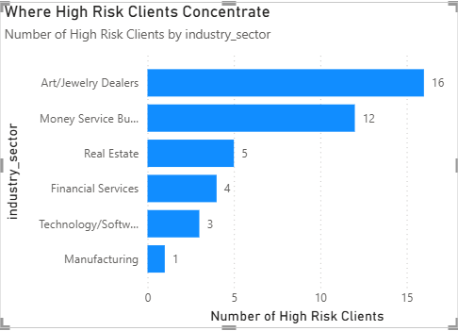
High risk clients are not evenly distributed across sectors
EDD is concentrated in in Art/Jewelry dealers and MSBs.
What this means
Art/Jewelry Dealers and Money Service Businesses show the highest share of high-risk clients in this portfolio.
That does not mean every customer in those sectors is problematic; it means those sectors may need stronger screening and review controls.
The takeaway
We need tighter onboarding rules, more EDD for the top two client categories.
Ayodeji Jolaoso | KYC Analytics Portfolio

Slide 6
The action queue
So what do we do now?
Clients that need remediation
69 Clients
15 Clients
60
need remediation. These Clients have missing, expired or failed documents that prevent their files from being treated as complete.
need faster review because they sit in the medium-risk bucket and still carry unresolved document gaps.
50
40
The takeaway
30
54
Prioritise the 15 medium-risk files first, then clear the 54 low-risk files in batches. Monitor overdue documents, failed verification, PEP links and ageing remediation items until closure.
20
10
15
0
Low
Medium
How can we use this
Assign medium-risk cases to senior analysts, batch low-risk fixes, and track weekly progress by owner, ageing, and closure rate.
Risk Tier ▼
Ayodeji Jolaoso | KYC Analytics Portfolio

Slide 7
Recommended actions
1. Clean the backlog
2. Automate follow-ups
3. Improve document standards
4. Report weekly
Start with files that combine high-risk or PEP signals with document issues. Those are the cases most likely to concern compliance management and auditors.
Use reminders and workflow controls for pending and expiring documents so analysts spend less time chasing routine updates manually.
High expired and failed-document volumes suggest a need for better submission guidance, stronger validation checks and earlier quality review.
Track remediation by queue, owner and status so progress is visible.
Ayodeji Jolaoso | KYC Analytics Portfolio

Slide 8
Recommended actions
1. Triage immediately
2. Clear the backlog
3. Tighten controls
4. Report weekly
Move all PEP-linked, failed-verification and ageing files to the front of the queue. These are the cases with the highest regulatory exposure.
Work the remaining remediation files in controlled batches with named owners, due dates and clear closure standards.
Strengthen intake checks, verification rules and expiry monitoring to stop repeat document exceptions entering the process.
Track ageing, overdue items, PEP files, failed verification and closure rates so management sees progress early.
Ayodeji Jolaoso | KYC Analytics Portfolio

