Slide 1
Computer Aided Education in Physics by using Double Pendulum Equipment
Mitsuo Suzuki, Mitsuhiko Toho¹,
Atsushi Minato and Satoru Ozawa
Graduate School of Science and Engineering,
Ibaraki University
Polish-Japanese Institute for Information Technology¹

Slide 2
IT is changing university
Development of digital audio & video devices
Digital video camera, Multimedia computer,
Large capacity digital storage devices, High intensity projector
→ (a) Improvement of teaching methods in classes
Development of digital telecommunications
Web Based Training System ( Web + Data base + VOD)
Remote lecture & Remote seminar equipments
Mobile terminals (Palm PC, Internet mobile phone)
→ (b) Virtual university, Virtual campus

Slide 3
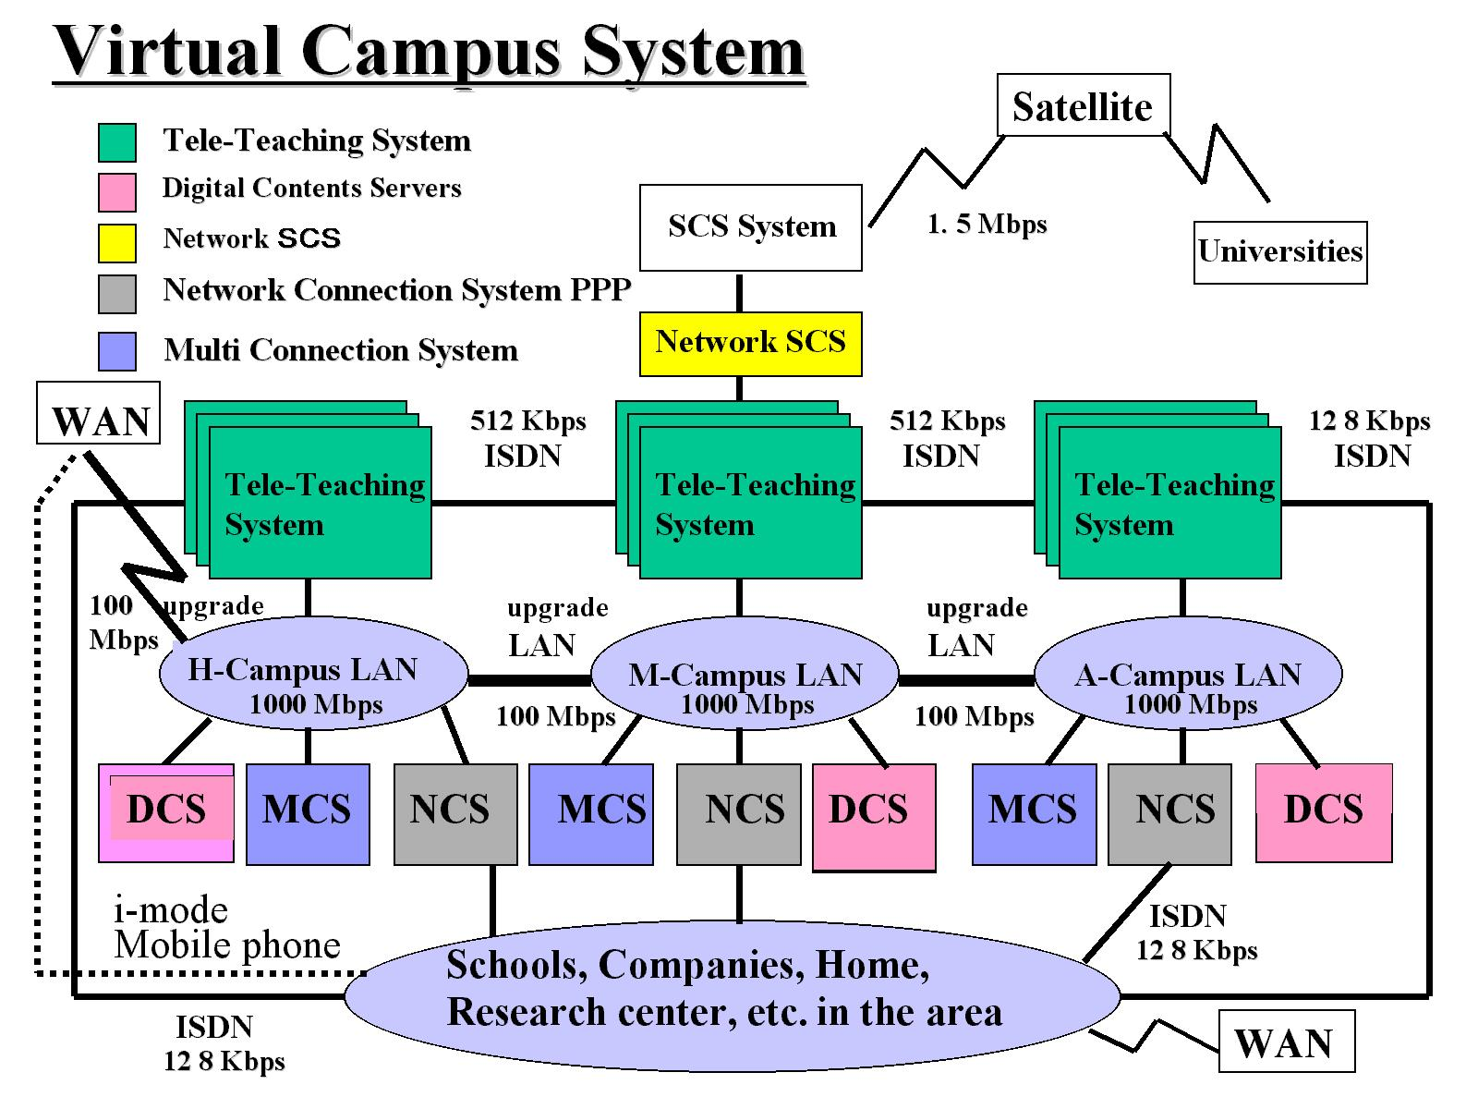
Virtual Campus Project, Ibaraki Univ.

Slide 4
Strategy of virtual campus project
New calcium free from the restrictions of the campus geometry (50km separation)
Collaboration in research between separated campuses
Virtual campus covers various activities in the area (schools, research centers, industries, people at homes)

Slide 5
How to improve teaching method in classes
Software rather than hardware
Achievement of Virtual Campus
→ Staff’s individual effort toward improvement of teaching method in classes
Example: Lecture on “mechanical chaos”
Topic : special
Discussion : general

Slide 6
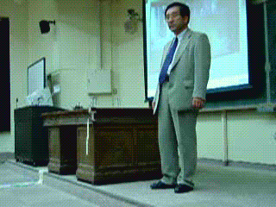
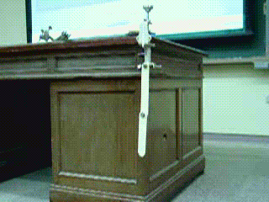
Begin with attractive demonstration
(Do not start with a flood of mathematical expressions !!)
Simple mechanical structure
→ Chaotic motion

Slide 7
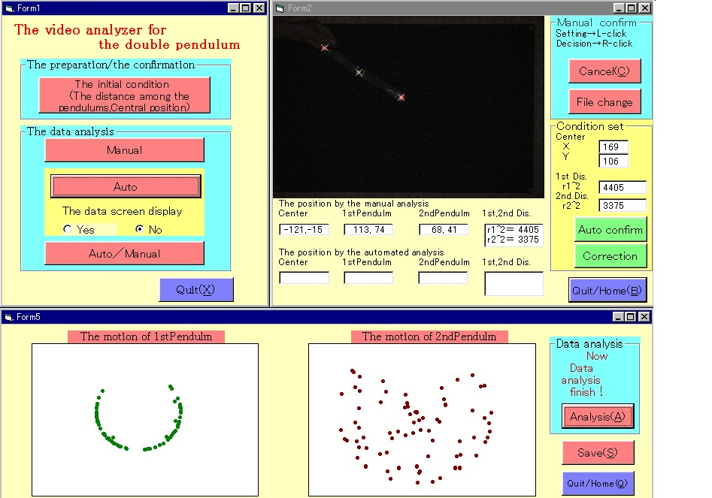
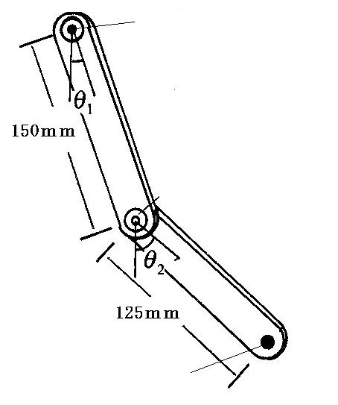
How to observe the motion precisely?
(Modern way of observation)
Monitor the movement by digital video camera
Analysis the image analysis on PC
.
hinge with red marker
upper bar
hinge with green marker
lower bar
red marker

Slide 8
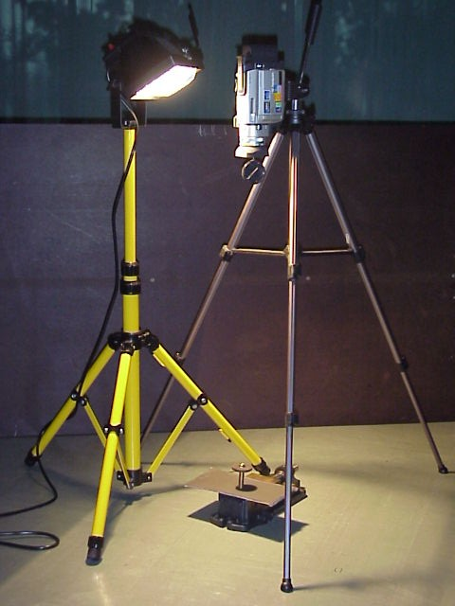
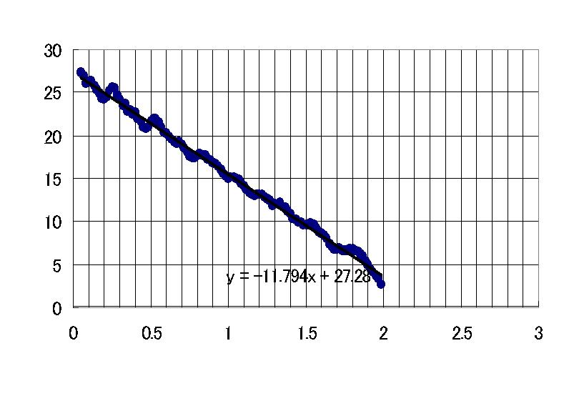
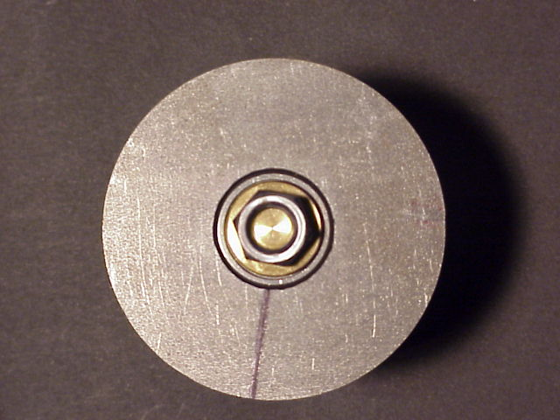
Give enough experimental information (1)
(Measurement of friction force at hinges)
Angular velocity (rad/sec)
Time (sec)
friction force = constant

Slide 9
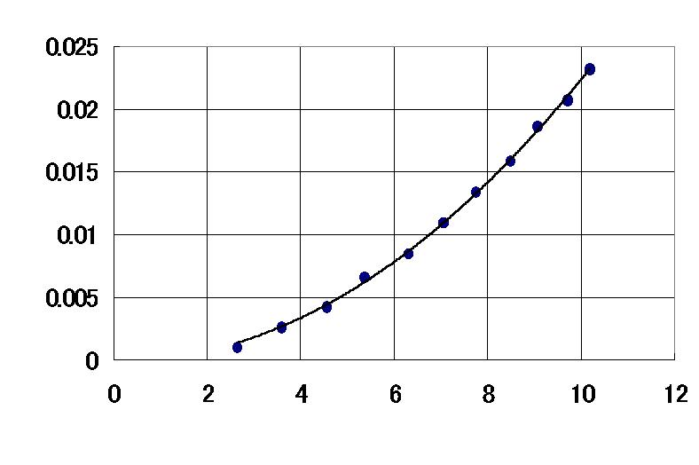
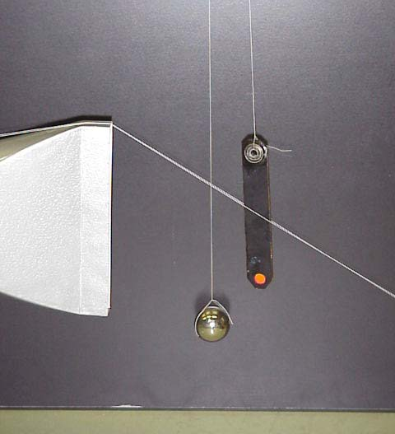
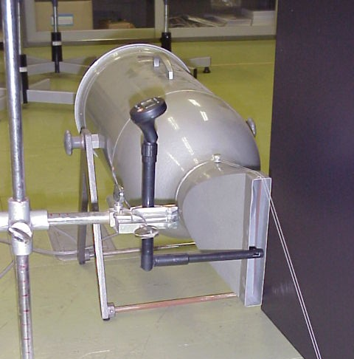
Give enough experimental information (2)
(Measurement of air resistance force, F_{air})
F_{air} (N)
Air stream velocity, v (m/s)
F_{air} = kv²

Slide 10
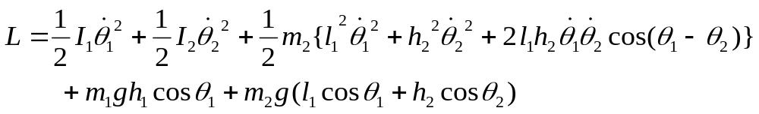
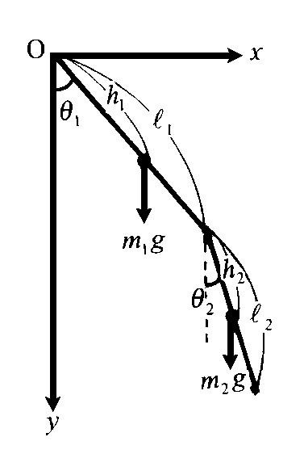


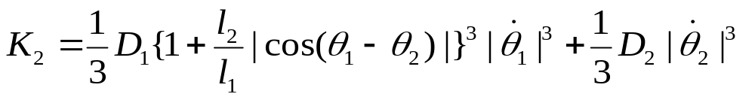
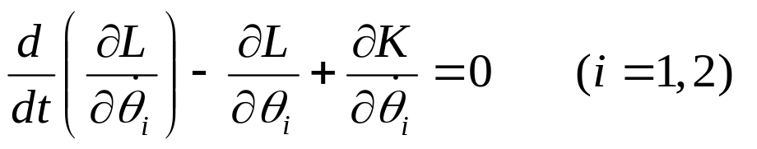
Express analytically as precisely as possible
(Easy simplification or modeling is no good!!)
Lagrangian formulation
Dissipation function
Equation of motion

Slide 11
Everything through computer simulation
Numerical integration of equation of motion
( Runge-Kutta method)
→ Produce all the possible motions in computer
Graphics presentation
(Original graphics software, SGL)
→ Interactive study with computer
What to see is determined by students!!

Slide 12
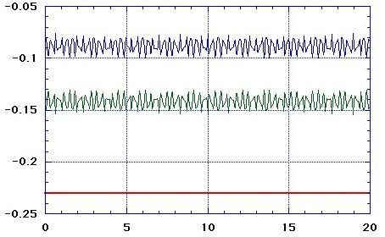
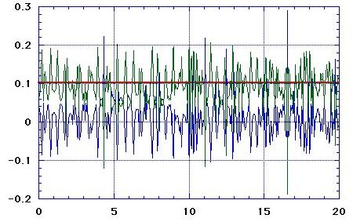


To see “pure chaotic motion” in computer
(Chaos is easily veiled by energy dissipation
→ neglect energy dissipation terms)
Quasi-harmonic
Chaotic
Upper bar
Lower bar
Energy (J)
Energy (J)
Sum of the two
Time (sec)
Time (sec)
(a) low energy initial state (b) high energy initial state

Slide 13
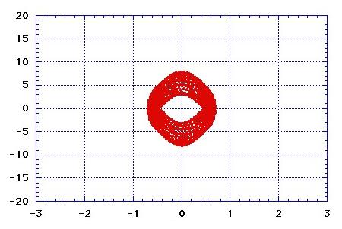
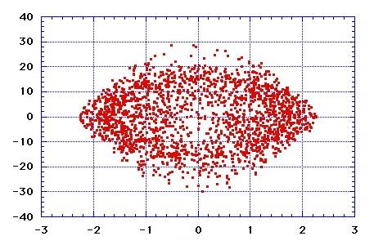

Poincare’s mapping
Quasi-harmonic
Chaotic
Angular velocity (rad/sec)
Angular velocity (rad/sec)
(a) low energy initial state (b) high energy initial state

Slide 14
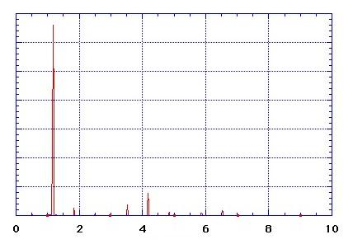
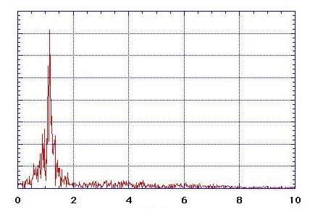
Fourier analysis
Quasi-harmonic
Chaotic
(b)
(a)
Power spectrum
Power spectrum
Frequency (Hz)
Frequency (Hz)
Frequency (Hz)
(a) low energy initial state (b) high energy initial state

Slide 15
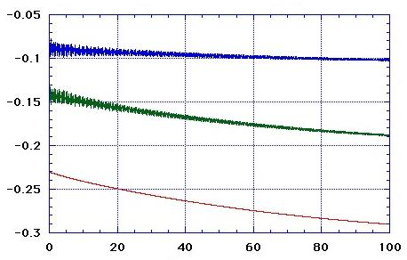
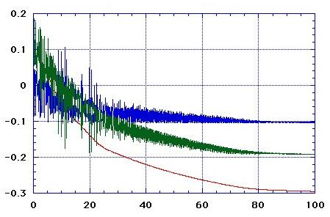
Quasi-harmonic
“Pure” chaotic
Upper bar
Lower bar
Energy (J)
Energy (J)
Sum of the two
Time (sec)
Time (sec)
Harmonic with energy dissipation
Chaotic with energy dissipation
Energy (J)
Energy (J)
Time (sec)
Time (sec)

Slide 16
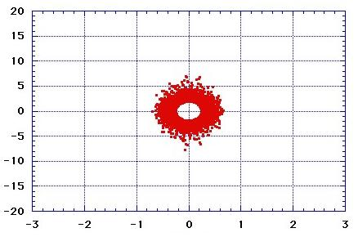
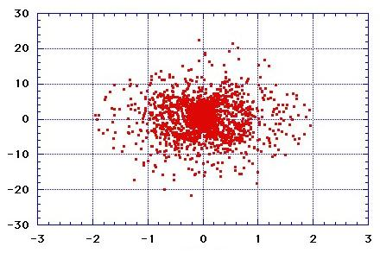
Quasi-harmonic
“Pure” chaotic
Angular velocity (rad/sec)
Angular velocity (rad/sec)
Harmonic with energy dissipation
Chaotic with energy dissipation
Angular velocity (rad/sec)
Angular velocity (rad/sec)

Slide 17
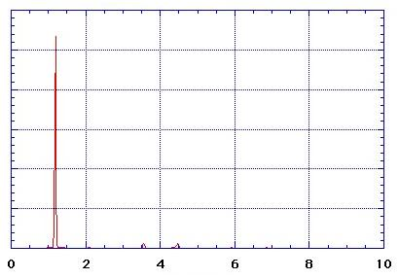
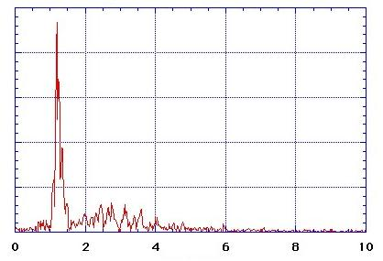
Quasi-harmonic
“Pure” chaotic
(b)
(a)
Power spectrum
Power spectrum
Frequency (Hz)
Frequency (Hz)
Frequency (Hz)
Harmonic with energy dissipation
Chaotic with energy dissipation
Power spectrum
Power spectrum
Frequency (Hz)
Frequency (Hz)

Slide 18
The topic covers 3 categories of physics
Experimental physics
Modern way of observation
(Monitor movement by digital video camera,
Analysis the image analysis on PC)
Theoretical physics
Lagrange’s equation of motion, Dissipation functions
Computational physics
Runge-Kutta method, Poincare’s mapping, Fourier analysis
The material is suited for digital contents

Slide 19
Advantages to use digital contents
Multimedia type information is inserted
into text base information
→ Attractive material for education
(2) Links between elements of content make it possible
to do “net surfing like study”
→ Kind supplemental explanations
→ Flexibility in learning (the material covers wide range of student’s abilities)
(3) Interactive learning between students and computers
can be realized
→ Stop student’s “passive” way of learning

Slide 20
Future university education
(Multimedia and Network will change university dramatically)
Flexible learning system
Depending upon student’s ability, multiple courses in “one” class
Whenever and Wherever learning
Role of professor
Prepare good digital contents
Human care program (consulting)

