Slide 1
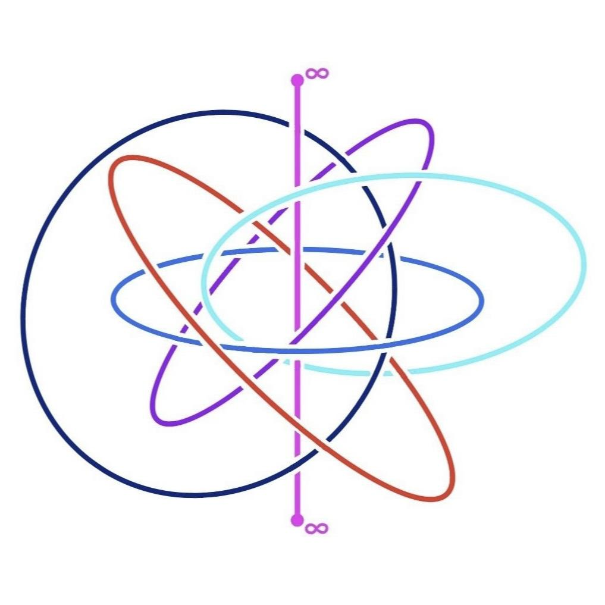
Geometric Design of Geometric Designs
Ayodeji Lindblad

Slide 2
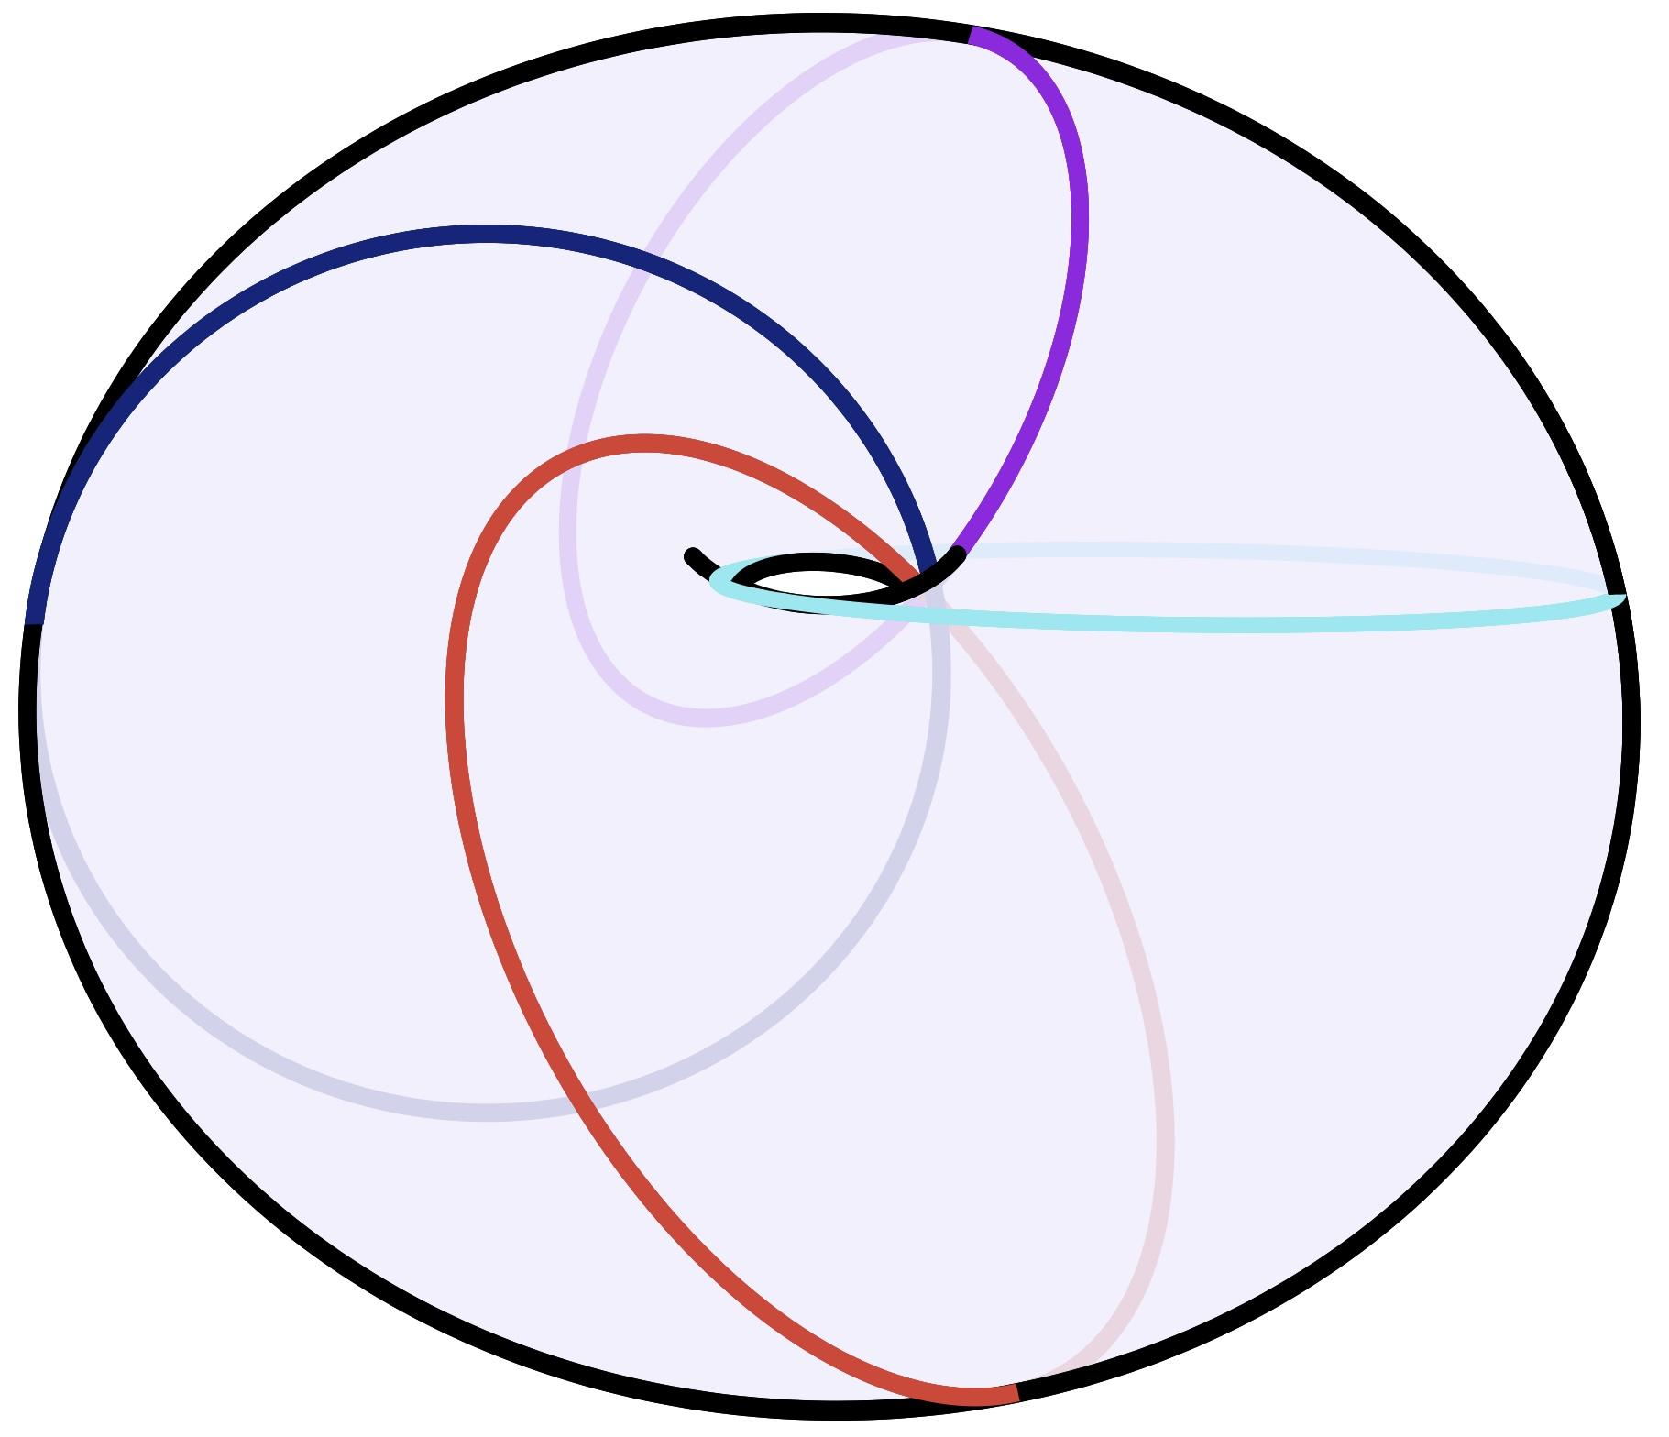
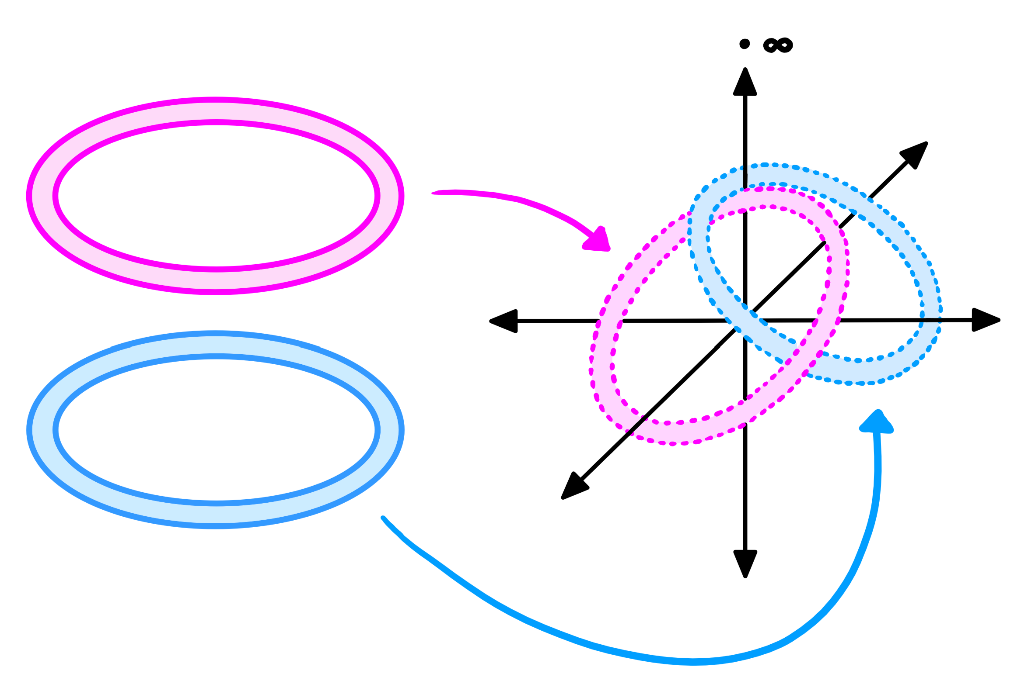
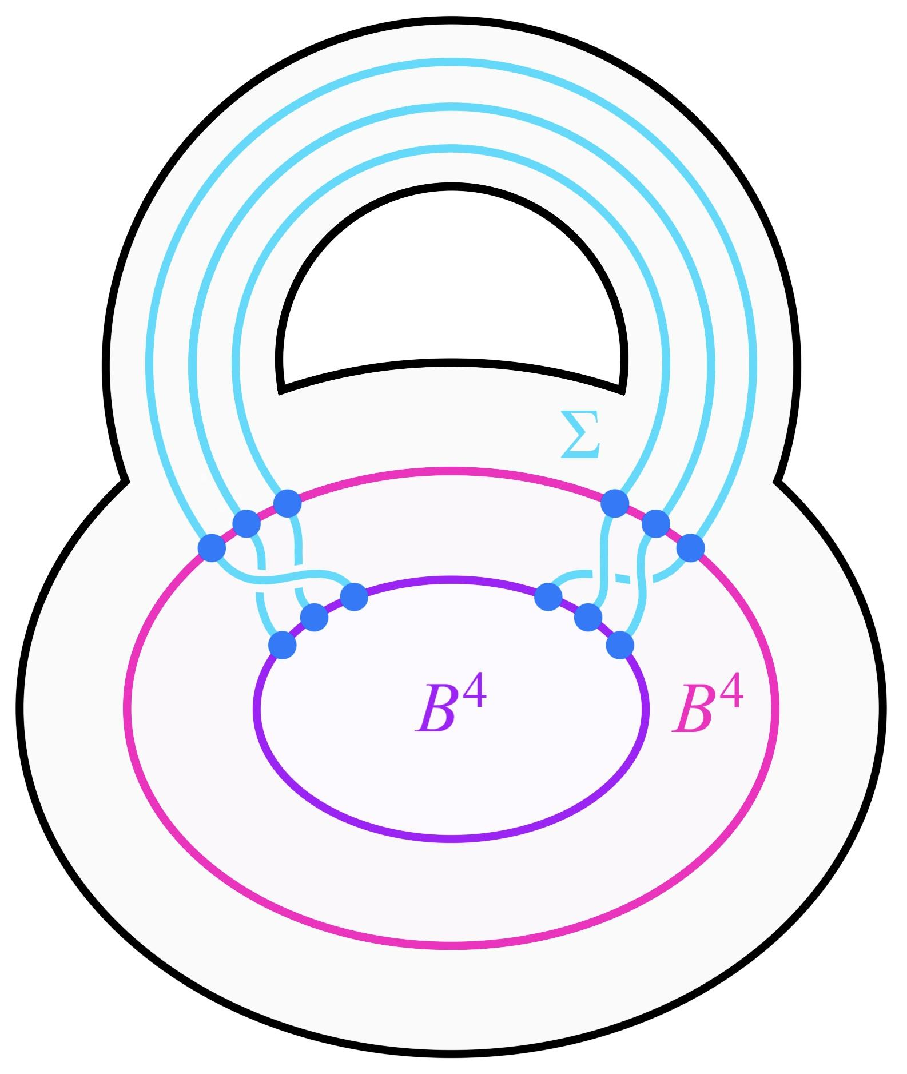
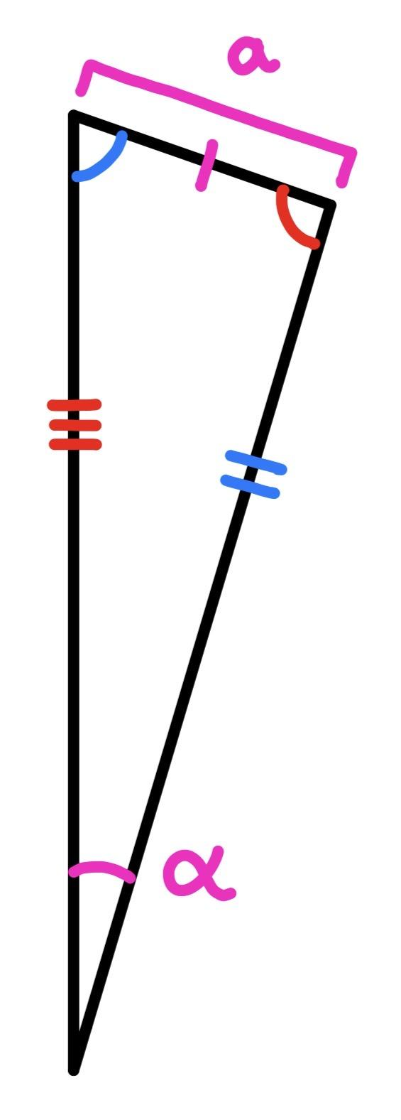
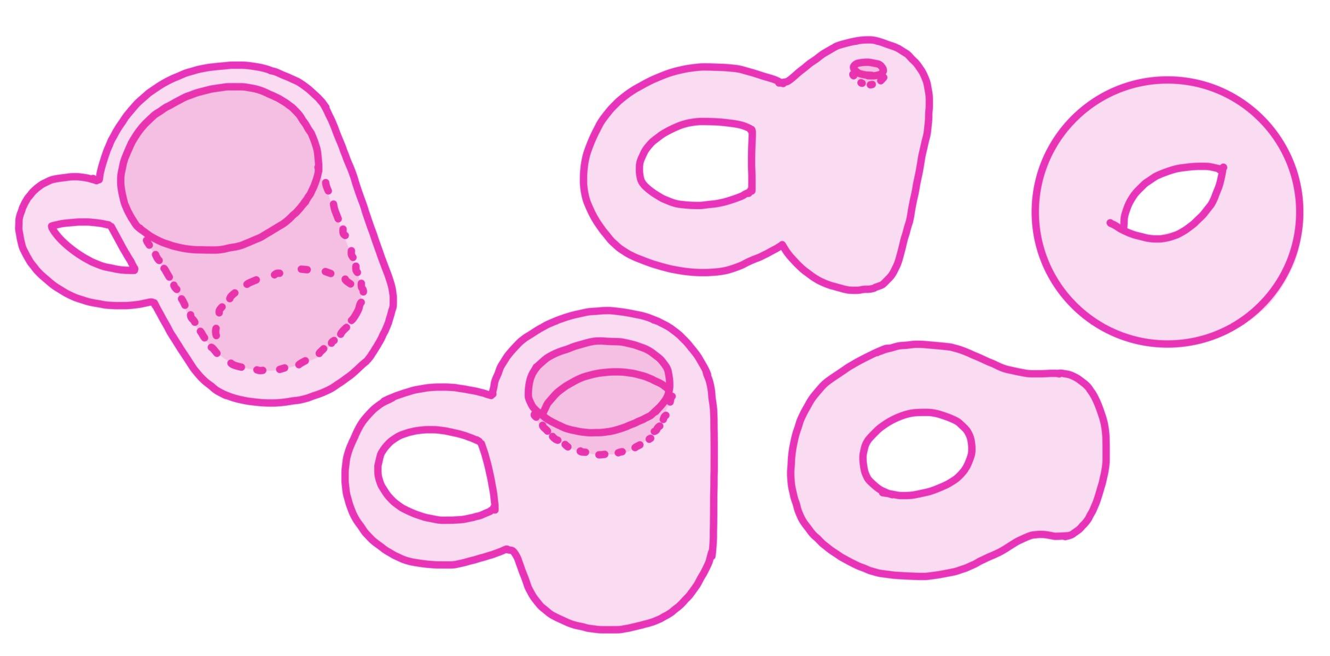
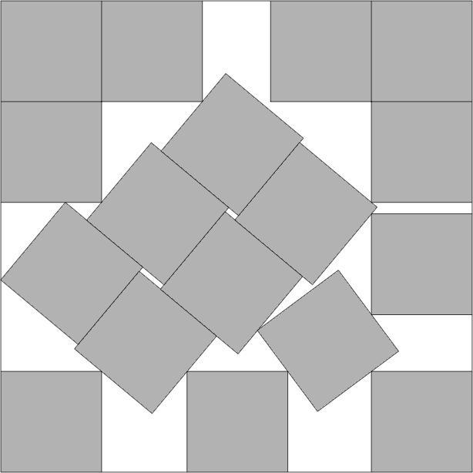
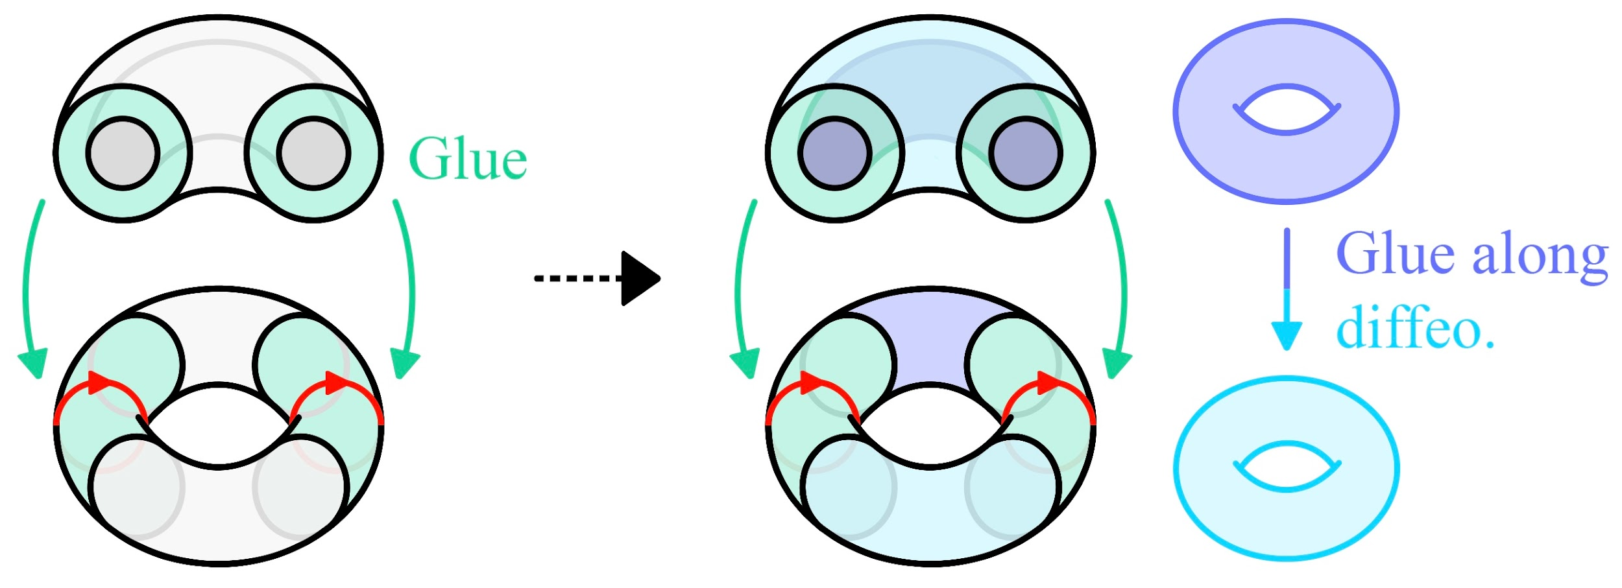
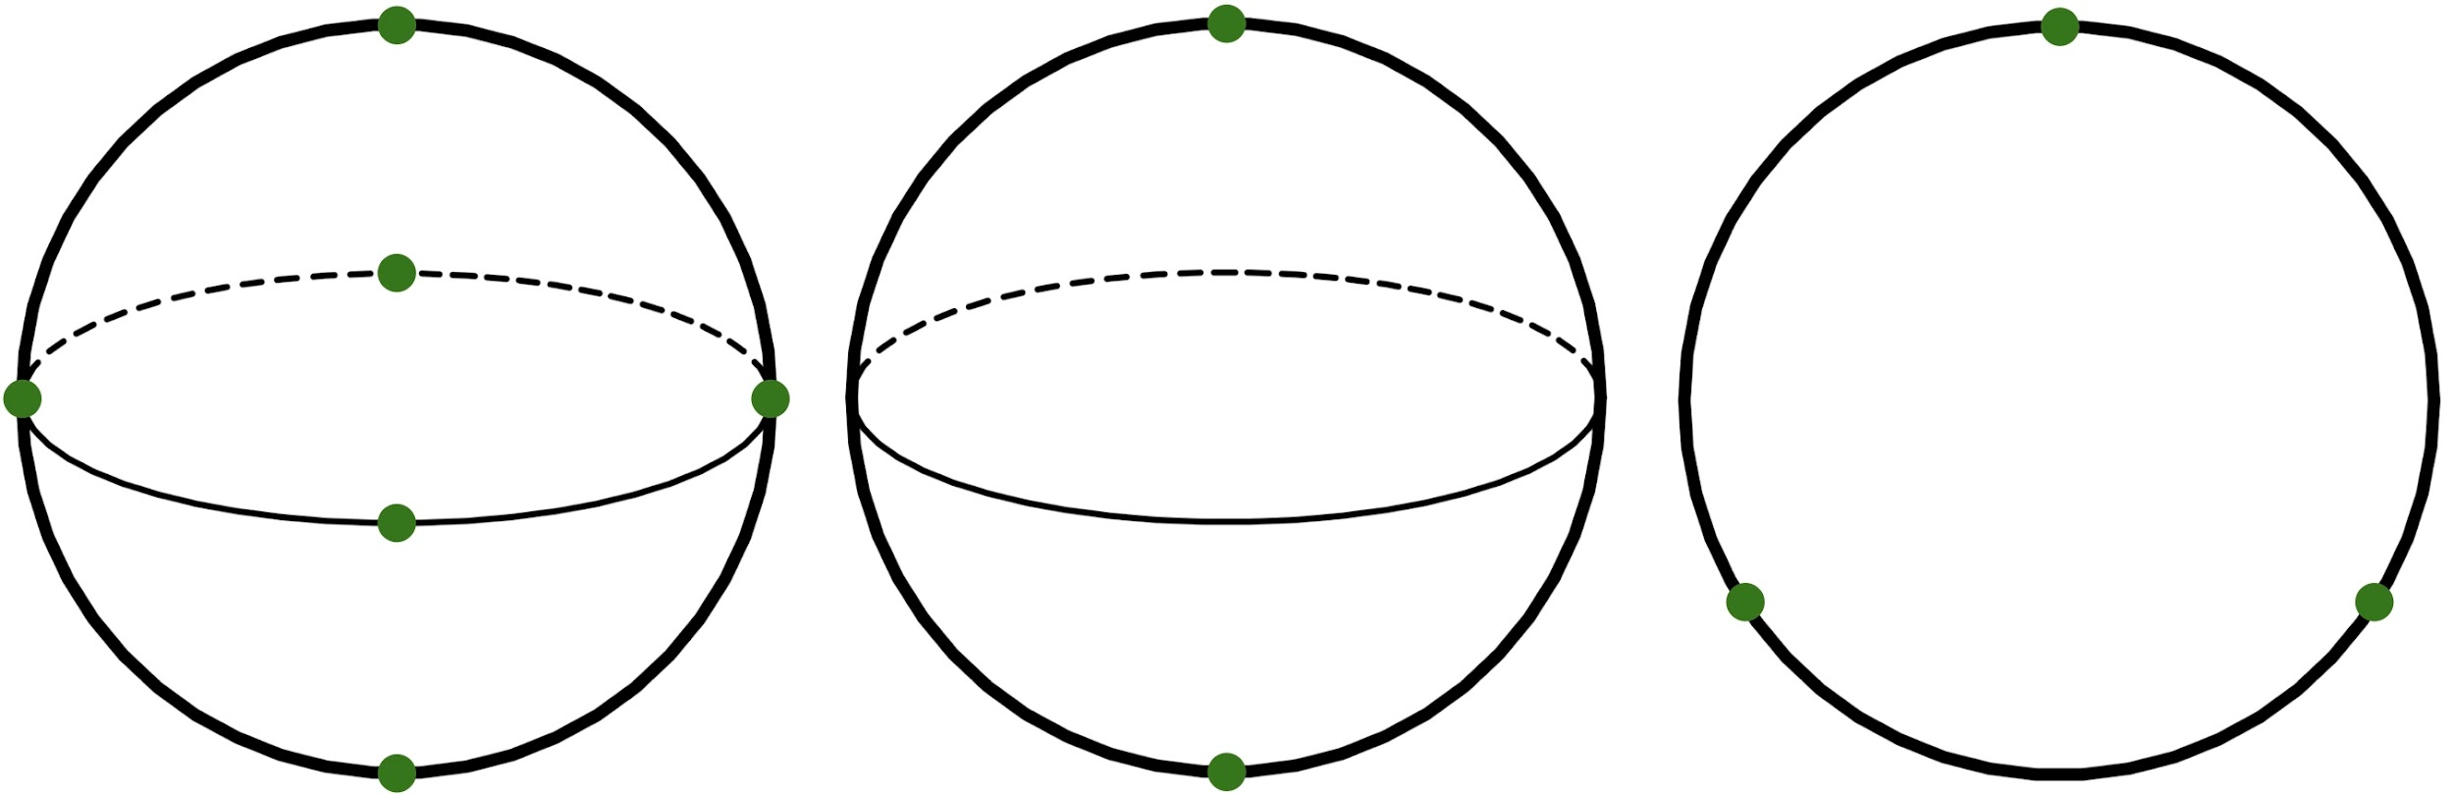
Geometry & Topology

Slide 3
Geometry & Topology
TODAY

Slide 4
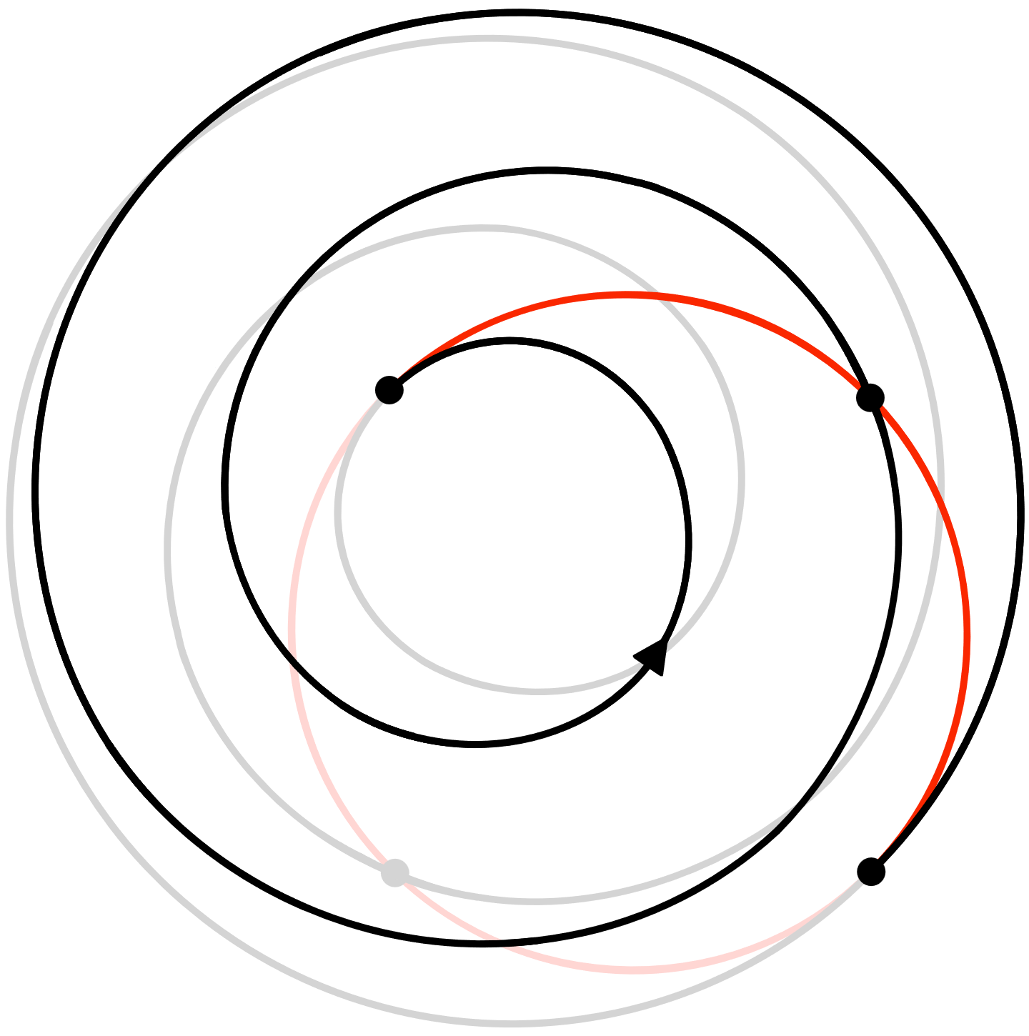
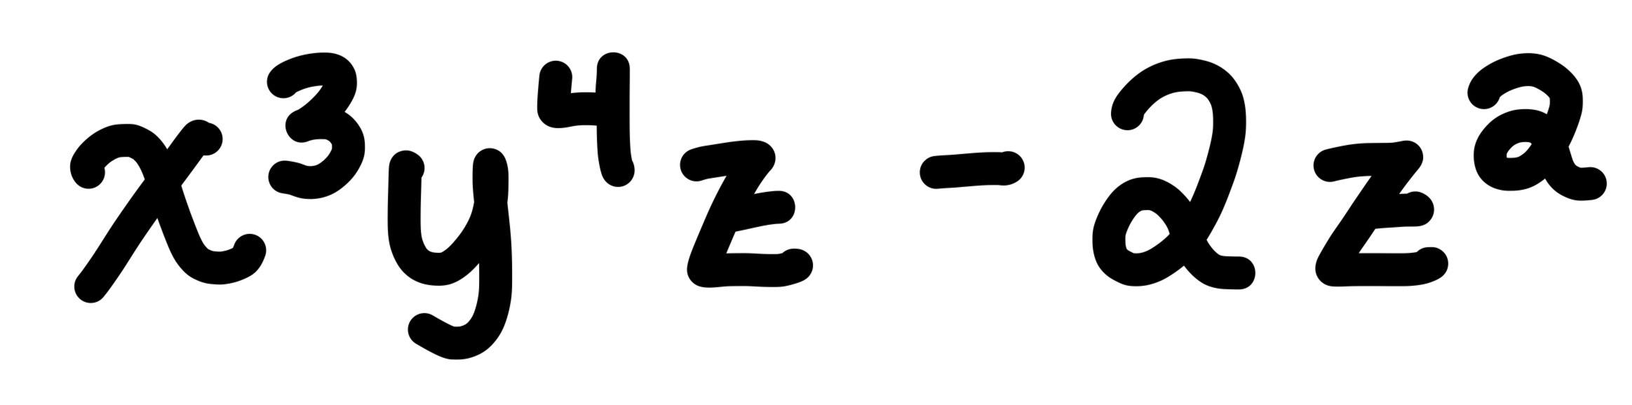
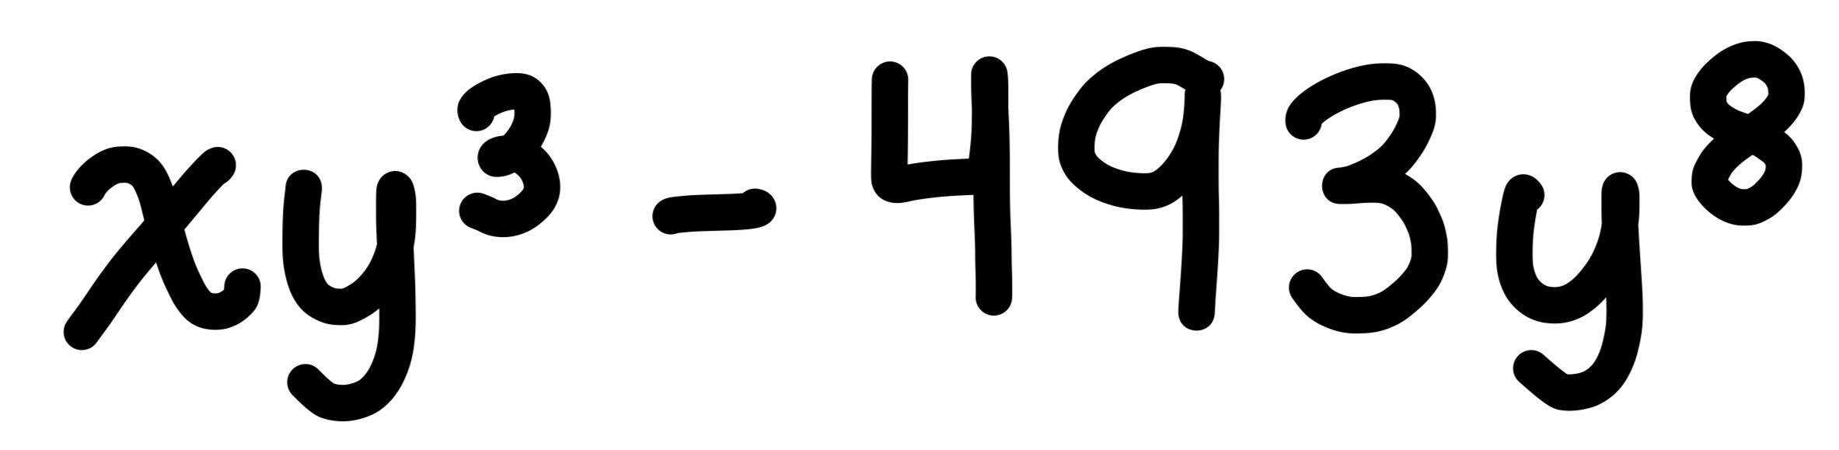
Geometric Designs
Special subsets of shapes (often points or curves on the d-dimensional sphere)
Average polynomials of degree ≤ t exactly!
Tell you how to design experiments

Slide 5
Design of Geometric Designs
Want explicit designs for applications
Making them is hard!
Special sets like vertices of platonic solids give good designs
Numerical approximations
We know a lot about geometry. Can we use this?

Slide 6
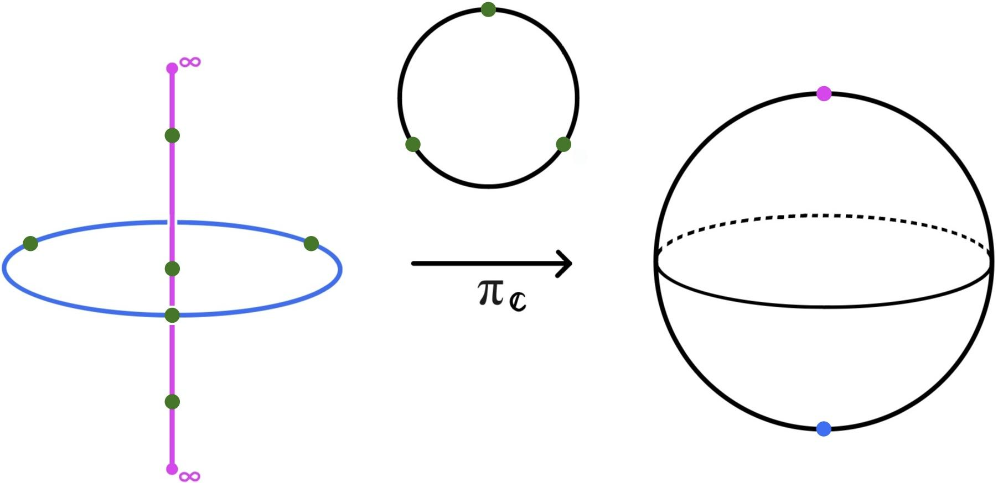
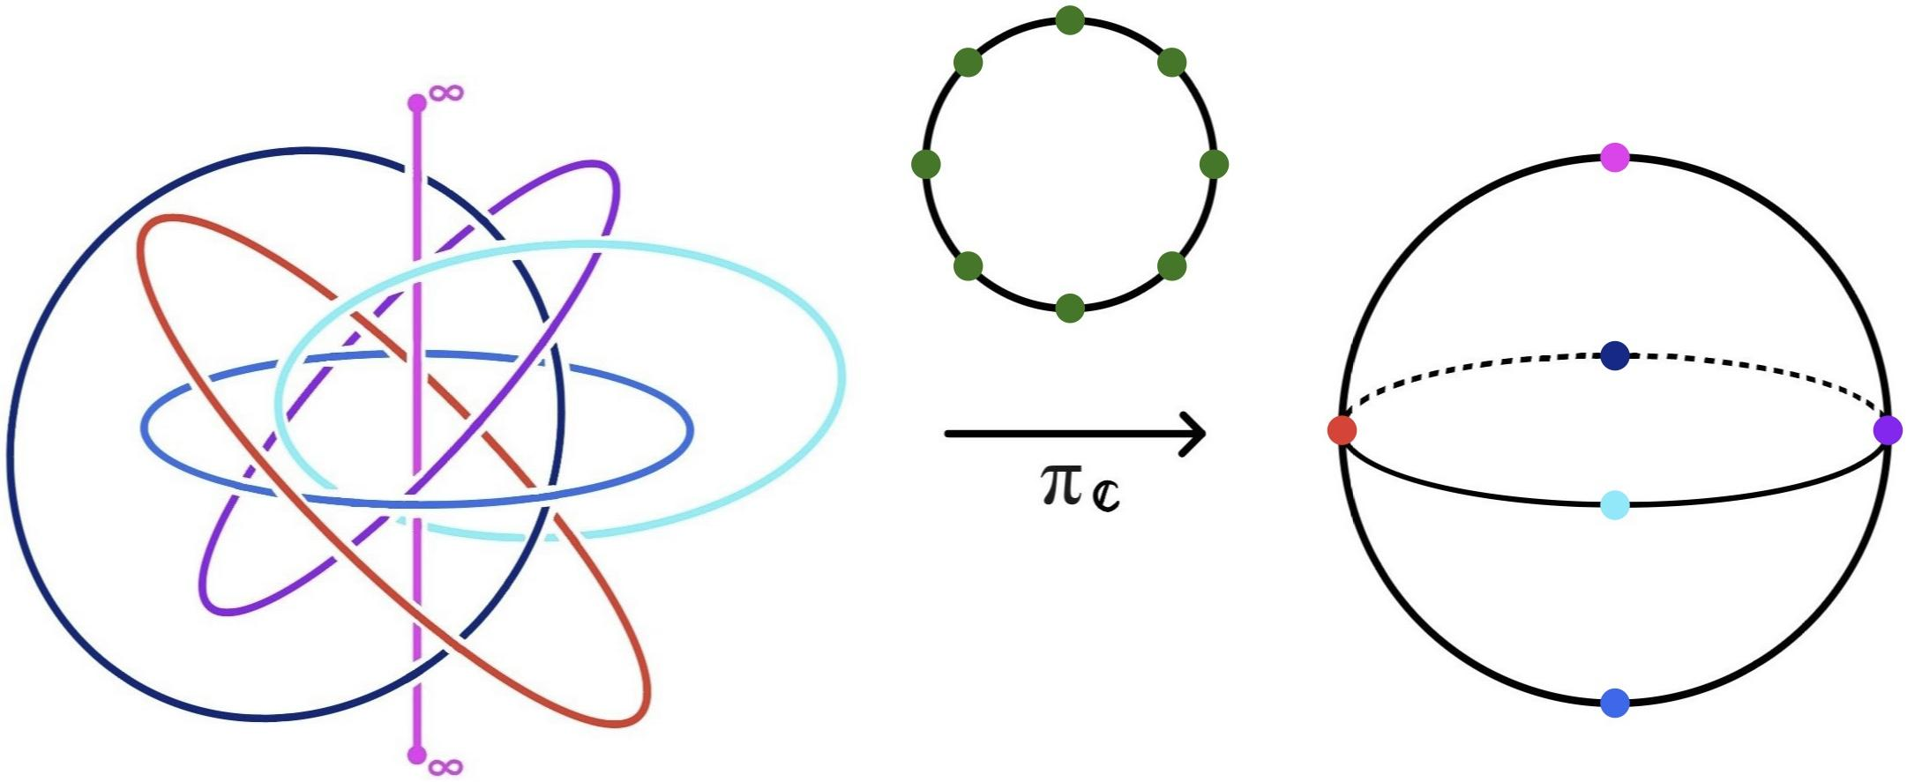
Geometric Design of Geometric Designs
My work: using geometric symmetries to build designs
Harder to build in higher dimensions, stitch together lower-dimensional designs to build higher-dimensional ones

Slide 7
Applications
New explicit designs for practitioners to use
Lifting asymptotic results to answer questions of interest to mathematicians
Learning more about geometry!

Slide 8
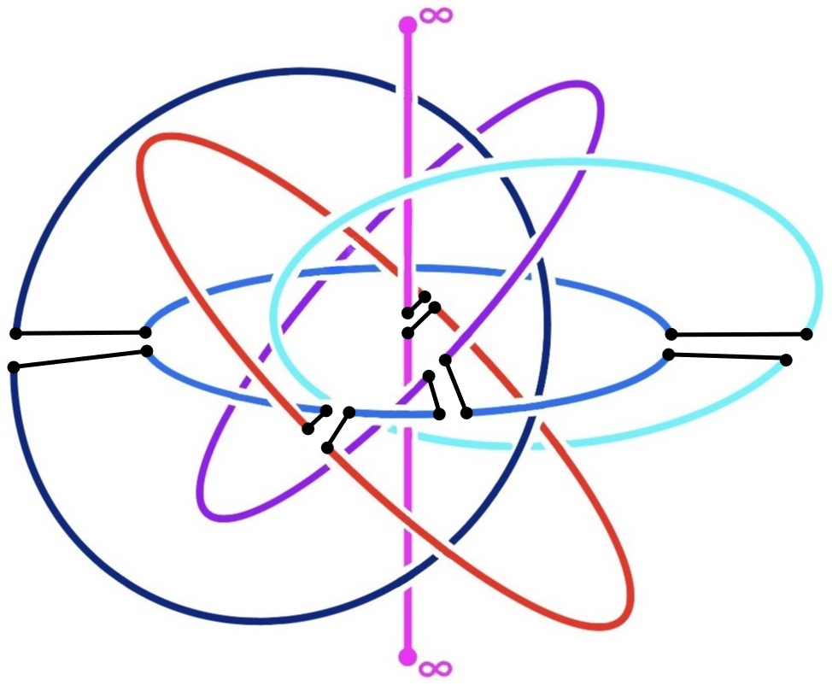
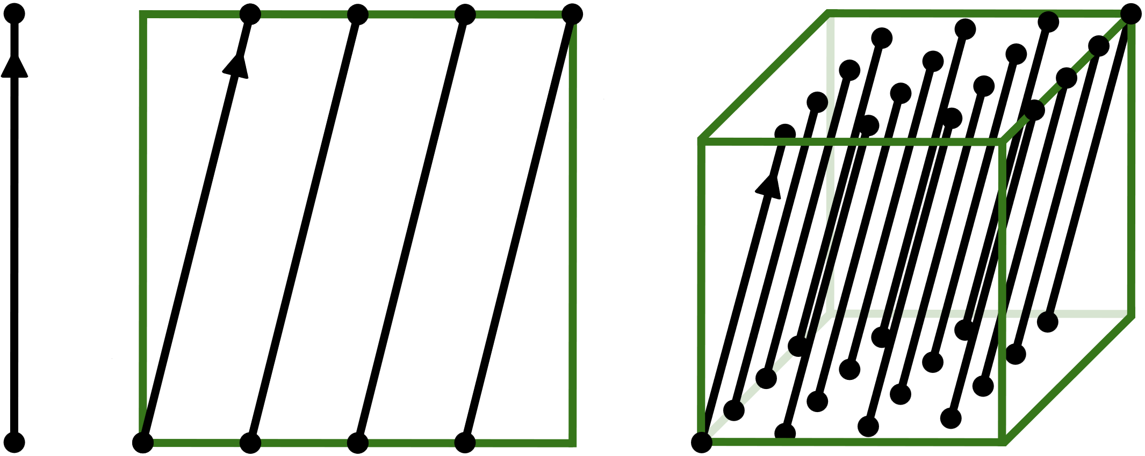
More to Come…
Generalizations that reveal the full mathematical truth behind these constructions
More applicable examples
Extensions which could
be useful and easier to build
More pictures to draw! :)

