Slide 1
Parch and Posey Sales and Customer Behavior Analysis
Presenters:
Samuel Oyedun
Ayodeji Ogunnaike
Ifeanyichukwu Onyechere

Slide 2
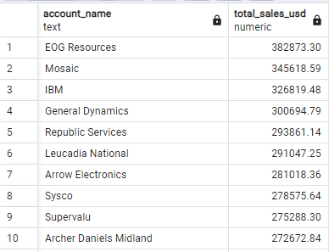
Total Sales Amount (in USD) Generated by Top 10 Account
Total revenue contribution from each account, enabling stakeholders to identify the most valuable customers.
Key Insights
Top Performing Accounts:
The query results reveal which accounts are the top revenue generators.
Sales Distribution:
Understanding sales distribution across accounts helps us identify high-priority customers and potential growth areas.
Actionable Insight:
Accounts generating the highest sales should be prioritized for customer retention strategies and personalized marketing efforts to maintain or increase their contribution.

Slide 3

Sales Representative with the Highest Total Sales
Key Insights
Top Sales Representative:
The query results reveal the name of the sales representative who has achieved the highest total sales. For example, [Sales Rep Name] may be identified as the top performer.
Performance Benchmark:
Understanding who the top sales representative is allows the organization to benchmark other sales reps and identify best practices.
Actionable Insight:
The strategies and approaches of the top sales representative should be analyzed and potentially replicated across the team to improve overall sales performance.
Top Sales Representative

Slide 4
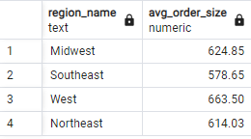
Average Order Size (in Terms of Total Quantity) by Region
Key Insights
Average Order Size by Region:
The result shows the average total quantity of items per order for each region.
Regional Differences:
Understanding regional variations in order size can highlight differences in purchasing behaviour and preferences across different areas.
Actionable Insight:
Tailor inventory and sales strategies based on regional order sizes. For example, regions with larger average orders might benefit from bulk discounts or targeted promotions.
Average Order Size by Region

