Slide 1
Sales Dashboard Analysis
Name: Oluwashinaayomi George
Tool: Power BI
Dataset: Superstore Dataset

Slide 2
Dataset Overview
Retail sales dataset including orders, customers, products, regions, and sales performance.

Slide 3
Business Objective
Understand sales performance
Identify profitable products
Analyze regional trends

Slide 4
Key Performance Indicators
Total Sales
Total Profit
Profit Margin

Slide 5
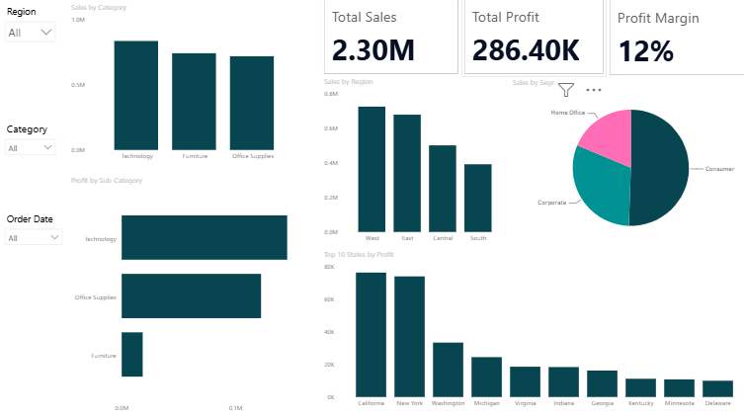
Dashboard Overview

Slide 6
Key Insights
Technology drives highest sales.
Consumer segment dominates.
Profit varies by state, with California and New York dominating the market.

Slide 7
Conclusion
Focus on high-performing products and regions to improve profitability

