Slide 1
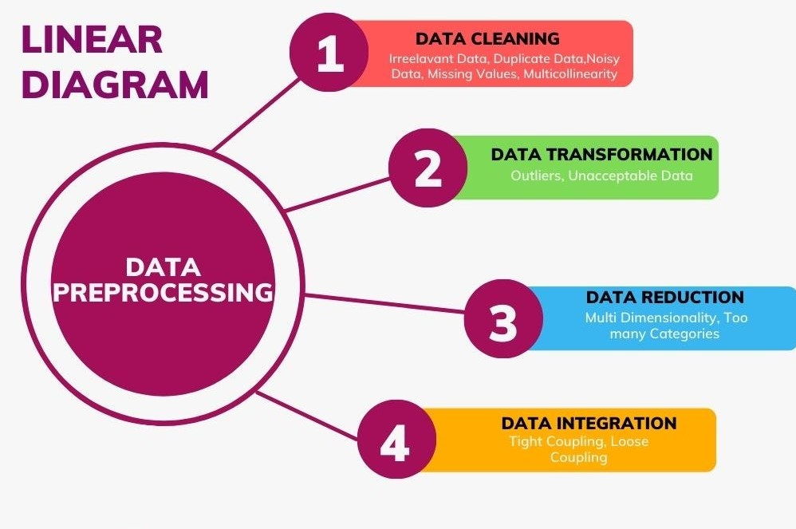
Optimising Data Quality, for effective Modelling.
Machine Learning CA.1 Coronavirus-19 (Covid-19).
My contributions
Oladipo Oluwatimileyin. A

Slide 2
Conceptual understanding.
Our assignment target is to predict weather a patient with Covid-19 survived or not, taking into consideration multiple comorbidities from each patient.
Data preparation also known as data preprocessing in a crucial step in machine learning process. DP ensures data used for modelling is of high quality, enhancing model training ultimately optimising model performance in making accurate prediction.
DP involves early data analysis (EDA), data cleaning, transformation, handling imbalanced data, feature engineering, handling imbalanced data, visualisation, and feature selection.
In other to optimize a model’s performance and predict accurately with the model, we must have an accurately and unbiasedly prepared data.

Slide 3
Data Preprocessing(DP)
DP involves early data analysis (EDA), data cleaning, transformation, handling imbalanced data, feature engineering, handling imbalanced data, visualisation, and feature selection.
DP takes over 80% of modelling process because if we put ill-prepared data into our machine learning model, we would get bad prediction, hence making through DP imperative, to getting a reliable result from our model.
Properly preparing data significantly influences the success and performance of ML models.

Slide 4
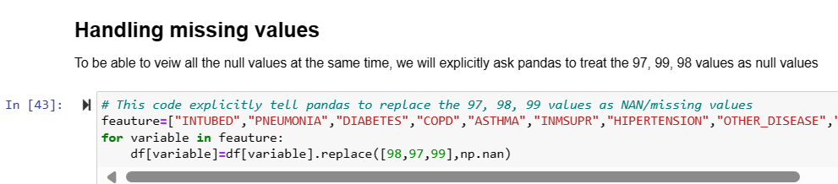
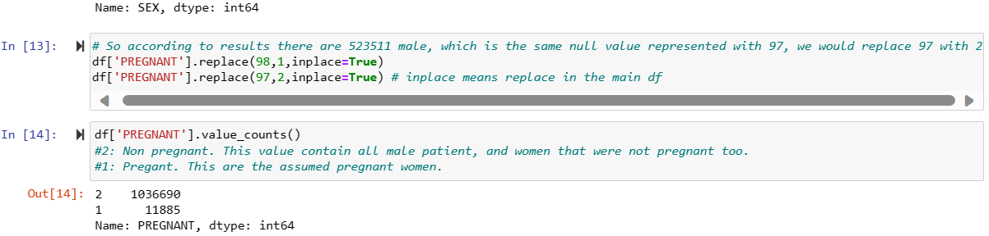

Data Cleaning.
Data cleaning involves removing unwanted data and columns from our data. Unwanted data also called noise in data if not removed, can reduce the performance of model.
With the code we were able to retrieve null values in the data and handled them by dropping variables that had significant numbers of NAN and dropping rows with NAN in other variables.

Slide 5
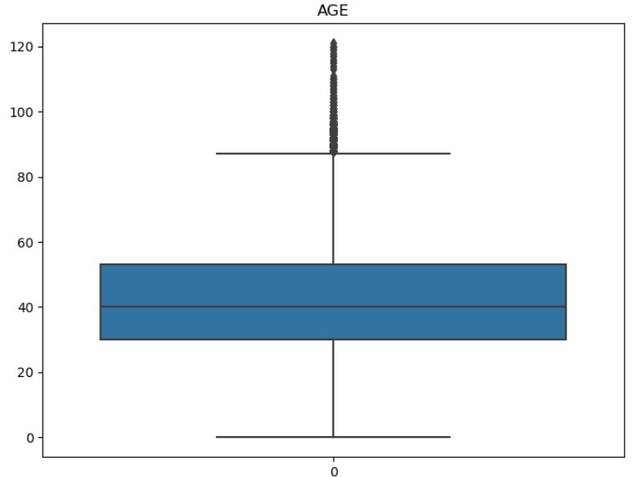
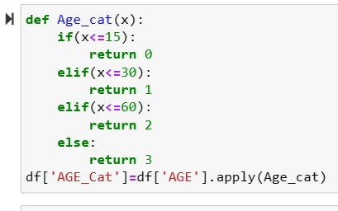
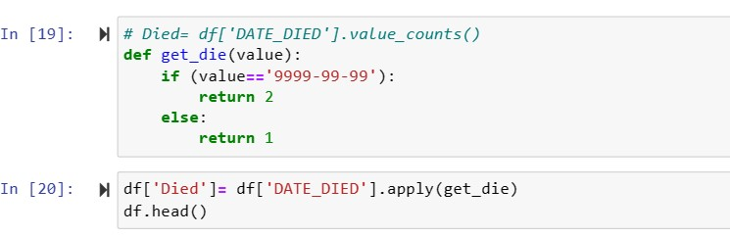
Early Data Analysis (EDA)
EDA is an early process in analysis, where we familiarize ourselves with dataset. It helps us to understand data structure, distribution and observation.
Age is the only numerical variable we had, to be able to see the trend in it, we categorise the ages, then box plot the observation.
To get or target variable, we had to engineer the dead-date column.

