Slide 1







Technology: Presentation of Analyses.
ADENIJI, AYOMIKUN
February 2022

Slide 2



OUTLINE
Executive Summary
Introduction
Methodology
Results
Visualization – Charts
Dashboard
Discussion
Findings & Implications
Conclusion
Appendix

Slide 3

EXECUTIVE SUMMARY
Programming in Recent times
Databases/Programming languages.
Current Most used databases/languages
Next year’s Most used databases/languages
Gender and Programming
Location/Programming

Slide 4

INTRODUCTION
Looking to get into Tech?
Changes in technology.
Following this growth would allow one stay relevant.
Percentage of women in tech.
The presentation is divided into:
Top language using
Top database using
Top web frame using
Top platform using

Slide 5

METHODOLOGY
The data used in this study was gotten from Stack Overflow Developer Survey (2019).
Simple count and percentages where used to analyze this data.
Dashboard was created using IBM Dashboard.

Slide 6


Slide 7
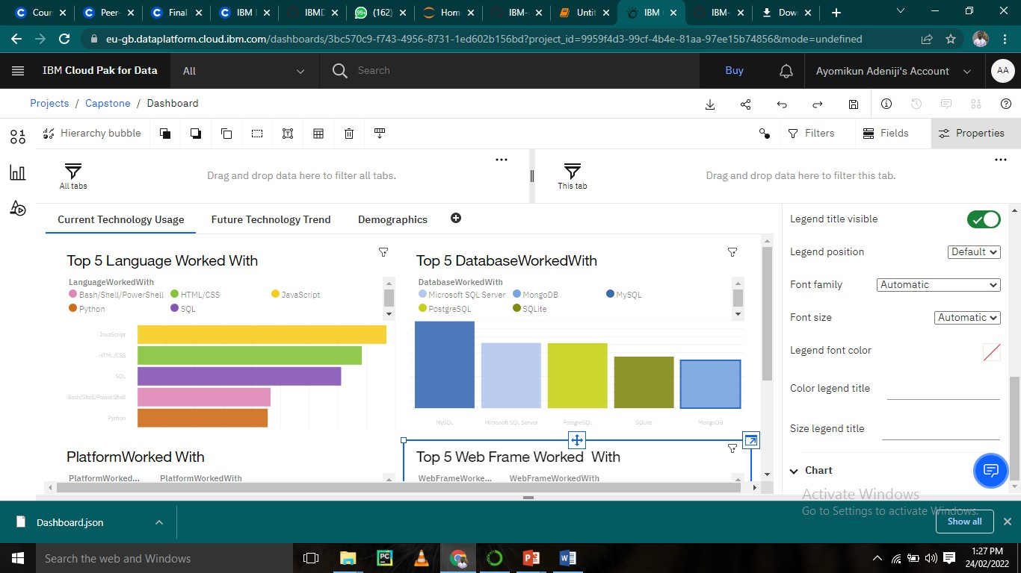
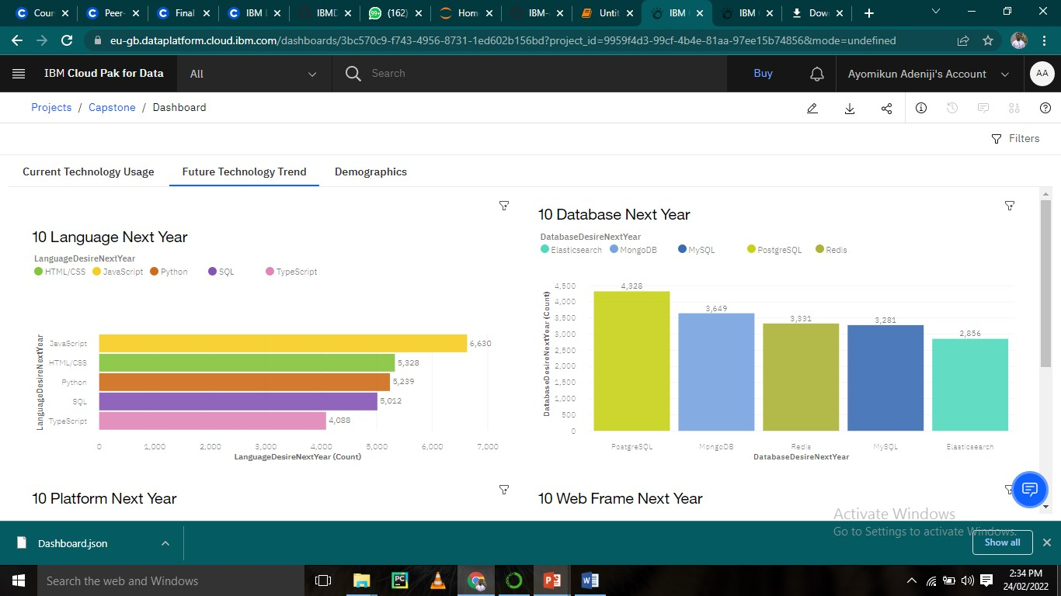
PROGRAMMING LANGUAGE TRENDS
Current Year
Next Year

Slide 8
PROGRAMMING LANGUAGE TRENDS - FINDINGS & IMPLICATIONS
Findings
JavaScript is top programming languages for both current and future.
Python moves from 5th position to 2nd position in top 5.
Bash/shell/power shell are not expected to be in future top 5.
Implications
Web programming languages are going to remain relevant in near future.
Python is becoming more popular while Bash/Shell/Power shell becomes less relevant.

Slide 9
DATABASE TRENDS
Current Year
Next Year

Slide 10
DATABASE TRENDS - FINDINGS & IMPLICATIONS
Findings
PostgreSQL & MongoDB quickly moves up to Nos 1 and 2 respectfully.
Redis & Elasticsearch joins the top 5.
SQL-lite disappear from top
Implications
Open source database becomes more and more popular compared with commercial one.
Relational database still takes a leading position in the near future.
Non-relational database see increasingly usage in the future.

Slide 11

DASHBOARD
https://eu-gb.dataplatform.cloud.ibm.com/dashboards/3bc570c9-f743-4956-8731-1ed602b156bd/view/0361d70237822bd110cddce40790250374612109b1bb8a0ad3d37b495d642497a96842c0c8264c0f8f100031f4e81a5ccf

Slide 12
Current Technology Usage

Slide 13
Future Technology Usage

Slide 14
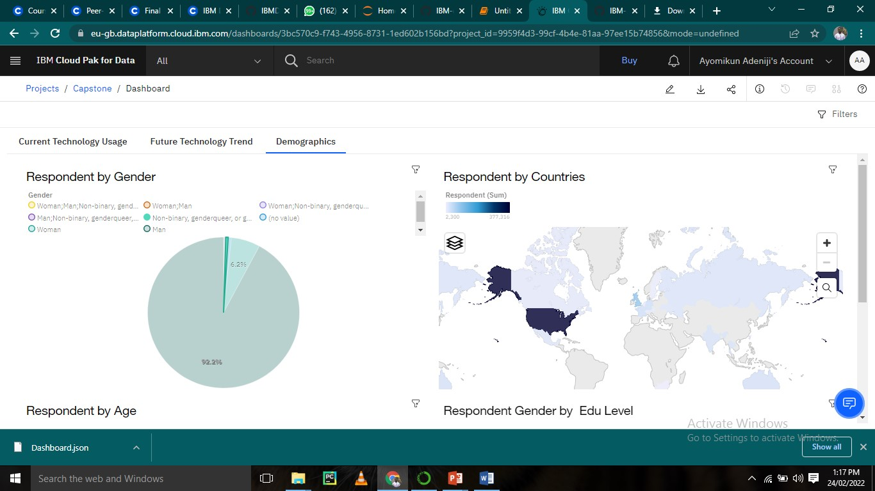
Demographics

Slide 15

DISCUSSION

Slide 16
OVERALL FINDINGS & IMPLICATIONS
Findings
Web based language stays at No.1
Non-relational database moves to No.2 & No.3
Cloud-based platform moves to No.1
React.js stays at No.1 on web framework
Implications
Web based application is taking over the traditional application.
Non-relational database sees increasing adoption.
Cloud-based services become top-choice for platform development.

Slide 17

CONCLUSION
Python is has an increasing number of users.
To stay relevant in the technology field, it’s important to learn web-based language & non-relational database.
Cloud based technology is here to stay.

Slide 18
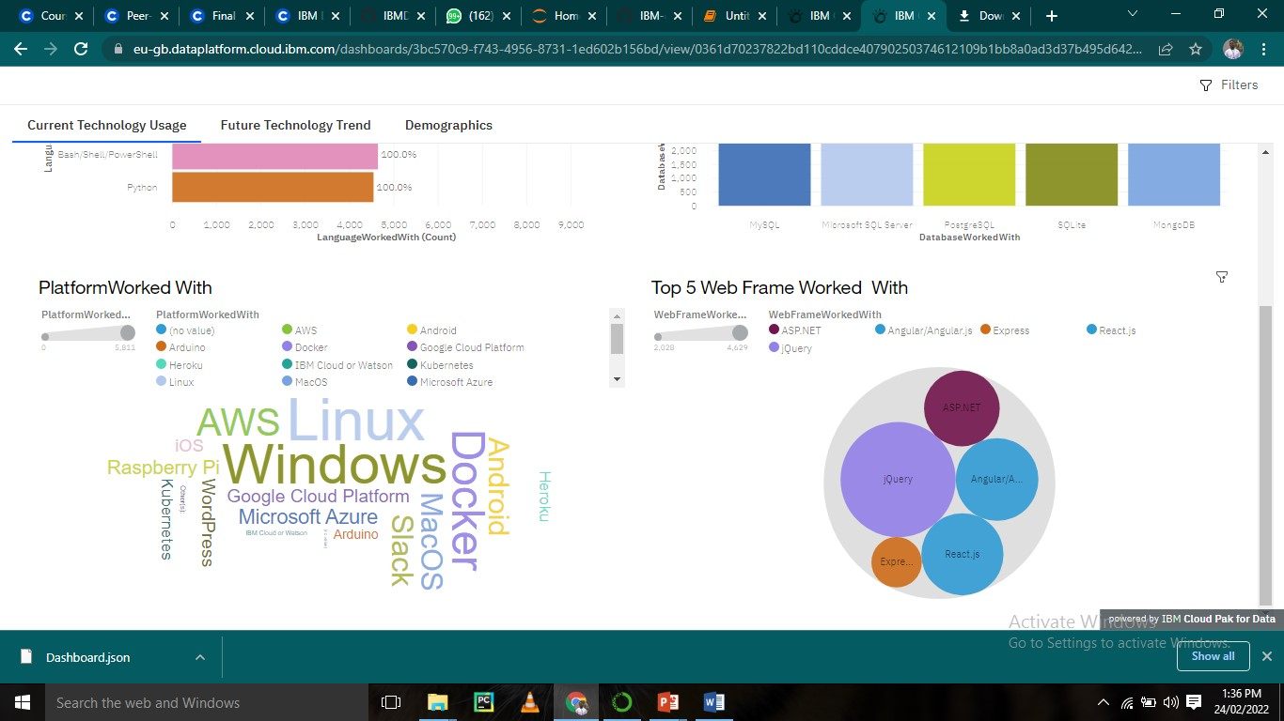
APPENDIX

Slide 19
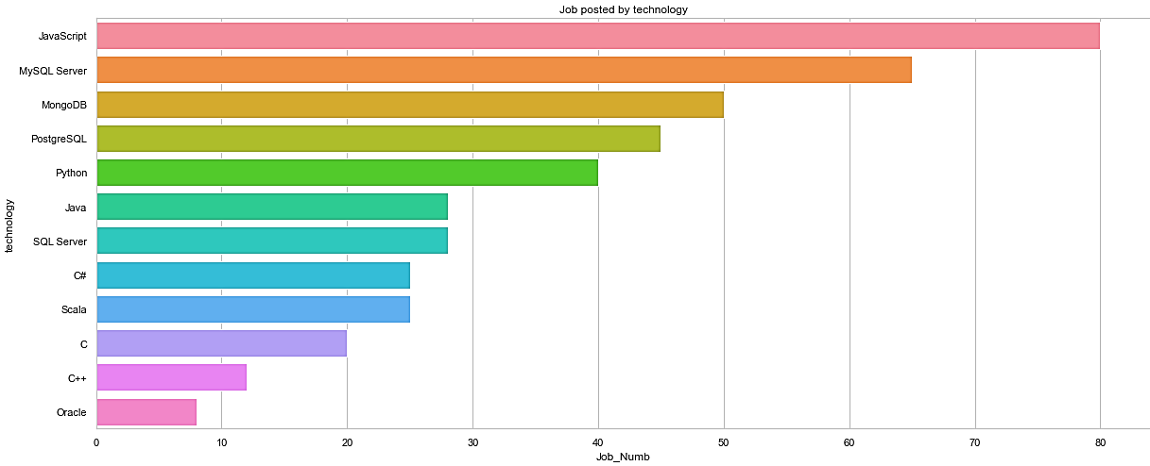
GITHUB JOB POSTINGS

Slide 20
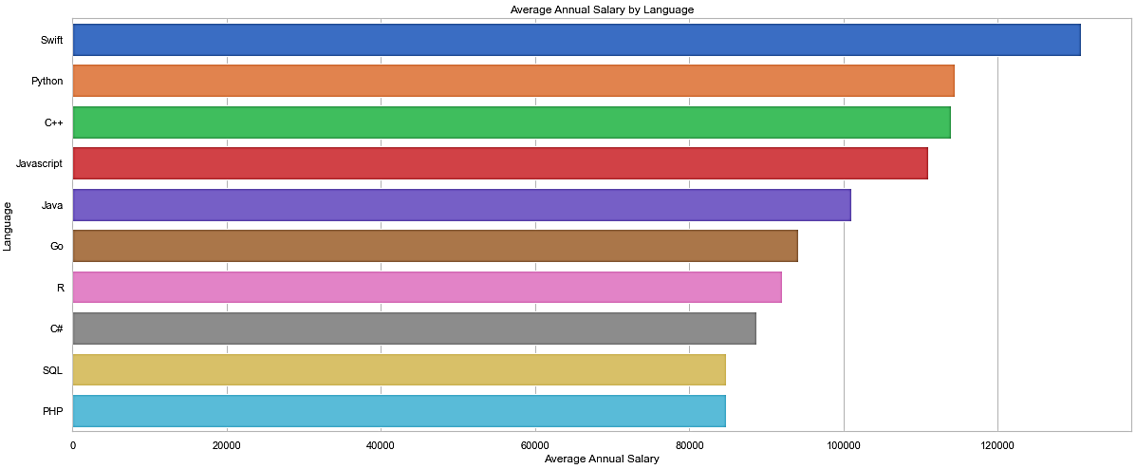
POPULAR LANGUAGES
In Module 1 you have collected the job postings data using web scraping in a file named “popular-languages.csv”. Present that data using a bar chart here. Order the bar chart in the descending order of salary.

