Slide 1
Basic Data Analysis The Case of a Superstore
Salau Ayomide

Slide 2
Outline
Dataset Information and Source
Case Questions
Data Cleaning using Spreadsheet
EDA using MySQL
Data Visualization with PowerBI
Findings and Recommendation
Conclusion.

Slide 3
Dataset Information and Source
This is a sample superstore dataset, a kind of a simulation where you perform extensive data analysis to deliver insights on how the company can increase its profits while minimizing the losses.
The dataset can be found on Kaggle.com.
The is the link to the dataset (https://www.kaggle.com/datasets/bravehart101/sample-supermarket-dataset)
The dataset will not be updated.

Slide 4
Case Questions
Which Category is Best Selling and Most Profitable?
What are the Best Selling and Most Profitable Sub-Category?
Which is the Top Selling Sub-Category?
Which Customer Segment is Most Profitable?
Which is the Preferred Ship Mode?
Which Region is the Most Profitable?
Which City has the Highest Number of Sales?

Slide 5

Data cleaning using Spreadsheet
The Data has 9,997 rows and 2 deleted empty cells at the bottom.
There are no whitespaces in the data.

Slide 6
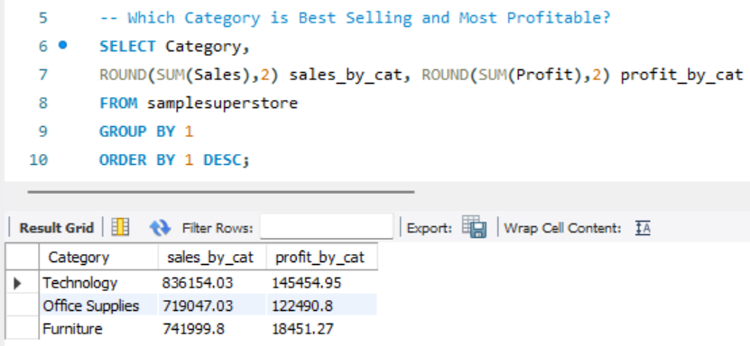
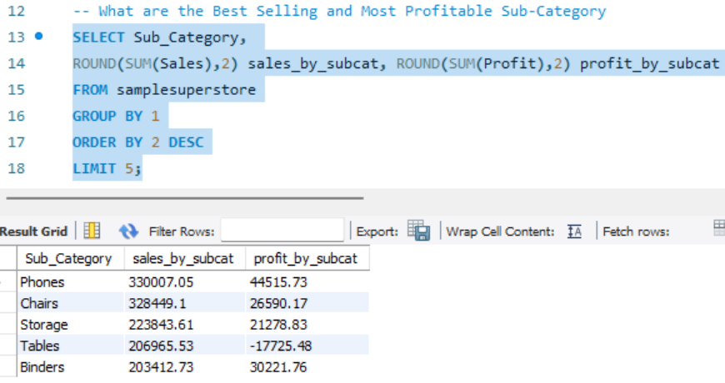
EDA using MySQL
Which Category is Best Selling and Most Profitable?
What are the Best Selling and Most Profitable Subcategory?

Slide 7
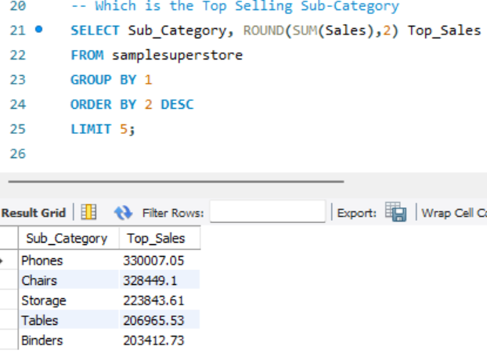
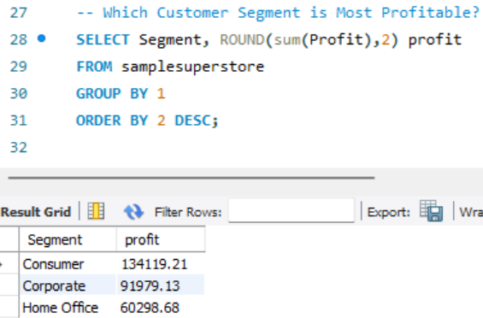
EDA using MySQL
Which is the Top Selling Sub-Category?
Which Customer Segment is Most Profitable?

Slide 8
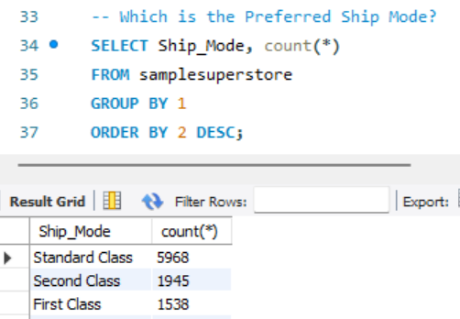
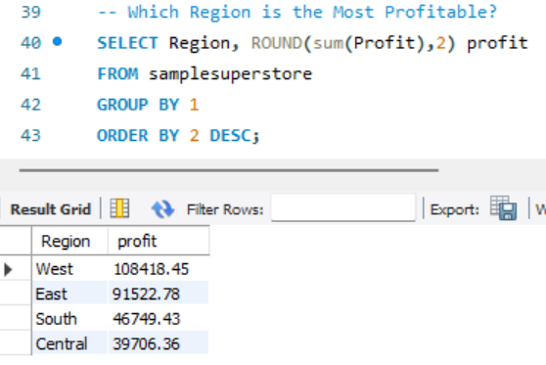
EDA using MySQL
Which is the Preferred Ship Mode?
Which Region is the Most Profitable?

Slide 9
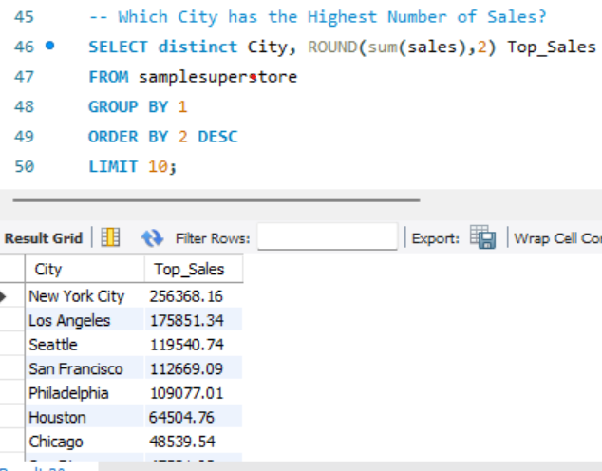
EDA using MySQL
Which City has the Highest Number of Sales?

Slide 10
Case Solution 1

Slide 11
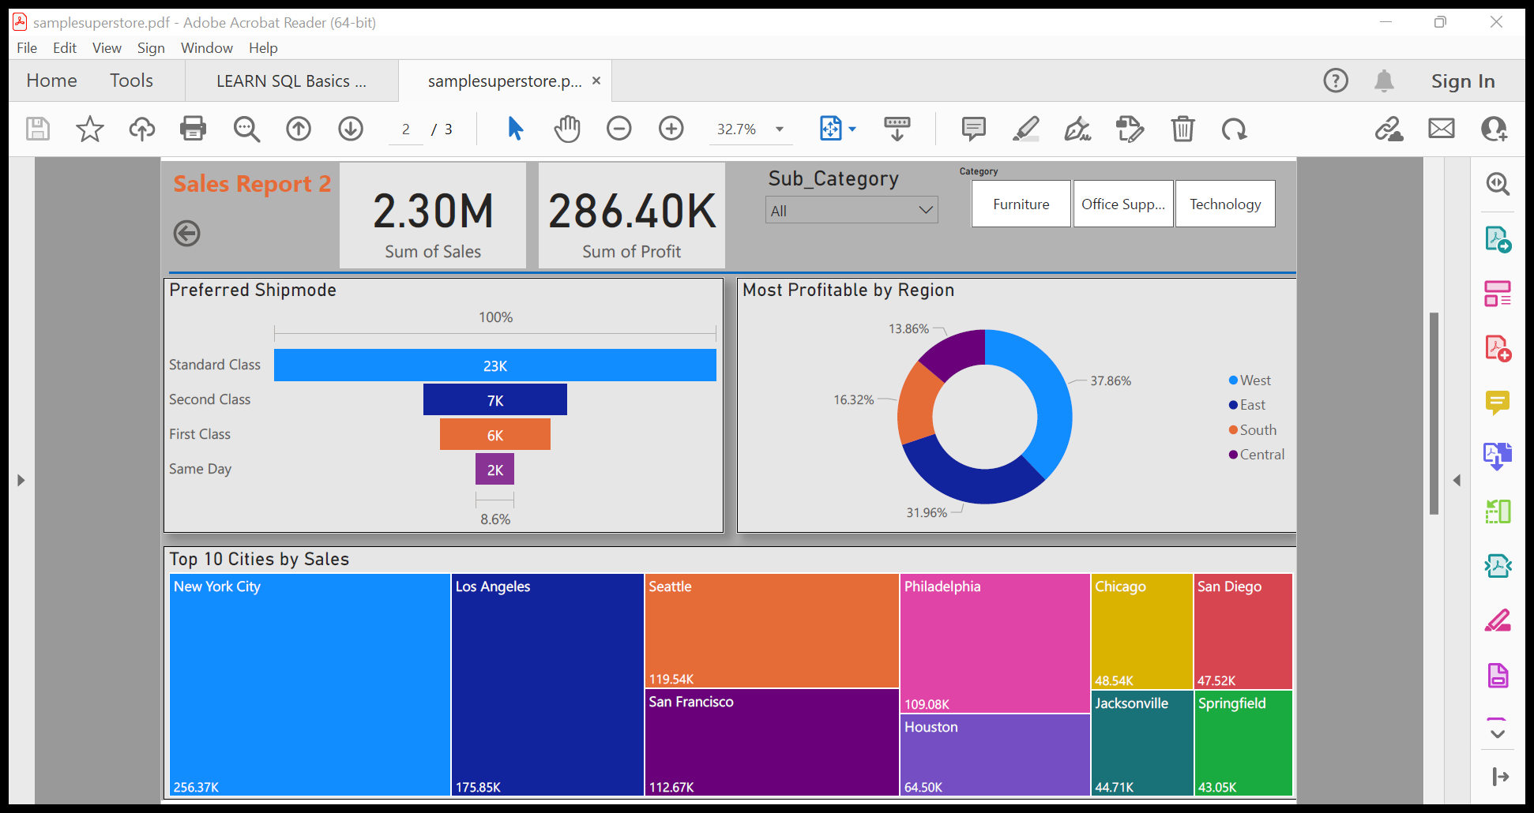
Case Solution 2

