Slide 1


Slide 2



LIMIARF LAB
Onset prediction of ci-DME on UWF images using fine-tuned ResNet with class
balanced focal loss
Done by :
Yassine LEHMIANI ¹
Ayoub ELKHOUZARI ¹
Abdlehak MAHMOUDI ^{1,2}
1. LIMIARF, Faculty of Sciences, Mohammed V University in Rabat, Morocco.
2. Ecole Normale Supérieure, Mohammed V University in Rabat, Morocco.

Slide 3






01. Introduction
02. Dataset
06. Conclusion
PLAN
03. Methods
05. Discussion
04. Results

Slide 4

01. Introduction
PLAN

Slide 5

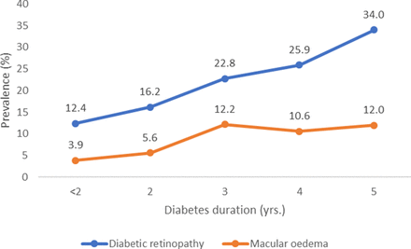
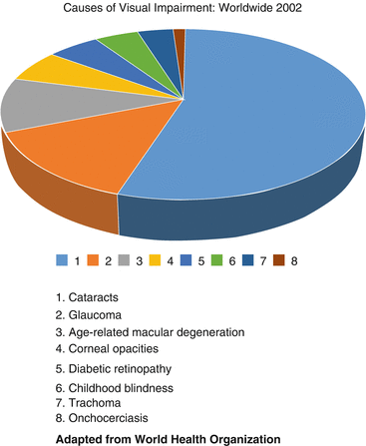
01. Introduction
Diabetic macular edema (DME) is a major complication of Diabetic Retinopathy (DR) causing blurred or distorted vision due to fluid leakage in the macula.
ci-DME: Center-involved DME occurs in the macula’s central zone, often linked to moderate or severe DR.can be detected using OCT.
PLAN

Slide 6
01. Introduction
Diabetic macular edema (DME) A major complication of Diabetic Retinopathy (DR) causing blurred or distorted vision due to fluid leakage in the macula.
ci-DME: Center-involved DME occurs in the macula’s central zone, often linked to moderate or severe DR.can be detected using OCT.
PLAN

Slide 7
01. Introduction
Diabetic macular edema (DME) A major complication of Diabetic Retinopathy (DR) causing blurred or distorted vision due to fluid leakage in the macula.
ci-DME: Center-involved DME occurs in the macula’s central zone, often linked to moderate or severe DR.can be detected using OCT.
PLAN

Slide 8
01. Introduction
OCT are costly and less accessible.
Recent studies^{[1]} show that ci-DME can be detected using 2D color fundus photography (CFP) with a sensitivity of 85% and specificity of 80%.
Diamond Challenge
Goal : Aims to predict ci-DME onset within one year.
Challege : the train, validation and test data named EviRed dataset is unseen.
Participants : Submit models as code using a synthetic dataset for model development.
PLAN
[1] Varadarajan AV, Bavishi P, Ruamviboonsuk P, et al. Predicting optical coherence tomography-derived diabetic macular edema grades from fundus photographs using deep learning. Nat Commun. 2020;11(1):130. doi:10.1038/s41467-019-13922-8

Slide 9

02. Dataset
PLAN

Slide 10

02. Dataset
Datasets for Model Development & Local Testing:
DeepDRiD Synthetic Dataset:
Composition
2,000 regular fundus images (500 patients).
PLAN
256 UWF retinal images (128 patients).
For Challenge
150 UWF-CFP images for training | 50 for validation.
Diagnostic Labels
ICDR classification (Grades 0-4).
Dataset Annotation
A ci-DME event is predicted for the next visit if the DR label is ≥ moderate non-proliferative DR.

Slide 11
02. Dataset
Datasets for Model Development & Local Testing:
DeepDRiD Synthetic Dataset:
Composition
2,000 regular fundus images (500 patients).
PLAN
256 UWF retinal images (128 patients).
For Challenge
150 UWF-CFP images for training | 50 for validation.
Diagnostic Labels
ICDR classification (Grades 0-4).
Dataset Annotation
A ci-DME event is predicted for the next visit if the DR label is ≥ moderate non-proliferative DR.

Slide 12
02. Dataset
Datasets for Model Development & Local Testing:
DeepDRiD Synthetic Dataset:
Composition
2,000 regular fundus images (500 patients).
PLAN
256 UWF retinal images (128 patients).
For Challenge
150 UWF-CFP images for training | 50 for validation.
Diagnostic Labels
ICDR classification (Grades 0-4).
Dataset Annotation
A ci-DME event is predicted for the next visit if the DR label is ≥ moderate non-proliferative DR.

Slide 13
02. Dataset
Datasets for Model Development & Local Testing:
DeepDRiD Synthetic Dataset:
Composition
2,000 regular fundus images (500 patients).
PLAN
256 UWF retinal images (128 patients).
For Challenge
150 UWF-CFP images for training | 50 for validation.
Diagnostic Labels
ICDR classification (Grades 0-4).
Dataset Annotation
A ci-DME event is predicted for the next visit if the DR label is ≥ moderate non-proliferative DR.

Slide 14
02. Dataset
Datasets for Evaluation
EviRed Real Dataset:
French Hospitals Data
From the EviRed project (14 hospitals).
PLAN
Independent Out-of-Domain Dataset:
From Algeria for evaluation.
Diagnostic Labels
ICDR classification (Grades 0-4).
Dataset Source
Data collected from French hospitals.

Slide 15
02. Dataset
Datasets for Evaluation
EviRed Real Dataset:
French Hospitals Data
From the EviRed project (14 hospitals).
PLAN
Independent Out-of-Domain Dataset:
From Algeria for evaluation.
Diagnostic Labels
ICDR classification (Grades 0-4).
Dataset Source
Data collected from French hospitals.

Slide 16
02. Dataset
Datasets for Evaluation
EviRed Real Dataset:
French Hospitals Data
From the EviRed project (14 hospitals).
PLAN
Independent Out-of-Domain Dataset:
From Algeria for evaluation.
Diagnostic Labels
ICDR classification (Grades 0-4).
Dataset Source
Data collected from French hospitals.

Slide 17
02. Dataset
Datasets for Evaluation
EviRed Real Dataset:
French Hospitals Data
From the EviRed project (14 hospitals).
PLAN
Independent Out-of-Domain Dataset:
From Algeria for evaluation.
Diagnostic Labels
ICDR classification (Grades 0-4).
Dataset Source
Data collected from French hospitals.

Slide 18

03. Methods
PLAN

Slide 19

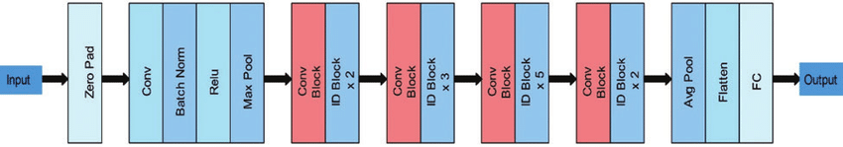
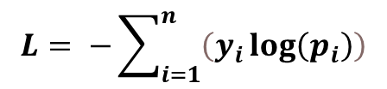
03. Methods
First Submission
Model : ResNet101
PLAN
Loss Function : cross-entropy loss
$$L= −\sum_{i=1}^{n}{\left(y_{i}\log\left(p_{i}\right)\right)}$$
Data:
154 images for training | 50 images for validation
Evaluation Metrics: F1 score, AUC, ECE
S = AUC + 0.5 × F1 + 0.5 × (1 − ECE)

Slide 20
03. Methods
First Submission
Model : ResNet101
PLAN

Slide 21
03. Methods
First Submission
Model : ResNet101
PLAN
Loss Function : cross-entropy loss
$$L= −\sum_{i=1}^{n}{\left(y_{i}\log\left(p_{i}\right)\right)}$$
Data:
154 images for training | 50 images for validation
Evaluation Metrics: F1 score, AUC, ECE
S = AUC + 0.5 × F1 + 0.5 × (1 − ECE)

Slide 22
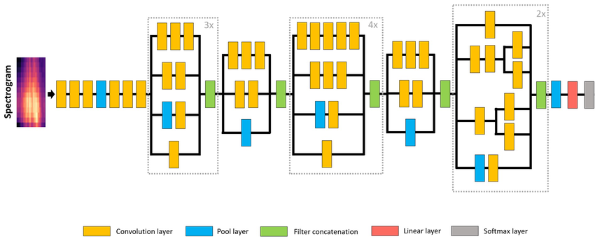
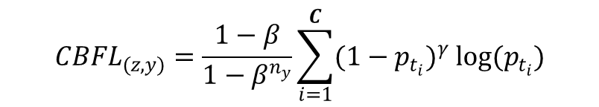
03. Methods
Second Submission
Model : inceptionV3
PLAN
Loss Function : ClassBalanced Focal Loss
$${CBFL}_{(z,y)}=\frac{1−β}{1−β^{n_{y}}}\sum_{i=1}^{C}{(1−p_{t_{i}})^{γ} log(p_{t_{i}})}$$
Data:
154 images for training | 50 images for validation
Evaluation Metrics: F1 score, AUC, ECE
S = AUC + 0.5 × F1 + 0.5 × (1 − ECE)

Slide 23
03. Methods
Second Submission
Model : inceptionV3
PLAN

Slide 24
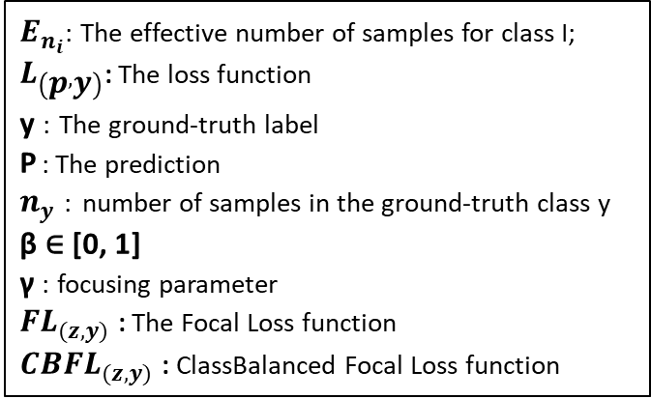
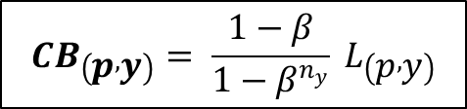
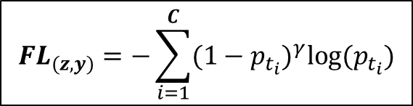

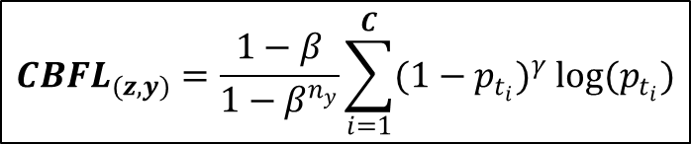
03. Methods
Second Submission
Model : inceptionV3
Loss Function : ClassBalanced Focal Loss
$$E_{n_{i}}= \frac{1−β^{n_{y}}}{1−β}$$
$E_{n_{i}}$: The effective number of samples for class I;
$L_{\left(p , y\right)}$: The loss function
y : The ground-truth label
P : The prediction
$n_{y}$ : number of samples in the ground-truth class y
β ∈ [0, 1]
γ : focusing parameter
${FL}_{(z,y)}$ : The Focal Loss function
${CBFL}_{(z,y)}$ : ClassBalanced Focal Loss function
PLAN
$${CB}_{\left(p , y\right)}= \frac{1−β}{1−β^{n_{y}}} L_{\left(p , y\right)}$$
$${FL}_{(z,y)}=−\sum_{i=1}^{C}{(1−p_{t_{i}})^{γ}log⁡(p_{t_{i}})}$$
$${CBFL}_{(z,y)}=\frac{1−β}{1−β^{n_{y}}}\sum_{i=1}^{C}{(1−p_{t_{i}})^{γ} log(p_{t_{i}})}$$

Slide 25
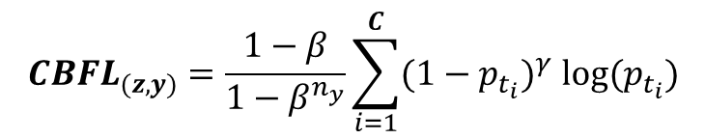
03. Methods
Second Submission
Model : inceptionV3
PLAN
Loss Function : ClassBalanced Focal Loss
$${CBFL}_{(z,y)}=\frac{1−β}{1−β^{n_{y}}}\sum_{i=1}^{C}{(1−p_{t_{i}})^{γ} log(p_{t_{i}})}$$
Data:
154 images for training | 50 images for validation
Evaluation Metrics: F1 score, AUC, ECE
S = AUC + 0.5 × F1 + 0.5 × (1 − ECE)

Slide 26
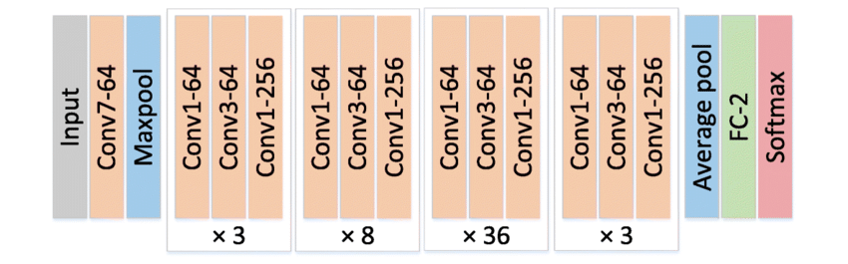
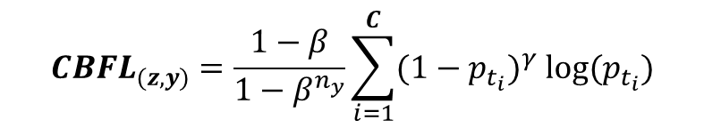
03. Methods
Third Submission
Model : ReNet152
PLAN
Loss Function : ClassBalanced Focal Loss
$${CBFL}_{(z,y)}=\frac{1−β}{1−β^{n_{y}}}\sum_{i=1}^{C}{(1−p_{t_{i}})^{γ} log(p_{t_{i}})}$$
Data: Two data augmentations
462 images for training / 50 images for validation
Evaluation Metrics: F1 score, AUC, ECE
S = AUC + 0.5 × F1 + 0.5 × (1 − ECE)

Slide 27
03. Methods
Third Submission
Model : resnet152
PLAN

Slide 28
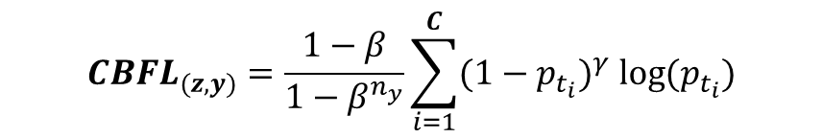
03. Methods
Third Submission
Model : resnet152
PLAN
Loss Function : ClassBalanced Focal Loss
$${CBFL}_{(z,y)}=\frac{1−β}{1−β^{n_{y}}}\sum_{i=1}^{C}{(1−p_{t_{i}})^{γ} log(p_{t_{i}})}$$
Data: Two data augmentations
Random Horizontal Flip & Random Vertical Flip
Random Crop Size & Gaussian Blur
462 images for training / 50 images for validation

Slide 29
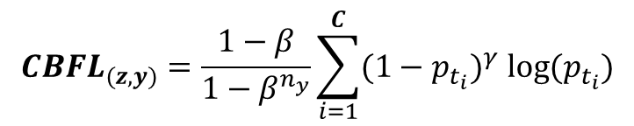
03. Methods
Third Submission
Model : ResNet152
PLAN
Loss Function : ClassBalanced Focal Loss
$${CBFL}_{(z,y)}=\frac{1−β}{1−β^{n_{y}}}\sum_{i=1}^{C}{(1−p_{t_{i}})^{γ} log(p_{t_{i}})}$$
Data: Two data augmentations
462 images for training / 50 images for validation
Evaluation Metrics: F1 score, AUC, ECE
S = AUC + 0.5 × F1 + 0.5 × (1 − ECE)

Slide 30

04. Results
PLAN

Slide 31

04. Results
Result for Submission 1
 | EviRed Real | DeepDRiD Synthetic
Submission 1 | 0.5 | 0.73 | AUC
Submission 1 | 0.0 | 0.0 | F1 Score
Submission 3 | 0.07 | 0.12 | ECE
 | 0.96 | 1.17 | Final Score
PLAN
Experimental Settings
Backbone | Loss Function | Batch Size | Number of epochs | Image Size
ResNet101 | Cross-Entropy Loss | 4 | 100 | 448x448

Slide 32
04. Results
Result for Submission 2
 | EviRed Real | DeepDRiD Synthetic
Submission 2 | 0.53 | 0.73 | AUC
Submission 1 | 0.14 | 0.57 | F1 Score
Submission 3 | 0.44 | 0.17 | ECE
 | 0.88 | 1.4 | Final Score
PLAN
Experimental Settings
Backbone | Loss Function | Batch Size | Number of epochs | γ | β | Image Size
Inception_V3 | CB Focal Loss | 4 | 100 | 2 | 0.9 | 448x448

Slide 33
04. Results
Result for Submission 3
 | EviRed Real | DeepDRiD Synthetic
Submission 3 | ------ | 0.79 | AUC
Submission 1 | ------ | 0.65 | F1 Score
Submission 3 | ------ | 0.11 | ECE
 | ------ | 1.56 | Final Score
PLAN
Experimental Settings
Backbone | Loss Function | Batch Size | Number of epochs | γ | β | Image Size
ResNet152 | CB Focal Loss | 40 | 100 | 2 | 0.9 | 448x448

Slide 34
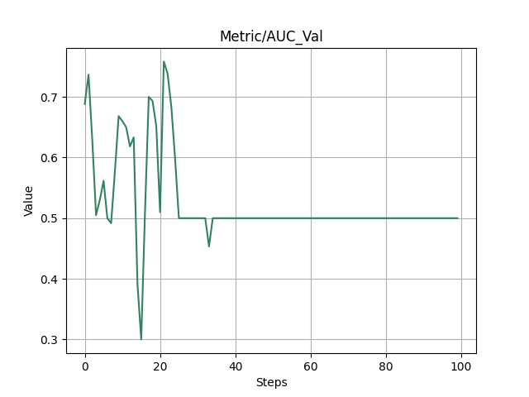
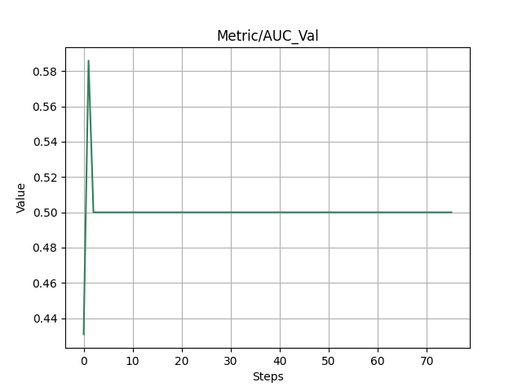
04. Results
Result for Submission 1 : AUC
EviRed Real Dataset
DeepDRiD Synthetic Dataset
PLAN
a)
b)

Slide 35
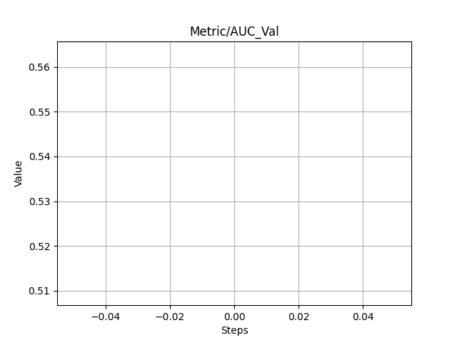
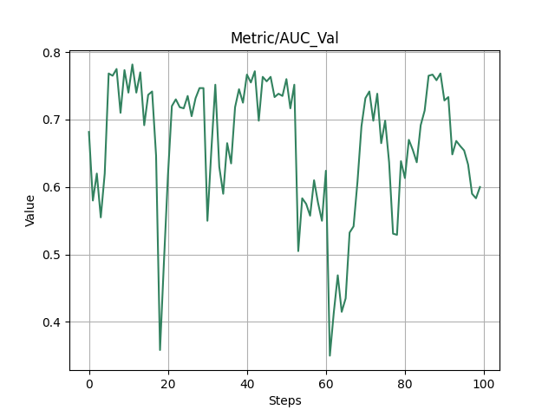
04. Results
Result for Submission 2 : AUC
EviRed Real Dataset
DeepDRiD Synthetic Dataset
PLAN
c)
d)
Not Available

Slide 36
04. Results
Result for Submission 3 : AUC
EviRed Real Dataset
DeepDRiD Synthetic Dataset
PLAN
e)
f)
Not Available

Slide 37
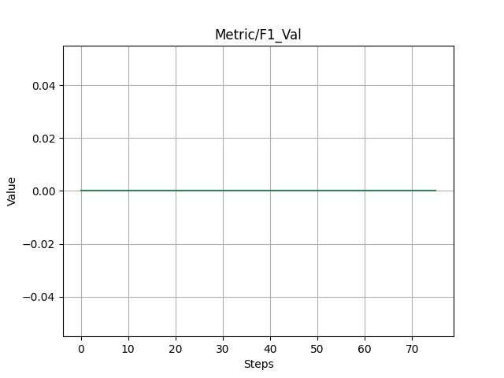
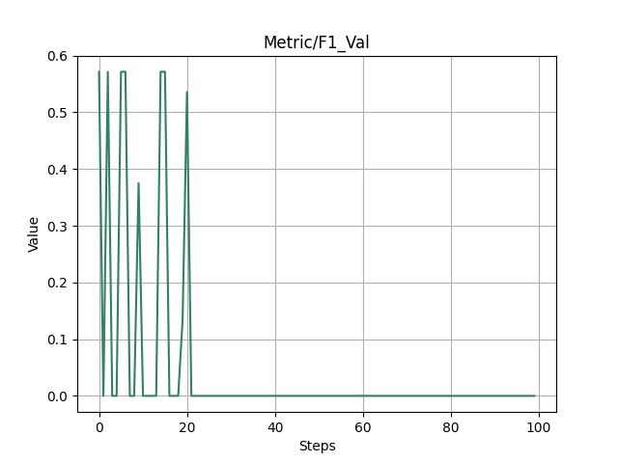
04. Results
Result for Submission 1 : F1 Score
EviRed Real Dataset
DeepDRiD Synthetic Dataset
PLAN
a)
b)

Slide 38
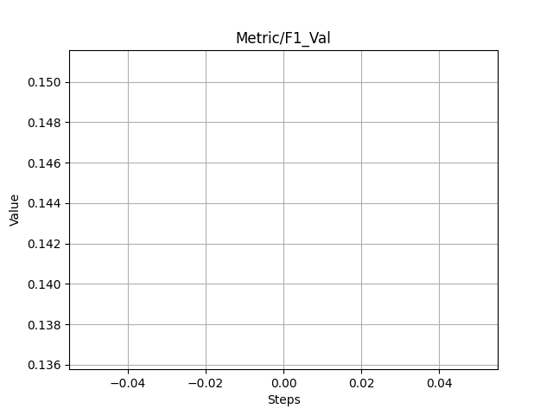
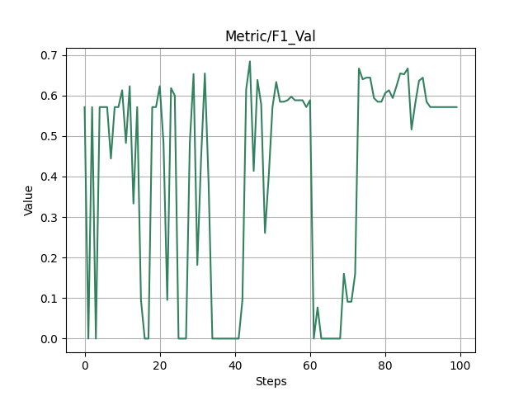
04. Results
Result for Submission 2 : F1 Score
EviRed Real Dataset
DeepDRiD Synthetic Dataset
PLAN
c)
d)
Not Available

Slide 39
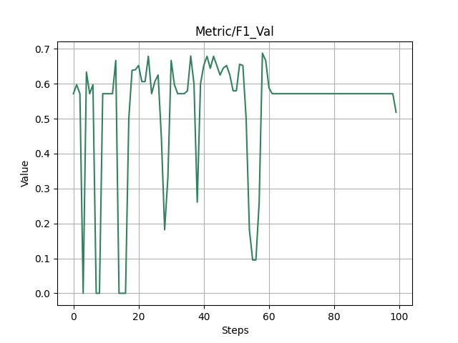
04. Results
Result for Submission 3 : F1 Score
EviRed Real Dataset
DeepDRiD Synthetic Dataset
PLAN
e)
f)
Not Available

Slide 40
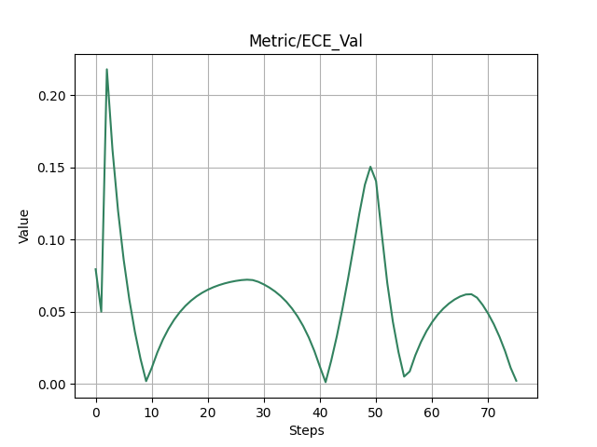
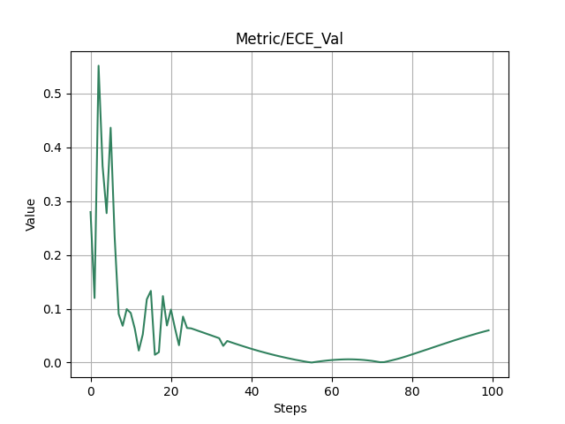
04. Results
Result for Submission 1 : ECE
EviRed Real Dataset
DeepDRiD Synthetic Dataset
PLAN
a)
b)

Slide 41
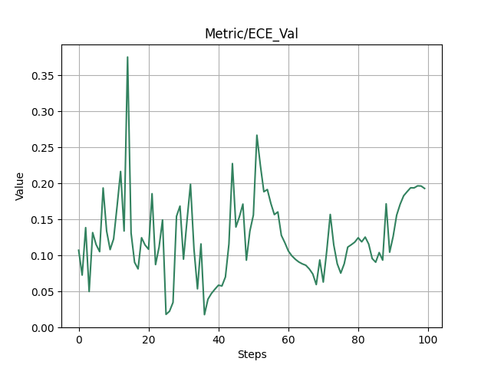
04. Results
Result for Submission 2 : ECE
EviRed Real Dataset
DeepDRiD Synthetic Dataset
PLAN
c)
d)
Not Available

Slide 42
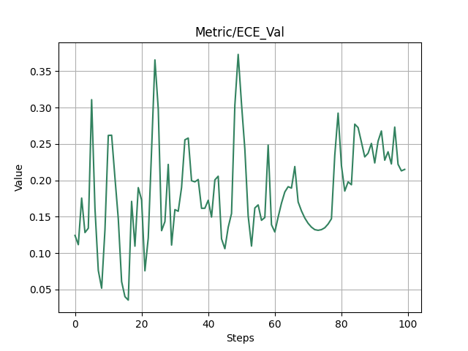
04. Results
Result for Submission 3 : ECE
EviRed Real Dataset
DeepDRiD Synthetic Dataset
PLAN
e)
f)
Not Available

Slide 43

05. Discussion
PLAN

Slide 44

05. Discussion
Submission 1 : ResNet101 with Cross-Entropy Loss
The model achieved an F1 score of 0 on both the DeepDRiD synthetic dataset and the EviRed dataset.
PLAN
The performance curve for EviRed remained stable at 0 from the beginning, while the curve for the synthetic dataset fluctuated initially before stabilizing at 0.
The poor performance is likely due to data imbalance, even though the model exhibited high confidence as reflected by a low ECE

Slide 45
05. Discussion
Submission 1 : ResNet101 with Cross-Entropy Loss
The model achieved an F1 score of 0 on both the DeepDRiD synthetic dataset and the EviRed dataset.
PLAN
The performance curve for EviRed remained stable at 0 from the beginning, while the curve for the synthetic dataset fluctuated initially before stabilizing at 0.
The poor performance is likely due to data imbalance, even though the model exhibited high confidence as reflected by a low ECE

Slide 46
05. Discussion
Submission 1 : ResNet101 with Cross-Entropy Loss
The model achieved an F1 score of 0 on both the DeepDRiD synthetic dataset and the EviRed dataset.
PLAN
The performance curve for EviRed remained stable at 0 from the beginning, while the curve for the synthetic dataset fluctuated initially before stabilizing at 0.
The poor performance is likely due to data imbalance, even though the model exhibited high confidence as reflected by a low ECE

Slide 47
05. Discussion
Submission 2 : inceptionV3 with CBFL Loss
The F1 score stabilized at 0.57 on the DeepDRiD dataset and at 0.14 on the EviRed dataset.
PLAN
Higher ECE scores indicated lower model calibration and overconfidence in predictions
While the CBFL helped mitigate the issues of imbalanced data, the model still exhibited inconsistencies, likely due to being trained for only one epoch.

Slide 48
05. Discussion
Submission 2 : inceptionV3 with CBFL Loss
The F1 score stabilized at 0.57 on the DeepDRiD dataset and at 0.14 on the EviRed dataset.
PLAN
Higher ECE scores indicated lower model calibration and overconfidence in predictions
While the CBFL helped mitigate the issues of imbalanced data, the model still exhibited inconsistencies, likely due to being trained for only one epoch.

Slide 49
05. Discussion
Submission 2 : inceptionV3 with CBFL Loss
The F1 score stabilized at 0.57 on the DeepDRiD dataset and at 0.14 on the EviRed dataset.
PLAN
Higher ECE scores indicated lower model calibration and overconfidence in predictions
While the CBFL helped mitigate the issues of imbalanced data, the model still exhibited inconsistencies, likely due to being trained for only one epoch.

Slide 50
05. Discussion
Submission 3 : ResNet152 with CBFL and Data Augmentation
This submission achieved the best overall performance on the DeepDRiD dataset, with improved generalization due to data augmentation.
PLAN
No results were reported for the EviRed dataset, as the model did not begin training on this dataset.
Data augmentation enhanced the model's ability to generalize, making it the best-calibrated model among the submissions.

Slide 51
05. Discussion
Submission 3 : ResNet152 with CBFL and Data Augmentation
This submission achieved the best overall performance on the DeepDRiD dataset, with improved generalization due to data augmentation.
PLAN
No results were reported for the EviRed dataset, as the model did not begin training on this dataset.
Data augmentation enhanced the model's ability to generalize, making it the best-calibrated model among the submissions.

Slide 52
05. Discussion
Submission 3 : ResNet152 with CBFL and Data Augmentation
This submission achieved the best overall performance on the DeepDRiD dataset, with improved generalization due to data augmentation.
PLAN
No results were reported for the EviRed dataset, as the model did not begin training on this dataset.
Data augmentation enhanced the model's ability to generalize, making it the best-calibrated model among the submissions.

Slide 53

06. Conclusion
PLAN
Participated in a challenge to predict ci-DME occurrence within one year using various deep learning models.
Evaluated three submissions, each employing different approaches.
The most successful approach was submission 3, achieving the best performance on the DeepDRiD synthetic dataset.

Slide 54
Thanks for your
attention!

