Slide 1
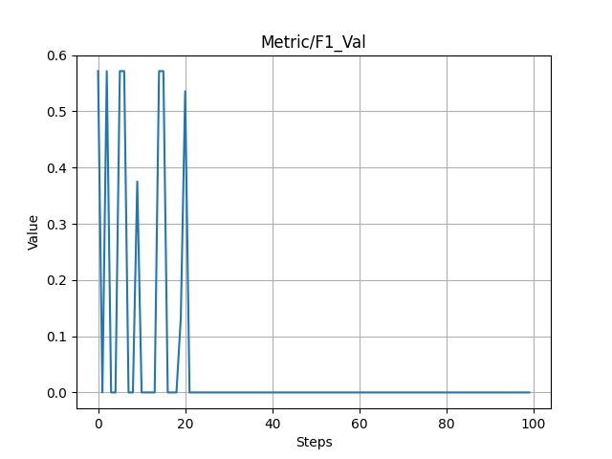
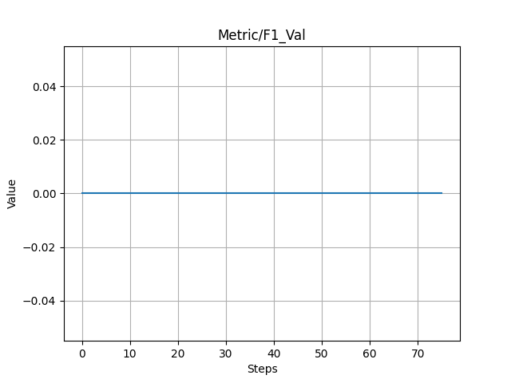
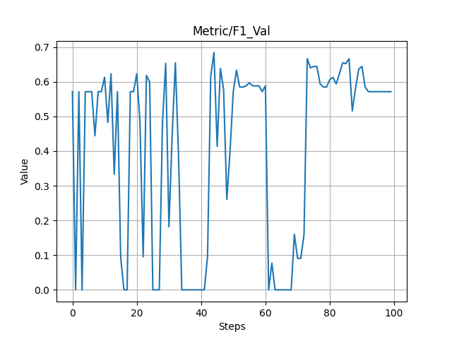
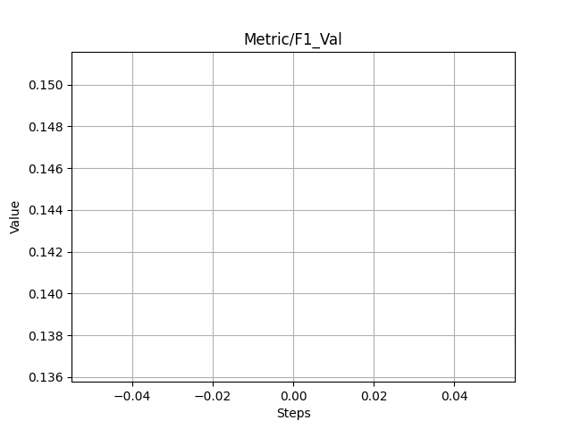
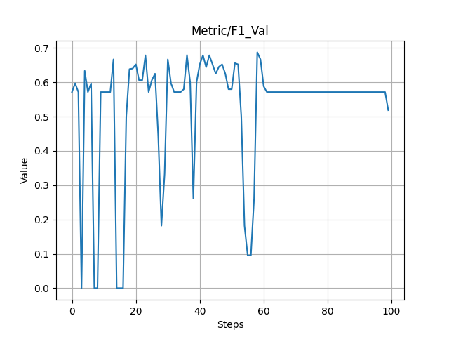
F1 Score
Synthetic Data
Real Data
DeepDRiD Data
EviRed Data
a)
b)
Submission_1
c)
d)
SUB1
Submission_2
Not available
e)
e)
Submission_3
Not available
SUB1

Slide 2
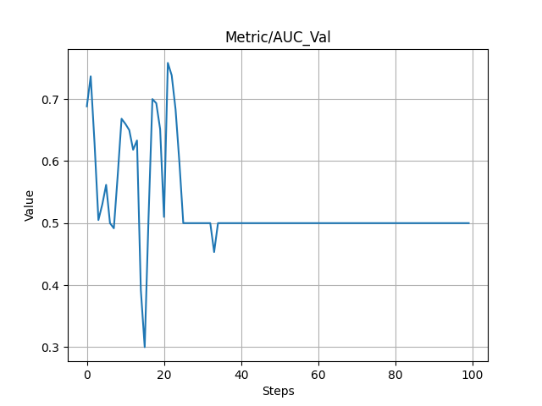
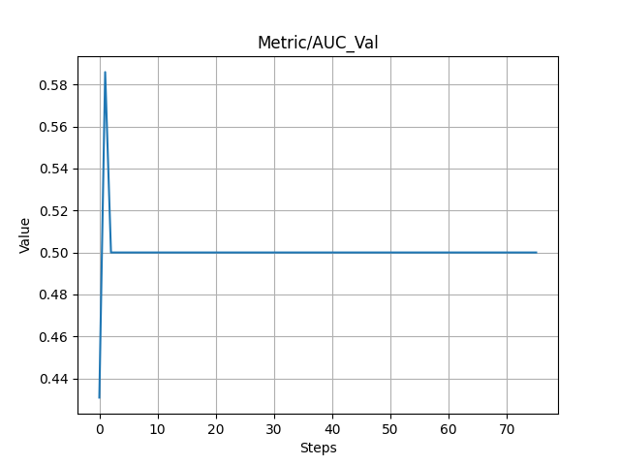
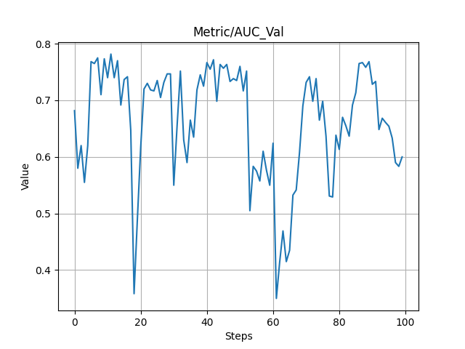
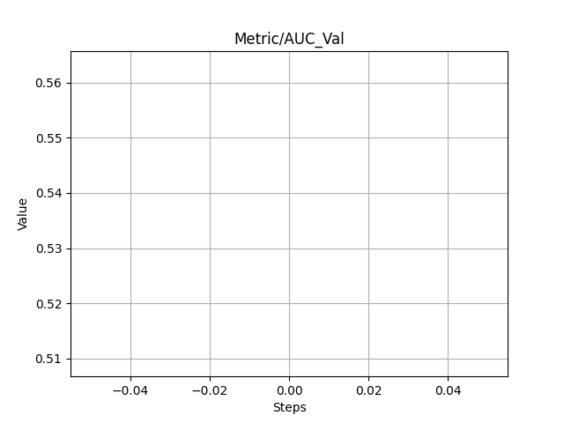
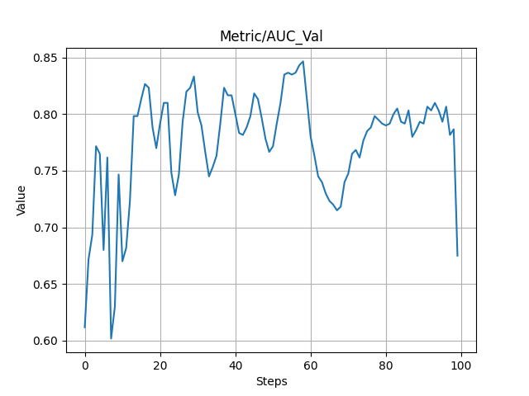
AUC
Synthetic Data
Real Data
DeepDRiD Data
EviRed Data
SUB1
a)
b)
Submission_1
c)
d)
SUB1
Submission_2
Not available
e)
f)
Submission_3
Not available
SUB1

Slide 3
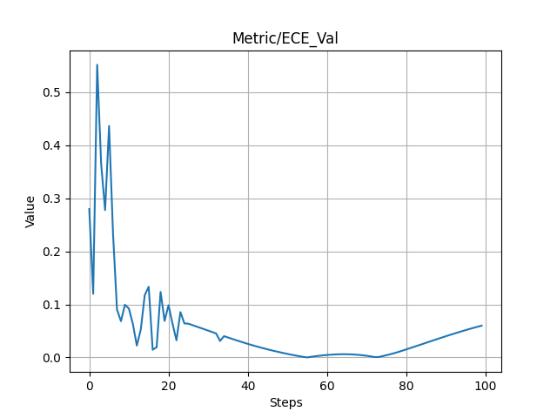
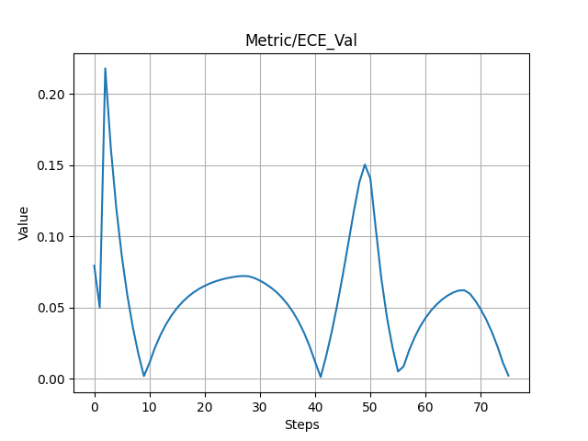
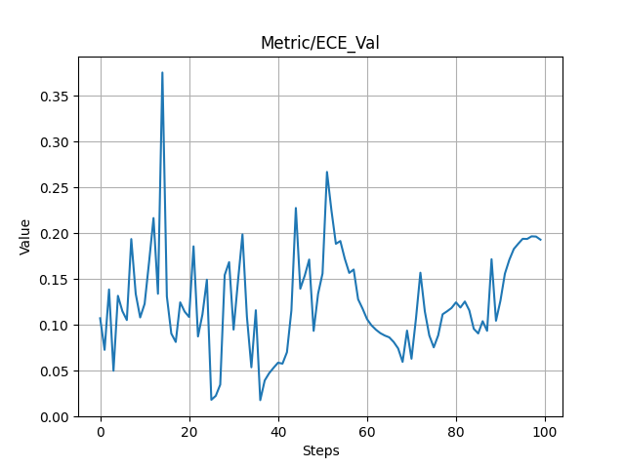
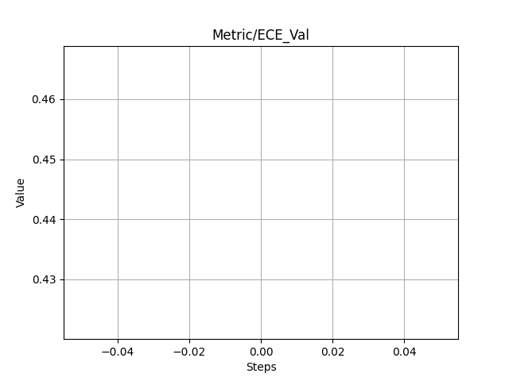
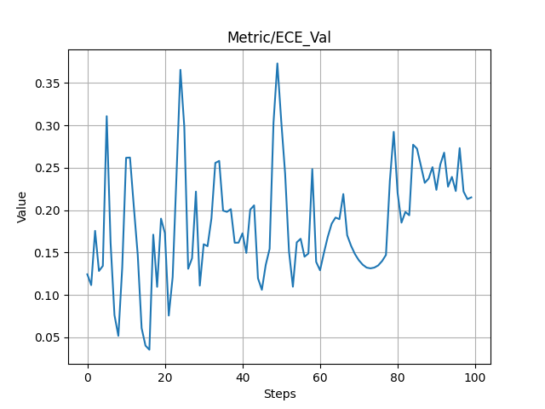
ECE
Synthetic Data
Real Data
DeepDRiD Data
EviRed Data
SUB1
a)
b)
Submission_1
c)
d)
SUB1
Submission_2
Not available
e)
f)
Submission_3
Not available
SUB1

Slide 4
Not available

Slide 6
Dataset
User
Project
1..*
Id: String
Name: String
description: String
type: String
Id: String
firstName: String
lastName: String
type: String
password: String
birthdate: Date
isVerified: bool
1..*
Id: String
title: String
description: String
1..1
1..1
1..*
registerUser()
loginUser()
createProject()
readProject()
updateProject()
deleteProject()
createQuize()
readQuize()
updateQuize()
deleteQuize()
1..1
Quiz
Id: String
title: String
associatedApi: String
subject: String
nbrQuestion: Integer
typeQuestion: String
promptText: String
diffuculty: diffucultyLevel
“Ennumerate”
diffucultyLevel
1..*
1..*
Very Low
Low
Medium
High
Very High

Slide 7



















Slide 8
04. Results
Result on DeepDRiD Synthetic Dataset
 | AUC | F1 Score | ECE | Final Score
Submission 1 | 0.73 | 0.0 | 0.12 | 1.17
Submission 2 | 0.73 | 0.57 | 0.17 | 1.4
Submission 3 | 0.79 | 0.11 | 0.11 | 1.56

