Slide 1
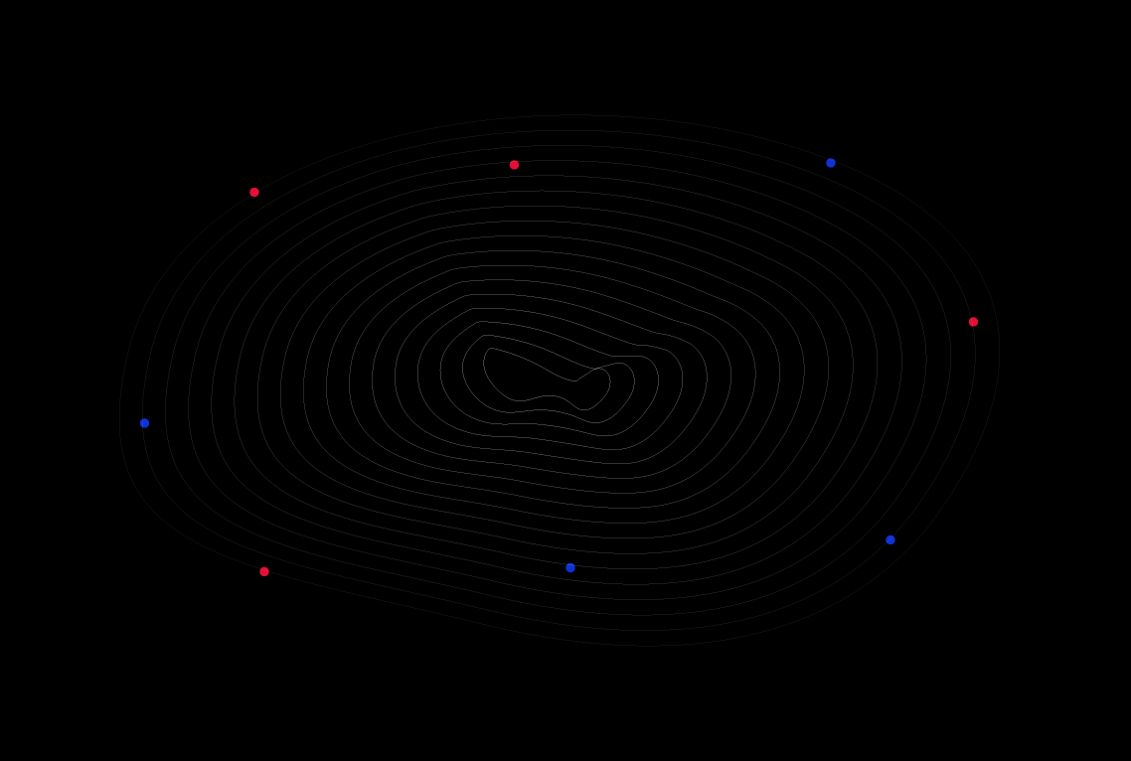
Intro To HTML

Slide 2
WHAT IS HTML
HTML means Hyper Text Markup Language and is the standard markup language for creating Web pages.
EVERY textual or visual content you see in a website is based on HTML.
HTML elements (<> tags) are the building blocks of HTML pages
Notes:
Browsers do not display the HTML tags and code, but use them to render the content of the page

Slide 3
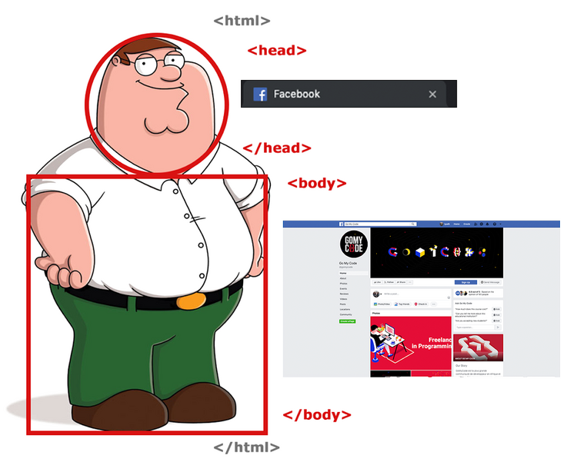
HTML STRUCTURE
Every html code is written inside a “.html” file.
The html file structure is always the same.
<!DOCTYPE HTML> document type
<html>
<head>
Page Title
Page Logo
Other functionalities (css, js)
</head>
<body>
Everything you see in the page
</body>
</html>
onglet
page

Slide 4
THE <HEAD> TAG
The <head> element is a container for all the head elements.
The <head> element can include a title for the document, scripts, styles, meta information, and more.
The following elements can go inside the <head> element:
Title
Style
Script
Link
Base
meta
Notes:
Dima n7elou tag nektbou fi westha chnoua n7ebou w nsakrouha mba3d
Br narj3ou biha lel star w tetsamma self closing tag
Hedhom des exemples w famma barcha o5rin w famma des tags teb3in lelli déjà hné
Nwarihom exemple code html

Slide 5
THE <body> TAG
The body element appears after the head element in the page. It should contain all the content of your web page: text, images, and so on. All web pages have 1 single body element, we can divide the tags inside the body into:
Headings <h1>…</h1>, <h2>…</h2>
Line Breaking Tags <br>
Paragraphs <p>…</p>, <span></span>
Images <img src=“…”>
Audio and Video <audio></audio>
Links <a></a>
Lists <ul></ul>
Tables <table></table>
Buttons <button></button>
Forms and Inputs <form></form>
Notes:
Dima n7elou tag nektbou fi westha chnoua n7ebou w nsakrouha mba3d
Br narj3ou biha lel star w tetsamma self closing tag
Hedhom des exemples w famma barcha o5rin w famma des tags teb3in lelli déjà hné
Nwarihom exemple code html

Slide 6
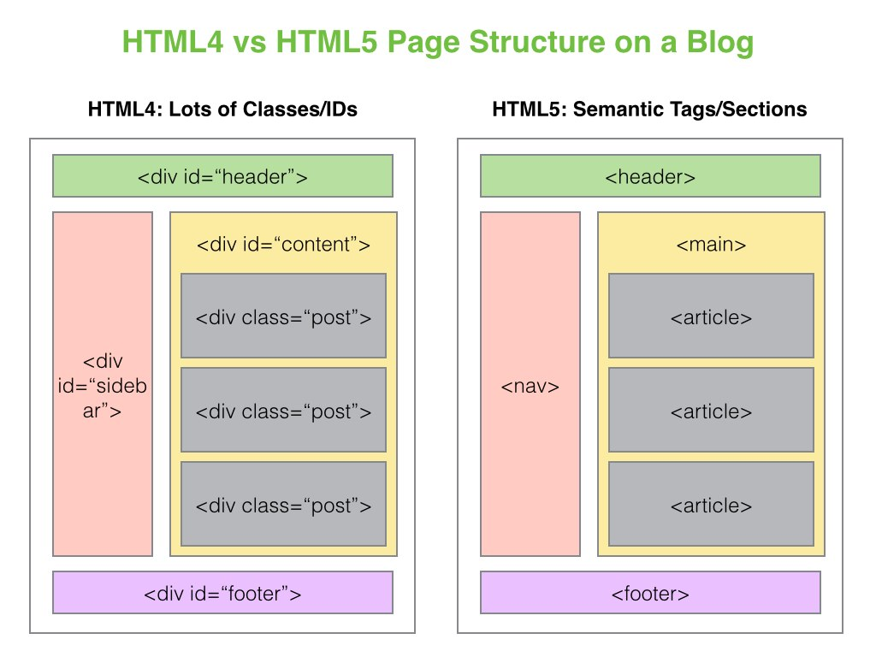

Slide 7
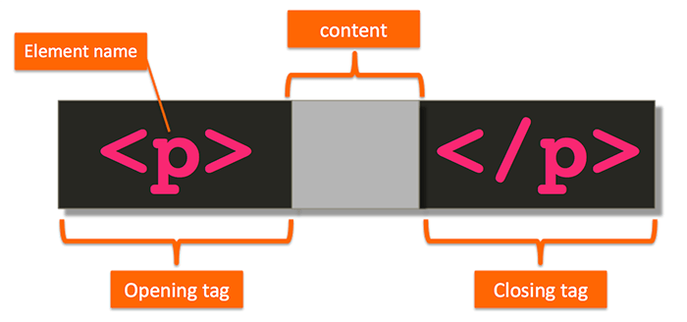
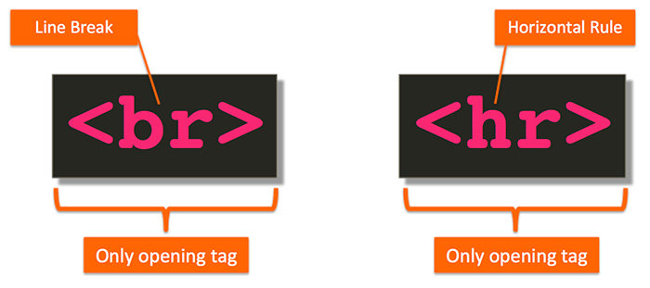
Types of HTML tags
Paired
Tags
Singular
Tags

Slide 8
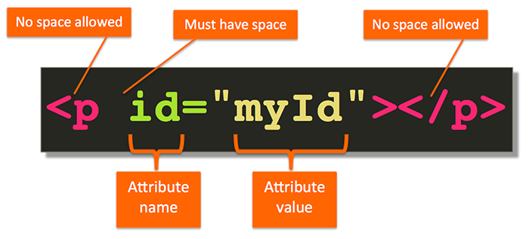
ELEMENT

