Slide 1
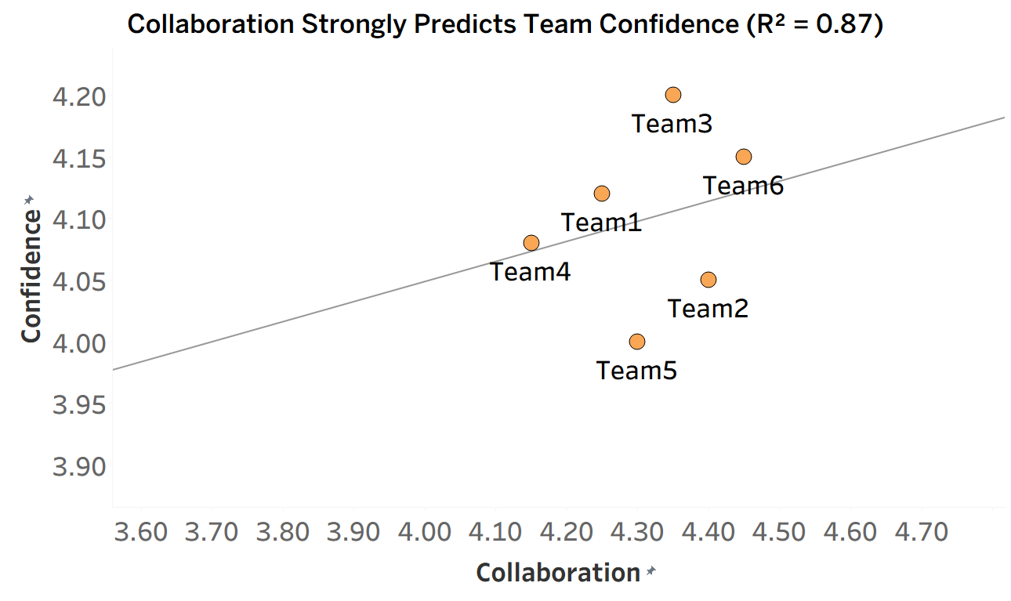
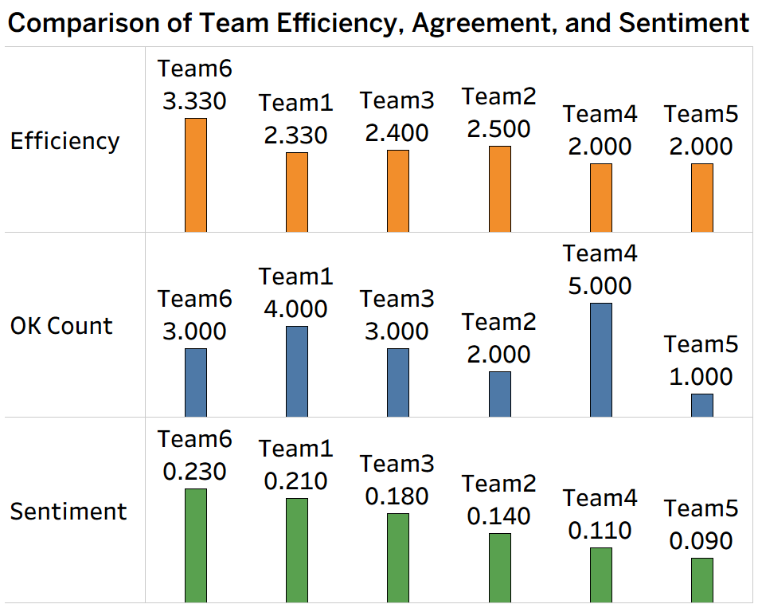
Relationships Between Team Communication Behaviors
and Problem-Solving Confidence
Ayoub Eabidawi
Masters in Applied Security and Analytics
ABSTRACT
OUTCOMES
DATA DESCRIPTION
This study examined communication behaviors in Software Engineering team meetings to understand how efficiency, sentiment, and agreement relate to students’ problem-solving confidence. Audio recordings and end-of-semester surveys were collected from six development teams (21 students total). Audio transcripts were coded for problem statements, solution proposals, “OK” agreement markers, and sentiment polarity. Survey data measured confidence, collaboration, commitment, and effectiveness using 5-point Likert scales. After cleaning and merging the datasets, analyses using Python, JASP, and Excel showed that efficiency and agreement behaviors strongly predicted positive sentiment at the individual level. At the team level, a combined regression model revealed that collaboration and communication efficiency together explained most of the variance in confidence.
How Do Collaboration and Efficiency Together Predict Team Confidence? (By teams, n = 6, audio + survey data combined)
  Multiple regression was conducted to predict Team Confidence from Team Collaboration and Team Efficiency.
  The regression model was statistically significant, F(2,3) = 9.92, p = 0.045, R² = 0.87, explaining 87% of the variance in team confidence.
  In the regression model, Collaboration statistically predicted Confidence (β = 0.72, t(3) = 3.84, p = 0.03).
  Efficiency showed a positive relationship but was not statistically significant in the regression model (β = 0.21, t(3) = 0.98, p = 0.39).
Correlations (reported after regression):
  r = 0.847, p = 0.034 → Collaboration × Confidence
  r = 0.320, p = 0.538 → Efficiency × Confidence
Interpretation: Team collaboration is a very strong predictor of self-reported confidence, combining survey perception with audio efficiency yields strong explanatory power, though the team sample is small.
Sample:
  Participants enrolled in an undergraduate software engineering course
  4 teams from 2024 and 2 teams from 2025
  21 individual students across 6 teams
Key Derived Variables:
  Efficiency = Solutions_Count ÷ Problems_Count
  OK_Count = count of “ok” per participant or team
  Sentiment = mean ChatGPT sentiment score per utterance (range –1 to +1)
  Confidence, Collaboration, Commitment, Effectiveness = survey means
INTRODUCTION
CONCLUSIONS
Stakeholder: Software Engineering course instructor seeking early indicators of struggling teams
Motivation: Enable instructors to monitor team health and provide timely coaching using automated analytics
Origin of Question: Stakeholder interviews emphasized a need to identify teams losing confidence before performance declines
Why It Matters: Early detection supports intervention, improves project outcomes, and enhances teamwork
Research Question: Are team communication behaviors (efficiency, sentiment, agreement) related to problem-solving confidence?
Long-Term Goal: Use results to guide development of an automated prototype assessment tool integrating audio + survey analytics for real-time team monitoring
Efficiency and OK_Count predict more positive Sentiment at the individual level
Collaboration is the strongest survey predictor of Confidence
Combined audio + survey regression model explained a large portion of variance in Confidence (R² = 0.87)
Findings support the development of an automated assessment prototype tool to assist instructors in monitoring and providing early team intervention
The scatter plot above displays Collaboration (X-axis) and Confidence (Y-axis), with a regression line showing the strong positive relationship. Teams with higher collaboration report higher confidence.
The bar chart above shows Efficiency, OK Count, and Sentiment for each team. Teams with higher efficiency also displayed higher positive sentiment.
Are Team Efficiency, OK Count, and Sentiment Related? (By teams, n = 6, audio data aggregated to team level)
  Multiple regression was conducted to predict Team Sentiment from Team Efficiency and OK Count
  The model was statistically significant and explained 79.2% of the variance in sentiment (R² = 0.792), F(2,3) = 5.72, p = 0.046
  Efficiency significantly predicted Sentiment (β = 0.619, t(3) = 2.94, p = 0.042)
  OK Count positively predicted Sentiment but was not statistically significant (β = 0.381, t(3) = 1.81, p = 0.138)
Correlations (reported after regression):
  r = 0.756, p = 0.028 → Efficiency × Sentiment
  r = 0.588, p = 0.116 → OK Count × Sentiment
Interpretation: Teams that were more efficient (proposed more solutions relative to problems) showed significantly more positive sentiment. Agreement (OK count) showed a positive relationship but was not statistically significant in this sample.
REFERENCE
Lencioni, P. (2002). The Five Dysfunctions of a Team

