Slide 1


END-TO-END
MLOps Workflow
CI/CD, Dockerized Training, Model Serving, and Monitoring
DevOps & MLOps Project | Academic Year 2025-2026
Omar Elkhali | Ayoub Moutik | Jamila Ouzzane

Slide 2
Project At A Glance
A text classification system wrapped in a practical MLOps workflow.
01
02
03
04
05
Scripts
Logging
Reproducibility
CI/CD
Monitoring
Convert the notebook into reusable Python modules.
Record training, evaluation, prediction, and errors.
Track code, data, dependencies, runs, and artifacts.
Build, test, train, evaluate, push, and deploy with Jenkins.
Observe API health and model behavior after release.
Main objective
Turn a machine learning prototype into an observable, traceable, and automated delivery workflow.
MLOps Exam Project
02

Slide 3
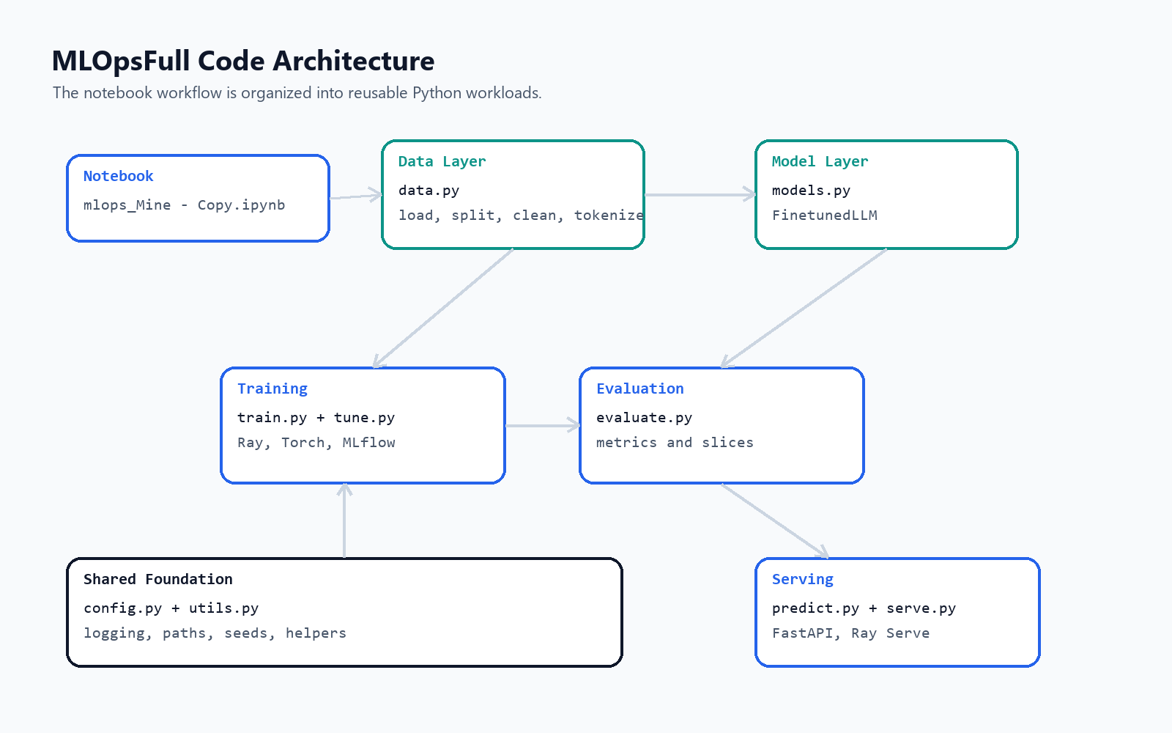
Part 1 - Moving From Notebooks To Scripts
The notebook becomes a modular codebase that Jenkins and tests can execute.
WHY
Notebooks are excellent for exploration, but production workflows need deterministic modules and terminal commands.
1
data.py
load, split, clean, tokenize
2
train.py
Ray Train and checkpoints
3
evaluate.py
overall, class, and slice metrics
4
serve.py
FastAPI and optional Ray Serve
Diagram from report/figures/code_architecture.png
MLOps Exam Project
03

Slide 4
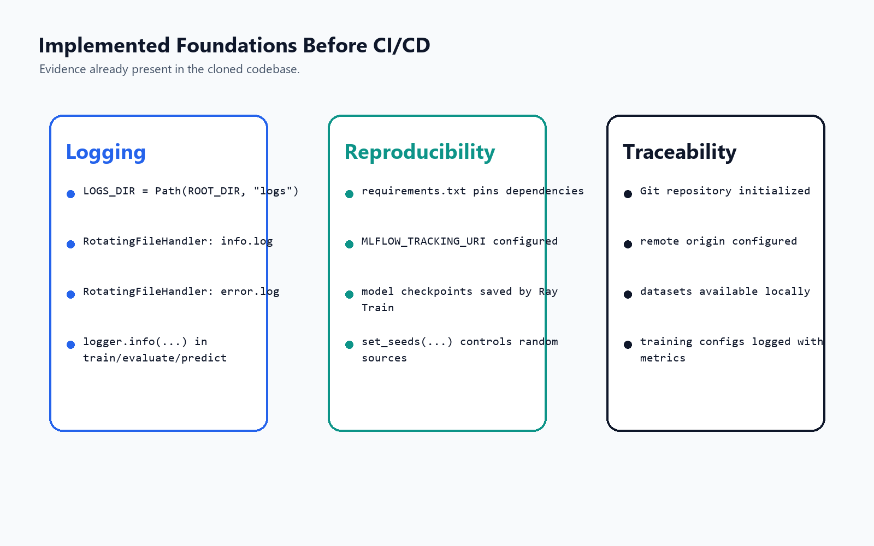
Part 2 - Logging For ML Systems
Logs make training and serving behavior inspectable after the run finishes.
LOG FLOW
1
2
3
4
App code
Handlers
Artifacts
Audit
logger.info / errors
console + rotating files
info.log and error.log
debug, trace, explain
Configuration lives in madewithml/config.py.
Training logs run ID, parameters, and metric history.
Evaluation and prediction logs support troubleshooting.
Diagram from report/figures/foundations_evidence.png
MLOps Exam Project
04

Slide 5
Part 3 - Reproducibility
A result is useful only when the team can explain and recreate it.
1
2
3
4
5
Git
requirements.txt
datasets/
MLflow
Checkpoints
code history
dependency versions
small data versioning
runs, params, metrics
model artifacts
Project evidence
Seed utilities, Ray checkpoints, MLflow file URI, tracked datasets, and archived CI artifacts.
Production path
Move large data and artifacts to DVC, object storage, or a remote MLflow server.
MLOps Exam Project
05

Slide 6
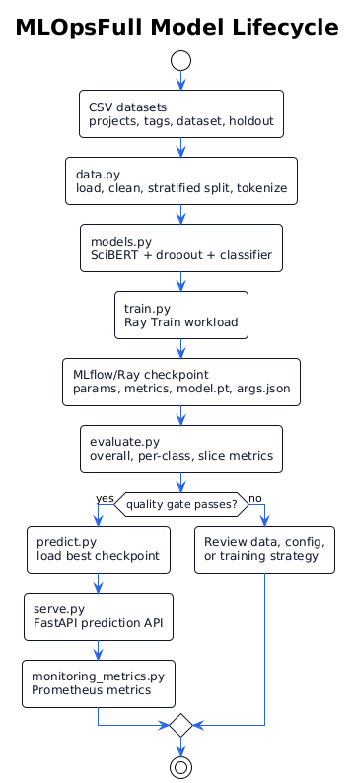
Training And Model Lifecycle
The reproducibility layer connects data, training, evaluation, serving, and monitoring.
1
Load and preprocess
CSV data is cleaned, tokenized, and split with stratification.
2
Train and track
Ray Train writes checkpoints while MLflow records params and metrics.
3
Evaluate and gate
Weighted F1 plus class and slice metrics decide deployability.
4
Serve and observe
FastAPI exposes predictions and Prometheus-format metrics.
Diagram from report/figures/ml_lifecycle.png
MLOps Exam Project
06

Slide 7
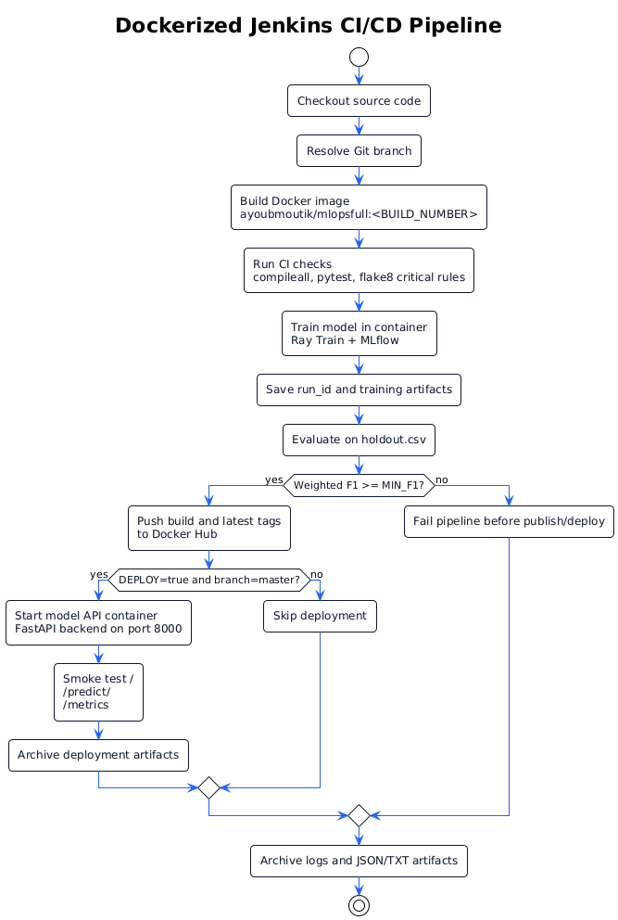
Part 4 - Dockerized Jenkins CI/CD
The pipeline validates both software correctness and model quality before deployment.
1
Checkout
2
Build image
Pull source code from GitHub
Create versioned Docker image
3
CI checks
4
Train
compileall, pytest, critical flake8
Run containerized Ray training
5
Evaluate
6
Deploy
Compare weighted F1 to MIN_F1
Start API and run smoke tests
Jenkins gate: weighted F1 = 0.9055 passed MIN_F1 = 0.85 and promoted the model.
Diagram from report/figures/cicd_pipeline.png
MLOps Exam Project
07

Slide 8
Deployment Decision Flow
The pipeline only promotes a model after the code, training job, evaluation, and smoke checks pass.
1
2
3
4
5
Build
Test
Train
Gate
Deploy
Docker image
4 tests passed
MLflow run ID
weighted F1
FastAPI :8000
Artifacts archived
train_results.json, eval_results.json, run_id.txt, metrics_smoke.txt
Serving choice
FastAPI was selected for stable local deployment; Ray remains in training and evaluation.
MLOps Exam Project
08

Slide 9
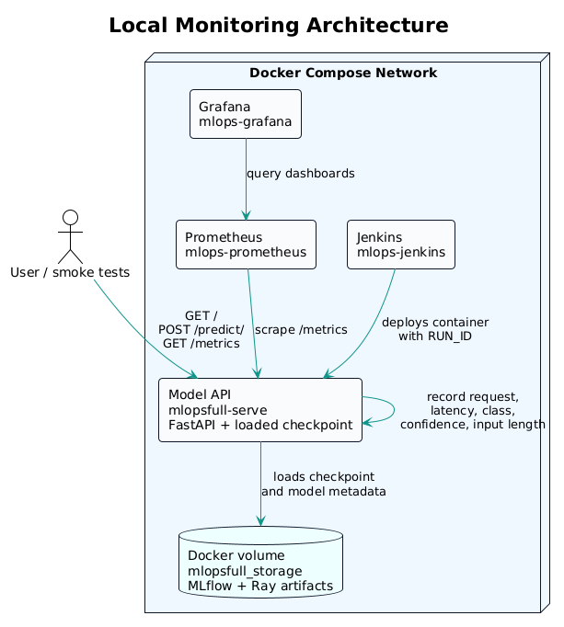
Part 5 - Monitoring Architecture
After deployment, the model API is measured by Prometheus and visualized in Grafana.
1
Jenkins
builds, trains, deploys
2
Model API
predicts and exposes /metrics
3
Prometheus
scrapes API metrics
4
Grafana
visualizes behavior
Diagram from report/figures/monitoring_architecture.png
MLOps Exam Project
09

Slide 10
Metrics, Drift, And Findings
The monitoring layer checks API health and model behavior, then guides action.
1
Request rate
2
Latency
3
Predictions
mlopsfull_requests_total
request_latency_seconds
predictions_total by class
4
Confidence
5
Input quality
6
Drift
prediction_confidence
validation_failures_total
length and class distribution
Observed demo finding
The service handled 200 prediction requests with 0 HTTP errors. Monitoring showed predictions across all classes with average confidence around 0.9285.
MLOps Exam Project
10

Slide 11
Limitations And Future Improvements
The project demonstrates the workflow locally; production hardening is the next step.
Current limitations
Next improvements
Local Docker-based stack
Small local training dataset
Stricter F1 deployment gate
Drift helpers are not scheduled
No alert routing yet
Add more labeled training data
Calibrate release thresholds
Add Prometheus alert rules
Store prediction events
Move toward Kubernetes or managed ML
MLOps Exam Project
11

Slide 12
Final Takeaway
This project is more than a trained model.
It is an operational workflow where code changes trigger validation, training creates tracked artifacts, deployment is gated by evaluation, and the running service is monitored after release.
Scripts -> Logging -> Reproducibility -> CI/CD -> Monitoring

