Slide 1
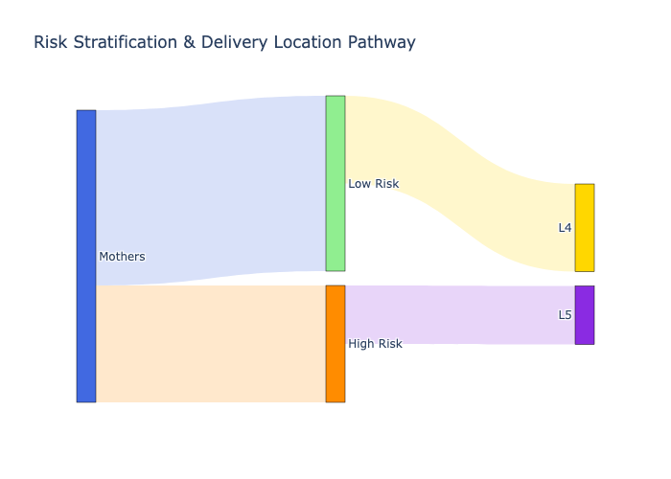
Sankey Diagrams for Pathway Analysis
• Sankey diagrams visualize patient journeys and intervention impacts across health pathways.
• Pathways modeled: Risk Stratification, ANC & Complications, Intrapartum Monitoring, SDR Delivery.
• Each stage is mapped to a node; flows represent transitions; color-coding highlights bottlenecks and effects.

Slide 2
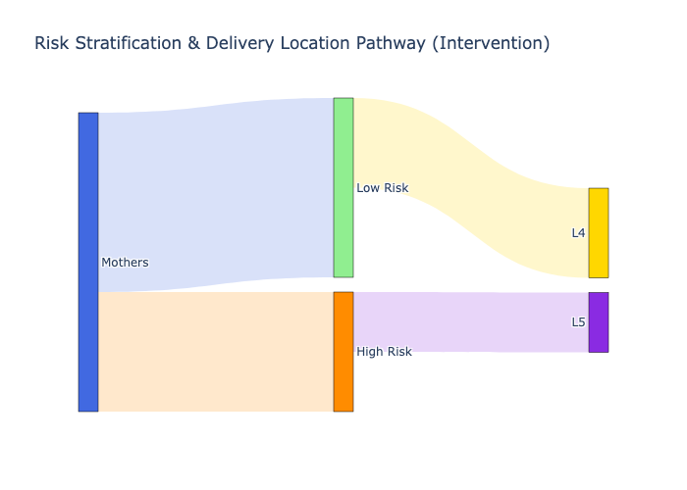
Comparative Insights from Sankey Visualizations
• Baseline vs. intervention Sankey diagrams reveal how interventions shift patient flows and outcomes.
• Quantifies reductions in adverse events and improvements in care pathways.
• Users can select pathways and scenarios in the dashboard for instant visual feedback.

Slide 3
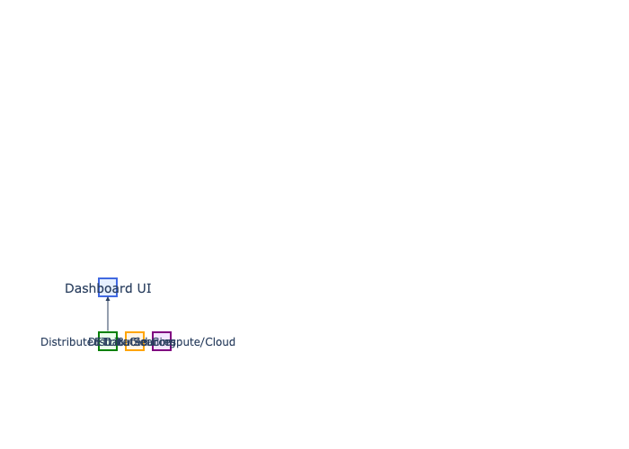
Deployment, Optimization, and Future Integration
• Dashboard optimized for online use (Streamlit, Plotly, caching, memory management).
• Future: Integrate with real-time, distributed health data (with missing/inconsistent data).
• Requires robust ETL, scalable backend, advanced analytics, and compliance with health data regulations.

