Slide 1





TWOS
Checkpoint 3 (Week 10-11)
Capstone Project: Checkpoint 3
Umair, Sangmin, Ayo
Created by Sangmin, Ayo, Umair
Notes:
Good Morning
We are Team TWOS
Umair, Sangmin, and Ayo.
Our project is AI-based Travel Companion
Travel Without Stress (TWOS).
It’s an intelligent platform that plans your entire trip
Flights, hotels, rentals, and attractions
All in one chat.

Slide 2
References
Booking.com Demand API. (2025). Booking.com. https://developers.booking.com/demand/docs/open-api/demand-api
Connect to Amadeus travel APIs | Amadeus for Developers. (n.d.). Amadeus IT Group SA. https://developers.amadeus.com/self-service
Flights - Expedia Group Developer Hub. (2025). Expediagroup.com. https://developers.expediagroup.com/rapid/flights#step-1---search-available-flight-offers
https://dev.to/gbengelebs/netflix-system-design-backend-architecture-10i3
Swagger-Api. (n.d.). GitHub - swagger-api/swagger-ui: Swagger UI is a collection of HTML, JavaScript, and CSS assets that dynamically generate beautiful documentation from a Swagger-compliant API. GitHub. https://github.com/swagger-api/swagger-ui
The PostgreSQL Global Development Group. (2025). PostgreSQL: Documentation. Www.postgresql.org. https://www.postgresql.org/docs/
Welcome to the Tiqets Distributor API | Tiqets for developers. (2025, September 5). Tiqets.dev. https://developers.tiqets.dev
Created by Umair, Sangmin, Ayo
Notes:
Here are our references for the project

Slide 3



Roles for Team Members
Sangmin Lee
Python, JS, Docker, Kubernetes
Key Responsibilities
Build NLU clarifier logic
Track and maintain slot-filling states
Optimize options based on rank/score
Create an explanation
Umair Dada
React Native Specialist, Node.js, Express
Key Responsibilities
Lead team & milestones
Build React Native app
Manage Node.js gateway
Handle testing & demo
Ayomika Ajibade
FastAPI, Database & API Design, Cloud Integration
Key Responsibilities
Design API schema
Create databases for local & prod
Integrate and scale Al solutions for the mobile app
Created by Umair, Sangmin, Ayo

Slide 4
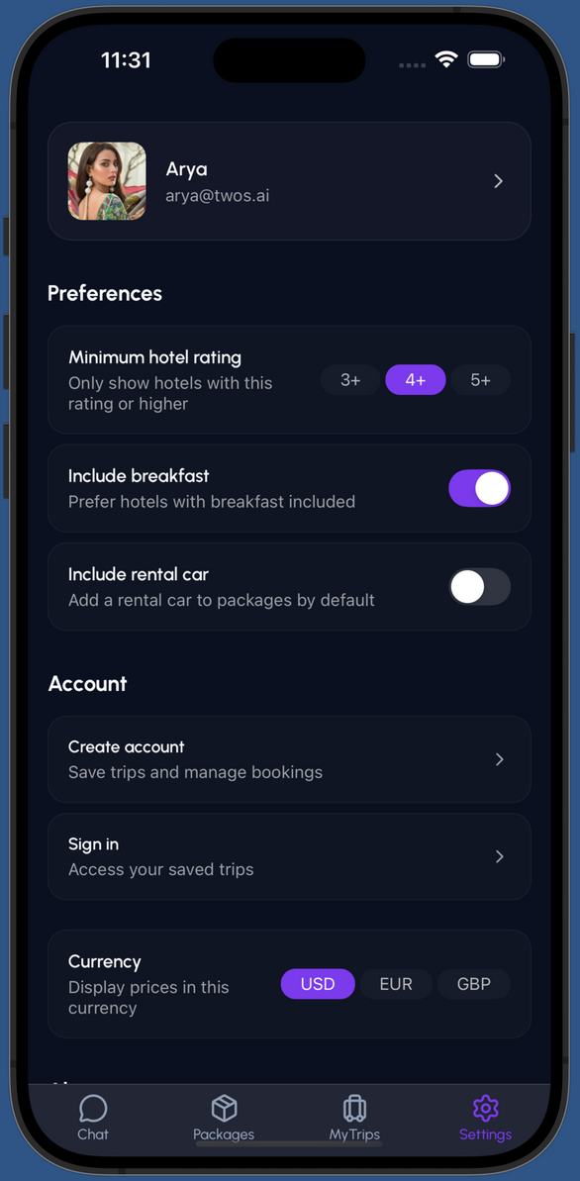
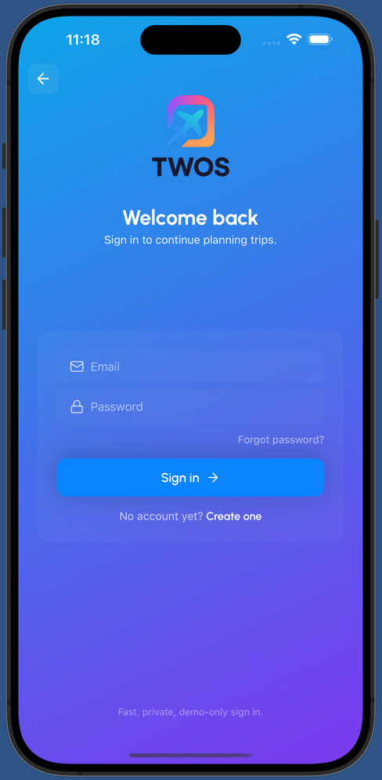
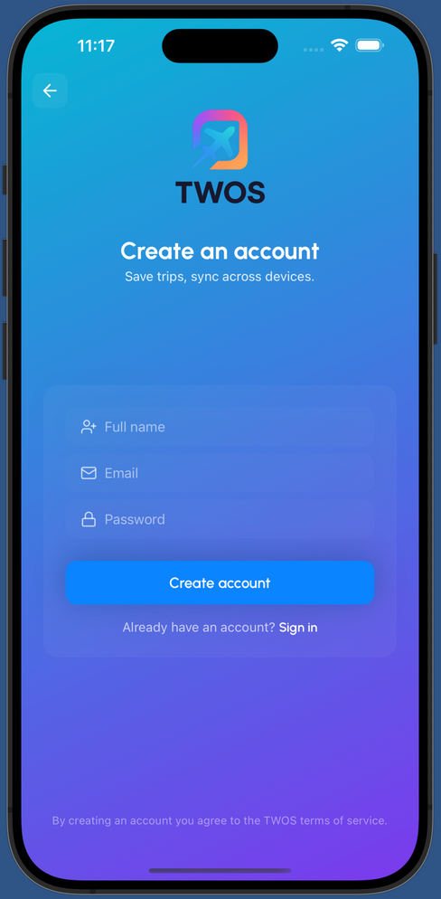
Progress #1 - Frontend
Signup Screen
The signup screen was designed with a clean gradient layout, clear input fields, and balanced spacing. It connects with the backend to handle user registration and was tested for smooth navigation and consistent visual alignment across devices.
Login Screen
The login screen follows the same design language for a unified look. It securely connects to the backend for authentication, allowing users to access their accounts easily. The back button and simple layout keep the flow quick and intuitive.
Created by Umair

Slide 5
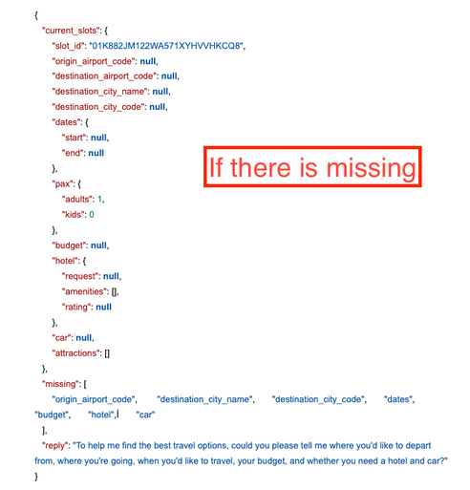
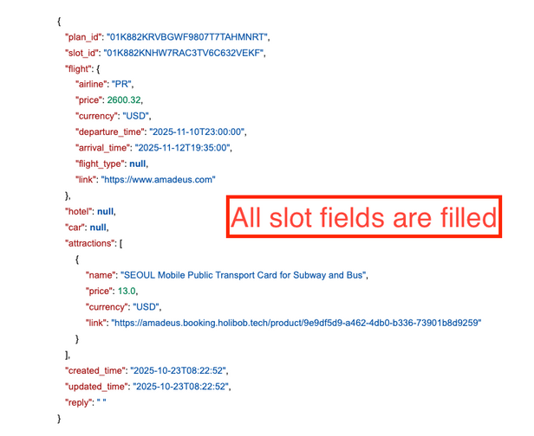
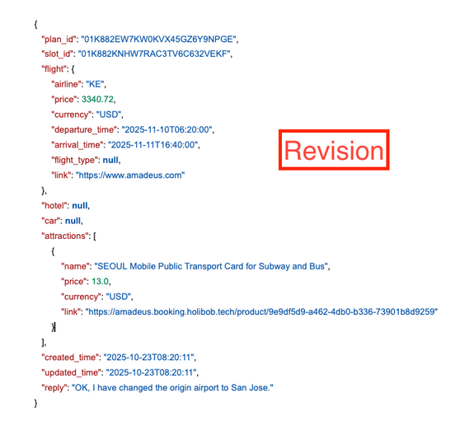
Progress #2 - Chatbox Optimization
Combine two endpoints
Now, chatbox(NLP) handles:
Parse the user’s inputs
Asking for missing information from the chat.
Provide a travel plan if there is no missing information.
Provide a revised plan based on the revised information.
Created by Sangmin
Notes:
(Sangmin)
Thank you Umair,
Here is our 2nd progress.
The FastAPI services for APIs are built. Currently, we successfully get data for flights and hotels based on the user's input.
I don't have screenshots here, but because of these services, our NLP has also improved. Now, it parses the users' natural language and makes API calls using parsed data at once.

Slide 6
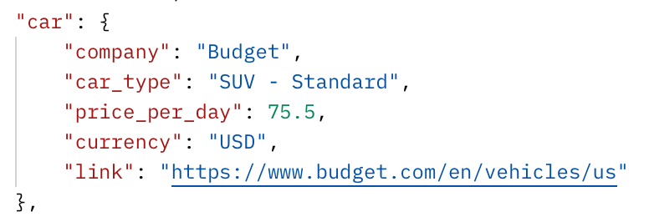
Progress #3 - Car API
Car Search Service
It returns
Rental company name
Car type
Price per day
Currency
Link
The car type is decided based on the number of people.
(e.g. 2 adults + 2 kids = SUV,
2 adults = Sedan)
Created by Sangmin
Notes:
And this is our progress #4
Finally, we succeeded in deploying the service in the IBM LinuxOne Cloud.
The issue was for some reason "ufw" command didn't work, but LinuxOne support team advice us to use "iptables" to override it and it worked.
Now, we can access to our endpoints from local browser which is good start.
Now, let me pass to the Ayo

Slide 7
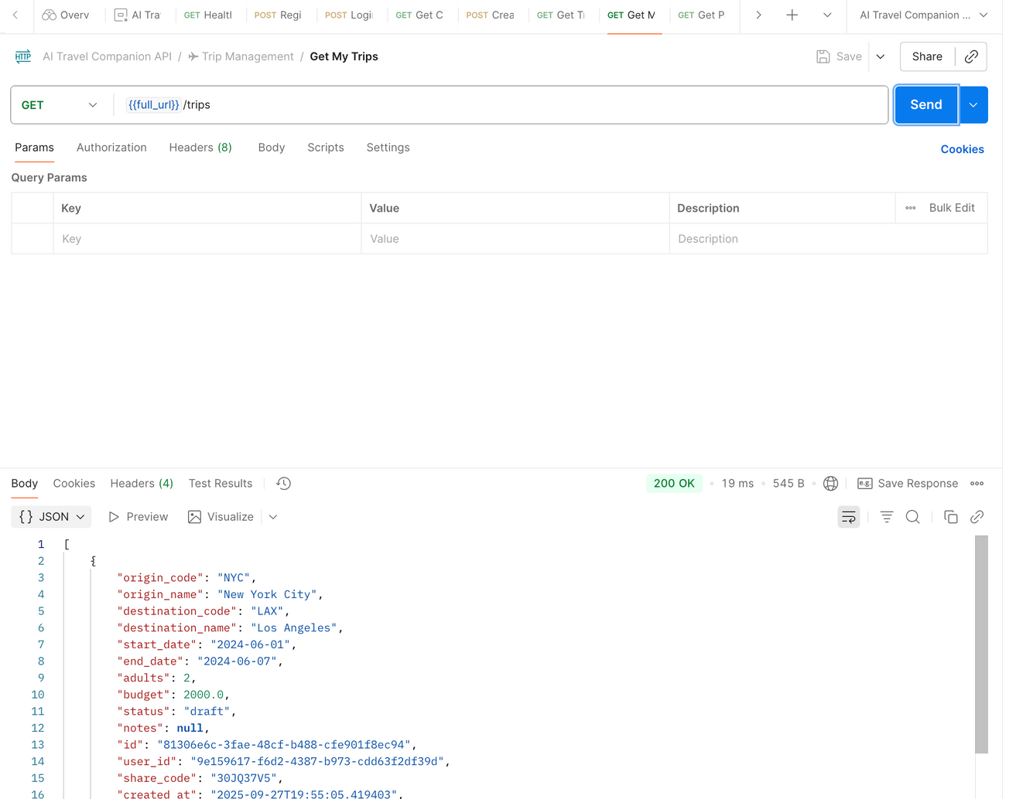
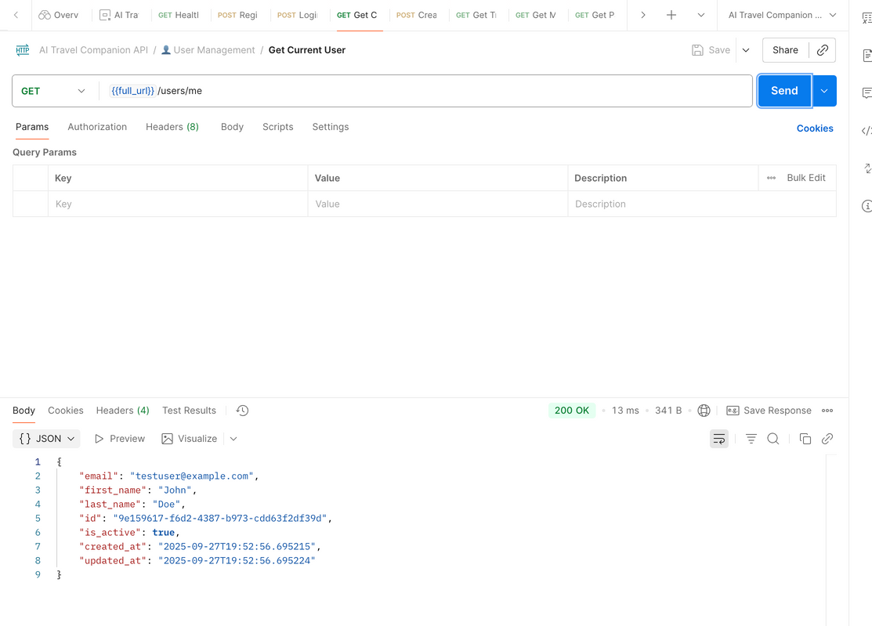
#4 - Optimise Backend Services For Better Performance
Connected to the AI Services (WIP)
Updated integral tables, relationships and fields based on the API and AI return response
Researched on optimisation tools like Redis and Cron Job
Reduced API request and response time by 20%
Integrated and implemented Redis and cron jobs into the system for speed and real-time updates
Created by Ayo

Slide 8
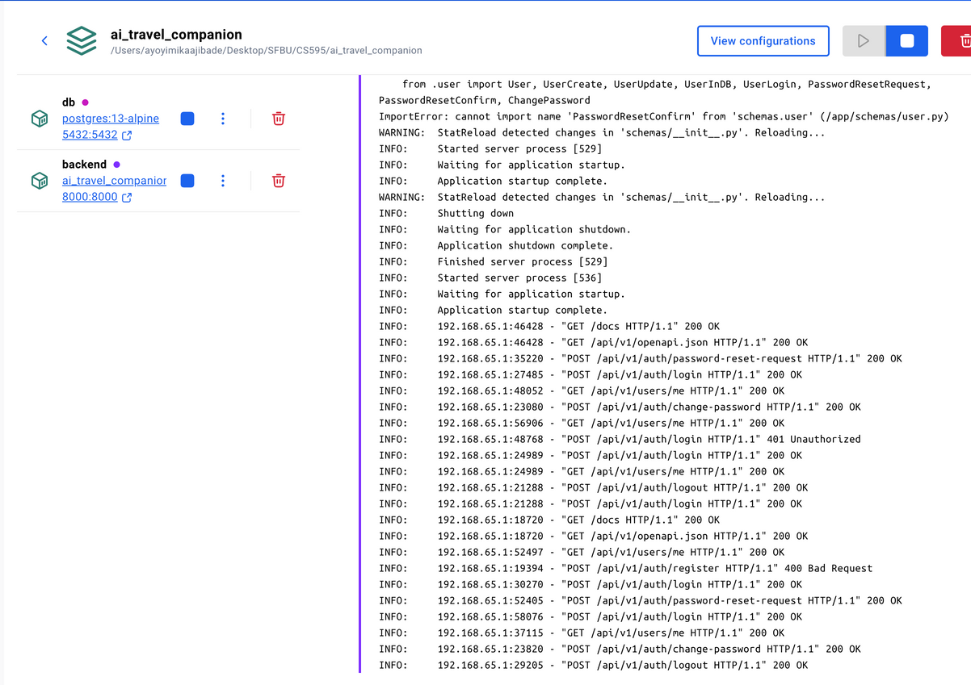
#5 - Integrating and Deploying AI Services
Ensured the system is centralised for smooth workflow amongst the team
Configured and deployed the AI services to IBM
Creating .sh script to have GitHub CI/CD working (WIP)
Created by Ayo

Slide 9
Project Timeline
Proposal and Setup
LLM + Chat Setup
Rent & Attractions Integration
Publish & Deployment
Prepare the project proposal and set up the development environment
Integrate LLM API, API, implement classification slots, and create chat endpoints
Integrate APIs for car rental, hotels and attractions search, and add an API endpoint
Publish an app to the Expo/Vercel
Week 1-3
Week 4-5
Week 6-7
Week 8-9
Week 10-11
Week 12-13
Week 14
Frontend & backend Setup
Flights & Hotels Integration
Orchestration & Testing
Initialize and design the frontend basic layout and the backend basic endpoints
Integrate APIs for flights and hotels, and add each API endpoint
Orchestrate flight, hotel, rental, and attractions based on inputs
Created by Sangmin, Umair, Ayo
Notes:
(Anyone)
Ok, here is our timeline
We are a little ahead of our plans. We already worked on Flights & Hotels APIs, and are working. We are planning to push ourselves more to implement rentals and attractions integrations.

Slide 10
What’s next?
Testing chatbox in the frontend
Goal: Test and make sure that the chatbox is working properly in the app.
Expected Result #1: Chatbox in the app should handle multiple use cases
Initial parse and making a plan
Revise slots and the plan
Connect FE and BE #4
Goal: Save the user’s chat, slots, and plan information into mobile devices/DB
Expected Result #1: Save the user’s chat and travel information on the mobile device
Expected Result #2: Save the user’s chat and travel information into the DB
Goal: Work on more side features from the product backlog
Created by Sangmin, Ayo, Umair
Notes:
(Sangmin)
Here are our goals for the next two weeks.
Our next goal is to complete a user authentication system working with a database, and save the user's travel plan to the database for the user's next plan.
Second, we will keep working on the Rental car and the finding attractions APIs part. After that, we still start optimizing API requests and DB connections for the best user experiences.

Slide 11
THANK YOU
twos
Created by Umair, Sangmin, Ayo
Notes:
(Umair!)
Thank you for your attention.
We’re excited to present TWOS, a smarter way to travel.
We’ll now open the floor for any questions.

