Slide 1


Slide 2





TWOS
Checkpoint 2 (Week 6-7)
Capstone Project: Checkpoint 2
Umair, Sangmin, Ayo
Notes:
Good Morning
We are Team TWOS
Umair, Sangmin, and Ayo.
Our project is AI-based Travel Companion
Travel Without Stress (TWOS).
It’s an intelligent platform that plans your entire trip
Flights, hotels, rentals, and attractions
All in one chat.

Slide 3
References
FastAPI. (n.d.). https://fastapi.tiangolo.com/
Gemini API | Google AI for Developers. (n.d.). Google AI for Developers. https://ai.google.dev/gemini-api/docs?_gl=1*10ikmno*_up*MQ..&gclid=CjwKCAjwiNXFBhBKEiwAPSaPCZwtSrEfGWXWv4V0wlEhPymF368axJBUUaK1Zt5pY8yoqw2DDUmD7BoC7
OpenAI. (2021, November 12). OpenAI API. OpenAI. https://openai.com/api/
TcQAvD_BwE&gclsrc=aw.ds&gbraid=0AAAAACn9t64vSgeSxG9ZQw6Z2w5wRLzK5
React Native · Learn once, write anywhere. (n.d.). https://reactnative.dev/
Swagger-Api. (n.d.). GitHub - swagger-api/swagger-ui: Swagger UI is a collection of HTML, JavaScript, and CSS assets that dynamically generate beautiful documentation from a Swagger-compliant API. GitHub. https://github.com/swagger-api/swagger-ui
The PostgreSQL Global Development Group. (2025). PostgreSQL: Documentation. Www.postgresql.org. https://www.postgresql.org/docs/
https://dev.to/gbengelebs/netflix-system-design-backend-architecture-10i3
‌
Created by Umair, Sangmin, Ayo
Notes:
Here are our references for the project

Slide 4



Roles for Team Members
Sangmin Lee
Python, JS, Docker, Kubernetes
Key Responsibilities
Build NLU clarifier logic
Track and maintain slot-filling states
Optimize options based on rank/score
Create an explanation
Umair Dada
React Native Specialist, Node.js, Express
Key Responsibilities
Lead team & milestones
Build React Native app
Manage Node.js gateway
Handle testing & demo
Ayomika Ajibade
FastAPI, Database & API Design, Cloud Integration
Key Responsibilities
Design API schema
Create databases for local & prod
Integrate and scale Al solutions for the mobile app
Created by Umair, Sangmin, Ayo

Slide 5
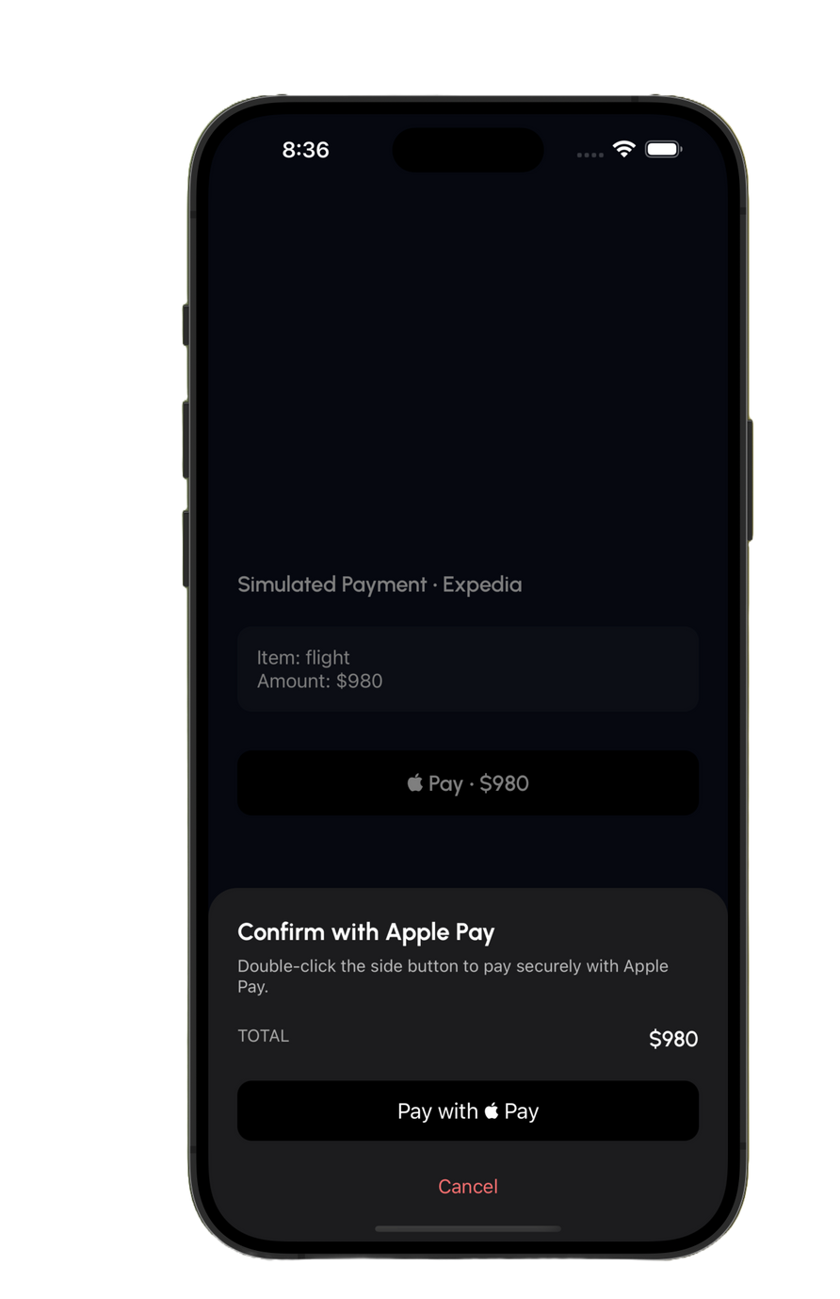
Progress #1 - Frontend
Mock Payment Simulation
Since the app isn’t fully deployed yet, we prepared a mock payment flow. The user can walk through selecting a package, proceeding to payment, and seeing a confirmation screen. This simulates how real payments (like card or wallet) will be integrated in future stages.
Focus on Demo Readiness
The goal for this checkpoint was to make sure we have working user flows to show in the app, even if they’re backed by mock data. This way, we can present login, trip planning, and payment as complete experiences while the actual backend gets built.
Created by Umair

Slide 6
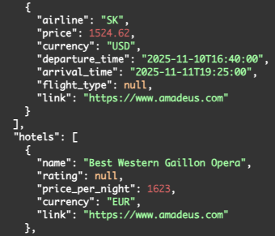
Progress #2 - NLP
Build a FastAPI service for APIs
This service will take the parsed information and remodel it into JSON that each API requires.
Flight - Expedia | Amadeus
Hotel - Booking | Amadeus
Car - Expedia | Hertz | Amadeus
Attraction - Tiqets |Amadeus
Created by Sangmin
Notes:
(Sangmin)
Thank you Umair,
Here is our 3rd progress.
We built the NLP service using FastAPI.
This service takes the user's natural language information and extracts entities for planning.
We made these(from origin to hotel amenities) as essential entities, and the car as an option entity.
Also, we started to set up the deployment in the LinuxOne community cloud.
The deployment manual has been created, and we are updating it if there is any progress.
One problem we have is that we finished firewall configuration and checked that the ports are active, but we were not able to ping the server from the local browser; it could be LinuxOne's issue, so we sent an email and are waiting for LinuxOne.

Slide 7
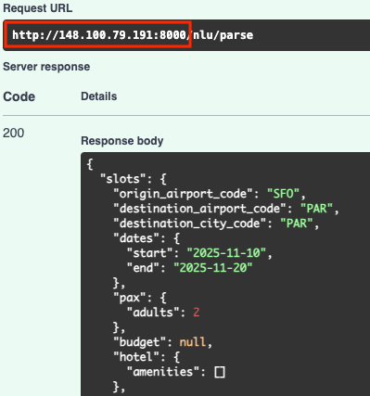
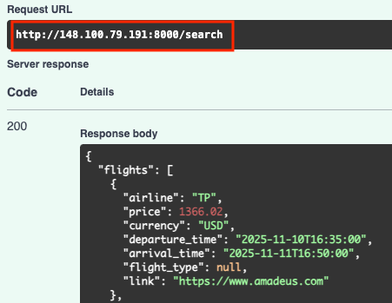
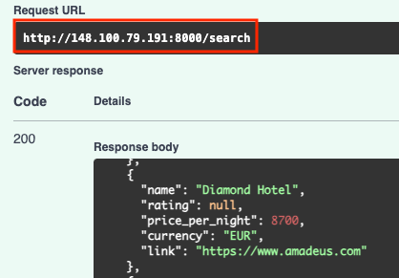
Progress #3 - Service Deployment
Deploy FastAPI server in LinuxOne Cloud
The issue we had before was resolved, and the FastAPI services for NLP and APIs are deployed in LinuxOne Cloud.
Created by Sangmin

Slide 8
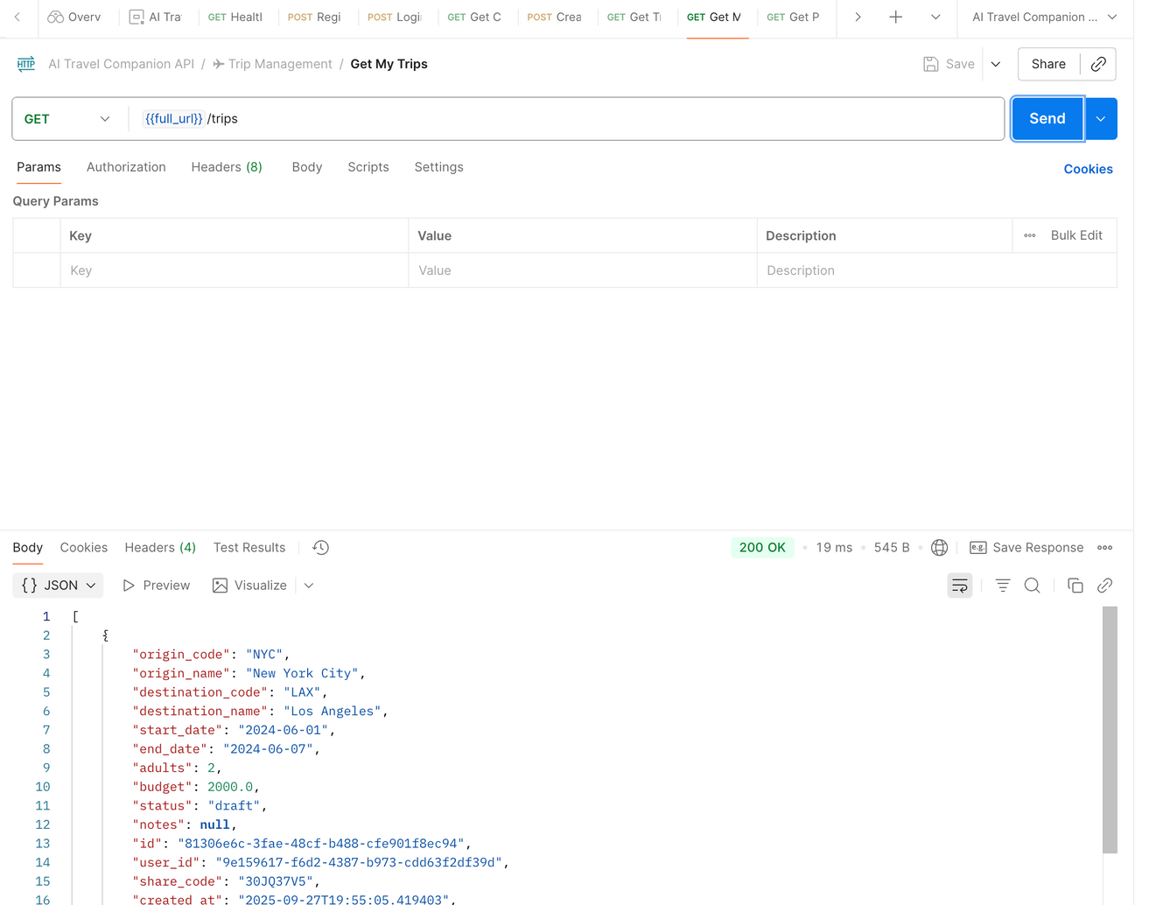
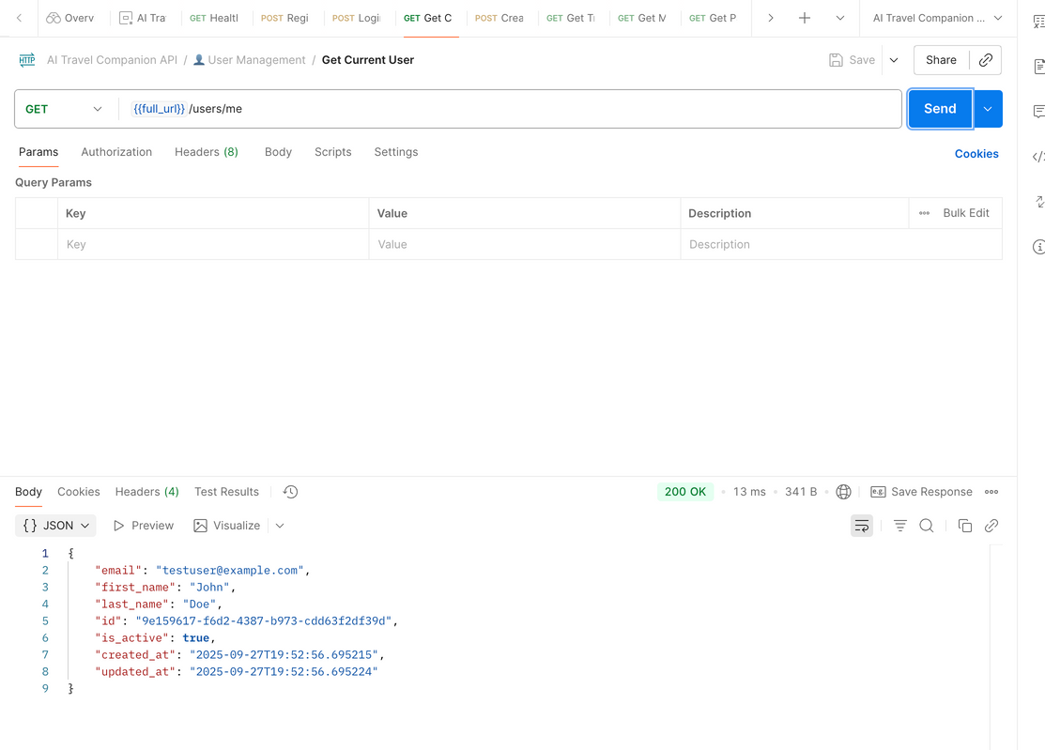
Progress #4 - Database & API Services
Core backend infrastructure, API Services and Database Management
Built an API for User Management and Authentication(JWT), which is fully implemented.
Booking management, Component management, Trip and Package management have their layout and integration created, tested and deployed on IBM
Created by Ayo

Slide 9
Project Timeline
Proposal and Setup
LLM + Chat Setup
Rent & Attractions Integration
Publish & Deployment
Prepare the project proposal and set up the development environment
Integrate LLM API, API, implement classification slots, and create chat endpoints
Integrate APIs for car rental, hotels and attractions search, and add an API endpoint
Publish an app to the Expo/Vercel
Week 1-3
Week 4-5
Week 6-7
Week 8-9
Week 10-11
Week 12-13
Week 14
Frontend & backend Setup
Flights & Hotels Integration
Orchestration & Testing
Initialize and design the frontend basic layout and the backend basic endpoints
Integrate APIs for flights and hotels, and add each API endpoint
Orchestrate flight, hotel, rental, and attractions based on inputs
Created by Sangmin, Umair, Ayo
Notes:
(Sangmin)
Ok, here is our timeline
We are a little ahead of our plans. We finished the setups and are working on LLM and also deployment at the same time.

Slide 10

What’s next?
Connecting Frontend and Backend #2
Goal: Complete user authentication/account system, and users’ accounts and databases in the cloud
Expected Result #1: User’s authentication without any issues
Expected Result #2: Once TWOS provides a travel plan for users, the plan should be stored in the database for users' next plan
Complete APIs Connections (Rental Car, Attractions)
Goal: Call APIs to get a list of options using information from the user and the LLM
Expected Result #1: List of rental car options based on the user’s dates and destination city
Expected Result #2: List of attractions based on the user’s destination. The attractions could be restaurants, local tours, etc.
Optimise API requests and Database connection for low latency, scalability and availability using Redis or cron jobs.
Created by Sangmin, Ayo, Umair
Notes:
(Sangmin)
Ok. Thank you, Ayo
Here are our goals for the next two weeks.
First, we have wonderful frontend and backend assets, and it's time to make the chatbot work.
We expect our AI service to extract and track the essential information from users.
Second, based on the extracted information, we reconstruct it and provide it to the required APIs, and expect responses from them.

Slide 11
THANK YOU
twos
Created by Umair, Sangmin, Ayo
Notes:
Thank you for your attention.
We’re excited to present TWOS, a smarter way to travel.
We’ll now open the floor for any questions.

