Slide 1





TWOS
Midterm (Week 3-9)
Capstone Project: Midterm
Umair, Sangmin, Ayo
Created by Sangmin, Ayo, Umair
Notes:
Good Morning
We are Team TWOS
Umair, Sangmin, and Ayo.
Our project is AI-based Travel Companion
Travel Without Stress (TWOS).
It’s an intelligent platform that plans your entire trip
Flights, hotels, rentals, and attractions
All in one chat.

Slide 2



Roles for Team Members
Sangmin Lee
Python, JS, Docker, Kubernetes
Key Responsibilities
Build NLU clarifier logic
Track and maintain slot-filling states
Optimize options based on rank/score
Create an explanation
Umair Dada
React Native Specialist, Node.js, Express
Key Responsibilities
Lead team & milestones
Build React Native app
Manage Node.js gateway
Handle testing & demo
Ayoyimika Ajibade
FastAPI, Database & API Design, Cloud Integration
Key Responsibilities
Design API schema
Create databases for local & prod
Integrate and scale Al solutions for the mobile app
Created by Umair, Sangmin, Ayo

Slide 3

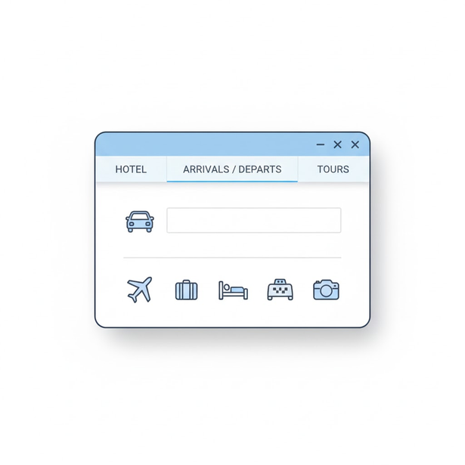


The Problem
The Solution: What is TWOS?
Why is planning travel so stressful?
What if I have a platform that make a travel plan for me?
Simply, it requires juggling
multiple platforms
TWOS (TravelWithOutStress) shows how AI can skip this process by generating optimized travel packages based on people needs
And...
This is where TWOS stars.
Created by Umair
Notes:
Why is travel planning so stressful?
Because it requires juggling multiple platforms like Expedia for flights, Booking.com for hotels, Hertz for cars, and more.
TWOS solves this by creating one unified AI platform that generates optimized travel packages instantly.

Slide 4
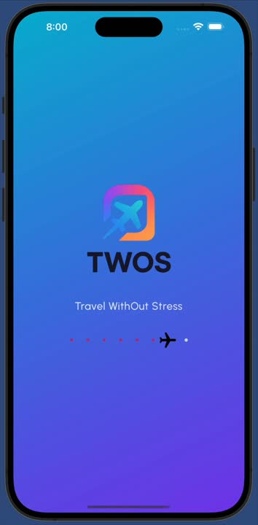
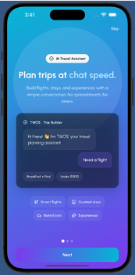
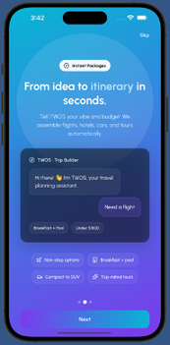
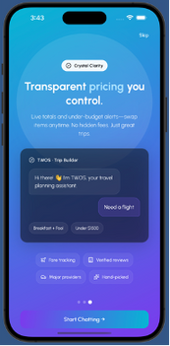
Frontend
Role and Work Summary
Built the full user interface for TWOS.
Designed the chat, onboarding, and payment screens.
Focused on clarity, speed, and real-app feel.
Made sure the app works even without backend.
I handled everything users see. My part was to turn our idea into a working mobile app that looks finished.
TWOS needed to feel real not like a demo, so I focused on simple layouts, fast interactions, and a chat that behaves like a travel assistant.
Created by Umair

Slide 5
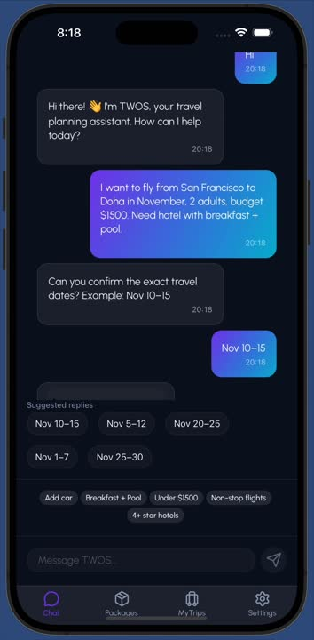
Frontend #2
Chat Interface and Flow
Main chat screen built from scratch.
Auto-scrolling messages and typing animation.
Detects missing info and asks next question.
Shows quick-reply chips for faster input.
The chat is the center of TWOS. When someone says, “I want to fly to Doha,” the app realizes it needs a departure city and asks, “Where will you be flying from?”
Then it offers ready-made answers like “San Francisco (SFO).” Even greetings like “Hi” or “How are you?” are handled instantly on the frontend.
Created by Umair

Slide 6
Frontend #3
User
Frontend
Logic and Local Intelligence
Frontend reads messages before calling backend.
Handles greetings, flight intents, and missing slots.
Uses three JSON files: prompts, replies, greetings.
Works smoothly offline using mock data.
API
Slots
+
Missing
I made the frontend smart enough to hold a conversation without the server. It uses local data to ask questions, reply to greetings, and fill in trip details.
This made the app ready for demos while the backend was still in progress. It feels intelligent and natural even without real AI.
Bot Prompt
User
Created by Umair

Slide 7
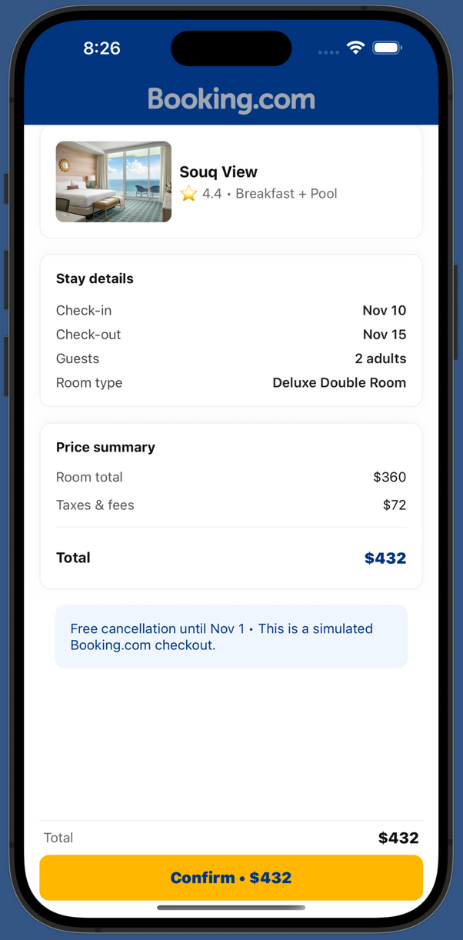
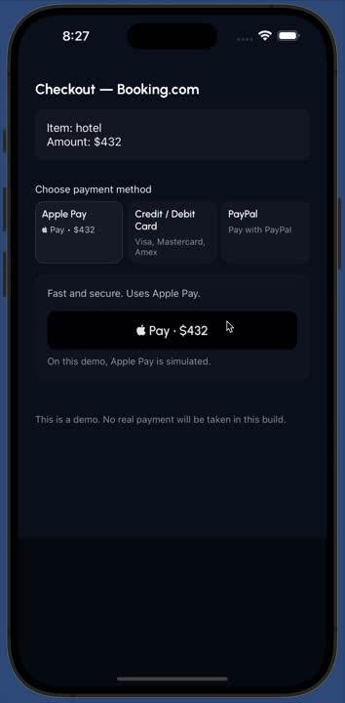
Frontend #4
Checkout and Finishing Touches
Added Booking.com and Expedia-style preview pages.
Built simulated payment with Apple Pay, Card, and PayPal.
Payment ends with success and returns to chat.
Clean design consistent with brand colors.
To make the app feel complete, I designed mock provider screens and a payment flow. The Booking.com page matches their real color scheme.
The payment screen lets users pick Apple Pay, Card, or PayPal and simulates a real checkout. It’s ready for backend connection later.
Created by Umair

Slide 8
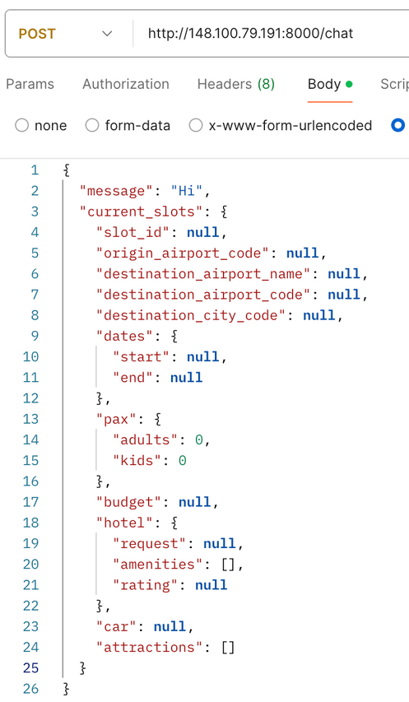
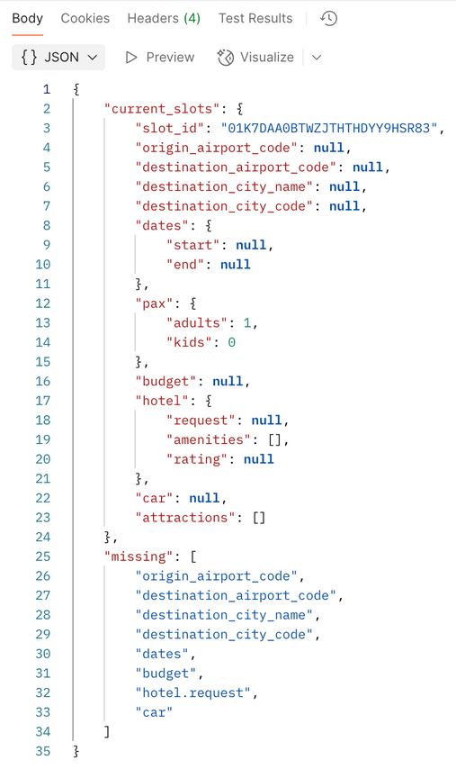
Natural Language Processing(NLP) #1
Chat service interacts with Frontend
When the user’s NL is entered at the chatbox,
The frontend(FE) communicates with the backend(BE) via the “/chat” endpoint.
Three major functionalities of the “/chat” endpoint.
Assigns a unique slot_id
Parses the user’s NL and fills out the slots
Edits the slot information if the FE sends different information (Ex, I want to leave from San Jose instead of SF.
FE requests with “message” + “current slots”.
NLP response with “current_slots” + “missing”
/chat request sample 1
/chat response sample 1
Created by Sangmin
Notes:
(Sangmin)
Thank you Umair.
Here is our completed work regarding NLP.
There are two main services - Chat and Search.
The chat service interacts with FE. Simply, FE sends a request to "/chat" endpoint whenever it needs something to parse.
There are three major functionalities.
First, if the FE request does not have a slot ID, then it assigns a unique slot ID automatically, and this ID never changes.
Second, it parses the message from FE and fills out the slots.
Last, it also supports editing the slot information. For example, if the user wants to change their departure, then it changes the departure information for the user.
The example is showing the case of assigning slot ID.

Slide 9
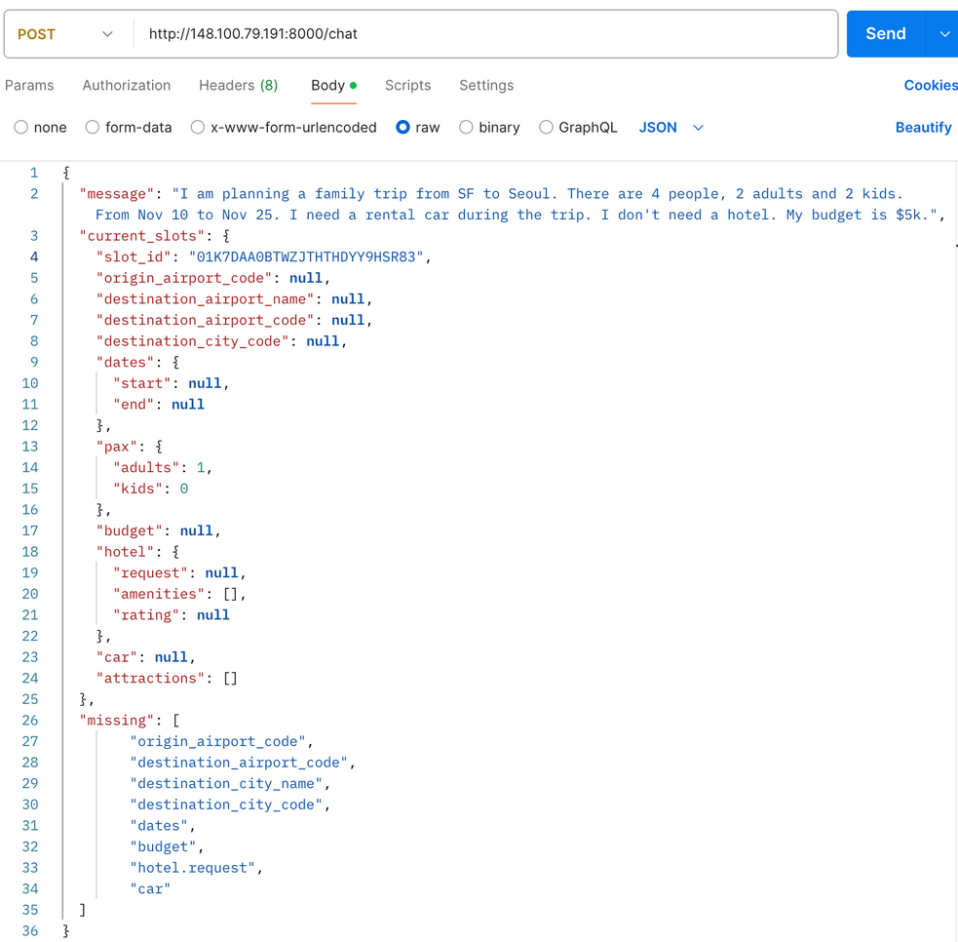
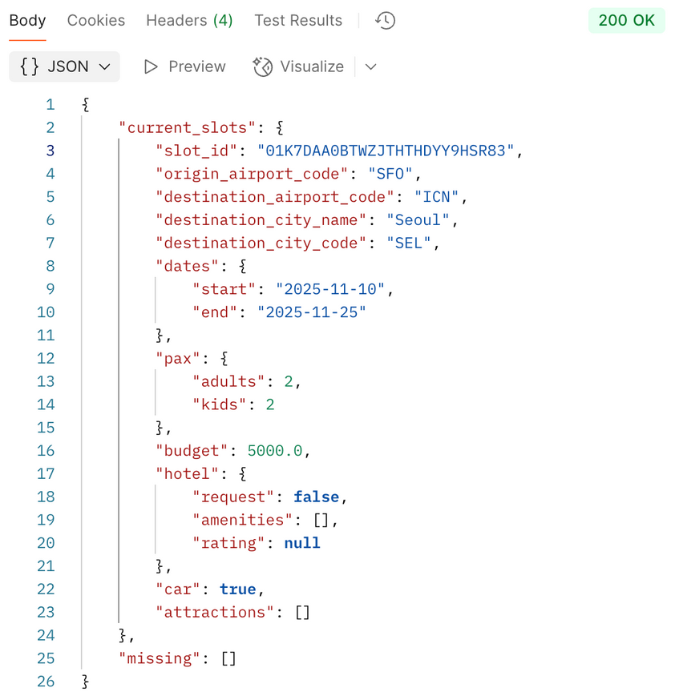
NLP #1.1
/chat request sample 2
/chat response sample 2
Created by Sangmin
Notes:
Second, the example shows the case when the user enters their travel plan in everyday language, the NLP module parses the information.

Slide 10
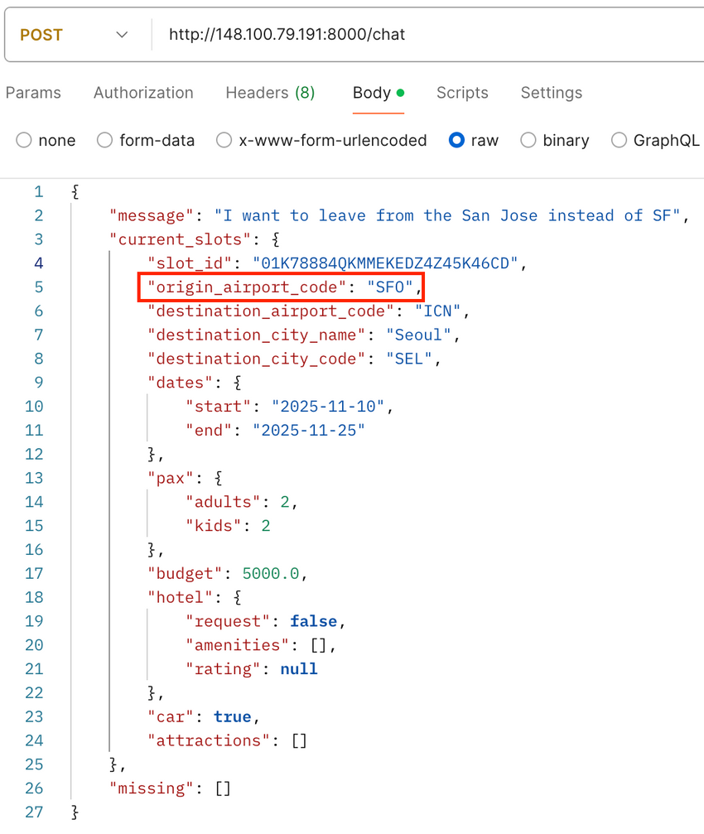
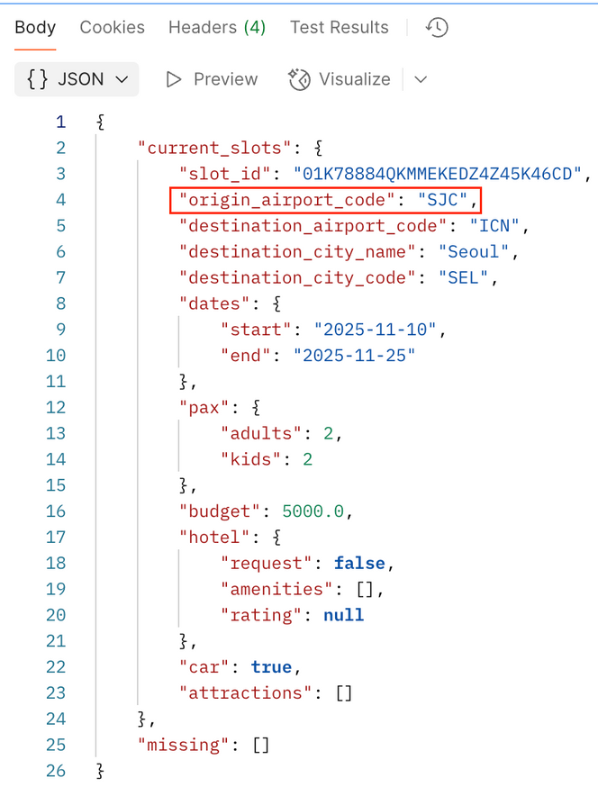
NLP #1.2
/chat request sample 3
/chat response sample 3
Created by Sangmin
Notes:
The last example shows the revision case.
As you can see, SFO changed to SJC.

Slide 11
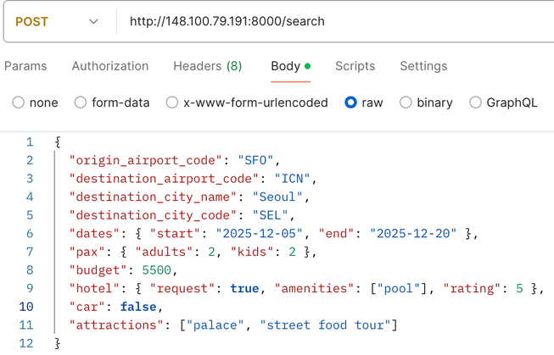
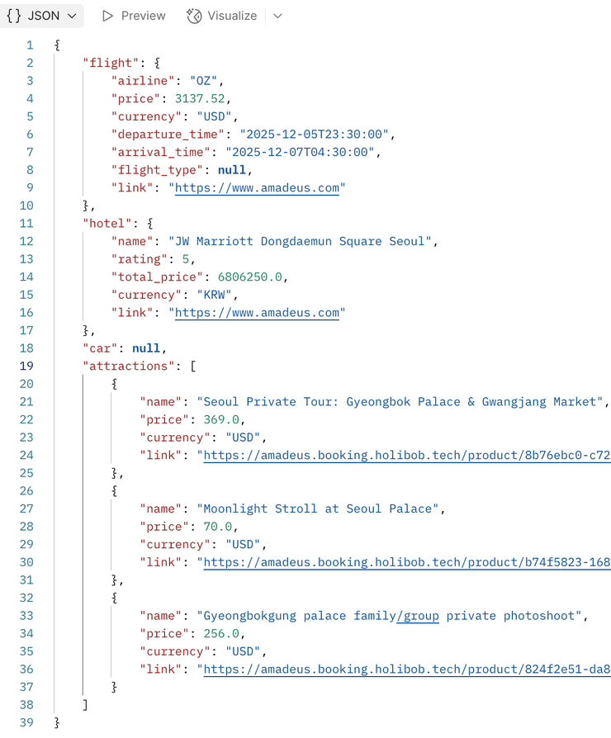
NLP #1.3
/search
request
sample
Search service
When slots are filled, FE calls the “/search” endpoint.
Two major functionalities of the “/search” endpoint.
Make API calls to search based on slots
Flight
Hotel - Rating(Star), Amenities
Car
Attractions - Name, Description
Make an travel plan based on each API call's responses.
FE requests with “current slots”.
NLP response with “travel plan”.
/search
response
sample
Created by Sangmin
Notes:
The second service is the "Search".
Once the slots are filled, this search service will call APIs and make a travel plan.
And it sends the plan information to FE.
In this example, the service found the cheapest flight and the cheapest 5-star hotel with a pool, and the top 3 local attractions that have "palace or street food tour" in the attraction name and description.

Slide 12
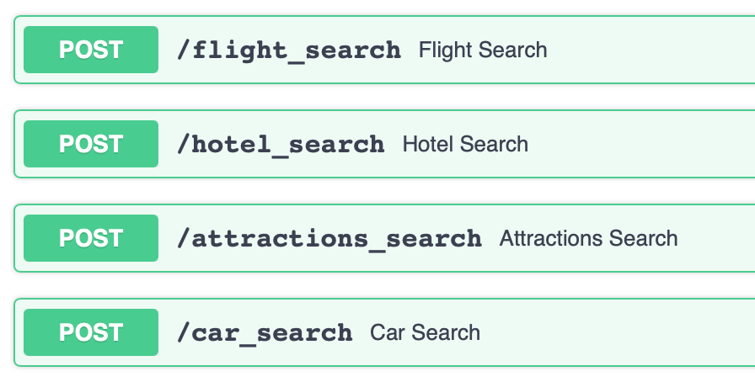
APIs #1
APIs - Flight, Hotel, Attractions, (Car)
Basic principles:
Receive data from the APIs.
Filter and/or sort data based on the user’s request.
Hotel & Car:
If the “request” field is false, then skip the related API calls.
Attractions:
Even though the attractions field is empty, call the API for a recommendation.
API endpoints list for search
Created by Sangmin
Notes:
Cuase we just talked about search.
I also want to talk about APIs that are used for the search service.
We set basic principles regarding calling APIs or utilizing data from APIs.
The very fundamental principles are these (1 and 2).
Receive data from the APIs and then apply filters and/or sort the data.
By following this, we are able to provide more suitable recommendations to users by creating multiple filter layers.
But at the same time, we need to manage the resources and keep low-latency. So if the "request" field of hotel and car is false, then NLP skips the related API calls.
However, for attractions, although the attractions field is empty, NLP will call the API for recommendations.

Slide 13
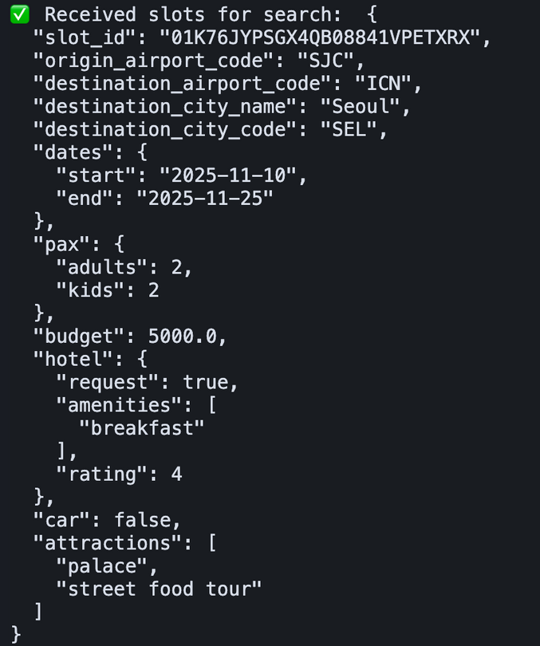
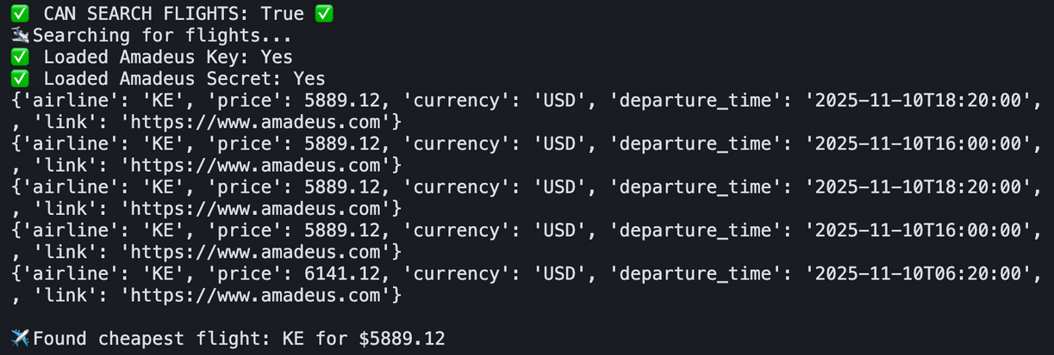
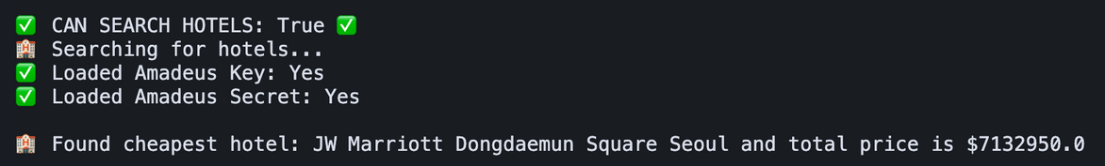
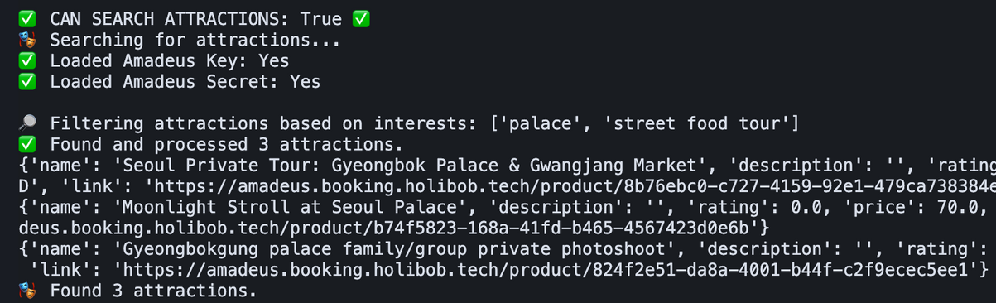
APIs #1.1
Flight API
sample 1
Hotel API
sample 1
Attractions API
sample 1
Requested slots sample 1
Created by Sangmin
Notes:
Ok,
Here are some logs to show how the APIs are working.

Slide 14
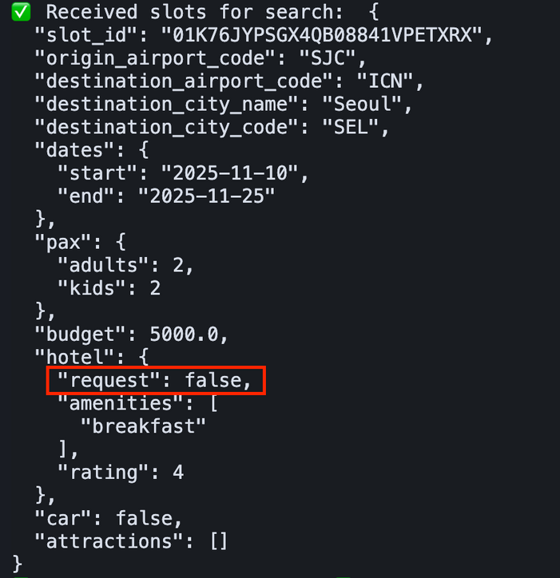
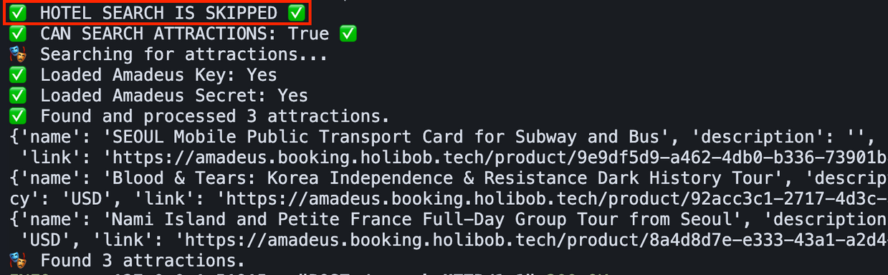
APIs #1.2
Flight API
sample 2
Attractions API
sample 2
Requested slots sample 2
Created by Sangmin
Notes:
Another example of skipping the API calls.
Now, let me pass to the Ayo.

Slide 15
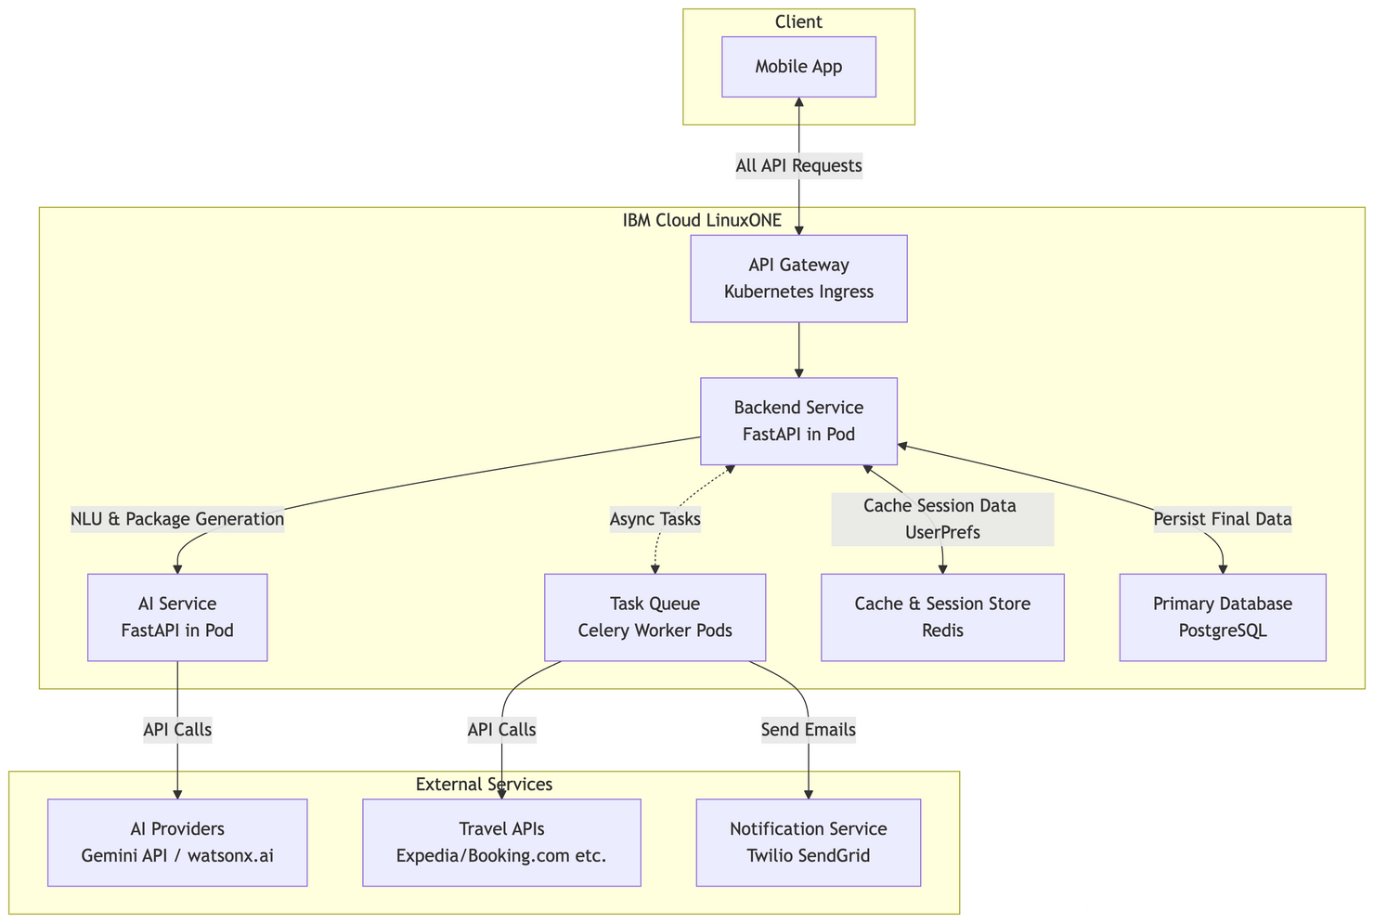
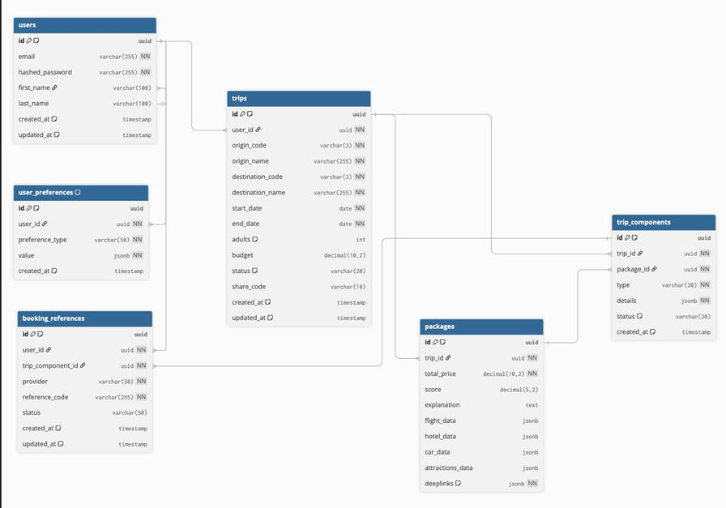
# Backend Architecture & Database Schema Design
The proposed architecture is designed for scalability and low latency, leveraging microservices principles. Taking inspiration from Netflix's backend architecture design
Created by Ayo

Slide 16
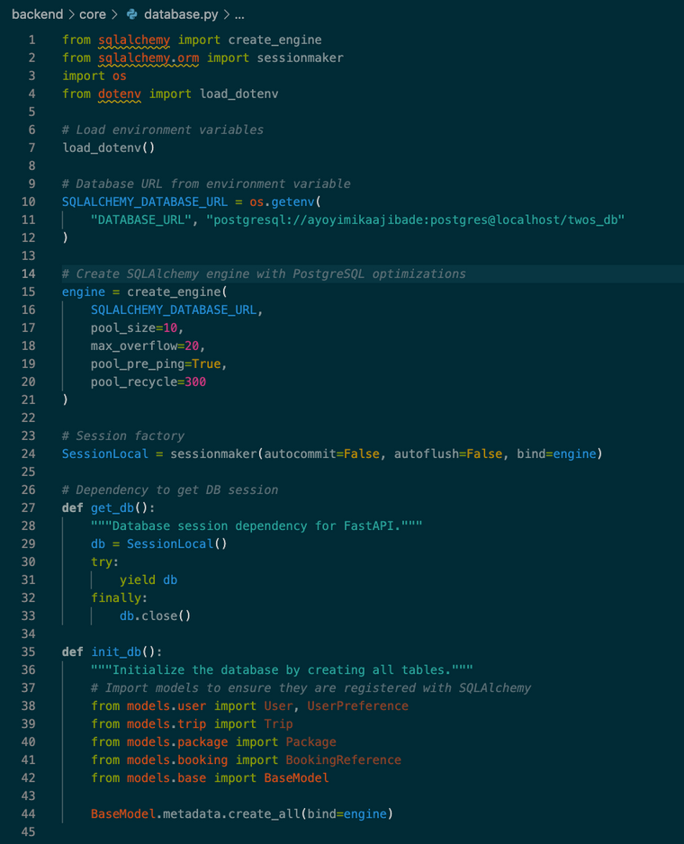
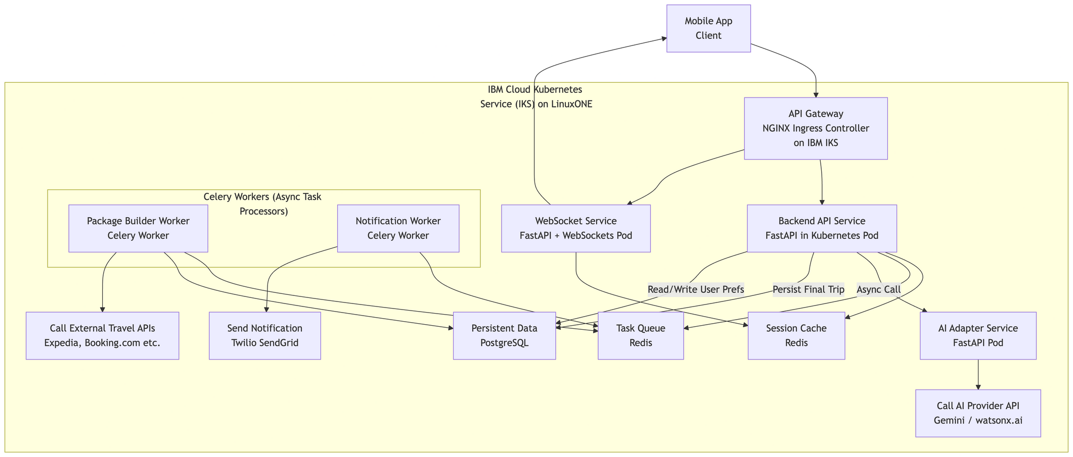
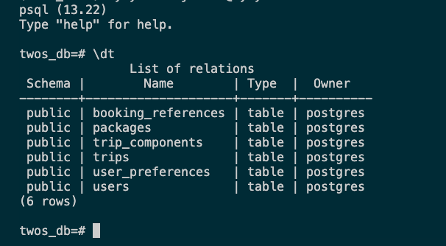
# Low Level Design & Database Integration
The diagrams illustrate the precise components, their technologies, and the data flow for a primary user interaction: processing a chat message and returning travel packages, plus how it’s integrated and stored on Postgresql
Created by Ayo
Notes:
(Sangmin)
Thank you Umair,
Here is our 2nd progress.
The FastAPI services for APIs are built. Currently, we successfully get data for flights and hotels based on the user's input.
I don't have screenshots here, but because of these services, our NLP has also improved. Now, it parses the users' natural language and makes API calls using parsed data at once.

Slide 17
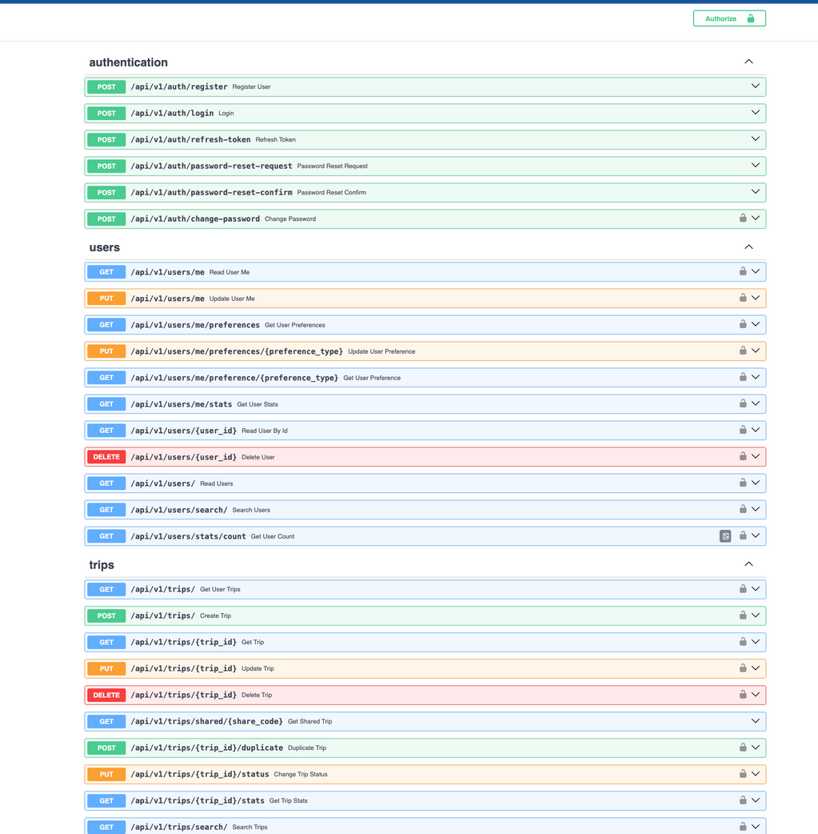
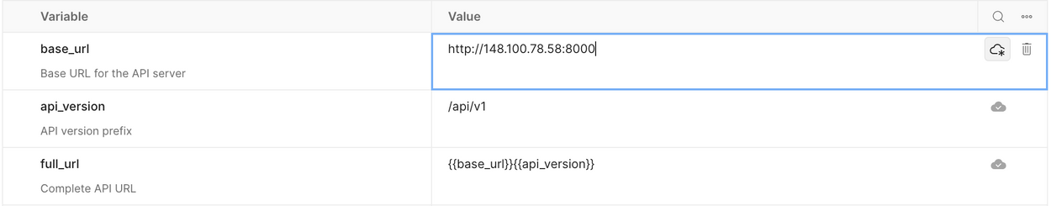
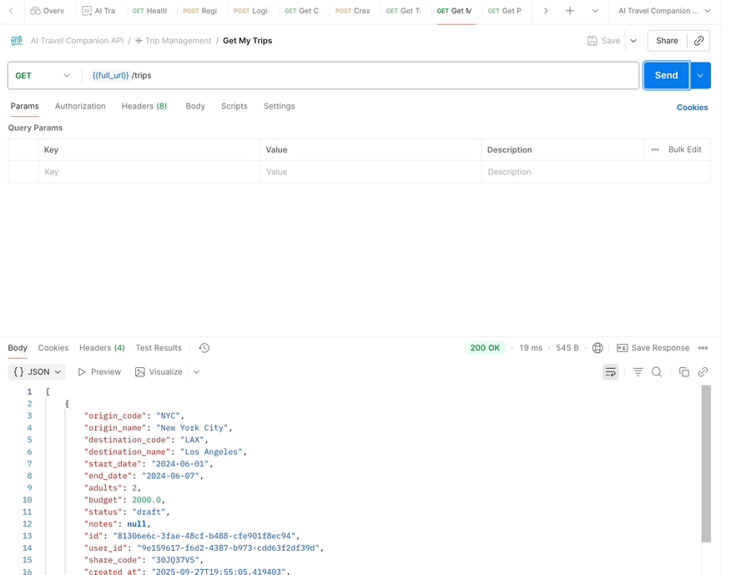
# Api Design
DONE
The FastAPI is organised around RESTful architecture principles for resource management, like Bookings, Trip-Component, Trip, Package, Authentication and Users with a full CRUD functionality, all deployed on IBM LinuxOne, publicly accessible via http://148.100.78.58:8000
WIP
WIP
Created by Ayo
Notes:
(Sangmin)
Thank you Umair,
Here is our 2nd progress.
The FastAPI services for APIs are built. Currently, we successfully get data for flights and hotels based on the user's input.
I don't have screenshots here, but because of these services, our NLP has also improved. Now, it parses the users' natural language and makes API calls using parsed data at once.

Slide 18
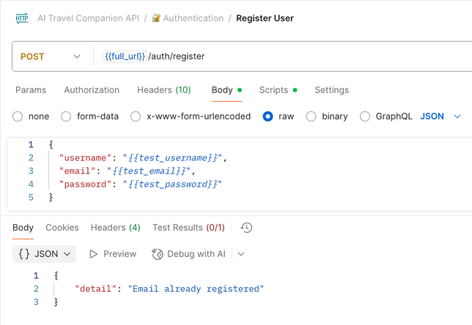
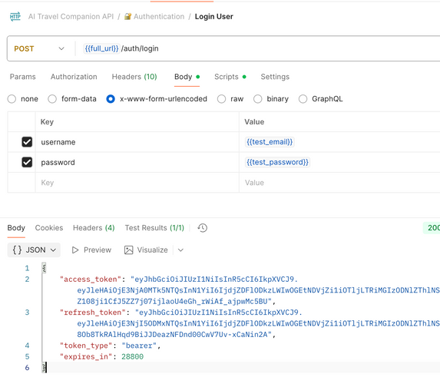
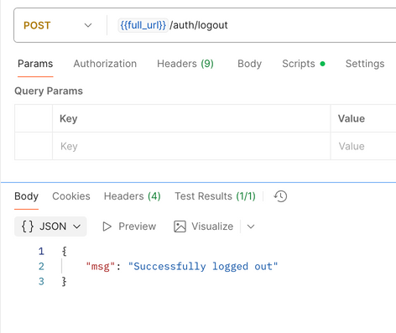
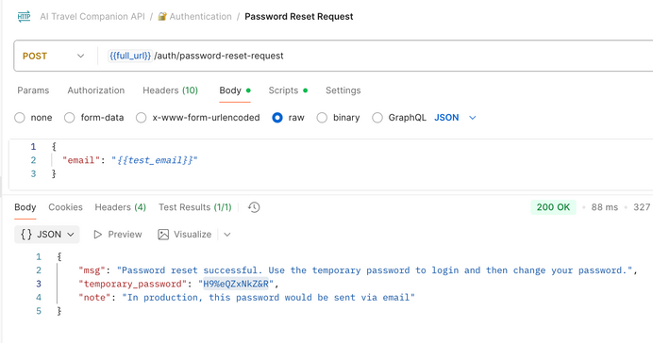
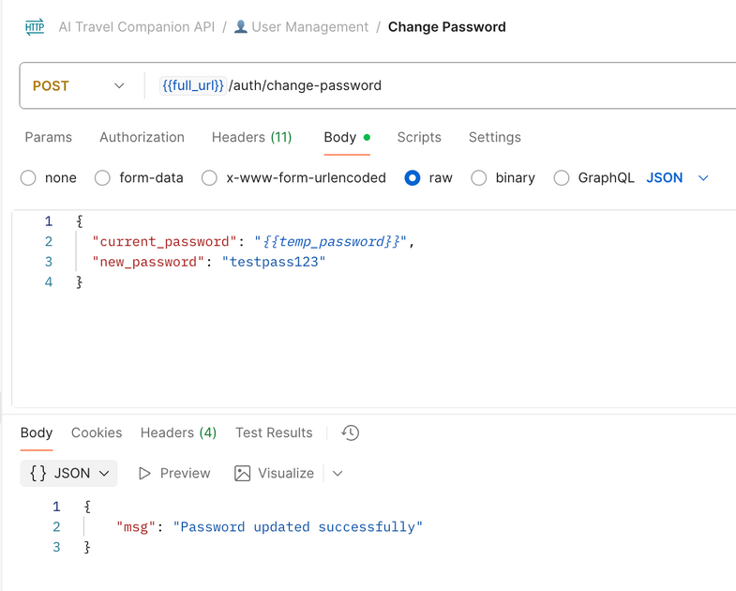
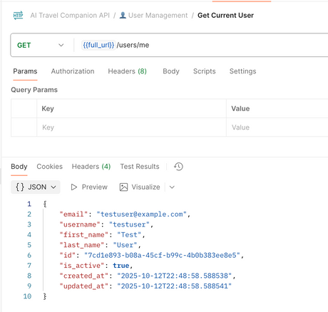
# Authentication Flow with JWT
Register User
Login User
Request Temp Password Reset
Logout User
Verify Logged in User via /user/me
Change Temp Password to Permanent
Created by Ayo
Notes:
(Sangmin)
Thank you Umair,
Here is our 2nd progress.
The FastAPI services for APIs are built. Currently, we successfully get data for flights and hotels based on the user's input.
I don't have screenshots here, but because of these services, our NLP has also improved. Now, it parses the users' natural language and makes API calls using parsed data at once.

Slide 19
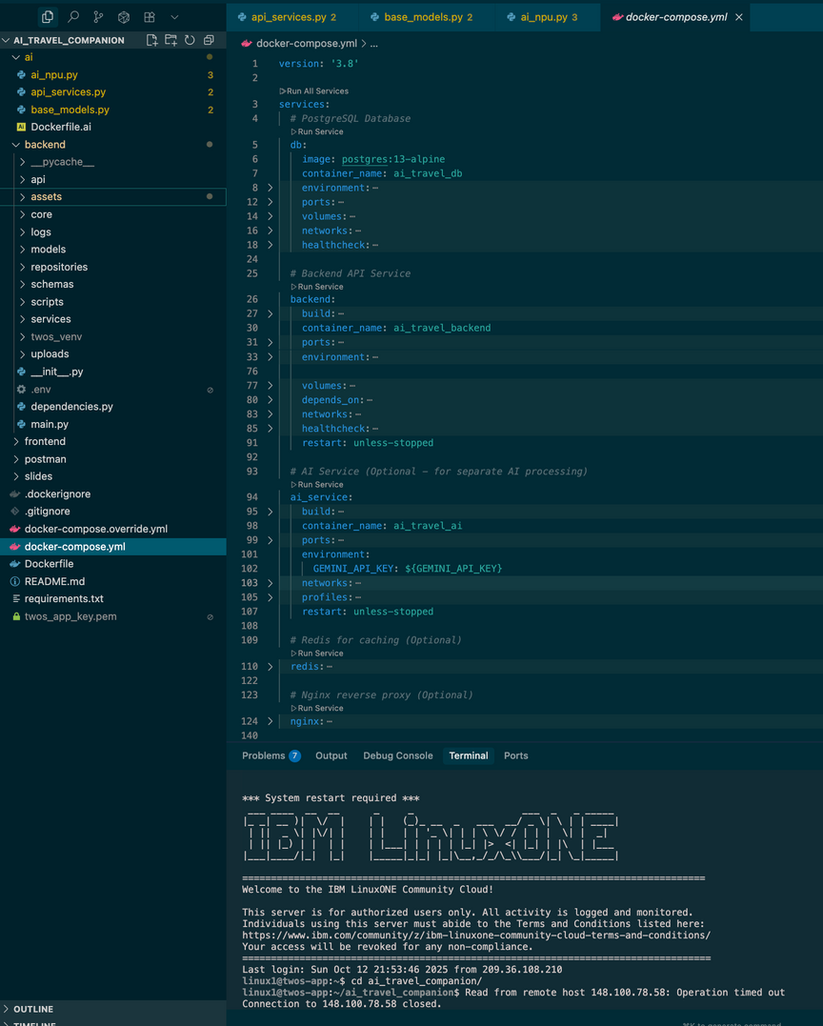
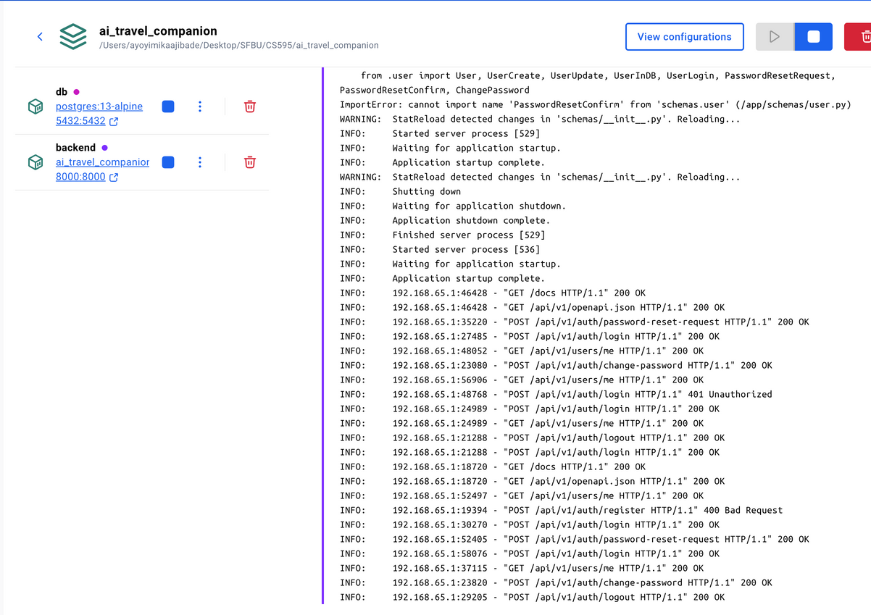
# Cloud Deployment | CI/CD
DONE
DONE
WIP
WIP
FastAPI services for backend and AI(NLP) services are individually deployed in LinuxOne Cloud. The next step is to sync all services together and improve our CI/CD workflow using GitHub Actions while optimising our application and business logic overall
Created by Ayo
Notes:
(Sangmin)
Thank you Umair,
Here is our 2nd progress.
The FastAPI services for APIs are built. Currently, we successfully get data for flights and hotels based on the user's input.
I don't have screenshots here, but because of these services, our NLP has also improved. Now, it parses the users' natural language and makes API calls using parsed data at once.

Slide 20
Project Timeline
Proposal and Setup
LLM + Chat Setup
Rent & Attractions Integration
Publish & Deployment
Prepare the project proposal and set up the development environment
Integrate LLM API, API, implement classification slots, and create chat endpoints
Integrate APIs for car rental, hotels and attractions search, and add an API endpoint
Publish an app to the Expo/Vercel
Week 1-3
Week 4-5
Week 6-7
Week 8-9
Week 10-11
Week 12-13
Week 14
Frontend & backend Setup
Flights & Hotels Integration
Orchestration & Testing
Initialize and design the frontend basic layout and the backend basic endpoints
Integrate APIs for flights and hotels, and add each API endpoint
Orchestrate flight, hotel, rental, and attractions based on inputs
Created by Sangmin, Umair, Ayo
Notes:
(Anyone)
Ok, here is our timeline
We are a little ahead of our plans. We already worked on Flights & Hotels APIs, and are working. We are planning to push ourselves more to implement rentals and attractions integrations.

Slide 21
What’s next?
Connecting Frontend and Backend #3
Goal: Complete the user’s record storage strategies.
Expected Result #1: The application can track the user’s record regardless of the user's registration.
Expected Result #2: Once TWOS provides a travel plan for users, the plan should be stored in the database for users' next plan and future optimized personlizations
Connect API(Rental Car) with Application and Optimizations
Goal: Call APIs to get a list of options using information from the user and the LLM
Expected Result #1: List of rental car options based on the user’s dates and destination city
Goal: Optimise API requests and AI services for low latency, scalability and availability using tools like Redis or cron jobs.
Expected Result #1: Zero-downtime or wait time for Chat, AI and external API services.
Goal: Implement future features and user stories as planned on Jira
Created by Sangmin, Ayo, Umair
Notes:
(Sangmin)
Here are our goals for the next two weeks.
Our next goal is to complete a user authentication system working with a database, and save the user's travel plan to the database for the user's next plan.
Second, we will keep working on the Rental car and the finding attractions APIs part. After that, we still start optimizing API requests and DB connections for the best user experiences.

Slide 22
References
Booking.com Demand API. (2025). Booking.com. https://developers.booking.com/demand/docs/open-api/demand-api
Connect to Amadeus travel APIs | Amadeus for Developers. (n.d.). Amadeus IT Group SA. https://developers.amadeus.com/self-service
Flights - Expedia Group Developer Hub. (2025). Expediagroup.com. https://developers.expediagroup.com/rapid/flights#step-1---search-available-flight-offers
https://dev.to/gbengelebs/netflix-system-design-backend-architecture-10i3
Swagger-Api. (n.d.). GitHub - swagger-api/swagger-ui: Swagger UI is a collection of HTML, JavaScript, and CSS assets that dynamically generate beautiful documentation from a Swagger-compliant API. GitHub. https://github.com/swagger-api/swagger-ui
The PostgreSQL Global Development Group. (2025). PostgreSQL: Documentation. Www.postgresql.org. https://www.postgresql.org/docs/
Welcome to the Tiqets Distributor API | Tiqets for developers. (2025, September 5). Tiqets.dev. https://developers.tiqets.dev
https://github.com/linuxone-community-cloud/technical-resources/blob/master/faststart/deploy-virtual-server.md
Created by Umair, Sangmin, Ayo
Notes:
Here are our references for the project

Slide 23
THANK YOU
twos
Created by Umair, Sangmin, Ayo
Notes:
(Umair!)
Thank you for your attention.
We’re excited to present TWOS, a smarter way to travel.
We’ll now open the floor for any questions.

Slide 24
THANK YOU
twos
https://www.canva.com/design/DAG0nyhxI-U/U2JOct1QP7BZe7yXJRgHvg/edit?utm_content=DAG0nyhxI-U&utm_campaign=designshare&utm_medium=link2&utm_source=sharebutton
Created by Umair, Sangmin, Ayo
Notes:
(Umair!)
Thank you for your attention.
We’re excited to present TWOS, a smarter way to travel.
We’ll now open the floor for any questions.

