Slide 1





TWOS
Checkpoint 4 (Week 12-14)
Capstone Project: Checkpoint 4
Umair, Sangmin, Ayo
Created by Sangmin, Ayo, Umair
Notes:
Good Morning
We are Team TWOS
Umair, Sangmin, and Ayo.
Our project is AI-based Travel Companion
Travel Without Stress (TWOS).
It’s an intelligent platform that plans your entire trip
Flights, hotels, rentals, and attractions
All in one chat.

Slide 2
References
Booking.com Demand API. (2025). Booking.com. https://developers.booking.com/demand/docs/open-api/demand-api
Connect to Amadeus travel APIs | Amadeus for Developers. (n.d.). Amadeus IT Group SA. https://developers.amadeus.com/self-service
Flights - Expedia Group Developer Hub. (2025). Expediagroup.com. https://developers.expediagroup.com/rapid/flights#step-1---search-available-flight-offers
https://dev.to/gbengelebs/netflix-system-design-backend-architecture-10i3
Swagger-Api. (n.d.). GitHub - swagger-api/swagger-ui: Swagger UI is a collection of HTML, JavaScript, and CSS assets that dynamically generate beautiful documentation from a Swagger-compliant API. GitHub. https://github.com/swagger-api/swagger-ui
The PostgreSQL Global Development Group. (2025). PostgreSQL: Documentation. Www.postgresql.org. https://www.postgresql.org/docs/
Welcome to the Tiqets Distributor API | Tiqets for developers. (2025, September 5). Tiqets.dev. https://developers.tiqets.dev
Created by Umair, Sangmin, Ayo
Notes:
Here are our references for the project

Slide 3



Roles for Team Members
Sangmin Lee
Python, JS, Docker, Kubernetes
Key Responsibilities
Build NLU clarifier logic
Track and maintain slot-filling states
Optimize options based on rank/score
Create an explanation
Umair Dada
React Native Specialist, Node.js, Express
Key Responsibilities
Lead team & milestones
Build React Native app
Manage Node.js gateway
Handle testing & demo
Ayomika Ajibade
FastAPI, Database & API Design, Cloud Integration
Key Responsibilities
Design API schema
Create databases for local & prod
Integrate and scale Al solutions for the mobile app
Created by Umair, Sangmin, Ayo

Slide 4
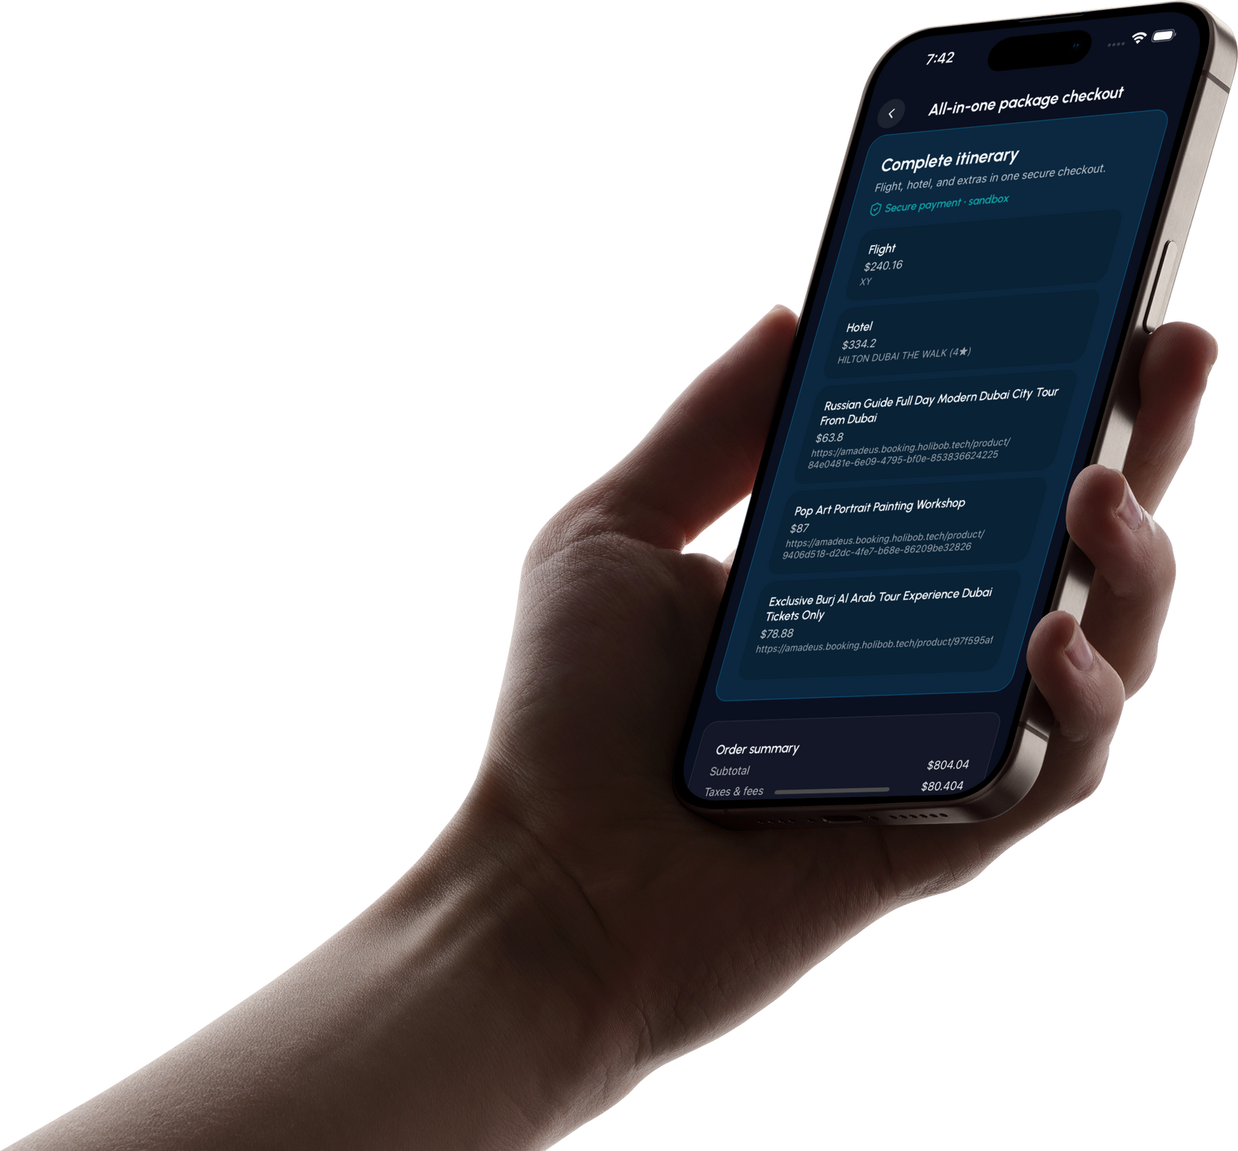
Progress #1 - Frontend
One screen to review the whole trip: flight, hotel, and add-ons. Prices are itemized, totals are clear, and the “Confirm” button sits fixed at the bottom so you can pay without scrolling back up.
Single, secure checkout for flight + hotel + experiences
Line-item pricing and running total
Consistent UI for every provider (no webviews)
Works on real device sizes; keyboard and safe-areas handled
Created by Umair

Slide 5
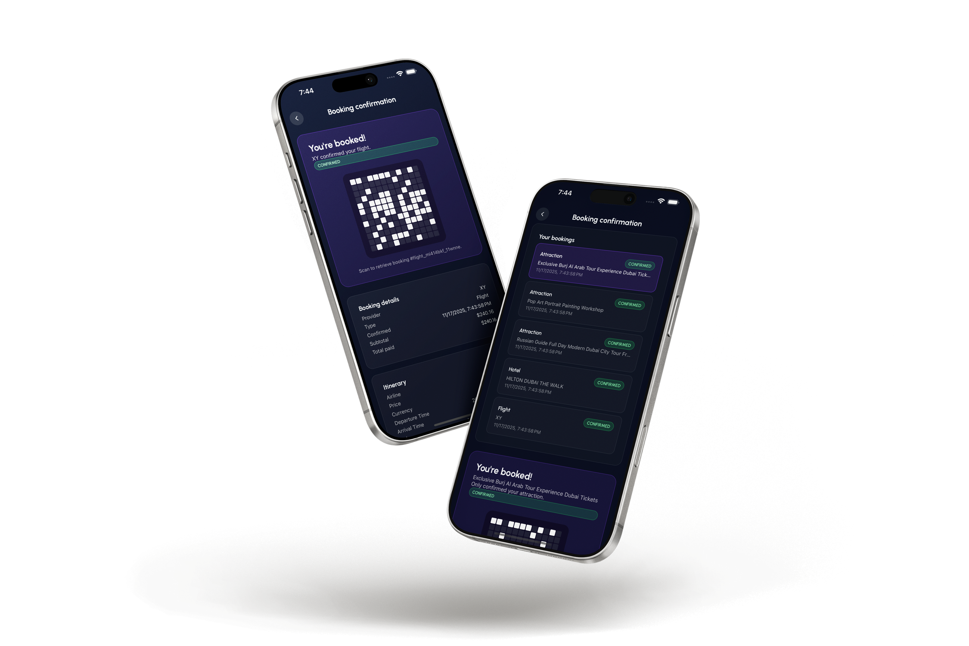
Progress #2 - Frontend
After payment, each item is confirmed and visible in one list. Tap any card to open a detail sheet with a scannable QR and the booking facts you need at the counter
No external apps.
Per-item status: Flight, Hotel, and Attractions
Tap to view QR + booking details
“Show at hotel/ticket desk” ready
Offline friendly layout
Time-stamped records for support
Created by Umair

Slide 6
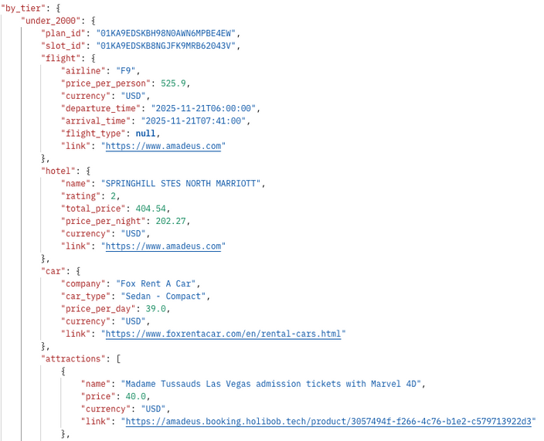
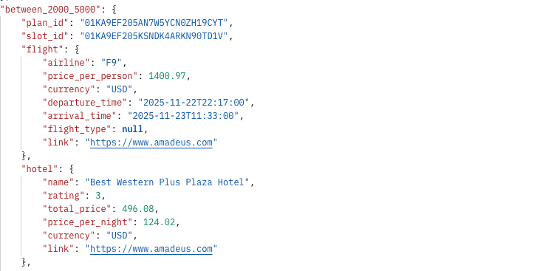
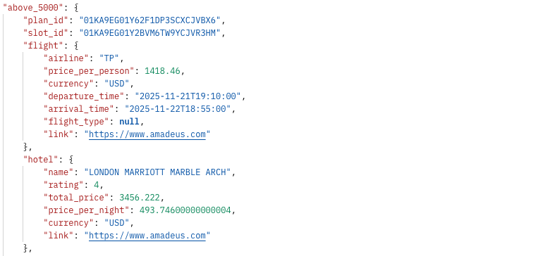
Progress #3 - Package Tab
/Package endpoint
The package endpoint will generate three random trips based on the budget.
Under $2000 | $2000 - $5000 | Over $5000
Created by Sangmin
Notes:
(Sangmin)
Thank you Umair,
Here is our 2nd progress.
The FastAPI services for APIs are built. Currently, we successfully get data for flights and hotels based on the user's input.
I don't have screenshots here, but because of these services, our NLP has also improved. Now, it parses the users' natural language and makes API calls using parsed data at once.

Slide 7
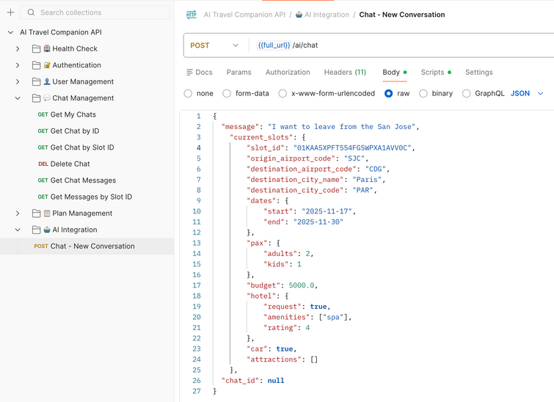
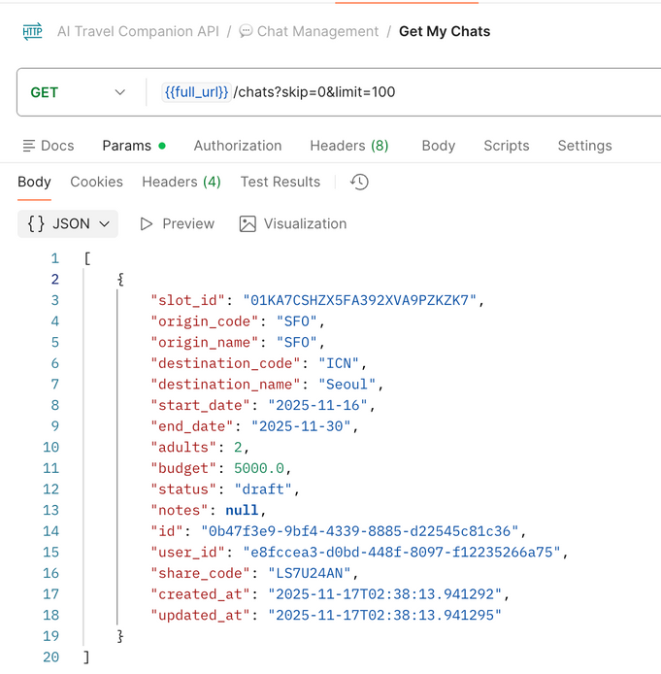
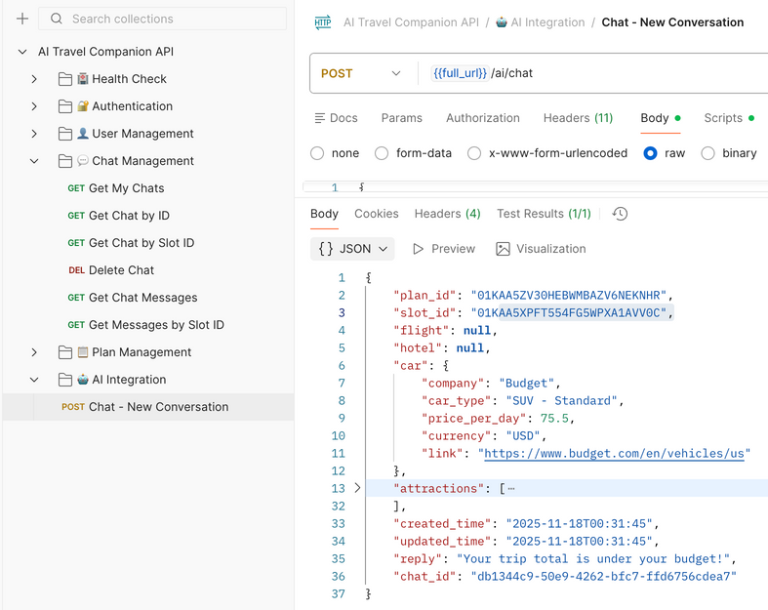
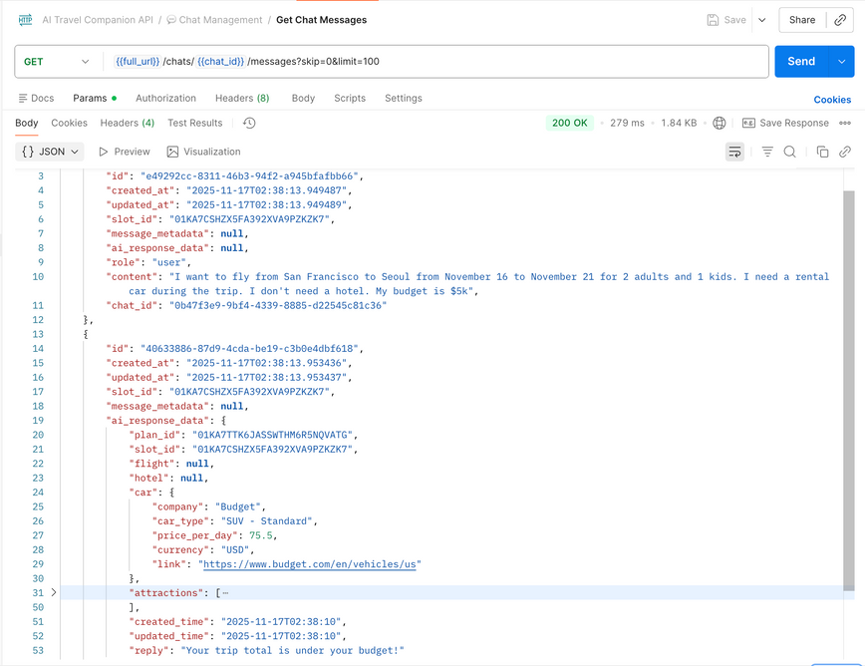
Progress #4 - Chats, ChatMessages and Plans API
/ai/chat (DONE)
Chats, Plans, ChatMessages, APIs (DONE)
The endpoint parses the user’s inputs, clarifies the user's Natural language intuitively, searches for information, and saves the chats and generated plans to their mobile device storage or database (IBM PSQL) based on their authentication status.
/chat: it retrieves chat history from the DB for only authenticated users
/chat/{{chat_id}}/message: retrieves individual messages and the AI bot response, plus timestamp
DELETE: Both the chat, plan and chat_messages api have the delete functionality
Request
Response
Created by Ayo

Slide 8
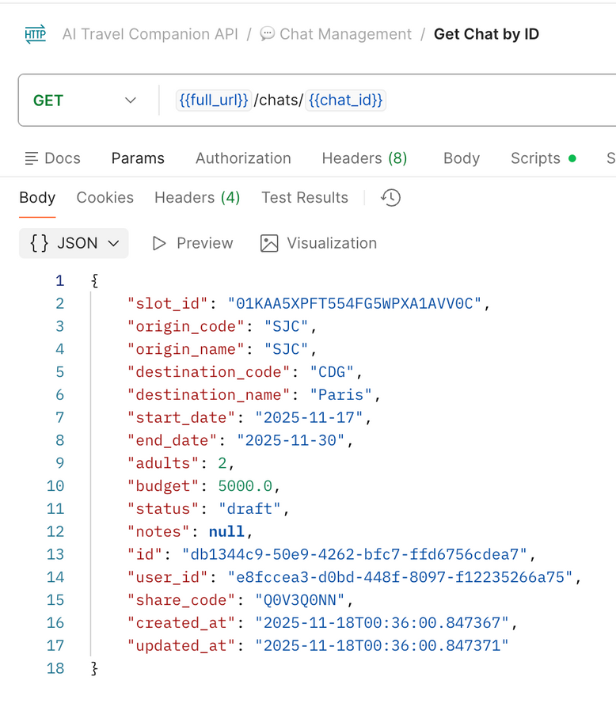
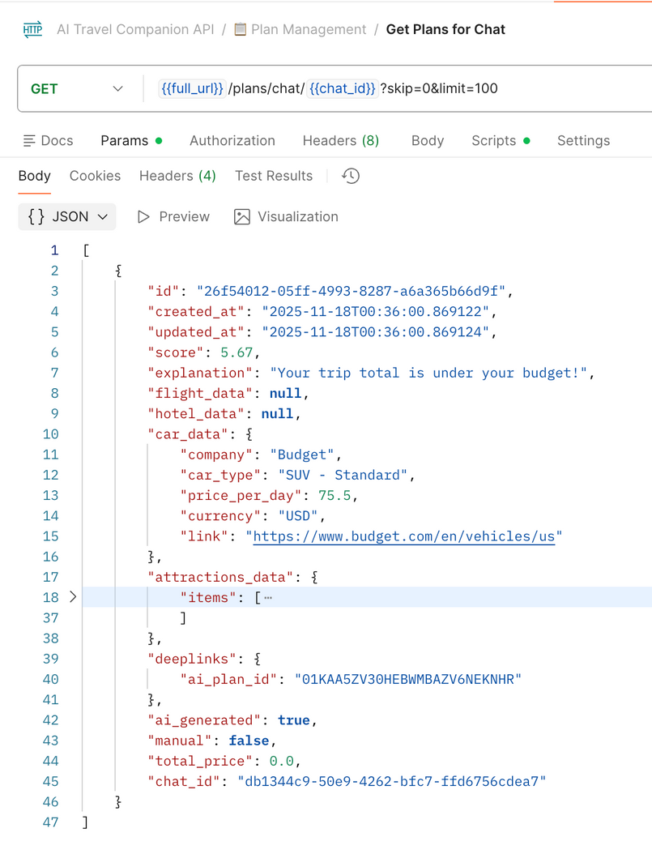
Progress #5 - Chats, ChatMessages and Plans API Cont’d
chats/{{chat_id}}: retreives individual chat with the chat_id or slot_id
/plans/chat/{{chat_id}}: retreives individual chat AI generated plans with the chat_id or slot_id for optimized future plan generation based on analysing user behavoir
Created by Ayo

Slide 9
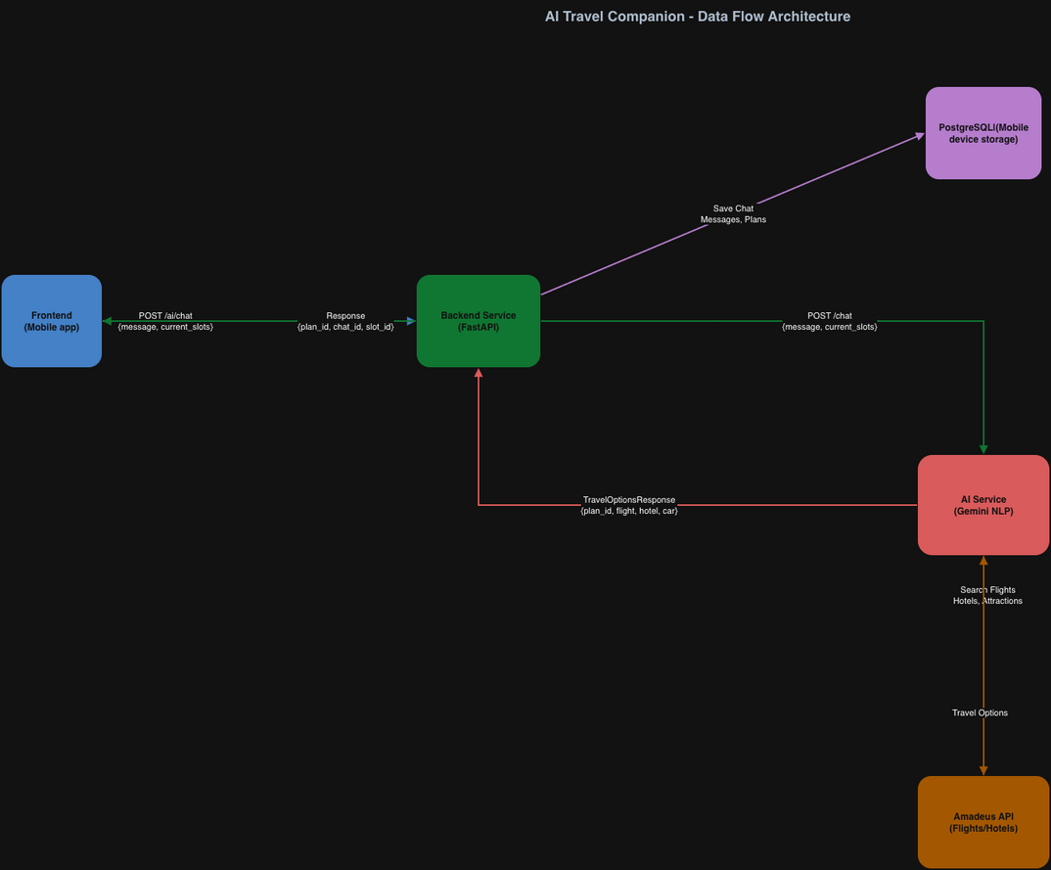
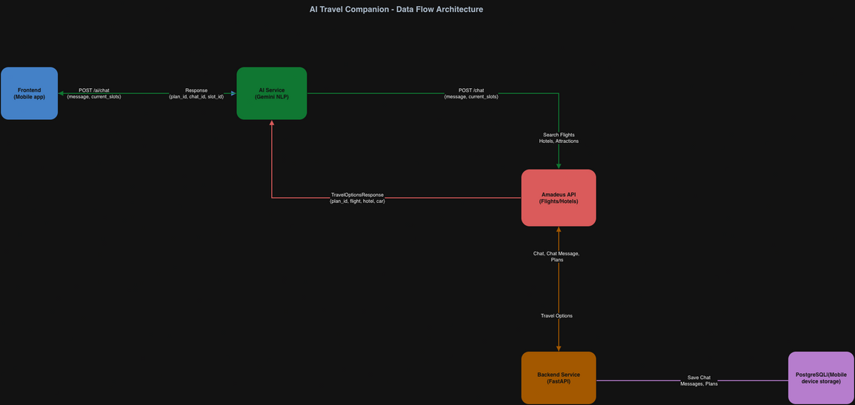
Progress#6 - Optimisation of Data flow for low latency (WIP)
from ~ max(6 mins)
to ~ max(1 - 2 mins)
Created by Ayo

Slide 10
Project Timeline
Proposal and Setup
LLM + Chat Setup
Rent & Attractions Integration
Publish & Deployment
Prepare the project proposal and set up the development environment
Integrate LLM API, API, implement classification slots, and create chat endpoints
Integrate APIs for car rental, hotels and attractions search, and add an API endpoint
Publish an app to the Expo/Vercel
Week 1-3
Week 4-5
Week 6-7
Week 8-9
Week 10-11
Week 12-13
Week 14
Frontend & backend Setup
Flights & Hotels Integration
Orchestration & Testing
Initialize and design the frontend basic layout and the backend basic endpoints
Integrate APIs for flights and hotels, and add each API endpoint
Orchestrate flight, hotel, rental, and attractions based on inputs
Created by Sangmin, Umair, Ayo
Notes:
(Anyone)
Ok, here is our timeline
We are a little ahead of our plans. We already worked on Flights & Hotels APIs, and are working. We are planning to push ourselves more to implement rentals and attractions integrations.

Slide 11
What’s next?
Debugging/Testing chatbox in the frontend
Goal: Test and make sure that the chatbox is working properly in the app.
Expected Result: Chatbox in the app should handle multiple use cases
Fix the bug that the API service sends multiple travel plans to FE
Improve slot-filling logic when the user sends the same information multiple times
Debugging/Testing backend in the frontend
Goal #1: Save the user’s chat, slots, and plan information into mobile devices/DB
Expected Result #1: Save the user’s chat and travel information into the DB
Expected Result #2: Pull out the previous chat/plan from the DB for registered users
Created by Sangmin, Ayo, Umair
Notes:
(Sangmin)
Here are our goals for the next two weeks.
Our next goal is to complete a user authentication system working with a database, and save the user's travel plan to the database for the user's next plan.
Second, we will keep working on the Rental car and the finding attractions APIs part. After that, we still start optimizing API requests and DB connections for the best user experiences.

Slide 12
THANK YOU
twos
Created by Umair, Sangmin, Ayo
Notes:
(Umair!)
Thank you for your attention.
We’re excited to present TWOS, a smarter way to travel.
We’ll now open the floor for any questions.

