Slide 1
SE / CS / CE 3354 . SOFTWARE ENGINEERING . SUMMER 2026
Interview Lens
An AI interview platform for mastering behavioral interviews
PROJECT DELIVERABLE #2 . TEAM 1
AS
BA
HS
SK
JA
Ayro S. Escobar
Ben Andre Quidlat
Hadeed Sarfaraz
Shaun Kenan Moukam
Joshua Asteway
Database & Endpoint Logic
Backend Integration & CI/CD
AI Pipeline & Logic
Frontend UI/UX & Deployment
Quality Assurance & Test Plan
github.com/AyroEscobar/3354-Team1-InterviewLens
Notes:
Ben: Welcome. We are Team 1 and our project is Interview Lens, an AI platform that helps college students practice and improve at behavioral interviews. Each of us will present the part of the project we owned. - ben

Slide 2
Objective of the Project
Why we built it and what it does
THE PROBLEM
OUR SOLUTION
Students can be technically excellent and still lose the offer in the behavioral round. Practice today means either paying for a coach, scheduling a peer who may not show, or rehearsing alone with no feedback and no way to see whether you are improving.
A browser based platform where a student picks a role and difficulty, answers AI generated behavioral questions by text or voice, and immediately receives a scored report on STAR structure, clarity and confidence, with every session tracked over time.
1
2
3
4
Adaptive
Measurable
Longitudinal
Campus ready
Follow up questions are generated from the answer you just gave, not read off a fixed list.
A 0 to 100 score per session on a fixed STAR, clarity and confidence rubric.
A progress dashboard shows score trends so improvement is visible, not guessed at.
FERPA aligned handling of transcripts and explicit AI disclosure on every report.
Interview Lens | Team 1 | SE 3354 Deliverable 2
2
Notes:
Ben: The behavioral round is where a lot of strong candidates lose the offer. Existing options are expensive, need scheduling, or give no feedback at all. Interview Lens is free, instant, adaptive, and it measures you the same way every time so progress is actually visible. - ben

Slide 3
Delegation of Tasks
Deliverable 2 responsibilities by team member
AS
Ayro S. Escobar
Section 4: project scheduling and Function Point cost estimation, including hardware, software and personnel cost. Owned the database schema, endpoint logic and class diagram content.
Estimation & Data Layer
BA
Ben Andre Quidlat
Report assembly and formatting. Sections 1, 2, 3, 7 and 8. Backend integration and CI/CD pipeline. Owned the GitHub repository structure and the GitHub plus eLearning submission.
Backend & Submission
HS
Hadeed Sarfaraz
AI pipeline design and prompt logic for behavioral scenarios. Section 6: comparison with similar designs, with cited sources. Sequence diagrams and process model rationale.
AI Pipeline & Analysis
SK
Shaun Kenan Moukam
Frontend UI/UX components, routing and public deployment. Section 9: the presentation deck and the Figma prototype. Use case diagram and MVC architecture sections.
Frontend & Prototype
JA
Joshua Asteway
Section 5: the full test plan, the automated unit test and its results, and the defined test cases. User acceptance testing on every increment and verification of the non functional targets.
Quality Assurance
Interview Lens | Team 1 | SE 3354 Deliverable 2
3
Notes:
Ben: Work was split so that every member owned one graded section end to end plus their engineering area. Everyone contributed and everyone presents. Note the team grew from four members in the original proposal to five, with Joshua joining to own quality assurance. - ben

Slide 4
Project Scheduling
Estimated schedule for building Interview Lens, not for the course work
START DATE
END DATE
WORKING DAYS
HOURS PER DAY
Jun 1, 2026
Sep 4, 2026
68 days
8 hours
Weekends are not counted.
The schedule assumes a Monday to Friday work week. Weekend days are excluded from the 68 working days entirely and are not treated as buffer.
Two federal holidays are excluded.
Juneteenth on Jun 19 and Independence Day observed on Jul 3 are removed from the working day count, which is why the end date sits in early September rather than late August.
Eight productive hours per developer per day.
Five developers times 68 days times 8 hours gives a capacity of 2,720 person hours against an estimated 2,002 person hours of effort. The remaining 718 hours, about 26 percent of capacity, is buffer.
Justification for the window.
Function Point analysis produced 2,002 person hours. Divided across five developers that is 50 working days of pure effort. Scheduling 68 working days adds roughly a third on top for integration, code review and AI prompt tuning.
Interview Lens | Team 1 | SE 3354 Deliverable 2
4
Notes:
These numbers describe building the product itself, not the semester. Weekends are out, two federal holidays are out, and eight hours a day per developer. The 68 day window is derived from the Function Point effort estimate on the next slides plus a 25 percent buffer. - ayro

Slide 5
Project Timeline
Incremental development across 14 weeks, Jun 1 to Sep 4, 2026
JUNE
JULY
AUGUST
SEP
W1
W2
W3
W4
W5
W6
W7
W8
W9
W10
W11
W12
W13
W14
Requirements & Design
Jun 1 - Jun 19
Increment 1 Auth, DB, Question Bank
Jun 22 - Jul 10
Increment 2 Session Engine & AI Pipeline
Jul 13 - Aug 7
Increment 3 Feedback Report & Dashboard
Aug 10 - Aug 21
System Test, Hardening & UAT
Aug 24 - Sep 1
Deployment & Handoff
Sep 2 - Sep 4
Milestones
Milestones: design freeze W3 . core release W10 . feature complete W12 . go live W14
Why incremental: the AI interviewer's behavior cannot be fully specified up front, so each increment ships a working slice and shapes the next one. Increment 2 is the longest because the AI pipeline carries the most requirement volatility.
Interview Lens | Team 1 | SE 3354 Deliverable 2
5
Notes:
Fourteen weeks, four increments. Design freeze at week three, core release at week ten, go live at week fourteen. Increment 2 gets four weeks because the AI pipeline is where the requirements are least stable. - ayro

Slide 6
Cost Estimation 1 of 3: Function Point Analysis
Technique chosen: Function Point (FP), applied to the Interview Lens system
FUNCTION TYPE
COMPONENTS COUNTED
COUNT
WEIGHTED
External Inputs (EI)
Register, log in, start session, submit text answer, submit audio answer, add/edit/delete question, update profile
8
30
External Outputs (EO)
Feedback report, progress dashboard, session summary, audit log export
4
24
External Inquiries (EQ)
Session history list, single past report, question bank search, retrieve next question
4
15
Internal Logical Files (ILF)
User, InterviewSession, Question / QuestionBank, Response, FeedbackReport, AuditLog
6
51
External Interface Files (EIF)
LLM provider API, speech to text transcription service
2
14
Unadjusted Function Points (UFP)
24
134
Weights are the standard IFPUG simple / average / complex values. Audio answer submission and the AI feedback report were rated complex; profile update and question deletion were rated simple.
Interview Lens | Team 1 | SE 3354 Deliverable 2
6
Notes:
We chose Function Point over application composition because our system is defined by well bounded transactions and data stores rather than by assembling prebuilt components. Twenty four functions across five types give 134 unadjusted function points. - ayro

Slide 7
Cost Estimation 2 of 3: Adjustment, Effort and Price
From 134 unadjusted function points to a quoted project price
>
>
>
134
1.15
154
2,002
UFP
VAF
ADJUSTED FP
PERSON HOURS
24 functions counted
and weighted
TDI = 50 across the
14 general characteristics
134 x 1.15 = 154.1,
rounded to 154
154 FP x 13 hrs/FP
team productivity rate
Value Adjustment Factor
From Cost to Price
VAF = 0.65 + (0.01 x TDI) = 0.65 + 0.50 = 1.15
Total development cost
$128,243
Highest rated characteristics (5 of 5): data communications, online data entry, complex processing.
Complex processing scored 5 because the AI engine performs transcription, rubric scoring and adaptive question generation.
Facilitate change scored 4 to reflect the volatility of AI requirements noted in our process model.
Overhead and contingency (15%)
$19,236
Subtotal
$147,479
Profit margin (20%)
$29,496
Quoted project price
$176,975
Interview Lens | Team 1 | SE 3354 Deliverable 2
7
Notes:
The adjustment factor pushes 134 up to 154 adjusted function points. At thirteen hours per function point, which is a realistic rate for a TypeScript web stack with a small team, that is 2,002 person hours. Add overhead and margin and the quoted price is about 177 thousand dollars. - ayro

Slide 8
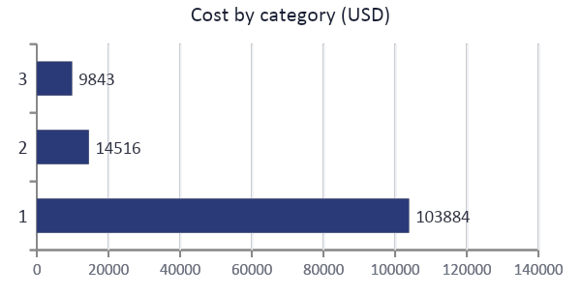
Cost Estimation 3 of 3: Hardware, Software and Personnel
Total development cost $128,243 over a 12 month first year of operation
PERSONNEL
HARDWARE
SOFTWARE
$103,884
$14,516
$9,843
Ayro, backend and database, 420 h at $50/h = $21,000
Ben, backend and DevOps, 420 h at $50/h = $21,000
Hadeed, AI engineer, 440 h at $60/h = $26,400
Shaun, frontend, 400 h at $48/h = $19,200
Joshua, QA engineer, 322 h at $42/h = $13,524
Post installation training: 2 admin sessions and documentation = $2,760
5 developer workstations at $1,600 = $8,000
2 application server instances, $140/mo = $3,360
Managed PostgreSQL instance, $95/mo = $1,140
Object storage for audio, 1 TB at $23/mo = $276
Load balancer and bandwidth, $45/mo = $540
Staging environment and backup storage = $1,200
LLM API usage, $0.09 per session at 60,000 sessions = $5,400
Speech to text, $0.006/min at 180,000 min = $1,080
Monitoring and error tracking = $1,428
GitHub Team plus CI/CD minutes, 5 seats = $660
Figma Professional, 2 seats = $360
IDE licenses, TLS certificate and domain = $915
Cost per function point
$833
$128,243 total development cost divided by 154 adjusted function points. This is the figure we would carry forward to estimate any future release of the platform.
Interview Lens | Team 1 | SE 3354 Deliverable 2
8
Notes:
Personnel dominates at eighty one percent of cost, which is what you expect for a software project. Hardware is mostly cloud rather than owned equipment because the platform is browser based. Software cost is driven by LLM and transcription usage, which scales with how many students use it. - ayro

Slide 9
Functional Requirements
What the system must do
FR-1
Accounts
FR-5
Feedback report
Register with name, email and password, then log in and log out. Duplicate emails are rejected.
On completion, each answer is scored on STAR structure, clarity and confidence, giving an overall 0 to 100 score with written suggestions.
FR-2
Start a session
FR-6
Progress history
A logged in student starts a mock behavioral interview by choosing a target job role and a difficulty level.
Every completed session and report is stored, and the dashboard displays history and score trends over time.
FR-3
Generate questions
FR-7
Question bank admin
The AI engine generates at least five behavioral questions per session, including adaptive follow ups based on the previous answer.
An administrator can add, edit and remove questions and question categories in the question bank.
FR-4
Answer input
FR-5 is the core of the product
Answers are accepted as typed text or recorded audio. Audio is transcribed to text before any analysis.
It is the requirement our unit test targets, and the one that separates Interview Lens from tools that only replay questions.
Interview Lens | Team 1 | SE 3354 Deliverable 2
9
Notes:
Seven functional requirements. FR-3 and FR-5 are the ones that matter most: adaptive question generation and the scored feedback report. FR-5 is also the requirement we chose to unit test later in this deck. - ben

Slide 10
Non-Functional Requirements
Representative items from the twelve NFRs, one per required type
NFR-1
Usability
NFR-2
Performance
NFR-3
Space
A first time user creates an account and starts their first interview in under 3 minutes with no training.
Next question within 2 seconds, full feedback report within 15 seconds, for 95% of requests under normal load.
Web bundle at most 5 MB. A completed session, transcript plus report, averages at most 2 MB of storage.
NFR-4
Dependability
NFR-5
Security
NFR-6
Environmental
At least 99.5% monthly availability. Every answer autosaves on submit, so a crash loses at most the answer in progress.
TLS 1.2 or higher, bcrypt password hashes, 24 hour session token expiry, and role based access control.
Runs in the two most recent versions of Chrome, Firefox, Safari and Edge, desktop and mobile, with no local install.
NFR-7
Operational
NFR-8
Development
NFR-9
Regulatory
Supports at least 500 concurrent sessions at peak. Question bank updates without taking the platform offline.
All TypeScript, merged only through reviewed pull requests, with 70% minimum line coverage enforced by CI/CD.
Transcripts and feedback are handled as FERPA aligned educational records, private by default.
NFR-10
Ethical
NFR-11
Accounting
NFR-12
Legislative
All feedback is labelled AI generated. No data sales, no training on responses without opt in, and prompt bias review.
Audit log of all account and data access events, retained for 12 months.
Complies with the assumed AI Interview Transparency Act of 2025 and deletes all user data within 30 days of request.
Interview Lens | Team 1 | SE 3354 Deliverable 2
10
Notes:
Twelve non functional requirements covering every required type. The three that shaped design hardest were performance, because LLM latency is unpredictable, security, because we hold student recordings, and development, because the 70 percent coverage gate is what forced the test work you will see shortly. - ben

Slide 11
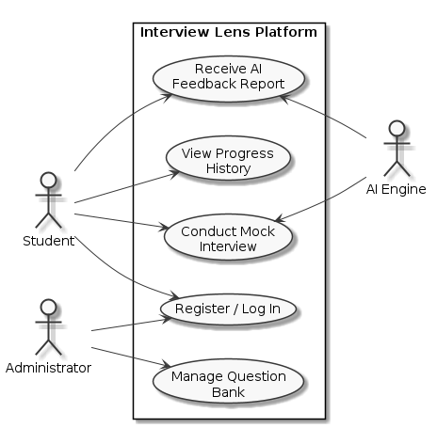
Use Case Diagram
Two human actors and one system actor across five use cases
Actors
Student
The primary actor. Registers and logs in, conducts mock interviews, receives feedback reports and reviews progress history.
Administrator
Manages the question bank. Also registers and logs in, but is separated by role based access control per NFR-5.
AI Engine
Modelled as a system actor rather than an internal component because it is an external service. It participates in Conduct Mock Interview and Receive AI Feedback Report.
Design decision
Register / Log In is shared by both human actors rather than duplicated, which keeps one authentication path and one place to enforce RBAC.
Figure 1. Use case diagram for Interview Lens
Interview Lens | Team 1 | SE 3354 Deliverable 2
11
Notes:
Student and Administrator are our two human actors. We modelled the AI Engine as a system actor because it is an external service we call rather than code we own, which matters for the cost estimate where it counts as an external interface file. - Shaun

Slide 12
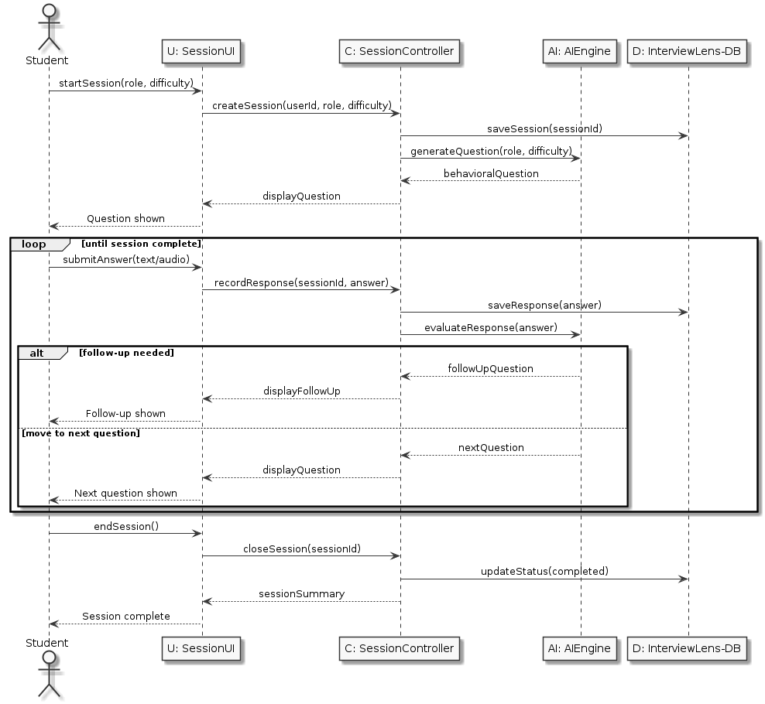
Sequence Diagram: Conduct Mock Interview
The representative operation, showing the loop over questions and the adaptive follow up branch
Walkthrough
1
The student starts a session with a role and difficulty. SessionController persists the session and asks AIEngine for the first behavioral question.
2
loop [until session complete]. The student submits an answer as text or audio. The controller saves the response and sends it to AIEngine for evaluation.
3
alt [follow-up needed]. AIEngine either returns a follow up question generated from the answer just given, or advances to the next planned question. This is FR-3 in action.
4
endSession() closes the loop, the session status is updated to completed, and a summary returns to the UI. The scored report is generated in a separate interaction.
Four more sequence diagrams are in the report: Register / Log In, Receive AI Feedback Report, View Progress History and Manage Question Bank.
Figure 3. Sequence diagram for Conduct Mock Interview
Interview Lens | Team 1 | SE 3354 Deliverable 2
12
Notes:
This is the operation that defines the product. The loop fragment covers the question cycle and the alt fragment is where the adaptive follow up happens. That branch is the difference between a real interview simulation and a list of questions on a page. - Hadeed
Hadeed

Slide 13
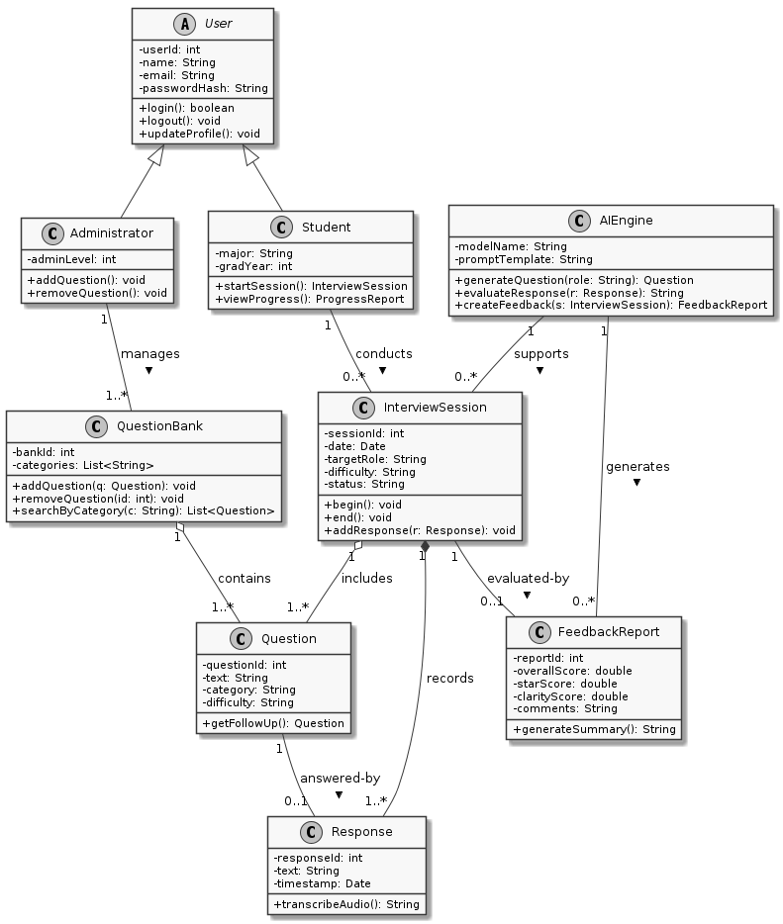
Class Diagram
Nine classes covering every actor, artifact and relationship in the system
Relationships Modelled
Generalization
Student and Administrator specialize the abstract User class, so authentication and profile behavior are defined once.
Aggregation
InterviewSession aggregates the Questions asked in it, and QuestionBank aggregates the reusable Question pool. Questions outlive any single session.
Composition
InterviewSession composes the Responses recorded in it. A Response has no meaning outside its session and is deleted with it.
Association
AIEngine supports 0..* sessions and generates 0..* FeedbackReports. Each completed session is evaluated by at most one report.
AIEngine holds modelName and promptTemplate, which is where the AI pipeline work lives.
Figure 7. Class diagram for Interview Lens
Interview Lens | Team 1 | SE 3354 Deliverable 2
13
Notes:
Nine classes. The relationship worth calling out is composition versus aggregation: responses die with their session, but questions are pooled and reused, so the question bank aggregates rather than composes. - Ayro

Slide 14
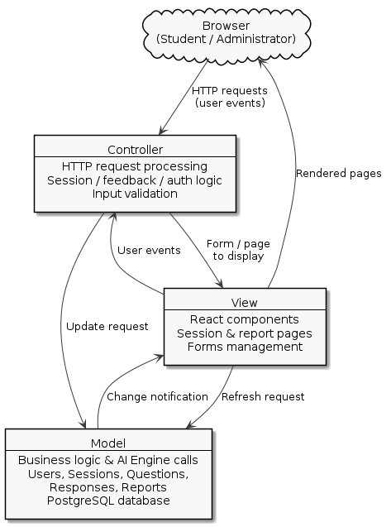
Architectural Design: Model-View-Controller
Sommerville Figure 6.6 pattern, applied to Interview Lens
Why MVC
The same underlying data, sessions, responses and feedback, is presented three different ways: a live interview screen, a feedback report and a progress dashboard. Presentation is also the part we expect to change most as we iterate on UI/UX. MVC isolates those views from the logic that produces them.
React components, session and report pages, form management.
View
HTTP request processing, input validation, session, feedback and auth logic.
Controller
Domain classes, AI Engine calls, and the PostgreSQL database.
Model
It also maps onto how we split the work
Frontend work stays in the View, endpoint work in the Controller, and database plus AI pipeline work in the Model. That lets all five of us work in parallel with very few merge conflicts.
Figure 8. MVC architecture of Interview Lens
Interview Lens | Team 1 | SE 3354 Deliverable 2
14
Notes:
We considered a layered pattern and a repository pattern. MVC won because our defining characteristic is one dataset presented several ways, and because it happens to line up exactly with how the five of us divided the work. - Shaun

Slide 15
Comparison with Similar Designs
Design decisions and assumptions measured against existing interview practice tools
Google Interview Warmup [2]
Where Interview Lens Differs
Free, browser based, five questions with transcript insights and highlighted job related terms.
Gap: No numeric scoring, no adaptive follow ups, no account, and no history across sessions.
Adaptive follow ups generated from the answer just given, rather than a static question list.
An explicit, fixed rubric: STAR structure, clarity and confidence, producing a comparable 0 to 100 score every session.
A longitudinal progress dashboard, so improvement is measured rather than assumed.
Text or voice input with transcription, so students can practise speaking, not just typing.
FERPA aligned handling and mandatory AI disclosure, which is what makes campus adoption realistic.
Free to the student and deployable per campus, with no scheduling and no matched peer required.
Pramp / Exponent [3]
Peer to peer live mock interviews with real human feedback at no cost.
Gap: Needs a matched peer who may not show, feedback quality varies with their skill, and the focus is largely technical.
interviewing.io [4]
Anonymous mock interviews with engineers from large technology companies.
Gap: Paid, technical interview focused, and limited behavioral coverage. Not viable for repeated weekly practice on a student budget.
Big Interview [5]
University licensed video practice with rubric based self and peer review.
Gap: Largely a pre recorded curriculum. AI feedback is limited and access depends on an institutional licence.
Assumption behind the positioning: no existing tool combines adaptive questioning, a fixed measurable rubric, and educational records handling in one free product. That combination, not any single feature, is our design decision.
Interview Lens | Team 1 | SE 3354 Deliverable 2
15
Notes:
We looked at four comparable tools. Each does one piece well. Google Warmup is free but does not score you(It is now a killed by google project). Pramp gives human feedback but needs a peer to show up. What none of them do is combine adaptive questioning, a fixed measurable rubric, and FERPA aligned handling in one free product. - Hadeed
Hadeed

Slide 16
Test Plan: Unit Under Test
Testing computeOverallScore(), the deterministic core of FR-5
SessionScorer.ts
Why this unit
export interface AnswerScore {
star: number; // 0 - 10
clarity: number; // 0 - 10
confidence: number; // 0 - 10
}
const W = { star: 0.5, clarity: 0.3, confidence: 0.2 };
export function computeOverallScore(
scores: AnswerScore[]
): number {
if (scores.length === 0)
throw new Error('Session has no answers');
const total = scores.reduce((sum, s) => {
const parts = [s.star, s.clarity, s.confidence];
if (parts.some(v => v < 0 || v > 10))
throw new RangeError('Score out of range 0-10');
return sum + s.star * W.star
+ s.clarity * W.clarity
+ s.confidence * W.confidence;
}, 0);
return Math.round((total / scores.length) * 10);
}
computeOverallScore() is the deterministic half of FR-5. The LLM call that produces the per answer scores is non deterministic and is mocked, but the weighting and aggregation that turn those scores into the 0 to 100 session score must be exactly right every time. If this unit is wrong, every progress trend in FR-6 is wrong too.
Scope and approach
Unit level, white box, using equivalence partitioning and boundary value analysis. Valid partition: all components in 0 to 10. Invalid partitions: an empty session, and any component outside 0 to 10.
Tooling and environment
TypeScript with Jest, run locally and on every pull request through GitHub Actions. The pipeline fails below 70 percent line coverage, satisfying NFR-8. The AI engine is stubbed so the test is deterministic.
Pass criteria
All defined test cases pass, line coverage of the module is at or above 70 percent, and no unhandled exception escapes the function for any input in the defined partitions.
Interview Lens | Team 1 | SE 3354 Deliverable 2
16
Notes:
We test the scoring aggregation rather than the AI call itself. The AI output is non deterministic so we stub it. But the maths that turns three component scores into one session score has to be exact, because every trend line on the progress dashboard is built on it. - Joshua

Slide 17
Test Case Execution: True and False Cases
Jest results for computeOverallScore(), 4 test cases, 1 defect found and fixed
ID
INPUT / CONDITION
EXPECTED
ACTUAL
RESULT
jest SessionScorer.test.ts
TC-01
Valid 5 answer session,
star 8 / clarity 7 / confidence 6
73
73
PASS
computeOverallScore
v TC-01 valid 5 answer session
v TC-02 perfect session -> 100
v TC-03 empty session throws
x TC-04 rejects out of range
* TC-04 rejects out of range
Expected: RangeError
Received: 96
Tests: 1 failed, 3 passed, 4 total
Coverage: 78.4% lines
PASS
TC-02
Perfect session,
all components at 10
100
100
PASS
TC-03
Empty session,
zero answers submitted
throws Error
throws Error
PASS
TC-04
Malformed AI payload,
star = 12, above the valid range
throws RangeError
returned 96
FAIL
TC-01 verification: (8 x 0.5) + (7 x 0.3) + (6 x 0.2) = 7.3 -> 7.3 x 10 = 73
DEF-01 | The failing case found a real defect
The first implementation weighted the components without validating their range, so a malformed AI response with star = 12 silently produced a session score of 96 instead of being rejected. A guard clause was added, the test was re-run, and all four cases now pass at 78.4 percent line coverage. This is exactly why we test the deterministic layer separately from the model.
Interview Lens | Team 1 | SE 3354 Deliverable 2
17
Notes:
Three cases pass, one fails. TC-04 is the important one. A malformed AI response with a component score of twelve was quietly producing a session score of ninety six instead of being rejected. That is a real defect our test caught. We added a range guard, re-ran, and all four pass at seventy eight percent coverage. - Joshua

Slide 18
Prototype of the Proposed Application
Interactive Figma prototype, three core screens shown
Interview Lens
Interview Lens
Interview Lens
Start a new session
Q 3 of 5
Session score
78
Target role
Tell me about a time you disagreed with a teammate. What did you do?
/ 100
Software Engineer Intern
Difficulty
STAR structure
Type your answer, or record it
Intermediate
Clarity
Begin interview
Confidence
5 questions . about 12 minutes
Submit answer
Strong situation and task. Quantify the result next time.
Autosaved
AI generated . flag for human review
1. Session Setup
2. Live Interview
3. Feedback Report
The student picks a target role and difficulty, then starts. Two fields and one button, which is what keeps NFR-1 under three minutes.
One question at a time with a text box and a record button. A progress pill shows position in the session and answers autosave on submit per NFR-4.
The 0 to 100 session score, the three rubric bars, written suggestions, and the AI generated disclosure label required by NFR-10.
Interview Lens | Team 1 | SE 3354 Deliverable 2
18
Notes:
Three core screens from the Figma prototype. Setup is deliberately two fields and a button so a first time user is interviewing in under three minutes. The interview screen shows one question at a time with text or voice input. The report gives the session score, the three rubric bars, and the AI disclosure label we are required to show. - Shaun

Slide 19
Challenges and Lessons Learned
What actually got in the way, and what we would do differently
1
Testing a non deterministic system
2
Guaranteeing NFR-2 against LLM latency
The AI engine returns different text for the same input, so conventional assertions do not work on it. We split the pipeline: the LLM call is stubbed in CI and only the deterministic scoring and aggregation layer is unit tested. That decision is what made TC-04 catchable at all.
A 2 second question turnaround is not something a model provider promises. We addressed it by pre generating a warm pool of opening questions per role and streaming follow ups, so the visible wait is decoupled from the model's response time.
3
Function Point estimation was new to all of us
The hardest judgement call was whether the AI engine counts as an internal logical file or an external interface file. We settled on EIF because we call it rather than own its data, which is also how it appears in the use case diagram.
Biggest lesson: choosing incremental development was the right call. Increment 2 shipped the interview loop, and using it is what told us the feedback rubric had to be fixed and numeric rather than free text. We could not have specified that up front.
Interview Lens | Team 1 | SE 3354 Deliverable 2
19
Notes:
Some real challenges. The one worth dwelling on is testing a non deterministic system. Splitting the pipeline so the deterministic half could be tested properly is what let us find a genuine defect instead of writing tests that only assert the AI returned something.
Hadeed

Slide 20
Conclusion
Evaluation of our work and deviations from the original plan
FEEDBACK SCOPE
DEFERRED TO A LATER RELEASE
Free text to fixed rubric
SSO and multi language
We narrowed AI feedback to a fixed STAR, clarity and confidence rubric. Free form critique reads better once, but it cannot be scored, compared across sessions, or unit tested.
University single sign on and non English interviews were deferred. Both are real demand, but neither is needed to validate the core loop in a first release.
Held unchanged from Deliverable 1
The incremental process model, the MVC architecture, the class model and all twelve non functional requirements survived Deliverable 2 without revision. The estimation work did not force a redesign, which we take as evidence that the Deliverable 1 design was sound.
Interview Lens remains true to its original motivation: giving students an accessible way to practise the behavioral round and build the people skills that technical ability alone does not demonstrate.
Thank you.
github.com/AyroEscobar/3354-Team1-InterviewLens
Notes:
Ben: To close: two things changed from the original plan, feedback scope and deferred features, and we have justified each. Everything from Deliverable 1, the process model, the architecture and the requirements, held up under the estimation and testing work. Thank you, and we are happy to take questions. - Ben

