Slide 1


Slide 2
Introduction
Agriculture is the backbone of food production.
Fertilizer misuse can lead to poor yield and environmental harm.
AI offers intelligent decision-making to assist farmers.
Our solution: AI-based fertilizer recommendation using Deep Neural Networks (DNN).

Slide 3
Objective
Develop a fertilizer recommendation system using DNN.
Use historical soil and crop data (dataset-based).
No hardware integration, purely software and data-driven.
Enable future integration with sensors.

Slide 4
Dataset Description
.
Source: [ Kaggle Fertilizer Prediction Dataset]
Soil nutrients: Nitrogen (N), Phosphorus (P),Potassium (K)Soil type, Moisture
Target: Recommended Fertilizer Type

Slide 5
Data Preprocessing
.
Removed missing values
Categorical data encoded using one-hot or label encoding
Normalization or Standardization of numeric features
Dataset split: 80% training, 20% testing

Slide 6
Deep Neural Network Model
.
Model Architecture:
Input Layer: Based on features
Hidden Layers: 2-3 layers with ReLU activation
Output Layer: Softmax for fertilizer class prediction
Optimizer: Adam
Loss Function: Categorical Crossentropy
Framework: TensorFlow / Keras

Slide 7
System Workflow
.
Input soil and crop details
Preprocess data
DNN predicts best fertilizer
Output displayed to the user

Slide 8
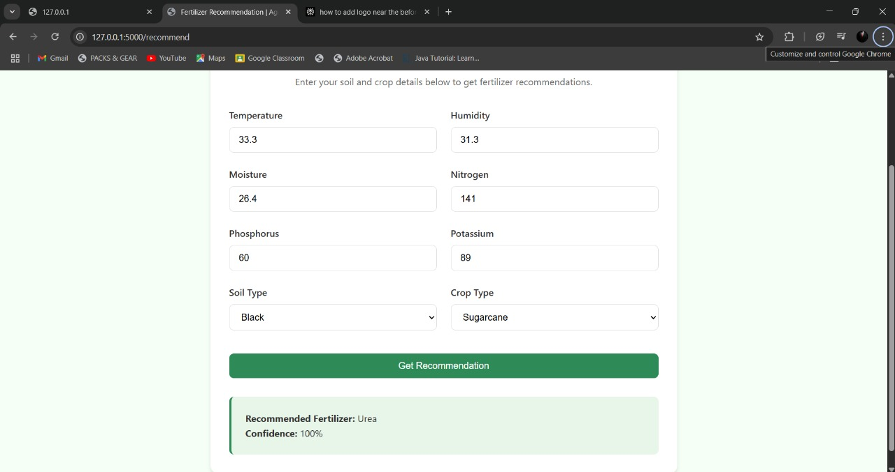
Results
Training Accuracy: 97%
Confusion Matrix for evaluation
Sample output:

Slide 9
Future Scope
Connect with real-time soil sensors (IoT)
Mobile App for local farmers
Voice assistant in local languages
Include weather prediction and crop rotation advice

Slide 10
Conclusion
Our project demonstrates how Deep Neural Networks (DNN) can effectively recommend the right fertilizer based on soil and crop data without the need for hardware. By training on real-world datasets, the model helps farmers make informed decisions that improve yield and reduce environmental damage. Though it's a software-only solution now, it is future-ready for integration with sensors and mobile apps. This project shows how AI can drive smarter, sustainable farming even with minimal resources.

Slide 11

Thank you!
TEAM MEMBERS:
SUBRAMANI A A
SURYA S
SUDHIRRAO R
SIVANTHRAJ SANTHANAM
SRI NITHIN

