Slide 1

MACHINE LEARNING FINAL PROJECT
LISH-MOA
Instructor: Çiğdem Eroğlu Erdem
Mustafa Abdullah Hakkoz
Ayşenur Yılmaz

Slide 2
Laboratory for Innovation Science at Harvard(LISH) presents
a Kaggle challenge to improve current Mechanism of Action(MoA)
prediction algorithms.

Slide 3
MoAs are known patterns in large genomic databases and it’s essential to match activities of molecules with high accuracy. These molecules will be used for modulating protein targets associated with diseases.
Experiments are done by analyzing effects of drugs on human cells with new technologies and responses are saved as labels.

Slide 4
Multiclass problem with 207 binary target attributes
(possible MoA patterns)

Slide 5

train_features.csv (23814 rows × 876 columns)
sig_id - Refers to a unique sample in the dataset.
Gene Expression - Contains variables with g- prefix which store gene expression related information. There are about 775 gene expression variables. These variables generally have a mean around zero and range of -10 to 10
Cell Viability - Contains variables with c- prefix which store cell viability information. There are about 100 cell viability variables. These variables also tend have a mean around zero and range of -10 to 5.
Drug Dosage - Has distinct values for D1 & D2, signifying low and high dosage
CP Time - Has three distinct values of 24, 28 and 72 hours
CP Type - Indicates whether a sample has been treated with a compound or control perturbation

Slide 6
train_targets_scored.csv (23814 rows × 207 columns)
Dataset containing the output variables for training data. There are 207 binary output variables showing MoAs triggered for a specific sig_id. This dataset is linked to the train_features dataset through sig_id column.
test_features.csv (3982 rows × 876 columns)
Test data on which our trained models have to make a prediction.
submission.csv (3982 rows × 207 columns)
Submission file consisting of rows(test dataset) and cols(target labels).

Slide 7
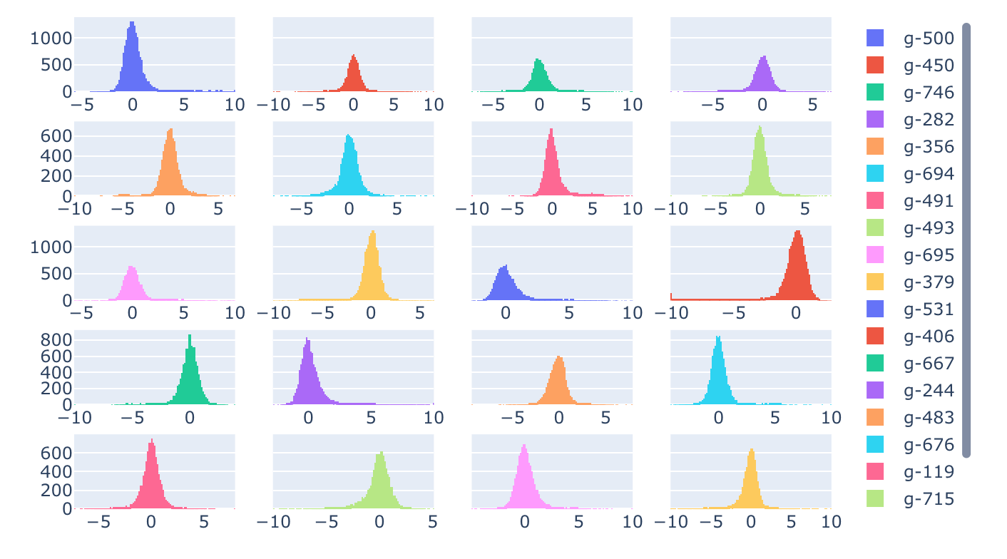
Distribution for randomly selected gene expression variable

Slide 8
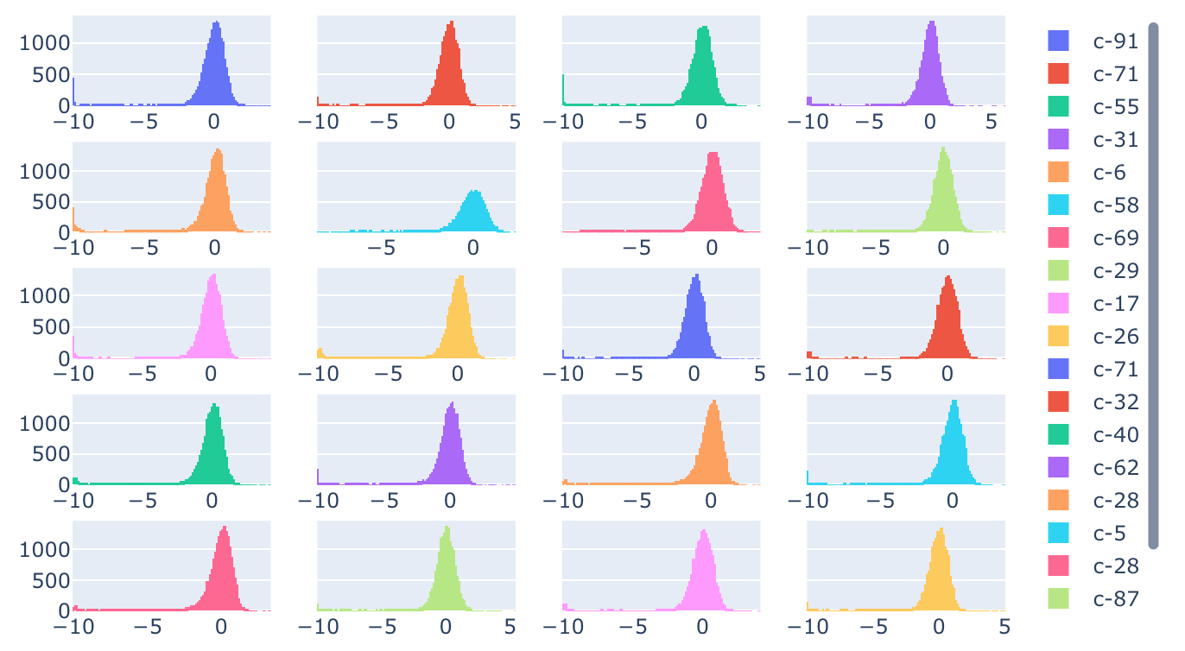
Distribution for randomly selected cell expression variable

Slide 9
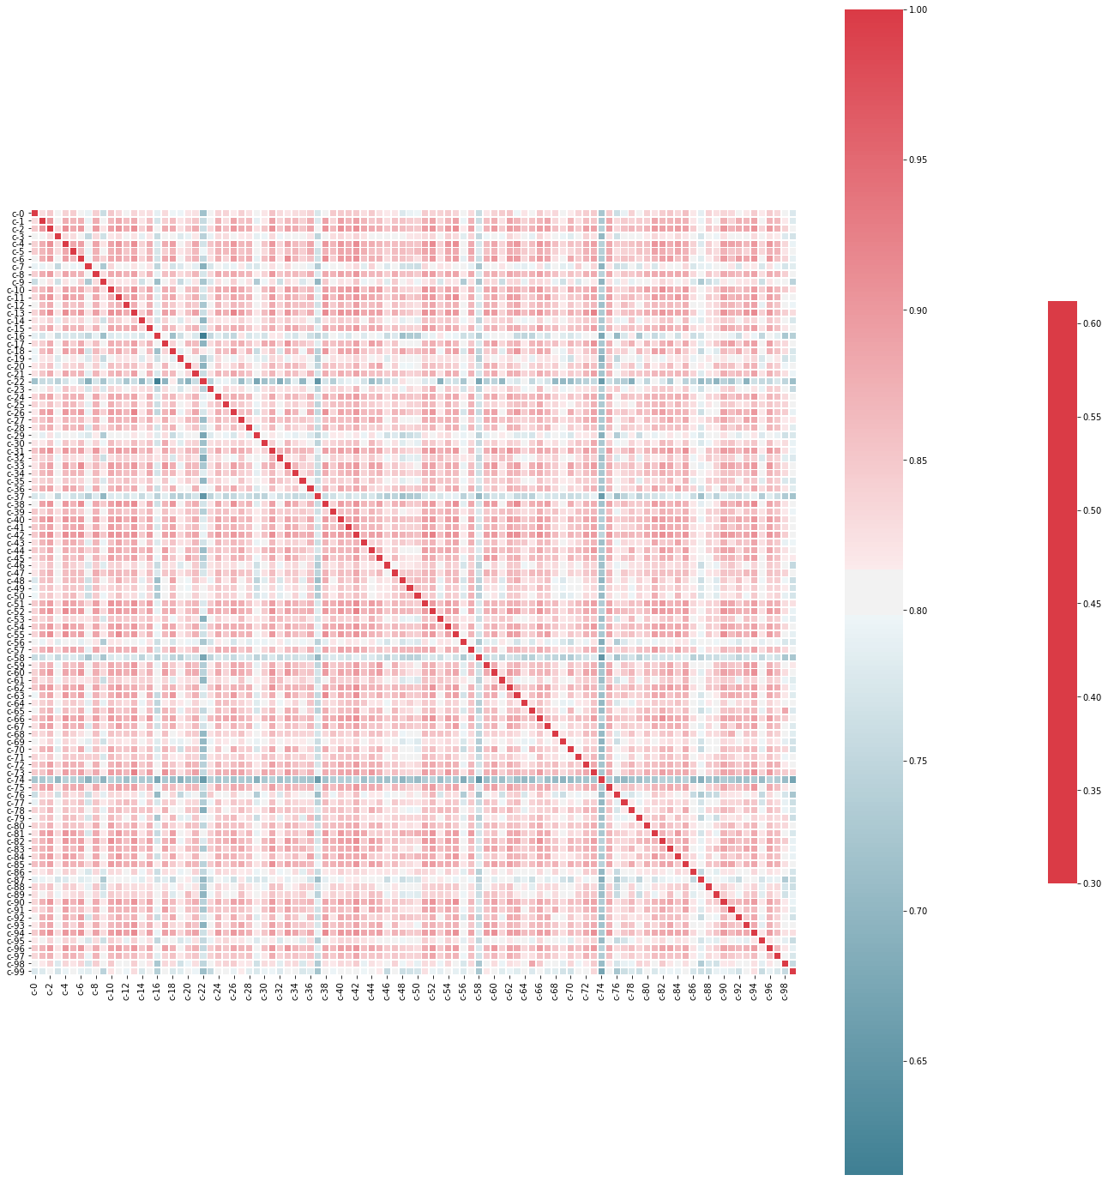
Heatmap
Heavy presence of red shows us that
cell viability variables are highly correlated with each other.
This information will be helpful for eliminating some features with PCA .

Slide 10
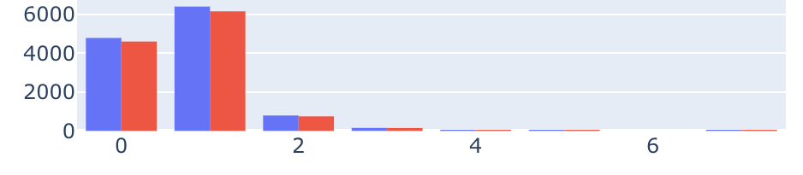

Sum of Drug Actions with different dosages

Slide 11
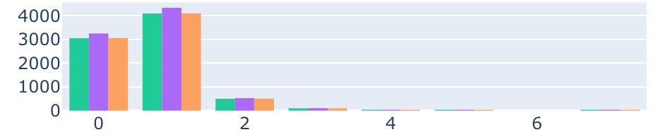
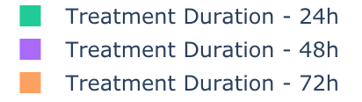
Sum of Drug Actions with different treatment durations

Slide 12
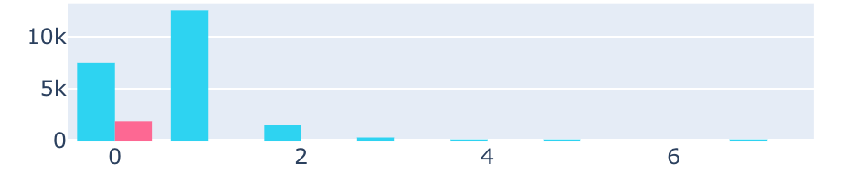

Sum of Drug Actions with different dosage types

Slide 13

We have 207 binary target features, with individual columns for each MoA.
We have to predict whether a particular gene expression&cell viability sample corresponds to a specific MoA.
One single drug sample can have multiple MoAs.

Slide 14
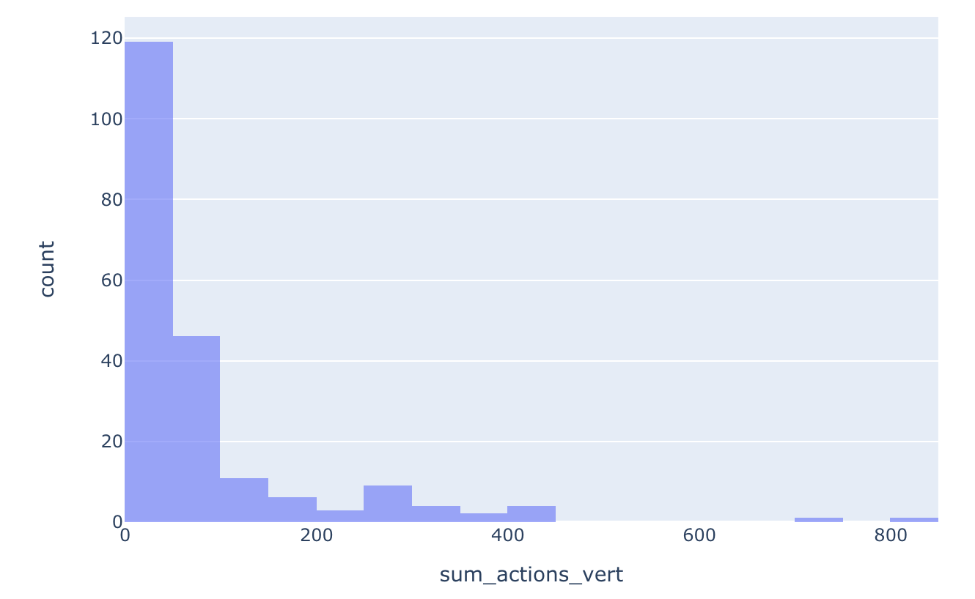
Histogram of Sum of Actions across MoAs

Slide 15
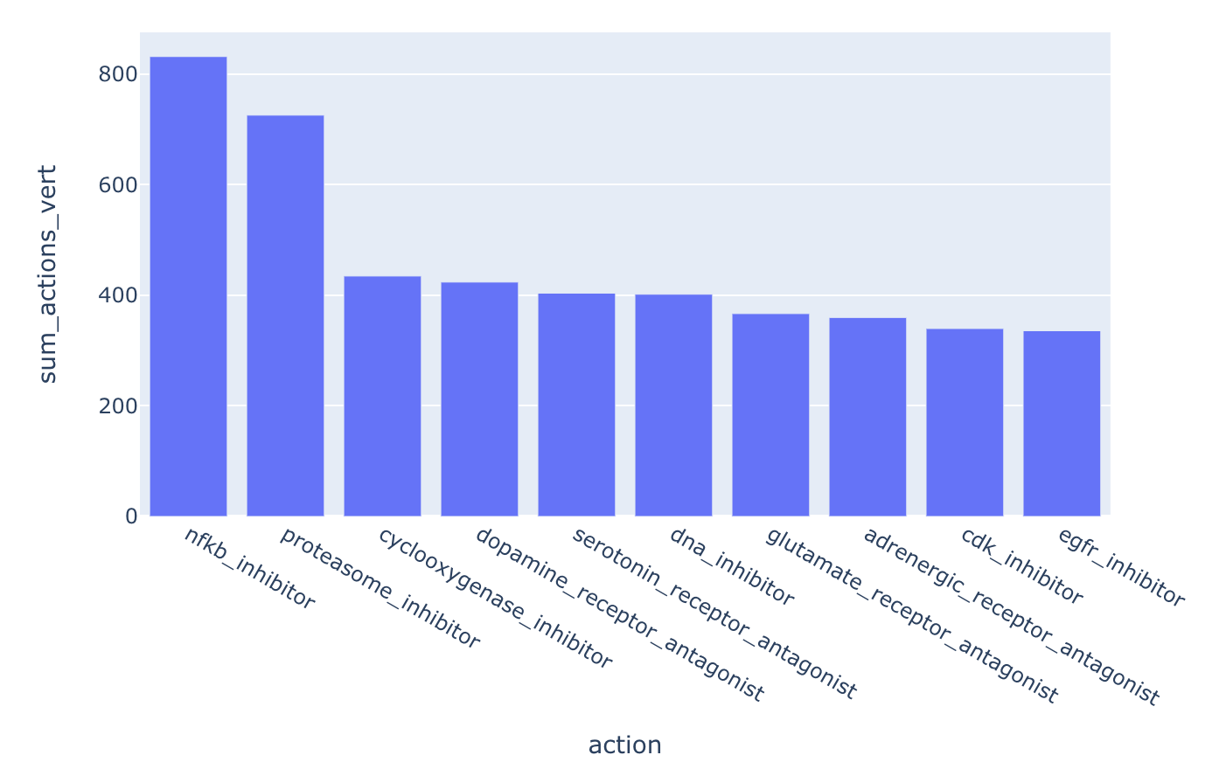
Most Common MoAs

Slide 16
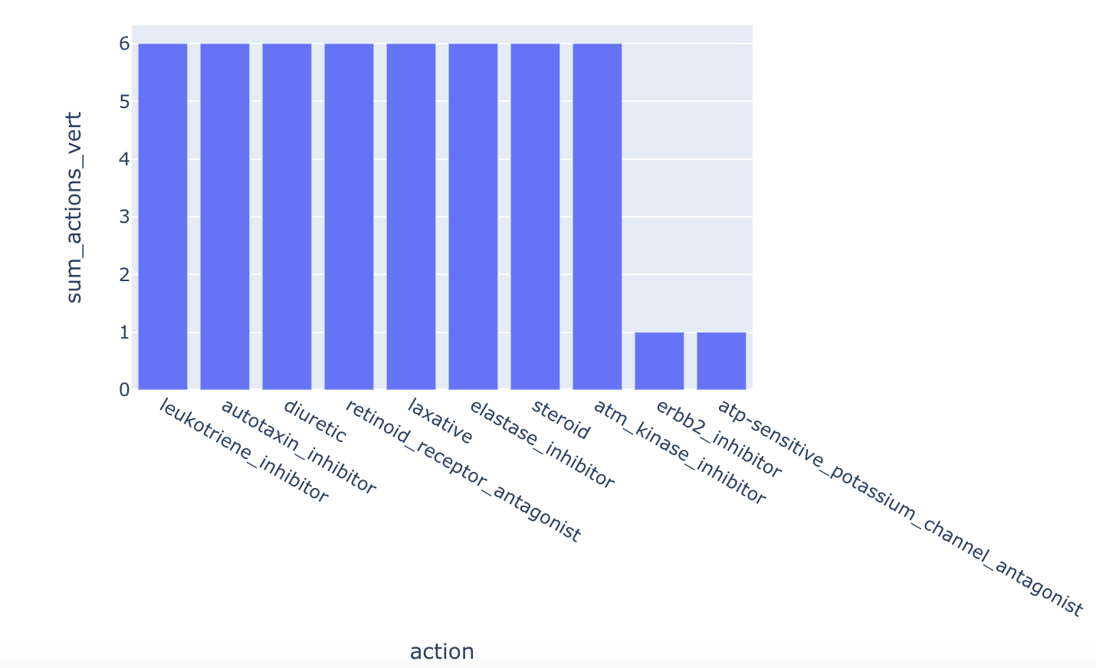
Least Common MoAs

Slide 17
Now look at correlation between MoAs to understand if a drug sample is likely to trigger multiple MoAs that are correlated to each other.

Slide 18
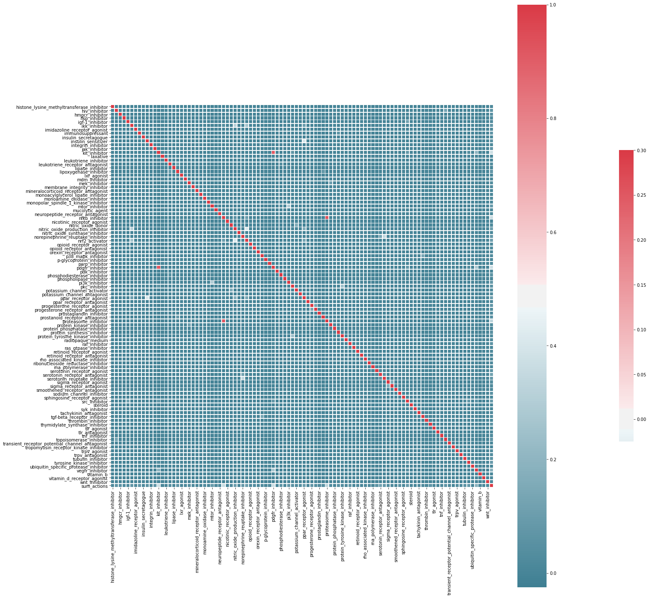
There is no correlation between MoA,
all MoAs are independent to each other.

Slide 19

Open notebooks:
EDA
XGBoost
ANN

Slide 20
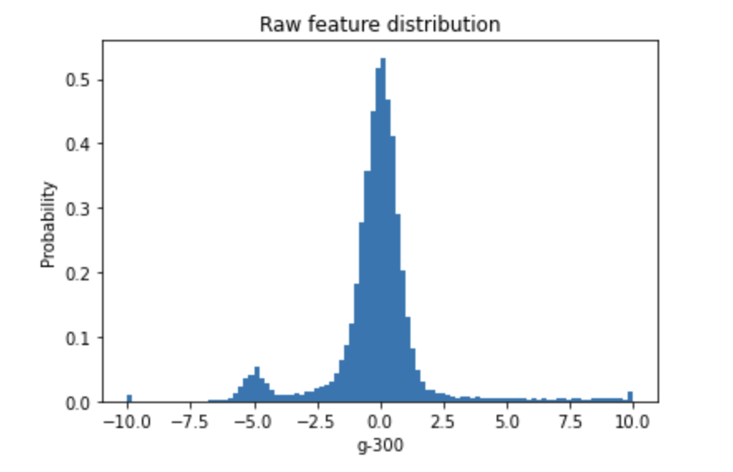
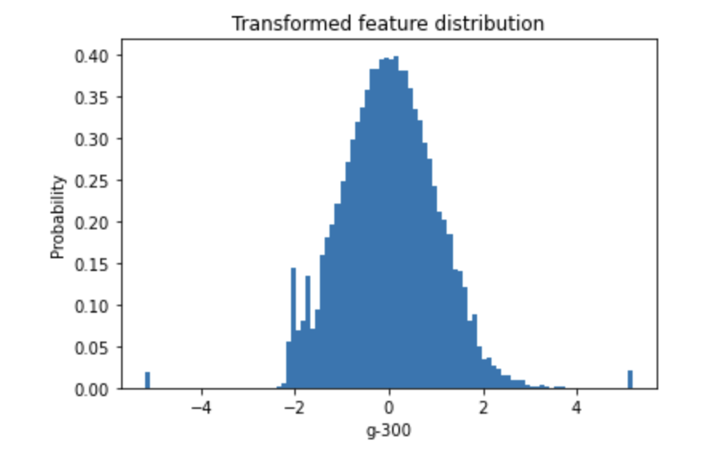
LISH-MoA || XGBoost
Transform all columns to normal distribution with help of RankGauss (QuantileTransformer)

Slide 21

dimensionality reduction with PCA
original dataset has
genes expression: 772
cell expression: 100
PCA orders
genes expression: 463
cell expression: 60
new dimension: 4 + (772 + 100) + (463 + 60) = 1399

Slide 22
feature elimination with variance threshold
var_threshold : 0.9
We eliminate columns who has variance value less than 0.9
new dimension: 1014

Slide 23
XGBoost with CountEncoder
The dataset includes two categoric variables: “cp_dose” and “cp_time”
We applied CountEncoder to these columns.

Slide 24
CV predictions with MultiLabelStratifiedKFold
Scikit-learn provides several cross validators with stratification.
However, these cross validators do not offer the ability to stratify multilabel data.
This iterative-stratification project offers implementations of MultilabelStratifiedKFold and we used it in our project.
Generally, out-of-fold predictions improves scores so that we used 5 fold to make predictions on test dataset
and take average on them. This technique resembles bagging ensemble.

Slide 25
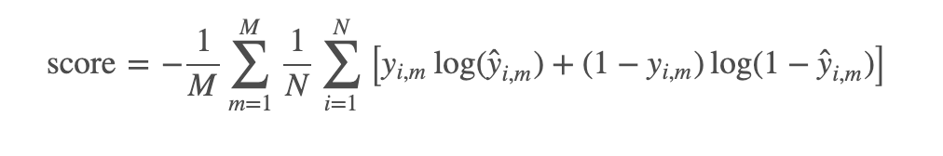
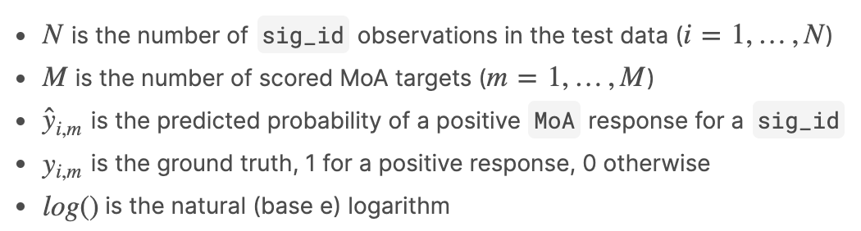
Evaluation Metric
For every sig_id we will be predicting the probability that
the sample has a positive response for each MoA target.

Slide 26
Analysis of Out-Of-Fold predictions
val scores
fold 0: 0.02406122794001431
fold 1: 0.02433675124618263
fold 2: 0.02420273200448477
fold 3: 0.02454542500329472
fold 4: 0.02404935582984132
mean oof loss: 0.024239098404763553
std oof loss: 0.00018565275351707533
test set score with XGBoost:
loss: 0.02423910244938239

Slide 27
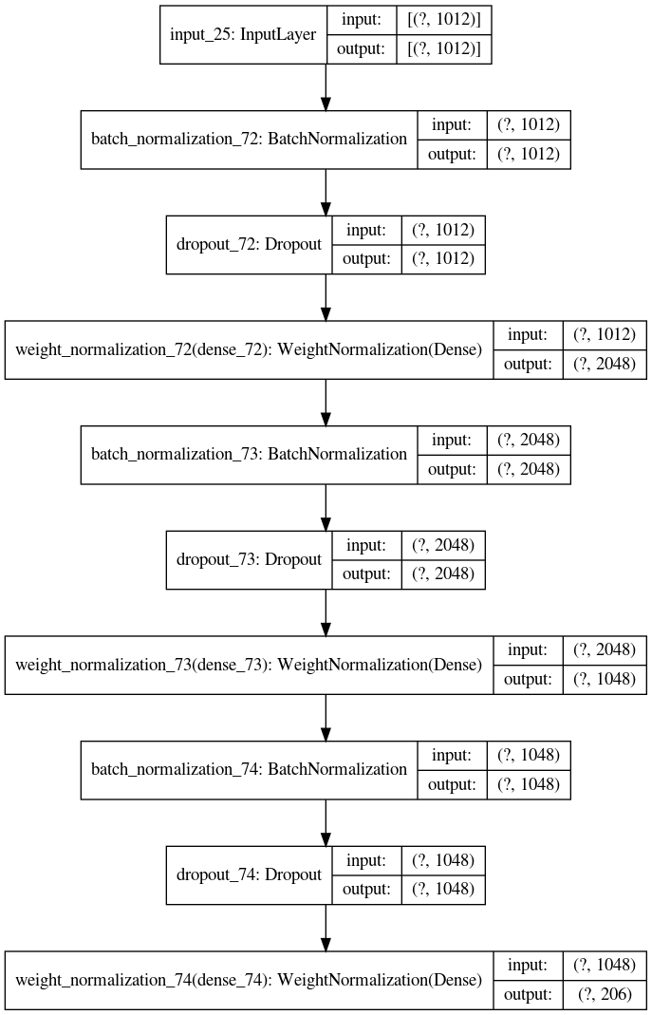
LISH-MoA || Neural Network
same preprocessing steps + standard scaler
parameters
dropout rate => 0.2, 0.5, 0.5
epoch => 35
batch size => 128
reduce learning rate on plateau:
factor => 0.1, patience =>3
model check point =>”saved based only”
optimizer:
”look ahead(adam)”, sync period =>10
loss =>”binary cross entropy”
test set score with ANN:
loss: 0.015989294744492445

Slide 28

THANK YOU FOR LISTENING US

