Slide 1

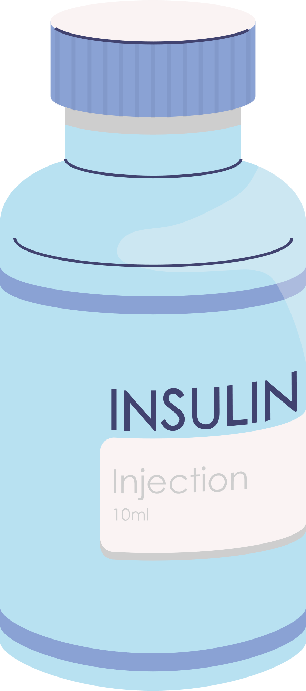

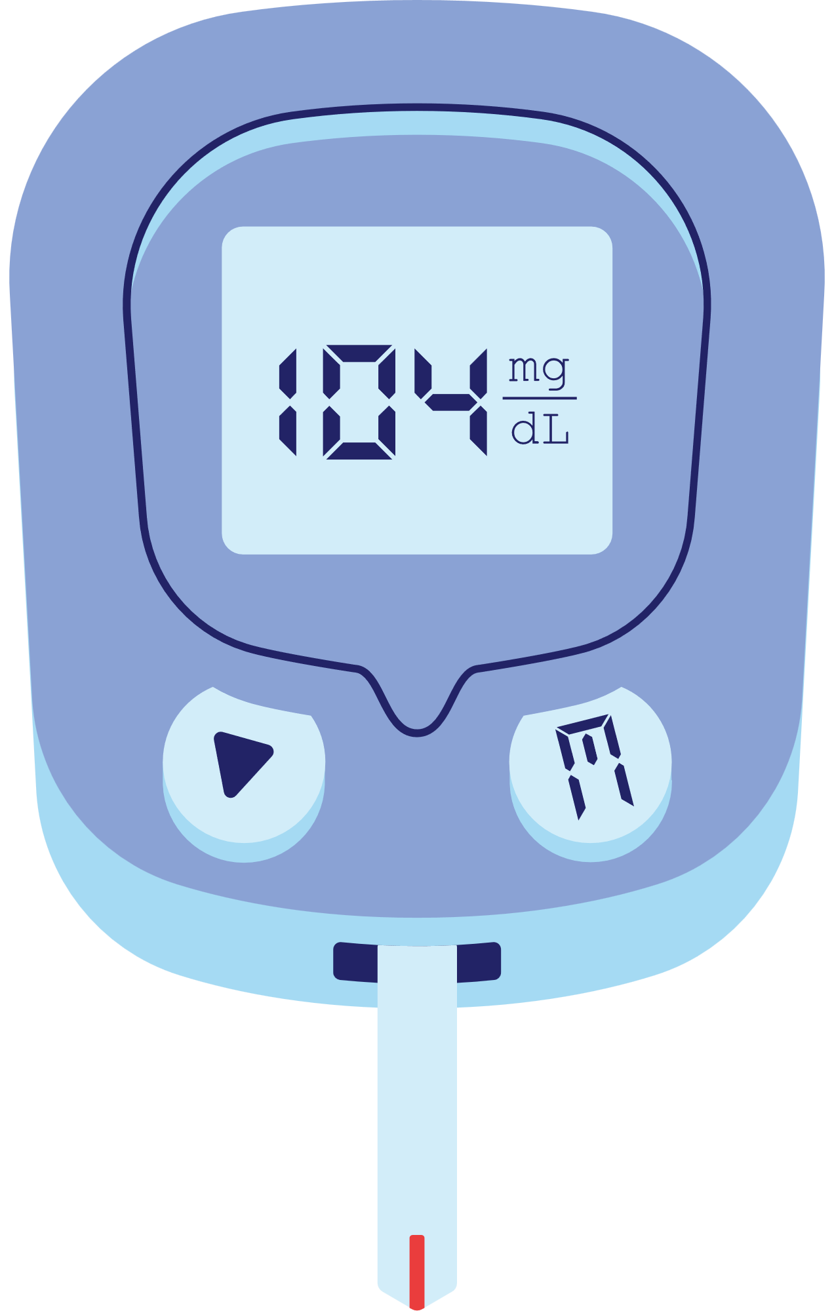

Diabetes Prediction Model
DataDiagnostics: Aysha, Godswill, Kehlani & Sum

Slide 2

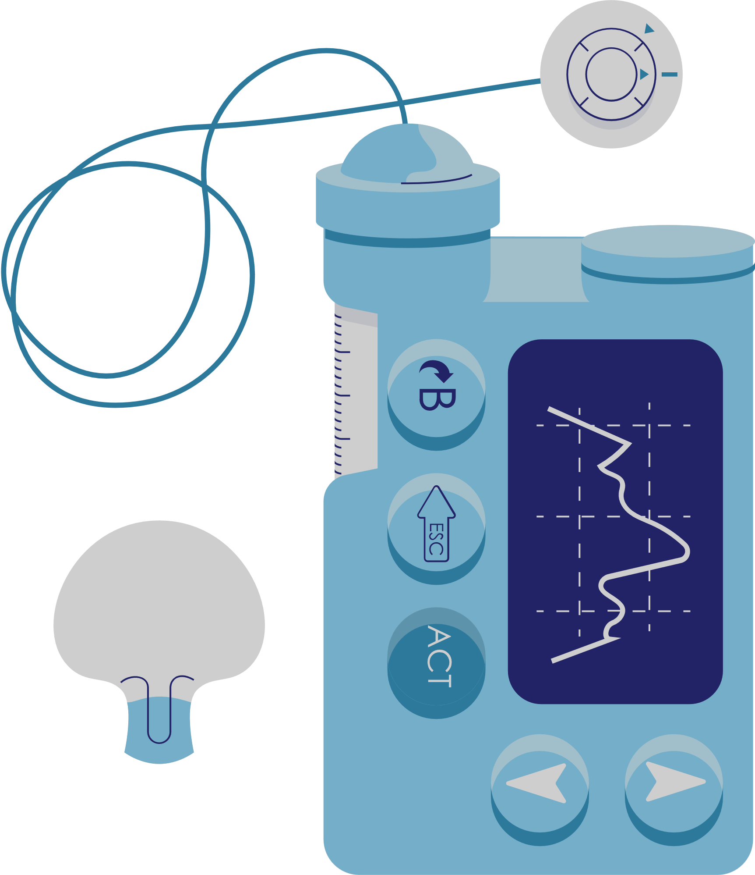
Project Overview
Why Diabetes?
Diabetes is a prevalent chronic disease, affecting millions of individuals and posing significant health risks if not managed effectively. Early detection and intervention are crucial in mitigating its adverse effects.
Our Goal
To develop a predictive model to identify individuals at risk of developing diabetes based on various health indicators.
Notes:
Diabetes is a prevalent chronic disease that affects millions of people worldwide. According to the International Diabetes Federation, approximately 537 million adults (20-79 years) are living with diabetes. Around 90% of diabetes cases are Type 2, influenced by factors like economy, age, environment, and lifestyles.
Early detection and prediction of diabetes are crucial for effective management and prevention of complications. This project aims to develop a predictive model to identify individuals at risk of developing diabetes based on various health indicators.
The project aims to predict Type 2 diabetes risk using machine learning algorithms based on lifestyle and family background. By leveraging machine learning algorithms and techniques, we will analyse anonymous health records encompassing parameters such as BMI, age, blood pressure, dietary habits, etc. The project will employ feature selection methods and experiment with various algorithms, including Logistic Regression, Random Forest, Decision Tree, Support Vector Machines (SVM), K-Nearest Neighbors (KNN) and Neural Network, to build a robust and accurate predictive tool.
The ultimate goal is to gain insights into the significant factors contributing to the prediction of diabetes occurrence. Through early detection and intervention, the project aims to contribute to better management and prevention of diabetes, thus improving public health outcomes.

Slide 3

Project Overview
Do you have diabetes?
How does a person know they have diabetes?
NHS Health Check 2022/2023 (England)
People invited: 2,925,325
People taking up: 1,136,770
Population in England: approx. 56M

Slide 4
Project Overview
Our Focus: Type 2 Diabetes
In the UK, over 90% of all adults with diabetes have Type 2.
It’s strongly associated with personal lifestyle factors like diet, exercise and family history.
Unlike Type 1 diabetes, Type 2 diabetes is largely preventable through lifestyle changes.
 | Health Check | Questionnaire
How | measure blood glucose (sugar) levels | ask health and lifestyle related questions
+ | highly accurate | extensive and cheap
- | expensive and limited in scope | less accurate
Can ML improve accuracy?

Slide 5

Data Source
Data Sourcing and Preprocessing
A dataset comprising of relevant health parameters such as BMI, age, blood pressure, family history of diabetes, and lifestyle factors
Preprocessing
Cleaned and pre-processed the collected data to handle missing values, converted categorical data to a numerical format and standardise features
Splitting
Defined the target and feature variables and split the data into subsets ready for the training and testing of models
Notes:
The Kaggle dataset utilised in this project was curated by researchers from the Department of Computer Science and Engineering at Birla Institute of Technology in India, for research purposes only and is not intended for commercial use. An article detailing the implementation of this dataset was published on ScienceDirect, providing further information.
Data Cleaning and Pre-Processing: - Parameter were renamed for consistency and accuracy.
- Redundant Columns like highBP was dropped. This reduces the possibility of conflicting information.
- Missing Value: Rows containing missing values were removed entirely to avoid corruption by incomplete data.
- Categorical Parameters were converted to numerical values. This conversion allows parameters to be used in machine learning algorithms that require numerical features.
Data Splitting:
Defined the target Diabetic and feature parameters and split the data into subsets ready for the training and testing of models.
Feature scaling:
Standardised numerical features using Z-score normalisation.

Slide 6
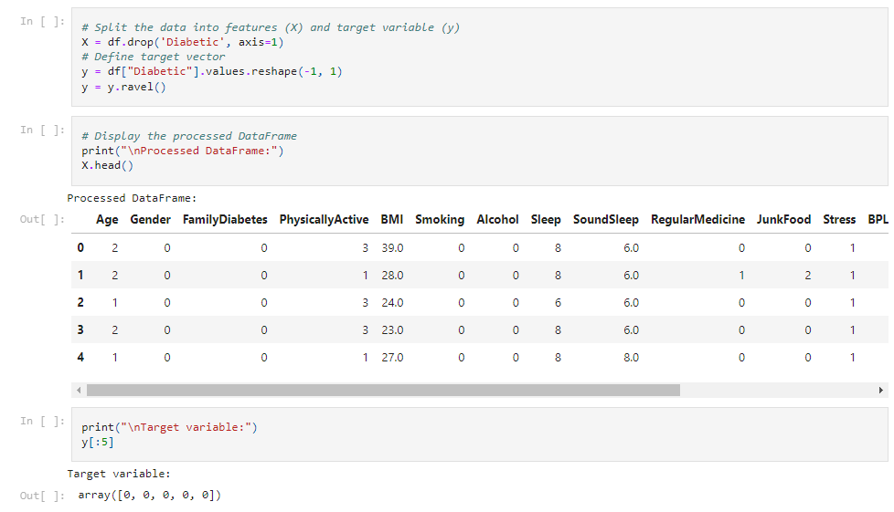
Target and Feature Variables
Sample Code

Slide 7

Machine Learning Models
Logistic Regression
Random Forest
Decision Tree
Implemented a random forest classifier to capture non-linear relationships between features
Built a decision tree classifier to understand the decision-making process
Trained a logistic regression model as a baseline model
Support Vector Machine
K-Nearest Neighbors
Neural Networks
Employed SVM with different kernels to find the best separating hyperplane. (Chosen Kernel:
Linear )
Implemented KNN to classify data points based on the majority class of their nearest neighbours
Constructed a Neural Network with multiple hidden layers using TensorFlow & optimised it using Keras-Tuner
Notes:
Model Building:
- Logistic Regression: Trained a logistic regression model as a baseline model.
- Random Forest: Implemented a random forest classifier to capture non-linear relationships between features. We will also determine which features are the most important and can influence diabetes predictions.
- Decision Tree: Built a decision tree classifier to understand the decision-making process.
- Support Vector Machine (SVM): Employed SVM with different kernels (linear, polynomial, and radial basis function) to find the best separating hyperplane. In this project, a linear kernel was selected due to its computational efficiency. It is important, however, to note that other kernels may help yield better accuracy.
- K-Nearest Neighbors (KNN): Implemented KNN to classify data points based on the majority class of their nearest neighbours.
- Neural Network: Constructed a Neural Network with multiple hidden layers using TensorFlow.
Tuning and Optimisation:
Hyperparameter Tuning:
- Utilised GridSearchCV to tune hyperparameters for Logistic Regression, Random Forest, Decision Tree, SVM and KNN.
Neural Network Optimisation:
- Used Keras Tuner to perform hyperparameter optimisation for the Neural Network model, including the number of hidden layers, neurons per layer, activation functions, and learning rate.

Slide 8
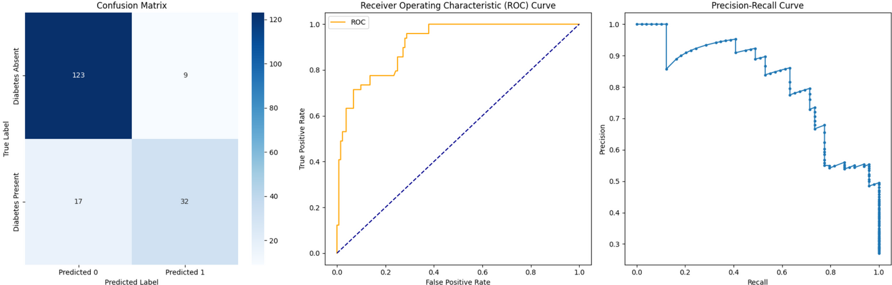
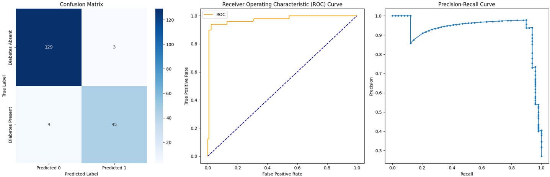

Model Results & Evaluation
Logistic Regression
Random Forest
Notes:
- Confusion matrix: Analysed true positive, false positive, true negative, and false negative predictions.
- Metrics: Calculated accuracy, precision, recall, F1-score to assess model performance.
- ROC curve and AUC-ROC: Plotted the Receiver Operating Characteristic (ROC) curve and calculated the Area Under the Curve (AUC) to evaluate model discrimination.
- Precision-recall curve: Visualised the trade-off between precision and recall for different threshold values.

Slide 9
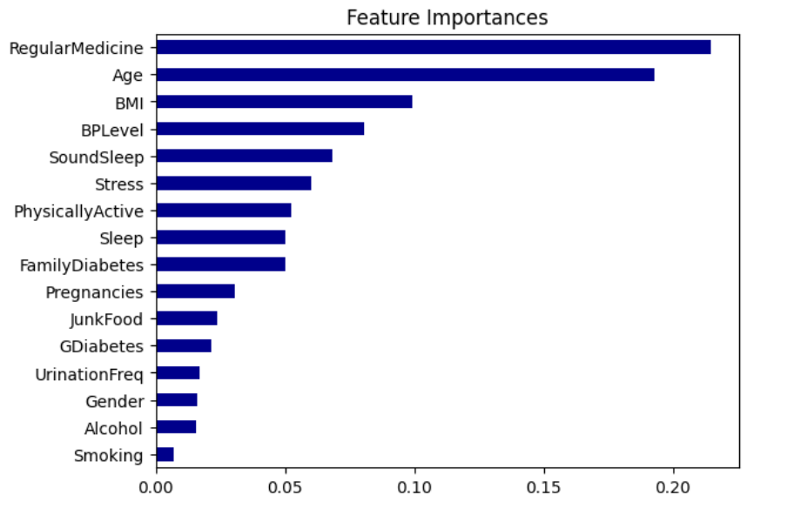
Model Feature Importances
Notes:
Model features showing the features significance in predicting diabetes among all variables

Slide 10
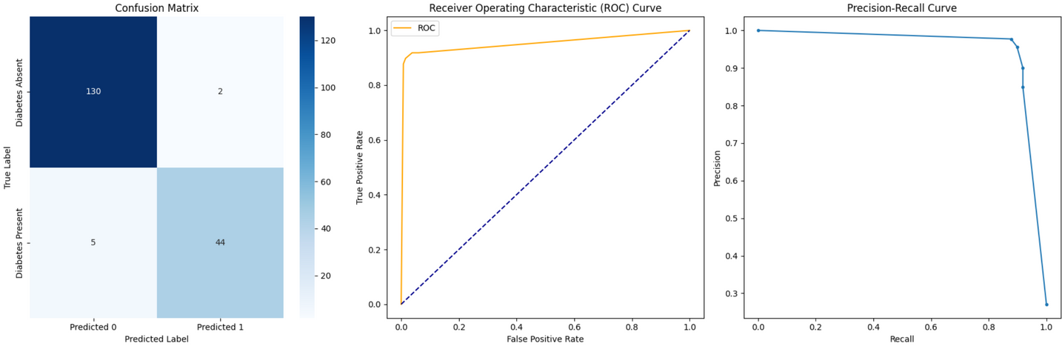
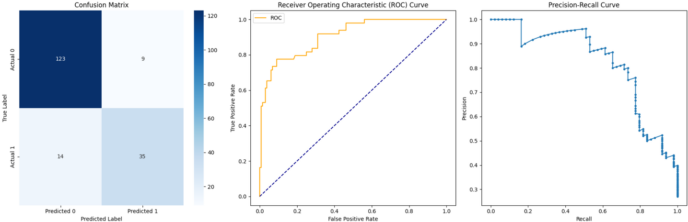
Model Results & Evaluation
Decision Tree
SVM

Slide 11

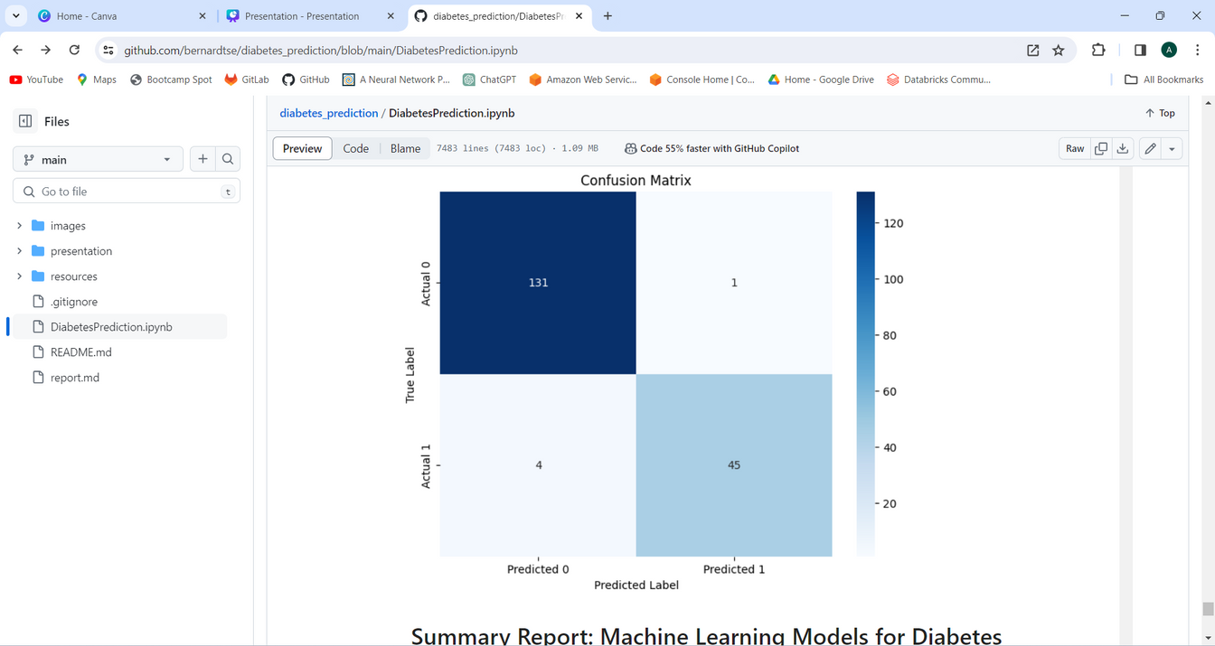
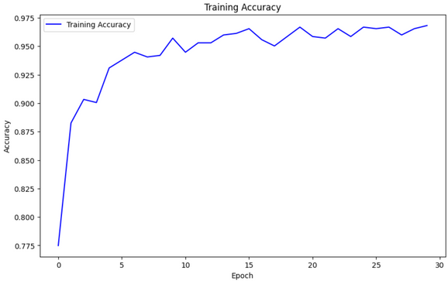
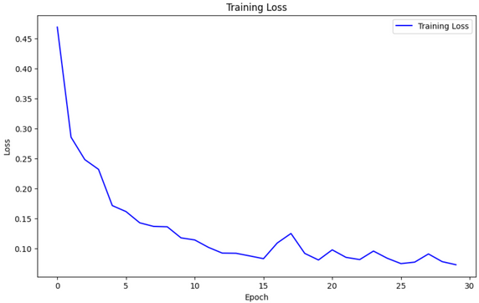
Model Results & Evaluation
KNN
Neural Network

Slide 12
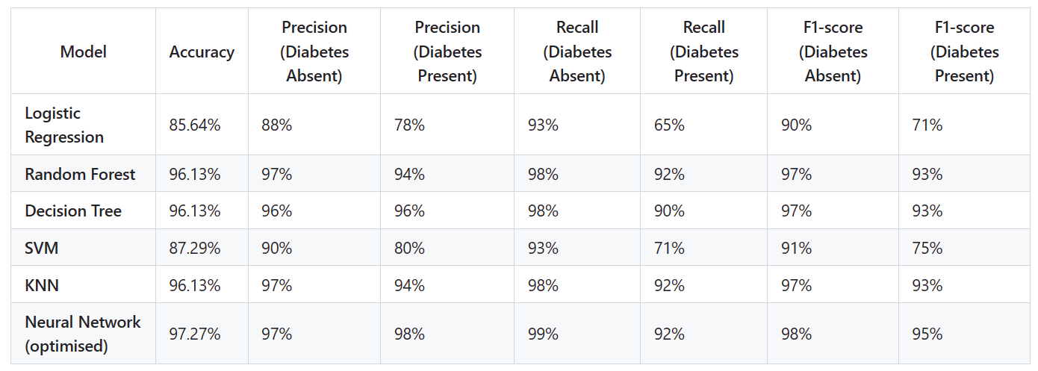
Model Results & Evaluation

Slide 13
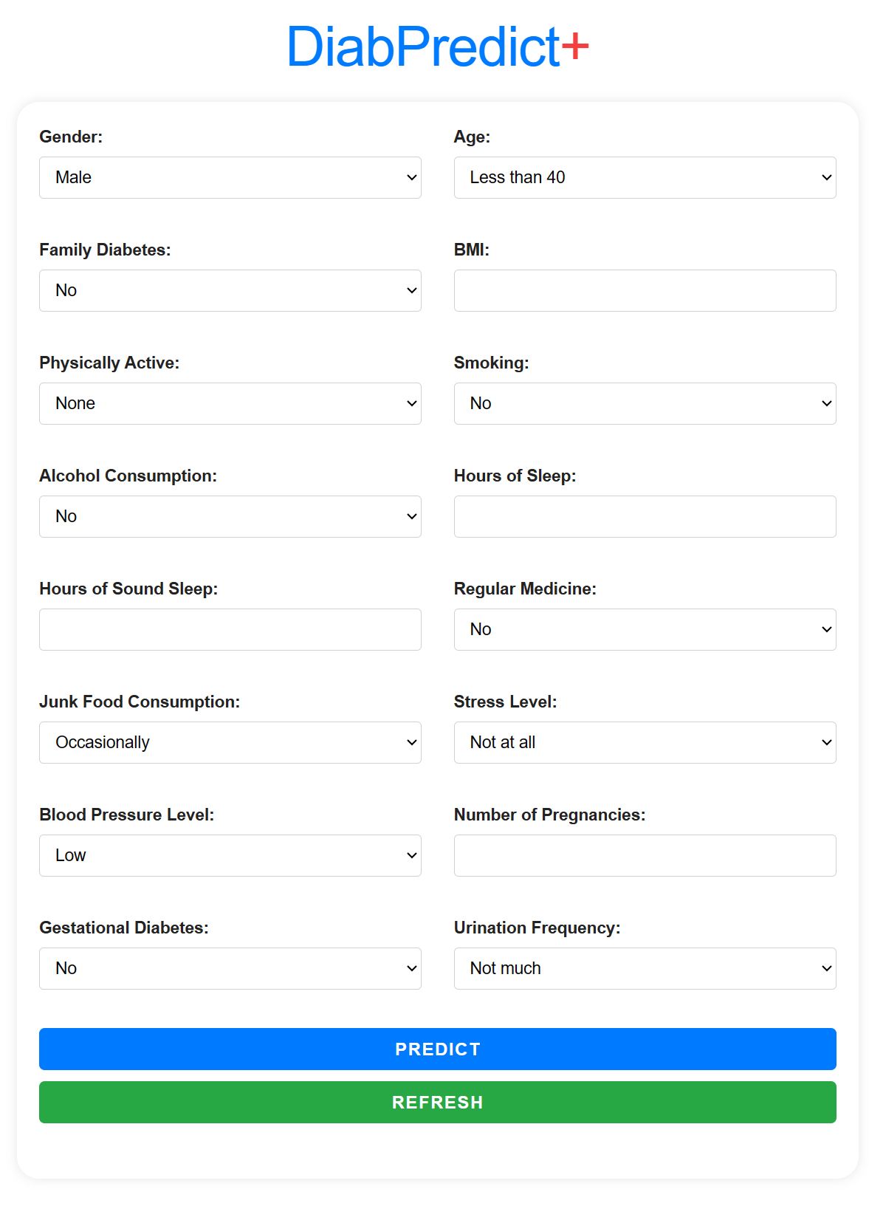
Front-end Visualisation Of Model Performance
DiabPredict+
Web app predicts diabetes risk using machine learning.
With input on age, gender, lifestyle, and medical history, it instantly assesses diabetes status and probability.
Built on Flask and Keras, it offers accurate predictions and promotes health awareness.
Notes:
Developed using Python-Flask, HTML, CSS and JavaScript

Slide 14

Conclusion
Neural Network model shows the highest accuracy in predicting Type 2 Diabetes
Random Forest, Decision Tree, and KNN also exhibit promising results
SVM and Logistic Regression show comparatively lower accuracy and performance metrics
Top 3 features influencing the predictions:
RegularMedicine
Age
BMI
Recommendation:
Accuracy: Neural Network
Balanced approach: Random Forest, Decision Tree, KNN
Neural Network
Random Forest, Decision Tree, KNN
Support Vector Machine
Logistic Regression
Notes:
The Neural Network model demonstrates the highest accuracy and balanced performance in predicting Type 2 diabetes. Random Forest, Decision Tree, and KNN also exhibit promising results, closely following the Neural Network in terms of accuracy and performance metrics. SVM and Logistic Regression show comparatively lower accuracy and performance metrics.
Using Random Forest, it was found that the top 3 features influencing the predictions are RegularMedicine, Age, and BMI.
Hyperparameter tuning by GridSearchCV resulted in significant improvement for SVM and minor improvement for Logistic Regression. However, due to diminishing returns, no visible improvements were observed in Decision Tree, Random Forest, and KNN after tuning.
Based on the results, the Neural Network model is recommended for accurate and reliable diabetes prediction. However, considering computational resources, Random Forest, Decision Tree, and KNN are also viable options as they strike a balance between accuracy and efficiency.

Slide 15



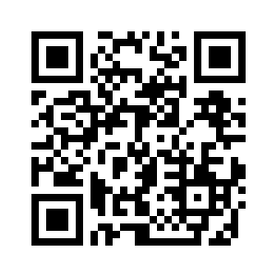
Thank you for your attention

