Slide 1



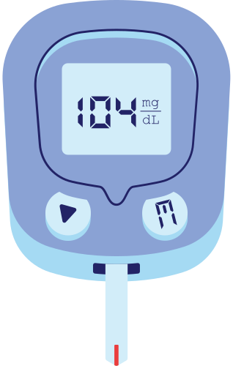

Diabetes Prediction Model
Godswill, Sum, Kehlani & Aysha

Slide 2

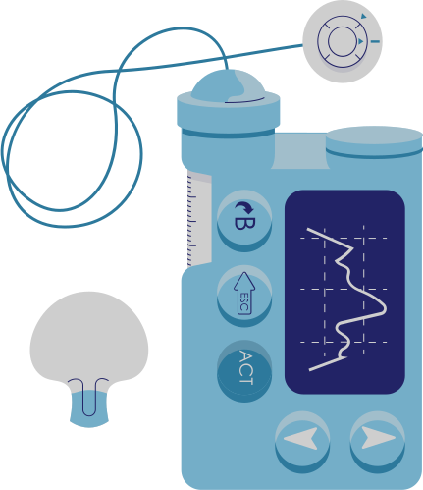
Project Overview
Why Diabetes?
Diabetes is a prevalent chronic disease, affecting millions of individuals and posing significant health risks if not managed effectively. Early detection and intervention are crucial in mitigating its adverse effects.
Our Goal
To develop a predictive model to identify individuals at risk of developing diabetes based on various health indicators.

Slide 3

Data Source
Data Sourcing and Preprocessing
A dataset comprising of relevant health parameters such as BMI, age, blood pressure, family history of diabetes, and lifestyle factors
Preprocessing
Cleaned and preprocessed the collected data to handle missing values, convert categorical data to a binary format and standardise features
Splitting
Defined the target and feature variables and split the data into subsets ready for the training and testing of models

Slide 4

Machine Learning Models
Logistic Regression
Random Forest
Decision Tree
Implemented a random forest classifier to capture non-linear relationships between features
Built a decision tree classifier to understand the decision-making process
Trained a logistic regression model as a baseline model
Support Vector Machine
K-Nearest Neighbors
Neural Networks
Implemented KNN to classify data points based on the majority class of their nearest neighbors
Constructed a neural network with multiple hidden layers using TensorFlow & optimised it using Keras-Tuner
Employed SVM with different kernels to find the best separating hyperplane

Slide 5
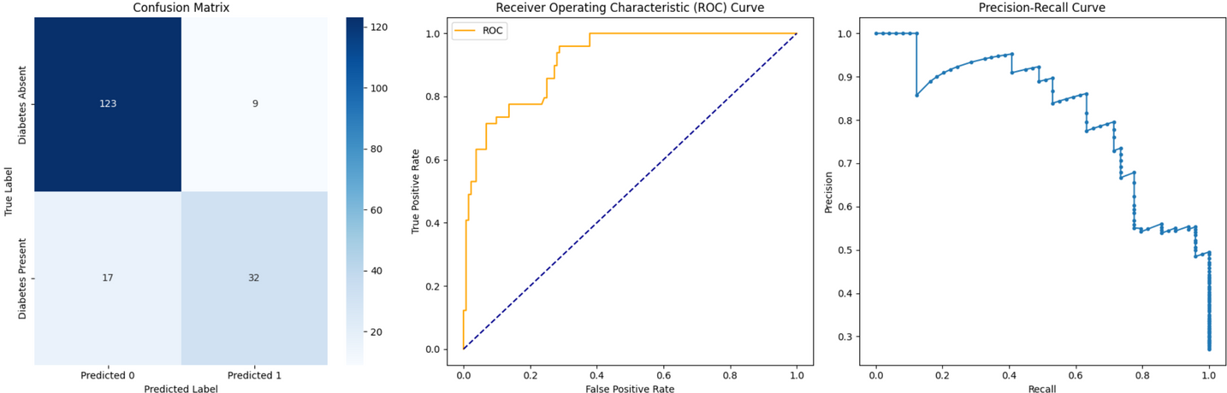
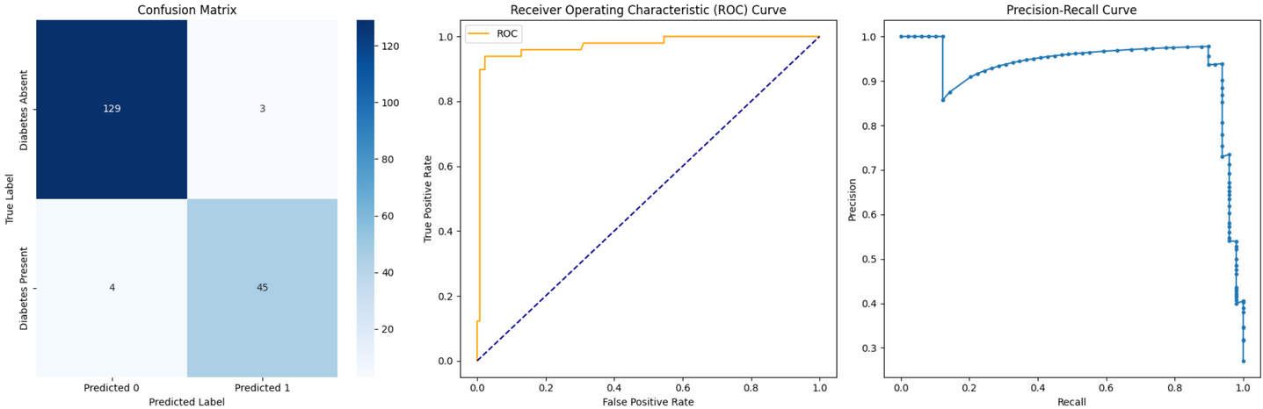

Model Results & Evaluation
Logistic Regression
Random Forest

Slide 6
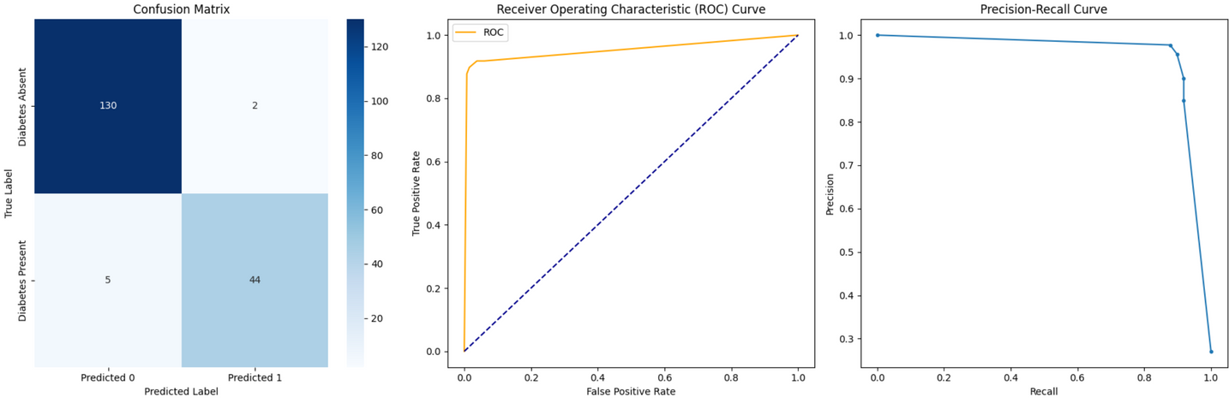
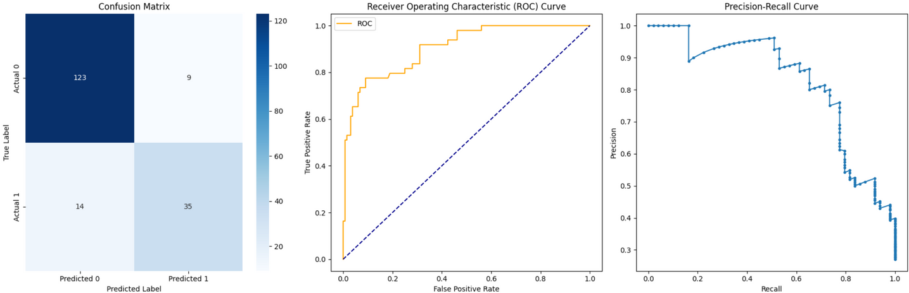
Model Results & Evaluation
Decision Tree
Support Vector Machine

Slide 7

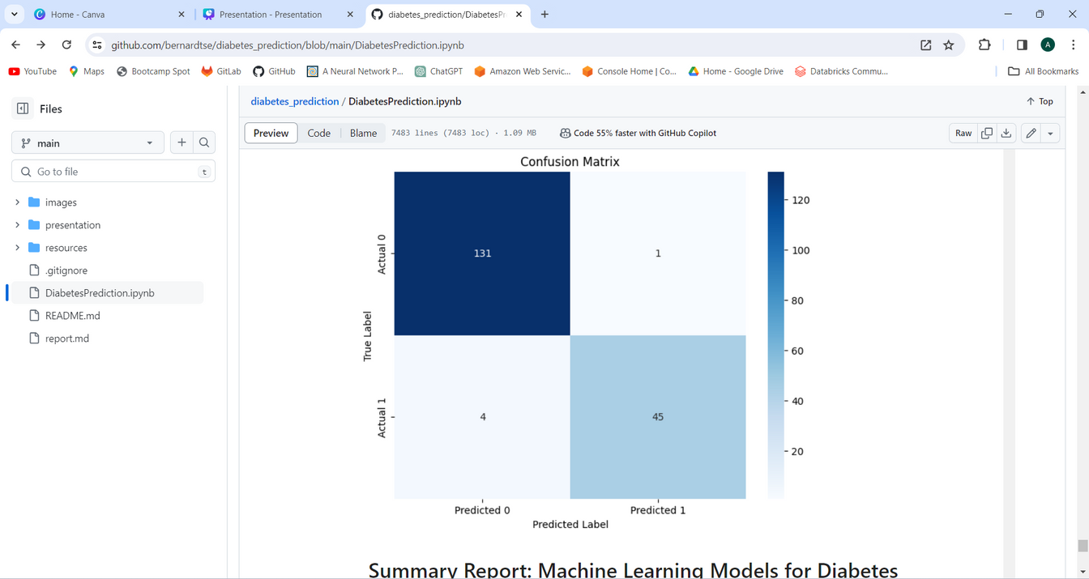
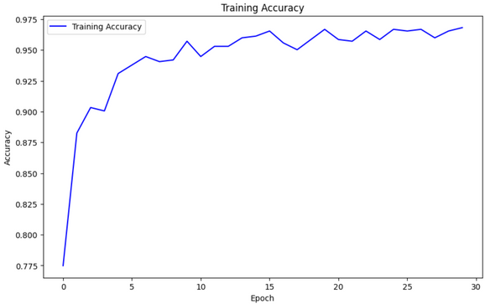
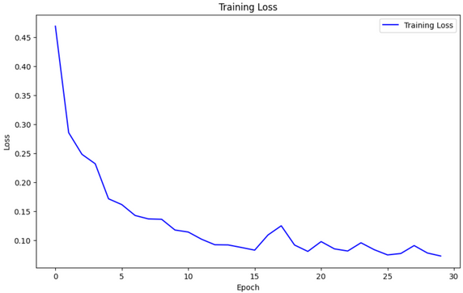
Model Results & Evaluation
K-Nearest Neighbors
Neural Networks

Slide 8

Conclusion
The Neural Network model demonstrates the highest accuracy and balanced performance in predicting both classes.
Decision Tree, Random Forest, and KNN also show promising results, closely following the Neural Network in terms of accuracy and performance metrics.
SVM, and Logistic Regression exhibit lower accuracy and performance metrics compared to the other models.
Based on the results, the Neural Network model is recommended for accurate and reliable diabetes prediction.
Neural Network
Decision Tree, Random Forest, and KNN
Support Vector Machine
Logistic Regression

Slide 9



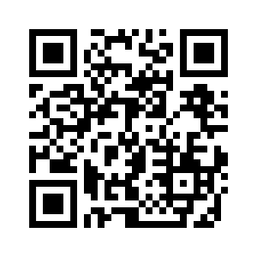
Thank you for your attention

