Slide 1

Data Analytics Portfolio
Aysha Samsudeen
March 2025

Slide 2

About me
Aspiring Data Analyst with over 11 years of experience in Human resources, Recruitment, Negotiations and Strategic Management and HRIS implementation.
B.A in Psychology – University of Missouri Science and Technology, Missouri, USA
Post graduate Diploma in Organisational Psychology – University of Waikato, Hamilton, NewZealand
AIHR certification in People Analytics
Data Analytics – Career Foundry ( Ongoing)
LinkedIn – https://www.linkedin.com/in/shanazsamsudeen/
Email – shanazdeen91@gmail.com

Slide 3





Project Overview
Games Co
US Influenza
Rockbuster Stealth
Instacart
Flavours of Cacao

Slide 4
Project | Game Co | Influenza Season US | Rockbuster Stealth | Instacart | Flavours of Cacao
Industry sector | Gaming | Public Health | Entertainment | E commerce | Chocolate
Relevance | Sales Planning | Medical Planning | Business Intelligence | Marketing strategy | Product Quality
Skills | Descriptive analysis; data grouping, summarising, visualisation. | Data cleaning, integration, transformation; hypothesis testing; visualisation | Querying, filtering, cleaning, summarising, joining tables, subqueries, CTE | Data wrangling, merging, grouping, grouping; deriving variables | Data Cleaning, Preprocessing, Descriptive statistics, Correlation analysis, Distribution analysis (e.g., geographic/regional comparison, and exploratory data visualization.
Tools | Excel, PPT | Excel, Tableau | SQL, Excel | Python, Excel | Excel, Tableau, PPT
Links to related files | Github | Tableau | Github | Github | Tableau, Github

Slide 5


Game Co
Game Co is a new profound video company that uses data to create and develop new video games.
Objective - The main focus of Game Co is to use the market data to review popularity, genre and sales of games across time.
Methods – Descriptive analysis, data grouping, summarising and visualisations.
Data – Encompasses video game sales from 1996 – 2016.

Slide 6
Insights into video game sales
NA sales are dominating the market for video games with EU in second place for games and JP sales to be the lowest. NA sales is 1561.18, EU sales is 901.85, Other sales 322.25 and JP sales 295.35.
Globally, Action games are the most popular, sports in second place with sales for strategy and simulation being the lowest.
We assume that sales for action games to be the highest, highest number of platform usage and sales for other games like puzzle, racing, role playing to be lowest with poor platform usage too.

Slide 7
Visualization 1 showcases the sum sector of sales per region, and we can view that NA sales scored the highest with EU sales in second place. The first critical insight was visualization 2 which was assessing the sum proportion of sales per region based on which genre performs the best. This shows that role playing, and strategy seem to have captured a higher market share.

Slide 8
New INSIGHT
However, if we analyze the top 10 games in the market in terms of genre and platform.
WII sports (Sporting) scoring the highest 82.74 in sales within the top 10 category with only one platform while Grand theft auto (Action) 55.92 in sales under the action category came in second place with 5 platforms being used.
Shooting games, puzzle, role playing also showed promising sales with platform usage.
Super Mario, Pokemon, Call of Duty, Mario Kart showing key interest as emerging games that can generate potential revenue globally.
This challenges Game co’s current understanding that action games generates the highest amount of sales and is the most profitable game.

Slide 9
Recommendations
Consider Multi-Platform Releases: Increase reach by developing games for multiple platforms like Role playing, Shooter and Puzzle.
Explore Classic & Family-Friendly Genres: Develop or enhance games that appeal to broad demographics.
Leverage Popular Franchises: Prioritize investments in emerging and successful franchises.
Plan for Sequels and Expansions: Expand on popular games with sequels, updates, or new content.
Monitor Trends: Regularly review market trends and consumer preferences.
Adjust Strategies Accordingly: Be flexible and adapt strategies based on the latest data and insights.
Engage with Developers and Publishers: Foster collaboration to ensure alignment on platform and genre strategies.

Slide 10

Influenza USA
Influenza death rate poses a challenge to the US healthcare system and evaluates the vulnerable population aged 65+ at risk.
The main objective is to create a staffing plan that takes into consideration challenges relating to influenza deaths in the US.
Focus on providing timely services and targeting treatment plans on time.
Methods – Data cleaning, intergration, tranformation, hypothesis testing and visualisations,
Data – US Census Bureau Data, Population Data and Age distribution
CDC Data set - Influenza deaths by state
CDC Data set: Survey of flu shot rates in children.

Slide 11
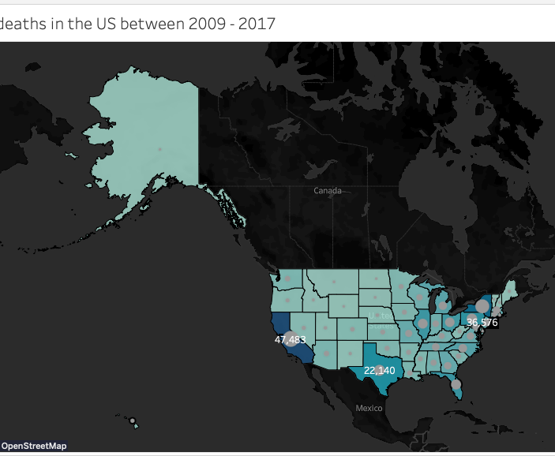
The rise of Influenza
Age is a significant factor contributes to influenza death this is inevitable in the world map attached with 65+ population high death rate.
States with the highest death rates are California, New York and Florida.

Slide 12
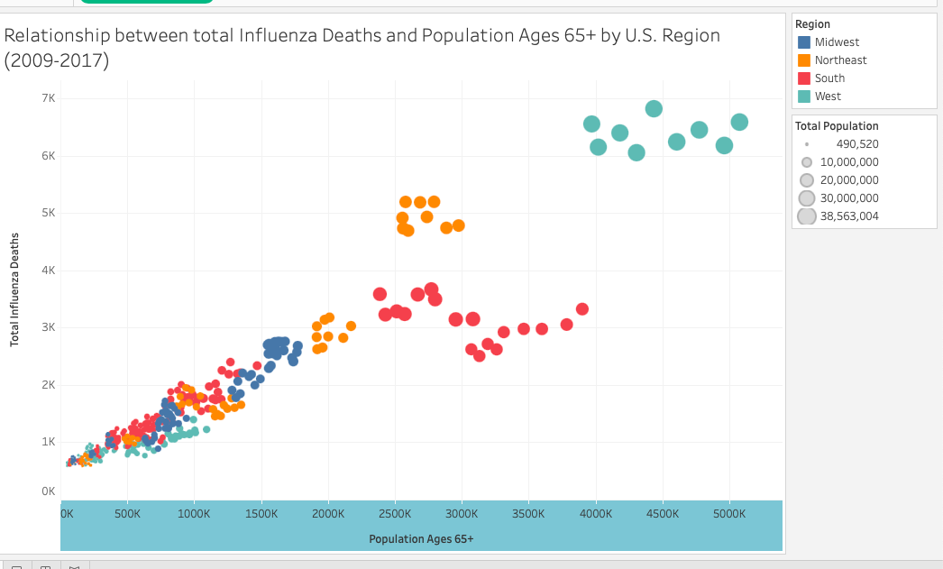
Overview of Influenza Deaths per state
This means that states with higher mortality rates among older adults also tended to report higher overall influenza deaths.
This rise may be influenced by factors such as the emergence of more virulent strains of the virus, increased awareness and reporting, or changes in vaccination rates.
This increases the need for targeted staffing needs for regions with higher rise of influenza.

Slide 13
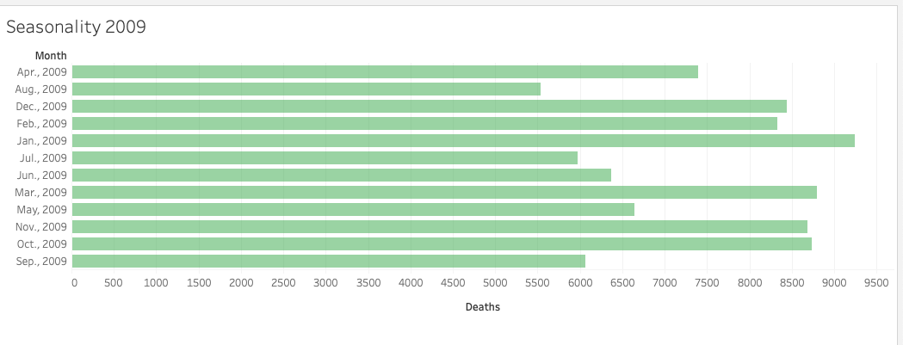
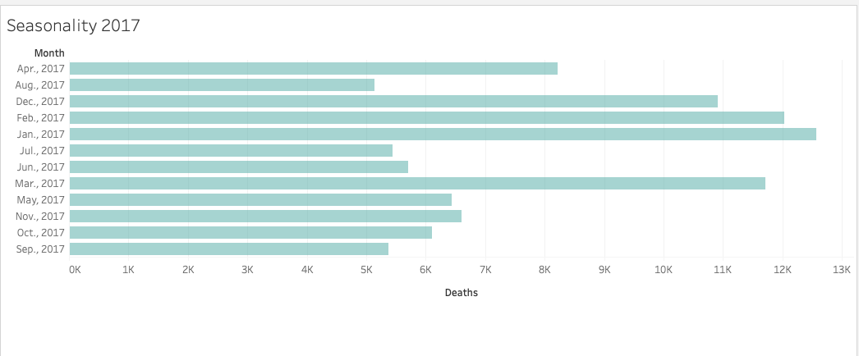
Seasonal changes create a rise in Influenza
Winter highs: Influenza-related deaths consistently spike during the winter months, particularly from January to March. However, 2009, we could view more prevalence of influenza even during the October and November. This could be due to less public sector readiness to fight the infection.
Seasonal Variation: There is a clear seasonal pattern, with deaths rising in winter and declining in summer, reflecting the flu virus's seasonality.
Implications
1. Seasonal readiness:
Vaccination Campaigns: Strong emphasis on influenza vaccination in the fall is essential to prepare for the winter peak.
Public Awareness: Educational initiatives should promote the importance of timely vaccinations.
Healthcare Resource Allocation:
Staffing Needs: Healthcare systems must be adequately staffed and resourced during winter to handle increased influenza cases.
Emergency Plans: Hospitals should have protocols in place to manage patient surges effectively.
Supply Management: Ensuring sufficient stock of antivirals, vaccines, and medical supplies is crucial for peak demand.

Slide 14

Recommendations
Plan for the future and ensure that we have enough supplies to control the spread per month and in the Winter season.
Targeted interventions by state to ensure that the West receives the required staffing allocations and medical supplies in a timely manner.
Taking into consideration that early prevention can save lives in the vulnerable populations. Having regulated awareness campaigns and vaccinations stalls early on before the peak season.

Slide 15

Rockbuster Stealth
Rockbuster Stealth is a fictional movie rental company.
The main objective is to focus on launching a new strategized streaming platform based on rating.
Customer analysis (regions, customer lifetime value)
Utilizing methods;
Querying, filtering, cleaning, summarizing, joining tables, subqueries, CTE
Technologies used: SQL, PostgreSQL
Data - Rockbuster film inventory and customer data

Slide 16
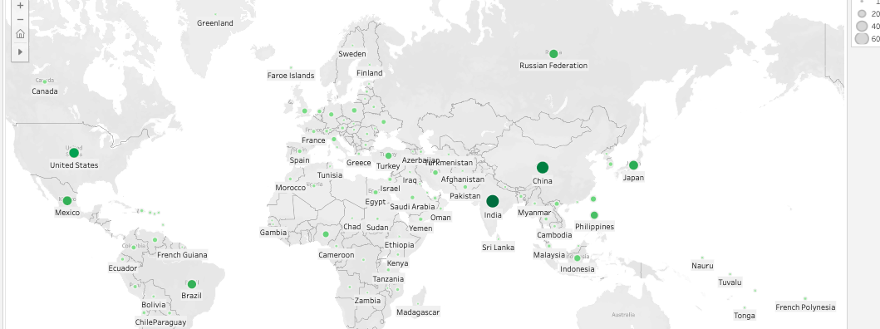
What are the main countries where Rockbuster customers are located? https://public.tableau.com/app/profile/aysha.samsudeen/viz/SQLresult/SQLresult
Top 10 countries with highest customer based : India , China, United states, Japan, Mexico, Brazil, Russian Federation, Philippines, Turkey and Indonesia

Slide 17
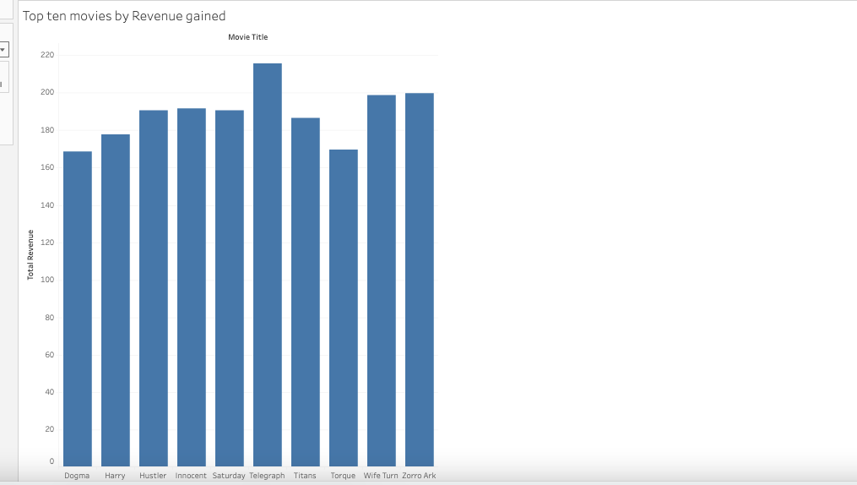
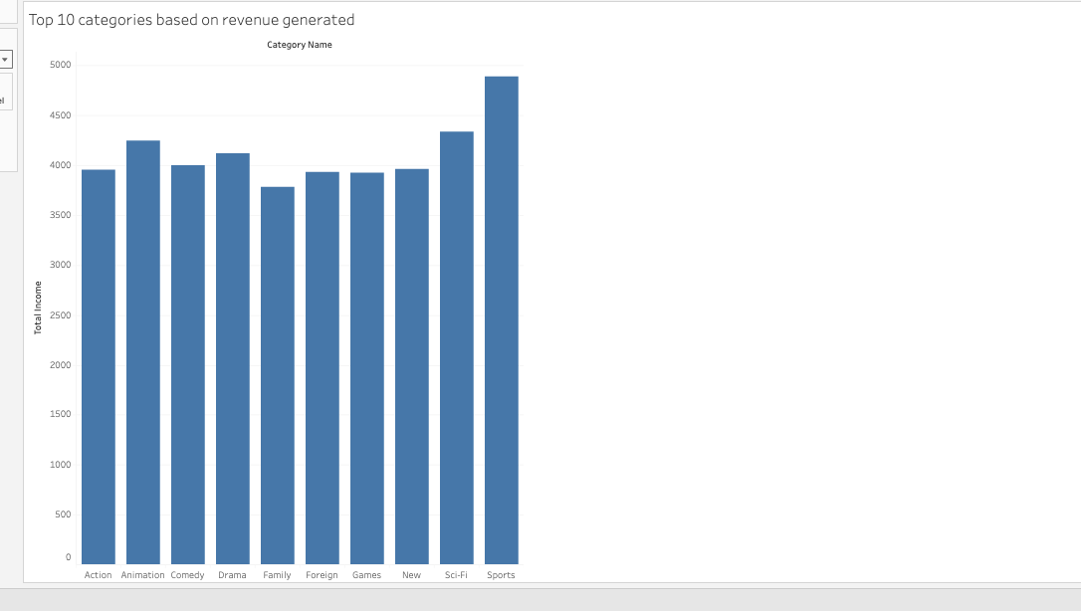
Which movies generated the highest and lowest revenue in the last 5 years?
https://public.tableau.com/app/profile/aysha.samsudeen/viz/Top10movietitle/Sheet1#1
https://public.tableau.com/app/profile/aysha.samsudeen/viz/Top10categoriesbasedonrevenuegenerated/Sheet1#1

Slide 18
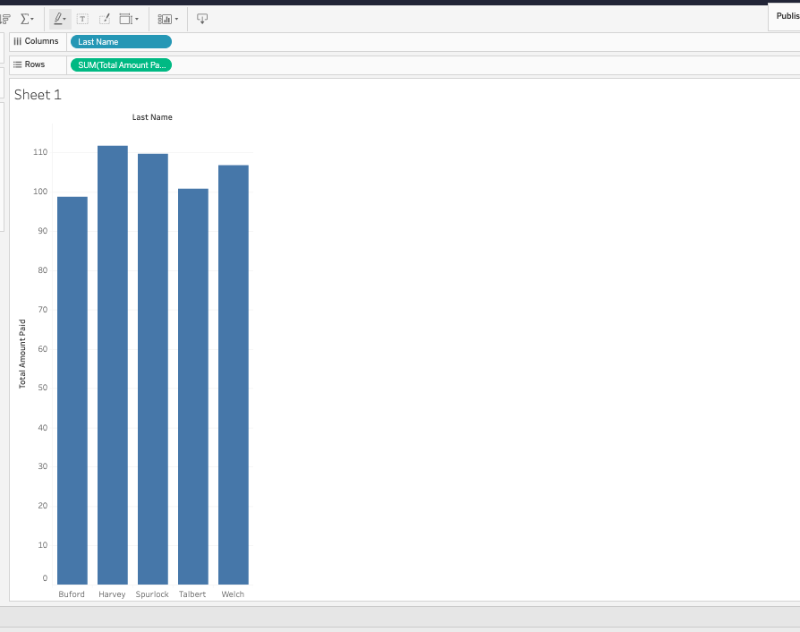
Who are the Top 5 customers with the highest purchasing? HARVEY PURLOCK WELCH TALBERT BUFORD

Slide 19

Recommendations:
Rockbuster Stealth has several categories they need to focus on to generate more revenue like Sports, Sci fi and Animation
Customers can be rewarded in many ways apart from gift vouchers even by sending new product launches.
Focusing on optimising maximum market share in India and China and figure out other market penetration tactics to grow in this part of the world.
Rockbuster overall focus should be to generate and optimise customer interest and venture into potential new markets if market conditions are favourable.

Slide 20

Instacart
Instacart is a real-life online grocery platform operating in the US and Canada.
The main focus is to develop a targeted marketing strategy with a focus on exploratory analysis, customer profiling and customer segmentation.
Methods utilized are Data wrangling, merging, grouping, grouping; deriving variables.
Data – Insta cart data set

Slide 21
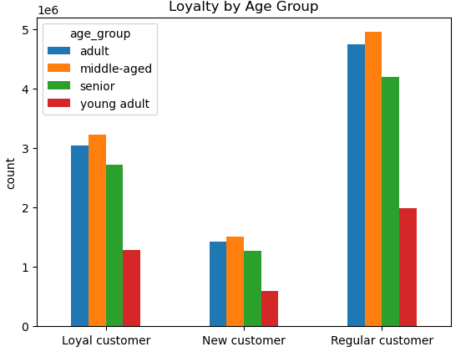
Target Audience for Instacart
Instacart is an online purchasing store, driven by senior, middle aged and adult customers. This group can be made up of below:
Professionals: Time-saving grocery shopping
Tech-Savvy Consumers: Convenient app-based shopping
Parents/Families: Easy grocery shopping from home
Elderly/Disabled: Accessible delivery for those with mobility challenges
Health-Conscious Shoppers: Quick access to healthy food options
Price-Sensitive Shoppers: Deals and discounts on groceries
Urban Dwellers: Convenient service for city living

Slide 22
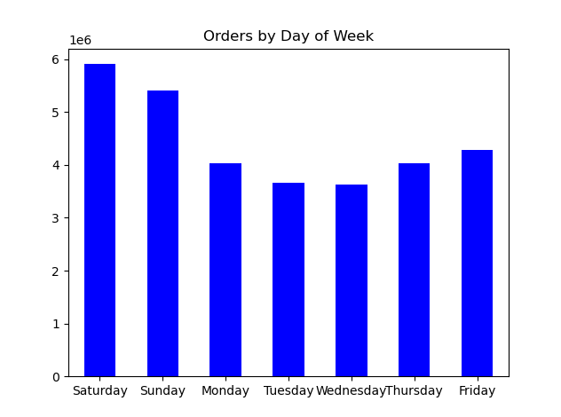
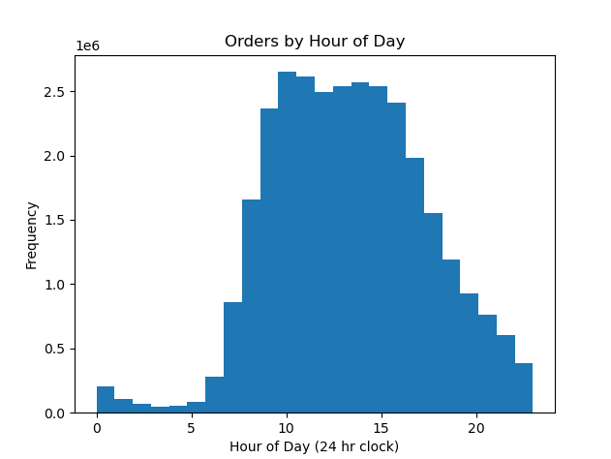
Instacart ordering strategy
The busiest ordering days are weekends (Saturday, Sunday, then Friday), with spending peaking on Friday and dropping after Saturday (bar chart).
Orders mostly occur between 8am to 7pm, aligning with regular store hours. Fewest orders happen before 8am, and orders gradually decline after 8pm (histogram).

Slide 23
Recommendations on Strategy
Target Audience
Focus: Low- and middle-income shoppers (<$200k)
Key Segment: Small families (higher per capita spending despite fewer members)
Mature Adults & Seniors with Small Families
Characteristics: Small family size, higher expenditures
Promotion Focus: Bulk, premium, and family-sized items
Appeal: Convenience, quality, and savings on trusted brands
Timing Strategy
Wed: Early promotions to tease weekend deals, Fri AM: Remind customers about weekend shopping , Fri–Sun: Exclusive weekend deals (8 AM–7 PM) Goal: Maximize engagement and boost orders
Convenience & Savings: Bulk, family-sized bundles and premium products at discounted prices
Personalized Deals: Tailored promotions based on shopping history
Channels: Emails, push notifications, social media, targeted ads
Focus: Highlight family-friendly, value-driven products

Slide 24

Flavours of Cacao
Analyzing factors that influence quality ratings, providing insights for manufacturers and consumers in the premium chocolate market.
Objective of the study is to understand the relationship between cocoa percentage and chocolate quality ratings.
Data Source: Flavours of Cacao dataset containing chocolate ratings, cocoa percentages, and manufacturer origins.
Key Finding: Higher cocoa percentage correlates with lower ratings (statistically significant but explains only 11% of variation.
Data Source - Dataset from Flavours of Cacao Chocolate Database, featuring 2693 chocolate bars with information on cocoa percentage, company location, bean origin, ingredients, and1,795 chocolate bar ratings from expert reviewers.

Slide 25

Data Collection & Preparation
Dataset: 1,795 chocolate bars worldwide
Key Variables:
- Manufacturer
- Bean Origin
- Cocoa Percentage
- Rating (1-5 scale)
Tools Used:
- Python for data cleaning
- Tableau for visualization
- Statistical analysis tools

Slide 26
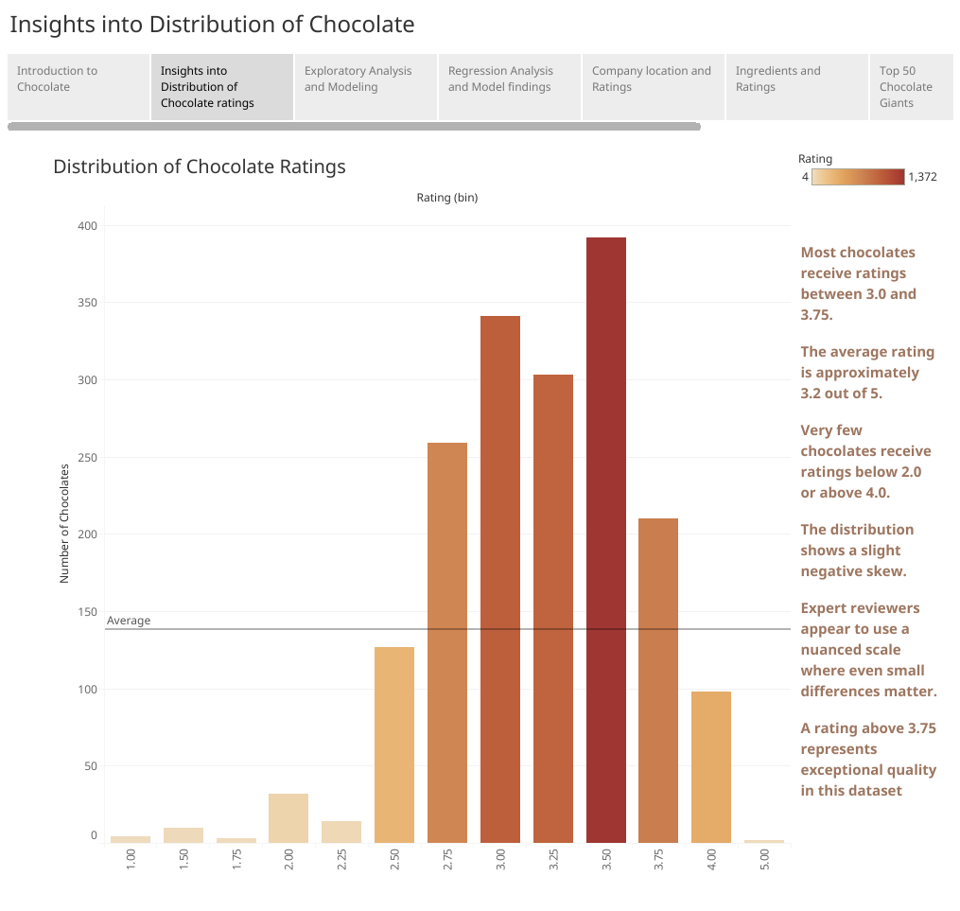
Rating Distribution Analysis

Slide 27
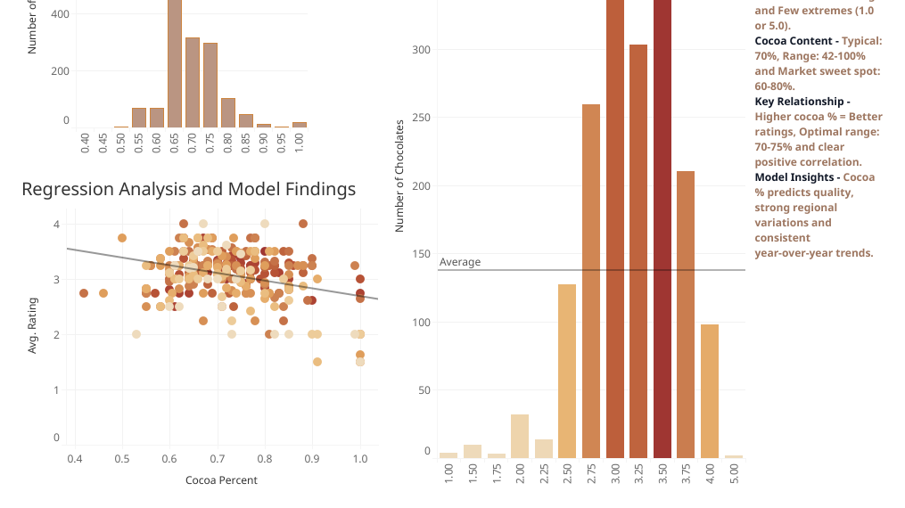

Slide 28
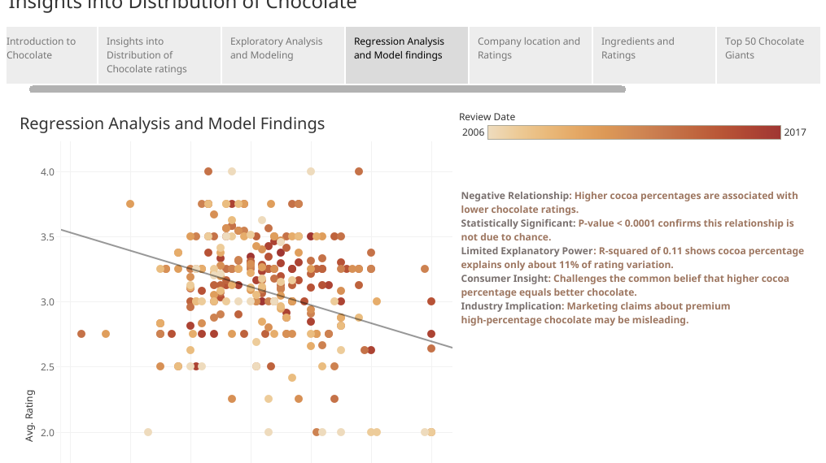

Slide 29
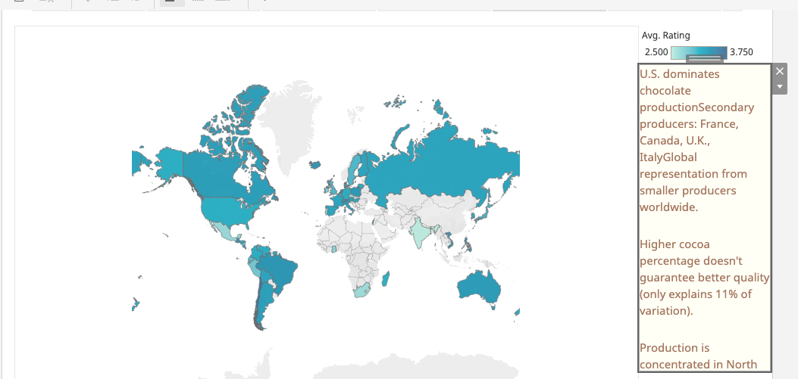
Company and location of Chocolate Distribution

Slide 30

Cocoa Content Impact
The analysis reveals:
60-70% cocoa content has the highest average rating (3.27)
Very high cocoa content (90-100%) has the lowest average rating (2.27)
Most chocolate bars fall in the 60-80% range
Extreme cocoa percentages (both low and high) tend to receive lower ratings
The sweet spot appears to be in the 60-70% range, balancing cocoa intensity with overall taste
This suggests that higher cocoa content doesn't necessarily mean better chocolate, and there's an optimal range for consumer preference.

Slide 31

Key Findings
• Rating Distribution:
- Average rating: 3.19 out of 5
- Most bars fall between 2.9-3.5
• Regional Leaders:
- Venezuela: 214 bars (3.25 avg rating)
- Ecuador: 193 bars (3.20 avg rating)
- Madagascar: Highest rated (3.27 avg)
• Cocoa Content Impact:
- Optimal range: 70-75%
- Premium segment (80%+) shows growth potential

Slide 32

Recommendations
Recommendations for the future:
Expand Variables: Integrate additional factors such as bean origin, processing techniques, and flavor profiles for a more comprehensive analysis.
Increase Sample Diversity: Incorporate data from a broader range of regions and producers to reduce sample bias.
Advanced Modeling: Utilize more sophisticated models (e.g., non-linear or multivariate regression) to capture complex interactions.
Longitudinal Analysis: Conduct studies over time to monitor trends and shifts in consumer preferences and production practices.
Consumer Sensory Panels: Incorporate objective, structured sensory testing alongside subjective ratings.
Qualitative Research: Supplement quantitative analysis with interviews or focus groups to better understand consumer perceptions.
Standardize Rating Methodologies: Establish consistent rating criteria to minimize variability in quality evaluations.
Cross-Market Comparison: Analyze regional differences and emerging markets to discover unique quality determinants.

