Slide 1

G2M insight for Cab Investment firm
Virtual Internship
16-11-2023

Slide 2

Executive Summary
This EDA delves into multiple datasets spanning the period from January 2016 to December 2018, provided by XYZ for investment decision-making in the US Cab Industry. The investigation encompasses four key datasets: Cab_Data, Customer_ID, Transaction_ID, and City. The primary objectives were to understand customer behavior, identify profitable trends, and propose actionable recommendations for investment.

Slide 3

Objective
The purpose of this analysis is to provide actionable insights to XYZ for making an informed decision regarding investment in the Cab Industry. Through a comprehensive investigation of multiple datasets, we aim to identify trends, patterns, and key performance indicators that will guide XYZ's investment strategy.

Slide 4
Approach
1. Data Understanding, Acquisition, and Preparation:
Source Documentation Review:
Thoroughly reviewed the source documentation for each dataset.
Identified field names, data types, and potential relationships.
Data Exploration:
Explored the structure of datasets (Cab_Data, Customer_ID, Transaction_ID, City).
Joining and Appending:
Established relationships across datasets using unique identifiers.
Decided on join versus append operations for creating master data.

Slide 5

CONTD..
2. Profit Calculation:
Profit Feature Creation:
Calculated profit for each transaction, considering Cost of Travel and Price charged.
Ensured accuracy in profit calculation for subsequent analysis.
3. Exploratory Data Analysis (EDA):
Hypothesis Formulation:
Developed 5-7 hypotheses to guide the analysis.
Defined hypotheses related to seasonality, company performance, and customer attributes.
Company Performance Analysis:
Assessed the performance of Yellow Cab and Pink Cab.
Compared customer usage, profitability, and seasonal patterns.

Slide 6
Profitability Metrics:
Explored the relationship between the number of customers and profit margins.
Investigated overall profitability trends and factors influencing profit.
Customer Segmentation:
Analyzed customer segments based on demographics, city, and payment mode.
Tailored marketing strategies for different customer profiles.
Geographical Trends:
Explored city-wise variations in cab usage to inform regional strategies.

Slide 7
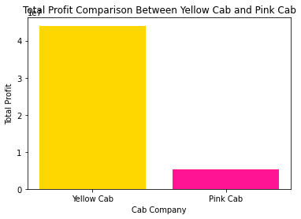
EXPLORATORY DATA ANALYSIS
Profit Comparison
As we see the profit for Yellow cab is much more than the Pink Cab under all conditions.Now Lets see the most preferred cab company by the users

Slide 8
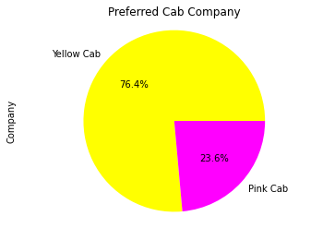
Preferred cab company
The analysis reveals a significant customer preference, with 76.4% of users favoring Yellow Cab and 23.6% preferring Pink Cab. This customer interest is a crucial factor in evaluating the performance of each cab company.
Yellow Cab's popularity suggests a higher level of trust among customers, potentially attributed to superior service, reliability, or brand recognition.Considering the overwhelming customer interest in Yellow Cab, there is a strong indication that strategic investments in this segment could yield substantial returns.

Slide 9
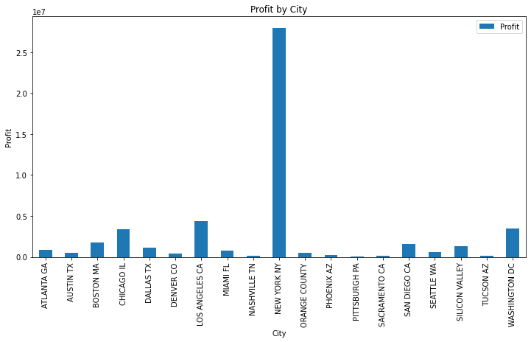
City with high profit from cab industry
Analysis reveals New York City as a profit leader, indicating strong market potential. Considering the focus of resources and expansion efforts in NYC for optimal returns and a competitive edge should be advantageous.
Investing in the New York City market offers a strategic advantage, leveraging the city's profit leadership for optimal returns and sustainable growth. The outlined recommendations aim to guide the company towards a robust and successful investment strategy in the competitive US cab industry.

Slide 10
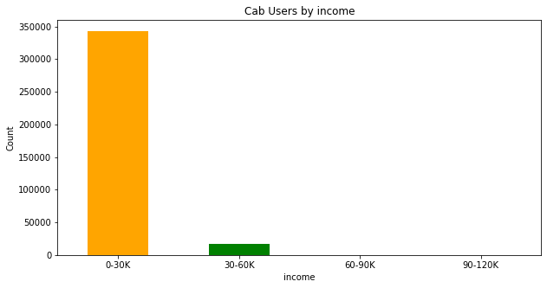
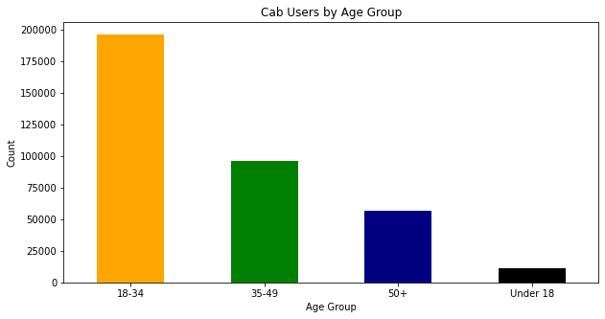
Cab Users by income and age group

Slide 11
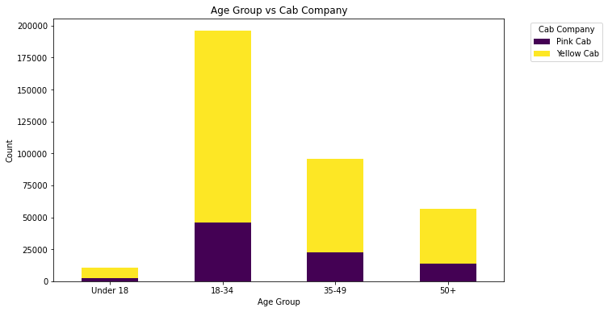

Slide 12
Contd..
The data highlights a trend where individuals aged 18-24 with an income between 0-30k are the primary users of cab services. Recognizing this pattern, focusing marketing efforts and services tailored to the preferences of this demographic can lead to increased customer satisfaction and retention.
The identified demographic trend presents a valuable opportunity for strategic investment. By aligning marketing efforts and services with the preferences of individuals aged 18-24 with lower income, the company can enhance customer satisfaction, drive usage, and establish a strong foothold in a key market segment.

Slide 13
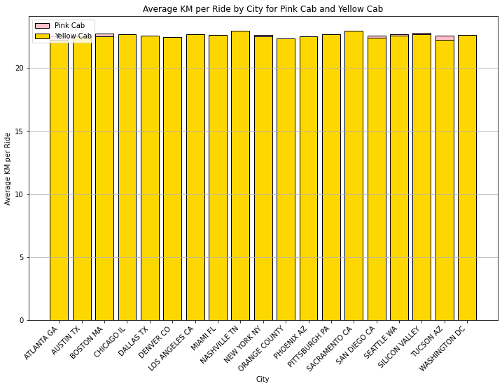
Average km ride by city
The average kilometers per ride in different cities indicate that Yellow Cab consistently has a higher value compared to Pink Cab.
The observed difference in average kilometers per ride between Yellow Cab and Pink Cab serves as a crucial indicator for operational efficiency. Strategic decisions should be guided by leveraging this efficiency, optimizing costs, and enhancing the overall market position of the cab services.

Slide 14
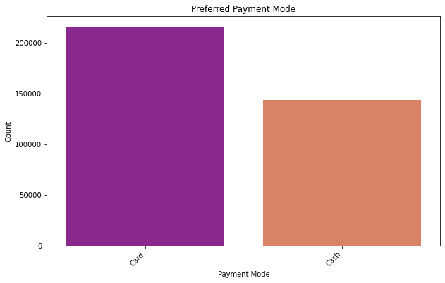
Preferred payment mode
The prevalence of card transactions among cab users presents an opportunity for cab companies to align their services with modern payment preferences. By investing in digital payment infrastructure and promoting the associated benefits, companies can enhance customer satisfaction, operational efficiency, and overall market competitiveness.

Slide 15

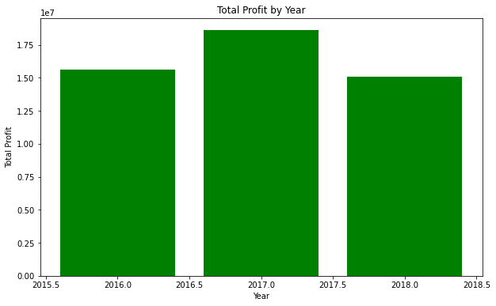
Total Profit from both cabs for all years
The notable profit boost in 2017 signals a positive trend, suggesting great opportunities for smart investments and improvements in how we operate. By digging into what drove this success, we can make informed decisions to keep growing and lead the market.

Slide 16
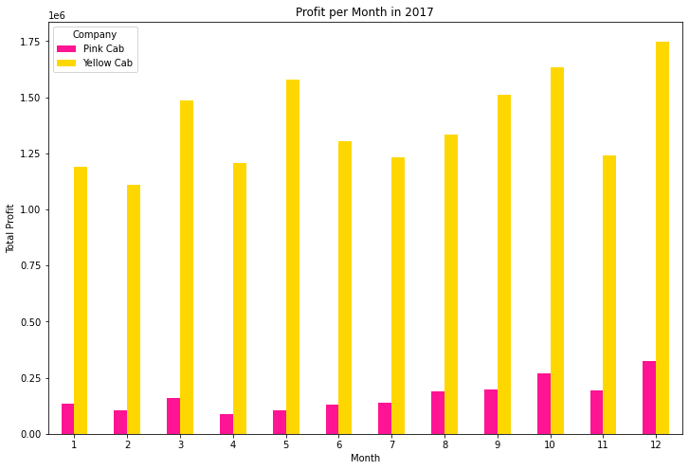
2017

Slide 17
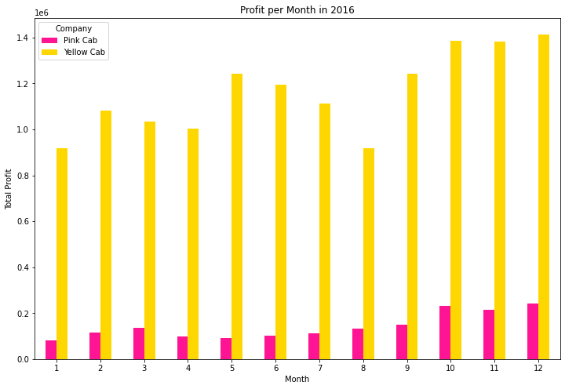

2016

Slide 18
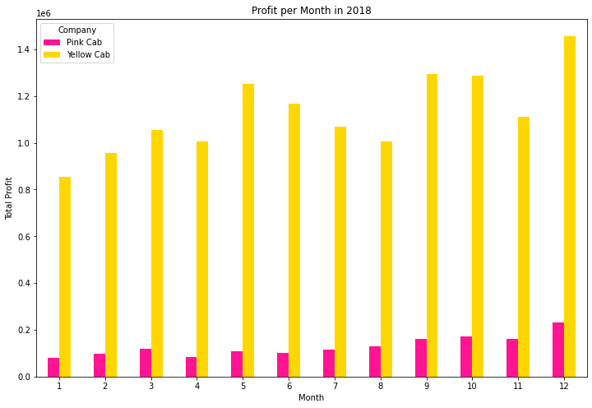
2018
The profitability analysis over three years highlights a significant increase, particularly in the year 2017. Further examination reveals a substantial spike in profits during the month of December, particularly attributable to Yellow Cab. This suggests a potential pattern of heightened profitability during specific time frames, providing an opportunity for strategic planning and targeted marketing efforts during peak months.

Slide 19

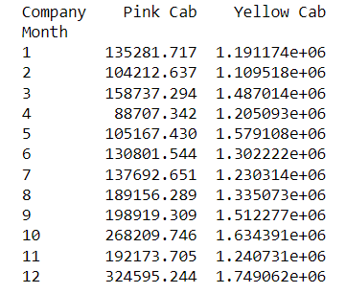
Over the three-year analysis, profits notably surged in 2017, with December being a standout month, driven by Yellow Cab. Recognizing this trend suggests strategic investments can focus on maximizing returns during peak periods, especially in December. Tailoring marketing efforts to align with these high-profit windows can enhance overall profitability.

Slide 20
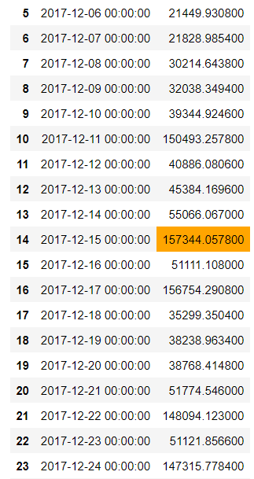
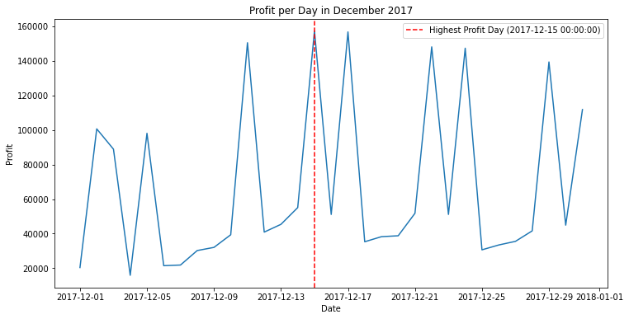
Profit per day in December

Slide 21
Identifying December 15th as the day with the highest profit unveils a specific peak within the peak month. For optimal results, targeted marketing campaigns, promotions, or service enhancements could be concentrated around this date to leverage the heightened customer activity and capitalize on the maximum profit potential.

Slide 22
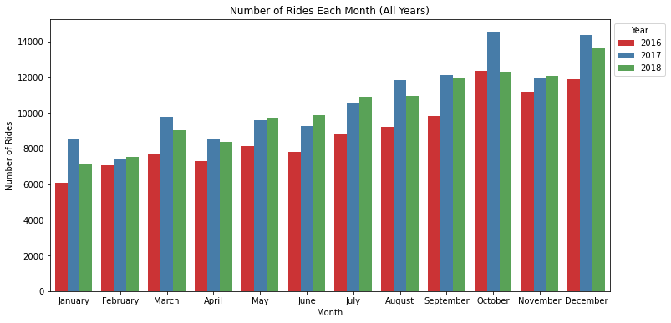
Number of rides each month
Seeing a rise in ride numbers in October is an opportunity. If there are specific events causing this, we can use smart promotions and manage our fleet better during those times. This ensures happier customers and helps us meet increased demand, potentially boosting revenue and market position. Understanding customer behavior in October guides smart investment choices and improves how we run our operations.

Slide 23
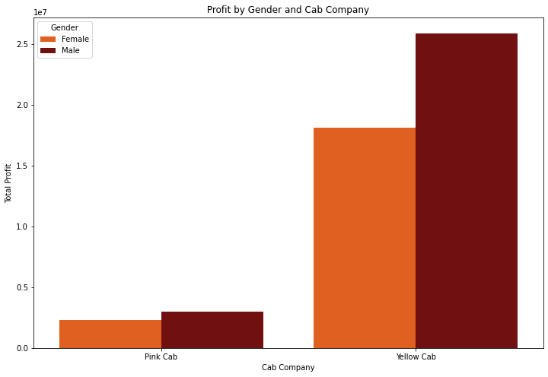
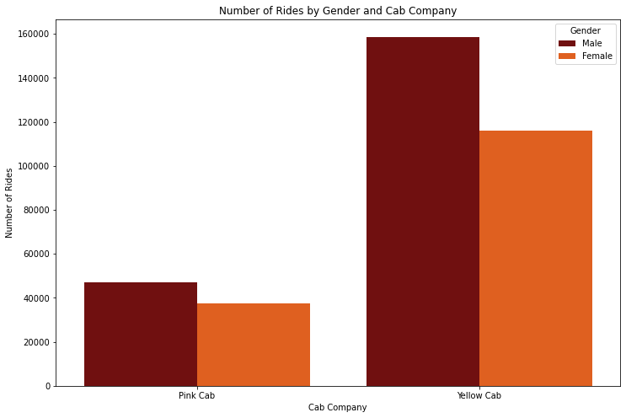
Number of rides and profit by gender

Slide 24
We observe a distinct trend in user demographics, with more male cab users compared to females. Importantly, the profit generated from male users outpaces that from females. This underscores the importance of customizing services and marketing strategies to align with the predominant user demographic, offering a pathway to potentially enhance overall profitability.

Slide 25
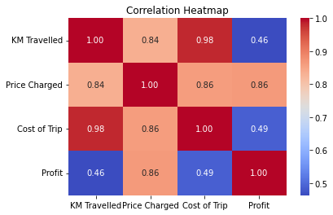
Correlation Heatmap
KM Travelled and Price Charged (0.84): There is a strong positive correlation (0.84) between the distance traveled (KM Travelled) and the charged price (Price Charged). This indicates that longer distances tend to result in higher charges.
KM Travelled and Cost of Trip (0.98): There is a very strong positive correlation (0.98) between the distance traveled (KM Travelled) and the cost of the trip (Cost of Trip). This suggests that as the distance increases, the cost of the trip also increases significantly.
KM Travelled and Profit (0.46): There is a moderate positive correlation (0.46) between the distance traveled (KM Travelled) and the profit. This indicates that longer distances contribute to higher profits, but the relationship is not as strong as with the cost or price.

Slide 26
Price Charged and Cost of Trip (0.86): There is a strong positive correlation (0.86) between the charged price (Price Charged) and the cost of the trip (Cost of Trip). This suggests that as the price charged increases, the cost of the trip also tends to increase.
Price Charged and Profit (0.86): There is a strong positive correlation (0.86) between the charged price (Price Charged) and the profit. This indicates that higher charged prices contribute significantly to higher profits.
Cost of Trip and Profit (0.49): There is a moderate positive correlation (0.49) between the cost of the trip (Cost of Trip) and the profit. This suggests that higher costs are associated with higher profits, but the relationship is not as strong as with the charged price.

Slide 27
Thank You

