Slide 1
Mehrallyeva Aytac

Slide 2
Searching algorithms
Searching algorithms are fundamental algorithms used to locate specific items within a collection of items, such as an array, list, or database. There are several popular searching algorithms, each with its own advantages and use cases. Here’s a brief overview of some common searching algorithms:

Slide 3
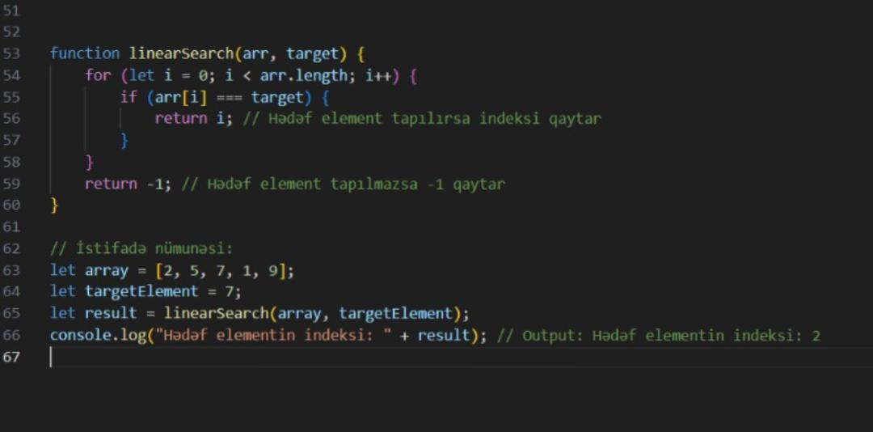
Linear Search
Linear search is the simplest search algorithm and is also known as sequential search. In this method, the algorithm sequentially checks each element of the list until a match is found or the whole list has been searched. Linear search has a time complexity of O(n), where n is the number of elements in the list.

Slide 4
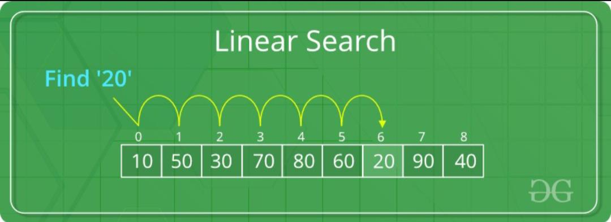
Algorithm
Start from the first element of the list. Compare the target element with the current element. If the target element matches the current element, the search is successful. If the target element is not found, move to the next element and repeat steps 2-3. If the end of the list is reached without finding the target element, the search is unsuccessful.

Slide 5
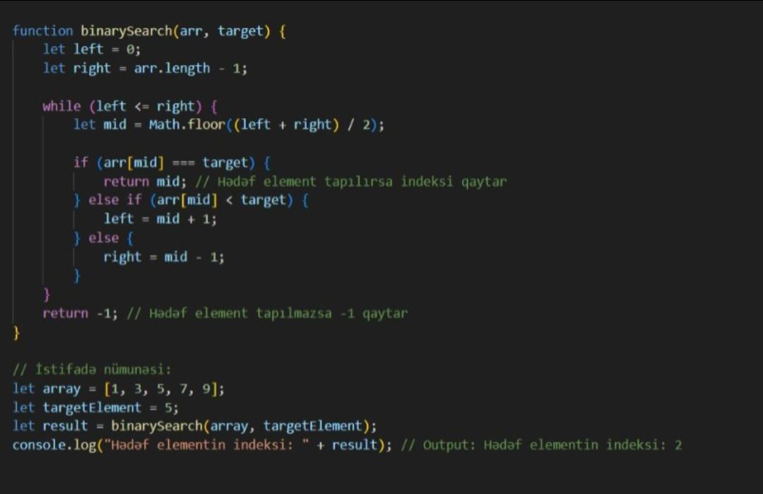
Binary search
Binary search is a more efficient search algorithm for sorted lists. It works by repeatedly dividing the portion of the list that could contain the target element in half. Binary search has a time complexity of O(log n), making it much faster than linear search for large datasets.

Slide 6
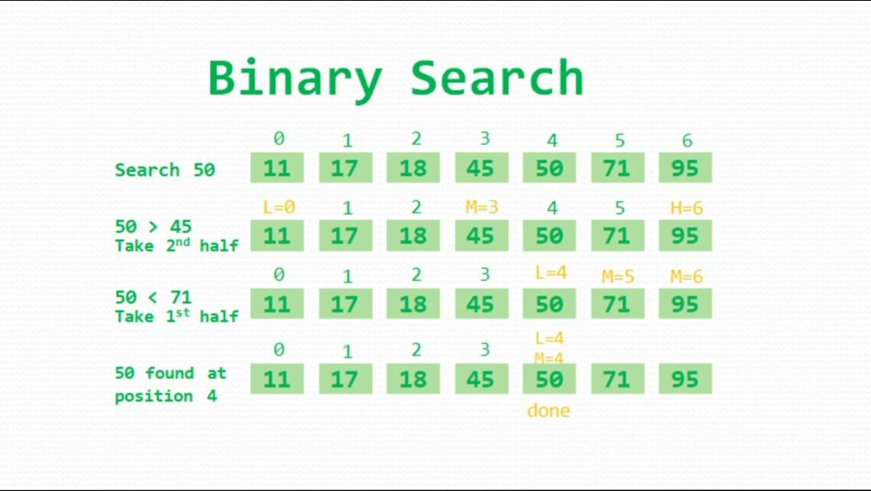
Algorithm
Compare the target element with the middle element of the list. If the target element matches the middle element, the search is successful. If the target element is less than the middle element, repeat the search on the left half of the list. If the target element is greater than the middle element, repeat the search on the right half of the list. Continue dividing the list and narrowing down the search range until the target element is found or the search range becomes empty.

Slide 7
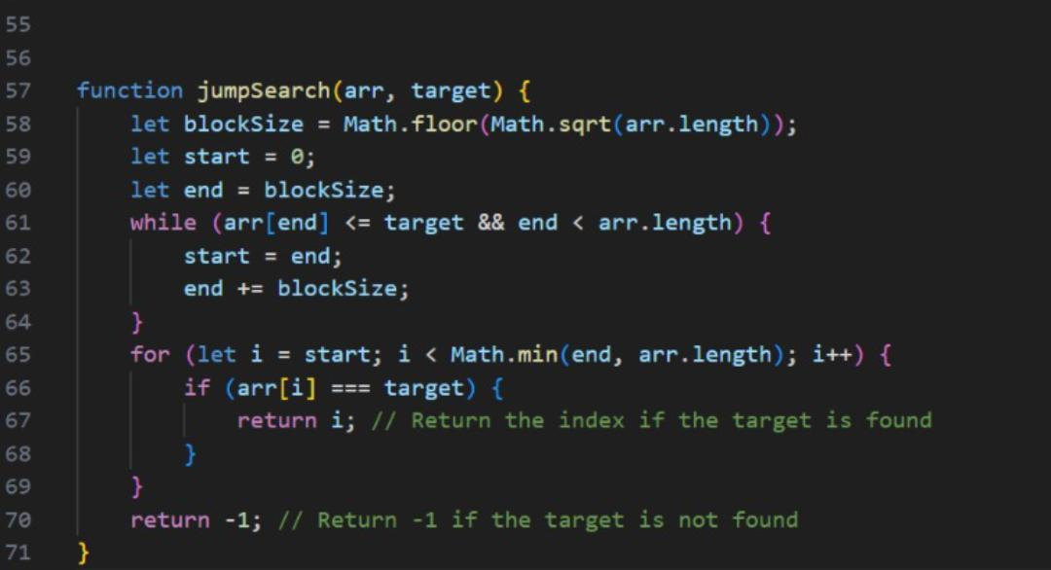
Jump Search
Jump search is an algorithm that works on sorted arrays. It divides the array into blocks and performs a linear search in each block. Jump search has a time complexity of O(√n), which is more efficient than linear search but slower than binary search.

Slide 8
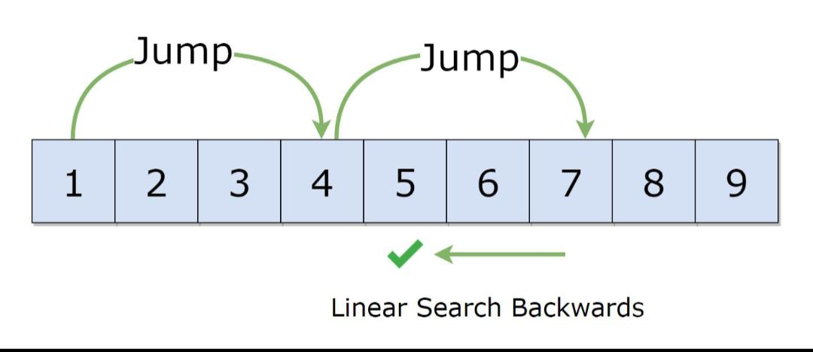
Algorithm
Determine the block size (usually √n, where n is the number of elements in the array). Jump through the array by block size until finding a block where the target element could be located. Perform a linear search within the identified block to find the target element. If the target element is found, the search is successful. If the end of the array is reached without finding the target element, the search is unsuccessful.

