Slide 1
Mehralıyeva Aytac

Slide 2
Sorting Algorithms
Sorting algorithms are fundamental algorithms used to arrange elements in a specific order, usually ascending or descending. There are various sorting algorithms, each with its own advantages, disadvantages, and use cases. Here are some commonly used sorting algorithms:

Slide 3
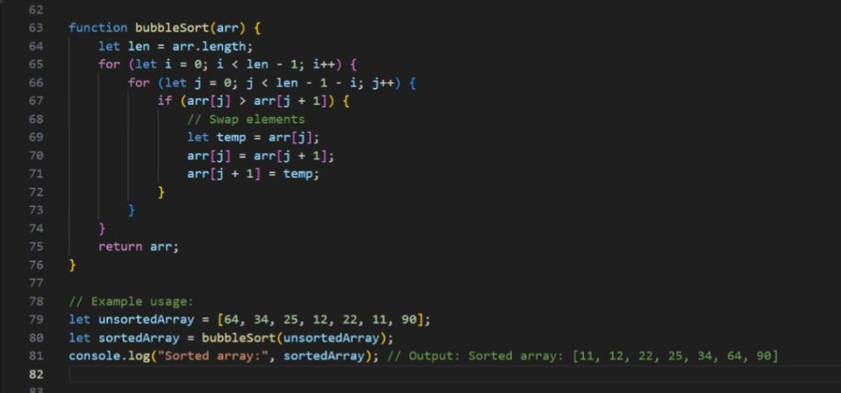
Bubble Sorting
Bubble sort is a simple sorting algorithm that repeatedly steps through the list of elements to be sorted, compares each pair of adjacent items, and swaps them if they are in the wrong order. The pass through the list is repeated until the list is sorted. It is called «bubble sort» because smaller elements gradually «bubble» to the top of the list.

Slide 4
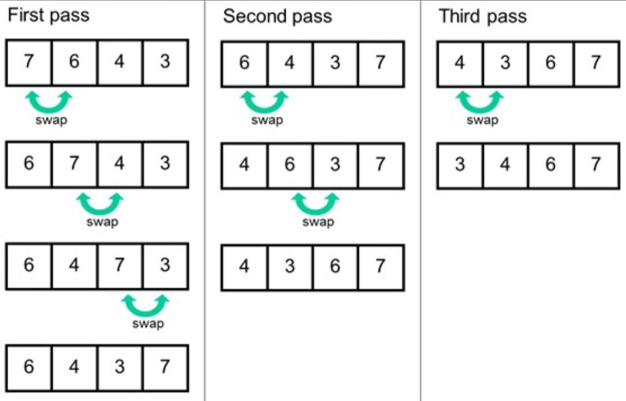
Algorithm
Start from the beginning of the list. Compare the first two elements. If the first element is greater than the second element, swap them. Move to the next pair of elements, and compare them in the same way. Continue this process for each pair of adjacent elements in the list, moving from the beginning to the end. After the first pass, the largest element will be in its correct position at the end of the list. Repeat steps 1-5 for the remaining elements in the list, excluding the last sorted element after each pass. The algorithm is complete when there are no more unsorted elements in the list.

Slide 5
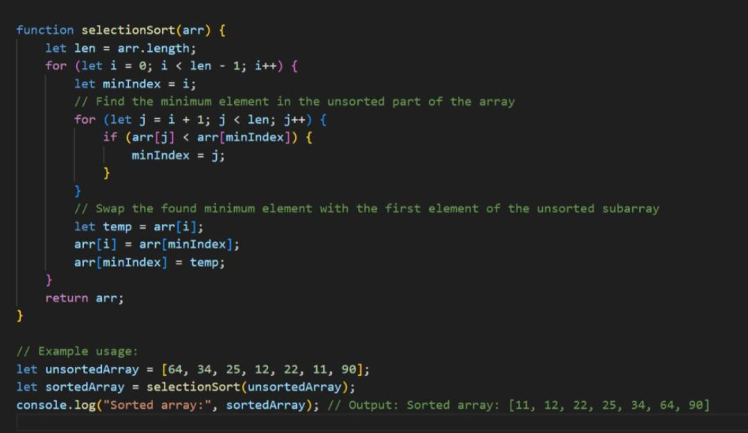
Selection Sorts
Selection sort is a simple sorting algorithm that works by repeatedly finding the minimum element from the unsorted part of the array and putting it at the beginning. The algorithm maintains two subarrays: a sorted subarray, which is built up from left to right, and an unsorted subarray to the right of the sorted subarray.

Slide 6
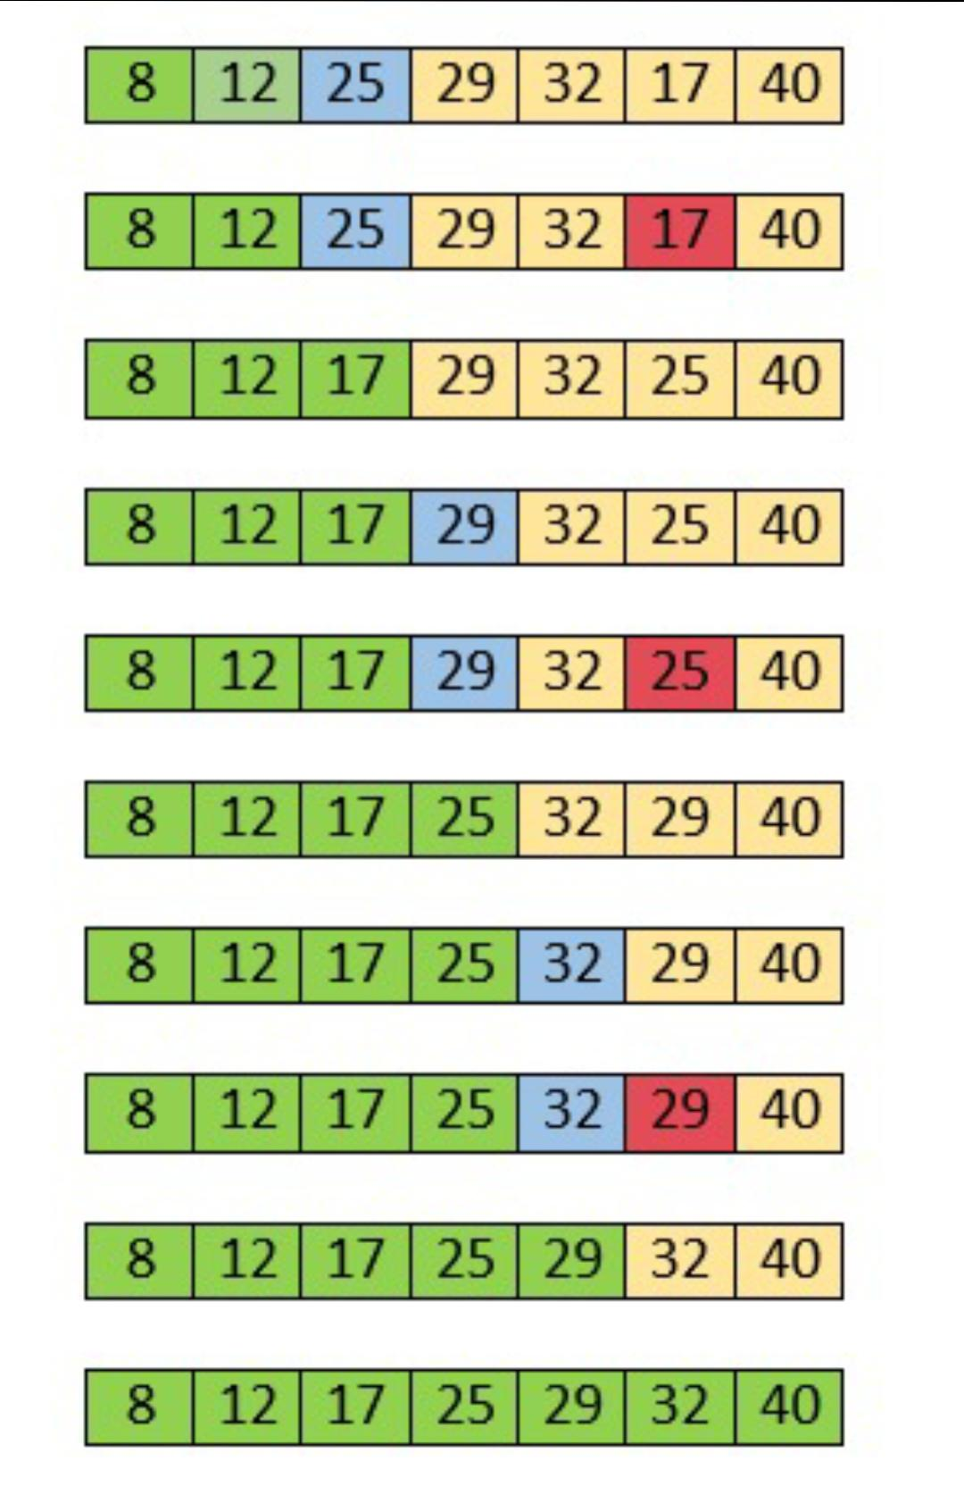
Algorithm
Find the minimum element: Iterate through the unsorted part of the array to find the minimum element. Swap with the first element: Swap the found minimum element with the first element of the unsorted subarray. Move the boundary: Move the boundary between the sorted and unsorted subarrays one element to the right.

Slide 7
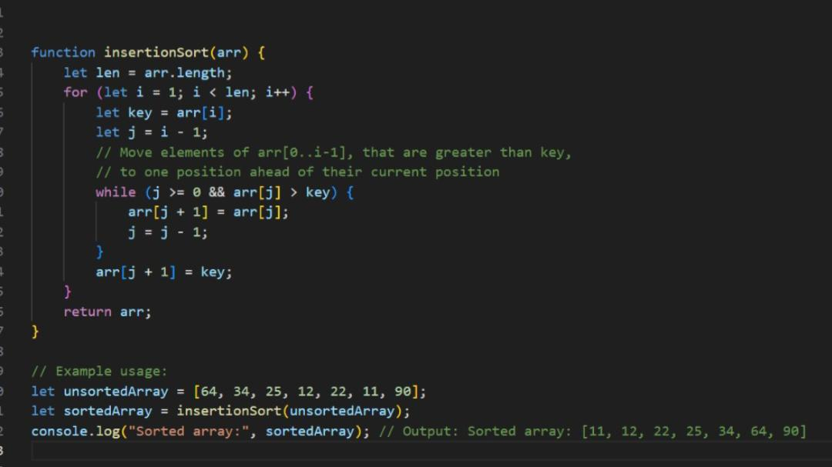
İnsertion Sorts
Insertion sort is a simple sorting algorithm that builds the final sorted array one item at a time. It is much less efficient on large lists than more advanced algorithms such as quicksort, heapsort, or merge sort. However, it has several advantages, including simplicity and adaptability. Insertion sort works by iteratively expanding the sorted portion of the array, one element at a time, and inserting the next element into its correct position within the sorted part of the array.

Slide 8
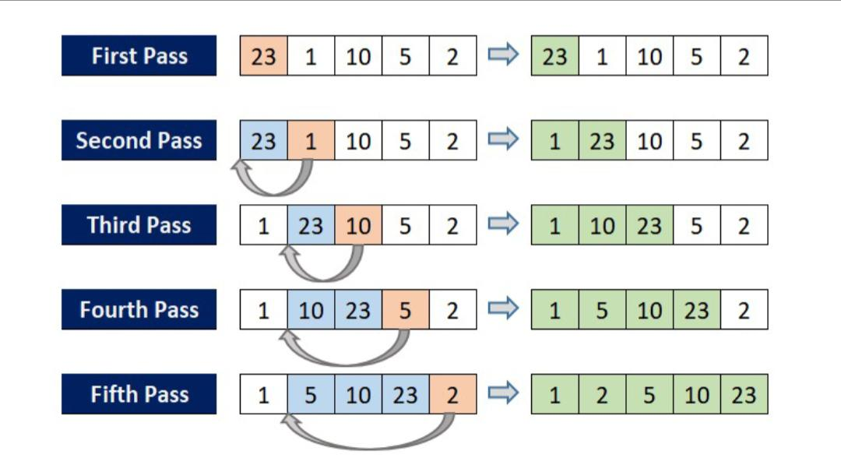
Algorithm
Start from the second element: Assume the first element is already sorted. Compare the current element with the sorted portion: Iterate through the sorted part of the array to find the correct position of the current element. Shift elements to make space: Move all the larger elements to the right to make space for the current element. Insert the current element: Place the current element in its correct position within the sorted part of the array. Repeat for the next element: Move to the next element and repeat steps 2-4 until the entire array is sorted.

Slide 9
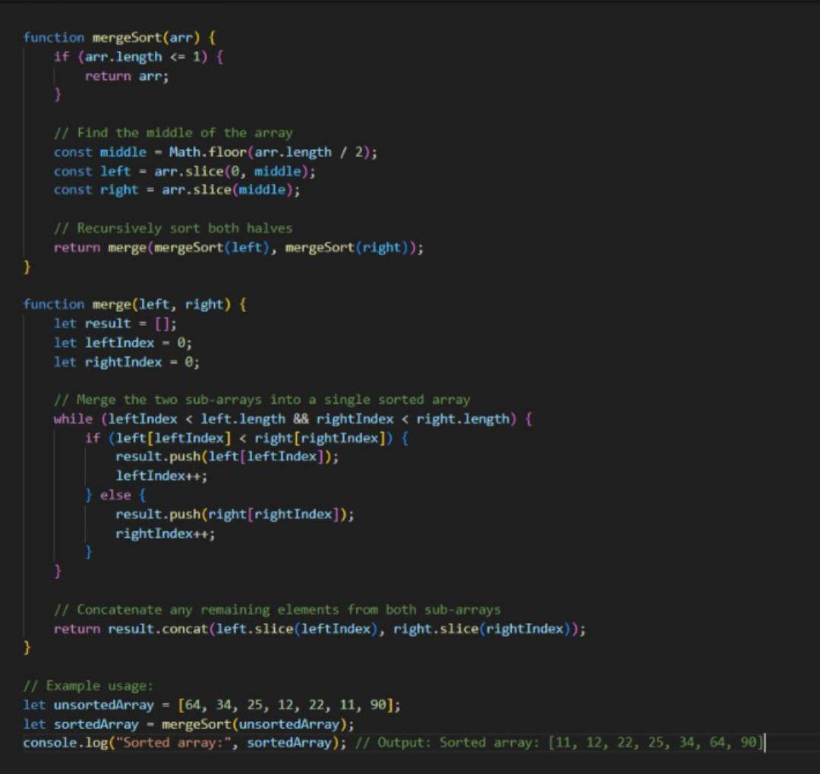
Merge Sorts
Merge sort is a divide and conquer sorting algorithm that divides an unsorted list into N sub-lists, each containing one element, and then repeatedly merges sub-lists to produce new sorted sub-lists until there is only one sub-list remaining. The merging process combines two or more sorted lists into a new sorted list.

Slide 10
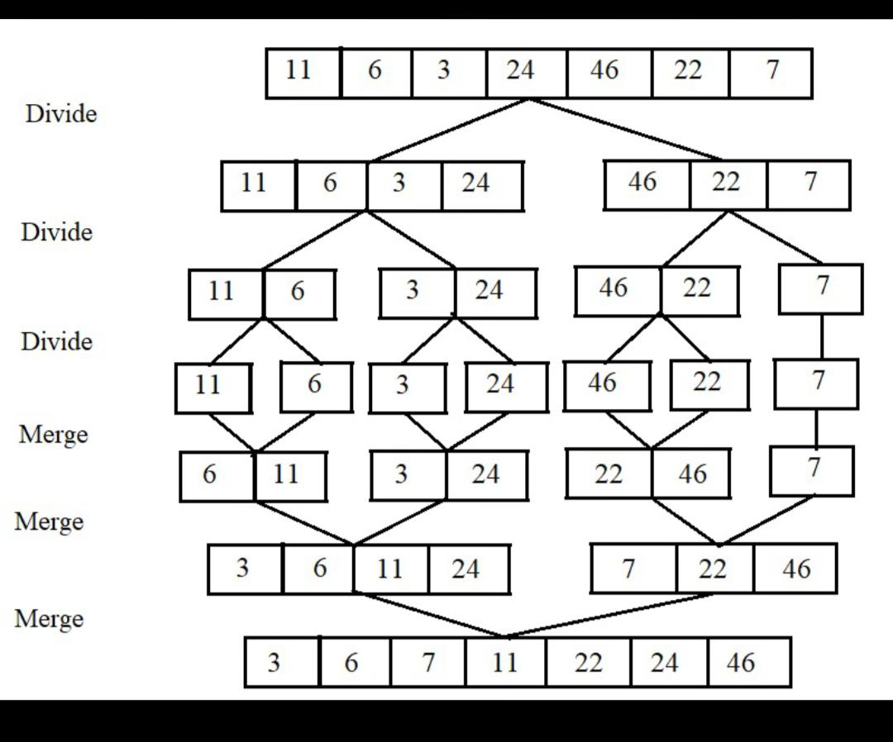
Algorithm
Divide: Split the unsorted list into N sub-lists, each containing one element. Conquer: Recursively sort each sub-list. Merge: Merge the sorted sub-lists back together to create a new sorted list.

