Slide 1
AIS Management Case Study
Frank Dönselmann
Aytekin Yenilmez

Slide 2
Agenda
What has been done for Completeness Check ?
Comments on Completeness
What has been done for EP Numbers ?
Comments on EP Number Filling
Future

Slide 3
What has been done for Completeness Check ?
Example Object Equipment and Customer Data Equipment Comparison
Domain Research and Implementation

Slide 4
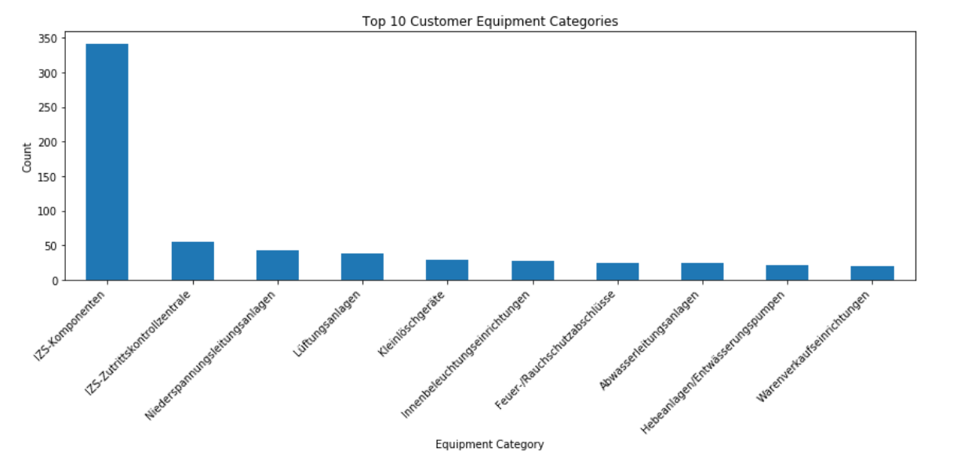
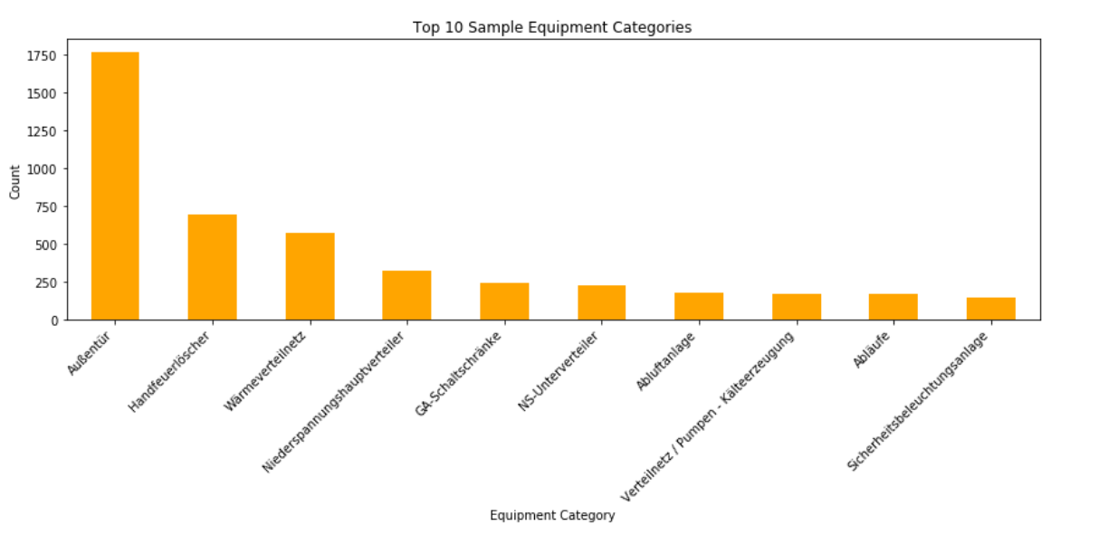
Comparison – Top 10 Equipments
Must Have: Some kind of Smart Matching

Slide 5
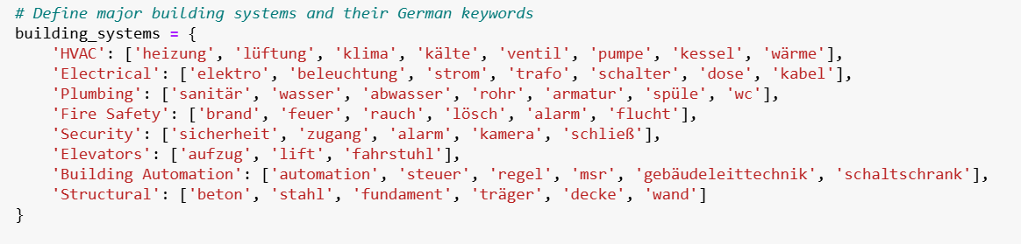
Keywords

Slide 6
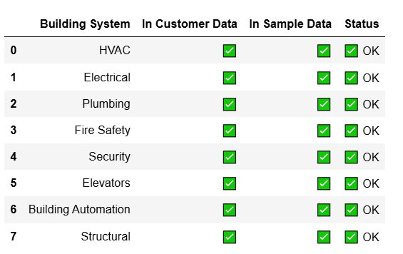
Domain Research and Implementation
DIN 276 – Cost Groups has been learned
Main building components:
Construction parts
Technical Parts
External Facilities
Equipment and Furnishings
Added some to be more conservative:

Slide 7
Important Comments
Consulting:
Do not ask useless questions to the client
If you must ask, do not do it frequently
Thus comes Senior Input into play! (Would say complete after 5 minute talk with a senior.)
A student dorm is different than a power plant. And their equipments would differ as well.
Detailed excel with sheets: Missing equipments, Potentially Missing Equipments, with summaries.

Slide 8
Task 2: EP Number Filling

Slide 9
Explatory Data Analysis
If rule-based, what are the rules ? Tree Structure
What did the client give us ?
Grouping Structure of Our Catalogue

Slide 10
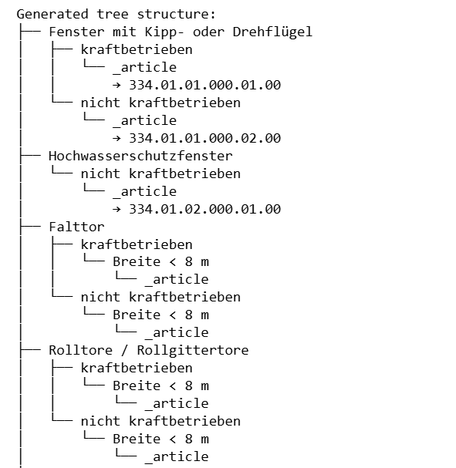
Know Your Data
Obviously Rule Based:
Challenges:
Lots of synonyms
Not a strict 1 to 1 match between customer and catalogue

Slide 11
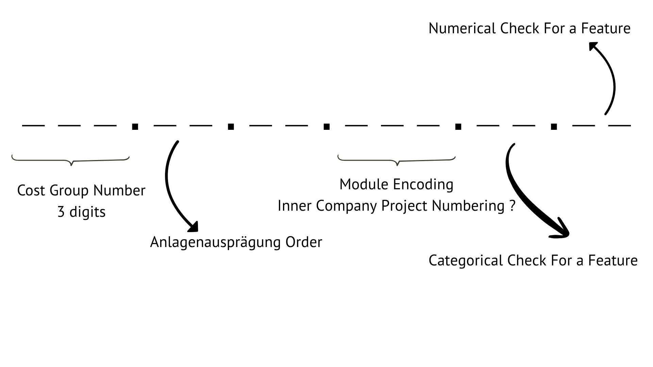
EP Number Structure
Reverse Engineer:

Slide 12
Know Your Data
Numbers:
973 equipments/systems from the customer
60 of them does not have DIN 276 cost group encodings ( generated by code just to show off )
913 of them has DIN 276
Of those 913:
794 have a KG number that exists within our catalogue
119 have KG numbers that will be added to the EP Catalogue (7 unique)

Slide 13
Multi-Algorithm Matching System
Algorithm 1: Basic Jaccard Similarity
Set-based comparison of normalized descriptor tokens
Matches within same KGR only
Fast, deterministic results for exact keyword matches
Low performance

Slide 14
Multi-Algorithm Matching System
Algorithm 2: Enhanced Fuzzy Matching
Synonym Dictionary: Maps variants (rolltor→rolltore, elektrisch→kraftbetrieben)
German Text Normalization: Handles umlauts (ä→ae, ö→oe, ü→ue)
Numeric Pattern Extraction: Identifies measurements, ranges, and technical specifications
Fuzzy String Matching: Uses RapidFuzz for approximate text matching
Bonus Scoring: Additional points for "Anlagenausprägung" field matches
!! Scoring Formula: max(jaccard, fuzzy) + numeric_bonus + system_type_bonus

Slide 15
Multi-Algorithm Matching System
Algorithm 3: Semantic Matching (SBERT)
Model: distiluse-base-multilingual-cased-v2 (German language support)
Approach: Neural embedding-based similarity using sentence transformers
Advantage: Captures semantic meaning beyond exact keyword matching
Scope: Global matching across entire catalog (not KGR-restricted)

Slide 16
Intelligent Result Selection
Hybrid Decision Logic:
Primary Rule: Use SBERT result if KGR matches customer's extracted cost group
Fallback Rule: Use enhanced fuzzy matching result if KGR mismatch detected
Rationale: Balances semantic accuracy with structural consistency
Saved every different result at a different column as a checkpoint for potential discussion with seniors

Slide 17
For No Cost Group Information Data
AI-Powered KGR Inference:
SBERT Matching: Compares customer descriptions to standard KGR definitions
Automatic Assignment: Assigns most semantically similar KGR
Code Generation: Applies same systematic approach as invalid KGR items
Normally company/internet catalogue would be way bigger and this would be safer.

Slide 18
Comments & Future
Use upgraded Google Colab's T4 GPU for faster training and bigger memory ( better models for AI .)
Use comprehensive catalogue for grouped titles rather than inference for the first 3 digits.
Create a synonym list/excel for most used keywords that are domain-specific, so that similarity score has room to improve
Train an LLM where main dataset is german for processing whole excel in an automated manner
Get Senior Input and Make Sure you are on the Right Path!

Slide 19
Thank you for your time!
I would love to get a feedback no matter the outcome. aytekin.yenilmez@gmail.com

