Slide 1
Glow Metrics: Sephora Analytics
Final Data Analytics Project
Presented by: Aya Maged Ahmed
Date:23/4/2025

Slide 2
Project Objective & Goal
Analyze skincare product data from Sephora.
Identify trends in pricing, rating, product popularity, and brand performance.
Use various tools to gain meaningful insights for business decisions.

Slide 3
Dataset Overview
Source: Kaggle (Sephora Skincare Reviews - product_info.csv)
Total Products: +8,000
Key Columns: product_name, brand_name, price, rating, reviews, category, etc.
Data Cleaning: Filled missing ratings/reviews, removed irrelevant columns, renamed columns

Slide 4
Tools Used
Python: Data cleaning & analysis (Pandas, NumPy, Matplotlib, Seaborn).
Excel: Summary statistics, pivot tables, charts.
Web scraping : BeautifulSoup
Power BI: Interactive dashboards.

Slide 5
Data Cleaning & Preprocessing Using Python
Handled missing values.
Converted data types where necessary.
Renamed columns to improve analysis process.
Create Charts to understand the data.
Import the data to Excel.

Slide 6
Excel Analysis
Summary Stats: Average Price, Max/Min Rating, Total Reviews.
Add Price_Category column divide the products into ‘High’ ,’Medium’ , ‘Low’ based on price.
Charts: Bar (Number Of Products By Top 10 Brands), Pie (Top 5 Brands by Reviews).
Use Conditional Formatting To highlight data patterns: highlight ’rating’ column.
Calculate Revenue per product.

Slide 7
Pivot Tables
Average Rating per Category
Reviews per Brand
Product Count per Brand
Top 10 Loving Brands
Count of Brands by primary category
Total Revenue for Top 10 Brands

Slide 8
Web scraping?

Slide 9
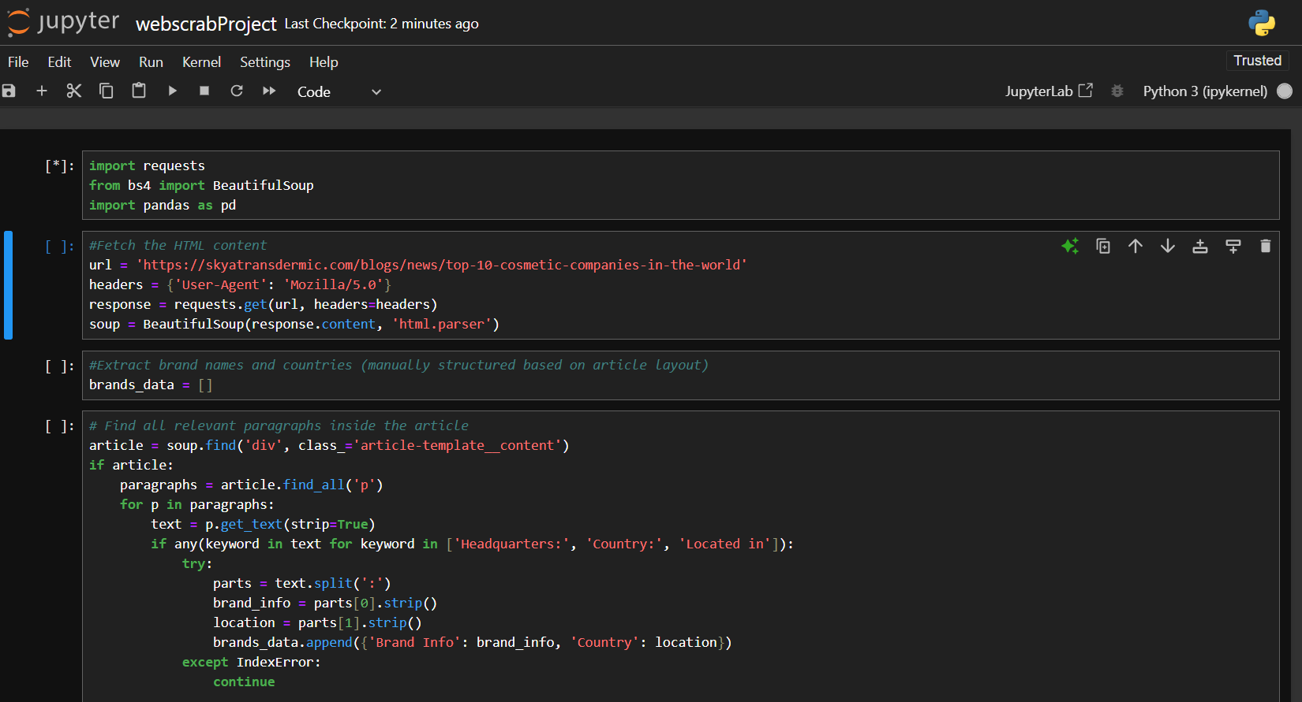
Get county for each brand by web scraping https://skyatransdermic.com/blogs/news/cosmetic-companies-in-the-world https://skyatransdermic.com/blogs/news/top-10-cosmetic-companies-in-the-world

Slide 10
Returning to Python Again
Enhancing Insights: Adding Country Information to Brands.
Objective: Obtain a list of countries for each brand and integrate it into the dataset to enrich insights.

Slide 11
Why Use Python Instead of Excel?

Slide 12
Python provides a more efficient and scalable solution for handling large datasets.
Easier to apply conditions across large data
Faster and more flexible for data transformation
Ideal for automating repetitive tasks

Slide 13
Power BI Dashboard
This dashboard offers an in-depth overview of Sephora’s skincare and beauty product analytics, help uncover key insights across brands, categories, and geographies .

Slide 14
KPIs at the top summarize key metrics:
Total Revenue: 5 billion USD
Total Reviews: 4 million
Number of Brands: 304
Total Products: 8413

Slide 15
Category Analysis

Slide 16
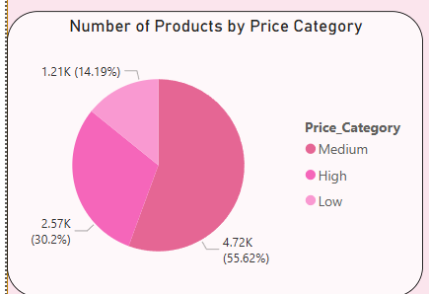
A pie chart displays the distribution of products by price category (Low, Medium, High).
highlighting that the majority fall in the Low to Medium range.

Slide 17
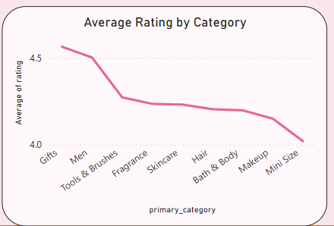
the line chart shows the average rating per primary category, giving insight into which product categories are most appreciated by customers.

Slide 18
Brand Performance

Slide 19
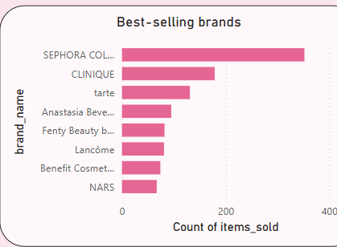
A bar chart shows the top best-selling brands based on items sold, with Sephora Collection Leading.

Slide 20
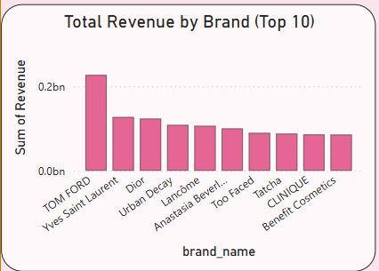
Another bar chart shows total revenue by brand, emphasizing top revenue contributors like Tom Ford and YSL.

Slide 21
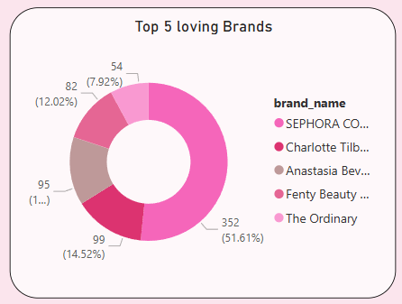
A donut chart visualizes the top 5 most loved brands, based on Loves counts.

Slide 22
Geographic Analysis

Slide 23
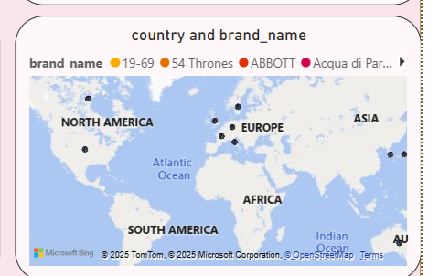
The map highlights the countries of origin for brands, offering a global view of Sephora’s brand diversity

Slide 24
Key Insights

Slide 25
Top Brands Dominate Sales
Sephora Collection leads in item sales.
Tom Ford and Yves Saint Laurent are top in revenue, indicating strong premium pricing power.

Slide 26
Customer Preferences by Category
Highest average ratings observed in categories like Gifts and Men's Products.
Most products fall under Skincare and Makeup, showing dominant consumer focus.

Slide 27
Price Sensitivity
Over 55% of products are in the Low price category, suggesting a wide focus on affordability.
However, premium brands still contribute a significant portion of total revenue.

Slide 28
Global Brand Footprint
Brands originate from diverse countries, with strong representation from France, USA, South Korea, and UK.
This diversity contributes to a broad product appeal across customer segments.

Slide 29
High Engagement
With over 4 million reviews, customer feedback is highly active, offering valuable insights for product improvement and marketing.

Slide 30
Conclusion
Multi-tool approach provided deeper insights
Clean data enabled effective visualization
Business can use findings to refine product offerings and marketing

Slide 31
Q&A
Any questions?

Slide 32
Thank You!

