Slide 1
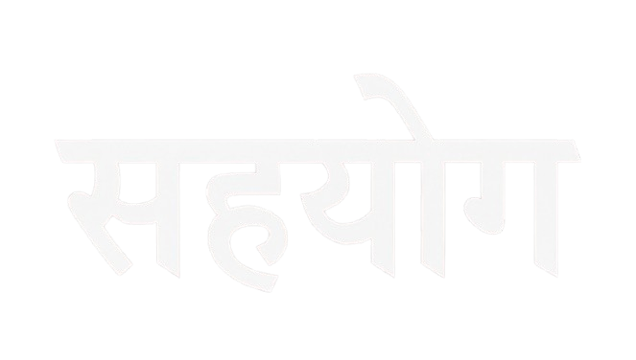
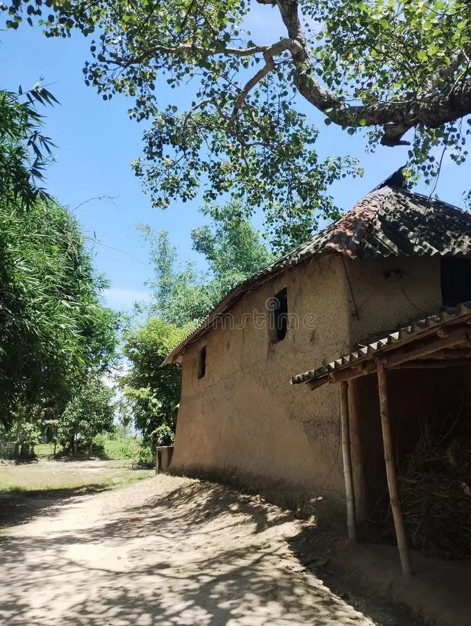
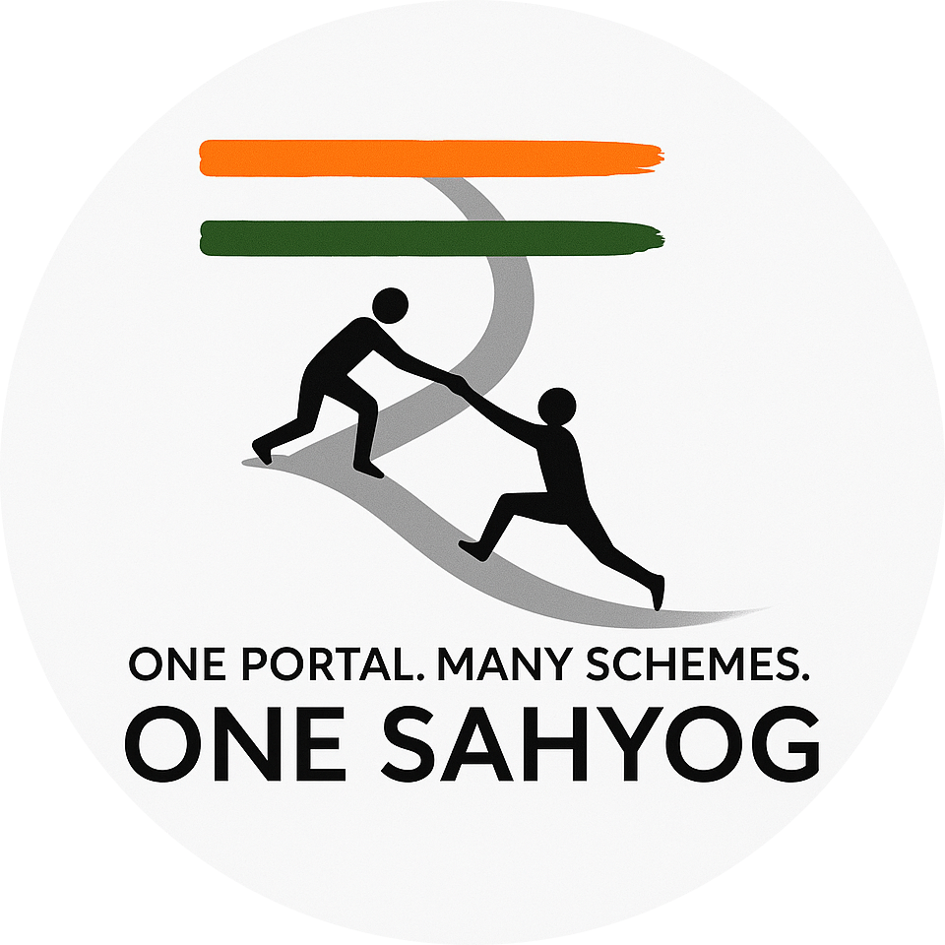

Web Portal for Government Schemes Awareness in Rural India…..
A policy is only as powerful as the number of people who know it exists.
Empowering Rural India Through Technology
By ZERO DAY

Slide 2
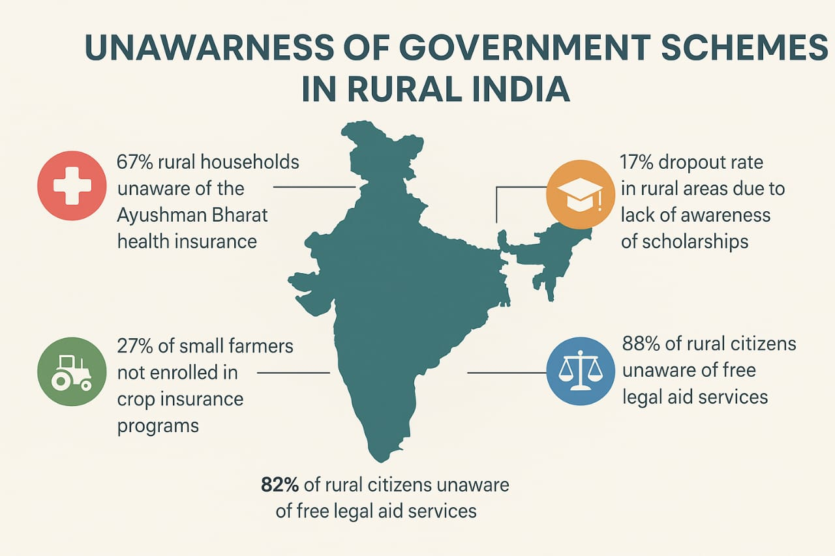

Problem Statement
Millions of Indians, especially in rural areas, remain unaware of government schemes made for their benefit — resulting in lost opportunities, suffering, and inequality.
Unawareness-
> According to NITI Aayog (2021), only 33% of
rural families were aware of PM-JAY.
Result: Millions fall into medical debt or skip treatment.
> A 2022 Agriculture Ministry survey found only
27% of small/marginal farmers enrolled in
the scheme.
Result: Massive loss of income after floods/droughts.
> Figure: UDISE+ (2022) reports a 17% dropout
rate at the secondary level in rural areas.
Result: Reduced chances of upward mobility.

Slide 3

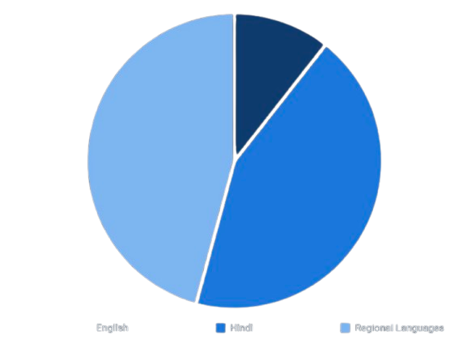
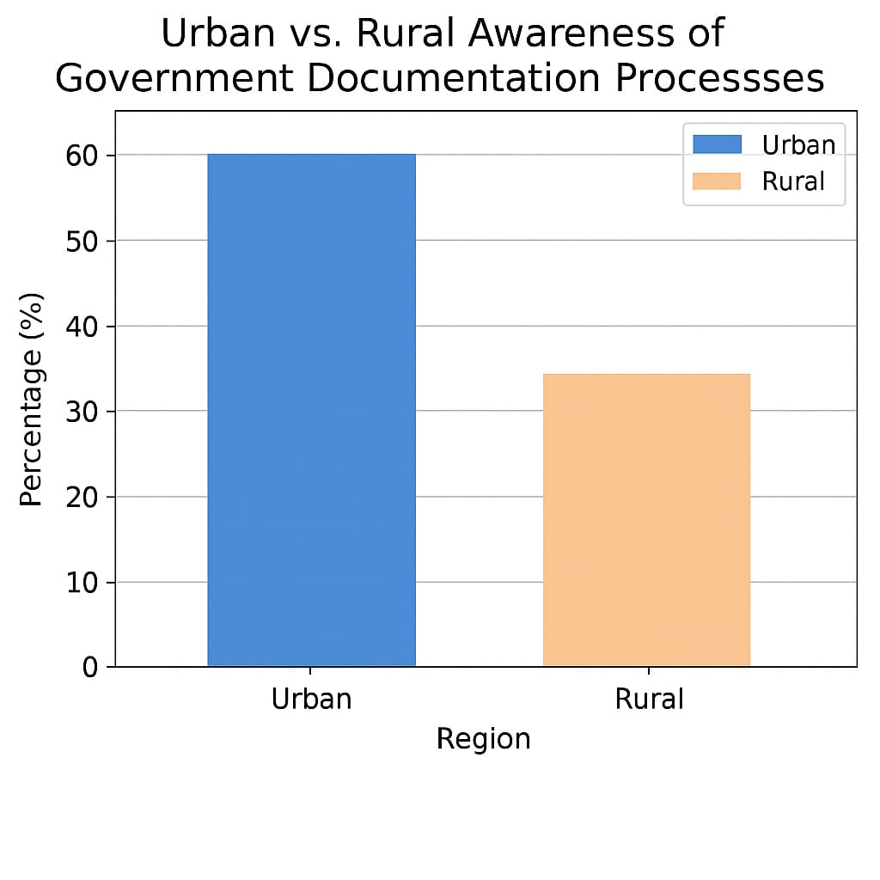
>Figure: NFHS-5 (2021) reported that only 45% of rural women had heard of these schemes.
Result: Health, education, and safety remain neglected
Incomplete Documentation & Language Barrier-
Incomplete documentation is a major barrier in rural India. Over 30% of rural citizens face difficulty accessing schemes due to missing or incorrect documents like Aadhaar, income or land records (Dalberg, 2020). As per NITI Aayog (2021), around 22% of eligible farmers were unable to get PM-Kisan benefits due to land verification issues. This leads to exclusion from crucial welfare programs
Language barrier limits access to schemes. Only 10.6% of Indians speak English, while 85% of rural people prefer local languages. Most scheme info is not in their native language, causing confusion and exclusion.
5%
42%
53%

Slide 4
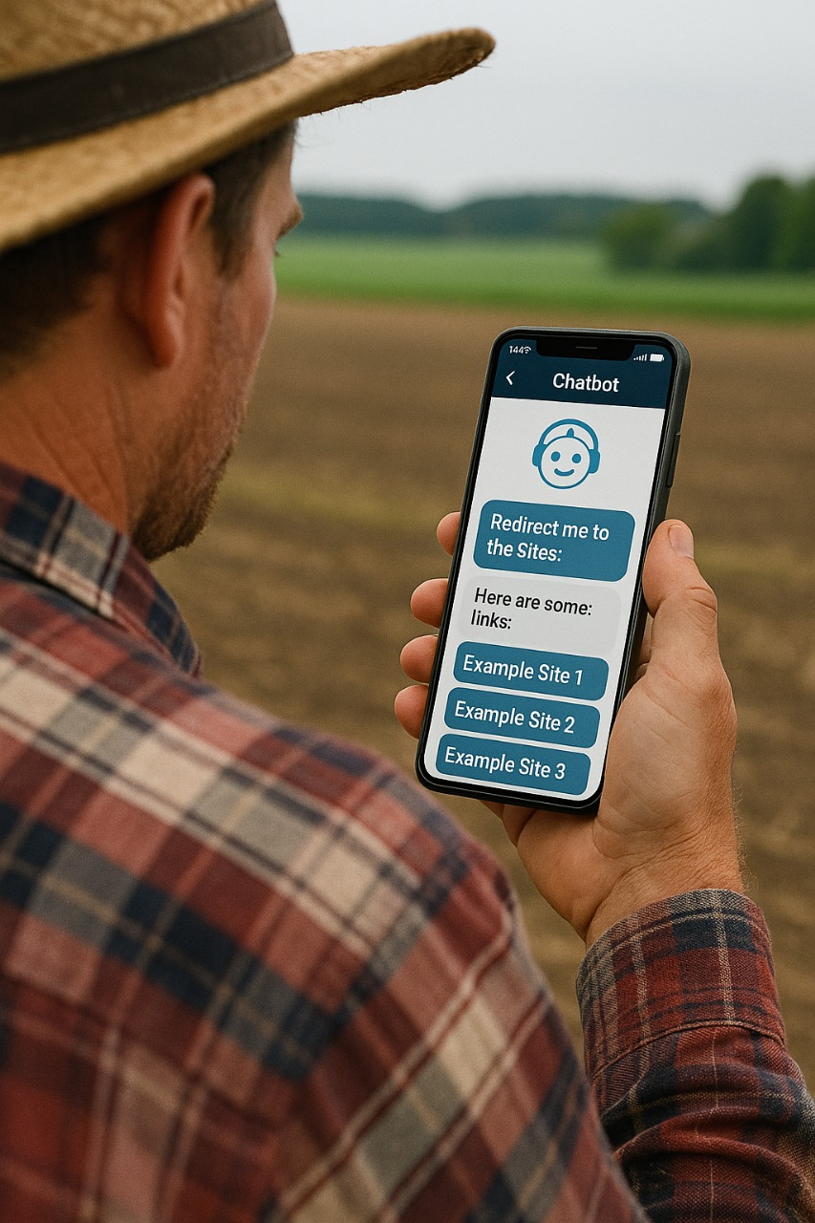
Solutions —
Increasing Awareness Through Our Website—
1. Categorized Schemes:
Schemes are grouped under clear sections like Health, Education, Farming, Housing, Women.
Simplifies navigation and improves discovery by up to 3x (Digital India Research, 2022).
2. Multilingual Support:
Website supports multiple Indian languages (e.g., Hindi, Bengali, Tamil).
Solves the language barrier: 85% of rural Indians prefer local languages,
while only 10.6% speak English (Census 2011).
3. User-Friendly Experience:
Intuitive design with icons, visuals, and simplified text for better understanding.
Helps users access the right schemes faster and more confidently.
Solving the Problem of Incomplete Documentation—
1. Chatbot Assistance
A friendly chatbot guides users step-by-step on how to get missing documents.
Explains what documents are needed, where to get them, and estimated time.
Supports local languages and voice for accessibility.
2. NGO Contact Section
Provides a list of NGOs and local help centers with contact details.
Users can call or WhatsApp for help with documentation.

Slide 5


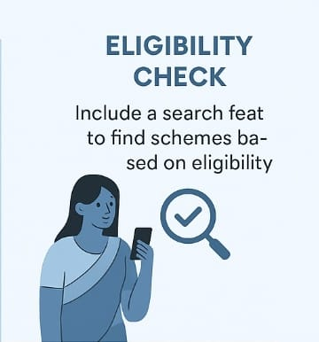
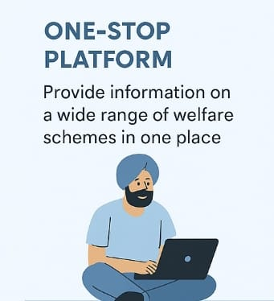

Impact & Features of Sahyog
Impact —
Increases awareness of government schemes among rural citizens.
Helps more users access and apply for schemes they’re eligible for.
Reduces rejection due to incomplete documentation.
Empowers rural communities through language-friendly digital access.
Features of Sahyog—
Schemes are organized in clear sections for easy access.
Sahayak, a multilingual chatbot, guides users step-by-step.
Users can contact local NGOs directly through the platform.
Supports regional languages, unlike many existing portals.
Designed to work smoothly on low-end devices and slow internet.
Empowering rural India through technology and information.

Slide 6




Technical Apprroach
Frontend Architecture: Built using HTML5, CSS & JS for a fast, responsive UI.
Backend Approach: Scheme info, and NGO directory, plus REST APIs for frontend
integration, and chatbot knowledge base management.
Multilingual Support: Google Translate API integration for real-time translation ,
which Supports 10+ Indian regional languages
Chatbot: Integrated chatbot offers document guidance and multilingual support.
Personalization: Smart recommendation engine suggests schemes based on user profile.
Hosting: Deployed on a scalable platform for smooth performance and uptime

