Slide 1
DBMS Assignment 3
Train Reservation System

Slide 2


Submitted by:
Atharva Gupta CS16B002 Ayush Kumar CS16B005 Pranav Jha CS16B019 Pratik Agrawalla CS16B020

Slide 3
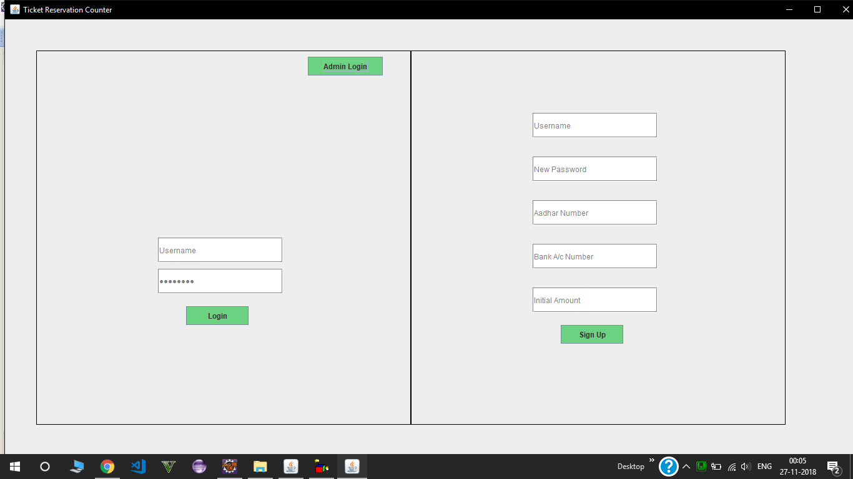
Login Screen and new User Registration Screen

Slide 4
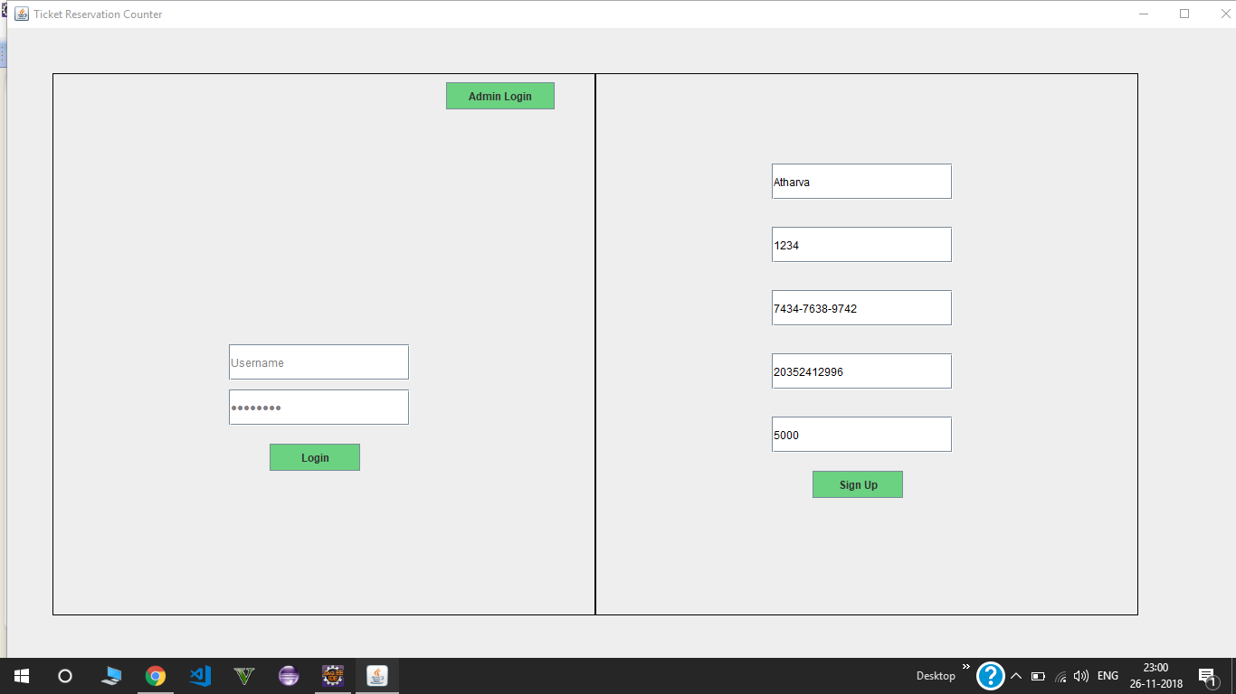
User Registration(Name,Password,Aadhar Number,Bank Account Number,Amount)

Slide 5
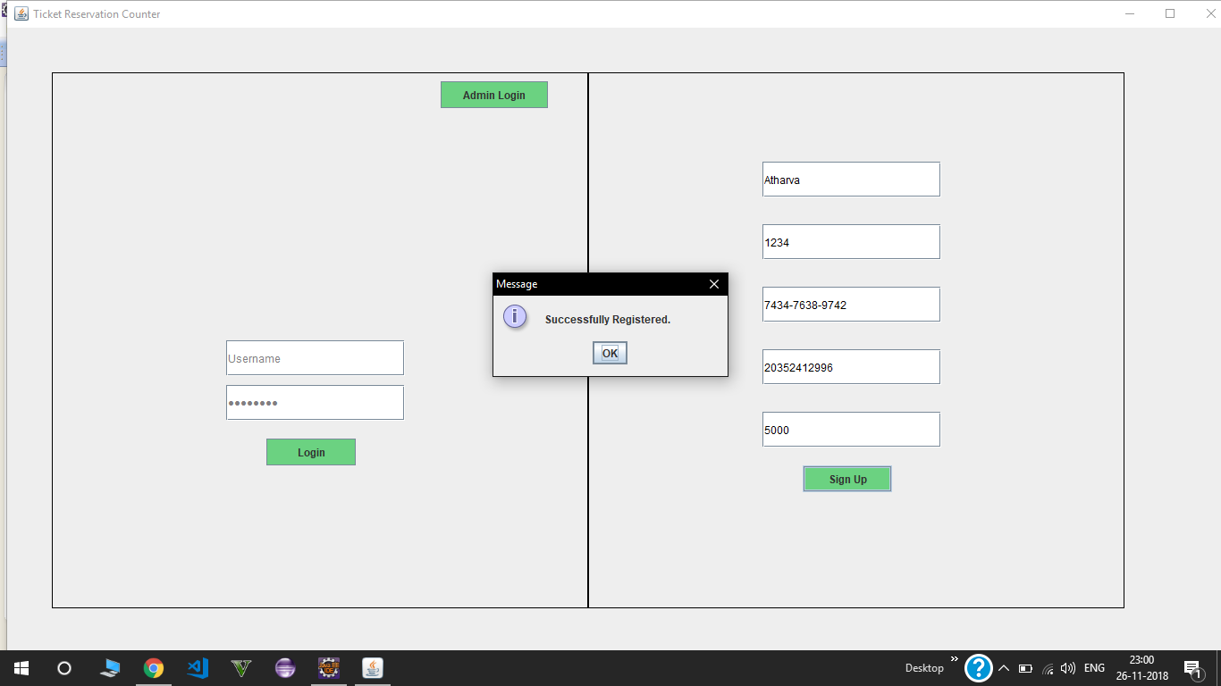
Registration completed of a New user

Slide 6
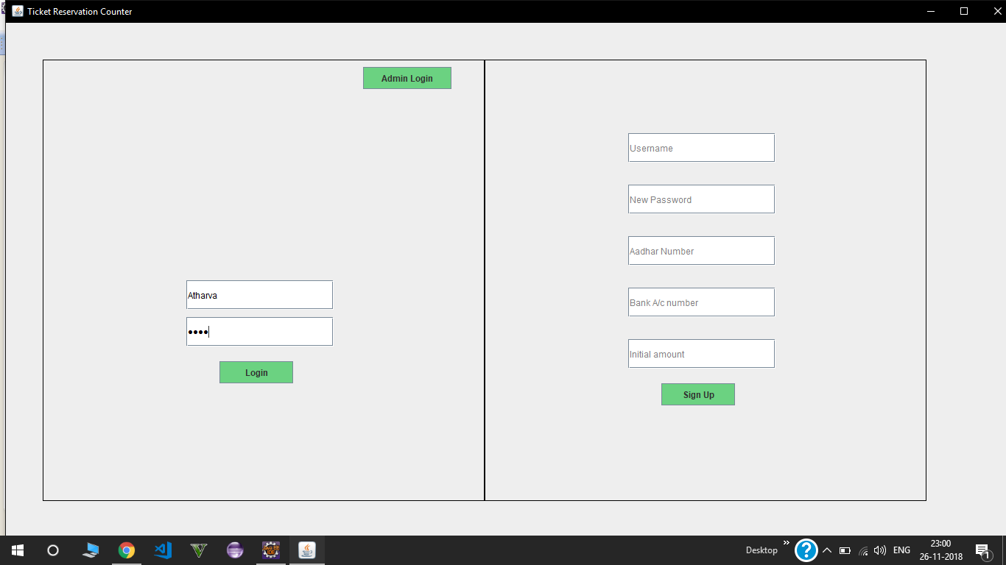
User Login (Checks username and password in Database)

Slide 7
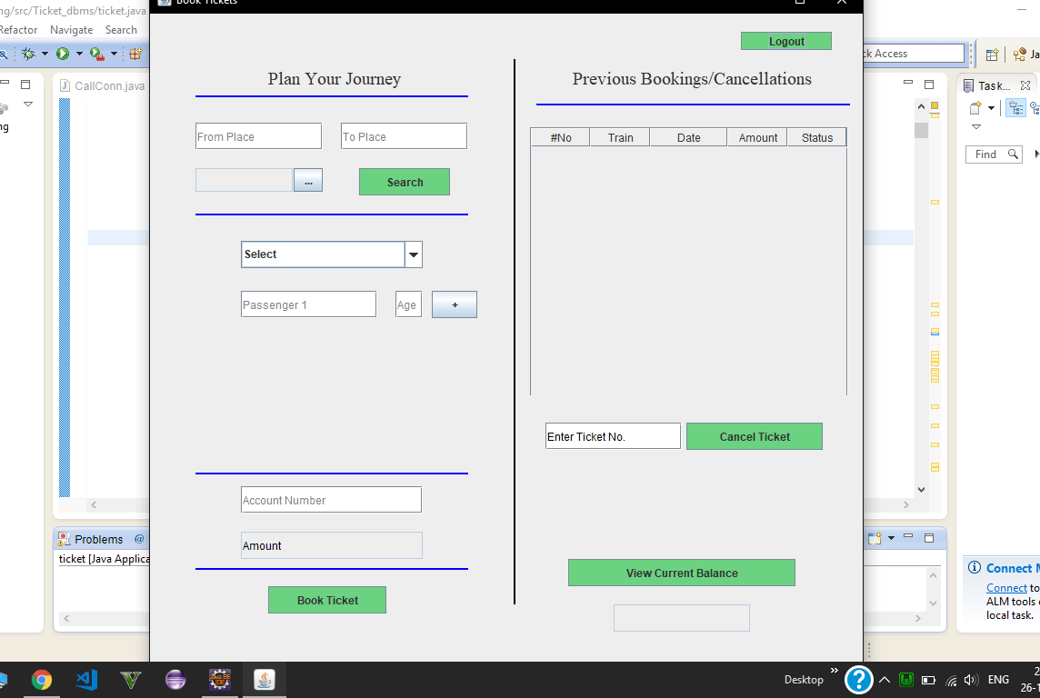
Plan your Journey
(From,To,Date,Train no,(Passenger name,age)(at max 4),account number
Check current balance and logout button

Slide 8
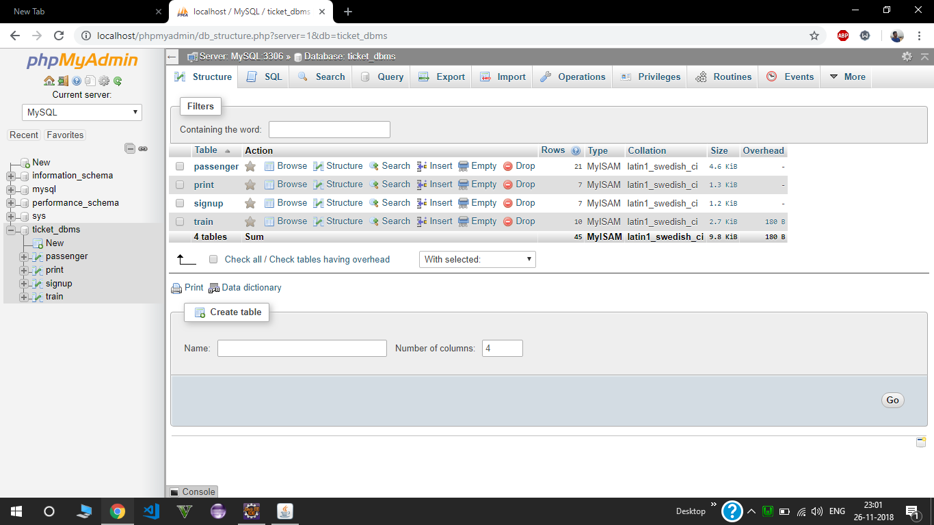
Database Table for passenger,train ,sign up(Registration of user) in SQL (PHP My Admin)

Slide 9
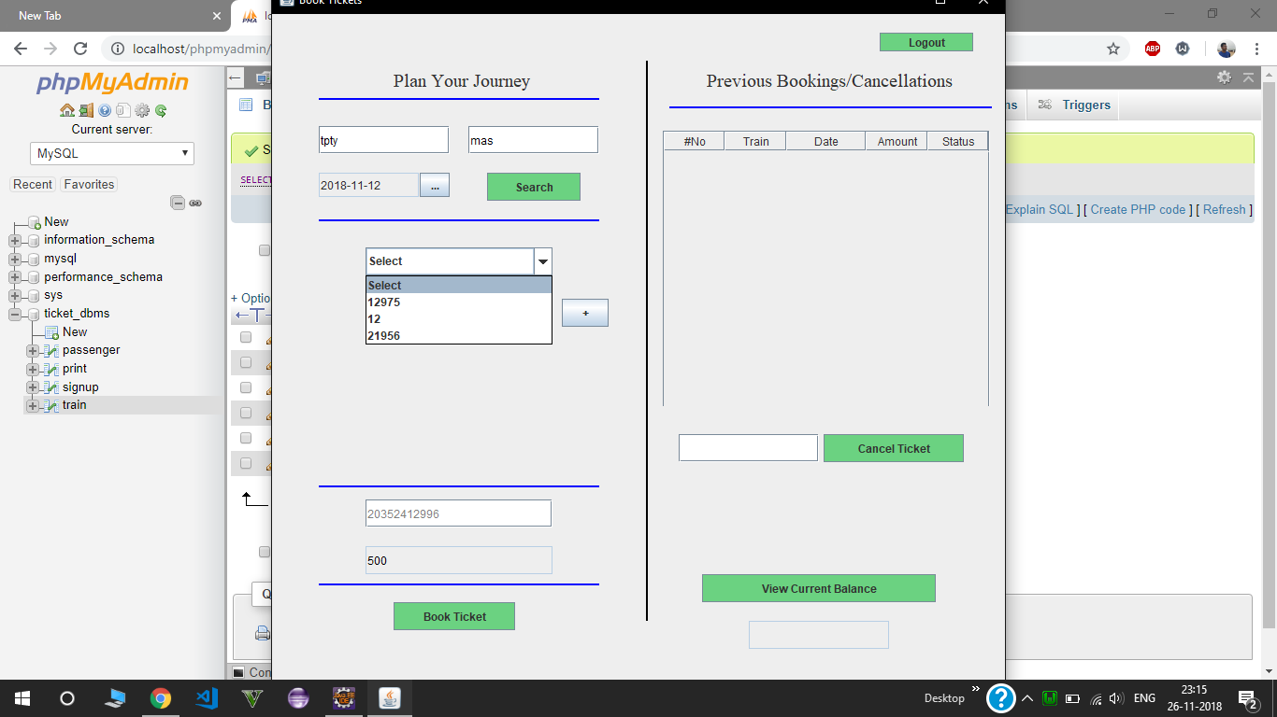
Train List in Drop down menu according to the date (Mon,Tue) and from & to station

Slide 10
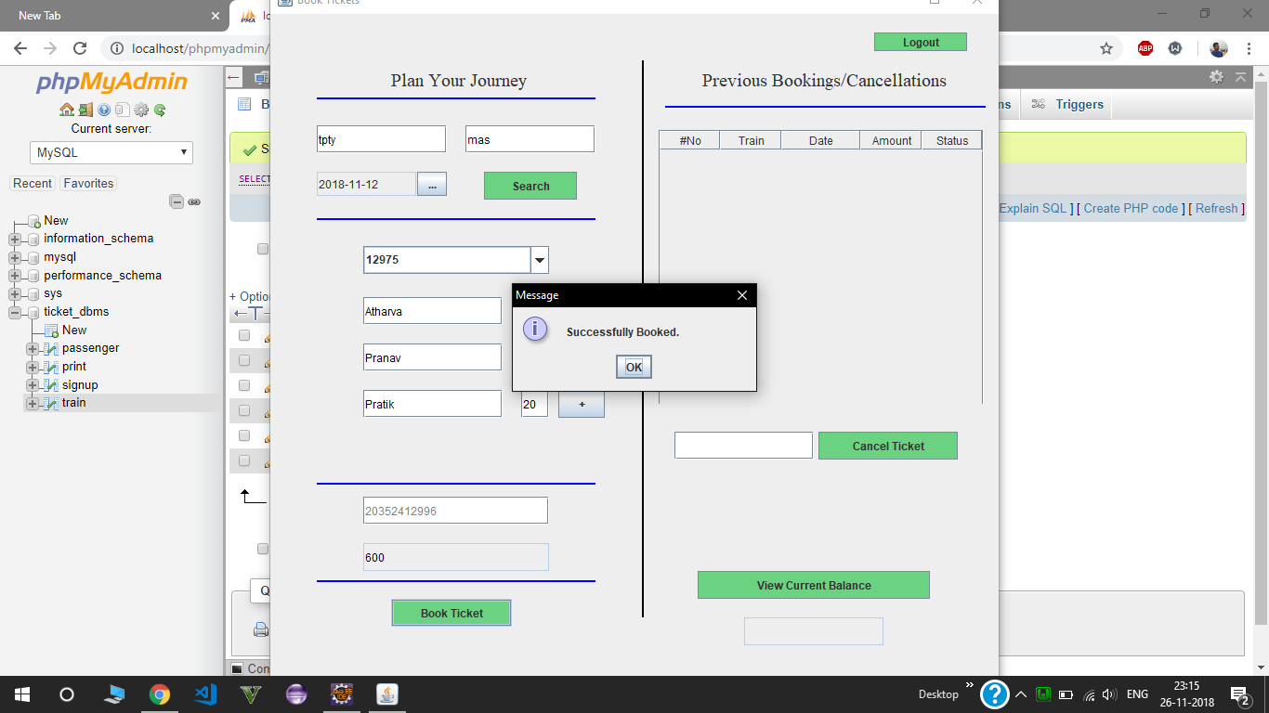
Train booking done based on availaibility

Slide 11
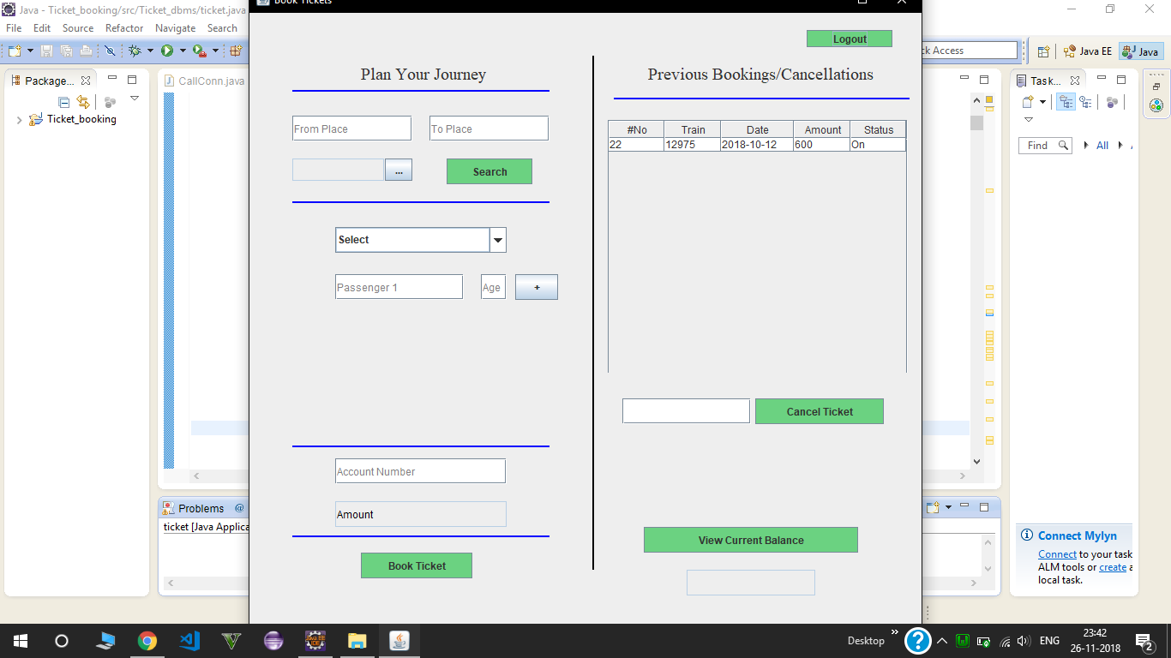
Booking automatically updates in the list and can also cancel ticket by entering ticket number

Slide 12
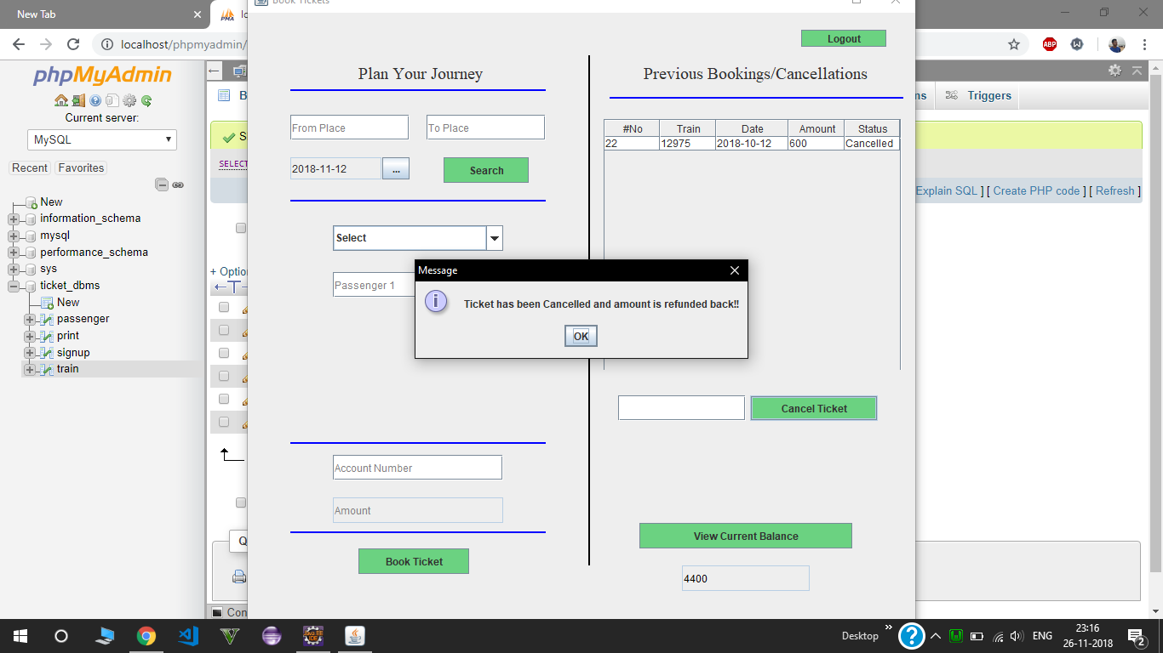
On cancelling a ticket amount is refunded to account number and availaibilty increases

Slide 13
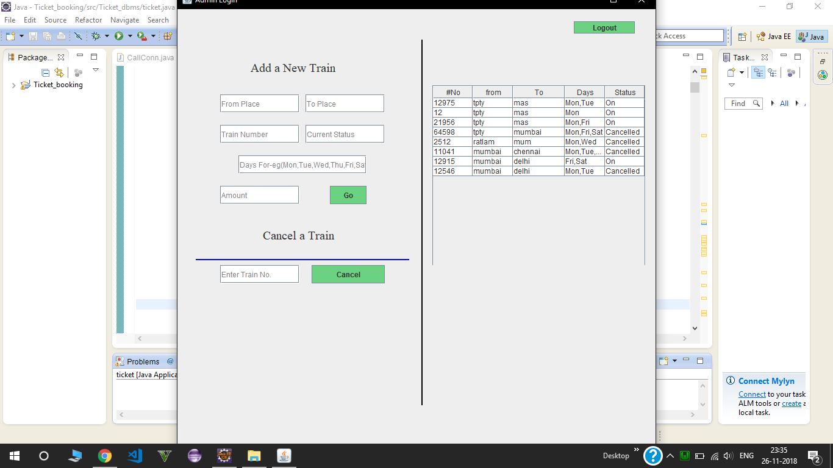
Admin Login(Enter a new train)(FROM,TO,Train no,Current status,Days,amount) and also the list shows the list of train .

Slide 14
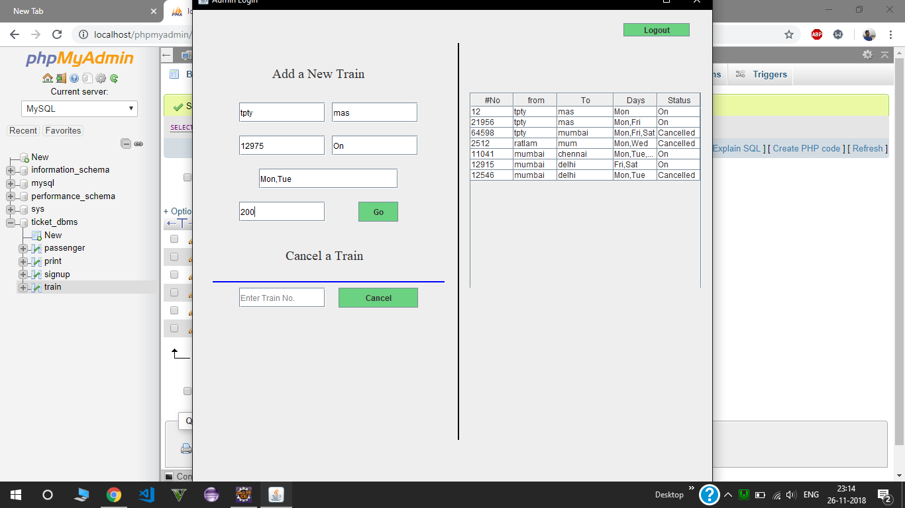
List automatically get updated with new train

Slide 15
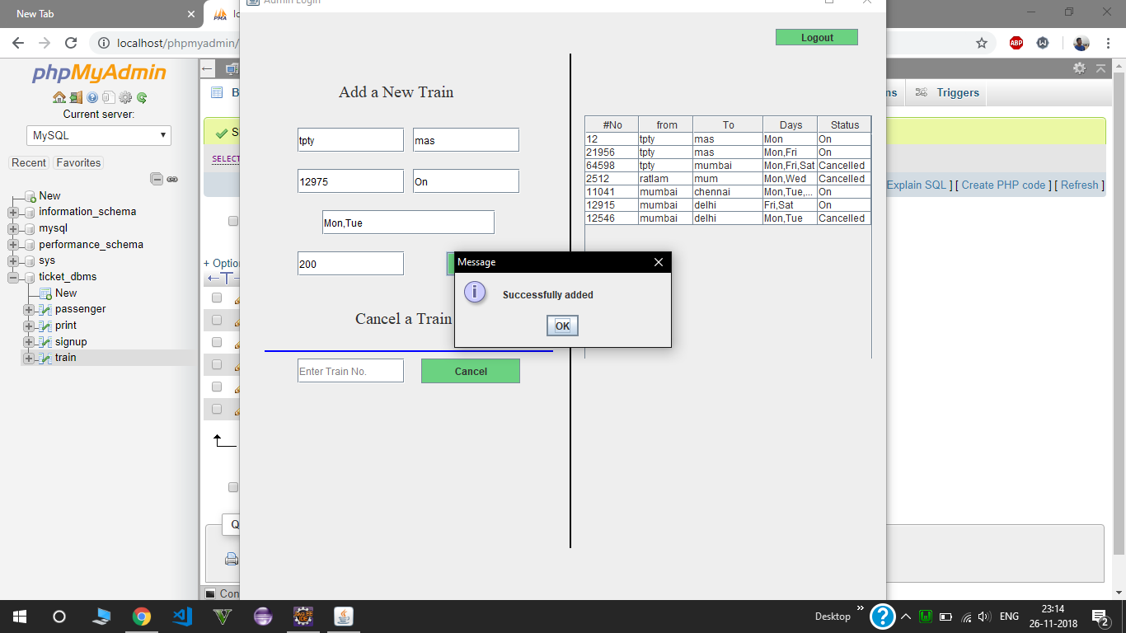
Successfully added a new train

Slide 16
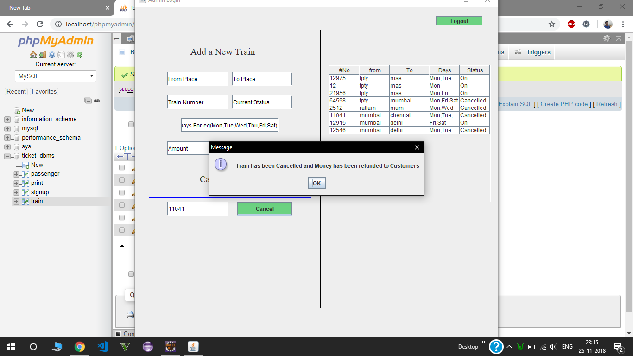
On cancelling train,automatically money gets refunded to all users and status get updated

Slide 17

Thank You

