Slide 1
Data Representation
1

Slide 2
Contents
Data Representation: Binary Representation, BCD, Alphanumeric Representation, Complements, Fixed Point representation, Representing Negative Numbers, Floating Point Representation, Arithmetic with Complements, Overflow, Detecting Overflow
Other Binary Codes: Gray Code, self Complementing Code, Weighted Code, Excess-3 Code, EBCDIC
Error Detection Codes: Parity Bit, Odd Parity, Even parity, Parity Generator & Checker
2

Slide 3
1.1 Data Types
Binary information in digital computer is stored in memory or processor registers. Registers contain either data or control information .
Control information is a bit or group of bits used to specify the sequence of command signals needed for data manipulation .
Data are numbers and other binary-coded information that are operated on
Possible data types in registers:
Numbers used in arithmetic computations
Letters of the alphabet used in data processing
Other discrete symbols used for specific purposes
All types of data, except binary numbers, are represented in binary-coded form.
3

Slide 4
1.2 Number Systems
A number system of base, or radix, r is a system that uses distinct symbols for r digits.
Numbers are represented by a string of digit symbols. To determine
the quantity that the number represents, it is necessary to multiply
each digit by an integer power of r and then form the sum of all weighted digits.
For example, the decimal number system in everyday use employs
the radix 10 system.
The 10 symbols are 0, 1, 2, 3, 4, 5, 6, 7, 8, and 9.
The string of digits 724.5 is interpreted to represent the quantity (724.5)₁₀ =7 x 10² + 2 x 10¹ + 4 x 10⁰ + 5 x 10⁻¹
4

Slide 5
The binary number system uses the radix 2. The two digit symbols used are 0 and 1.
The string of digits 101101 is interpreted to represent the quantity 101101 =>1 x 2⁵ + 0 x 2⁴ + 1 x 2³ + 1 x 2² + 0 x 2¹ + 1 x 2⁰ = 45
To show the equality between decimal and binary forty-five we will write (101101)₂ = (45)₁₀
Octal and Hexadecimal Number system
Octal (radix 8) and hexadecimal (radix 16) number systems
The eight symbols of the octal system are 0, 1, 2, 3, 4, 5, 6, and 7. The 16 symbols of the hexadecimal system are 0, 1, 2, 3, 4, 5, 6, 7, 8, 9, A, B, C, D, E, and F.
5

Slide 6
The symbols A, B, C, D, E, F correspond to the decimal numbers 10, 11,
12, 13, 14, 15, respectively.
For example, octal 736.4 is converted to decimal as follows: (736.4)₈ = 7 x 8² + 3 x 8¹ + 6 x 8⁰ + 4 x 8⁻¹
= 7 x 64 + 3 x 8 + 6 x 1 + 4/8
= (478.5)₁₀
The equivalent decimal number of hexadecimal F3 as: (F 3)₁₆ = F x 16 + 3 = 15 x 16 + 3 = (243)₁₀
Decimal to binary conversion(float numbers)
Example: 28.125 and 28 and 0.125
division = quotient + remainder ;
28 ÷ 2 = 14 + 0;
14 ÷ 2 = 7 + 0;
7 ÷ 2 = 3 + 1;
3 ÷ 2 = 1 + 1;
1 ÷ 2 = 0 + 1;
So, 28=11100
0.125*2=.250 0
.250*2=.500 0
.500*2=1.00 1
0.125=001 so, 28.125=11100.001
6

Slide 7
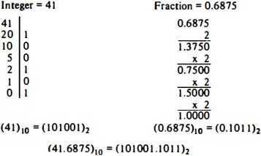
Conversion from decimal to radix r system is carried out by separating the
number into its integer and fraction parts and converting each part separately
Divide the integer successively by r and accumulate the remainders
Multiply the fraction successively by r until the fraction becomes zero
Figure 1. Conversion of decimal 41.6875 into binary.

Slide 8
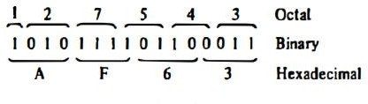
Each octal digit corresponds to three binary digits
Each hexadecimal digit corresponds to four binary digits
Rather than specifying numbers in binary form, refer to them in octal or hexadecimal and reduce the number of digits by 1/3 or 1/4, respectively
Figure 2. Binary ,octal and hexadecimal conversion.

Slide 9
Q. Convert (761)₈ =( )₂ and (71.3)₈=( )₂ ?
Solution: 7=111,6=110,1=001,3=011
(761)₈=( 111110001)₂ and (71.3)₈=(111001.011)₂
Q. Convert (10011)₂ =( )₈ and (10.11)₂ =( )₈
Solution: Group 3 bits,
(10011)₂ => 010=2 and 011=3 so,(23)₈
(10.11)₂ =>010=2 and 110=6 so,(2.6)₈
Q. Convert (61)₁₆ =( )₂ and (8A.D)₁₆ =()₂ ?
Solution: Group 4 bits,6=0110 and 1=0001 So,(0110 0001)₂
8=1000 A=1010 and D=1101 S0, (1000 10101.1101)₂
Q. Convert (7A.c)₁₆ =()₈ ?
Solution: 7=0111 A=1010 and C=1100 so,(01111010.1100)₂
Group 3 bits using table now, (172.60)₈

Slide 10
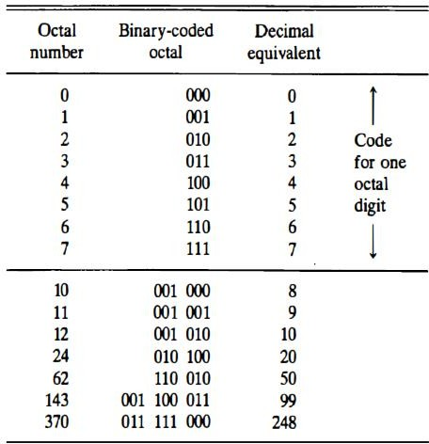
Table 1.1 Binary-Coded Octal Numbers

Slide 11
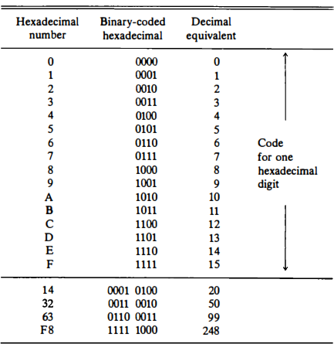
Table 1.2 Binary-Coded hexadecimal Numbers

Slide 12
A binary code is a group of n bits that assume up to 2^{n} distinct combina- tions of 1's and 0's with each combination representing one element of the set that is being coded.
For example, a set of four elements can be coded by a 2-bit code with each element assigned one of the following bit combinations; 00, 01, 10, or 11. A set of eight elements requires a 3-bit code, a set of 16 elements requires a 4-bit code, and so on.
A binary code that distinguishes among 10 elements must contain at least
four bits, but six combinations will remain unassigned.

Slide 13
Binary-coded Decimal (BCD)
Also 8421 Code .
The most popular decimal code is called binary-coded decimal (BCD) .
For example, when converted to a binary number, the decimal number 99
is represented by the string of bits 1100011, but when represented in BCD, it becomes 1001 1001.
The only difference between a decimal number represented by the familiar digit symbols 0, 1, 2, ... 9 and the BCD symbols 0001,0010, …., 1001 is in the symbols used to represent the digits-the number itself is exactly the

Slide 14
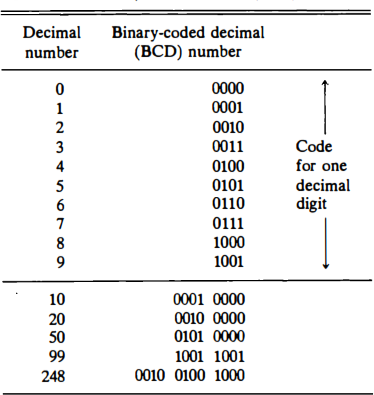
Table 1.3 Binary-Coded decimal (BCD) Numbers

Slide 15
Alphanumeric Representation
An alphanumeric character set is a set of elements that includes the 10 decimal digits, the 26 letters of the alphabet and a number of special characters, such as $, +, and = .
Such a set contains between 32 and 64 elements (if only uppercase letters are included) or between 64 and 128 (if both uppercase and lowercase letters are included). In the first case, the binary code will require six bits and in the second case, seven bits.
The standard alphanumeric binary code is ASCII (American Standard Code for Information Interchange), which uses seven bits to code 128 characters.
Binary codes are required since registers can hold binary information only.

Slide 16
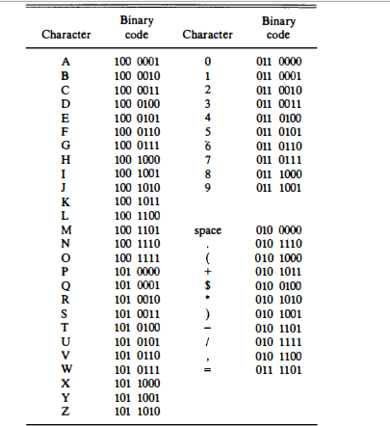
Table 1.4 American Standard Code for Information Interchange (ASCII)

Slide 17
1.3 Complements
Complements are used in digital computers for simplifying subtraction and logical manipulation
Two types of complements for each base r system:
r’s complement and
(r – 1)’s complement
When the value of the base r is substituted in the name, the two types are referred to as the 2's and 1's complement for binary numbers and the 10's and 9's complement for decimal numbers.

Slide 18
(r – 1)’s Complement
Given a number N in base r having n digits, the (r - 1)'s complement of N is
defined as (r^{n} -1) - N.
For decimal numbers r = 10 and r - 1 = 9, so the 9’s complement of N is (10^{n} - 1) - N. Now, 10^{n} represents a number that consists of a single 1 followed by n 0's.
10^{n} - 1 is a number represented by n 9's. For example, with n = 4 we have 10⁴ = 10000 and 10⁴ - 1 = 9999.
It shows that the 9' s complement of a decimal number is obtained by
subtracting each digit from 9.
For example, the 9's complement of 546700 is 999999 - 546700 = 453299 and the 9's complement of 12389 is 99999 - 12389 = 87610.

Slide 19
For binary numbers, r = 2 and r - 1 = 1, so the 1's complement of N is (2^{n} -
- N. Again, 2^{n} is represented by a binary number that consists of a 1 followed by n 0's. 2^{n} - 1 is a binary number represented by n 1’s.
For example, with n = 4, we have 2^{n} = (10000)_{2,} and 2⁴ - 1 = (1111_{)2 .}
Thus, the 1’s complement of a binary number is obtained by subtracting
each digit from 1.
However, the subtraction of a binary digit from 1 causes the bit to change
from 0 to 1 or from 1 to 0.
For example, the 1's complement of 1011001 is 0100110 and the 1' s complement of 0001111 is 1110000.

Slide 20
(r's) Complement
The r's complement of an n-digit number N in base r is defined as r' - N for N ≠ 0 and 0 for N = 0.
Comparing with the (r - 1)'s complement, we note that the r's complement
is obtained by adding 1 to the (r - 1)'s complement since r' - N = [(r' - 1)
- N] + 1.
Thus the 10's complement of the decimal 2389 is 7610 + 1 = 7611 and
is obtained by adding 1 to the 9' s complement value.
The 2's complement of binary 101100 is 010011 + 1 = 010100 and is obtained by adding 1 to the 1's complement value.

Slide 21
Subtraction of Unsigned Numbers
Subtraction of unsigned n-digit numbers: M – N
Add M to the r’s complement of N – this results in M + (r^{n} – N) =
M – N + r^{n}
If M ≥ N, the sum will produce an end carry r^{n} which is discarded
If M < N, the sum does not produce an end carry and is equal to r^{n}
– (N – M), which is the r’s complement of (N – M). To obtain the answer in a familiar form, take the r’s complement of the sum and place a negative sign in front.

Slide 22
Example 1: the subtraction 72532 - 13250 = 59282. The 10's complement of
13250 is 86750. Therefore:
M = 72532
10's complement of N = +86750
Sum = 159282
Discard end carry = -100000
Answer = 59282
Note : Both numbers must have the same number of digits; if not add 0 .eg.
72532 - 3250 then 72532 - 03250 .
Example for M < N: 13250 – 72532 = -59282
M = 13250
10’s comp. of N = +27468
Sum = 40718
(There is no end carry)
Answer = -59282 (10’s comp. of 40718)

Slide 23
Example for X = 1010100 and Y = 1000011 we perform the subtraction X – Y and Y -X using 2's complements:
X = 1010100
2’s comp. of Y = + 0111101
Sum = 10010001
Discard end carry = -10000000
Answer X – Y = 0010001
Y = 1000011
2’s comp. of X = +0101100
Sum = 1101111
No end carry
Answer = -0010001 (2’s comp. of 1101111)

Slide 24

Fixed-point representation
Fixed number of bits for integer part and for fractional part.
The fixed-point numbers in binary uses a sign bit.
Unsigned Notation : A positive number has a sign bit 0, while Signed Notation: the negative number has a sign bit 1.
Two ways to designate binary point position in a register
Fixed point position
Floating-point representation
Less hardware required for processing.
Fixed point position usually uses one of the two following positions
A binary point in the extreme left of the register to make it a fraction
A binary point in the extreme right of the register to make it an integer
In both cases, a binary point is not actually present

Slide 25
Representing Negative Numbers
A negative number can be represented in one of the following ways:
Signed magnitude representation
Signed 1 's complement representation, or
Signed 2's complement representation.
Examples 1:
Assumption: size of register=8bits including the sign bit.
Signed magnitude representation
+6 = 0 0000110 =>( sign bit(1 bit) and (7 bits) magnitude)
-6= 1 0000110
No change in the magnitude, only sign bit changes
Signed 1 's complement representation
+6= 0 0000110
-6= 1 1111001

Slide 26
For negative number take 1’s complement of all the bits( including sign bit) of the positive number then add 1.
Signed 2's complement representation.
+6= 0 0000110
-6= 11111010 (1’s complement +1)
For negative number take 2’s complement of all the bits (including sign bit) the positive number.
Example 2: Consider an 8-bit register and the number +14
The only way to represent it is 00001110
Consider an 8-bit register and the number –14
Signed magnitude: | 1 | 0001110
Signed 1’s complement: | 1 | 1110001
Signed 2’s complement: | 1 | 1110010

Slide 27
Arithmetic Addition
Addition of two signed-magnitude numbers follow the normal rules
If same signs, add the two magnitudes and use the common sign
Different signs, subtract the smaller from the larger and use the sign of
the larger magnitude
Must compare the signs and magnitudes and then either add or subtract For example,
(+25) + (-37) = -(37 - 25) = -12 and is done by subtracting the smaller magnitude 25 from the larger magnitude 37 and using the sign of 37 for the sign of the result

Slide 28
Addition of two signed 2’s complement numbers does not require a comparison or subtraction – only addition and complementation
Add the two numbers, including their sign bits
Discard any carry out of the sign bit(leftmost) position
All negative numbers must be in the 2’s complement form
If the sum obtained is negative, then it is in 2’s complement form
Examples:
+6 00000110
-6 11111010
+13 00001101
+7 00000111
+13 00001101
+19 00010011
+6 00000110
-13 11110011
-7 11111001
-6 11111010
-13 11110011
-19 11101101
28

Slide 29
Arithmetic Subtraction
Subtraction of two signed 2’s complement numbers is as follows
Take the 2’s complement form of the subtrahend (including sign bit)
Add it to the minuend (including the sign bit)
A carry out of the sign bit position is discarded
This procedure stems from the fact that a subtraction operation can be changed to an addition operation if the sign of the subtrahend is changed.
(±A) - (+B) = (±A) + (-B)
(±A) - (-B) = (±A) + (+B)
Example: (-6) - (-13) = +7. In binary with eight bits this is written as 11111010 - 11110011.The subtraction is changed to addition by taking the 2's
complement of the subtrahend (-13) to give (+13). In binary this is 11111010
+ 00001101 = 100000111. Removing the end carry, we obtain the correct answer 00000111 ( + 7).

Slide 30
Overflow
An overflow occurs when two numbers of n digits each are added and the sum occupies n + 1 digits
An overflow is a problem in digital computers because the width of registers is
finite.
Therefore, when it occurs, a corresponding flip-flop is set which can then be checked by the user
Detection of an overflow depends on if the numbers are signed or unsigned
For unsigned numbers addition, an overflow is detected from the end carry out of the MSB
For addition of signed numbers, an overflow cannot occur if one is positive and one is negative – both have to have the same sign
An overflow can be detected if the carry into the sign bit position and the carry out of the sign bit position are not equal

Slide 31
Example:
Two signed binary numbers, +70 and +80, are stored in two 8 bit registers. Range from binary 127 to binary -128.since sum is +150
Overflow occurred if the numbers are both +ve or both –ve. Carries: 0 1 Carries: 1 0
+70 0 1000110 -70 1 0111010
+80 0 1010000
-80 1 0110000
-150 0 1101010
+150 1 0010110

Slide 32
Decimal Fixed-Point Representation
The representation of decimal numbers in registers is a function of the binary
code used to represent a decimal digit .
A 4-bit decimal code requires four flip-flops for each decimal digit .
The representation of 4385 in BCD requires 16 flip-flops, four flip-flops for
each digit. The number will be represented in a register with 16 flip-flops as follows: 0100 0011 1000 0101
This takes much more space than the equivalent binary representation and the circuits required to perform decimal arithmetic are more complex.
This eliminates the need for conversion to binary and back to decimal .
Representation of signed decimal numbers in BCD is similar to the
representation of signed numbers in binary.
Either signed magnitude or signed complement systems

Slide 33
It is customary to designate a plus with four 0' s and a minus with the BCD
equivalent of 9, which is 1001 .
The sign of a number is represented with four bits 0000 for +
1001 for –
To obtain the 10’s complement of a BCD number, first take the 9’s complement and then add one to the least significant digit
Example: (+375) + (-240) = +135
0 375 (0000 0011 0111 0101)_{BCD}
+9 760 (1001 0111 0110 0000)_{BCD}
0 135 (0000 0001 0011 0101)_{BCD} (End carry discarded)
The 9 in the leftmost position of the second number indicates that the number is negative. 9 760 is the 10's complement of 0240. The two numbers are added and
the end carry is discarded to obtain + 135.
33

Slide 34

Floating-Point Representation
The floating-point representation of a number has two parts
The first part represents a signed, fixed-point number – the mantissa
The second part designates the position of the binary point – the
exponent
The mantissa may be a fraction or an integer
Decimal Value
N = m * r^{e}
Where , m is mantissa, r is base ,e is exponent
11 * 10⁸ => m=11, r=10, e=8
Example 1: the decimal number N= +6132.789 is Fraction (m): +6132789
Exponent (e): +04 , r=10

Slide 35
Equivalent to the scientific notation N = m * r^{e} = +0.6132789 x 10⁺⁴
A floating-point number is always interpreted to represent m × r^{e}
Example 2: the binary number +1001.11 (with 8-bit fraction and 6-bit
exponent)
Fraction (m): 01001110
Exponent (e): +4 =000100 r=2
Sign bit=0
Equivalent to +(.1001110)₂ × 2⁺⁴
A floating-point number is said to be normalized if the most significant
digit of the mantissa is nonzero digit.

Slide 36
The decimal number 350 is normalized, 00350 is not.
The 8-bit number 00011010 is not normalized because the three leading 0’s.
Normalize it by fraction = 11010000 and exponent = -3
Normalized numbers provide the maximum possible precision for the floating- point number.

Slide 37
1.4 Other Binary Codes
Digital systems can process data in discrete form only.
Continuous, or analog, information is converted into digital form by means
of an analog-to-digital converter
The reflected binary or Gray code, is sometimes used for the converted
digital data .
The advantage of the Gray code over straight binary numbers is that the Gray code changes by only one bit as it sequences from one number to the next.
In other words, the change from any number to the next in sequence is recognized by a change of only one bit from 0 to 1 or from 1 to 0.
Gray code counters are sometimes used to provide the timing sequences that control the operations in a digital system
Binary codes for decimal digits require a minimum of four bits.
Other codes besides BCD exist to represent decimal digits.
37

Slide 38
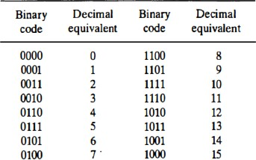
Gray codes are used in the general sequence of hardware-generated binary
numbers.
Cause ambiguities or errors when the transition from one number to its successive is done.
This code simply solves this problem by changing only one bit when the transition is between numbers is done.
Exclusive –OR operation used during conversion.
Table 1.5 : 4-bit Gray Code

Slide 39
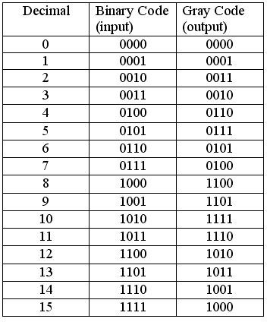

Slide 40
Weighted code (2421)
2421 code is another BCD
code.
It is weighed code.
4 bit application code where the binary weights carry 2,
4, 2, 1 from left to right.
For example, 6 is 1100 and 3 is 0011.
Decimal Number | Binary Number | 2421 Code
0 | 0 | 0000
1 | 1 | 0001
2 | 10 | 0010
3 | 11 | 0011
4 | 100 | 0100
5 | 101 | 1011
6 | 110 | 1100
7 | 111 | 1101
8 | 1000 | 1110
9 | 1001 | 1111
Table 1.6 : 2421 code

Slide 41
Self Complementing Codes
Self-complementing binary codes are those whose members complement on themselves. For a binary code to become a self-complementing code, the following two conditions must be satisfied:
The complement of a binary number should be obtained from that
number by replacing 1’s with 0’s and 0’s with 1’s (already stated procedure).
The sum of the binary number and its complement should be equal to
decimal 9.
The Excess-3 (Xs-3) Code
It is a non-weighted code used to express code used to express decimal numbers.
It is a self-complementary binary coded decimal (BCD) code and numerical system which has biased representation.
41

Slide 42
An Xs-3 equivalent of a given binary number is obtained using the following
steps:
Find the decimal equivalent of the given binary number.
Add +3 to the decimal equivalent obtained in 1.
Convert the newly obtained decimal number back to binary number to get the desired Xs-3 equivalent.
The codes 0000 and 1111 are not used for any digit.

Slide 43
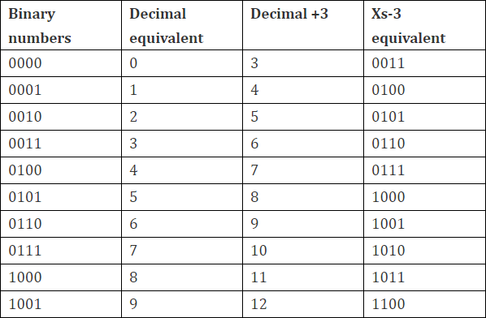
Table 1.7 : Excess-3 Code

Slide 44
Example 1: Convert decimal number 23 to Excess-3 code. Solution:
add 3 to both digit in the decimal number then convert into 4-bit binary number for result of each digit.
So, 23+33=56 =0101 0110
Example 2: Convert decimal number 15.46 into Excess-3 code. Solution:
= 15.46+33.33=48.79 =0100 1000.0111 1001
Example 3: Convert (11110)2 to Excess-3 Solution:
(11110)2 =((1 × 24) + (1 × 23) + (1 × 22) + (1 × 21) + (0 × 20))₁₀ =(16 + 8 + 4 +
2 + 0)₁₀ =(30)₁₀
So,=30+33
= 63

Slide 45
Binary Coding Schemes
Binary Coding schemes represent the data such as alphabets, digits 0−9, and symbols in a standard code.
The binary coding schemes that are most commonly used are:
Extended Binary Coded Decimal Interchange Code (EBCDIC),
American Standard Code for Information Interchange (ASCII), and
Unicode
EBCDIC
The Extended Binary Coded Decimal Interchange Code (EBCDIC) uses 8 bits (4 bits for zone, 4 bits for digit) to represent a symbol in the data.
EBCDIC allows 28 = 256 combinations of bits.
256 unique symbols are represented using EBCDIC code. It represents decimal numbers (0−9), lower case letters (a−z), uppercase letters (A−Z), Special characters, and Control characters (printable and non−printable,
e.g., for cursor movement, printer vertical spacing, etc.)
45

Slide 46
EBCDIC codes are mainly used in the mainframe computers.
ASCII
The American Standard Code for Information Interchange (ASCII) is widely used in computers of all types. ASCII codes are of two types—ASCII−7 and ASCII−8.
ASCII-7 is a 7-bit standard ASCII code. In ASCII-7, the first 3 bits are the zone bits and the next 4 bits are for the digits. ASCII-7 allows 2⁷ = 128 combinations. 128 unique symbols are represented using ASCII-7. ASCII-7 has been modified by IBM to ASCII-8.
ASCII-8 is an extended version of ASCII-7. ASCII-8 is an 8-bit code having 4 bits for zone and 4 bits for the digit. ASCII-8 allows 2⁸ = 256 combinations. ASCII-8 represents 256 unique symbols. ASCII is used widely to represent data in computers.
46

Slide 47
The ASCII-8 code represents 256 symbols.
Codes 0 to 31 represent control characters (non−printable), because they
are used for actions like, Carriage return (CR), Bell (BEL), etc.
Codes 48 to 57 stand for numeric 0−9.
Codes 65 to 90 stand for uppercase letters A−Z.
Codes 97 to 122 stand for lowercase letters a−z.
Codes 128 to 255 are the extended ASCII codes.

Slide 48
Unicode
Unicode is a universal character encoding standard for the representation of text which includes letters, numbers and symbols in multi−lingual environments. Unicode uses 32 bits to represent a symbol in the data.
Unicode allows 2³²= 4164895296 (~ 4 billion) combinations.
Unicode can uniquely represent any character or symbol present in any language like Chinese, Japanese, etc. In addition to the letters; mathematical and scientific symbols are also represented in Unicode codes.
An advantage of Unicode is that it is compatible with the ASCII−8 codes. The first 256 codes in Unicode are identical to the ASCII-8 codes.

Slide 49
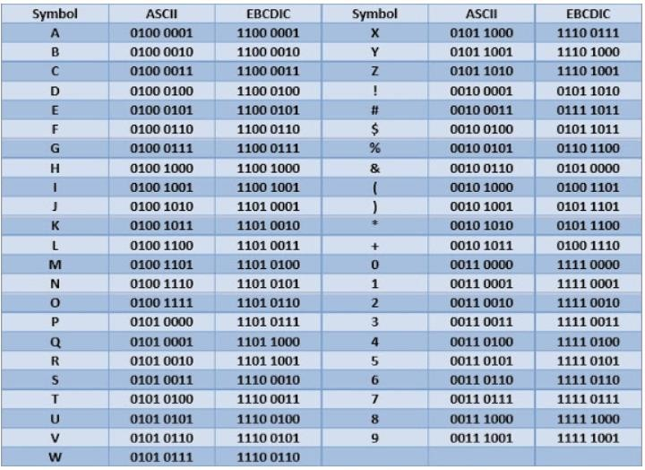
Table 1.8 : ASCII and EBCDIC binary coding schemes
49

Slide 50
1.5 Error detection codes
Binary information transmitted through some form of communication medium is subject to external noise that could change bits from 1 to 0, and vice versa.
An error detection code is a binary code that detects digital errors
during transmission.
The most common error detection code used is the parity bit.
A parity bit is an extra bit included with a binary message to make the
total number of 1's either odd or even. Or A parity bit(s) is an extra bit that is added with original message to detect error in the message during data transmission.
Two possible parity bits: Even Parity and Odd Parity

Slide 51
Even Parity:
One bit is attached to the information so that the total number of 1’s an even number .
Message 10110100
10010010
Odd Parity:
Parity
0
1
One bit is attached to the information so that the total number of 1’s an odd
number .
Message 10110100
10010010
Parity
1
0

Slide 52
Parity Generator and Parity Checker
A Parity Generator is a combinational logic circuit that generates the parity bit in the transmitter (sender end).
A circuit that checks the parity in the receiver end is called Parity Checker.
A combined circuit or device of parity generators and parity checkers are commonly used in digital systems to detect the single bit errors in the transmitted data.

Slide 53
Message x y z | p(odd) | P(even)
0 0 0 | 1 | 0
0 0 1 | 0 | 1
0 1 0 | 0 | 1
0 1 1 | 1 | 0
1 0 0 | 0 | 1
1 0 1 | 1 | 0
1 1 0 | 1 | 0
1 1 1 | 0 | 1

Slide 54
Parity generator and checker networks are logic circuits constructed
with exclusive-OR functions.
P = x ⊕ y ⊕ z
Parity Checker:
Considers original message as well as parity bit e = p ⊕ x ⊕ y ⊕ z
e= 1 => No. of 1’s in pxyz is even => Error in data
e= 0 => No. of 1’s in pxyz is odd => Data is error free
This circuit consists of one exclusive-OR and one exclusive-NOR gate
even-parity generators and checkers can be implemented with exclusive-OR functions. Odd-parity net works need an exclusive-NOR at the output to complement the function.

Slide 55
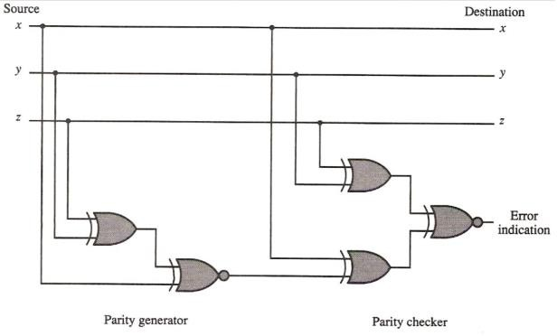
Circuit diagram for
parity generator and parity checker
Figure: Error detection with odd parity bit

Slide 56
Questions
Find the signed magnitude of – (63)₁₀ using 8-bit binary sequence?
Derive the circuit for a 3-bit parity generator and a 4-bit parity checker using even parity bit.
Differentiate between parity checker and parity generator. (T.U. 2066)
Explain the error detection code with example. (T.U. 2068)
Explain the subtraction algorithm with signed 2’s compliment. (T.U. 2067)
What is an error detection code? Explain with example. (T.U. 2070)
Differentiate between fixed point representation and floating point representation. (T.U.2069)
Write short notes on: (T.U. 2069)
-Alphanumeric Representation
-Parity Generator

