Slide 1
Computer Arithmetic

Slide 2
Contents
Introduction
Addition and Subtraction
Multiplication Algorithms
Division Algorithms

Slide 3
Introduction
Arithmetic instructions in digital computers manipulate data to produce results necessary for the solutions of computational problems. These instructions perform arithmetic calculations and are responsible for the bulk of activity involved in processing data in a computer.
The four basic arithmetic operations are addition,subtraction,multiplication and division.
From these four basic operations , it is possible to formulate other arithmetic functions and solve problems by means of numerical analysis methods.
An arithmetic processor is the part of a processor unit that executes arithmetic operations.
An arithmetic instruction may specify binary or decimal data, and in each case the data may be in fixed-point or floating point form.
Negative numbers may be in signed magnitude or signed compliment representation.
Fixed point numbers may represents integers or fractions.

Slide 4
Addition and Subtraction
The addition and subtraction algorithm for data represented in signed magnitude and again data represented in signed 2’s complement.
It is important to realize that the adopted representation for negative numbers refers to the representation of numbers in the register before and after the execution of the arithmetic operations.
Addition and Subtraction with Signed-magnitude Data:
The representation of numbers in signed-magnitude is familiar because it is used in everyday arithmetic calculations. The procedure for adding or subtracting two signed binary numbers with paper and pencils simple and straight-forward. A review of this procedure will be helpful for deriving the hardware algorithm.
When two numbers A and B are signed numbers are added or subtracted, we find that there are eight different conditions to consider, depending on the sign of the numbers and the operation performed.

Slide 5
These conditions are listed in the first column of the table below. The other column in the table show the actual operation to be performed with the magnitude of the numbers. The last column is needed to prevent negative zero.
In other words ,when two equal numbers are subtracted, the result should be +0 not -0.
The algorithms for addition and subtraction are derived from the table and can be stated as follows (the words inside parentheses should be used for the subtraction algorithm) Addition (subtraction) algorithm:
when the signs of A and B are identical (different), add the two magnitude and attach the sign of A to the result.
When the sign of A and B are different (identical),compare the magnitudes and subtract the smaller number from the larger .

Slide 6
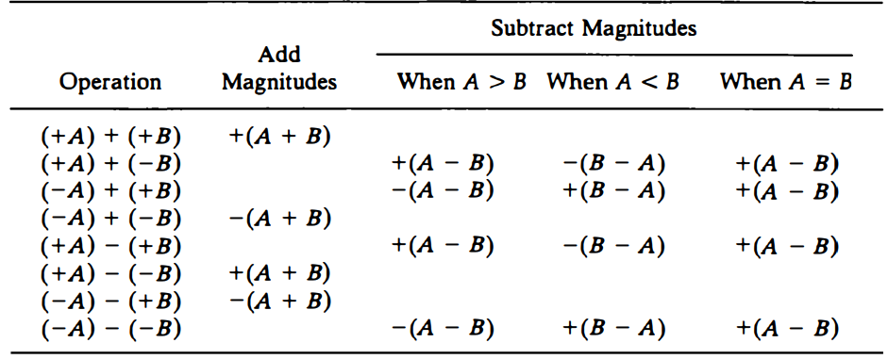
Table : Addition and Subtraction of Signed Magnitude Numbers

Slide 7
Hardware implementation
To implement the two arithmetic operations with hardware, it is first necessary that the two numbers be stored in registers.
Let A and B be two registers that hold the magnitude of the numbers, and A_{s} and B_{s} be two flip-flops that hold the corresponding signs. The results of the operation may be transferred to a third register however, a saving achieved if the result is transferred into A and A_{s} . thus A and A_{s} together from an accumulator register.
Consider now the hardware implementation of the algorithms above.
First, a parallel adder is needed to perform the micro operation A+B.
second, comparator circuit is needed to establish if A>B, A=B, or A<B.
third, two parallel subtractor circuits are needed to perform the micro operation A-B and B-A.
The sign relationship can be determined from an exclusive-OR gate with As and B_{s} as inputs.

Slide 8
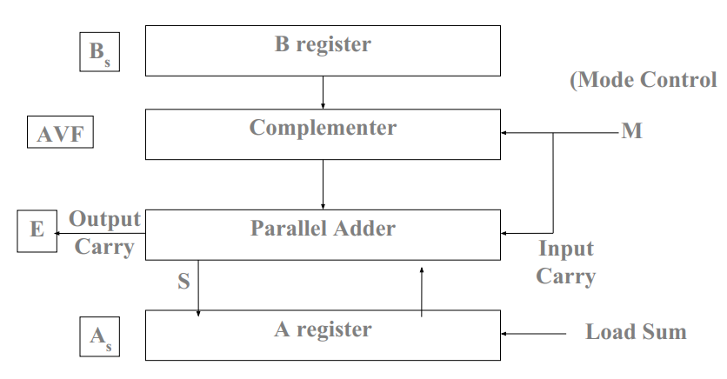
The output carry is transferred to flip-flop E.
The complementer consists of exclusive-OR gates and the parallel adder consists of full adder circuit.
Figure : Hardware for signed magnitude addition and subtraction

Slide 9
For addition: A=3 and B=2, add A+B
+3 0011
+2 0010
……………………
+5 0101
For subtraction: add A+B’ +1
+3 0011
-2 1110
……………………..
+1 00 01

Slide 10
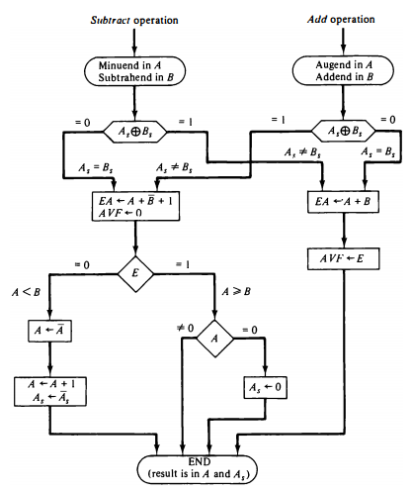
Hardware Algorithm
Figure : Flowchart for add and subtract operations

Slide 11
The two signs A_{s} and B_{s} are compared by an exclusive-OR gate . If the output of the gate is 0, the signs are identical if it is 1, the signs are different.
The magnitudes are added with a micro operation EA ← A+B.. Where EA is a register that combines E and A . The carry in E after the addition constitutes an overflow if it is equal to 1 and transferred into the add overflow flip-flop AVF.
The two magnitudes are subtracted if the signs are different for an add operation or identical for a subtract operation.
The magnitudes are subtracted by adding A to the 2’s complement of B.
No overflow can occur if the numbers are subtracted to AVF is cleared to 0. A 1 in E, indicates that A ≥ B and the number in A is the correct result.
If this number is zero, the sign A, must be made positive to avoid a negative zero. A 0 in E indicates that A < B.
Examples : (+8) + (-3) = +5, (-8) +(-3)= -11, (+8) - (-3) = +11, (-8) - (-3) = -5

Slide 12
Addition and Subtraction with Signed 2’s Complement Data
The left most bit of binary number represents the sign bit 0 for positive and 1 for negative. If the sign bit is 1, the entire the entire number is represented in 2’s compliment form (+33 is represented as 00100001 and -33 as 11011111. Note that 11011111 is the 2's complement of 00100001, and vice versa ).
The addition of two numbers in signed 2’s complement form consists of adding the number with the sign bits treated the same as the other bits of the number . A carry out of the sign bit position is discarded .
The subtraction consists of first taking the 2’s compliment of the subtrahend and then adding it to the minuend
When two numbers of n digits each are added and the sum occupies n+1 Digits, we say that an overflow occurred.
When the two carries are applied to an exclusive-OR gate, the overflow is detected when the output of the gate is equal to 1.

Slide 13
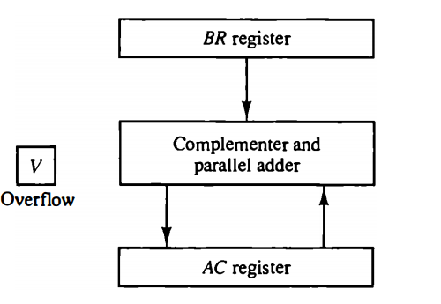
AC and BR are the registers to hold the numbers.
The leftmost bit in AC and BR represent the sign bits of the numbers.
The two sign bits are added or subtracted together with the other bits in the complementer and parallel adder.
The overflow flip flop V is set to 1 if there is an overflow. The output carry in this case is discarded.
Figure : Hardware for signed 2's complement addition and subtraction.

Slide 14
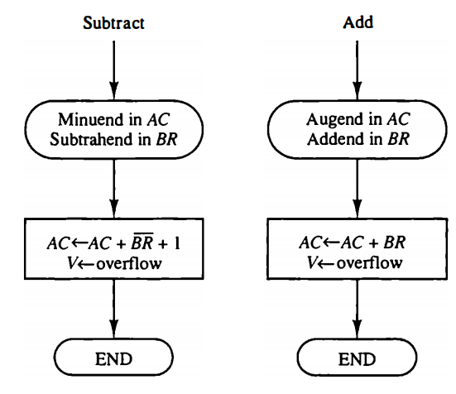
The sum is obtained by adding the contents of AC and BR.
The overflow bit V is set to 1 if the exclusive OR of the last two carries is 1, and it is cleared to 0 otherwise.
The subtraction operation is accomplished by adding the content of AC to the 2’s complement of BR. Taking the 2’s complement of BR has the effect of changing a positive number to negative, and vice versa.
Figure : Algorithm for adding and subtracting numbers in signed-2's complement representation.

Slide 15
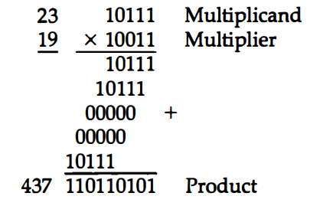
Multiplication Algorithms
Signed Magnitude representation
Multiplication of two fixed point binary numbers in signed magnitude representation is done with paper and pencil of successive shift and add operation.
If the multiplier bit is a 1, the multiplicand is copied down; otherwise, zeros are copied down.

Slide 16
Hardware Implementation for Signed Magnitude data
When multiplication is implemented in a digital computer, it is convenient to change the process slightly. First instead of providing register to store and add simultaneously as many binary numbers as there are bits in the multiplier , as it is convenient to provide an adder for the summation of only two binary numbers and successively accumulate the partial products in a register. Second instead of shifting the multiplicand to the left , the partial product is shifted to the right
The hardware for multiplication consists of the equipment shown in fig. plus two are more registers.
These registers are together with registers A and B.
The multiplier stored in the Q register and its sign in Qs The sequence counter SC is initially set to a number equal to the number of bits in the multiplier. The counter is decremented by 1 after forming each partial product
The sum of A and B forms a partial product which is transferred to the EA register .

Slide 17
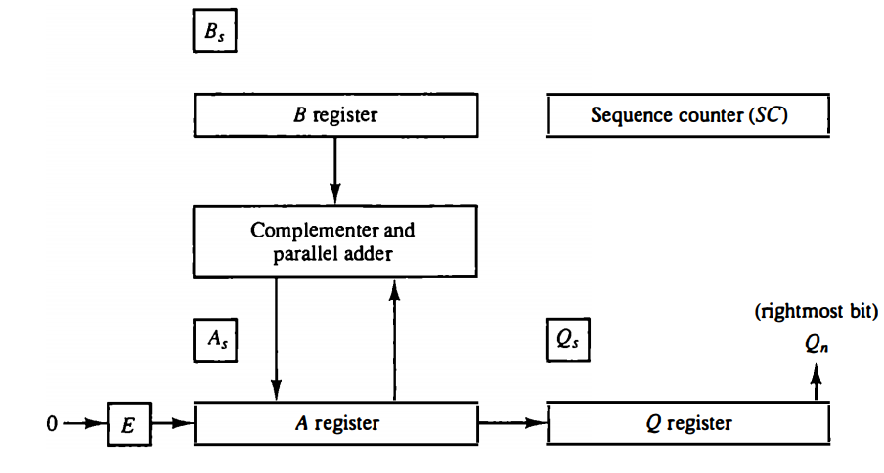
Figure : Hardware for multiply operation.
The shift will be denoted by the statement shr EAQ to designate the right shift depicted .
The least significant bit of A is shifted into the most significant position of Q.

Slide 18
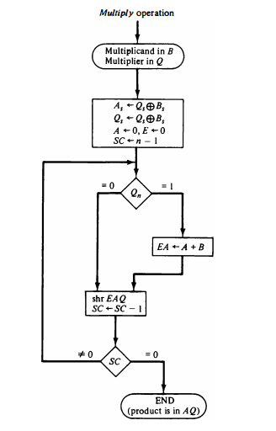
Hardware Algorithm
Initially the multiplicand is in B and the multiplier in Q there corresponding signs are in B_{s} and Q_{s} .,respectively.
Register A and E are cleared and the sequence counter SC is set to a number equal to the number of bits of the multiplier.
After the initialization , the low order bit of the multiplier is in Q_{n} is tested .if it is 1,the multiplicand In B is added to the present partial product in A . If it is 0, nothing is done .
Register EAQ shifted once to the right to form the new partial product.
The process stops when SC=0.
Note that the partial product formed in A is shifted into Q one bit at a time and eventually replaces multiplier. The final product is available in both A and Q,with A holding the most significant bits and Q holding the least significant bits.
Figure : Flowchart for multiply operation.

Slide 19
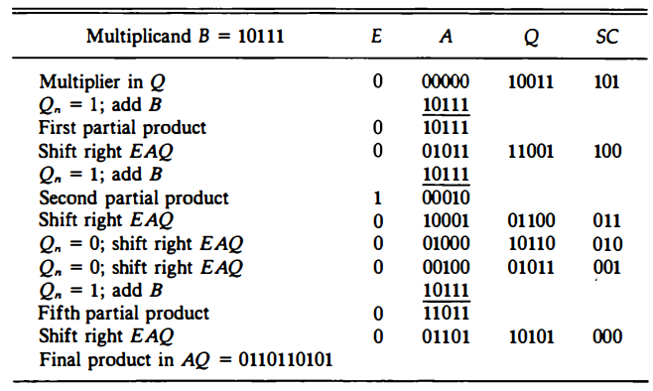
Booth Multiplication Algorithm
Example: 23 x 19 = 437, B=10111 and Q=10011
TABLE : Numerical Example for Binary Multiplier

Slide 20
Signed 2’s complement representation
Booth algorithm gives a procedure for multiplying binary integers in signed 2’s complement representation.
It operates on the fact that strings of 0's in the multiplier require no addition but just shifting, and a string of 1's in the multiplier from bit weight 2^{k} to weight 2^{m} can be treated as 2^{k+1} – 2^{m}.
For example, the binary number 001110 (+ 14) has a string of 1's from 2³ to 2¹ (k = 3, m = 1). The number can be represented as 2^{k-1} - 2^{m} = 2⁴ – 2¹ = 16-2 = 14.
Therefore, the multiplication M x 14, where M is the multiplicand and 14 the multiplier, can be done as M x 2⁴ - M X 2¹ Thus the product can be obtained by shifting the binary multiplicand M four times to the left and subtracting M shifted left once.

Slide 21
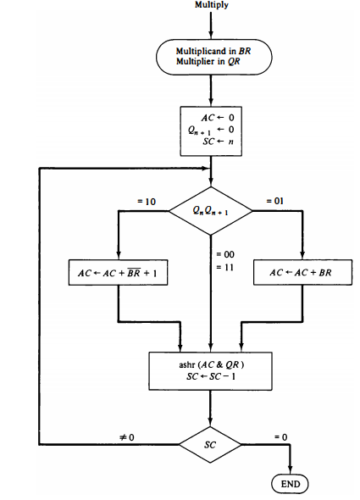
Hardware for booth algorithm
The two bits of multiplier in Q_{n} and Q_{n+1} are inspected . If the two bits are equal to 10 it means that the first 1 in a string of 1’s has been encountered.
The final value of Q_{n+1} is the original sign bit of the multiplier and should not be taken as part of the product.
Figure : Booth algorithm for multiplication of signed 2's complement numbers.

Slide 22
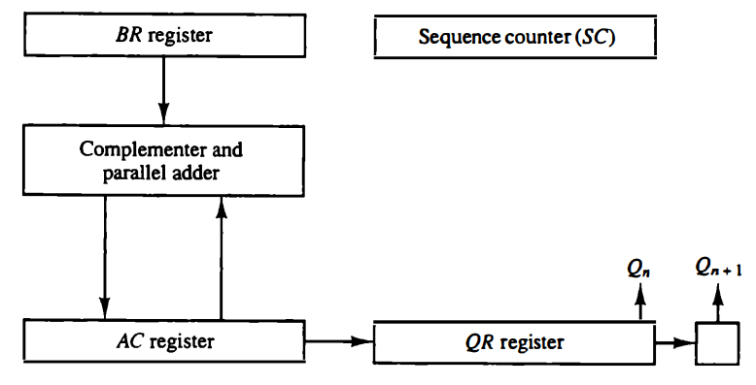
Figure : Hardware for Booth algorithm

Slide 23
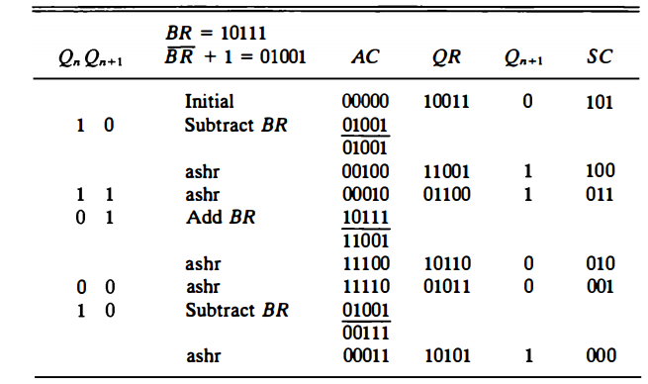
Example : (-9) x ( - 13) = + 117 BR=10111 (multiplicand) and QR=10011 (multiplier)

Slide 24
Q. Multiply the two numbers 23 and -9 by using the Booth's multiplication algorithm.
Here, BR = 23 = (010111) and QR= -9 = (110111)
Q_{n} Q_{n + 1} | BR= 0 1 0 1 1 1 BR' + 1 = 1 0 1 0 0 1 Operation | AC | QR | Q_{n + 1} SC
 | Initially | 000000 | 110111 | 0 6
1 0 | Subtract BR | 101001
 |  | 101001
 | ashr | 110100 | 111011 | 1 5
1 1 | ashr | 111010 | 011101 | 1 4
1 1 | ashr | 111101 | 001110 | 1 3
0 1 | Addition BR | 010111
 |  | 010100
 | ashr | 001010 | 000111 | 0 2
1 0 | Subtract BR | 101001
 |  | 110011
 | ashr | 111001 | 100011 | 1 1
1 1 | ashr | 111100 | 110001 | 1 0

Slide 25
Q_{n + 1} = 1, it means the output is negative.
Hence, 23 * -9 = 2's complement of 111100110001 => (00001100111)
Solve
Q. Multiply 3 x 5 using booth algorithm.
Q. Multiply -5 x 4 using booth algorithm.
Q. Multiply (-10) *(-4) using Booth's algorithm.

Slide 26
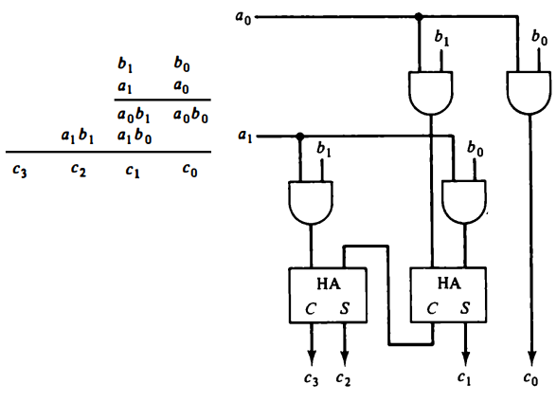
Array multiplier
The multiplication of the two binary numbers can be done with one micro-operation by means of a combinational circuit that forms the product bits all at once. This is a fast way of multiplying two numbers since all it takes is the time for the signals to propagate through the gate that form the multiplication array.
Figure : 2-bit by 2-bit array multiplier

Slide 27
Consider the multiplication of two 2-bit numbers as shown in Figure. The multiplicand bits are b1 and b0, the multiplier bits are a1 and a0, and the product is c3 c2 c1 c0.
This is identical to an AND operation and can be implemented with an AND gate. the first partial product is formed by means of two AND gates.
The second partial product is formed by multiplying a1 by b1 b0 and is shifted one position to the left. The two partial products are added with two half-adder (HA) circuits.
A combinational circuit binary multiplier with more bits can be constructed in a similar fashion.
For j multiplier bits and k multiplicand bits we need j x k AND gates and (j - 1) k-bit adders to produce a product of j + k bits.

Slide 28
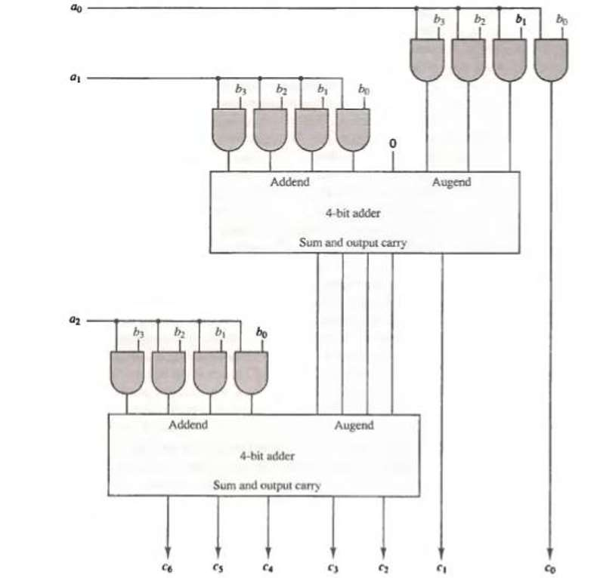
Figure : 4-bit by 3-bit array multiplier

Slide 29
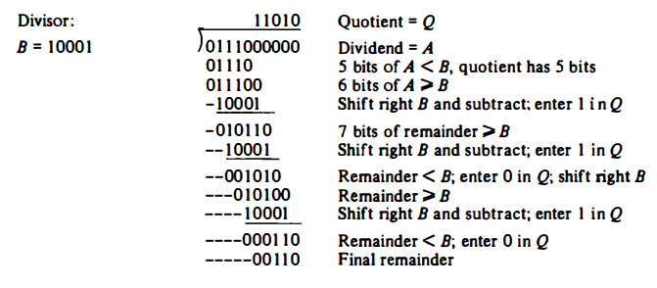
Division Algorithm
Division of two fixed-point binary numbers in signed magnitude representation is done with paper and pencil by a process of successive compare ,shift ,and subtract operations.
Figure : Example of binary division, 448/17

Slide 30
Hardware Implementation for Signed-Magnitude Data
When the division is implemented in a digital computer, it is convenient to change the process slightly. Instead of shifting the divisor to the right, the dividend, or partial remainder, is shifted to the left, thus leaving the two numbers in the required relative position. Subtraction may be achieved by adding A to the 2's complement of B. The information about the relative magnitudes is then available from the end-carry.
Register EAQ is now shifted to the left with 0 inserted into Q, and the previous value of E lost.
Restoring Method: The reason for the name is that the partial remainder is restored by adding the divisor to the negative difference. Two other methods are available for dividing numbers, the Comparision method and the Nonrestoring method.
No restoring method B is not added if the difference is negative but instead, the negative difference is shifted left and then B is added.

Slide 31
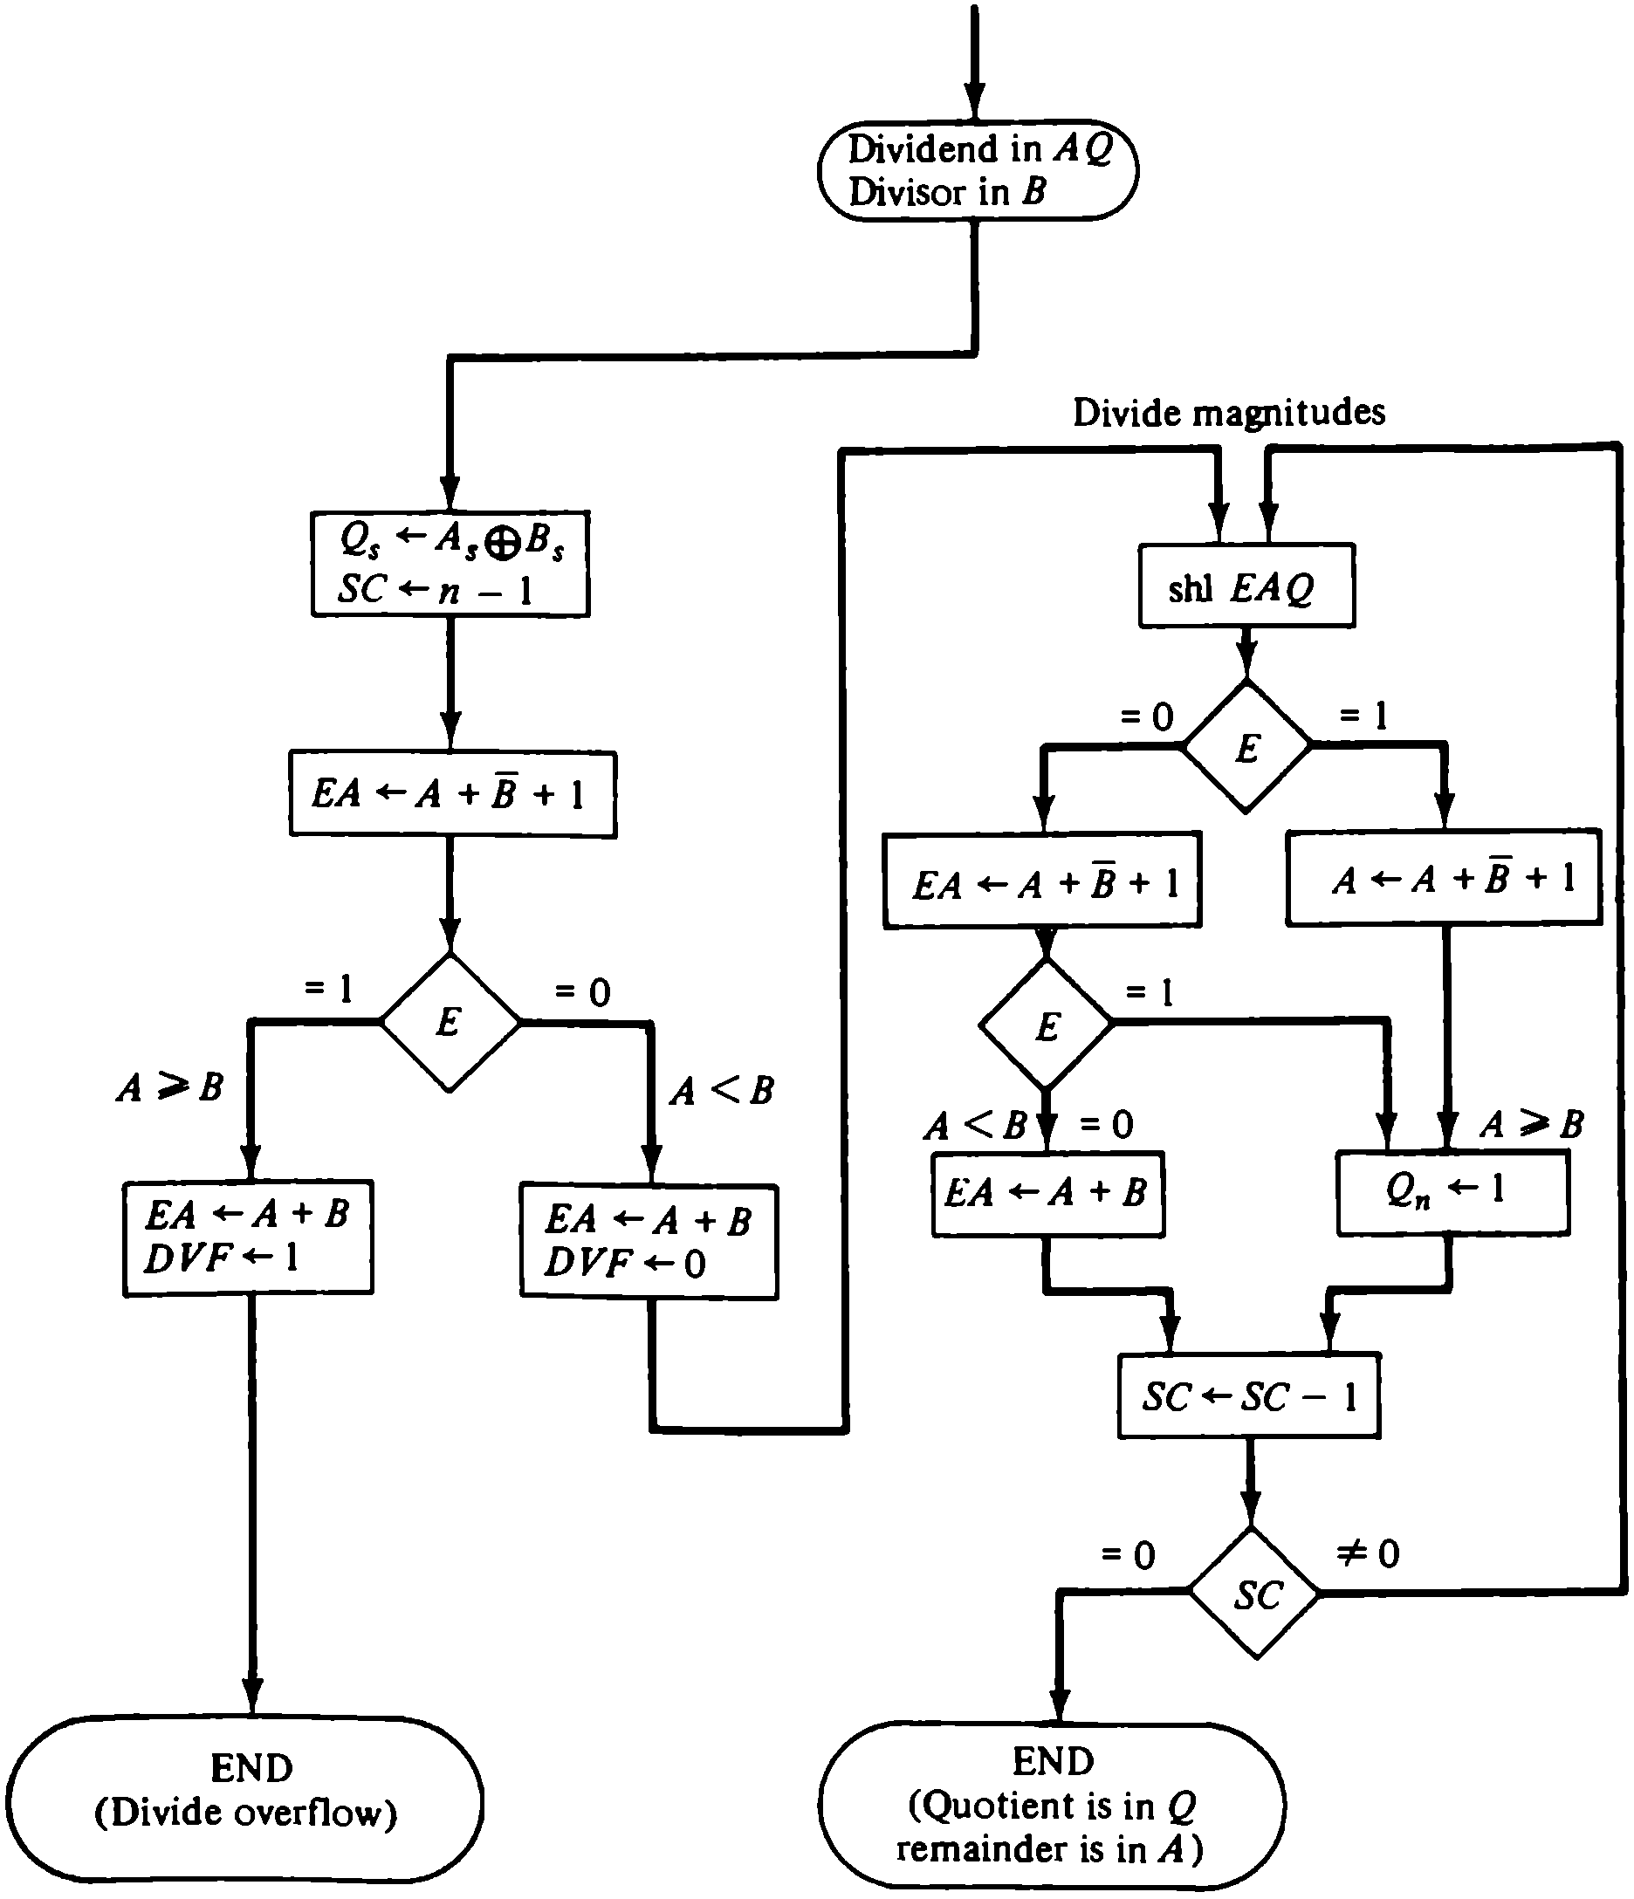
Hardware Algorithm (Restoring Algorithm)
Divide operation
This is restoring step
The dividend AQ and the divisor is B . The sign of the result is transferred into Q_{s} to be part of the quotient.
The sequence counter SC to specify the number of bits in the quotient.
If A >= B, the divide-overflow flip-flop DVF is set and the operation is terminated prematurely. If A < B, no divide overflow occurs so the value of the dividend is restored by adding B to A .

Slide 32
The division o f the magnitudes starts by shifting the dividend in A Q to the left with the high-order bit shifted into E. If the bit shifted into E =1, EA > B so B is subtracted from EA and Q_{n} is set to 1.
If E=0, the divisor is subtracted by adding its 2's complement value and the carry is transferred into E .If E = 1, it signifies that A >=B; therefore, Q_{n} is set to 1. If E = 0, it signifies that A < B and the original number is restored by adding B to A and we leave a 0 in Q_{n} .
This process is repeated again with register A holding the partial remainder. After n - 1 times, the quotient magnitude is formed in register Q and the remainder is found in register A . The quotient sign is in Q_{s} and the sign of the remainder in A_{s}

Slide 33
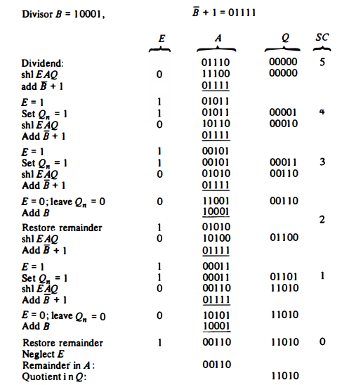

Example : 448/17
Figure :Example of binary division with digital hardware.

Slide 34
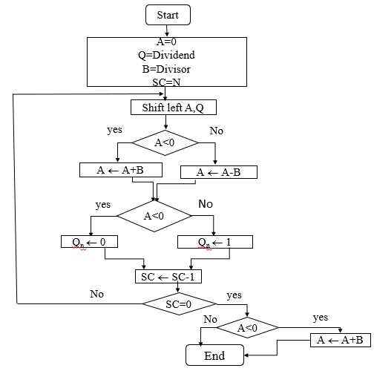
Non-restoring division Algorithm

Slide 35
First the registers are initialized with corresponding values (Q = Dividend, B= Divisor, A = 0, SC = number of bits in dividend)
Step2: Check the sign bit of register A
If it is 1 shift left content of AQ and perform A = A+B, otherwise shift left AQ and perform A = A-B (means add 2’s complement of M to A and store it to A)
Again the sign bit of register A
If sign bit is 1 Q_{n} become 0 otherwise Q_{n} become 1 (Q_{n} means least significant bit of register Q)
Decrements value of SC by 1
If SC is not equal to zero go to Step 2 otherwise go to next step
If sign bit of A is 1 then perform A = A+B
Register Q contain quotient and A contain remainder

Slide 36
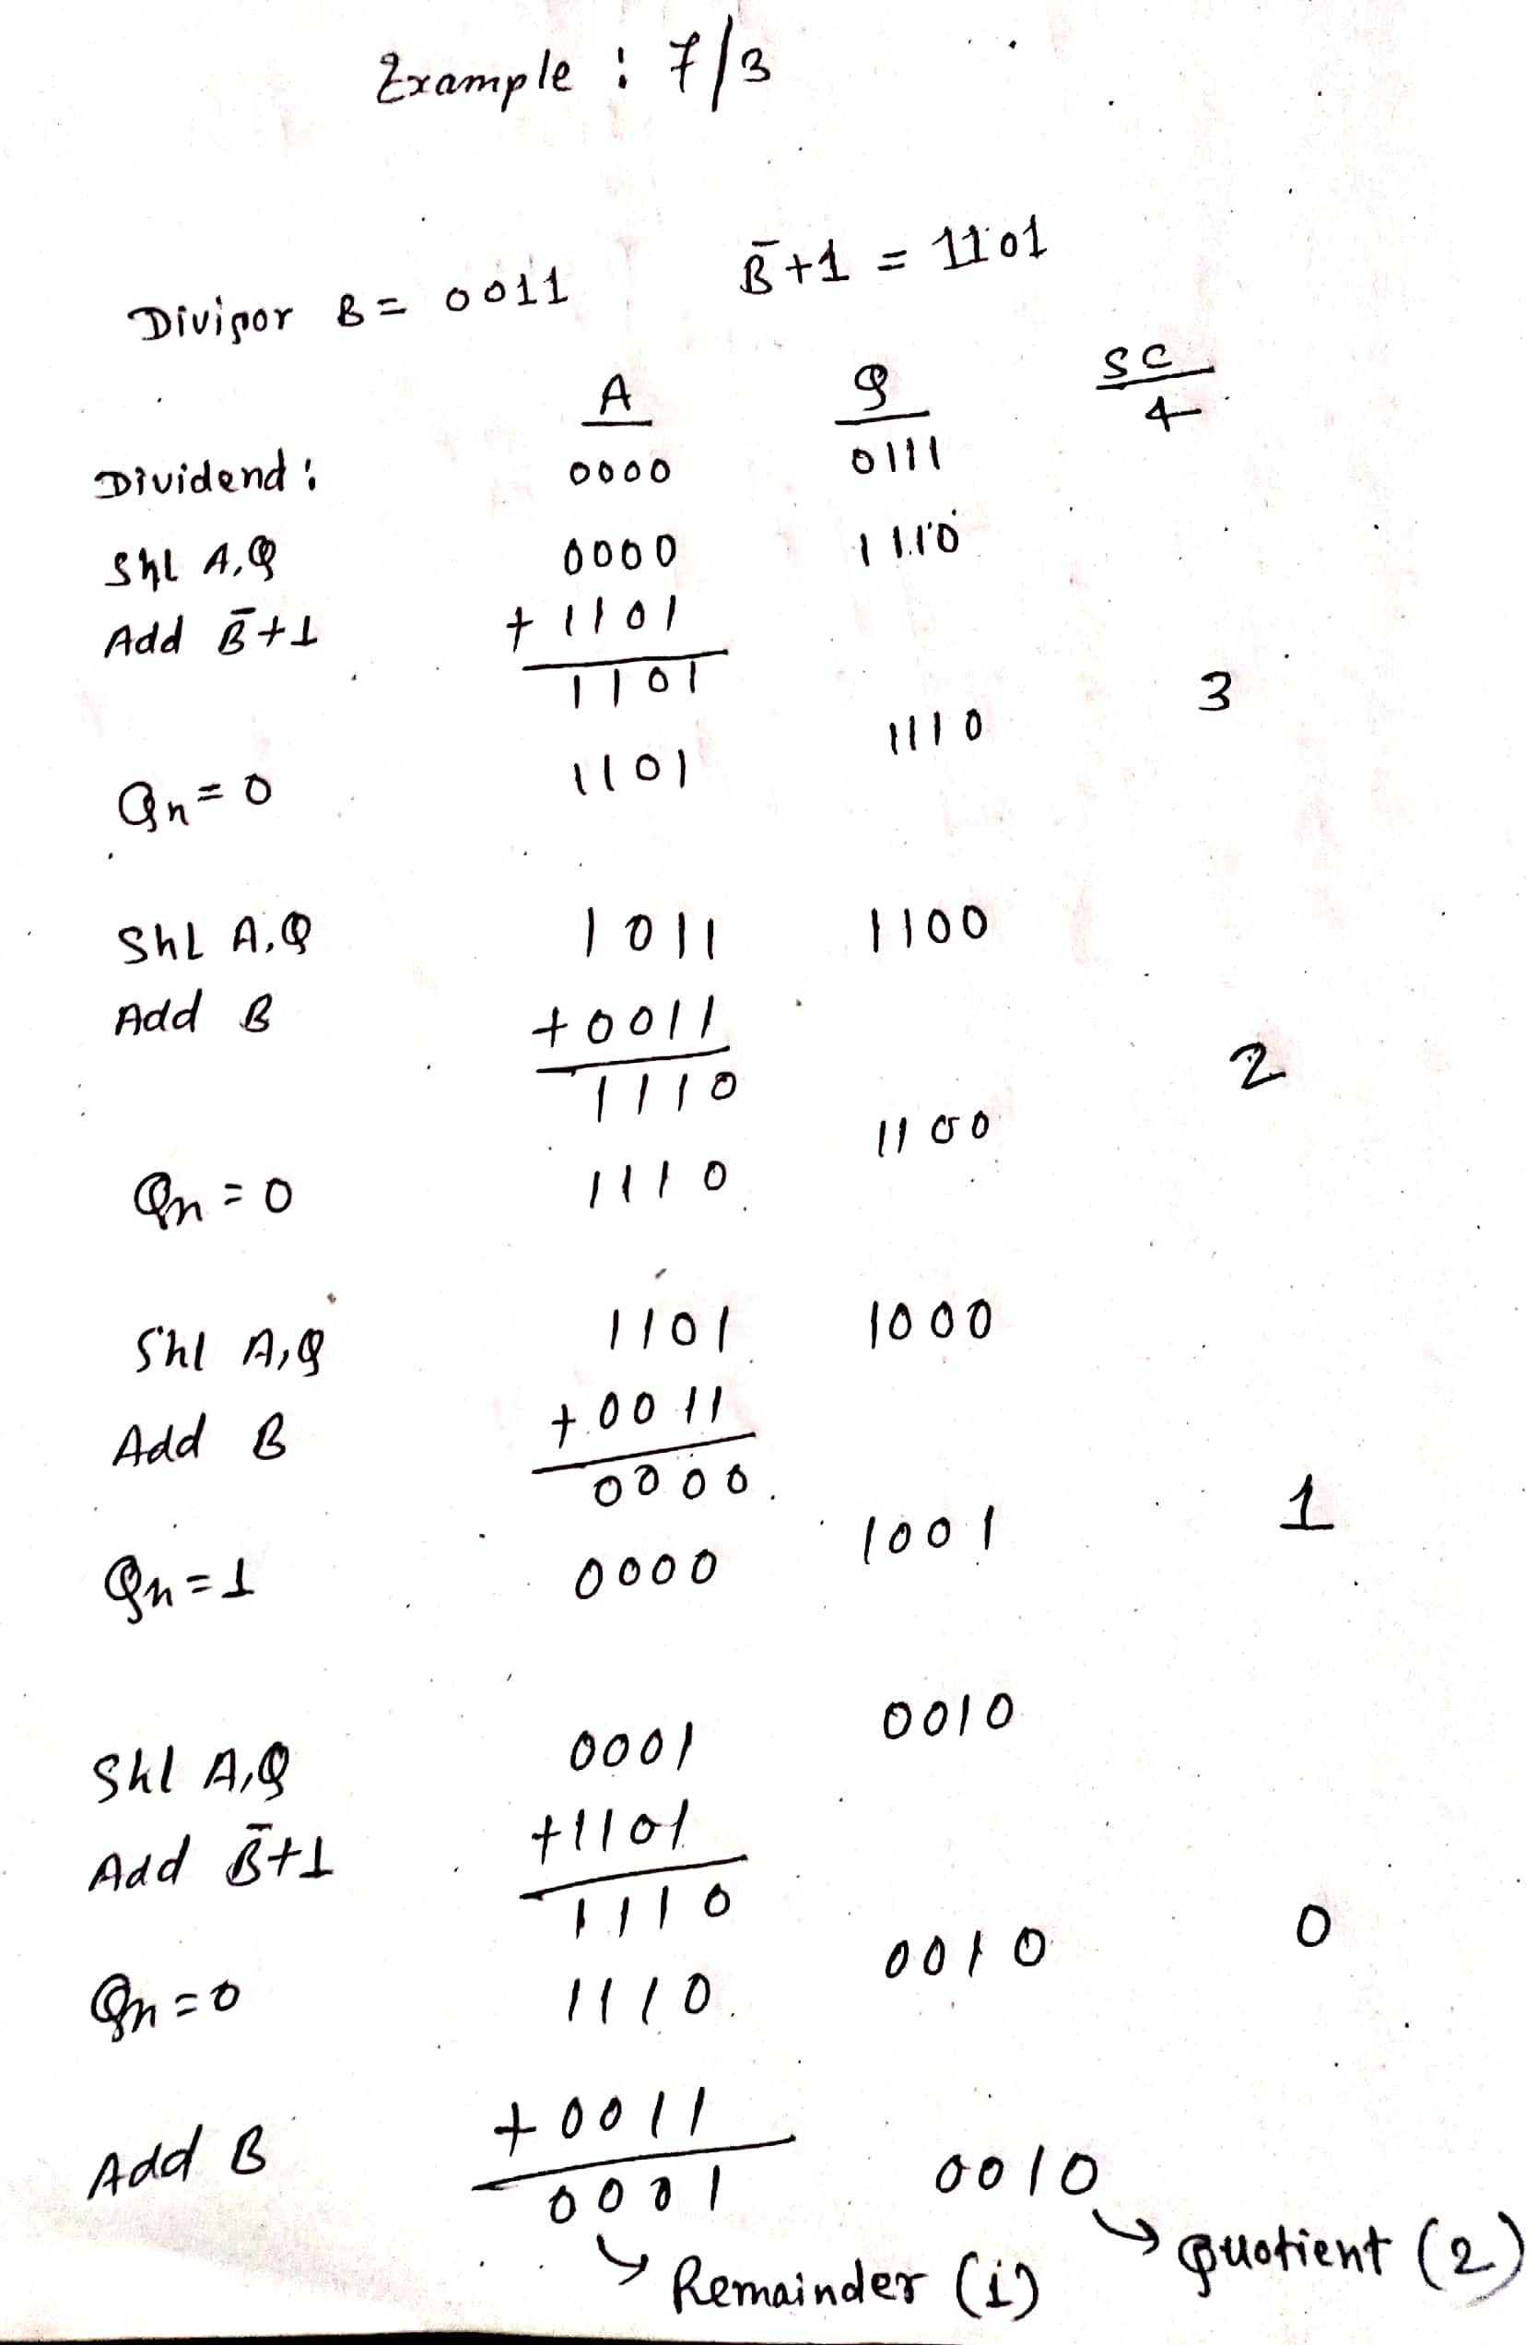
Example: 7/3

Slide 37
Q. Divide 11/3 using non-restoring division
Q. Divide 5/3 using non-restoring division

