Slide 1
Searching and Hashing

Slide 2
Contents
Introduction
Search Algorithm: Sequential Search ,Binary Search
Efficiency of search algorithms
Hashing: Hash function and hash tables
Collision Resolution techniques

Slide 3
Introduction
The process of finding the location of an element with a specific value (key) within a collection of elements. or
Searching is a process of checking and finding an element from a list of elements.
Let A be a collection of data elements, i.e., A is a linear array of say n elements. If we want to find the presence of an element “data” in A, then we have to search for it. The search is successful if data does appear in A and unsuccessful if otherwise.
Searching is divided into two categories Linear and Binary search.

Slide 4
Linear or Sequential Searching
In linear search, each element of an array is read one by one sequentially and it is compared with the desired element.
A search will be unsuccessful if all the elements are read and the desired element is not found.
The technique can be implemented on a small size of list, efficiency of sequential
search is low compared to other searching techniques.
The simplest search algorithm, but is also the slowest.
Searching is done from the 0th index and is traversed through the complete list until the element is found or the end of the list is reached.

Slide 5

Algo:
linearSearch(A, n,target){ for(i = 0; i < n; i++){
if (A[i] == target){ return i;
}
return -1; //-1 indicates unsuccessful search
}

Slide 6
Time complexity:
Best case: the desired element is present in the first position of the array, i.e. only
one comparison is made. So , O(1).
Average case: the desired element is found in the half position of the array, 1+2+3+…+n/n = n(n+1)/2n=O(n+1/2)
Worst case: the desired element is present in the nth (or last) position of the array,
so, O(n)

Slide 7
Examples :
Input : arr[] = {10, 90, 80, 30, 60, 50, 110, 100}
target = 110;
Output : 6 // Element target is present at index
Input : arr[] = {10, 20, 80, 30, 60, 50,110, 100}
x = 175;
Output : -1 // Element target is not present in arr[].
Time complexity: O(n)
Linear search can be applied to both single-dimensional and multi-dimensional arrays.

Slide 8
Binary search
Binary search is an extremely efficient algorithm when it is compared to linear search.
Binary search technique searches “data” in minimum possible comparisons.
Used to construct a BST and traverse in preorder, post order, inorder
Suppose the given array is a sorted one, otherwise first we have to sort the array elements. Then apply the following conditions to search a “data”.
Then apply the following conditions to search a “data”.
Find the middle element of the array (i.e., n/2 is the middle element if the array or the sub-array contains n elements).
Compare the middle element with the data to be searched, then there are following
three cases.

Slide 9
If it is a desired element, then search is successful.
If it is less than desired data, then search only the first half of the array, i.e.,
the elements which come to the left side of the middle element.
If it is greater than the desired data, then search only the second half of the array, i.e., the elements which come to the right side of the middle element.
Repeat the same steps until an element is found or exhaust the search area.

Slide 10
BinarySearch(A[], data, low, high) {
low=0,high=n-1;
while (low <= high) { mid =(low+ high)/ 2; if (data= A[mid] )
return mid; // target found else if (data< A[mid]) high= mid -1;
else
low = mid +1;
} return -1; // target not found
}

Slide 11
Example:
0
1
2
3
4
5
6
10 | 14 | 19 | 26 | 31 | 42 | 44
Item to be searched =14 Low=0,high=6 Mid=(0+6)/2=3
Key=14, A[mid]=26 High=mid-1=3-1=2 Low=0,high=2
mid=0+2/2=1
Key=A[mid],A[1]=14 Element found at index 1, Hence 1 will get returned.

Slide 12
Q. Tress a Binary search algorithm I/P data:- 75, 151, 203, 275, 318, 489, 524, 591, 647, 727
Search Pop x = 275, 727, 725.
Time complexity:
Best Case Complexity - In Binary search, the best case occurs when the element to search is found in the first comparison, i.e., when the first middle element itself is the element to be searched. The best-case time complexity of Binary search is O(1).
Average Case Complexity - The average case time complexity of Binary search is O(logn).
Worst Case Complexity - In Binary search, the worst case occurs, when we have to keep reducing the search space till it has only one element. The worst-case time complexity of Binary search is O(logn).

Slide 13
Tree Search
Whenever an element is to be searched, start searching from the root node. Then
if the data is less than the key value, search for the element in the left sub-tree.
Otherwise, search for the element in the right sub-tree. Follow the same algorithm for each node. Time Complexity: O(log2 n)
Algorithm
Step 1: Start
Step 2: Create a binary tree
Step 3: Declare a variable x to store the element to be searched

Slide 14
Step 4: If x = current node
Print current node value, go to step 5
If x > current node, move to right child If x < current node, move to left child
Step 5: Stop
Example:
Search the element 11 from the given element. 43, 10, 79, 90, 12, 54, 11, 9, 50
Solution: First of all we need to create binary search tree from given data

Slide 15
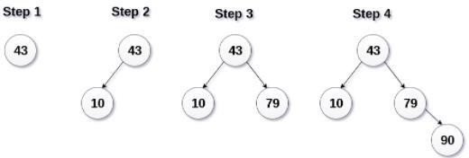
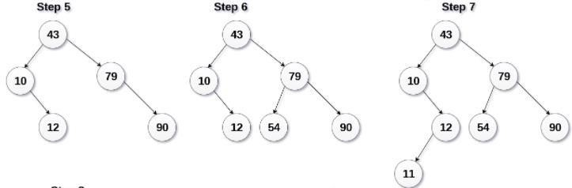

Slide 16
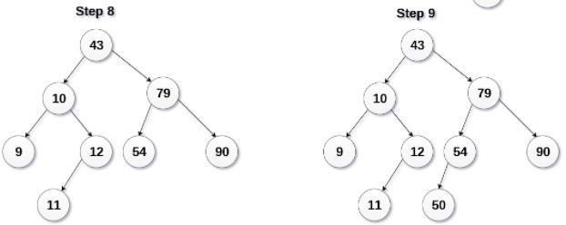
New Search the element 11 from the binary tree

Slide 17
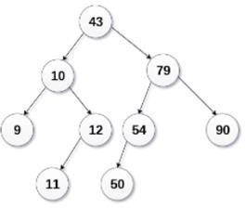
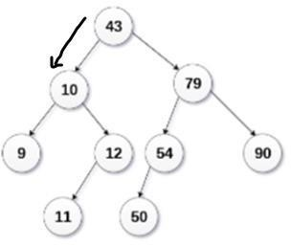
Compare 11 with current node 43, 11 is less than 43. So, move to left child

Slide 18
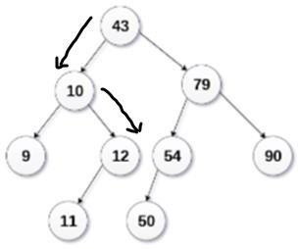
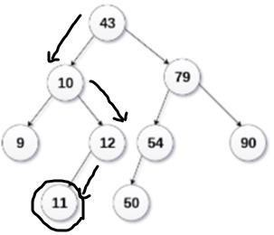
Now, compare 11 with current node 10, 11 is greater than 10. So, move to rightchild
Now, compare 11 with current node 12, 11 is less than 12. So, move to left child
Now, compare 11 with current node 11, 11 is equals to current node. So, element is found, retrieve the current node value i.e. 11.

Slide 19
Hashing
The searching time of the each searching technique, that were discussed in the previous section, depends on the comparison. i.e., n comparisons required for an array A with n elements.
To increase the efficiency, i.e., to reduce the searching time, we need to avoid unnecessary comparisons.
Hashing is a technique where we can compute the location of the desired record in order
to retrieve it in a single access (or comparison).
Let there is a table of n employee records and each employee record is defined by a
unique employee code, which is a key to the record and employee name. If the key (or employee code) is used as the array index, then the record can be accessed by the key directly.

Slide 20
Hash function is the transformation of the key into the corresponding location in the
hash table.
A Hash function H can be defined as a function that takes key as input and transforms
it into a hash table index.
Hash functions are of two types:
Distribution- Independent function
Distribution- Dependent function
We are dealing with Distribution - Independent function. Following are the most popular Distribution - Independent hash functions :
Division method
Mid Square method
Folding method.

Slide 21
Division Method : The division method is one of the simplest and most commonly used hash functions in hashing. It works by dividing the key by a prime number and using the remainder as the hash value.
Formula
h(k)=k mod m
Where:
h(k) = Hash value of key k
k = Key (input data)
m= Table size (usually a prime number)
\mod = Modulus operator (returns remainder)

Slide 22
Example:
Let's say we have a hash table of size 7 (m=7), and we need to store the key 50.
h(50)=50 mod 7 =1
So, the key 50 is stored in index 1 of the hash table.

Slide 23
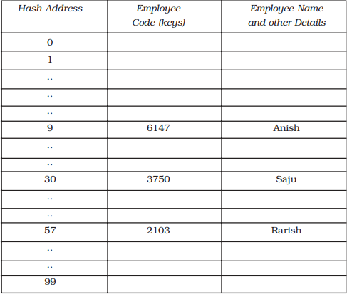
Mid Square Method :The key k is squared. Then the hash function H is defined by H(k) = k² = l
Where l is obtained by digits from both the end of k² starting from left. Same number of digits must be used for all of the keys.
For example consider following keys in the table and its hash index :
Fig. Hash table

Slide 24
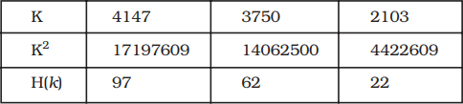
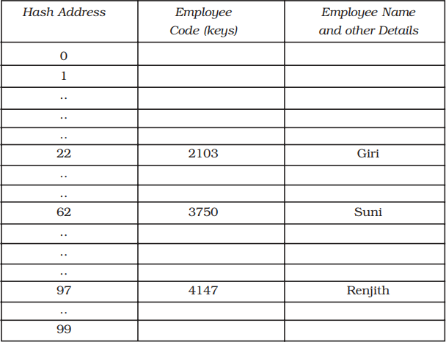
Fig. Hash table with mid square division

Slide 25
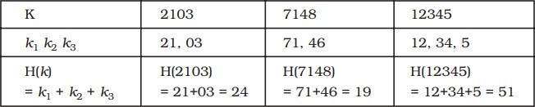
Folding Method :The key K, k₁, k₂,...... k_{r} is partitioned into number of parts. The parts have same number of digits as the required hash address, except possibly for the last part. Then the parts are added together, ignoring the last carry. i.e., H(k) = k₁ + k₂ + ...... + k_{r}
Here we are dealing with a hash table with index form 00 to 99, i.e., two-digit
hash table. So we divide the K numbers of two digits.

Slide 26
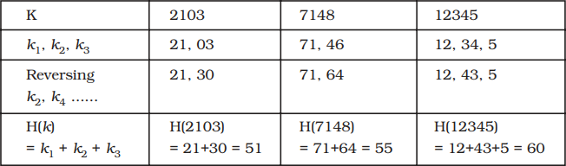
Let’s say we have a key = 123456789 and a table size = 1000.
Break the key into parts (3-digit parts):
123 | 456 | 789
Sum the parts:
123+456+789=1368
Apply modulus with table size (1000):
1368 mod 1000=368
Final hash index: 368

Slide 27
Hash collision : If two or more than two records trying to insert in a single index of a hash table then such a situation is called hash collision.
It is possible that two non-identical keys K₁, K₂ address.
Collision Resolution technique:
are hashed into the same hash
Open Hashing: separate chaining
Closed chaining: Open Addressing
Linear probing
Quadratic probing
Double hashing

Slide 28
Separate chaining:
All keys that map to the same hash value are kept in a list (or “bucket”)
Example:
Insert the following sequence of keys in the hash table 50, 700, 76, 85, 92, 73 and 101 Use separate chaining technique for collision resolution using the hash function H(k) = k (mod m).
Sol^{n}: Here, hash table consisting of 7 locations(0-6).
H(7) = 50 mod 7 = 1. So, key 50 will be inserted in location-1 of the hash table
H(700)=700 mod 7 = 0. So, key 700 will be inserted in location-0 of the hash table H(76) =76 mod 7 = 6. So, key 76 will be inserted in location-6 of the hash table

Slide 29
H(85)=85 mod 7 = 1 Since location-1 is already occupied, so collision occurs. So, key 85 will be inserted in location-1 of the hash table
H(92)=92 mod 7 = 1. Since location-1 is already occupied, so collision occurs. So,
key 92 will be inserted in location-1 of the hash table
H(73)=73 mod 7 = 3. So, key 73 will be inserted in location-3 of the hash table H(101)=101 mod 7 = 3 Since location-3 is already occupied, so collision occurs key 101 will be inserted in location-3 of the hash table

Slide 30
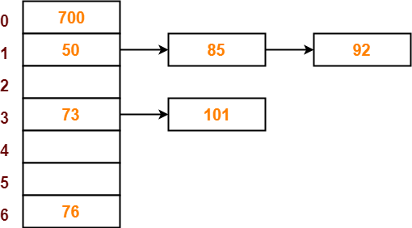

Slide 31
Open Addressing Techniques
Linear probing:
A hash-table in which a collision is resolved by putting the item in the next empty place within the occupied array space.
It starts with a location where the collision occurred and does a sequential search
through a hash table for the desired empty location. Hence this method searches in
straight line, and it is therefore called linear probing.
Example:
Insert keys {50, 700, 76, 85, 92, 73 ,101} with the hash function h(k)=k mod 7 using linear
probing.
Solution:
when k=50: H(50)=50%7=1,insert key 50 in hash-table in location 1

Slide 32
when k=700: H(700)=700%7=0,insert key 700 in hash-table in location 0
when k=76: H(76)=76%7=6,insert key 76 in hash-table in location 6
when k=85: H(85)=85%7=1,insert key 85 in hash-table in location 1,location-1 is already occupied, so collision occurs. So, key 85 will be inserted in location-2 of the hash table.
when k=92: H(92)=92%7=1,insert key 92 in hash-table in location 1,location-1 is already occupied, so collision occurs. The first empty bucket is location-3.So, key 92 will be inserted in bucket-3 of the hash table.
when k=73: H(73)=73%7=3,insert key 73 in hash-table in location 3, Since location-3 is already
occupied, so collision occurs. The first empty bucket is location-4.So, key 73 will be inserted in
bucket-4 of the hash table.
when k=101: H(101)=101%7=3,insert key 101 in hash-table in location 3, The first empty
bucket is location-5.So, key 101 will be inserted in location of the hash table.

Slide 33
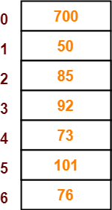
Advantages:
Simple to implement
Data tend to cluster
around
home
address resulting to compactness of
disk spaces
Disadvantages:
Data tend to cluster around specific home address (Primary Clustering)
The linear searching is required if data is not present in the searched location,
this is very slow process

Slide 34
Quadratic probing:
Quadratic probing is a collision resolution method that eliminates the primary clustering problem take place in a linear probing.
In case of collision Rehash functions : (Hash value + 1²) % size if there is again collision occur then there exist rehashing. (Hash value + 2²) % size & so on.
Example:
Insert keys {29, 18, 43, 10, 46, 54} with the hash-table size 11 using quadratic probing.
solution:
when k=29: H(29)=29%11=7. insert key 29 in hash-table in location 7
when k=18: H(18) = 18%11 = 7 (Collision occur), so use following hash function,(hash value + 1²) %11=(7 + 1 ) % 11 = 8. hence insert key 18 in hash-table in location 8

Slide 35
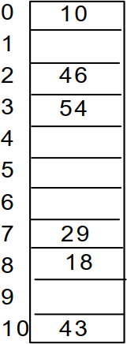
when k=43: H(43) = 43%11= 10, insert key 43 in hash-table in location
10
when k=10: H(10) = 10 % 11 = 10 (Collision occur)
so use following hash function,(hash value + 1²) %11=(10 + 1 ) % 11 = 0, insert key 10 in hash-table in location 0
when k=46: H(46) = 46%11 = 2, insert key 46 in hash-table in location 2 when k=54 : H(54) = 54%11 = 10, (Collision occur)
so use following hash function,(hash value + 1²) %11=(10 + 1 ) % 11 = 0,
(Again Collision occur) so,again use hash function (10 + 2²) % 11= 3, insert key 54 in hash-table in location 0

Slide 36
Advantages:
Works much better than linear probing
Removes primary clustering
Disadvantages:
Time consuming than linear probing
Produces secondary clustering

Slide 37
Double hashing :
This technique requires hashing second time in case of collision. Suppose h is a hash key then in case of collision we will again do the hashing of this hash key. i.e. Hash( h) = h’
now, we will search the hash key location as h, h+h’, h+2h’ & h+3h’ & so on.
Consider, the table size = 13 then two hash functions are H = key % 13
and h’ = 11-(key % 11)
At the time of collision, hash address for next probability is (h+h’) % 13 ((key % 13) + (11 – (key %11) ))) % 13
Or, h+ 2h’
Or, (key % 13) + 2(1) – key % 11))

Slide 38
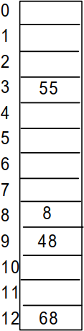
Example:
consider elements 8, 55, 48, 68 table size = 13 h = key % 13 and h’ = 11 – (key % 11)
now, applying modulus operation,
h(8) = 8%13= 8
h(55) = 55%13= 3
h(48) = 48%13 = 9
h(68) = 68 % 13= 3
hence, collision occurs at table location 3.
so, applying double hashing, we get (key % 13) + (11- key %11) ) % 13
(3 + 11 – 2) % 13 = 12 % 13 = 12

