Slide 1
Sorting

Slide 2
Contents
Introduction and Types of sorting: Internal and External sort
Comparison Sorting Algorithms: Bubble, Selection and Insertion Sort, Shell Sort
Divide and Conquer Sorting: Merge, Quick and Heap Sort
Efficiency of Sorting Algorithms

Slide 3
Introduction
Sorting refers to the operation or technique of arranging and rearranging sets of data in some specific order.
A collection of records called a list where every record has one or more fields. The
fields which contain a unique value for each record is termed as the key field.
For example, a phone number directory can be thought of as a list where each record has three fields - 'name' of the person, 'address' of that person, and their 'phone numbers'. Being unique phone number can work as a key to locate any record in the list.
Sorting is the operation performed to arrange the records of a table or list in some order
according to some specific ordering criterion, according to some key value of each record.

Slide 4
The records are either sorted either numerically or alphanumerically. The records are then arranged in ascending or descending order depending on the numerical value of the key.
Categories of Sorting
The techniques of sorting can be divided into two categories. These are:
Internal Sorting
External Sorting
Internal sorting takes small input, whereas external sorting can take as much as large input.
The internal sorting methods are applied to small collection of data. It means that, the entire collection of data to be sorted in small enough that the sorting can take place within main memory.

Slide 5
The External sorting methods are applied only when the number of data elements to be sorted is too large. These methods involve as much external processing as processing in the CPU. This sorting requires auxiliary storage, tape floppy disk etc.
Any sort algorithm that uses main memory exclusively during the sorting is called as internal sort algorithms. Internal sorting is faster than external sorting. Some example internal sorting algorithms are Insertion Sort, Bubble Sort, Selection Sort, Heap Sort, Shell Sort, Bucket Sort, Quick Sort, Radix Sort.
Any sort algorithm that uses external memory, such as tape or disk, during the sorting is called as external sort algorithms. Merge Sort is one of the external sort algorithms.

Slide 6
Insertion Sort
Insertion sort is based on the idea that one element from the input elements is consumed in each iteration to find its correct position i.e, the position to which it belongs in a sorted array.
Insertion sort works similar to the sorting of playing cards in hands. It is assumed that the first card is already sorted in the card game, and then we select an unsorted card. If the selected unsorted card is greater than the first card, it will be placed at the right side; otherwise, it will be placed at the left side. Similarly, all unsorted cards are taken and put in their exact place.
The pseudo code is as follows:

Slide 7
Insertion Sort Algorithm
The simple steps of achieving the insertion sort are listed as follows -
Step 1 - If the element is the first element, assume that it is already sorted. Return 1.
Step2 - Pick the next element, and store it separately in a key.
Step3 - Now, compare the key with all elements in the sorted array.
Step 4 - If the element in the sorted array is smaller than the current element, move to the next element. Else, shift greater elements in the array towards the right.
Step 5 - Insert the value.
Step 6 - Repeat until the array is sorted.

Slide 8
void insertion_sort ( int A[ ] , int n){
for( int i = 1 ;i < n ; i++ ) {
int temp = A[ i ]; int j = i-1;
while( j >= 0 && A[ j ] > temp) {
/* Move the elements greater than temp to one position ahead from their current position*/ A[ j +1] = A[ j];
_{j}-- ;
}
A[ j+1 ] = temp;
}}

Slide 9
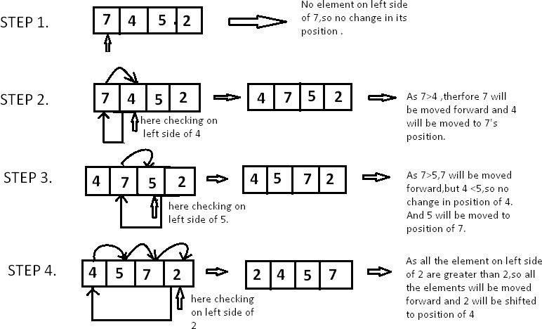
Take array A[]=[7,4,5,2]

Slide 10
Time Complexity of Insertion Sort Algorithm:
Best Case: O(N)
The best-case time complexity of Insertion Sort occurs when the input array is already sorted.
In this scenario, each element is compared with its preceding elements until no swaps are needed, resulting in a linear time complexity.
Therefore, the best-case time complexity is O(N), where n is the number of elements in the array.
Average Case: O(N²)
The average-case time complexity of Insertion Sort is also O(N²).
This complexity arises from the nature of the algorithm, which involves pairwise comparisons and swaps to sort the elements.
Although the exact number of comparisons and swaps may vary depending on the input, the average-case time complexity remains quadratic.
Worst Case: O(N²)
The worst-case time complexity of Insertion Sort occurs when the input array is in reverse sorted order.
In this scenario, each element needs to be compared and possibly swapped with every preceding element, resulting in a quadratic time complexity.
Therefore, the worst-case time complexity is O(N²), where n is the number of elements in the array.

Slide 11
Space Complexity of Insertion Sort Algorithm:
The space complexity of Insertion Sort is O(1), indicating it uses constant extra space regardless of the input size.
This is because the algorithm typically performs in-place sorting, meaning it rearranges the elements within the input array itself without requiring additional data structures or memory allocation proportional to the input size. Therefore, regardless of the size of the input array, the amount of extra space used by the Insertion Sort algorithm remains constant.

Slide 12
Selection Sort
Selection Sort algorithm is used to arrange a list of elements in a particular order (Ascending or Descending).
Selection sort is a sorting algorithm that selects the smallest element from an unsorted list in each iteration and places that element at the beginning of the unsorted list.
In selection sort, the first element in the list is selected and it is compared repeatedly
with all the remaining elements in the list.
If any element is smaller than the selected element (for Ascending order), then both are swapped so that first position is filled with the smallest element in the sorted order. Next, we select the element at a second position in the list and it is compared with all the remaining elements in the list. If any element is smaller than the selected element,
then both are swapped. This procedure is repeated until the entire list is sorted.

Slide 13
The pseudo code is as follows:
void selection_sort ( int A[ ] , int n){ for( int i = 0 ;i < n-1 ; i++ ) {
int min = i ;
for( j = i+1; j<n; j++) {
if(A[j] < A[min]){
min=j;
}}
if(min!=i){
swap(A[i],A[min])
}}

Slide 14
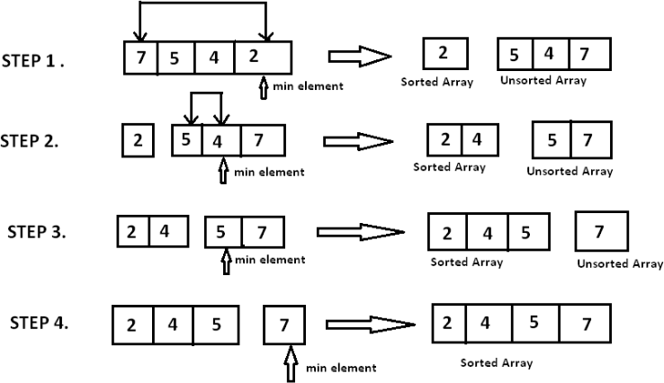

Slide 15
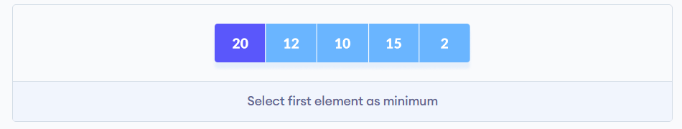
.
Working of Selection Sort
1. Set the first element as minimum.

Slide 16
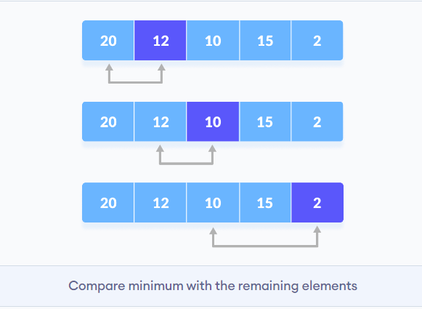
Working of Selection Sort
2. Compare the minimum with the second element. If the second element is smaller than the minimum, assign the second element as the minimum. Compare minimum with the third element. Again, if the third element is smaller, then assign a minimum to the third element otherwise do nothing. The process goes on until the last element.

Slide 17
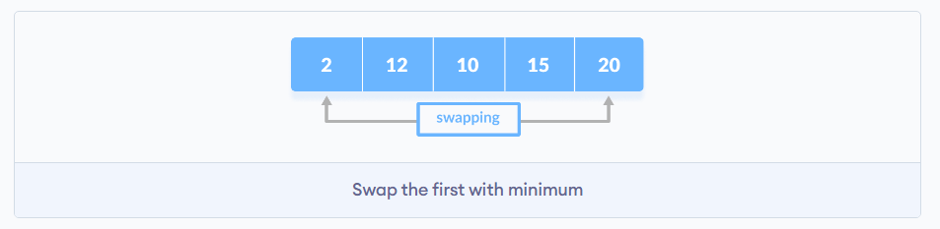
Working of Selection Sort
3. After each iteration, minimum is placed in the front of the unsorted list.

Slide 18
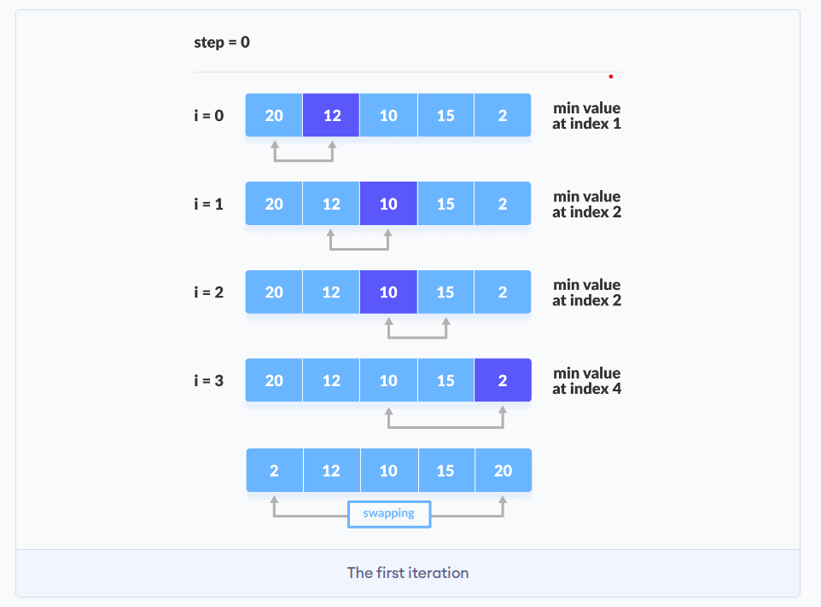
Working of Selection Sort
4. For each iteration, indexing starts from the first unsorted element. Step 1 to 3 are repeated until all the elements are placed at their correct positions.

Slide 19
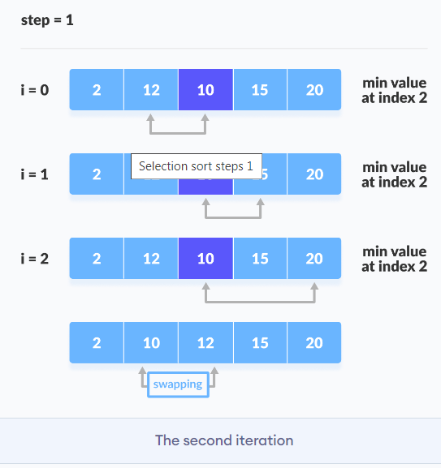
Working of Selection Sort

Slide 20
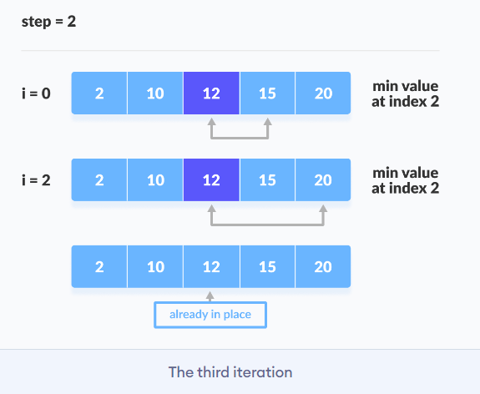
Working of Selection Sort

Slide 21
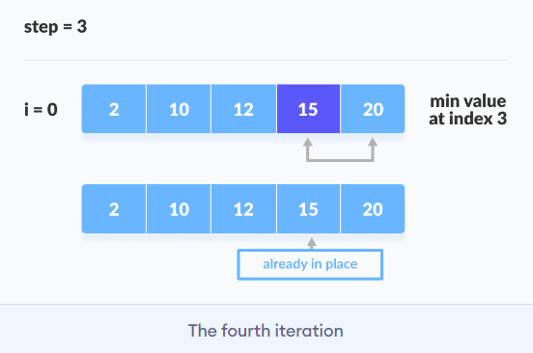
Working of Selection Sort

Slide 22
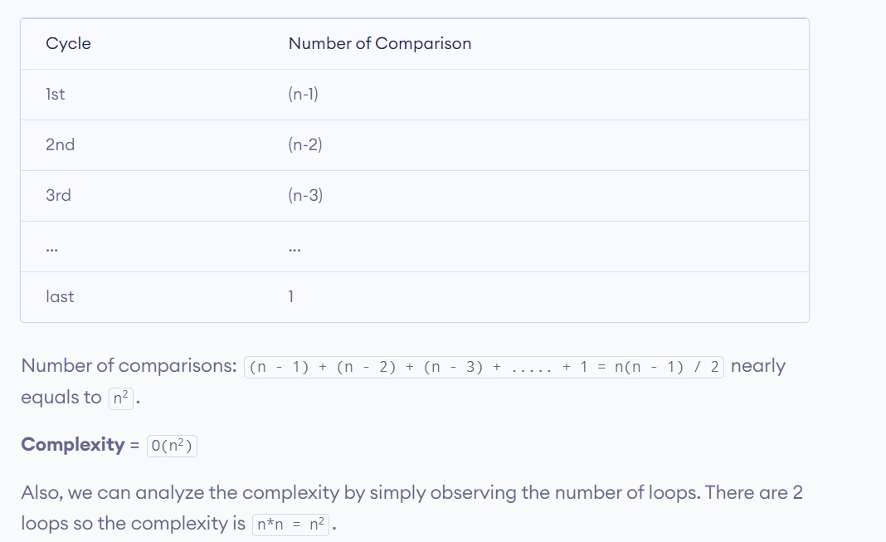

Slide 23
Time Complexity:
Best Case Complexity-It occurs when there is no sorting required. O(n²).
Average Case Complexity - It occurs when the array elements are not properly ascending and not properly descending. O(n²).
Worst Case Complexity - It occurs when the array elements are required to be sorted in reverse order. O(n²).
O(n²) as there are two nested loops
Space complexity :O(1)

Slide 24
Bubble Sort
Sorting Algorithms are concepts that every competitive programmer must know. Sorting algorithms can be used for collections of numbers, strings, characters, or a structure of any of these types.
Bubble sort is based on the idea of repeatedly comparing pairs of adjacent elements and then swapping their positions if they exist in the wrong order.
Assume that A[] is an unsorted array of n elements. This array needs to be sorted in
ascending order.
The pseudo code is as follows:

Slide 25
void bubble_sort( int A[ ], int n ) {
int temp;
for(int k = 0; k< n-1; k++) {
// (n-k-1) is for ignoring comparisons of elements which have already been compared in earlier iterations
for(int i = 0; i < n-k-1; i++) {
if(A[ i ] > A[ i+1] ) {
// here swapping of positions is being done.
temp = A[ i ]; A[ i ] = A[ i+1 ];
A[ i + 1] = temp;
}
}
}}

Slide 26
Working of Bubble Sort
Suppose we are trying to sort the elements in ascending order.
First Iteration (Compare and Swap)
Starting from the first index, compare the first and the second elements.
If the first element is greater than the second element, they are swapped.
Now, compare the second and the third elements. Swap them if they are not in order.
The above process goes on until the last element.

Slide 27
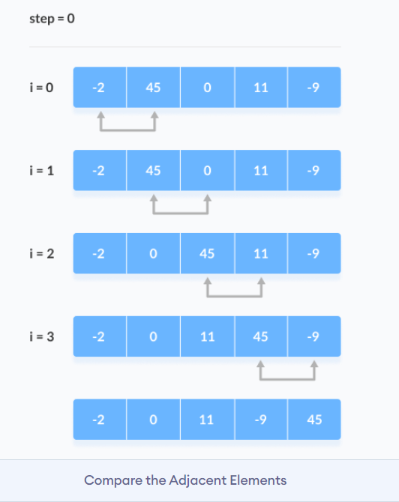
Working of Bubble Sort

Slide 28
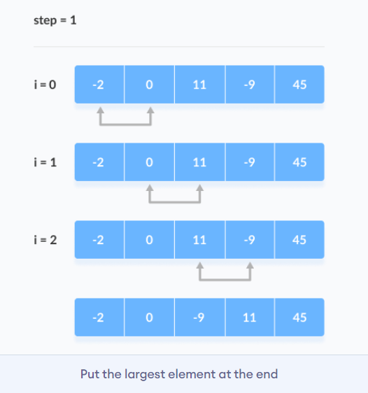
Working of Bubble Sort
2. Remaining Iteration
The same process goes on for the remaining iterations.
After each iteration, the largest element among the unsorted elements is placed at the end.

Slide 29
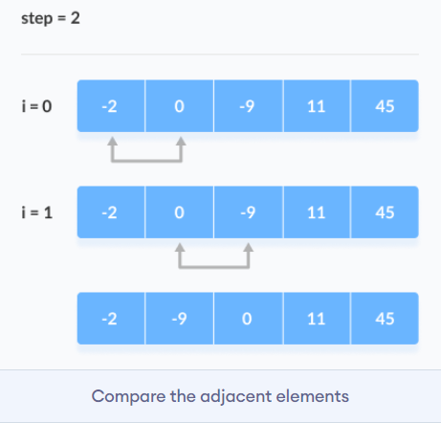
Working of Bubble Sort
In each iteration, the comparison takes place up to the last unsorted element.

Slide 30
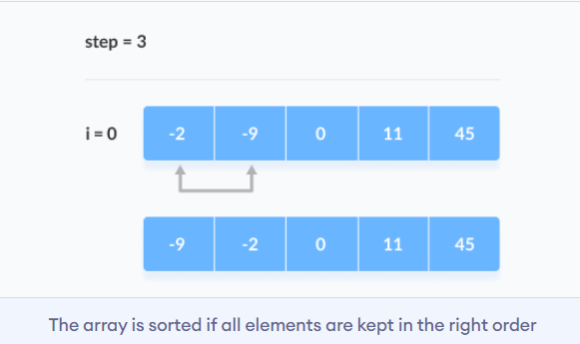
Working of Bubble Sort
The array is sorted when all the unsorted elements are placed at their correct positions.

Slide 31
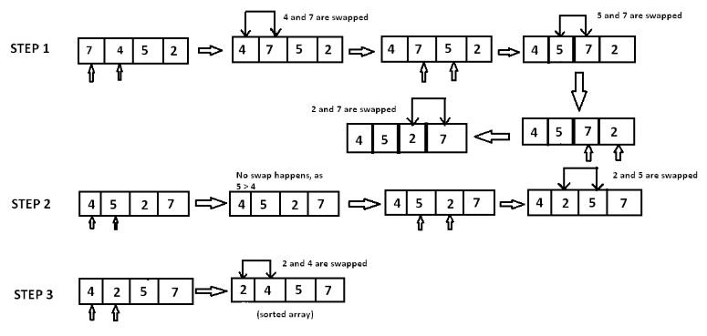
Example: A [ ]={ 7, 4, 5, 2}

Slide 32
In step 1, 7 is compared with 4. Since 7>4, 7 is moved ahead of 4. Since all the other elements are of a lesser value than 7, 7 is moved to the end of the array.
Now the array is A[]={4,5,2,7}.
In step 2, 4 is compared with 5. Since 5>4 and both 4 and 5 are in ascending order, these elements are not swapped. However, when 5 is compared with 2, 5>2 and these elements are in descending order. Therefore, 5 and 2 are swapped.
Now the array is A[]={4,2,5,7}.
In step 3, the element 4 is compared with 2. Since 4>2 and the elements are in descending order, 4 and 2 are swapped.
The sorted array is A[]={2,4,5,7}.
Complexity:
The complexity of bubble sort is O(n²) in both worst and average cases, because the entire array
needs to be iterated for every element.

Slide 33
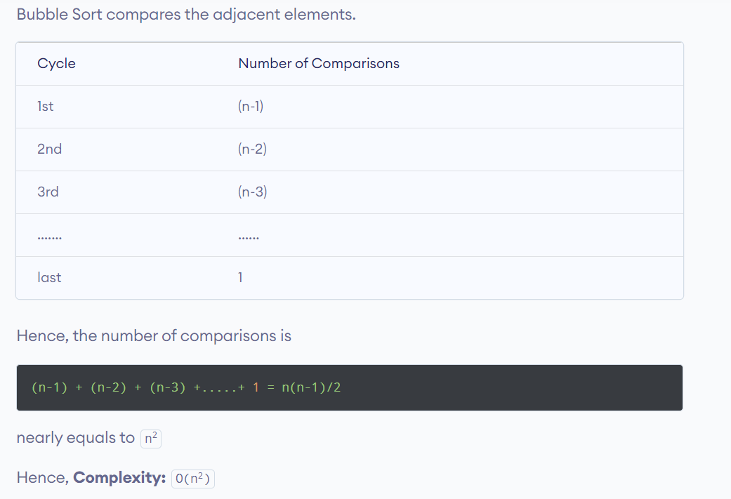
Bubble Sort

Slide 34
Bubble Sort
Also, if we observe the code, bubble sort requires two loops. Hence, the complexity is n*n = n²
1. Time Complexities
Worst Case Complexity: O(n²) If we want to sort in ascending order and the array is in descending order then the worst case occurs.
Best Case Complexity: O(n) If the array is already sorted, then there is no need for sorting.
Average Case Complexity: O(n²) It occurs when the elements of the array are in jumbled order (neither ascending nor descending).
2. Space Complexity
Space complexity is O(1) because an extra variable is used for swapping

Slide 35
Complexity of Optimized Bubble Sort
For (int pass=1; pass<=n-1; pass++)
{
flag=0
For(int i=0; i<=n-2; i++)
{
if (A[i]> A[i+1]
{
swap(I, i+1, A);
flag=1
}
}
If (flag==0)break;
}
Void swap (int x, int y, int[] A)
{
Int temp = A[x];
A[x]=A[y];
A[Y] =temp;
Return;
}

Slide 36
Shell Sort
Shell Sort is also called diminishing increment sort . Unlike Insertion Sort, instead of comparing contiguous items, it breaks the master list into several sub-lists using an interval i (which is known as the gap), then sorts the sub-lists with Insertion Sort.
The insertion sort is used on wide spread elements, to sort them and then sort the less widely spaced elements. The spacing is known as interval, sometimes called the gap.
The shell sort is still significantly slower than the merge, heap, and quick sorts
Interval/Gap=floor(n/2) i,e, ⌊n/2⌋ Gap=floor(gap1/2) Gap=floor(gap 2/2)
….
repeat the steps above until the gap becomes 1, then apply a standard insertion Sort.

Slide 37
Shell Sort
Algorithm:
Step 1 − Start Step 2 − Initialize the value of gap size. Example: h Step 3 − Divide the list into smaller sub-parts. Each must have equal intervals to h Step 4 − Sort these sub-lists using the insertion sort Step 5 – Repeat this step 2 until the list is sorted. Step 6 – Print a sorted list. Step 7 – Stop.

Slide 38
Example: 18 32 12 5 38 33 16 2
8 Numbers to be sorted, Shell’s increment will be floor(n/2) Gap=floor(8/2) ➔ floor(4) = 4
Step 1) Only look at 18 and 38 and sort in order;
18 and 38 stays at its current position because they are in order
Step 2) Only look at 32 and 33 and sort in order;
32 and 33 stays at its current position because they are in order.
Step 3) Only look at 12 and 16 and sort in order;
12 and 16 stays at its current position because they are in order.
Step 4) Only look at 5 and 2 and sort in order; 2 and 5 need to be switched to be in order.

Slide 39
Resulting numbers after increment 4 pass:
18 32 12 2 38 33 16 5
Gap=floor(4/2) ➔ floor(2) = 2
Step 1) Look at 18, 12, 38, 16 and sort them in their appropriate location:
12 32 16 2 18 33 38 5
Step 2) Look at 32, 2, 33, 5 and sort them in their appropriate location:
12 2 16 5 18 32 38 33
Gap= floor(2/2) ➔ floor(1) = 1
2 5 12 16 18 32 33 38
The last increment or phase of Shell sort is basically an Insertion Sort algorithm.

Slide 40
Radix Sort /Bucket Sort Algorithm
Radix sort is one of the sorting algorithms used to sort a list of integer numbers in order. In radix sort algorithm, a list of integer numbers will be sorted based on the digits of individual numbers. Sorting is performed from least significant digit to the most significant digit.
Radix sort algorithm requires the number of passes which are equal to the number
of digits present in the largest number among the list of numbers.
For example, if the largest number is a 3 digit number then that list is sorted with 3 passes.

Slide 41
Step by Step Process
- Define 10 queues each representing a bucket for each digit from 0 to 9.
- Consider the least significant digit of each number in the list which is to be sorted.
- Insert each number into their respective queue based on the least significant digit.
- Group all the numbers from queue 0 to queue 9 in the order they have inserted
into their respective queues.
- Repeat from step 3 based on the next least significant digit.
- Repeat from step 2 until all the numbers are grouped based on the most significant digit.

Slide 42
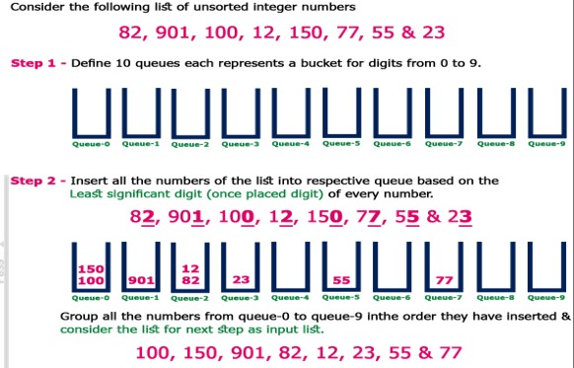

Slide 43
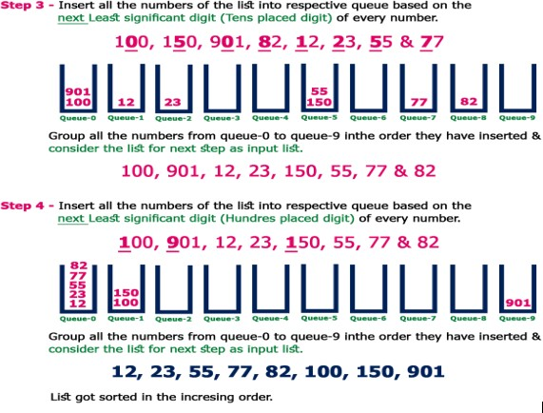

Slide 44
Complexity of the Radix Sort Algorithm
To sort an unsorted list with 'n' number of elements, Radix sort algorithm needs
the following complexities...
Worst Case : O(n) Best Case : O(n) Average Case : O(n)

Slide 45
Divide and Conquer Sorting
Divide-and-conquer algorithm as having three parts:
Divide the problem into a number of subproblems that are smaller instances of the same
problem.
Conquer the subproblems by solving them recursively. If they are small enough, solve
the subproblems as base cases.
Combine the solutions to the subproblems into the solution for the original problem.
Merge Sort Algorithm
Merge Sort follows the rule of Divide and Conquer to sort a given set of numbers/elements, recursively, hence consuming less time.

Slide 46
void merge(int A[ ] , int start, int mid, int end) {
//stores the starting position of both parts in temporary variables.
int p = start ,q = mid+1;
int Arr[end-start+1] , k=0;
for(int i = start ;i <= end ;i++) {
if(p > mid) //checks if first part comes to an end or not .
Arr[ k++ ] = A[ q++] ;
else if ( q > end) //checks if second part comes to an end or not
Arr[ k++ ] = A[ p++ ];
else if( A[ p ] < A[ q ])
Arr[ k++ ] = A[ p++ ];
else
Arr[ k++ ] = A[ q++];
//checks which part has smaller element.
}

Slide 47
for (int p=0 ; p< k ;p ++) {
/* Now the real array has elements in sorted manner including both
parts.*/
A[ start++ ] = Arr[ p ] ;
}
}

Slide 48
Now consider the following 2 branched recursive function :
void merge_sort (int A[ ] , int start , int end )
{
if( start < end ) {
int mid = (start + end ) / 2 ; merge_sort (A, start , mid ) ; merge_sort (A,mid+1 , end ) ;
// defines the current array in 2 parts .
// sort the 1st part of array .
// sort the 2nd part of array.
// merge the both parts by comparing elements of both the parts.
merge(A,start , mid , end );
}
}

Slide 49
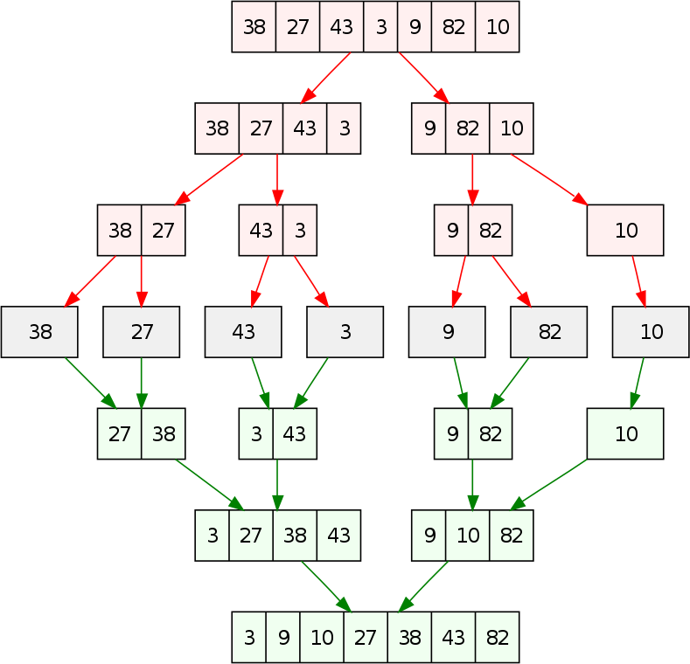

Slide 50
Time Complexity:
The list of size N is divided into a max of logN parts, and the merging of all sublists into a single list takes O(N) time, the worst case run time of this algorithm is O(NlogN)
worst-case running time of O(n²). As the size of input grows, insertion and
selection sort can take a long time to run.
Merge sort ,on the other hand, runs in O(n*log n) time in all the cases.

Slide 51
Quick Sort
Quick sort is a fast sorting algorithm used to sort a list of elements. Quick sort algorithm is invented by C. A. R. Hoare.
The quick sort algorithm attempts to separate the list of elements into two parts and then sort each part recursively. That means it use divide and conquer strategy.
In quick sort, the partition of the list is performed based on the element called pivot. Here pivot element is one of the elements in the list. The list is divided into two partitions such that "all elements to the left of pivot are smaller than the pivot and all elements to the right of pivot are greater than or equal to the pivot".
Step by Step Process

Slide 52
Step 1-Consider the first element of the list as pivot (i.e., Element at first position in the list). Step 2-Define two variables i and j. Set i and j to first and last elements of the list respectively. Step 3-Increment i until list[i] > pivot then stop.
Step 4-Decrement j until list[j] < pivot then stop.
Step 5-If i < j then exchange list[i] and list[j].
Step 6-Repeat steps 3,4 & 5 until i > j.
Step 7-Exchange the pivot element with list[j] element.

Slide 53
void quickSort(int list[10],int first,int last){ int pivot,i,j,temp;
if(first < last){ pivot = first;
if(i < j){
temp = list[i]; list[i] = list[j]; list[j] = temp;
i = first; j = last;
while(i < j){
while(list[i] <= list[pivot] && i < last) i++;
while(list[j] && list[pivot])
}}
temp = list[pivot]; list[pivot] = list[j]; list[j] = temp; quickSort(list,first,j-1); quickSort(list,j+1,last);
j--;
}}

Slide 54
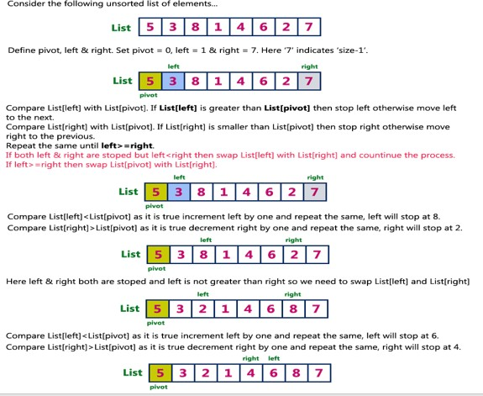

Slide 55
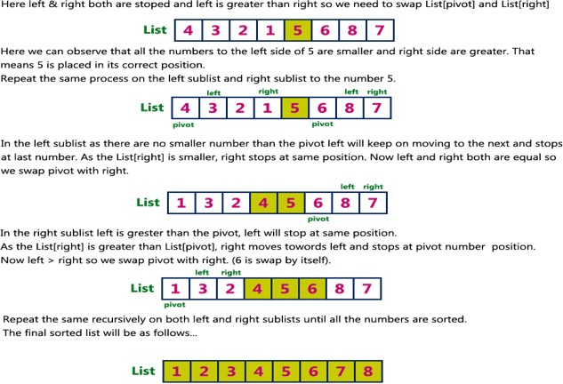

Slide 56
Complexity:
To sort an unsorted list with 'n' number of elements, we need to make ((n-1)+(n- 2)+(n-3)+......+1) = (n (n-1))/2 number of comparisions in the worst case. If the list is already sorted, then it requires 'n' number of comparisions.
Worst Case : O(n²)
Best Case : O (n log n)
Average Case : O (n log n)

Slide 57
Heap Sort Heap:
A Heap is a complete binary tree i.e. all levels are completely filled except possibly the lowest one, which is filled from the left. This means that the depth of the tree (and every path length from the root to a leaf) is O (log n).
The elements are stored level wise from left to right in ascending cells of the array.
Heap implementation using array representation
Case1: if array start from 1 index
A[1] is the root; the left and right child of A[i] are A[2i] and A[2i+1], respectively; and its parent is A[⌊i/2⌋].
Case 2: if array start from 0 index
A[0] is the root; the left and right child of A[i] are A[(2i+1] and A[2i+2], respectively; and its parent is A[⌊i-1/2⌋].

Slide 58
Heap Sort Heap:
Heap implementation using array representation
A heap of tree is A[1]
Left child of A[i]= A[2i]
Right child of A[i] =A[2i+1]
Parent of A[i] = A[⌊i/2⌋]
Number of elements in the array =A.length
The elements in the subarray A[(⌊n/2⌋]+1)…….n] are leaves (if index i start from 1)

Slide 59
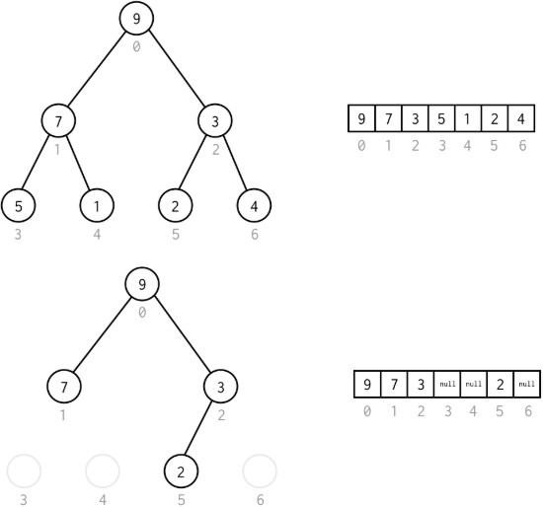

Slide 60
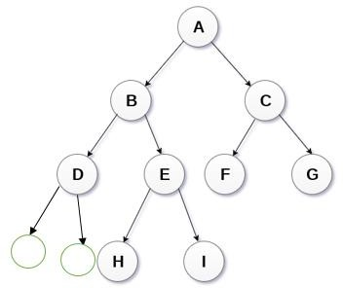
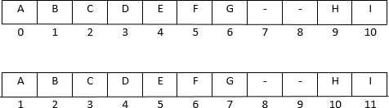

Slide 61
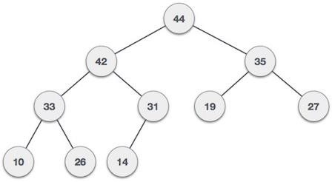
Types of Binary Heap
Max Heap
Min Heap
Max-Heap : Where the value of the root node is greater than or equal to either of its
children.
A[parent[i])>=A[i]
44 | 42 | 35 | 33 | 31 | 19 | 27 | 10 | 26 | 14

Slide 62
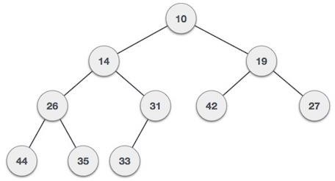
Min-Heap :Where the value of the root node is less than or equal to either of its children.
i,e. A[parent[i])<=A[i]
10 | 14 | 19 | 26 | 31 | 42 | 27 | 44 | 35 | 33

Slide 63
Operations on Heaps
The common operation involved using heaps are:
Heapify: Process to rearrange the heap in order to maintain heap-property.
Find-max (or Find-min): Find a maximum item of a max-heap, or a minimum item of a min-heap, respectively.
Insertion : Add a new item in the heap.
Deletion : Delete an item from the heap.
Extract Min-Max: Returning and deleting the maximum or minimum element in max- heap and min-heap respectively.

Slide 64
Heapify:
It is a process to rearrange the elements of the heap in order to maintain the heap property. It is done when a certain node causes an imbalance in the heap due to some operation on that node.
The heapify can be done in two methodologies:
up_heapify():It follows the bottom-up approach. In this, we check if the nodes are following
heap property by going in the direction of rootNode and if nodes are not following the heap property we do certain operations to let the tree follows the heap property.
down_heapify(): It follows the top-down approach. In this, we check if the nodes are following heap property by going in the direction of the leaf nodes and if nodes are not following the heap property we do certain operations to let the tree follows the heap property.

Slide 65
Pseudo Code
void down_heapify(int heap[], int parent, int size){
largest = parent
leftChild = 2*parent + 1 rightChild = 2*parent + 2
if(leftChild < size && heap[leftChild] > heap[largest]) largest = leftChild
if(rightChild < size && heap[rightChild] > heap[largest]) largest = rightChild
if(parent != largest){
swap(heap[parent], heap[largest])
down_heapify(heap,largest,size) }}

Slide 66
void up_heapify(int heap[], int child)
{
parent = (child-1)/2; if(heap[parent] < heap[child]) {
swap(heap[parent], heap[child]) up_heapify(heap,parent)
}
}

Slide 67
Find-max (or Find-min):
The maximum element and the minimum element in the max-heap and min-heap is
found at the root node of the heap.
Finding Maximum Value Operation in Max Heap Finding the node which has maximum value in a max heap is very simple. In max heap, the root node has the maximum value than all other nodes in the max heap. So, directly we can display root node value as maximum value in max heap.
int findMax(int heap[])
{
return heap[0]
}

Slide 68
Insertion Operation:
Max Heap
Step 1 - Insert the newNode as last leaf from left to right.
Step 2 - Compare newNode value with its Parent node.
Step 3 - If newNode value is greater than its parent, then swap both of them.
Step 4 - Repeat step 2 and step 3 until newNode value is less than its parent node (or) newNode reaches to root.

Slide 69
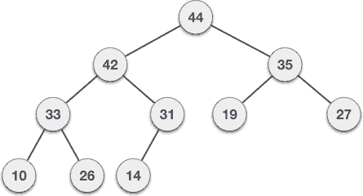
Input: 35 33 42 10 14 19 27 44 26 31

Slide 70
void max_heapify (int Arr[ ], int i, int N)
{
int left = 2*i
int right = 2*i +1
//left child
//right child
if(left<= N and Arr[left] > Arr[i] )
largest = left; else
largest = i;
if(right <= N and Arr[right] > Arr[largest] )
largest = right; if(largest != i )
{
swap (Arr[i] , Arr[largest]);
max_heapify (Arr, largest, N);
}
}

Slide 71
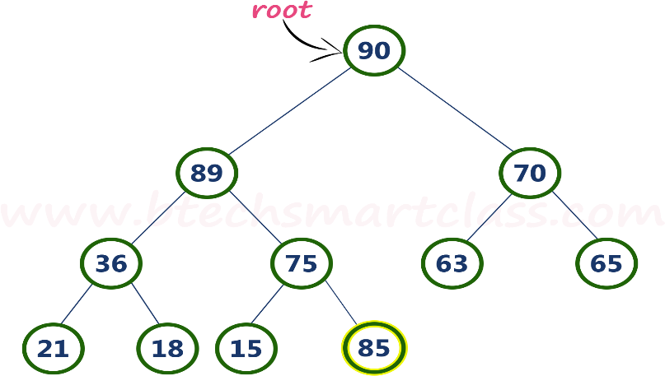
Example: 90 89 70 36 75 63 65 21 18 15
Consider the above max heap. Insert a new node with value 85.
Step 1: Insert the newNode with value 85 as last leaf from left to right. That means newNode
is added as a right child of node with value 75. After adding max heap is as follows

Slide 72
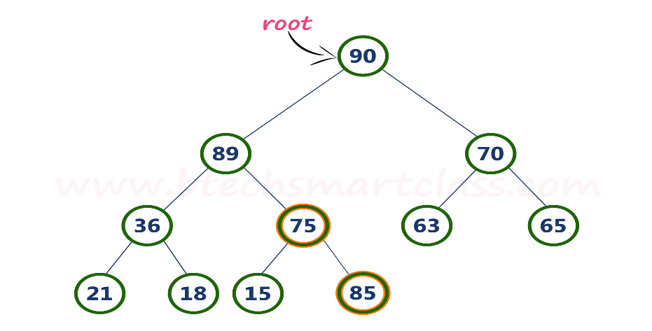
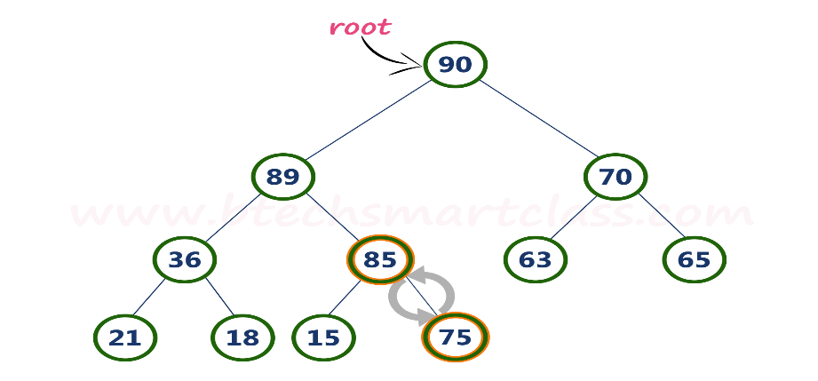
Step 2: Compare newNode value (85) with its Parent node value (75). That means 85 > 75
Step 3: Here newNode value (85) is greater than its parent value (75), then swap both of them. After swapping, max heap is as follows

Slide 73
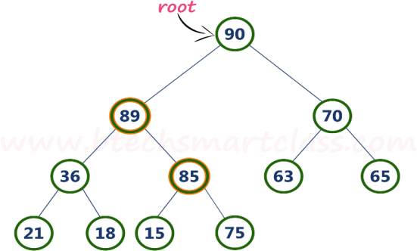
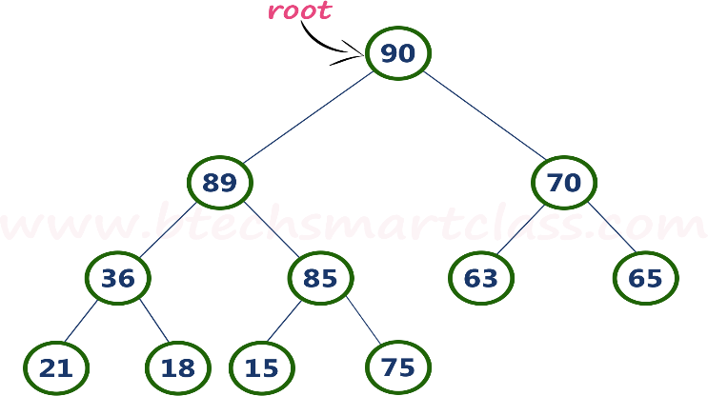
Step 4: Now, again compare newNode value (85) with its parent node value (89).
Here, newNode value (85) is smaller than its parent node value (89).
So, we stop insertion process. Finally, max heap after insertion of a new node with value 85 is
as follows

Slide 74
Note: for insertion of Min heap is also has same representations as Max heap with minimum
value at root node.
Deletion Operation:
Max Heap
In a max heap, deleting the last node is very simple as it does not disturb max heap properties.
Deleting root node from a max heap is little difficult as it disturbs the max heap properties.

Slide 75
Input: 35 33 42 10 14 19 27 44 26 31

Slide 76
Step 1 -Swap the root node with last node in max heap Step 2 -Delete last node.
Step 3 -Now, compare root value with its left child value.
Step 4-If root value is smaller than its left child, then compare left child with its right sibling. Else goto Step 6
Step 5-If left child value is larger than its right sibling, then swap root with left child otherwise swap root with its right child.
Step 6-If root value is larger than its left child, then compare root value with its right child value.
Step 7-If root value is smaller than its right child, then
child otherwise stop the process.
Step 8-Repeat the same until root node fixes at its exact position.
swap root with right

Slide 77
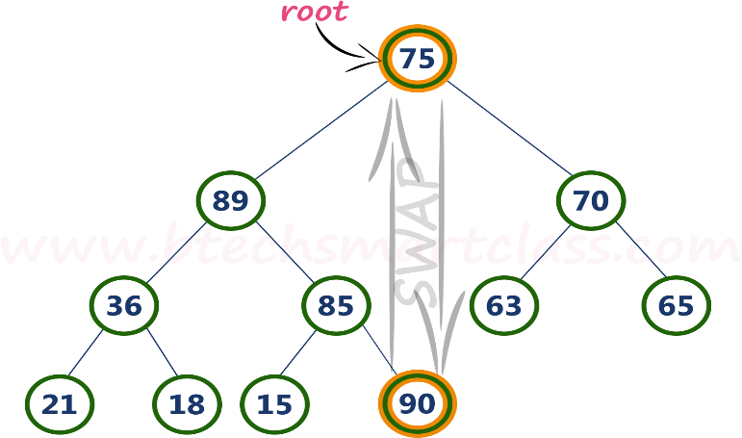
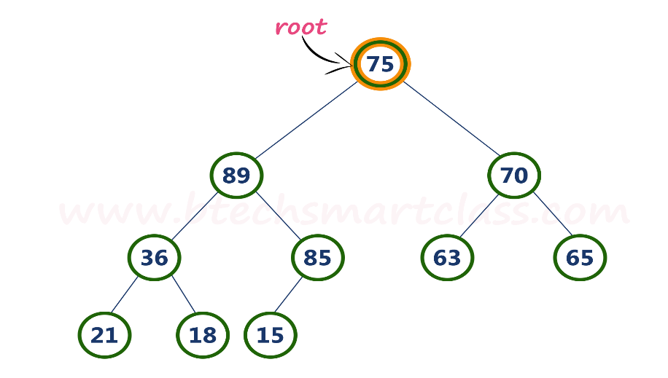
Example:
Consider the above max heap. Delete root node (90) from the max heap.
Step 1-Swap the root node (90) with last node 75 in max heap. After swapping max heap is as follows.
Step 2-Delete last node. Here the last node is 90.
After deleting node with value 90 from heap, max heap is as follows

Slide 78
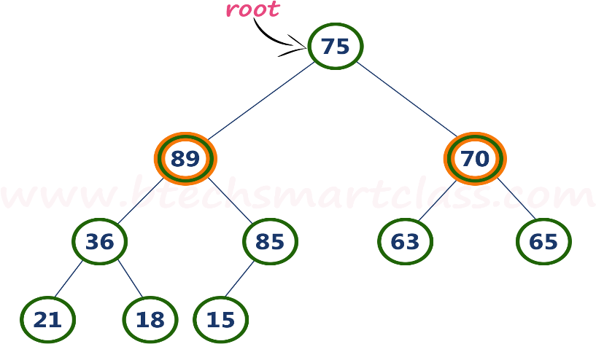
Step 3-Compare root node (75) with its left child (89).
Here, root value (75) is smaller than its left child value (89). So, compare left child (89) with its right sibling (70).
Step 4-Here, left child value (89) is larger than its right sibling (70), So, swap root
(75) with left child (89).

Slide 79
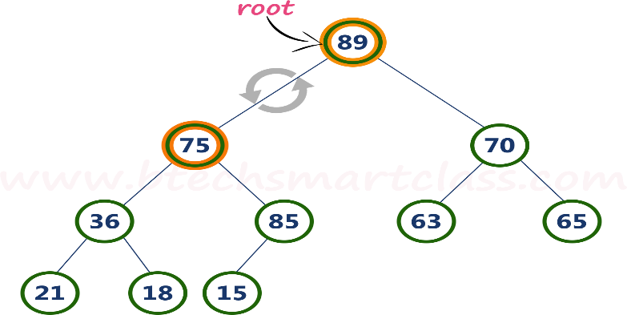
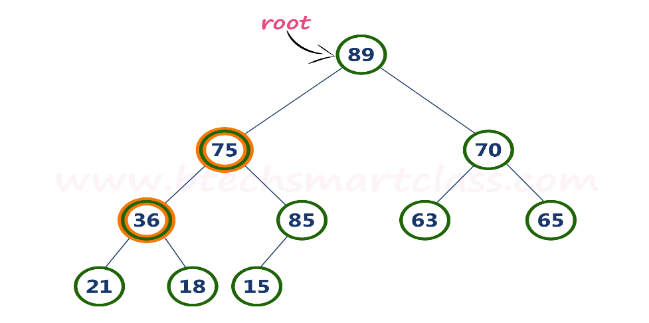
Step 5-Now, again compare 75 with its left child (36). Here, node with value 75 is larger than its left child.
So, we compare node 75 with its right child 85.

Slide 80
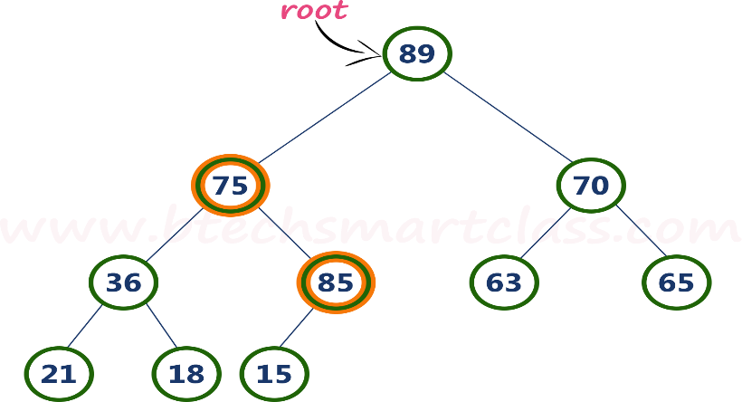
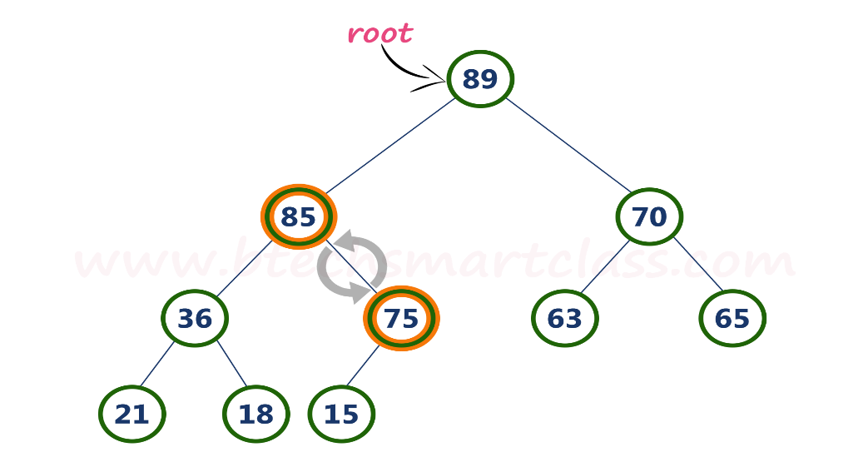
Step 6-Here, node with value 75 is smaller than its right child (85). So, we swap both of them. After swapping max heap is as follows

Slide 81
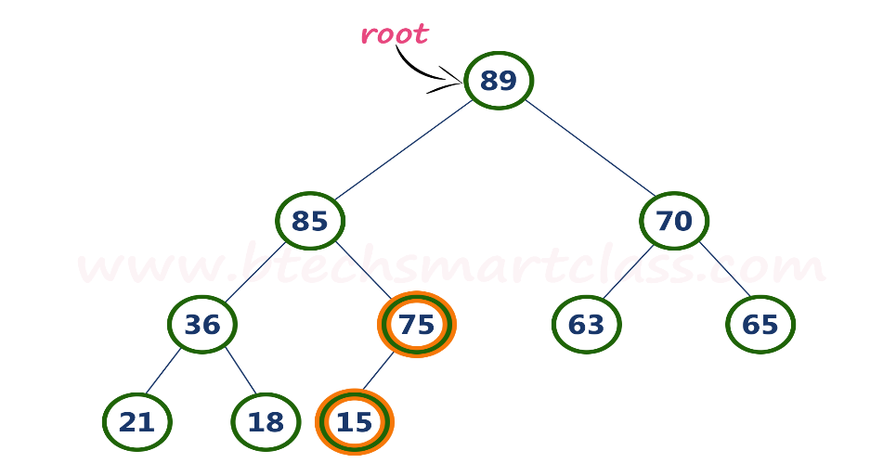
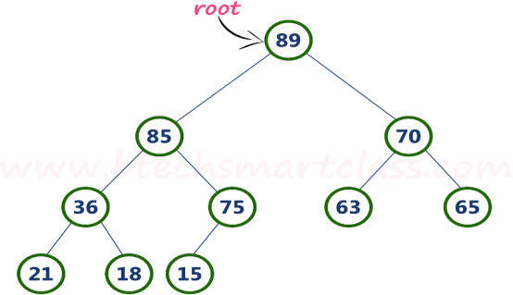
Step 7-Now, compare node with value 75 with its left child (15).
Here, node with value 75 is larger than its left child (15) and it does not have right child. So we stop the process. Finally, max heap after deleting root node (90) is as follows

Slide 82
Note: Min heap is also has same representations as Max heap with minimum value at root node.

Slide 83
Heap Sort
Heap sort is one of the sorting algorithms used to arrange a list of elements in order. Heapsort algorithm uses one of the tree concepts called Heap Tree.
We use Max Heap to arrange list of elements in Ascending order and Min Heap to arrange list elements in Descending order.
Sorting in Ascending order
Step 1-Construct a Binary Tree with given list of Elements.
Step 2-Transform the Binary Tree into Max Heap.
Step 3-Delete the root element from Max Heap using Heapify method. Step 4-Insert deleted element at the end into the Sorted list.
Step 5-Repeat the same until Max Heap becomes empty.
Step 6-Display the sorted list.

Slide 84
Sorting in descending order
Step 1-Construct a Binary Tree with given list of Elements. Step 2-Transform the Binary Tree into Min Heap.
Step 3-Delete the root element from Min Heap using Heapify method. Step 4-Put the deleted element into the Sorted list.
Step 5-Repeat the same until Min Heap becomes empty. Step 6-Display the sorted list.
Example: Sorting in Ascending order

Slide 85
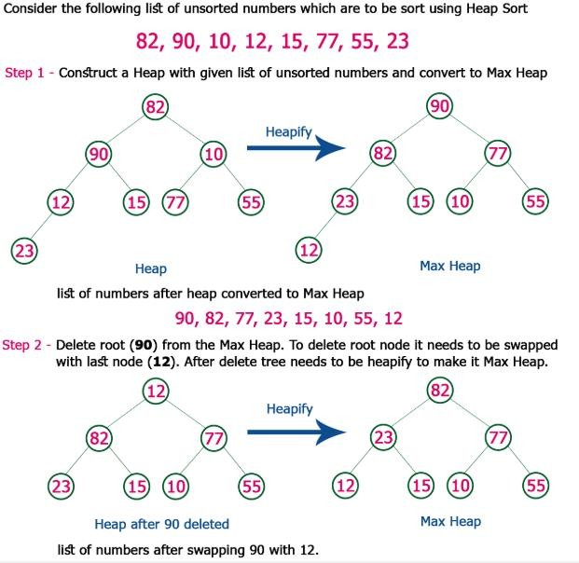

Slide 86
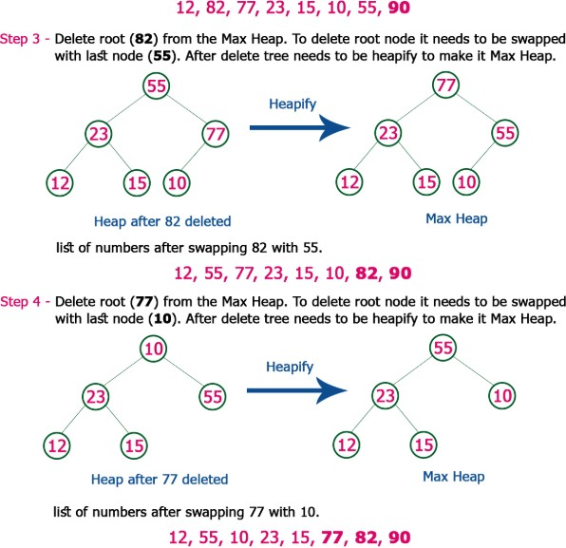

Slide 87
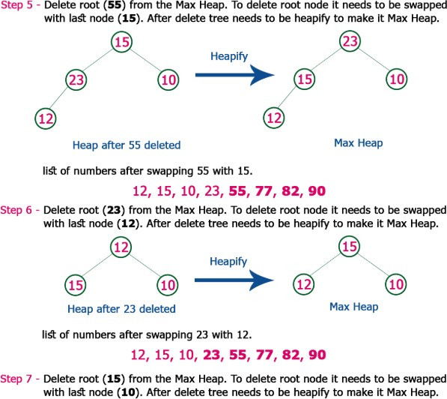

Slide 88
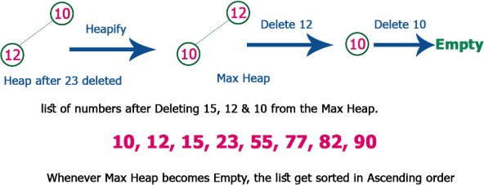

Slide 89
Complexity of the Heap Sort Algorithm
To sort an unsorted list with 'n' number of elements, following are the complexities...
Worst Case : O(n log n) Best Case : O(n log n) Average Case : O(n log n)

Slide 90

Algorithm |  | Time Complexity
 | Best | Average | Worst
Selection Sort | Ω(n²) | θ(n²) | O(n²)
Bubble Sort | Ω(n) | θ(n²) | O(n²)
Insertion Sort | Ω(n) | θ(n²) | O(n²)
Heap Sort | Ω(n log(n)) | θ(n log(n)) | O(n log(n))
Quick Sort | Ω(n log(n)) | θ(n log(n)) | O(n²)
Merge Sort | Ω(n log(n)) | θ(n log(n)) | O(n log(n))
Bucket Sort | Ω(n+k) | θ(n+k) | O(n²)
Radix Sort | Ω(nk) | θ(nk) | O(nk)

