Slide 1

Tour Planner
Presented by:
Ayush Tuladhar

Slide 2
Introduction
Console-based travel planning system
Allows users to manage destinations, attractions, and routes
Supports traveler profile creation and budget tracking
Provides route optimization (cost/time)
Facilitates efficient and organized trip planning
Data storage and retrieval

Slide 3
Features
Graph Representation for routes between destinations
Dijkstra’s Algorithm for finding shortest/cheapest paths
Depth-First Search (DFS) for exploring all possible routes
File Handling for saving and loading profiles, destinations, and routes
Object-Oriented Programming (OOP) for managing destinations, attractions, routes, and user profiles
Structured Arrays and Pointers for managing multiple destinations and routes efficiently

Slide 4
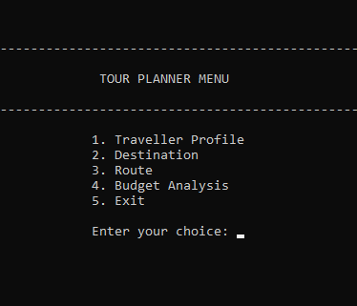
Functions
addDestinationDetails() – Add destination and attractions
addRoute() – Define travel routes with transport info
budgetAnalysis() – Compare estimated trip cost with budget
findBestRoute() – Determine optimal route by cost or time
displayDestinations() & displayRoutes() – Visualize trip plans

Slide 5
Advantages
Automates trip planning
Saves time with predefined destinations and routes
Helps stay within budget
Offers route optimization
Intuitive and interactive console interface
Enhances travel planning efficiency

Slide 6
Conclusion
Automates entire trip planning process
Enchances efficieny through data structures and algorithms
Provides optimal travel solutions
Helps user to stay within budget and manage time

Slide 7
Thank you

