Slide 1
DMA & IOP
Presenter : Ayush Tuladhar
Subject : Computer Architecture
CSIT III

Slide 2
Direct Memory Access (DMA)
Definition : feature that allows data transfer between peripherals and memory directly without involvement of CPU
Peripheral devices manage the memory bus directly
CPU is free to perform other tasks

Slide 3
How DMA Works
DMA Controller : dedicated hardware component that manages the data transfer between memory and peripheral devices.
CPU Initiation : The CPU sets up the DMA transfer by specifying the source, destination, and the size of the data.
Data Transfer : The DMA controller takes control of the memory bus and performs the transfer without CPU intervention.
Completion & Interrupt : Once the transfer is complete, the DMA controller sends an interrupt to notify the CPU.

Slide 4
Types of DMA
Burst Mode: The DMA controller transfers an entire block of data in one go, temporarily locking the CPU out of memory access.
Cycle Stealing Mode: The DMA controller transfers data in small chunks, allowing the CPU to access memory in between transfers.
Transparent Mode: The DMA controller transfers data only when the CPU is not using the system bus, ensuring no CPU slowdown.

Slide 5
DMA Controller
A control unit which is a part of I/O device’s interface circuit that can transfer blocks of data between I/O devices and main memory with minimal intervention from the CPU
The DMA controller has 3 registers:
Address Register : specifies the desired location of memory which is incremented after each word is transferred to memory
Word Count Register : holds no. of words to be transferred which is decrement after each transfer, zero indicates end of transfer
Control Register : specifies mode of transfer, read or write

Slide 6
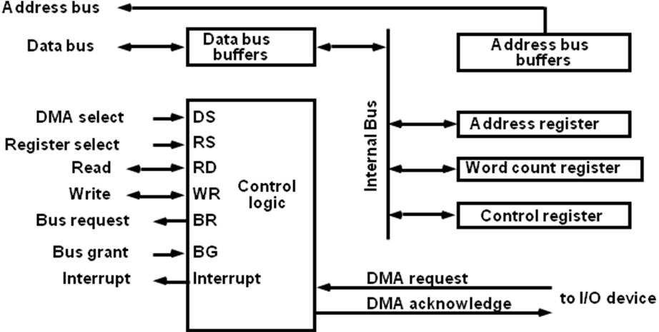
Block Diagram of DMA Controller

Slide 7
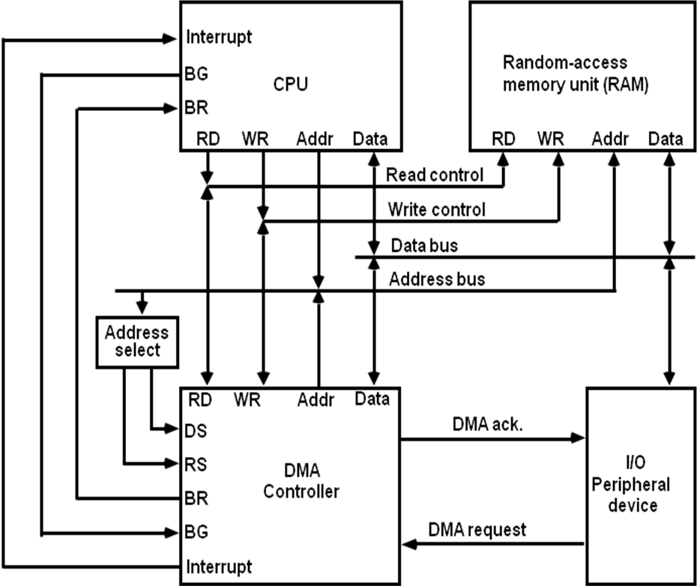
DMA Transfer in a Computer System

Slide 8
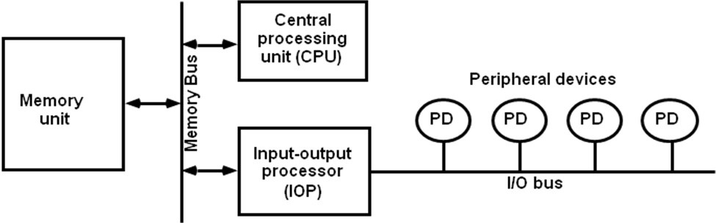
I/O Processor (IOP)
Specialized processor that manages I/O operations independently
Provides path for data transfer between peripherals and memory
Figure: Block diagram of a computer with I/O Processor

Slide 9
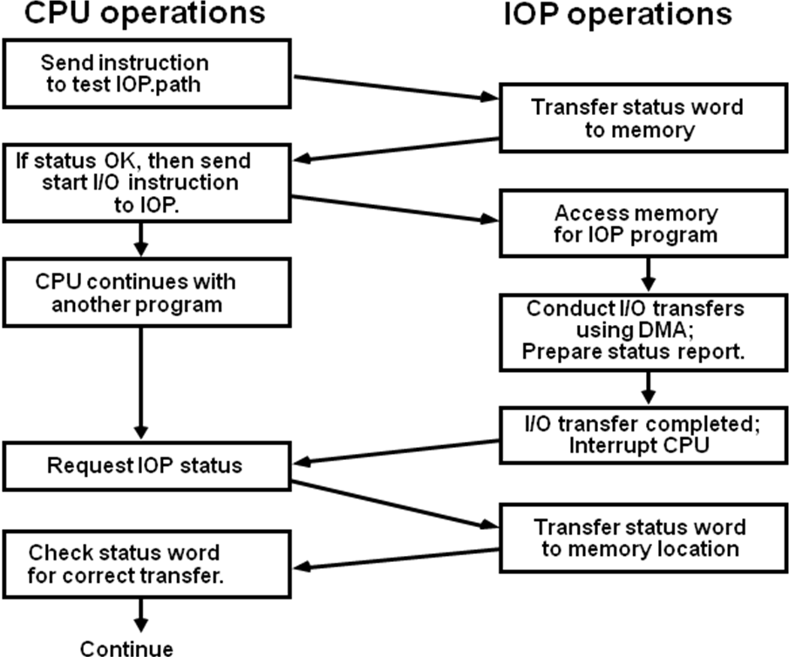
How IOP Works

Slide 10
DMA vs IOP
Feature | DMA | IOP
Definition | Hardware mechanism allowing peripherals to access memory with minimal CPU involvement | Specialized processor that manages I/O operations independently of the CPU
Complexity | Simple; only handles data transfers | Complex; executes instructions and process data
Independence | Needs CPU to initiate transfers but work autonomously afterwards | Works almost completely independently
Speed | Faster for simpler memory transfers | Slightly slower as it involves processing
Applications | Used in RAM, disk controllers and network adapters for fast data transfer | Used in high-end systems like mainframes and large servers to manage multiple I/O devices

Slide 11
Thank you

