Slide 1
List and Linked lists

Slide 2
Contents
Basic Concept, List and ADT, Array Implementation of Lists, Linked List
Types of Linked List: Singly Linked List, Doubly Linked List, Circular
Linked List
Basic operations in Linked List: Node Creation, Node Insertion and Deletion from Beginning, End and Specified Position
Stack and Queue as Linked List

Slide 3
List
The list can be defined as an abstract data type in which the elements are stored in an ordered manner for easier and efficient retrieval of the elements.. In the case of multiple entries of the same data, each entry of that repeating data is considered a distinct item or entry. It is very similar to the array but the major difference between the array and the list data structure is that the array stores only homogenous data in them. In contrast, the list (in some programming languages) can store heterogeneous data items in its object. A list is an ordered data structure with elements separated by a comma and enclosed within square brackets. For example, list1 and list2 shown below contains a single type of data.

Slide 4
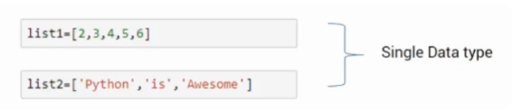
List
Here, list1 has integers while list2 has strings. Lists can also store mixed data types as shown in the list3 here.

Slide 5
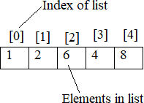
Static List
Static list is a type of list which contains fixed size of data elements. If we know the number of data element that to be inserted in the list, in that case static list is used. This is also called fixed sized list.
For example: int array[5];
We can perform insert, delete, modify, read operation at any position in this list.

Slide 6
Dynamic List
Dynamic list is a type of list in which size of list is variable. When number of elements is not defined during creating the list, in that case dynamic list is used.
In the dynamic list we can store any number of elements of same data type at any position of the list. Actually list is an array which holds collection of elements with homogenous data type.
We can insert, delete, modify, read elements at any position to the list. And array gives all this operation in the list.

Slide 7
There are some list of operations perform in the list using array
Create list
Insert
Delete
Retrieve
Modify
isEmpty
isFull
Size

Slide 8



Create List: We can create a dynamic empty list with n size
int list[n];
Insert: We can insert elements in the list at any
position
insert(5);
insert(7); insert(4); insert(3);

Slide 9

insert(8,2);
This function insert the element 8 at the position having list index [2], and move element after index [2] at one step forward.
Time complexity of insertion: O(n)

Slide 10


Delete:
We can delete the element from any position of the list until list become empty. If list become empty then, error will occur.
For Example:
delete(1);
After deletion operation is complete, then, all the elements after index [1] will move one step backward.
Time complexity of deletion: O(n)

Slide 11
Retrive:
We can retrieve or read data from the array at any position.
retrive(2); this will display the element from the array at index [2]
Time complexity of retrieve: O(1)

Slide 12

Modify: We can modify or write the element of array at any position of the list. Modify(6,3);
this will replace the element of index [3] by new element 6
Time complexity is O(1)

Slide 13
isEmpty(): this function check the index of the list, if index is [-1] then this gives message as list is empty.
isFull(): this function check the index of the list, if index is [n] then this gives message as list is full.
Size(): this function display the size of current list.
size() function display the result as 4.

Slide 14
Limitation of array implementation
An array size is fixed at the start of execution and can store only the limited number of elements.
Insertion and deletion of array are expensive. Since insertion is performed by pushing the entire array one position down and deletion is performed by shifting the entire array one position up.

Slide 15
LinkedList
A linked list is a linear data structure where each element is a separate object.
A linked list is a collection of records called nodes arranged in a sequential order
Linked list elements are not stored at contiguous location; the elements are linked
using pointers.
A linked list is a dynamic data structure. The number of nodes in a list is not fixed and can grow and shrink on demand.
Each node of a list is made up of two items
the data and
a reference to the next node.

Slide 16
Data Field: It is a field that stores the element value of a specific data type in the list.it is also called info filed.
Link Field: This field contains the address of the next node in the linked list. It is also called next field.
Linked List Applications
Dynamic memory allocation
Implemented in stack and queue
In undo functionality of software
Hash tables, Graphs

Slide 17
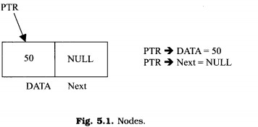
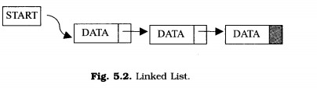
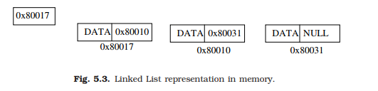
The NULL value of the next field of the linked list indicates the last node.

Slide 18

Representation of linked list
Suppose we want to store a list of integer numbers using linked list. Then it can be schematically represented as
The linear linked list can be represented in memory with the following declaration.
struct Node{
int DATA; //Instead of ‘DATA’ we also use ‘Info’
struct Node *Next; //Instead of ‘Next’ we also use ‘Link’
};
typedef struct Node *NODE;

Slide 19
Linked List Implementations in C Example
#include <stdio.h> #include <stdlib.h>
// Creating a node
struct node { int value;
struct node *next;
};
// print the linked list value
void printLinkedlist(struct node *p) { while (p != NULL) {
printf("%d ", p->value);
p = p->next; }}

Slide 20
// Assign value values
one->value = 10;
two->value = 20;
three->value = 30;
// Connect nodes
int main() {
// Initialize nodes struct node *head;
struct node *one = NULL; struct node *two = NULL; struct node *three = NULL;
// Allocate memory
one = malloc(sizeof(struct node));
two = malloc(sizeof(struct node));
three = malloc(sizeof(struct node));
one->next = two; two->next = three; three->next = NULL;
// printing node-value
head = one;
printLinkedlist(head);
Output: 10 20 30
}

Slide 21
Linked List Complexity
Time Complexity:
 | Worst case | Average Case
Search | O(n) | O(n)
Insert | O(1) | O(1)
Deletion | O(n) | O(n)
Space Complexity: O(n)

Slide 22
Advantages and disadvantages
Linked list are dynamic data structure. That is, they can grow or shrink during the execution of a program.
Efficient memory utilization: In linked list (or dynamic) representation, memory is not pre-
allocated. Memory is allocated whenever it is required. And it is deallocated (or removed) when it is not needed.
Insertion and deletion are easier and efficient. Linked list provides flexibility in inserting a
data item at a specified position and deletion of a data item from the given position.
Many complex applications can be easily carried out with linked list. Linked list has
following disadvantages
More memory: to store an integer number, a node with integer data and address field is allocated. That is more memory space is needed.
Access to an arbitrary data item is little bit cumbersome and also time consuming.

Slide 23
Operation on linked list
The primitive operations performed on the linked list are as follows
Creation
Insertion
Deletion
Traversing
Searching
Concatenation
Creation operation is used to create a linked list. Once a linked list is created with
one node, insertion operation can be used to add more elements in a node.

Slide 24
Insertion operation is used to insert a new node at any specified location in the
linked list. A new node may be inserted.
At the beginning of the linked list
At the end of the linked list
At any specified position in between in a linked list
Deletion operation is used to delete an item (or node) from the linked list. A node may be deleted from the
Beginning of a linked list
End of a linked list
Specified location of the linked list

Slide 25
Traversing is the process of going through all the nodes from one end to another end of a linked list.
In a singly linked list we can visit from left to right, forward traversing, nodes only.
In doubly linked list forward and backward traversing is possible.
Searching or find: This operation is used to find an element in a linked list. In the desired element is found then we say operation is successful otherwise unsuccessful.
Concatenation is the process of appending the second list to the end of the first list.
Consider a list A having n nodes and B with m nodes. Then the operation concatenation
will place the 1st node of B in the (n+1)th node in A. After concatenation A will contain (n+m) nodes.

Slide 26
Types of LinkedList
Basically, there are the following four types of linked lists:
Single/Singly Linked List
Double/Doubly Linked List
Circular Linked List
Double Circular Linked List

Slide 27
Singly linked list
We can create a structure for the singly linked list the each node has two members, one is info that is used to store the data items and another is next field that store the address of next node in the list.
A singly linked list can grow or shrink, because it is a dynamic data structure.

Slide 28
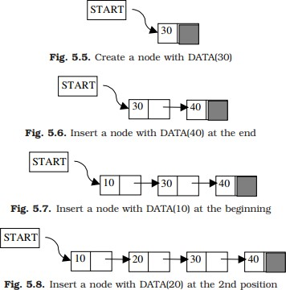

Slide 29
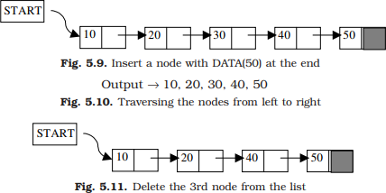
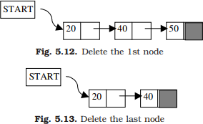

Slide 30
Insertion a node at the beginning of the singly linked list:
There are following steps which need to be followed in order to insert a new node in the list at beginning.
Step 1: Allocate the space for the new node and store data into the data part of the node.
NewNode = (struct node *) malloc(sizeof(struct node *)); NewNode -> data = item;
Step 2: Place the head (containing the address of the existing first node) to the next field of the new node.
NewNode -> next = head;
Step 3: At the last, we need to make the new node as the first node of the list this will be done by using the following statement.
head = NewNode;

Slide 31
Algorithm:
Step 1: Start
Step 2: Create New Node
NewNode = (struct node *) malloc(sizeof(struct node *)); Step 3 : Assign data to the info field of new node NewNode -> data = item;
Step 4: NewNode -> next = head; head = NewNode;
Step 5: Exit

Slide 32
Insertion a node at the end of the singly linked list:
In order to insert a node at the end, there are two scenarios which need to be mentioned.
The node is being added to an empty list
The node is being added to the end of the existing linked list

Slide 33
Algorithm:
Step 1: Start
Step 2: Create New Node
NewNode = (struct node *) malloc(sizeof(struct node *)); NewNode -> data = item;
Step 3: If head == Null NewNode -> next = Null; head = NewNode;
Go to step 6;

Slide 34
Step 4: if head != Null
Create a temporary pointer temp and put head in to temp temp = head;
Step 5: Then, traverse through the entire linked list until next part of the node containing Null not found.
while (temp -> next != NULL)
{
temp = temp -> next;
}
temp -> next = NewNode; NewNode -> next = Null Step 6: Exit

Slide 35
Insertion after and before existing node:
Suppose we have a linked list nodes A and B.
Here we insert the new node after node A and before node B in the list
Step 1: Create a new node called C
NewNode = (struct node *) malloc(sizeof(struct node *)); NewNode -> data = item;
Step 2: Find the position where you want to insert new node.
Case 1: insert before any node Create a temporary variable temp, and move temp to (n-1)^{th} position NewNode -> next = temp -> next;
temp -> next = NewNode;

Slide 36
Case 2: insert after any node
Create a temporary variable temp, and move temp to (n)^{th} position
temp -> next = NewNode; NewNode -> next = temp -> next;

Slide 37
Algorithm: Insert before any node
Step 1: Start
Step 2: Create a new node
NewNode = (struct node *) malloc(sizeof(struct node *)); NewNode -> data = item;
Step 3: Create temp and move temp to (n-1)^{th} position for (int i=1; i<n-1; i++)
temp = temp -> next; end for
NewNode -> next = temp -> next;
temp -> next = NewNode;
Step 4: Exit

Slide 38
Algorithm: Insert after any node
Step 1: Start
Step 2: Create a new node
NewNode = (struct node *) malloc(sizeof(struct node *)); NewNode -> data = item;
Step 3: Create temp and move temp to (n)^{th} position for (int i=1; i<n; i++)
temp = temp -> next;
end for
NewNode -> next = temp -> next; temp -> next = NewNode;
Step 4: Exit

Slide 39
Deleting nodes: A node may be deleted:
From the beginning of the linked list
From the end of the linked list
From the specified position in a linked list

Slide 40
Deletion from the beginning of Linked List:
If(head==NULL) then exit.
Suppose we have a linked list A B and C.
Since the first node of the list is to be deleted, therefore, we just need to make the temporary pointer temp which point to the head, then, head point to the next field of the first node (containing address of second node).
temp = head;
head = temp ->next;
Then, make next field of first node point to null temp -> next = null
Now, free the pointer temp which was pointing to the head node of the list. free(temp);

Slide 41
Algorithm:
Step 1: Start
Step 2: If(head==NULL) then
print “Void deletion” and exit
Step 3: Create a temporary pointer temp and store head to the temp temp = head;
Step 4: head = temp -> next
Step 5: Then, make next field of first node point to null temp -> next = Null
free(temp);
Step 6: Exit

Slide 42
Deletion from the ending of Linked List:
There are two scenarios in which, a node is deleted from the end of the linked list.
There is only one node in the list and that needs to be deleted.
There are more than one node in the list and the last node of the list will be deleted.
If (head==NULL) then //if list is empty print “Void deletion” and exit
In the first scenario: There is only one node in the list
The condition (head -> next = NULL) will satisfy and therefore, the only node head of the list will be assigned to null.
temp = head head = NULL free(temp)

Slide 43
In the second scenario: There are many nodes in the list
The condition (head -> next = NULL) would fail
We have to traverse the node in order to reach the last node of the list. To delete the last node, we also need to keep track of the second last node of the list. For this purpose two pointers temp1 and temp2 will be used, where temp1 will point to the last node and temp2 will point to the second last node of the list.
temp1 = head;
while(temp1 -> next != NULL){ temp2 = temp1;
temp1 = temp1 -> next;}
temp2 -> next = NULL; free(temp1);

Slide 44
Algorithm:
Step 1: Start
Step 2: if head->next ==Null
temp = head;
head = Null; free(temp); Go to Step 4;
Step 3: if head !=Null
Crate two pinter temp1 and temp2 and move to last and second last node
temp1 = head;
while(temp1 -> next != NULL){ temp2 = temp1;

Slide 45
temp1 = temp1 -> next;
}
temp2 -> next = NULL; free(temp1);
Step 4: Exit

Slide 46
Deletion in singly linked list after the specified node :
Deletion from (n)^{th} position: Suppose we have linked list A, B and C
To delete the any node from the linked list, first of all we have to find the target node by using searching algorithm. Then we perform deletion operation at (n)^{th} node Or before (n)^{th} node or after (n)^{th} node.
Case 1: We are deleting the node B which is the Target Node, at (n)^{th} position.
Step 1: Start
Step 2: Create two temporary pointer temp1 and temp2 then move those pointer to (n)^{th} and (n-1)^{th} position respectively.

Slide 47
temp1 = head; for(int i=1; i<n; i++)
{
temp2 = temp1;
temp1 = temp1 -> next;
}
temp2 -> next = temp1->next;
Step 3: Make target node pointing to null temp1 -> next = null
Step 4: free (temp1)
Step 5: Exit

Slide 48
Case 2: Deleting the node before target at (n-1)^{th} position
Algorithm:
Step 1: Start
Step 2: Create two temporary pointer temp1 and temp2 then move those pointer to (n-1)^{th} and (n-2)^{th} position respectively.
temp1 = head;
for(int i=1; i<n-1; i++)
{
temp2 = temp1;
temp1 = temp1 -> next;
}

Slide 49
temp2 -> next = temp1->next;
Step 3: Make (n-1)^{th} node pointing to null temp1 -> next = null
Step 4: free (temp1)
Step 5: Exit
Case 3: Deleting the node after target at (n+1)^{th} position
Step 1: Start
Step 2: Create two temporary pointer temp1 and temp2 then move those pointer to (n+1)^{th} and (n)^{th} position respectively.

Slide 50
temp1 = head;
for(int i=1; i<n+1; i++)
{
temp2 = temp1;
temp1 = temp1 -> next;
}
temp2 -> next = temp1->next;
Step 3: Make (n+1)th node pointing to null temp1 -> next = null
Step 4: free (temp1)
Step 5: Exit

Slide 51
Searching in singly linked list
Searching is performed in order to find the location of a particular element in the list. Searching any element in the list needs traversing through the list and make the comparison of every element of the list with the specified element.
If the element is matched with any of the list element then the location of the element is returned from the function.

Slide 52
Algorithm:
Step 1: Initialize the Current pointer with the beginning of the List.
Step 2: Compare the KEY value with the Current node value;
if they match then quit there else go to step-3.
Step 3: Move the Current pointer to point to the next node in the list and go to step-2, till the list is not over or else quit.

Slide 53
/*Search An Element in Linked List*/ #include<stdio.h>
#include<conio.h> #include<malloc.h> struct node
{ int data;
struct node *next;
} first, *nw; int search(int); void main(){
int no, i, item, pos; clrscr(); first.next=NULL; nw=&first;
printf("Enter The No of nodes, you want in linked list: "); scanf("%d",&no);
printf("\n"); for(i=0;i< no;i++)
{

Slide 54
nw->next=(struct node *)malloc(sizeof(struct node));
printf("Enter element in node %d: ",i+1);
scanf("%d",&nw->data);
nw=nw->next;
}
nw->next=NULL; printf("Linked list is:\n"); nw=&first;
while(nw->next!=NULL)
{
printf("%d\t",nw->data);
nw=nw->next;
}
printf("\n");
printf("Enter item to be searched : "); scanf("%d",&item); pos=search(item);
if(pos<=no)
printf("Your item is at node=%d",pos);

Slide 55
else
printf("Sorry! your item is not in linked list.");
getch();
}
int search(int item)
{
int count=1;
nw=&first;
while(nw->next!=NULL)
{
if(nw->data==item)
break; else count++;
nw=nw->next;
}
return count;
}

Slide 56
Double/ Doubly Linked List(DLL)
Doubly-linked list contains two pointers, next and previous for each node in the list.
The first pointer points to the next element and the second pointer points to the previous
element.
The previous pointer for the first node points to NULL and the next pointer for the last node points to NULL.
Doubly-linked list is also known as a two-way list as both forward and backward traversal is possible.
Therefore, in a doubly linked list, a node consists of three parts: node data, pointer to the next node in sequence (next pointer) , pointer to the previous node (previous pointer).

Slide 57
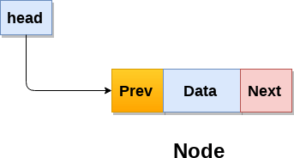

Fig: Doubly linked list

Slide 58
The data structure for DLL is Struct node
{
Struct node * previous; Int info;
Struct node * next;
}
Here, struct node * previous is pointer to structure which will contain the address of
previous node & struct node * next will contain the address of next node in list. Thus we can travel in both the direction.

Slide 59
Operations:
Insertion
At beginning
At specific position
At last
Deletion
From first
From specific position
From last
Searching
Traversing

Slide 60
Algorithm to insert a node at the beginning of a doubly linked list:
Allocate memory for the new node as, newnode=(NodeType*)malloc(sizeof(NodeType))
Assign value to info field of a new node set newnode->info=item
set newnode->prev=newnode->next=NULL
set newnode->next=head
4. set head->prev=newnode
set head=newnode
End

Slide 61
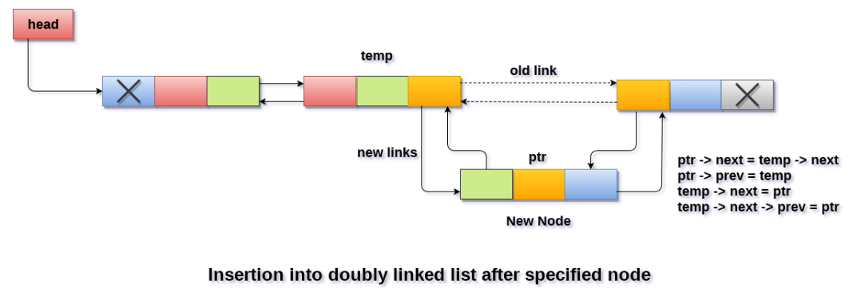
Algorithm to insert a node at the specified position of a doubly linked list:

Slide 62
Algorithm to insert a node at the end of a doubly linked list:
Allocate memory for the new node as, newnode=(NodeType*)malloc(sizeof(NodeType))
Assign value to info field of a new node set newnode->info=item
set newnode->next=NULL
if head==NULL
set newnode->prev=NULL;
set head=newnode;
if head!=NULL set temp=head
while(temp->next!=NULL) temp=temp->next;
end while
set temp->next=newnode; set newnode->prev=temp
6. End

Slide 63
Algorithm to delete a node from beginning of a doubly linked list:
if head==NULL then print “empty list” and exit
else
set hold=head
set head=head->next set head->prev=NULL; free(hold)
End

Slide 64
Algorithm to delete a node from end of a doubly linked list:
if head==NULL then print “empty list” and exit
else if(head->next==NULL) then set hold=head
set head=NULL
free(hold)
3. else
set temp=head;
while(temp->next->next !=NULL)
temp=temp->next end while
set hold=temp->next set temp->next=NULL free(hold)
4. End

Slide 65
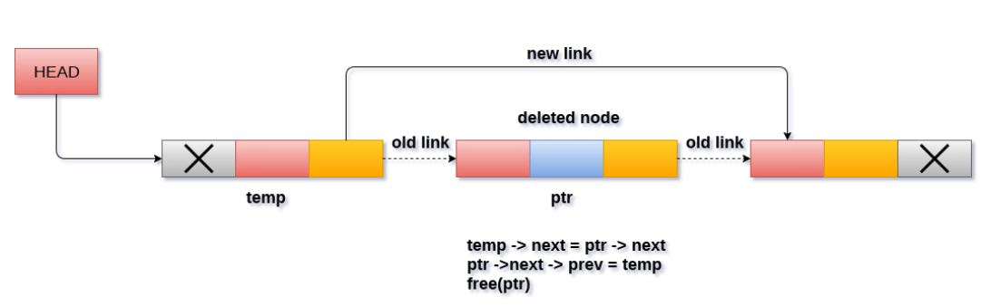
Algorithm to delete a specified node in a doubly linked list:

Slide 66
Algorithm to delete a specified node in a doubly linked list:
In a doubly linked list traversal operation, we visit every node at least once to display all the data elements or perform operations.
You can traverse this linked list in two different directions, they are:
Normal traversal, i.e., from head node to tail node
Reverse traversal, i.e., from tail node to head node

Slide 67
Circular Linked List
A circular linked list is such a linked list in which the last node of the linked list points to the first node.
It is more complicated than a singly linked list and does not have any end.
In circular linked lists each node has a successor, such that it forms a loop.
There is no null value present in the next part of any of the nodes.
The first node is referred as first, while the last node is referred as last.

Slide 68
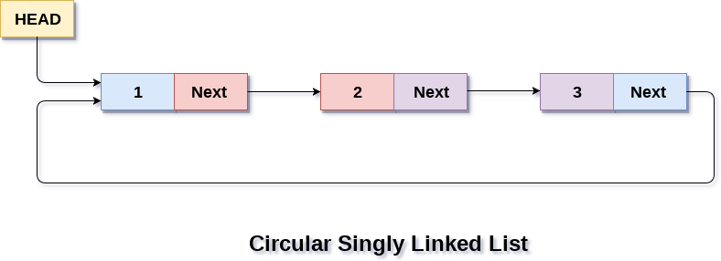

Slide 69
Operations:
Insertion
At beginning
At specific position
At last
Deletion
From first
From specific position
From last
Searching
Traversing

Slide 70
Double Circular Linked List
Circular Doubly Linked List has properties of both doubly linked list and circular linked list, contains two pointers, next and previous for each node in the list
Circular doubly linked list doesn't contain NULL in any of the node.
The last node of the list contains the address of the first node of the list.
The first node of the list also contain address of the last node in its previous pointer.

Slide 71

// Structure of the node struct node {
int data;
struct node *next; // Pointer to next node
struct node *prev; // Pointer to previous node
};
Operations
Insertion at beginning
Insertion at end
Deletion at beginning
Deletion at end

Slide 72
Following are advantages and disadvantages of circular doubly linked list:
Advantages
List can be traversed from both the directions i.e. from head to tail or from tail to head.
Jumping from head to tail or from tail to head is done in constant time O(1).
Circular Doubly Linked Lists are used for implementation of advanced data structures like Fibonacci Heap.
Disadvantages
It takes slightly extra memory in each node to accommodate previous pointer.
Lots of pointers involved while implementing or doing operations on a list. So, pointers should
be handled carefully otherwise data of the list may get lost.
Applications of Circular doubly linked list
Managing songs playlist in media player applications.
Managing shopping cart in online shopping.

Slide 73
Linked list implementation of Stack
The major problem with the stack implemented using an array is, it works only for a fixed number of data values. i.e., static memory allocation.
Stack implemented using an array is not suitable, when we don't know the size of data which we are going to use.
A stack data structure can be implemented by using a linked list data structure. The stack
implemented using linked list can work for an unlimited number of values.
Implementation issues of the stack (Last In First Out - LIFO) using linked list is
illustrated in following figures.

Slide 74
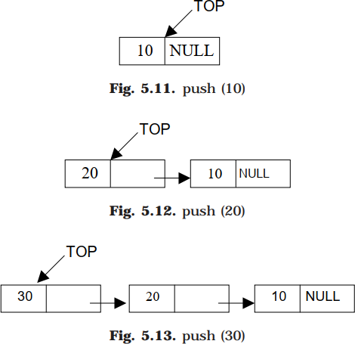
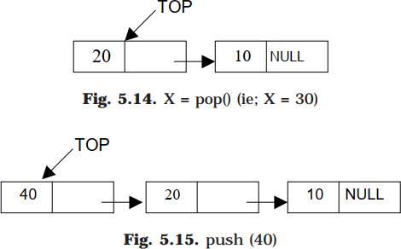

Slide 75
Push Operation- Algorithm:
Step 1: Start
Step 2: Create a newNode with given value.
NewNode = (struct node *) malloc(sizeof(struct node *)); NewNode -> data = item;
Step 3: Check whether stack is Empty (top == NULL)
If it is Empty, then newNode ->next = NULL;
Step 4: If it is Not Empty, then
newNode -> next = top;
Step 5: Finally, top = newNode;
Step 6: Exit

Slide 76
Pop Operation-
Algorithm:
Step 1: Start
Step 2: Check whether the stack is Empty (top == NULL);
If it is Empty, then display "Stack is Empty. and go to step 5.
Step 3: If it is Not Empty, then define a Node pointer 'temp' and set it to 'top'. temp = top;
top = top -> next; temp -> next = Null
Step 4: Finally, delete temp
free(temp)
Step 5: Exit

Slide 77
Display Operation:
Algorithm Step 1: Start
Step 2: Check whether stack is Empty (top == NULL) ,If it is Empty, then display 'Stack is Empty!!!'
and go to step 5
Step 3: If it is Not Empty, then define a Node pointer 'temp' and initialize with top.
temp = top
Step 4: Display data of top node and move it to the next node. Repeat the same until temp reaches to the first node in the stack.
while (temp -> next != NULL){
Display(temp -> data); temp = temp -> next; } Display(temp -> data); Step 5: Exit

Slide 78
Linked list implementation Queue
Queue is a first in first out [FIFO] data structure.
The major problem with the queue implemented using an array is, it will work for
an only fixed number of data values.
Queue using an array is not suitable when we don’t know the size of data which we are going to use. A queue data structure can be implemented using a linked list data structure.
The queue which is implemented using a linked list can work for an unlimited number of values. That means, queue using linked list can work for the variable size of data (No need to fix the size at the beginning of the implementation).

Slide 79
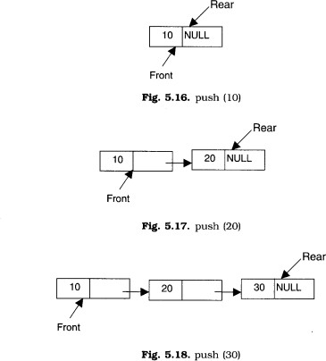

Slide 80
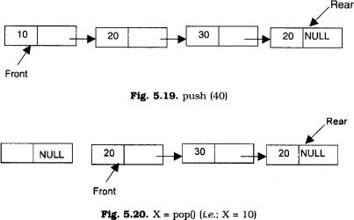
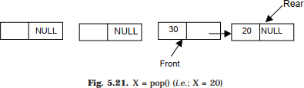

Slide 81
Pushing an element to a queue
REAR is a pointer in a queue where the new elements are added. FRONT is a pointer, which is pointing to the queue where the elements are popped. DATA is an element to be pushed.
Input the DATA element to be pushed
Create a New Node
NewNode → DATA = DATA
NewNode → Next = NULL
If(REAR not equal to NULL)
(a) REAR → next = NewNode;
REAR =NewNode;
Exit

Slide 82
Popping an element from a queue
REAR is a pointer in queue where the new elements are added. FRONT is a pointer, which is pointing to the queue where the elements are popped. DATA is an element popped from the queue.
1. If (FRONT is equal to NULL)
(a) Display “The Queue is empty”
2. Else
Display “The popped element is FRONT → DATA”
If(FRONT is not equal to REAR)
FRONT = FRONT → Next
Else
FRONT = NULL;
3. Exit

Slide 83
Thank You

