Slide 1
Stack

Slide 2
Introduction
Stack is an abstract data type.
It is defined as linear data structure, where items are inserted and deleted from the same end known as “top” (or top of stack)
In stack, the last inserted element is deleted first
Thus, stack is also known as LIFO (Last-In-First-Out) data structure

Slide 3
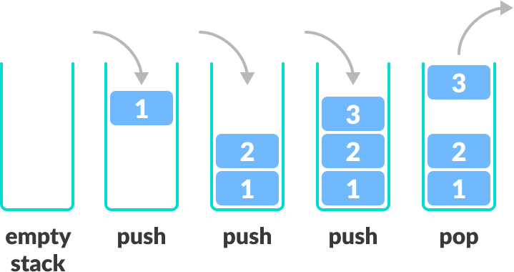
Pictorial representation

Slide 4
Basic feature of stack
Stack is an ordered list of similar data type.
Stack is a LIFO(Last in First out) structure or we can say FILO(First in Last out).
push() function is used to insert new elements into the Stack and pop() function is used to remove an element from the stack. Both insertion and removal are allowed at only one end of Stack called Top.
Stack is said to be in Overflow state when it is completely full and is said to be in Underflow state if it is completely empty.

Slide 5
Applications of Stack:
Stack is used directly and indirectly in the following fields:
To evaluate the expressions (postfix, prefix)
To keep the page-visited history in a Web browser
To perform the undo sequence in a text editor
Used in recursion
To pass the parameters between the functions in a C program
Can be used as an auxiliary data structure for implementing algorithms
Can be used as a component of other data structures

Slide 6
Operations of Stack
Push: Add an element to the top of a stack
Pop: Remove an element from the top of a stack
IsEmpty: Check if the stack is empty
IsFull: Check if the stack is full
Peek: Get the value of the top element without removing it

Slide 7
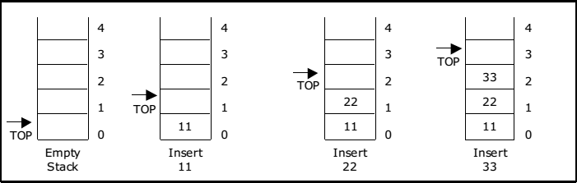
PUSH operation
The push operation is used to add (or push or insert) elements in a stack
When we add an item to a stack, we say that we push it onto the stack
The last item put into the stack is at the top

Slide 8
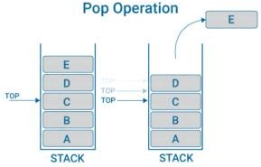
POP operation
The pop operation is used to remove or delete the top element from the stack.
When we remove an item, we say that we pop it from the stack
When an item popped, it is always the top item which is removed

Slide 9
The Stack ADT
CreateEmptyStack(S): Create or make stack S be an empty stack
Push(S, x): Insert x at one end of the stack, called its top
Top(S): If stack S is not empty; then retrieve the element at its top
Pop(S): If stack S is not empty; then delete the element at its top
IsFull(S): Determine if S is full or not. Return true if S is full stack; return false otherwise
IsEmpty(S): Determine if S is empty or not. Return true if S is an empty stack; return
false otherwise.

Slide 10
Stack implementation
Stack can be implemented in two ways:
Static implementation (using arrays)
Dynamic implementation (using pointers)
Static implementation uses arrays to create stack. Static implementation using arrays is a very simple technique but is not a flexible way, as the size of the stack has to be declared during the program design, because after that, the size cannot be varied (i.E. Increased or decreased).
Moreover static implementation is not an efficient method when resource optimization is concerned (i.e., Memory utilization).

Slide 11
For example a stack is implemented with array size 50. That is before the stack operation begins, memory is allocated for the array of size 50. Now if there are only few elements (say 30) to be stored in the stack, then rest of the statically allocated memory (in this case 20) will be wasted, on the other hand if there are more number of elements to be stored in the stack (say 60) then we can not change the size array to increase its capacity.
The above said limitations can be overcome by dynamically implementing (is also
called linked list representation) the stack using pointers

Slide 12
Operations

Slide 13
Algorithm for Operation
Algorithm for PUSH operation
Check if the stack is full or not.
If the stack is full, then print error of overflow and exit the program.
If the stack is not full, then increment the top and add the element.
Algorithm for POP operation
Check if the stack is empty or not.
If the stack is empty, then print error of underflow and exit the program.
If the stack is not empty, then print the
element at the top and decrement the top.
Position of Top | Status of Stack
-1 | Stack is Empty
0 | Only one element in stack
Max-1 | Stack is Full
Max | Stack is Overflow

Slide 14
Push Operation(Algorithm)
Step 1: Start
Step 2: Check whether stack is full or not (if top == Max-1)
If stack is full, then display error message as “Stack overflow” and go to step 4.
Else if stack is not full, increment top by 1, i.e. top=top+1 and insert element at the
new top of the stack.
Step 3: Repeat step 2 until top reach to (n-1) position i.e. max size of the stack.
Step 4: Stop

Slide 15
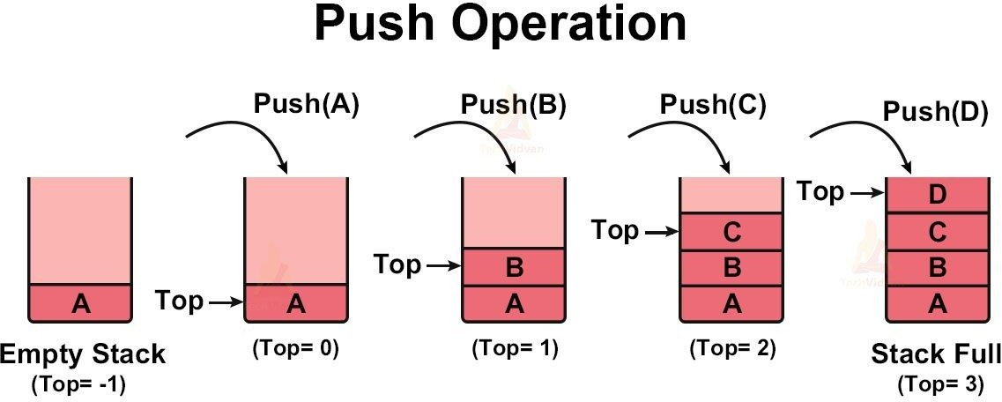

Slide 16
Pop Operation(Algorithm)
Step1: Start
Step 2: Check whether the stack is empty or not. (if top == -1)
If stack is empty, then display error message as “Stack underflow” and go to step 4
Else if stack is not empty, pop or delete element from the top of the stack and decrement top by 1, i.e. top=top-1.
Step 3: Repeat step 2 until top reach to (-1) position i.e. Stack is empty.
Step 4: Stop

Slide 17
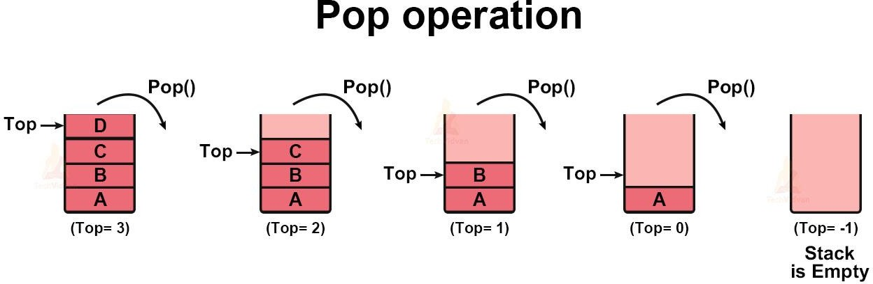

Slide 18
PUSH function
void push(){
int item;
if(top == MAXSIZE - 1) //Checking stack overflow
printf("\n The Stack Is Full"); else {
printf("Enter the element to be inserted"); scanf("%d",&item); //reading an item top= top+1; //increase top by 1
stack[top] = item;//storing the item at the top of the stack
}
}

Slide 19
POP function
void pop(){
int item;
if(top <0) //Checking Stack Underflow printf("The stack is Empty");
else{
item = stack[top]; //Storing top element to item variable
top = top-1; //Decrease top by 1
printf(“The popped item is=%d”,item); //Displaying the deleted item
}
}

Slide 20
Expression

Slide 21
An expression is a collection of operators and operands that represents a specific value.
An example of expression as x+y*z.
Expression Types
Based on the operator position, expressions are divided into THREE types
Infix expression: In this expression an operator is in-between every pair of operands. For example: a+b
Prefix (Polish notation) expression: In this expression an operator is place before every
pair of operands. For example: +ab
Postfix (Reverse-Polish notation) expression: In this expression an operator is place after every pair of operands. For example: ab+

Slide 22
Expression Evaluation
To evaluate an expression we need to know the Precedence and Associativity of the expression which determines the order of evaluation of an expression. Following is an operator precedence and associativity table (highest to lowest)
S.N. | Operator | Precedence | Associativity
1 | Parenthesis ( ) { } [ ] | Highest | Left to Right
2 | Exponentiation ^ | Second Highest | Right to Left
3 | Multiplication ( ∗ ) & Division ( / ) | Third Highest | Left to Right
4 | Addition ( + ) & Subtraction ( - ) | Lowest | Left to Right

Slide 23
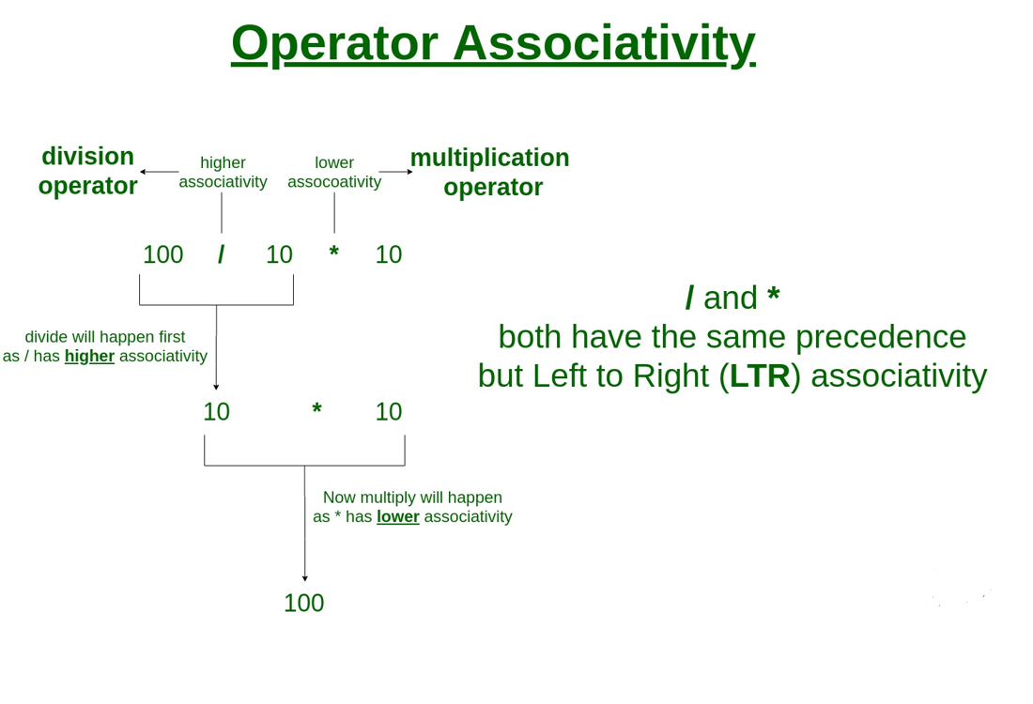
Expression Evaluation

Slide 24
In the normal expression evaluation we do evaluation according to precedence of operator. And iterate the process until result is found. For example, consider the following expression
5 * ( 6 + 2 ) - 12 / 4
Parenthesis has the highest precedence among the arithmetic operators, (6 +2) = 8 will be evaluated first. Now, the expression becomes
5 * 8 - 12 / 4
* and / have equal precedence and their associativity is from left-to-right. So, start evaluating the expression from left-to-right.
5 * 8 = 40 and 12 / 4 = 3
Now, the expression becomes
40 - 3
And the value returned after the subtraction operation is 37.

Slide 25
There are three types of expression evaluation
Infix Expression Evaluation
Prefix Expression Evaluation
Postfix Expression Evaluation

Slide 26
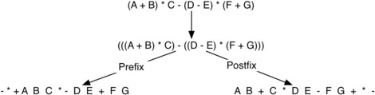
Examples of Infix, Prefix, and Postfix
Infix Expression | Prefix Expression | Postfix Expression
(A + B) * C A + B * C + D | * + A B C + + A * B C D | A B + C * A B C * + D +
(A + B) * (C + D) | * + A B + C D | A B + C D + *
A * B + C * D | + * A B * C D | A B * C D * +
A + B + C + D | + + + A B C D | A B + C + D +
Here is a more complex expression: (A + B) * C - (D - E) * (F + G). Figure shows the conversion to postfix and prefix notations.

Slide 27
1. Infix expression evaluation using stack Algorithm for Infix expression evaluation Step 1: Start
Step 2: If the character is an operand, push it to the operand stack.
Step 3: If the character is “(”, then push it onto the operator stack.
Step 4: If the character is “)”, then do Process until the corresponding “(” is encountered in
operator stack. Then, just pop out and ignore the “(”.
Step 5: If the character is an operator,
If the operator stack is empty then push it to the operator stack.
If the operator stack is not empty,

Slide 28
If the character’s precedence is greater than or equal to the precedence of the top of the operator stack, or “(” is encountered, then push the character to the operator stack.
If the character’s precedence is less than the precedence of the top of the operator stack then, pop two characters from the operand stack and process according to the operator in (p2 operator p1) pattern until the top of the operator in stack precedence is less or “(” is encounter or stack is empty.
Step 6: Once the expression iteration is completed and the operator stack is not empty,
Process until the operator stack is empty. The value left in the operand stack is our final result.
Step 7: Stop
Note: p1 = first popped operand
p2= second popped operand

Slide 29
Example: Evaluate the expression 2+(5-3*6/2) using stack
Input Character | Operand Stack | Operator Stack | Process
2 | 2
+ | 2 | +
( | 2 | +(
5 | 2,5 | +(
- | 2,5 | +(-
3 | 2,5,3 | +(-
* | 2,5,3 | +(-*
6 | 2,5,3,6 | +(-*
/ | 2,5,3,6 | +(-*/
2 | 2,5,3,6,2 | +(-*/
) | 2,5,3,3 | +(-* | 6/2=3
 | 2,5,9 | +(- | 3*3=9
 | 2,-4 | + | 5-9=-4
 | -2 |  | 2+(-4)=-2
Hence, the result is -2.

Slide 30
Q. Evaluate the expression using stack A*(B*(C+D))/E-F where A=2,B=5,C=3,D=6,E=5 and
F=2
Solution:
Given expression becomes,
2 * (5 * (3 + 6)) / 5 – 2
The final answer is 16.
Q. Evaluate the expression using stack 5/(5*(2+1))*2-10

Slide 31
2. Prefix expression evaluation using stack Algorithm for Prefix expression evaluation Step 1: Start
Step 2: Read character from right to left in given expression or reverse given expression
Step 3: If character is operand, push it in to stack
Step 4: If the character is “(”, then push it onto the stack.
Step 5: If the character is “)”, then do Process according to operator until the corresponding “(”
is encountered in stack. Then, just pop out and ignore the “(”.
Step 6: If character is operator
Pop the two operand from the top of the stack
Perform the operation according to operator in (p1 operator p2) pattern. Then, push the result to the stack
Step 7: Stop

Slide 32
Example: Evaluate the prefix expression -,+*2,3,*,5,4,9 using stack
Input Character | Stack | Evaluation
9 | 9
4 | 9,4
5 | 9,4,5
* | 9,20 | 5*4=20
3 | 9,20,3
2 | 9,20,3,2
* | 9,20,6 | 2*3=6
+ | 9,26 | 6+20=26
- | 17 | 26-9=17
Hence, the result is 17.

Slide 33
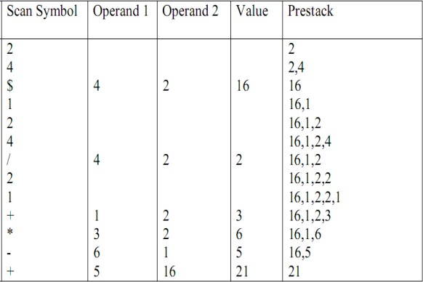
Q. Evaluate the expression – / * 2 * 5 + 3 6 5 2 using stack.
Q. Evaluate the expression +-*+12/421$42

Slide 34
Postfix expressing evaluation using stack Algorithm for Postfix expression evaluation Step 1: Start
Step 2: Read the character from left to right in the given expression
Step 3: If a character is an operand, push it in to stack
Step 4: If the character is “(“, then push it onto the stack.
Step 5: If the character is “)”, then do Process according to the operator until the corresponding “(”
Is encountered in the stack. Then, just pop out and ignore the “(”.
Step 6: If a character is an operator
Pop the two operands from the top of the stack
Perform the operation according to the operator in (p2 operator p1) pattern. Then, push the result to the stack
Step 7: Stop

Slide 35
Example: Evaluate the postfix expression 2,3,*,5,4,*,+,9,- using stack
Input Character | Stack | Evaluation
2 | 2
3 | 2,3
* | 6 | 2*3=6
5 | 6,5
4 | 6,5,4
* | 6,20 | 5*4=20
+ | 26 | 6+20=26
9 | 26,9
- | 17 | 26-9=17
Hence, the result is 17.

Slide 36
Q. Evaluate the expression 5 4 6 + * 4 9 3 / + * using stack.

Slide 37
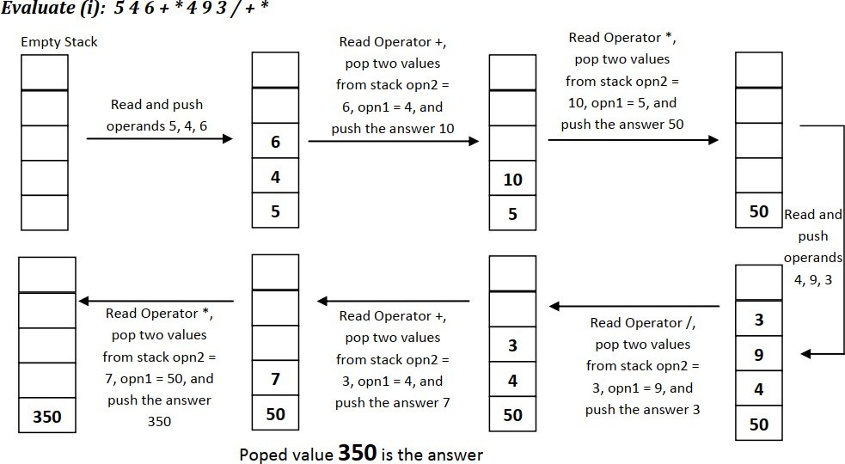

Slide 38
Expression Conversion Using Stack

Slide 39
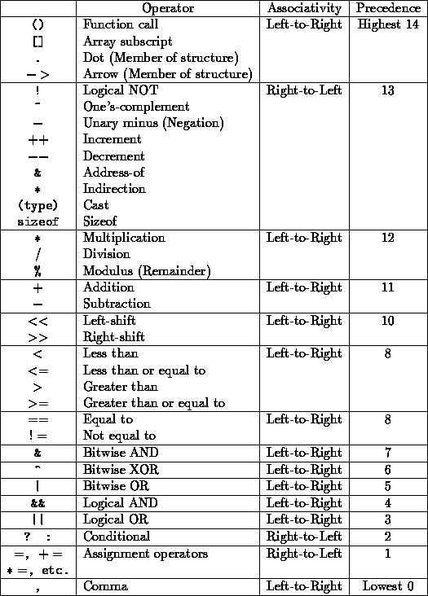
While converting infix to postfix or prefix expression we have to consider the precedence rule.

Slide 40
another
Expression conversion is the process of converting expression from one form to
form. Following are the list of expression conversion.
Infix to Prefix
Infix to Postfix
Prefix to Infix
Prefix to Postfix
Postfix to Infix
Postfix to Prefix

Slide 41
Why we use stack for expression conversion?
Ans: let’s take an example to expression conversion without using stack Convert infix
expression A+(B*C) in to postfix expression
Step 1: search for higher precedence operator and perform the operation. Here, ( ) is there so do operation for ( ) i.e. A+BC*
Step 2: then, again repeat the step 1, i.e. ABC*+
For this, we have to scan whole expression for every iteration, if the expression is complex then it takes lots of time and memory. So, to overcome this problem stack is used in expression conversion.

Slide 42
1. Conversion of Infix to Prefix expression using stack
Algorithm for Infix to Prefix Conversion:
Step 1: Start
Step 2: First, reverse the given infix expression.
Step 3: Scan the characters one by one.
Step 4: If the character is an operand, Display the prefix expression.
Step 5: If the character is “)”, then push it to the stack.
Sep 6: If the character is “(”, pop the elements from the top of the stack until the corresponding
“)” is not found.
Step 7: If the character is an operator
If the character has precedence greater than the top of the stack, OR, top of the stack is
“)”, OR, stack is empty, push the operator to the stack.
If the character is equals to top of the stack check associativity.

Slide 43
If associativity is left to right push the character in the stack
If the associativity is right to left, pop the operator from top of the stack and go to step 7.
c. If the character has precedence lesser than the top of the stack, pop the operator and
display it and go to step 7.
Step 8: If there is no more input, pop out the remaining operators and display.
Step 9: After all the characters are scanned, reverse the output.
Step 10: Stop

Slide 44
Example: Convert the infix A+B-C*D+(E^F)*G/H/I in to Prefix expression.
First of all reverse the given infix expression I/H/G*)F^E(+D*C-B+A
Input Character | Stack | Prefix Expression
I |  | I
/ | / | I
H | / | IH
/ | // | IH
G | // | IHG
* | //* | IHG
) | //*) | IHG
F | //*) | IHGF
^ | //*)^ | IHGF
E | //*)^ | IHGFE
( | //* | IHGFE^

Slide 45
+ | // | IHGFE^*
 | / | IHGFE^*//
 | + | IHGFE^*//
D | + | IHGFE^*//D
* | +* | IHGFE^*//D
C | +* | IHGFE^*//DC
- | + | IHGFE^*//DC*
 | +- | IHGFE^*//DC*
B | +- | IHGFE^*//DC*B
+ | +-+ | IHGFE^*//DC*B
A | +-+ | IHGFE^*//DC*BA
 |  | IHGFE^*//DC*BA+-+
New, reverse the final expression +-+AB*CD//*^EFGHI this is prefix expression.

Slide 46
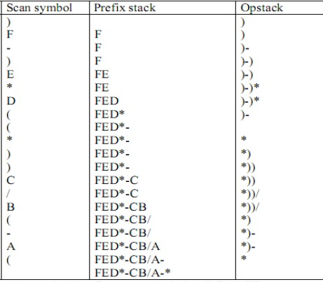
Example: (A-(B/C))*((D*E)-F)
Hence, required expression is
*-A/BC-*DEF

Slide 47
Q. Trace algorithm to convert given infix to prefix expression (A+B*C$D)/((E+F-G)*H)$I/J
Q. Trace algorithm to convert given infix to prefix expression ((A-(B+C))*D)^(E+F)
Notes:
Ans ->$/($+A*BCD*+E-FGH/IJ 2) ^*-A+BCD+EF

Slide 48
2. Conversion of Infix to Postfix using Stack
Algorithm for Infix to Postfix Conversion:
Step 1: Start
Step 2: Scan the infix expression character.
Step 3: If character is operand, display it.
Step 4: If character is “(”, insert it on stack.
Step 5: If it is “)”, Pop out the operator from stack and display them until “(” is not found. Then, Pop out and discard the “(”.
Step 6: If character is an operator, then
If character has higher precedence than the top of stack, OR top of the stack is empty OR stack
has “(”, insert the operator on stack.
If the character has lower precedence than top of the stack, pop out the operator from the stack and display it. Then go to Step 5.
If it has equal precedence check associativity.

Slide 49
If associativity is Left to Right, then, pop out the operator at top of the stack and display. Then go to step 5.
If associativity is Right to Left insert the operator in the stack.
Step 8: If there is no more input, pop out the remaining operators and display.
Step 9: Stop

Slide 50
Example: Covert the Infix expression L-M*N+(O/P)+W^U^V in to Postfix expression using Stack
Input Character | Stack | Postfix Expression
L |  | L
- | - | L
M | - | LM
* | -* | LM
N | -* | LMN
+ | + | LMN*-
( | +( | LMN*-
O | +( | LMN*-O
/ | +(/ | LMN*-O
P | +(/ | LMN*-OP
) | + | LMN*-OP/
+ | + | LMN*-OP/+
W | + | LMN*-OP/+W
^ | +^ | LMN*-OP/+W
U | +^ | LMN*-OP/+WU
^ | +^^ | LMN*-OP/+WU
V | +^^ | LMN*-OP/+WUV
 |  | LMN*-OP/+WUV^^+
Hence, the postfix expression is LMN*- OP/+WUV^^+

Slide 51
Q. Trace algorithm to convert given infix to postfix expression K + L - M*N + (O^P) * W/U/V * T + Q
Q. Trace algorithm to convert given infix to postfix expression A + ( B / C - ( D * E ^ F ) + G ) * H
Solution:
Character scanned | Stack | Postfix Expression (Q)
A + ( B / C | + + ( + ( + ( / + ( / | A A A A B A B A B C
Notes:
Ans- K+ L - MN* + OP^ * WU/V/ * T + Q ans-

Slide 52
– ( D * E ^ F ) + G ) * H | + ( - + ( - ( + ( - ( + ( - ( * + ( - ( * + ( - ( * ^ + ( - ( * ^ + ( - + ( + + ( + + + * + * | A B C / A B C / A B C / D A B C / D A B C / D E A B C / D E A B C / D E F A B C / D E F ^ * A B C / D E F ^ * - A B C / D E F ^ * - G A B C / D E F ^ * - G + A B C / D E F ^ * - G + A B C / D E F ^ * - G + H A B C / D E F ^ * - G + H * +
Hence, the postfix
expression is
A B C / D E F ^ * - G + H * +

Slide 53
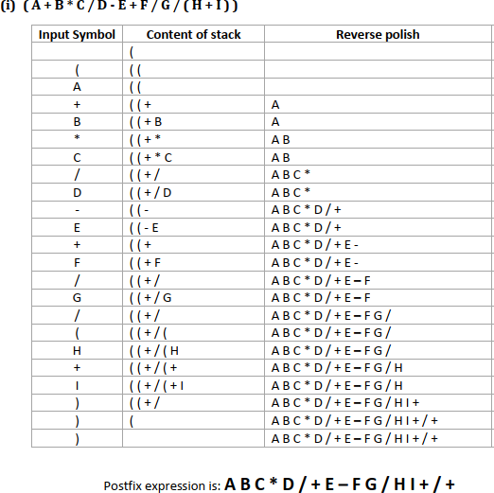

Slide 54
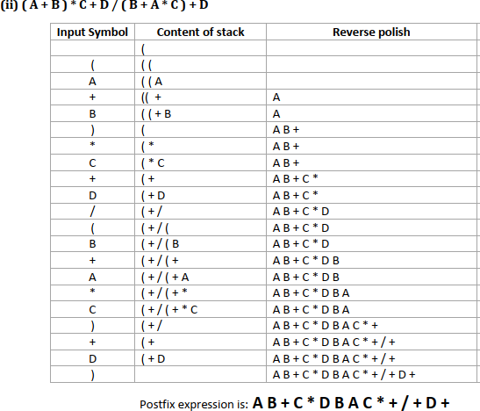

Slide 55
3. Conversion of Prefix to Infix
Algorithm for Prefix to Infix Conversion:
Step 1: Start
Step 2: Read the Prefix expression from right to left
Step 3: If the character is an operand, then push to the Stack
Step 4: If the character is an operator,
Pop two operands from the Stack
Create a string by concatenating the two operands and the operator between them i.e.
string = (operand1, operator, operand2)
Push the resultant string back to Stack
Step 5: Repeat the above steps until end of Prefix expression.
Step 6: Stop

Slide 56
Example: Convert Prefix expression *+AB/CD to Infix expression
Input Character | Stack | New String
D | D
C | D,C
/ | C/D | (C/D)
B | (C/D),B
A | (C/D),B,A
+ | (C/D), (A+B) | (A+B)
* | ((A+B)*(C/D)) | (A+B)*(C/D)
Hence, Infix expression if ((A+B)*(C/D))

Slide 57
4. Conversion of Prefix to Postfix
Algorithm for Prefix to Postfix Conversion:
Step 1: Start
Step 2: Read the Prefix expression from right to left
Step 3: If the character is an operand, then push to the Stack
Step 4: If the character is an operator
Pop two operands from the Stack
Create a string by concatenating the two operands and the operator after them. i.e. string
= operand1, operand2, operator
And push the resultant string back to Stack
Step 5: Repeat the above steps until end of Prefix expression.
Step 6: Stop

Slide 58
Example: Convert prefix expression * - A / B C - / A K L to postfix expression
Input Character | Stack | New String
L | L,
K | L,K,
A | L,K,A
/ | L, AK/ | AK/
- | AK/L- | AK/L-
C | AK/L-,C
B | AK/L-,C,B
/ | AK/L-,BC/ | BC/
A | AK/L-,BC/,A
- | AK/L-, ABC/- | ABC/-
* | ABC/-AK/L-* | ABC/-AK/L-*
Hence, the Postfix expression is ABC/-AK/L-*

Slide 59
5. Conversion of Postfix to Infix expression
Algorithm for Postfix to Infix Conversion:
Step 1: Start
Step 2: Read the Prefix expression from left to right
Step 3: If the character is an operand, then push to the Stack
Step 4: If the character is an operator,
Pop two operands from the Stack
Create a string by concatenating the two operands and the operator
between them i.e. string = (operand2, operator, operand1)
Push the resultant string back to Stack
Step 5: Repeat the above steps until end of Prefix expression.
Step 6: Stop

Slide 60
Example: Convert the Postfix expression AB+CD/* in to Infix expression
Input Character | Stack | New String
A | A
B | A,B
+ | (A+B) | (A+B)
C | (A+B),C
D | (A+B),C,D
/ | (A+B), (C/D) | (C/D)
* | ((A+B)*(C/D)) | ((A+B)*(C/D))
Hence, Infix expression is ((A+B)*(C/D))

Slide 61
6. Conversion of Postfix to Prefix expression
Algorithm for Postfix to Prefix Conversion:
Step 1: Start
Step 2: Read the Postfix expression from left to right
Step 3: If the character is an operand, then push to the Stack
Step 4: If the character is an operator
Pop two operands from the Stack
Create a string by concatenating the two operands and the operator before them i.e. string
= operator, operand2, operand1
And push the resultant string back to Stack
Step 5: Repeat the above steps until end of Prefix expression.
Step 6: Stop

Slide 62
Example: Convert Postfix expression AB + CD - * in to Prefix expression
Input Character | Stack | New String
A | A
B | A,B
+ | +AB | +AB
C | +AB,C
D | +AB,C,D
- | +AB, -CD | -CD
* | *+AB-CD | *+AB-CD
Hence, Prefix expression is *+AB-CD

Slide 63
1.convert infix to postfix ((A + B) - C * D/E) *(H-I) *F+G
2.Define stack. List the applications of stack. Trace the algorithm to convert infix to postfix with following infix expression ((A + B) - C * D/E)*(H-I)*F+G and evaluate the obtained postfix expression with the following values: A = 4, B = 2, C = 4, D = 3, E = 8, F = 2, G = 3, H =5, I = 1 [1 + 1 + 4 + 4]

