Slide 1
Queue

Slide 2
Introduction
Queue is also an abstract data type or a linear data structure, just like stack data structure, in which the first element is inserted from one end called the REAR(also called tail), and the removal of existing element takes place from the other end called as FRONT(also called head).
This makes queue as FIFO(First in First Out) data structure, which means that element inserted first will be removed first.
Which is exactly how queue system works in real world. If you go to a ticket counter to buy movie tickets, and are first in the queue, then you will be the first one to get the tickets. Right? Same is the case with Queue data structure. Data inserted first, will leave the queue first.
The process to add an element into queue is called En-queue and the process of removal of an element from queue is called De-queue.

Slide 3
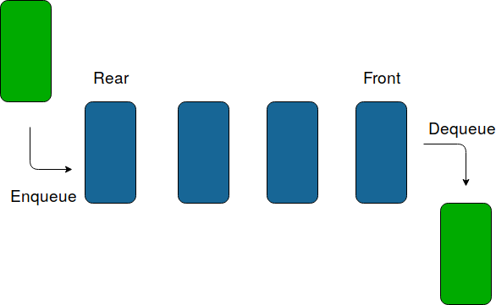
Pictorial Representation

Slide 4
Basic features of Queue:
Like stack, queue is also an ordered list of elements of similar data types.
Queue is a FIFO( First in First Out ) structure.
Once a new element is inserted into the Queue, all the elements inserted
before the new element in the queue must be removed, to remove the new
element.
peek() function is often used to return the value of first element without
dequeuing it.

Slide 5
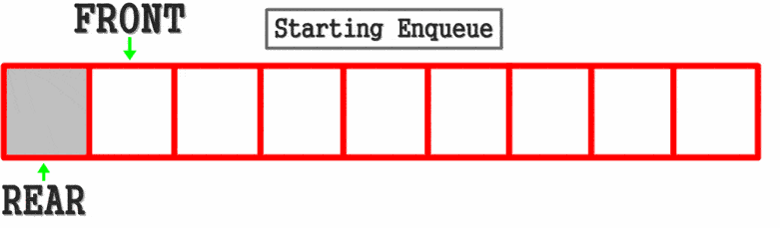

Slide 6
Applications of queue:
Serving requests
on a single shared resource, like a printer, CPU task
scheduling, buffer of keyboard etc.
All types of customer service software (like Railway/Air ticket
designed using queue to give proper service to the customers.
Handling of interrupts in real-time systems. The interrupts are same order as they arrive i.e. First come first served.
In Networks: Queues in routers/ switches, Mail Queues
reservation) are
handled in the

Slide 7
Operations on queue:
MakeEmpty(q): To make q as an empty queue
Enqueue(q, x): To insert an item x at the rear of the queue, this is also called by names add, insert.
Dequeue(q): To delete an item from the front of the queue q. This is also known as
Delete, Remove.
IsFull(q): To check whether the queue q is full.
IsEmpty(q): To check whether the queue q is empty
Traverse (q): To read entire queue that is display the content of the queue.

Slide 8
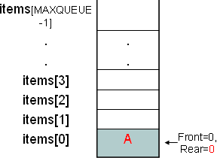
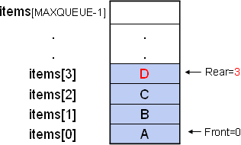
Enque
Enqueue(A):
Enqueue(B,C,D):

Slide 9
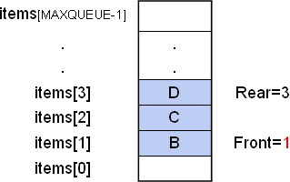
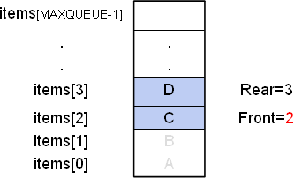
Dequeue
Dequeue(A):
Dequeue(B):

Slide 10
The Queue as a ADT:
A queue q of type T is a finite sequence of elements with the operations
MakeEmpty(q): To make q as an empty queue
IsEmpty(q): To check whether the queue q is empty. Return true if q is empty, return false
otherwise.
IsFull(q): To check whether the queue q is full. Return true in q is full, return false otherwise.
Enqueue(q, x): To insert an item x at the rear of the queue, if and only if q is not full.
Dequeue(q): To delete an item from the front of the queue q. if and only if q is not empty.
Traverse (q): To read entire queue that is display the content of the queue.

Slide 11
Queue can be implemented in two ways:
Using arrays (static)
Using pointers (dynamic)
Implementation of queue using pointers will be discussed in further unit. Let us discuss underflow and overflow conditions when a queue is implemented using arrays.
If we try to dequeue (or delete or remove) an element from queue when it is empty, underflow occurs. It is not possible to delete (or take out) any element when there is no element in the queue. Suppose maximum size of the queue (when it is implemented using arrays) is 50. If we try to enqueue (or insert or add) an element to queue, overflow occurs. When queue is full it is naturally not possible to insert any more elements.

Slide 12
Types of Queue
Linear/Ordinary Queue
Circular Queue
Priority Queue
Double/Doubly Ended Queue

Slide 13
Linear/Ordinary Queue
It is the simplest form of queue where the elements are accessed based on First
Come First Serve (FCFS)
It consists of data elements which are connected in a linear fashion. It is so called
linear because it resembles to a straight line where the elements are positioned
one after the other.
The data items are inserted from the rear end and deleted from the front end
Whenever, the queue is empty, the front is initialized with zero and the rear is
initialized as -1

Slide 14
Operation in Queue
Enqueue
Dequeue
Traversal

Slide 15
Algorithm For Enqueue (Ordinary Queue)
Let Q[Max] be an empty queue with size Max and Set front=-1 and rear=-1
Step 1: Start
Step 2: Check if the queue is full (if rear == max - 1)
Step 3: If the queue is full, Display “Queue is full, Cannot insert”, and go to step 7
Step 4: If the queue is not full, ask the user to enter the number (item) Step 5: Set rear=rear+1
Step 6: Set Q[rear] = item
Step 7: Stop

Slide 16
Code logic for enqueue
if (rear == MAX - 1) // Queue if full
printf("Queue Overflow \n");
else if (front=rear=-1) // Queue is empty
front= rear =0
Queue[rear]=data
else
rear= rear+1
Queue[rear]=data

Slide 17
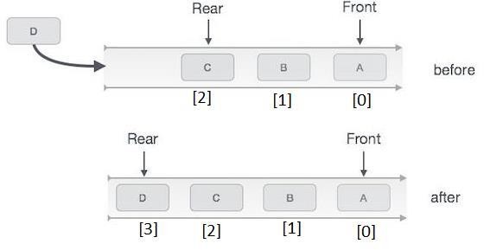
Example:

Slide 18
Algorithm For Dequeue (Ordinary Queue)
Let Q [Max] be an empty queue with size Max and Set front =-1 and rear = -1
Step 1: Start
Step 2: Check if the queue is empty (if front =-1)
Step 3: If the queue is empty, Display “Queue is empty, Cannot dequeue”, assign front=-1 and rear =-1 and go to step 7
Step 4: If the queue is not empty, Display “Item being dequeued is” Q [front]
Step 5: Set Q [front] = 0
Step 6: Set front=front+1 Step 7: Stop

Slide 19
Code logic for dequeue
if (front == - 1 )// queue is empty
printf("Queue Underflow \n");
else if (front== rear)// queue has only one element
data = queue[front]);
front = rear=-1;
else
data= queue[front]
front =front+1
}

Slide 20
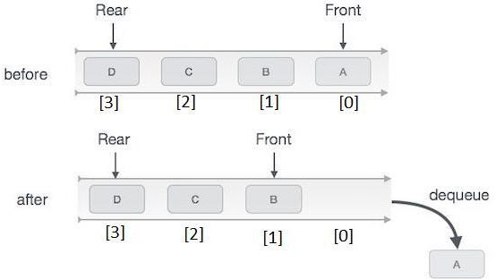

Slide 21
Algorithm For Display (Ordinary Queue)
Step 1 - Check whether queue is EMPTY. (front == rear)
Step 2 - If it is EMPTY, then display "Queue is EMPTY!!!" and terminate the function.
Step 3 - If it is NOT EMPTY, then define an integer variable 'i' and set 'i = front+1'.
Step 4 - Display 'queue[i]' value and increment 'i' value by one (i++). Repeat the same until 'i' value reaches to rear (i <= rear)

Slide 22
Drawback of Linear Queue
In a Linear queue, once the queue is completely full, it's not possible to insert
more elements. Even if we dequeue the queue to remove some of the elements,
until the queue is reset, no new elements can be inserted.
Suppose we have queue of 7 elements and we insert 7 items into queue, and then
delete some items, then queue has space, but at that condition we cannot insert
items into queue.
You must be wondering why?

Slide 23
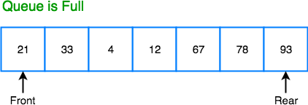
When we dequeue any element to remove it from the queue, we are moving the front of the queue forward, thereby reducing the overall size of the queue. And we cannot insert new elements, because the rear pointer is still at the end of the queue.

Slide 24
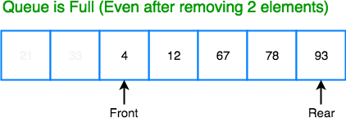
The only way is to reset the linear queue, for a fresh start.

Slide 25
Circular Queue
A circular queue is a variant of the linear queue which effectively overcomes the limitation of the
linear queue.
In circular queue, the new element is added at the very first position of the queue if the last is
occupied and space is available.
When it comes to linear queue the insertion can be performed only from the rear end and deletion from the front end.
In a full queue after performing series of successive deletions in the queue arises a certain situation where no new element can be added further even if the space available because the underflow condition (Rear = max – 1) still exists.
Circular queue connects the two ends through a pointer where the very first element comes after the last element.

Slide 26
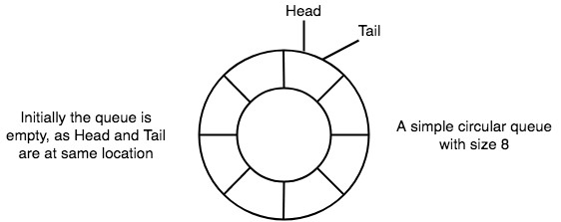
Basic features of Circular Queue
In case of a circular queue, head pointer will always point to the front of the queue,
and tail pointer will always point to the end of the queue.
Initially, the head and the tail pointers will be pointing to the same location, this
would mean that the queue is empty.

Slide 27
New data is always added to the location pointed by the tail pointer, and once the data is added, tail pointer is incremented to point to the next available location
In a circular queue, data is not actually removed from the queue. Only the head pointer
is incremented by one position when dequeue is executed. As the queue data is only the data between head and tail, hence the data left outside is not a part of the queue anymore, hence removed.
The head and the tail pointer will get initialised to 0 every time they reach the end of the queue.

Slide 28
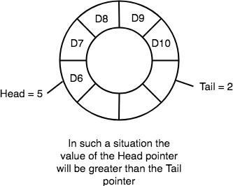
Also, the head and the tail pointers can cross each other. In other words, head pointer can be greater than the tail. Sounds odd? This will happen when we dequeue the queue a couple of times and the tail pointer gets reinitialized upon reaching the end of the queue.
At any time the position of the element to be inserted will be calculated by the relation Rear =
(Rear + 1) % SIZE
After deleting an element from circular queue the position of the front end is calculated by the relation Front= (Front + 1) % SIZE

Slide 29
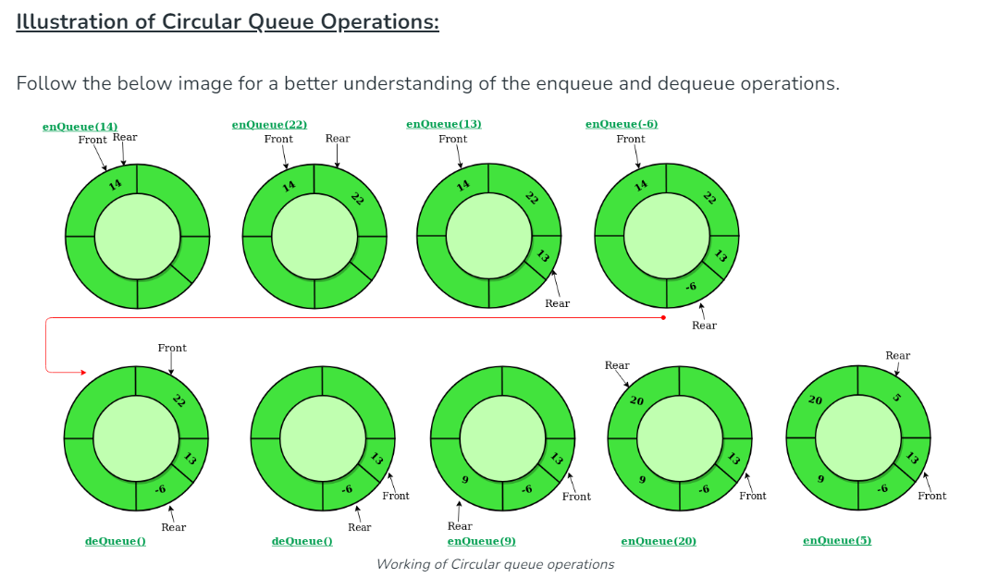

Slide 30
Algorithms for inserting an element in a circular queue:
This algorithm assumes that the rear and front are initially set to rear=front= -1.
Step 1: Start
Step 2: Check if the Queue is full or not if (front == 0 && rear == MAX-1)|| (front == rear+1)
Step 3: If the queue is full print Queue is full and go to Step 7
Step 4: Check if (front =rear== -1) then front = 0; rear= 0; else goto step 6
Step 5: set rear=(rear+1)%MAXSIZE; [increment rear by 1]
Step 6: queue[rear]=item;
Step 7:end

Slide 31
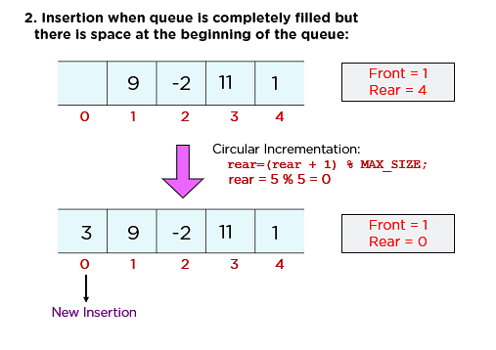
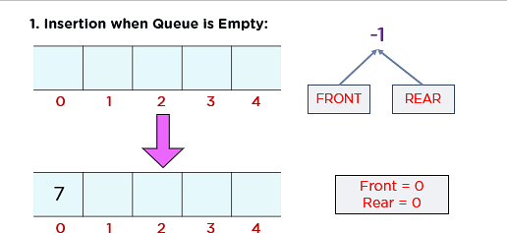

Slide 32
Algorithms for deleting an element from a circular queue
This algorithm is assume that rear and front are initially set to rear=front= MAXSIZE-1.
Step 1: Start
Step 2:Check if queue is Empty or not (if (rear==front or Front = -1 & Rear = -1))
Step 3: If queue is empty then print Queue is empty and go to step 7
Step 4: Set front=(front+1)%MAXSIZE; [increment front by 1] Step 5: Set item=cqueue[front];
Step 6: Print Item being displayed item.
Step 7: end.

Slide 33
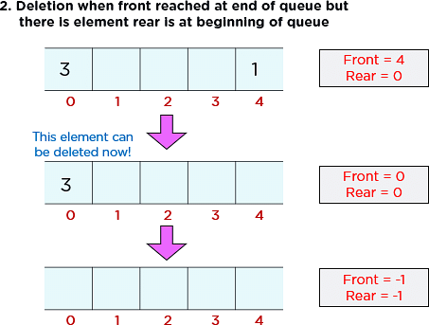
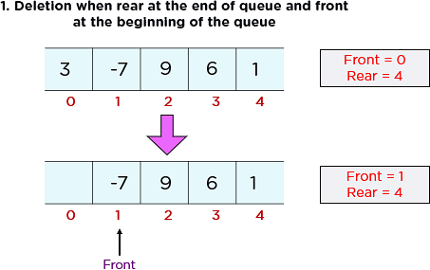

Slide 34
Priority Queue
A priority queue is a special type of queue in which each element is associated with a
priority and is served according to its priority.
A priority queue is a collection of elements such that each element has been assigned a priority and the order in which elements are deleted and processed comes from the following rules:
An element of higher priority is processed before any element of lower priority.
Two elements with the same priority are processed according to the order in which they were inserted to the queue.

Slide 35
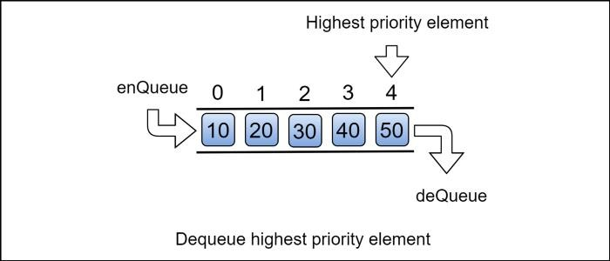

Slide 36
Application of Priority queue:
The best application of priority queue is observed in CPU scheduling.
The jobs which have higher priority are processed first.
If the priority of two jobs is same this jobs are processed according to their position in queue.
A short job is given higher priority over the longer one.

Slide 37
Characteristics of Priority Queue
Priority queue in a data structure is an extension of a linear queue that possesses the following properties:
Every element has a certain priority assigned to it.
Every element of this queue must be comparable.
It will delete the element with higher priority before the lower priority.
If multiple elements have the same priority, it does their removal from the queue according to the FCFS principle.

Slide 38
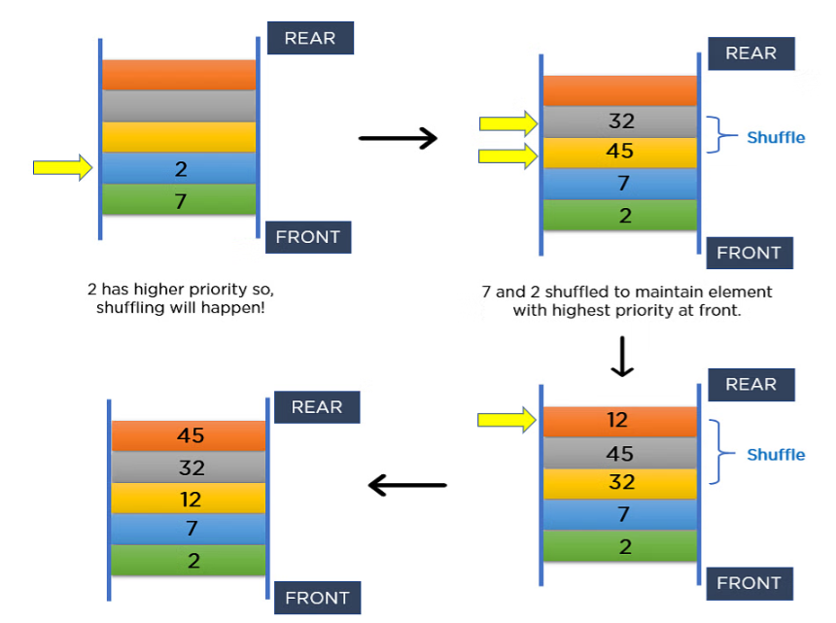
Priority Queue
Now, understand these properties with the help of an example. Consider inserting 7, 2, 45, 32, and 12 in a priority queue. The element with the least value has the highest property. Thus, you should maintain the lowest element at the front node. The image above shows how it maintains the priority during insertion in a queue.

Slide 39
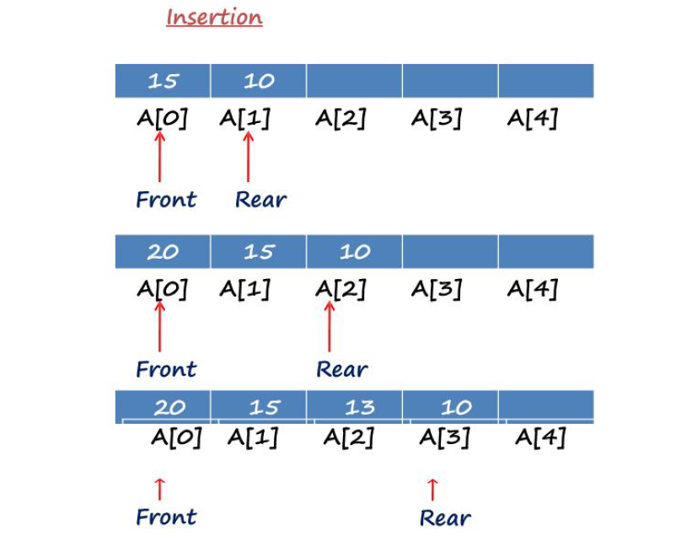
Priority Queue
Array representation of priority queue

Slide 40
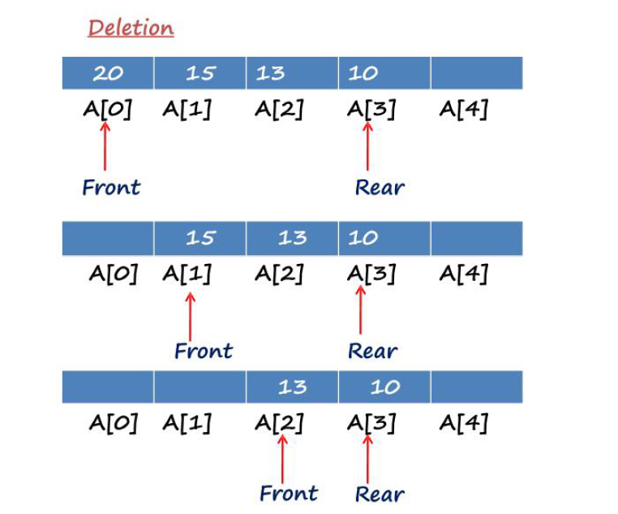
Priority Queue
Array representation of priority queue

Slide 41
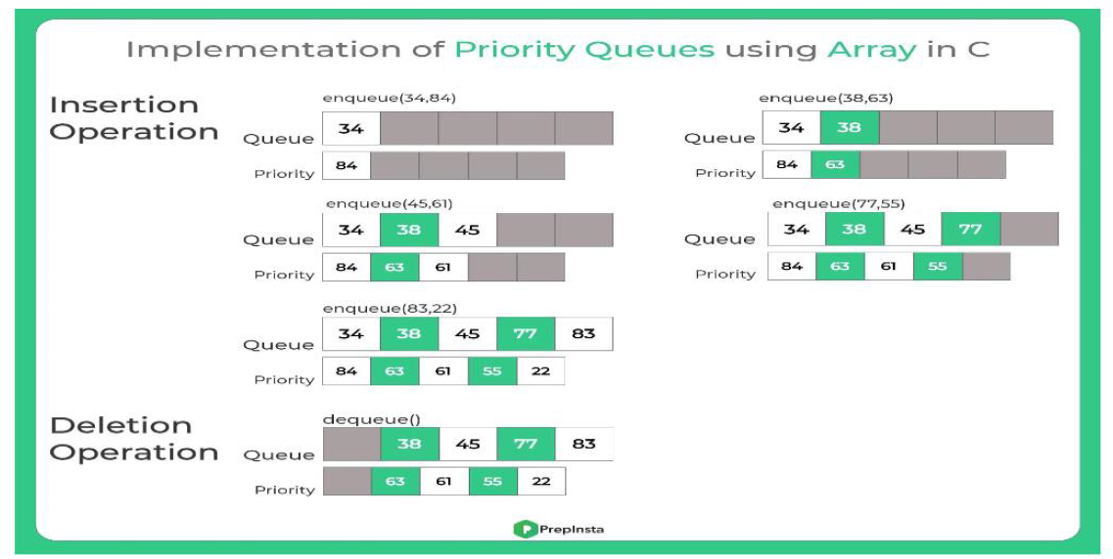
Priority Queue

Slide 42
Types of priority queues:
Ascending priority queue(min priority queue):
An ascending priority queue is a collection of items into which items can be inserted
arbitrarily but from which only the smallest item can be removed.
For example, we take the numbers from 1 to 5 arranged in ascending order like 1,2,3,4,5; therefore, the smallest number, i.e., 1 is given as the highest priority in
priority queue.
Descending priority queue(max priority queue):
A descending priority queue is a collection of items that can be inserted
arbitrarily but only the largest item can be removed.
For example, we take the numbers from 1 to 5 arranged in descending order like 5, 4, 3, 2, 1; therefore, the largest number, i.e., 5 is given as the highest priority in a priority queue.

Slide 43
Priority QUEUE Operations:
Insertion :
The insertion in Priority queues is the same as in non-priority queues.
Deletion :
Deletion requires a search for the element of highest priority and deletes the element with highest priority. The following methods can be used for deletion/removal from a given Priority Queue:
After each deletion elements can be moved up in the array decrementing the rear.
The array in the queue can be maintained as an ordered circular array.

Slide 44
Representation of priority queue in list
When a priority queue is implemented with a linked list, each node will contain three
parts:
Data.
The priority number of the element (PRN).
The address of the next element.
Following is an example of a linked representation of a priority queue.

Slide 45
The priority queue ADT:
A ascending priority queue of elements of type T is a finite sequence of elements of T together
with the operations:
MakeEmpty(p): Create an empty priority queue p
Empty(p): Determine if the priority queue p is empty or not
Insert(p,x): Add element x on the priority queue p
DeleteMin(p): If the priority queue p is not empty, remove the minimum element of the queue and return it.
FindMin(p): Retrieve the minimum element of the priority queue p.

Slide 46
Priority Queue Implementation
Priority Queue can be implemented in two ways:
Using ordered Array: In ordered array insertion or enqueue operation takes O(n) time complexity because it enters elements in sorted order in queue. And deletion takes O(1) time complexity.
Using unordered Array:In unordered array deletion takes O(n) time complexity because it search for the element in Queue for the deletion and enqueue takes o(1) time complexity.

Slide 47
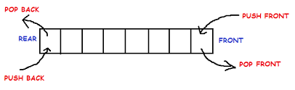
Double Ended Queue
Double Ended Queue is also a Queue data structure in which the insertion and deletion operations are performed at both the ends (front and rear). That means, we can insert at both front and rear positions and can delete from both front and rear positions.
A double-ended queue also called as deque (pronounced as ‘deck’ or ‘dequeue’)
Elements can be added to or removed from either the front (head) or the back (tail) end. However, no element can be added and deleted from the middle.

Slide 48
Can be represented in TWO ways
Input Restricted Double Ended Queue
An input restricted deque is a deque, which allows insertion at only 1 end, rear end, but allows deletion at both ends.
Output Restricted Double Ended Queue
An output-restricted deque is a deque, which allows deletion at only one end, front end, but
allows insertion at both ends.
The possible operation performed on deque is
Add an element at the rear end
Add an element at the front end
Delete an element from the front end
Delete an element from the rear end

Slide 49
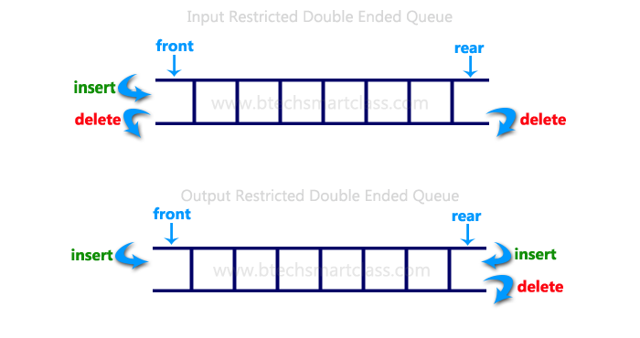
Only 1st, 3rd and 4th operations are performed by input-restricted deque and 1st, 2nd and 3rd
operations are performed by output-restricted deque.

Slide 50
1. Algorithms for inserting an element
Let Q be the array of MAX elements. front (or left) and rear (or right) are two array indexes (pointers), where the addition and deletion of elements occur. Let DATA be the element to be inserted. Before inserting any element to the queue left and right pointers will point to the – 1.
Insert an element at the front side of the de-queue
If ((FRONT == 0 && REAR == MAX–1) || (FRONT == REAR+ 1))
Display “Queue Overflow”
If (FRONT == –1) set
FRONT=REAR = 0
else if FRONT==0, set FRONT = MAX-1
else FRONT= FRONT-1
Queue [Front] = Item

Slide 51
Insert an element at the rear side of the de-queue
If ((FRONT == 0 && REAR == MAX–1) || (FRONT == REAR+ 1))
Display “Queue Overflow”
If (FRONT == –1) set
FRONT=REAR = 0
else if REAR==MAX-1, set Rear = 0
else REAR= REAR+1
Queue [rear] = Item

Slide 52
2. Algorithms for deleting an element
Let Q be the array of MAX elements. front (or left) and rear (or right) are two array index
(pointers), where the addition and deletion of elements occurred. DATA will contain the element just deleted.
Delete an element from the front side of the de-queue
1. If (FRONT== – 1)
Display “Queue Underflow”
If FRONT= REAR set FRONT = REAR =-1
else if
FRONT= =MAX-1 set FRONT = 0
else
FRONT= FRONT+1

Slide 53
Delete an element from the REAR side of the de-queue
1. If (FRONT== – 1)
Display “Queue Underflow”
If FRONT= REAR set FRONT = REAR =-1
else if
REAR= = 0 set REAR = MAX -1
else
REAR= REAR-1

Slide 54
The Deque Abstract Data Type
Deque() creates a new deque that is empty. It needs no parameters and returns an empty deque.
addFront(item) adds a new item to the front of the deque. It needs the item and returns nothing.
addRear(item) adds a new item to the rear of the deque. It needs the item and returns nothing.
removeFront() removes the front item from the deque. It needs no parameters and returns the
item. The deque is modified.
removeRear() removes the rear item from the deque. It needs no parameters and returns the item. The deque is modified.
isEmpty() tests to see whether the deque is empty. It needs no parameters and returns a
boolean value.
size() returns the number of items in the deque. It needs no parameters and returns an integer.

Slide 55
Memory Representation
The deque can be implemented using two data structures, i.e.,
circular array, and
doubly linked list.

