Slide 1
Tree

Slide 2
Tree
Tree is a hierarchical data structure which stores the information naturally in the form of hierarchy style.
Tree is one of the most powerful and advanced data structures.
A tree is a nonlinear data structure, compared to arrays, linked lists, stacks and queues which are linear data structures.
A tree is a collection of entities called nodes. Nodes are connected by edges. Each node contains a value or data, and it may or may not have a child node

Slide 3
Important Terms
Root is the topmost node of the tree
Edge is the link between two nodes
Child is a node that has a parent node
Parent is a node that has an edge to a child node
Leaf is a node that does not have a child node in the tree
Height is the length of the longest path to a leaf
Depth is the length of the path to its root
Siblings Nodes with the same parent are called Siblings.
Degree of Node Degree of a node represents a number of children of a node.
Visiting refers to checking the value of a node when control is on the node.

Slide 4
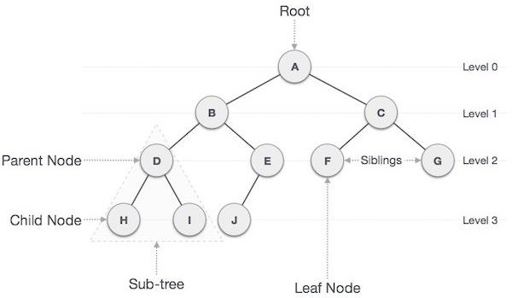
Traversing means passing through nodes in a specific order.
Level of a node represents the generation of a node. If the root node is at level 0, then its next child node is at level 1, its grandchild is at level 2, and so on.
Key represents a value of a node based on which a search operation is to be carried
out for a node.

Slide 5
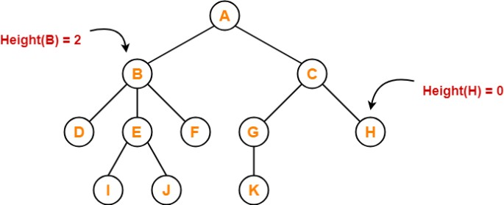
Height of tree
Height of node – The height of a node is the number of edges on the longest downward path
between that node and a leaf.
Height of tree –The height of a tree is the number of edges on the longest downward path between the root and a leaf.
Here, Height of node A = 3, B = 2, C = 2, D = 0, E = 1, F = 0, G = 1, H = 0, I = 0,J = 0, K = 0

Slide 6
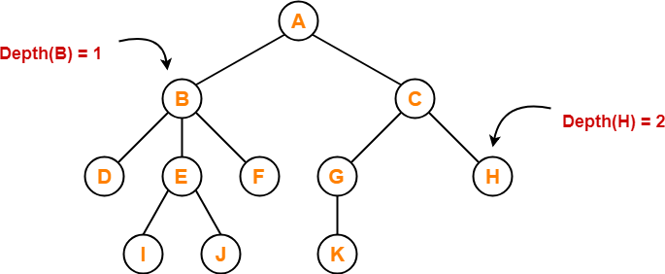
Depth of tree
Total number of edges from root node to a particular node is called as depth of that node.
Depth of a tree is the total number of edges from root node to a leaf node in the longest path.
Depth of the root node = 0
Here, Depth of node A = 0, B = 1, C = 1, D = 2, E = 2, F = 2, G = 2,
H = 2, I = 3, J = 3, K = 3

Slide 7
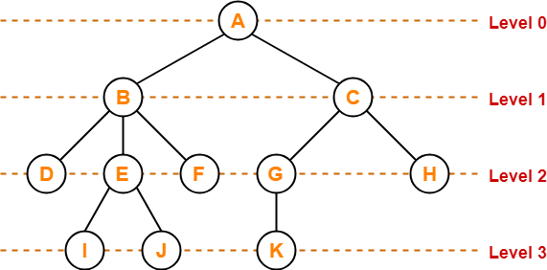
Level of tree
In a tree, each step from top to bottom is called as level of a tree.
The level of a node is defined by 1 + the number of connections between the node and the
root.

Slide 8
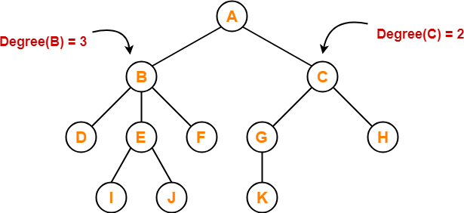
Degree
Degree of a node is the total number of children of that node.
Degree of a tree is the highest degree of a node among all the nodes in the tree.
Here,Degree of node A = 2, B = 3, C = 2, D
= 0, E = 2, F = 0, G = 1, H = 0, I = 0, J = 0,
K = 0

Slide 9
Applications of Trees
Binary Search Trees(BSTs) are used to quickly check whether an element is present in a set or not.
Heap is a kind of tree that is used for heap sort.
A modified version of a tree called Tries is used in modern routers to store routing information.
Most popular databases use B-trees and T-trees, which are variants of the tree structure we learned above to store their data
Compilers use a syntax tree to validate the syntax of every program you write.
Spanning Trees and shortest path trees are used in routers and bridges respectively in
computer networks

Slide 10
Binary Tree
Binary tree is a special type of data structure. In binary tree, every node can have a maximum of 2 children, which are known as Left child and Right Child.
A tree in which every node can have a maximum of two children is called Binary
Tree.
More tree terminology:
The depth of a node is the number of edges from the root to the node.
The height of a node is the number of edges from the node to the deepest leaf.
The height of a tree is a height of the root.

Slide 11
Types
A full binary tree/Strictly Binary Tree is a binary tree in which each node has exactly zero
or two children.
A complete binary tree is a binary tree, which is completely filled, with the possible exception of the bottom level, which is filled from left to right.
A Binary Tree is a complete Binary Tree if all levels are completely filled except possibly
the last level and the last level has all keys as left as possible.
The height h of a complete binary tree with N nodes is at most O (log N). We can easily prove this by counting nodes on each level, starting with the root, assuming that each level has the maximum number of nodes:
= O(log n)

Slide 12
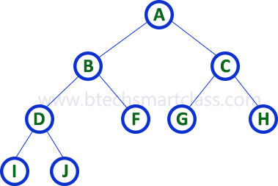
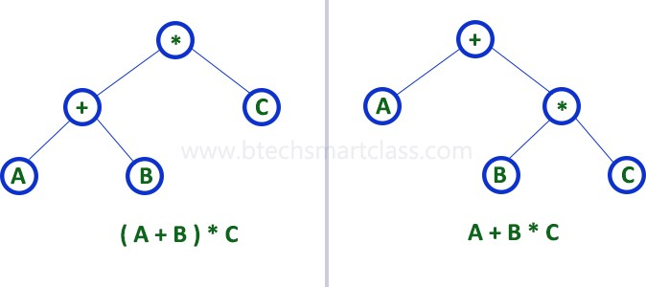
Strictly binary tree is also called as Full Binary Tree or Proper Binary Tree or 2-Tree
Example: Strictly binary tree data structure is used to represent mathematical expressions.

Slide 13
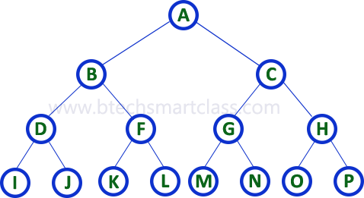
Complete binary tree is also called as Perfect Binary Tree
Extended Binary Tree: A binary tree can be converted into Full Binary tree by adding dummy nodes to existing nodes wherever required.
The full binary tree obtained by adding dummy nodes to a binary tree is called as Extended Binary Tree.

Slide 14
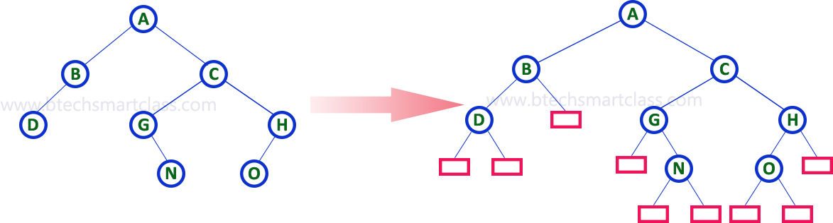

Slide 15
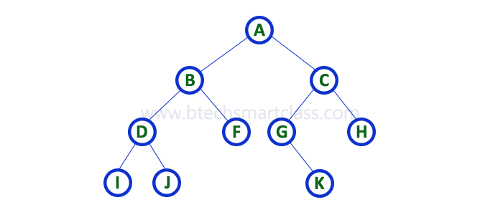
Binary Tree Representations
A binary tree data structure is represented using two methods.
Sequential representation using arrays
Linked List Representation
We use one-dimensional array (1-D Array) to represent a binary tree. Consider the above example of a binary tree and it is represented as follows

Slide 16

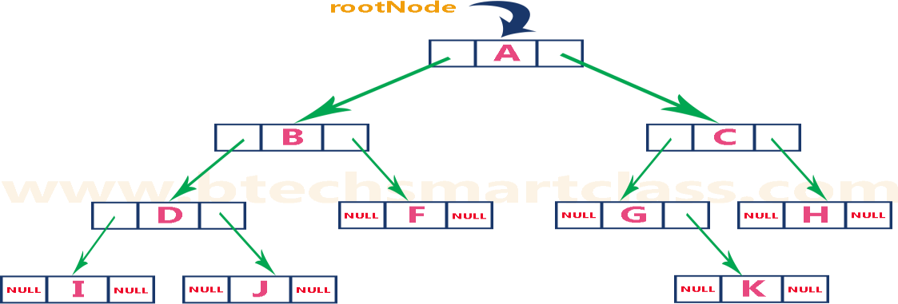
In a double linked list, every node consists of three fields. First field for storing left child address, second for storing actual data and third for storing right child address.
In this linked list representation, a node has the following structure

Slide 17
Applications of binary trees
Binary Search Tree-Used in many search applications where data is constantly entering/leaving, such as the map and set objects in many languages' libraries.
Binary Space Partition-Used in almost every 3D video game to determine what objects need to
be rendered.
Binary Tries-Used in almost every high-bandwidth router for storing router-tables.
Hash Trees-used in p2p programs and specialized image-signatures in which a hash needs to be verified, but the whole file is not available.
Heaps-Used in implementing efficient priority-queues, which in turn are used for scheduling processes in many operating systems, Quality-of-Service in routers, and A* (path-finding algorithm used in AI applications, including robotics and video games). Also used in heap-sort.
Huffman Coding Tree- used in compression algorithms, such as those used by the .jpeg and
.mp3 file-formats.

Slide 18
GGM Trees-Used in cryptographic applications to generate a tree of pseudo-random numbers.
Syntax Tree-Constructed by compilers and (implicitly) calculators to parse expressions.
Treap-Randomized data structure used in wireless networking and memory allocation.
T-tree-Though most databases use some form of B-tree to store data on the drive, databases which keep all (most) their data in memory often use T-trees to do so.

Slide 19
Binary Search Trees
Binary search tree (BST) is a special kind of binary tree where each node contains-
larger values in its right subtree.
smaller values in its left subtree.
A BST is a binary tree where nodes are ordered in the following way:
each node contains one key (also known as data)
the keys in the left subtree are less then the key in its parent node, in short L < P;
the keys in the right subtree are greater the key in its parent node, in short P < R;
duplicate keys are not allowed.

Slide 20
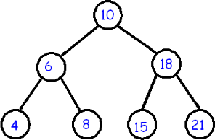
In the above tree all nodes in the left subtree of 10 have keys < 10 while all nodes in the
right subtree > 10. Because both the left and right subtrees of a BST are again search trees;

Slide 21
Binary Search Tree Operations:
Search Operation
Insertion Operation
Deletion Operation
Search Operation :Search Operation is performed to search a particular element in the
Binary Search Tree.
Rules
For searching a given key in the BST,
Compare the key with the value of root node.
If the key is present at the root node, then return the root node.
If the key is greater than the root node value, then recur for the root node’s right subtree.
If the key is smaller than the root node value, then recur for the root node’s left subtree.

Slide 22
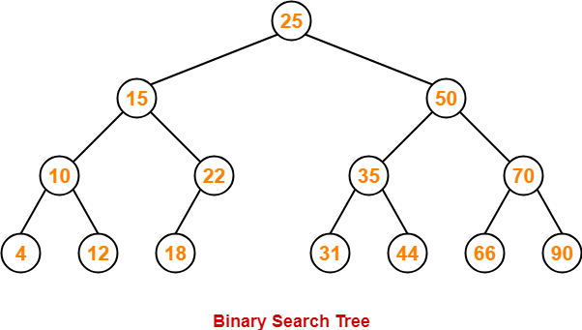
Example
Consider key = 45 has to be searched in the given BST-
We start our search from the root node 25.
As 45 > 25, so we search in 25’s right subtree.
As 45 < 50, so we search in 50’s left subtree.
As 45 > 35, so we search in 35’s right subtree.
As 45 > 44, so we search in 44’s right subtree but 44 has no subtrees.
So, we conclude that 45 is not present in the above BST.

Slide 23
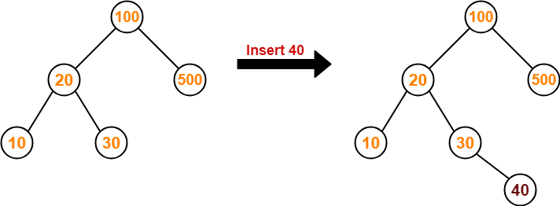
Insertion Operation-Insertion Operation is performed to insert an element in the Binary Search
Tree.
Rules
The insertion of a new key always takes place as the child of some leaf node.
For finding out the suitable leaf node,
Search the key to be inserted from the root node till some leaf node is reached.
Once a leaf node is reached, insert the key as child of that leaf node.
Example
Consider the following example where key = 40 is inserted in the given BST-

Slide 24
We start searching for value 40 from the root node 100.
As 40 < 100, so we search in 100’s left subtree.
As 40 > 20, so we search in 20’s right subtree.
As 40 > 30, so we add 40 to 30’s right subtree.
Deletion Operation-Deletion Operation is performed to delete a particular element from the Binary Search Tree.
Case-01: Deletion of A Node Having No Child (Leaf Node)
Just remove / disconnect the leaf node that is to deleted from the tree.
Example
Consider the following example where node with value = 20 is deleted from the BST-

Slide 25
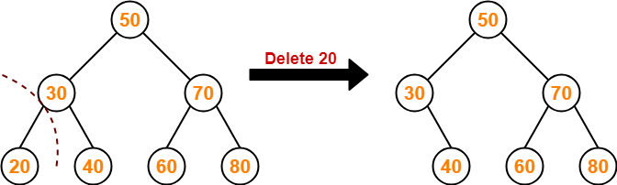
Case-02: Deletion of A Node Having Only One Child
Just make the child of the deleting node, the child of its grandparent.
Example
Consider the following example where node with value = 30 is deleted from the BST-

Slide 26
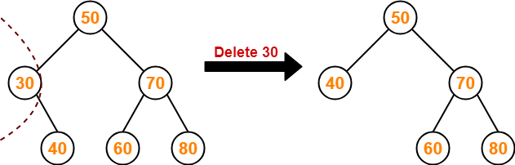
Case-02: Deletion of A Node Having Two Children-
A node with two children may be deleted from the BST in the following two ways-
Method-01:
Visit to the right subtree of the deleting node.
Pluck the least value element called as inorder successor.
Replace the deleting element with its inorder successor.
Example
Consider the following example where node with value = 15 is deleted from the BST-

Slide 27
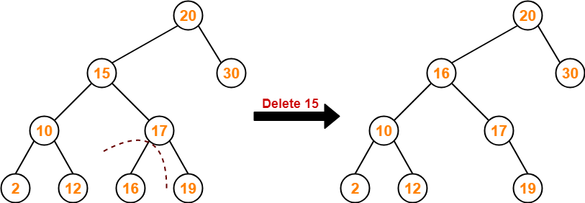
Method-02:
Visit to the left subtree of the deleting node.
Pluck the greatest value element called as inorder predecessor.
Replace the deleting element with its inorder predecessor.
Example
Consider the following example where node with value = 15 is deleted from the BST-

Slide 28
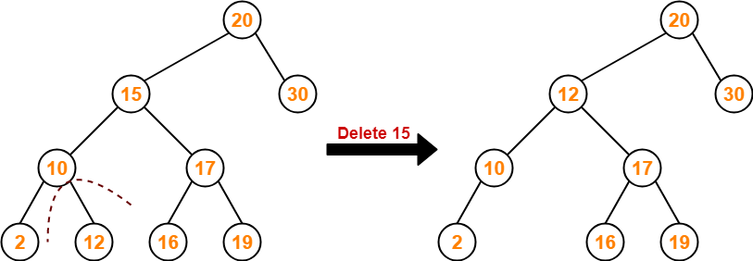
The time complexity of all these operations is O(h), where h is the height of the tree. Represents
the longest path we can take.
In the best case, h = O(log n) and all operations take time O(log n).
In the worst case, h = Θ(n) and some operations will take time Θ(n).

Slide 29
Traversals of Binary Trees:
A traversal is a process that visits all the nodes in the tree. Since a tree is a nonlinear data structure, there is no unique traversal. We will consider several traversal algorithms with we
group in the following two kinds.
Depth-First Traversal
Breadth-First Traversal
There are three different types of Depth-First Traversals,
PreOrder traversal - visit the parent first and then left and right children;
InOrder traversal - visit the left child, then the parent and the right child;
PostOrder traversal - visit the left child, then the right child, and then the parent;

Slide 30
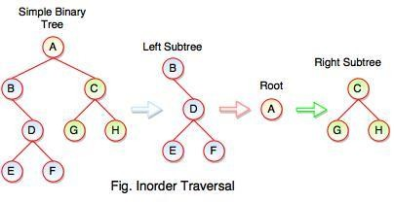
Inorder Traversal
Inorder Traversal: B E D F A G C H
Following steps can be defined the flow of inorder traversal:
Step 1 : B + (Inorder on E) + D + (Inorder on F) + (Root A ) + (Inorder on G) + C (Inorder on H) Step 2 : B + (E) + D + (F) + A + G + C + H
Step 3: B + E + D + F + A + G + C + H
Inorder Traversal: B E D F A G C H
Algorithm
Step 1: Start from the Left Subtree.
Step 2: Then, visit the Root.
Step 3: Then, go to the Right Subtree.

Slide 31
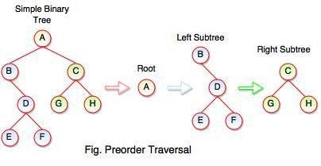
Preorder Traversal
Preorder Traversal: A B C D E F G H
Following steps can be defined the flow of preorder traversal:
Step 1: A + B (B + Preorder on D (D + Preorder on E and F)) + C (C + Preorder on G and H)
Step 2: A + B + D (E + F) + C (G + H)
Step 3: A + B + D + E + F + C + G + H
Preorder Traversal: A B C D E F G H
Algorithm
Step 1: Start from the Root.
Step 2: Then, go to the Left Subtree.
Step 3: Then, go to the Right Subtree.

Slide 32
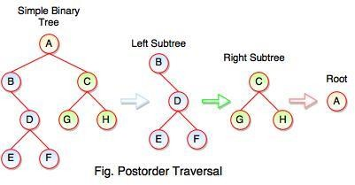
Postorder Traversal : E F D B G H C A
Postorder Traversal
Algorithm
Step 1: Start from the Left Subtree (Last Leaf).
Step 2: Then, go to the Right Subtree.
Step 3: Then, go to the Root.
Following steps can be defined the flow of postorder traversal:
Step 1: As we know, preorder traversal starts from left subtree (last leaf) ((Postorder on E + Postorder on F) + D + B )) + ((Postorder on G + Postorder on H) +
C) + (Root A)
Step 2: (E + F) + D + B + (G + H) + C + A
Step 3: E + F + D + B + G + H + C + A
Postorder Traversal : E F D B G H C A

Slide 33
Inorder: visit left subtree, visit root, visit right subtree | Preorder: visit root, visit left, visit right | Postorder: visit left, visit right, visit root
private void Inorder (BSTNode root) { if(root != null) { Inorder(root.left); Process(root.value); Inorder(root.right); } } public void Inorder() { Inorder(root); } | Private void Preorder (BSTNode root) { if(root != null) { Process(root.value); Preorder(root.left); Preorder(root.right); } } public void Preorder(){ Preorder(root); } | private void Postorder (BTSNode root){ if(root != null) { Postorder(root.left); Postorder(root.right); Process(root.value); }} public void Postorder(){ Postorder(root); }

Slide 34
Breadth-First Traversal:
Depth-first is not the only way to go through the elements of a tree. Another way is to go through
them level-by-level.For example, each element exists at a certain level (or depth) in the tree:
j
/ \
f k <-- level 1
/ \ \
a h z <-- level 2
\
d
<-- level 0
<-- level 3
This level-by-level traversal is called a breadth-first traversal because we explore the breadth, i.e., full
width of the tree at a given level, before going deeper.

Slide 35
Balanced binary trees
A balanced binary tree is one in which the largest path through the left sub tree is the same length as the largest path of the right sub tree, i.e., from root to leaf.
Searching time is very less in balanced binary trees compared to unbalanced binary tree. i.e.,
balanced trees are used to maximize the efficiency of the operations on the tree.
There are two types of balanced trees :
Height Balanced Trees
Weight Balanced Trees

Slide 36
Height balanced trees
There are two main approaches, which may be used to balance (or decrease) the depth of a binary
tree :
Insert a number of elements into a binary tree in the usual way, using the algorithm given in the
previous section (i.e., Binary search Tree insertion). After inserting the elements, copy the tree
into another binary tree in such a way that the tree is balanced. This method is efficient if the data(s) are continually added to the tree.
Another popular algorithm for constructing a height balanced binary tree is the AVL tree.
AVL tree
This algorithm was developed in 1962 by two Russian Mathematicians, G.M. Adel’son Vel’sky and
E.M. Landis; here the tree is called AVL Tree.
A binary tree is said to be balanced if the height of left and right children of every node differ by either
- 1, 0 or +1. In an AVL tree, every node maintains an extra information known as balance factor.

Slide 37
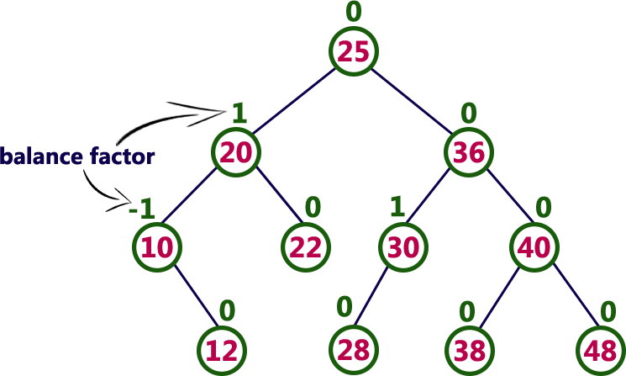
In an AVL tree, balance factor of every node is either -1, 0 or +1.
Balance factor = heightOfLeftSubtree – heightOfRightSubtree

Slide 38
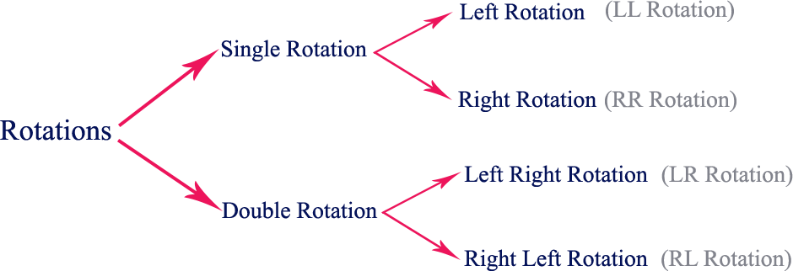
AVL Tree Rotations:
In AVL tree, after performing operations like insertion and deletion we need to check the balance
factor of every node in the tree.
If the tree becomes imbalanced due to any operation, we use rotation operations to make the tree balanced.
Rotation is the process of moving nodes either to left or to right to make the tree balanced.
Four types of rotations and they are classified into two types.

Slide 39
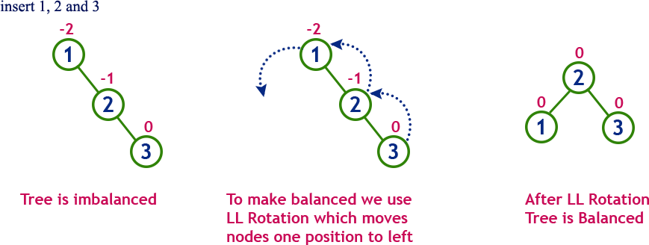
Left Rotation:
If a tree becomes unbalanced, when a node is inserted into the right subtree of the right subtree, then we perform a single left rotation.

Slide 40
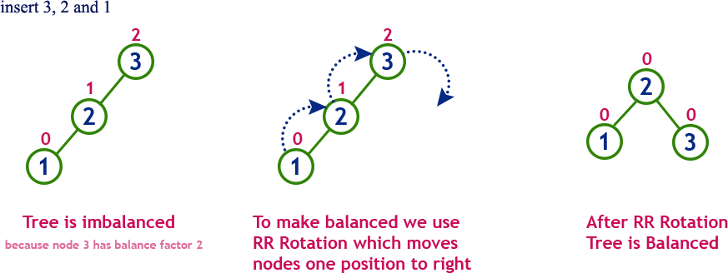
Right Rotation
AVL tree may become unbalanced, if a node is inserted in the left subtree of the left subtree. The
tree then needs a right rotation.

Slide 41
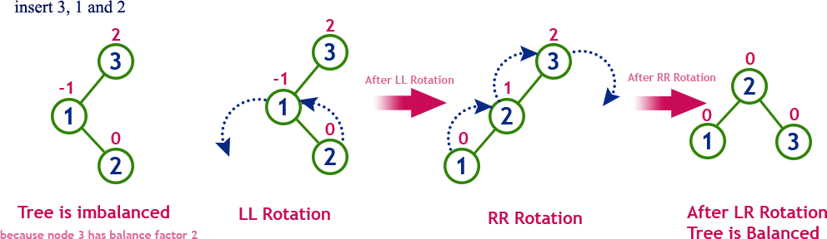
Left-Right Rotation
In LR Rotation, at first, every node moves one position to the left and one position to right from the current position.

Slide 42
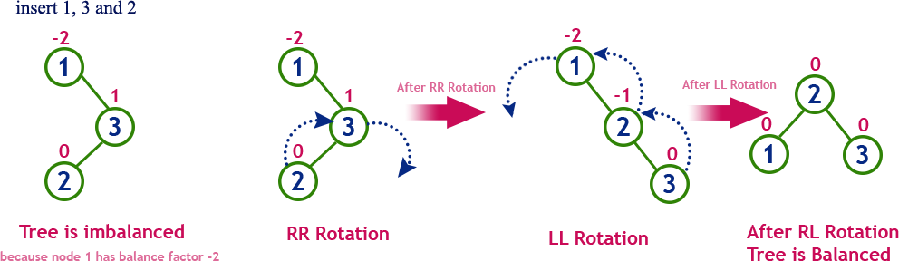
Right Left Rotation:
In RL Rotation, at first every node moves one position to right and one position to left from the
current position.

Slide 43
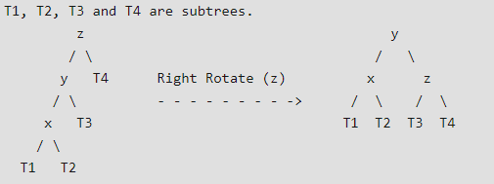
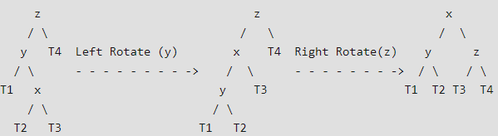
Some Special cases:
Left Left Case
Left Right Case

Slide 44
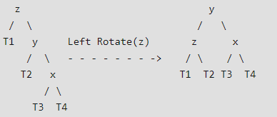
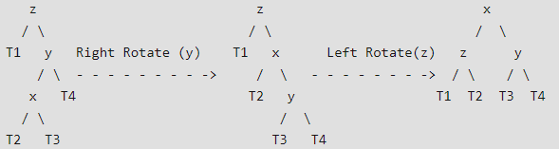
Right Right Case
Right Left Case

Slide 45
The following operations are performed on AVL tree...
Search
Insertion
Deletion
Example
Build an AVL tree with the following values: 15, 20, 24, 10, 13, 7, 30, 36, 25

Slide 46
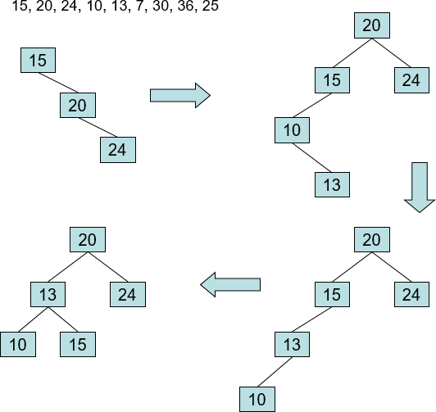

Slide 47
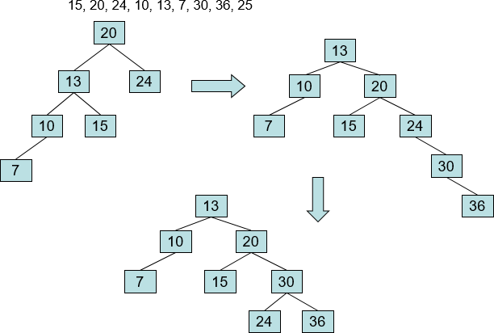

Slide 48
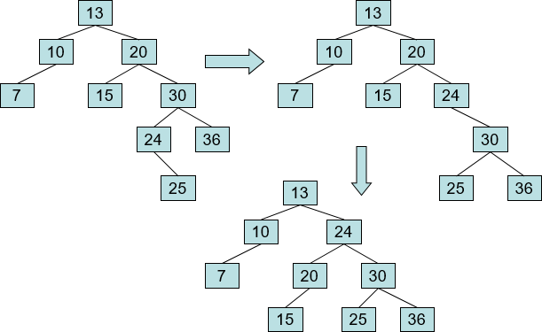

Slide 49
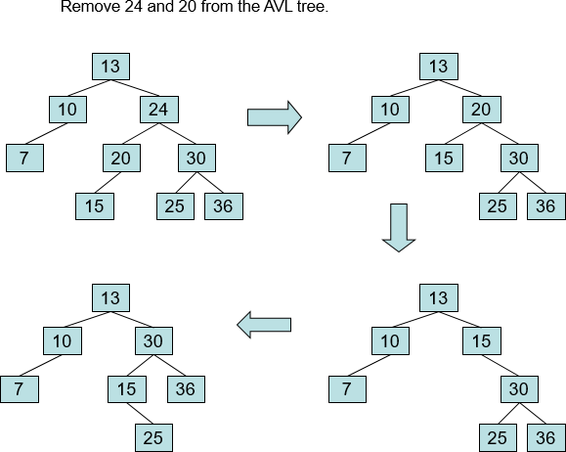
The deletion operation in AVL Tree is similar to deletion operation in BST.
But after every deletion operation, we need to check with the Balance Factor condition. If the tree is balanced after deletion go for next operation otherwise perform suitable rotation to make the tree Balanced.

Slide 50
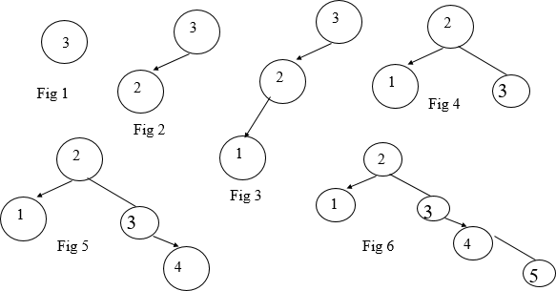
Example
Insert 3,2,1,4,5,6,7, 16,15,14

Slide 51
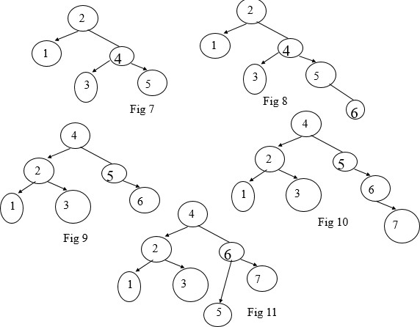

Slide 52
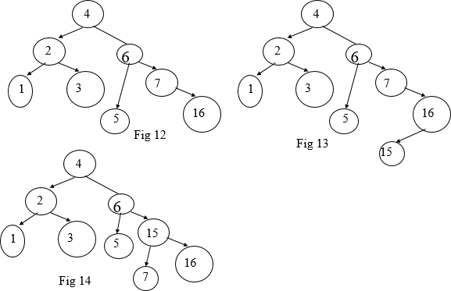

Slide 53
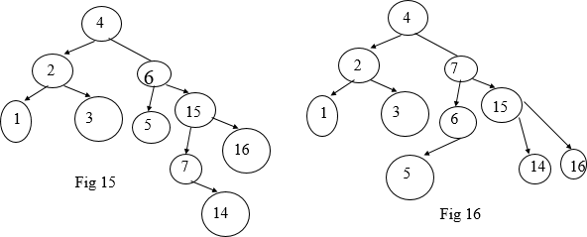

Slide 54
Applications:
Memory management subsystem of Linux kernel to search memory regions of processes during preemption.
Data analysis, data mining
Time complexity: O(log n)

Slide 55
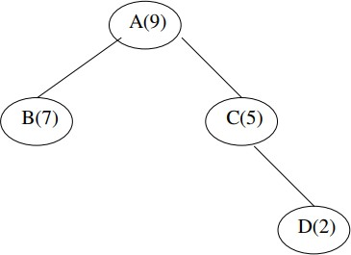
Weight balanced tree
A weight-balanced tree is a balanced binary tree in which additional weight field is also there. The
nodes of a weight-balanced tree contain four fields :
Data Element
Left Pointer
Right Pointer
A probability or weight field
The data element, left and right pointer fields are save as that in any other tree node. The probability field is a specially added field for a weight-balanced tree.

Slide 56
B-Tree
B-Tree was developed in the year 1972 by Bayer and McCreight with the name Height Balanced m-way Search Tree. Later it was named as B-Tree.
B-Tree is a self-balanced search tree in which every node contains multiple keys and has more than two children.
B-Tree of Order m has the following properties
Property 1 - All leaf nodes must be at same level.
Property 2 - All nodes except root must have at least [m/2]-1 keys and a maximum of m-1 keys.
Property 3 - All non-leaf nodes except root (i.e. all internal nodes) must have at least m/2 children.
Property 4 - If the root node is a non-leaf node, then it must have at least 2 children.
Property 5 - A non-leaf node with n-1 keys must have n number of children.
Property 6 - All the key values in a node must be in Ascending Order.

Slide 57
For example, B-Tree of Order 4 contains a maximum of 3 key values in a node and maximum of 4 children
for a node
Insertion Operation in B-Tree
Step 1 - Check whether tree is Empty.
Step 2 - If tree is Empty, then create a new node with new key value and insert it into the tree as a root node. Step 3 - If tree is Not Empty, then find the suitable leaf node to which the new key value is added using Binary
Search Tree logic.
Step 4 - If that leaf node has empty position, add the new key value to that leaf node in ascending order of key value within the node.
Step 5 - If that leaf node is already full, split that leaf node by sending middle value to its parent node. Repeat
the same until the sending value is fixed into a node.
Step 6 - If the spilting is performed at root node then the middle value becomes new root node for the tree and
the height of the tree is increased by one.

Slide 58
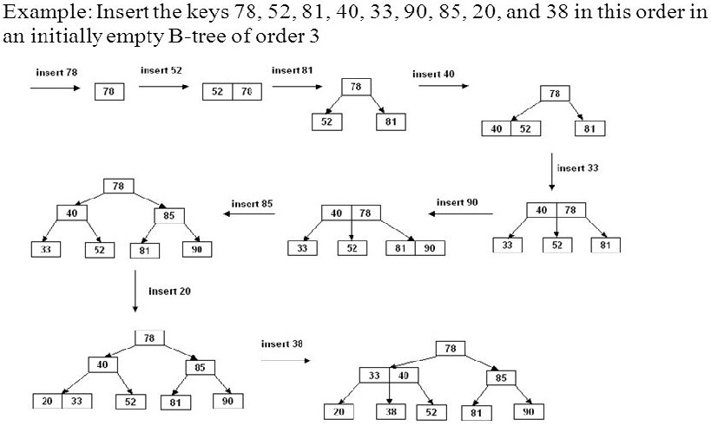
Construct a B-Tree of Order 3
Key=m-1 i,e. non-leaf node with M children contains M − 1 keys. and non-leaf node (except root) has at least M

Slide 59
Complexity of B Tree operations
max depth of an order m BTree is h=⌈log⌈m/2⌉​(n)⌉
At each node, we do O(log m) work to choose branch
An insert or delete may need O(m) work to fix up info in a node
Worst cases are:
find: O(log(m)⋅logm(n))
But, since logm(n)=log(n)log(m), this simplifies to O(log(n)).
insert/delete: O(mlogm(n))=O(mlog(m)log(n))
Applications
B-trees are preferred when decision points, called nodes, are on hard disk rather than in random-
access memory (RAM)
B-trees save time by using nodes with many branches (called children), compared with binary trees, in which each node has only two children, thereby speeding up the process.

Slide 60
Huffman tree
Huffman algorithm or Huffman coding is an entropy encoding algorithm.
It is used widely for data compression (like Winzip Compression-Winzip doesn’t use it but!)
Huffman coding tree or Huffman tree is a full binary tree in which each leaf of the tree corresponds to a letter in the given alphabet.
This is a technique which is used in a data compression or it can be said that it is a coding technique
which is used for encoding data.
Huffman coding is used in JPEG compression.
Greedy method
This technique is a mother of all data compression scheme.
This idea is basically dependent upon the frequency, i.e. the frequency of the corresponding character
which needs to be compressed, and by that frequency, only Huffman code will be generated.
In case of Huffman coding, the most generated character will get the small code and least generated character will get the large code.

Slide 61
Huffman tree is a specific method of representing each symbol.
This technique produces a code in such a manner that no codeword is a prefix of some other code word. These codes are called as prefix code.

Slide 62
Huffman Algorithm
Step 1: Create a leaf node for each character. Add the character and its weight or frequency of
occurrence to the priority queue.
Step 2: Repeat Steps 3 to 5 while the total number of nodes in the queue is greater than 1 Step 3: Remove two nodes that have the lowest weight (or highest priority)
Step 4: Create a new internal node by merging these two nodes as children and with weight equal to the sum of the two nodes' weights.
Step 5: Add the newly created node to the queue. Step 6: Add the newly created node to the queue.

Slide 63
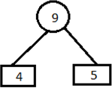
Example
Let obtain a set of Huffman code for the message (m1.....m7) with relative frequencies (q1.....q7) = (4,5,7,8,10,12,20). Let us draw the Huffman tree for the given set of codes.
Step 1: Arrange the data in ascending order in a table.
4,5,7,8,10,12,20
Step 2: Combine first two entries of a table and by this create a parent node.

Slide 64
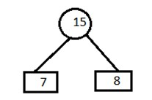
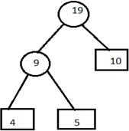
Step 3:
A) Remove the entries 4 and 5 from the table and inert 9 at its appropriate position. 7,8,9,10,12,20
Combine minimum value of table and create a parent node.
B) Now remove the entries 7 and 8 from the table
position. 9,10,12,15,20
Combine minimum value of two blocks and create a parent node.
and insert 15 at its appropriate

Slide 65
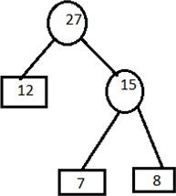
C) Remove the entries 9 and 10 from the table and insert 19 at its proper position. 12,15,19,20.
Combine minimum value of two blocks and create parent node.
D) Remove the entries 15 and 12 from the table and insert 27 at its appropriate position. 19,20,27 Combine minimum value of two blocks and create parent node.

Slide 66
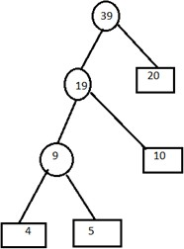
E) Remove the entries 19 and 20 from the table and insert 39 in the table. 27,39
Combine minimum value of two blocks and create parent node.

Slide 67
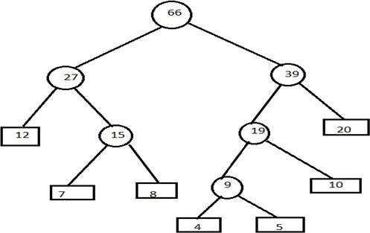

Slide 68
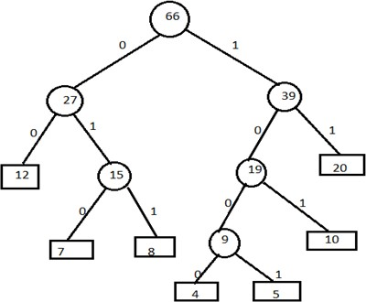
Step 4: Now assign left child as 0 and right child as 1 to encode the frequencies.
Now, codes for the given frequencies are given below:
Characters | Codes | counts
4 | 1000 | 4
5 | 1001 | 4
7 | 010 | 3
8 | 011 | 3
10 | 101 | 3
12 | 00 | 2
20 | 11 | 2

Slide 69
Important Formulas:
Formula 1: Average code length per character=∑ (probability i* code length i)
Formula 2: Total number of bits in Huffman encoded message= Total number of characters in the
message x Average code length per character
= ∑ ( frequency i * Code length i)
Time complexity: O(n log n) is the overall time complexity. Where n is the number of characters.

Slide 70

Example
Assume that relative frequencies are:
A: 40
B: 20
C: 10
D: 10
R: 20
Step 1: Smallest number are 10 and 10 (C and D), so connect those

Slide 71
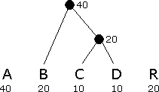
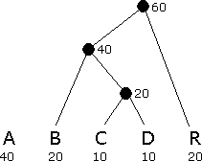
Step 2: C and D have already been used, and the new node above them (call it C+D) has value 20
The smallest values are B, C+D, and R, all of which have value 20. So, Connect any two of these
Step 3: The smallest values is R, while A and B+C+D all have value 40. So , Connect R to either of the others

Slide 72


Step 5: Assign 0 to left branches, 1 to right branches, Each encoding is a path from the root
Step 4: Connect the final two nodes

Slide 73
Game Tree
A knowledge representation structure shaped like a decision tree. Nodes of the tree represent game positions possible through legal moves (from the position in the parent connecting node). The layers of the game tree expand or contract based on the possible legal moves at that point in the game.
Let’s consider a game of two players, and call them MIN and MAX. These two players will compete where MAX will try to maximize the payoff. A search problem in the form of a game can be defined with the following 4 components:
Initial state: This state indicates the board position and whose move it is
Terminal test: This test indicates when the game is over
Set of operators: These define the possible moves that a player can make
Payoff function / Utility function: This gives a numeric value for the outcome

Slide 74
In a normal search problem, the objective of MAX would be to search for a payoff value that leads to a terminal state that is a winner, thereby making its first move. However, in the presence of adversary MIN, the strategy of MAX will be to find a winning terminal state regardless of what move MIN makes.
Minimax Algorithm:
It is a decision tree algorithm
It is used backtracking method
The best move strategy is used for game play to beat opponent
Player Max will try to maximize the utility (Best move)
Player Min will try to minimize the utility (Worst move for player Max)

Slide 75
To determine the optimal strategy for MAX, the minimax algorithm is used to determine the best first move. The 5 steps in this algorithm are:
Generate the entire game tree till the terminal nodes.
Apply the payoff function to each terminal state to get its value.
Use the payoff of the terminal states to determine the payoff of the nodes one level
above in the search tree.
If node is terminal state return payoff value
If the node is at player Max, return max value of result of minimax function
If the node is at player Min, return min value of result of minimax function
Continue step 3 one layer at a time till you reach the root node.
Choose the move that leads to the highest payoff value.

Slide 76

Time complexity of minimax algorithm is O(b^{m})
Where, b is number of legal moves and m is maximum depth of tree Let’s take an example of game tree using minimax algorithm
Player Max try to get maximum value to win with maximum benefit
Player Min try to get minimum value to minimize player max benefit

Slide 77

Here, at the terminal node player Max is attached so first, Max player take the value which is maximum of two child i.e. 8 at node D. similarly -1 at node E, 2 at node F, and 4 at node G

Slide 78

Now the turn is goes to player Min who is try to minimize the benefit by taking minimum value. Player Min takes minimum value from node D and E to node B
i.e. -1 and 2 from node F and G to node C.

Slide 79

Now the turn goes to player Max, which take maximum value from node B and C to node A i.e. 2.
Here we reach to root node so game is over.
Hence, if player Max chooses the route A, C, F and terminal with max value, then player Max will win with payoff value 2.

Slide 80

Example: Tic tac toe game using minimax algorithm Suppose, Max move = X and Min move = O
Win = w and Draw = d

Slide 81
Hence, if player max chooses right most child then player max will definitely win. If player max chooses left most or middle child then chances of win is half.
Alpha Beta pruning algorithm:
This algorithm is advance version of minimax algorithm. It is used to cutoff the number of
search by exploring less number of nodes.
Let’s explain by the help of following game tree.

Slide 82

Here, the Alpha is the player max and Beta is the player min. Terminal is the leaf node which contains the payoff value.
Player max try to get maximum value from terminal and player min try to get minimum value
from terminal.
Here the player min is connected to terminal so it chooses the min value from the terminal.

Slide 83


Slide 84

Here, min player which is beta, chooses the minimum value from the terminal and pass to the player max which is alpha. The max player searches the value greater than 3 from the child. If found replace the value 3 by maximum value otherwise prune the node. This process goes on to root node.
Here in the above figure, if max player choose the left child first it will win with payoff value 3.

Slide 85

Comparison of Search Trees

