Slide 1
Graph

Slide 2
Contents
Introduction and Representation of Graph
Transitive Closure, Floyd-Warshall algorithm
Graph traversal
Minimum spanning tree: Kruskal and Prims Algorithm
Shortest path Algorithms: Dijkstra Algorithm and Bellman Ford

Slide 3
Introduction of Graph
Graph is a non-linear data structure; A map is a well-known example of a graph. In a map
various connections are made between the cities. The cities are connected via roads, railway lines and aerial network. We can assume that the graph is the interconnection of cities by roads. Euler used graph theory to solve Seven Bridges of Königsberg problem. Is there a possible way to traverse every bridge exactly once – Euler Tour
A graph contains a set of points known as nodes (or vertices) and set of links known as edges
(or Arcs) which connects the vertices.
A graph G is represented as G = ( V , E ), where V is set of vertices and E is set of edges.
Example: graph G can be defined as G = ( V , E ) Where V = {A,B,C,D,E} and E =
{(A,B),(A,C)(A,D),(B,D),(C,D),(B,E),(E,D)}. This is a graph with 5 vertices and 6 edges

Slide 4
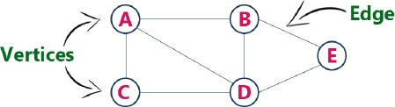
Graph Terminology
Vertex : An individual data element of a graph is called as Vertex. Vertex is also known as node. In above example graph, A, B, C, D & E are known as vertices.
Edge : An edge is a connecting link between two vertices. Edge is also known as Arc. An edge
is represented as (starting Vertex, ending Vertex).
In above graph, the link between vertices A and B is represented as (A,B).

Slide 5
Edges are three types:
Undirected Edge - An undirected edge is a bidirectional edge. If there is an undirected edge between vertices A and B then edge (A , B) is equal to edge (B , A).
Directed Edge - A directed edge is a unidirectional edge. If there is a directed edge between vertices A and B then edge (A , B) is not equal to edge (B , A).
Weighted Edge - A weighted edge is an edge with cost on it.
Degree: Total number of edges connected to a vertex is said to be degree of that vertex.
Indegree: Total number of incoming edges connected to a vertex is said to be indegree of that vertex.
Outdegree: Total number of outgoing edges connected to a vertex is said to be outdegree of that vertex.
Parallel edges or Multiple edges: If there are two undirected edges to have the same end vertices, and for two directed edges to have the same origin and the same destination. Such edges are called
parallel edges or multiple edges.

Slide 6
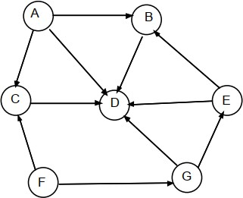
Here, in degree of nodes:- A = 0
B = 2
C = 2
D = 6
E = 1
F = 0
G = 1
Out degree of A = 3 B = 1
C = 1
D = 0
E = 2
F = 3
G = 2

Slide 7
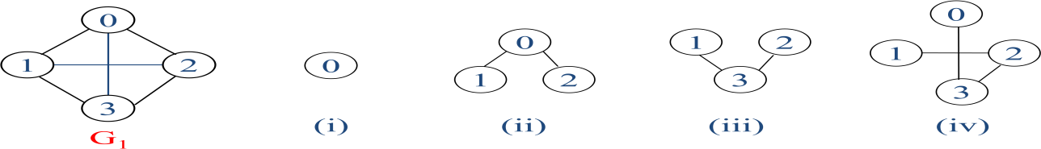
Sub Graph: A graph S is said to be a sub graph of a graph G if all the vertices and all the edges of S are in G, and each edge of S has the same end vertices in S as in G. A subgraph of G is a graph G’ such that V(G’) ⊆ V(G) and E(G’) ⊆ E(G)

Slide 8
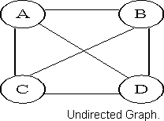
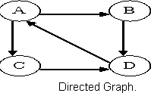
Types of Graphs
1.Undirected Graph: A graph with only undirected edges is said to be undirected graph.
2. Directed Graph: A graph with only directed edges is said to be directed graph.

Slide 9
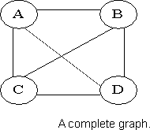
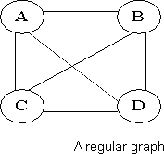
3. Complete Graph: A graph in which any V node is adjacent to all other nodes present in the graph is known as a complete graph. An undirected graph contains the edges that are equal to edges = n(n-1)/2 where n is the number of vertices present in the graph. The following figure shows a complete graph.
4. Regular Graph: Regular graph is the graph in which nodes are adjacent to each other, i.e., each node is accessible from any other node. Regular graph has all vertices with the same degree (number of connections). A complete graph is always regular, but a regular graph isn't always complete.

Slide 10
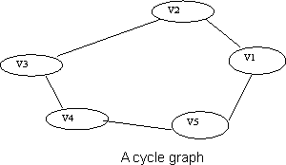
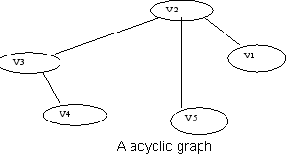
5. Cycle Graph: A graph having cycle is called cycle graph. In this case the first and last nodes are the same. A closed simple path is a cycle.
6. Acyclic Graph: A graph without cycle is called acyclic graphs.

Slide 11
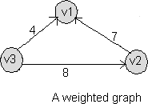
7. Weighted Graph: A graph is said to be weighted if there are some non negative value assigned to each edges of the graph. The value is equal to the length between two vertices. Weighted graph is also called a network.

Slide 12
ADT of Graph:
Graph Create() : return an empty graph
Graph InsertVertex(graph, v): return a graph with v inserted. v has no edge.
Graph InsertEdge(graph, v1,v2): return a graph with new edge between v1 and v2
Graph DeleteVertex(graph, v) :return a graph in which v and all edges incident to it are
removed
Graph DeleteEdge(graph, v1, v2): return a graph in which the edge (v1, v2) is removed Boolean IsEmpty(graph): if (graph==empty graph) return TRUE else return FALSE List Adjacent(graph,v): return a list of all vertices that are adjacent to v

Slide 13
Representation of Graph
following ways:-
Sequential representation (adjacency matrix)
linked list representation (adjacency list)
Incidence Matrix
Adjancy matrix:
Adjancy matrix is the matrix which keeps information of adjacent nodes i.e. keeps the information weather node is adjacent to any other node or not. Suppose there are four nodes in a graph then row one represents the node 1, row 2 represents the node 2 & so on .
Similarly, column 1 represents node 1 & column 2 represents node 2 & so on. The entry of the matrix will be.
= 1 if there is an edge from node I to node j
= 0 if there is no edge from node I to node j.
Arr[i][j]

Slide 14
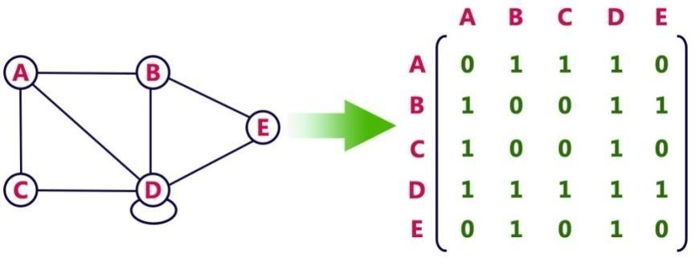
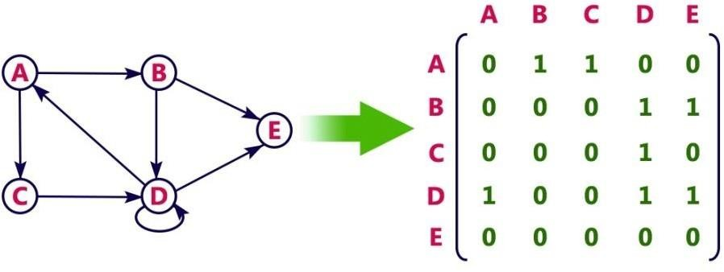
Example : for undirected graph
For a Directed graph

Slide 15
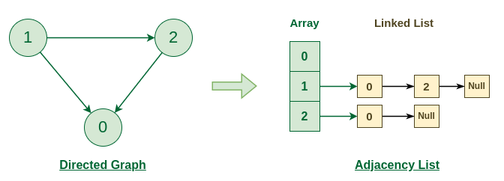
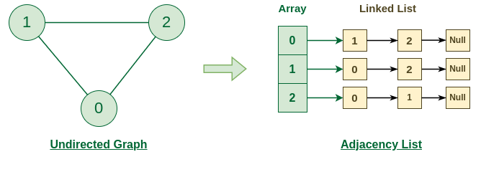
Adjacency List:
In this representation, every vertex of graph contains list of its adjacent vertices. The n rows of the adjacency matrix are represented as n chains. The nodes in chain I represent the vertices that are adjacent to vertex i.
It can be represented in two forms. In one form, array is used to store n vertices and chain is used to store its adjacencies.

Slide 16
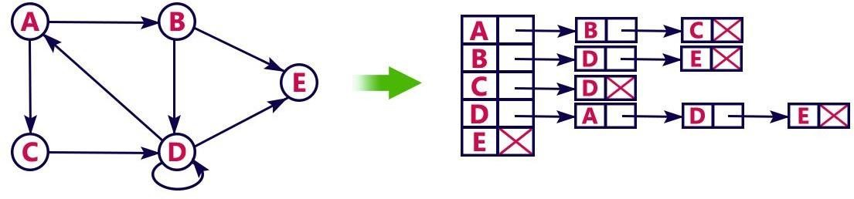
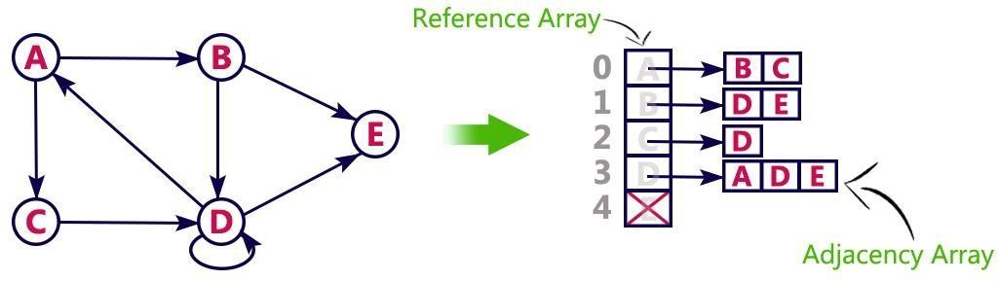
So that we can access the adjacency list for any vertex in O(1) time. Adjlist[i] is a pointer to to first node in the adjacency list for vertex i.
Another type of representation is given below.
Consider the following directed graph representation implemented using linked list.
This representation can also be implemented using array

Slide 17
Incidence Matrix:
In this representation, the graph is represented using a matrix of size total number of vertices by a total number of edges. That means graph with 4 vertices and 6 edges is represented using a matrix of size 4X6. In this matrix, rows represent vertices and columns represents edges.
This matrix is filled with 0 or 1 or -1. Here, 0 represents that the row edge is not connected to column vertex, 1 represents that the row edge is connected as the outgoing edge to column vertex and -1 represents that the row edge is connected as the incoming edge to column vertex.
For example, consider the following directed graph representation.

Slide 18
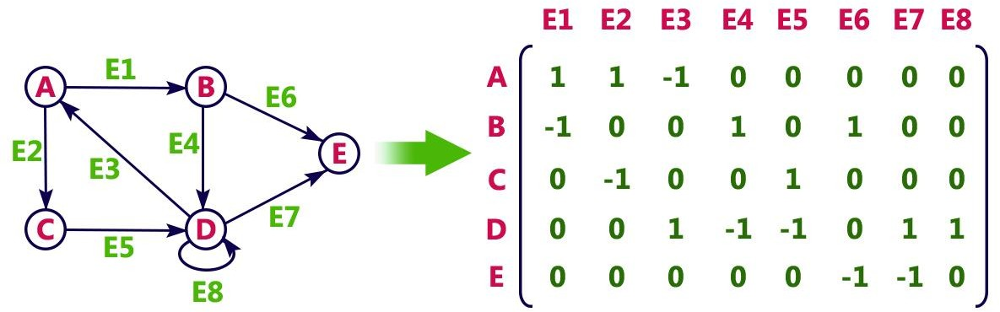

Slide 19
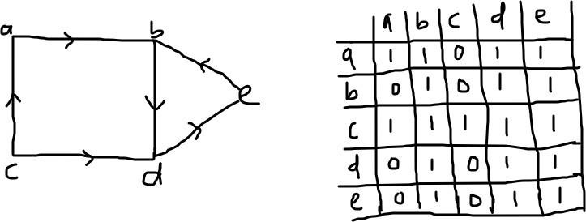
Transitive Closure of Graph
Transitive Closure is the reachability matrix to reach from vertex u to vertex v of a graph. In the graph we have to find a vertex v which is reachable from another vertex u, for all vertex pairs (u, v).
The final matrix is the Boolean type. When there is a value 1 for vertex u to vertex v, it means that there is at least one path from u to v. When there is a value 0 for vertex u to vertex v, it means that there is no path from u to v.
Example: Find the transitive closure of the given graph.

Slide 20
Floyd-Warshall algorithm
Used to find all pair shortest path problems from a given weighted graph.
As a result of this algorithm, it will generate a matrix, which will represent the minimum distance from any node to all other nodes in the graph. Time complexity: O(n³)
Algorithm:
Step 1: Start
Step 2: Create a [n x n] matrix say M
Step 3: For each cell (i,j) in M do if i = = j
Set all diagonal element value as 0 M[ i ][ j ] = 0 if (i , j) is an direct edge
M[ i ][ j ] = weight(i,j)

Slide 21
Else
Set value as infinite, there is no direct edge between the vertices,M[ i ][ j ] = ∞
Step 4:
for k from 1 to n for i from 1 to n for j from 1 to n
if M[ i ][ j ] > M[ i ][ k ] + M[ k ][ j ]
M[ i ][ j ] = M[ i ][ k ] + M[ k ][ j ]
Step 5: Stop

Slide 22
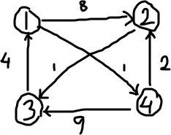
Example: Find the Warshall’s algorithm.
shortest path between all the vertex in the following graph using
Solution:
Formula to calculate the distance between vertices is D^{k} [i,j]= min {D^{k-1} [i,j], D^{k-1} [i,k]+D^{k-1} [k,j]}
Create a distance matrix (D⁰) for all the vertex of the graph which are directly connected.

Slide 23
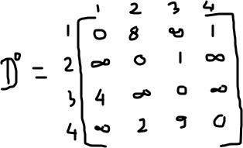
Create a distance matrix (D¹) for all the vertex of the graph which are connectedvia vertex 1.
D¹ [i,j]= min {D⁰ [i,j], D⁰ [i,k]+D⁰ [k,j]}
D¹ [2,3]= min {D⁰ [2,3], D⁰ [2,1]+D⁰ [1,2]}
D¹ [2,3]= min (1, infinite)
D¹ [2,3]=1

Slide 24
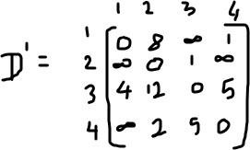
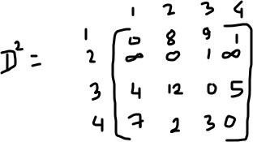
Likewise find all the distance between vertices
Create a distance matrix (D²) for all the vertex of the graph which are connected via vertex 2.

Slide 25
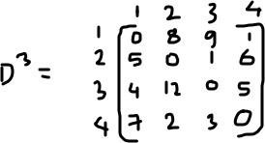
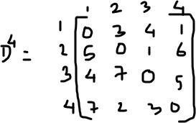
Create a distance matrix (D³) for all the vertex of the graph which are connectedvia vertex 3.
Create a distance matrix (D⁴) for all the vertex of the graph which are connected via vertex 4.
This is the final distance matrix for all the vertices.

Slide 26
Graph Traversal
Graph traversal is a technique used for searching a vertex in a graph.
The graph traversal is also used to decide the order of vertices is visited in the search
process.
A graph traversal finds the edges to be used in the search process without creating loops. That means using graph traversal we visit all the vertices of the graph without getting into looping path.
There are two types of graph traversal techniques and they are as follows
BFS (Breadth First Search/ Level Order Search)
DFS (Depth First Search)

Slide 27
BFS (Breadth First Search)
BFS traversal of a graph produces a spanning tree as final result. Spanning Tree is a graph without loops.
We use Queue data structure with maximum size of total number of vertices in the graph to implement BFS traversal.

Slide 28
Algorithm for BFS Step 1: Start
Step 2: Define a Queue of size total number of vertices in the graph.
Step 3: Select any vertex as starting point for traversal. Visit that vertex and insert it into the Queue.
Step 4: Visit all the non-visited adjacent vertices of the vertex which is at front of the Queue and insert them into the Queue.
Step 5: When there is no new vertex to be visited from the vertex which is at front of the Queue then delete that vertex.
Step 6: Repeat steps 4 and 5 until queue becomes empty.
Step 6: When queue becomes empty, then produce final spanning tree by removing unused edges from the graph
Step 7: Stop

Slide 29
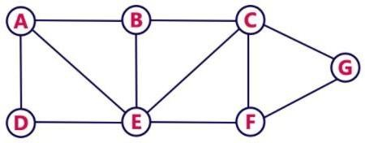
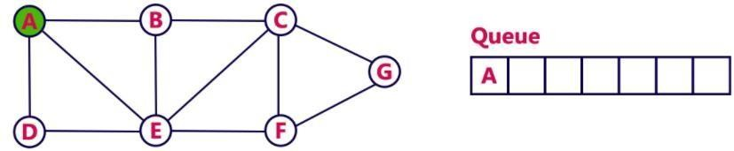
Example: Display all the value from the following graph using BFS Traversal
Solution:
Step 1: Select the vertex A as starting vertex, visit A and insert into the queue

Slide 30
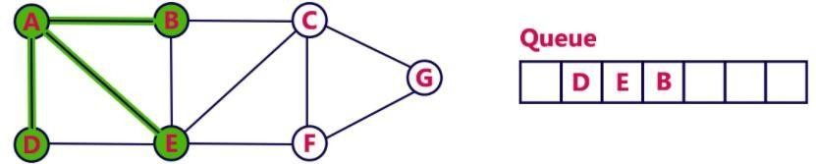
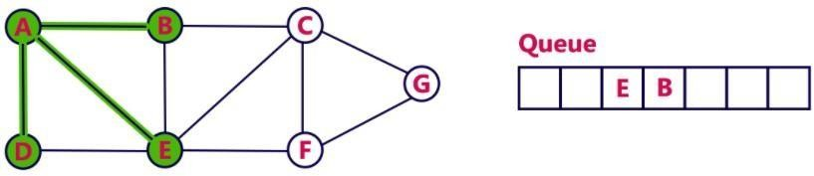
Step 2: Visit all the adjacent vertices of A which are not visited (B,D,E) and insert newly visited vertices into the queue and delete A from queue.
Step 3: Visit all the adjacent vertices of D which are not visited (no vertices) and delete D from
queue.

Slide 31
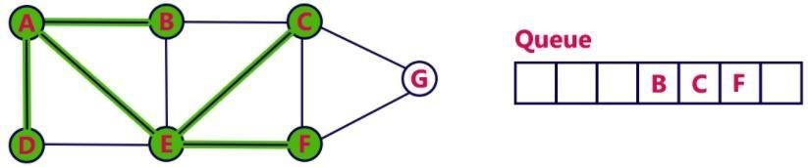
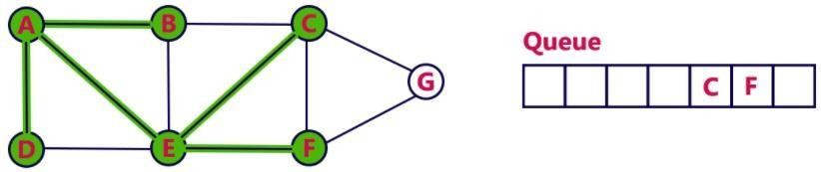
Step 4: Visit all the adjacent vertices of E which are not visited (C,F) and insert newly
visited vertices into the queue and delete E from queue.
Step 5: Visit all the adjacent vertices of B which are not visited (no vertices) and delete B
from queue.

Slide 32
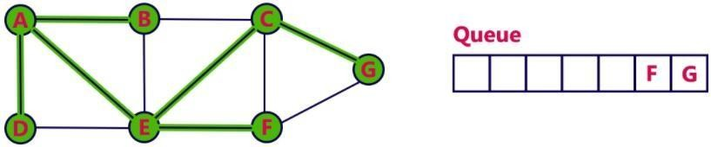
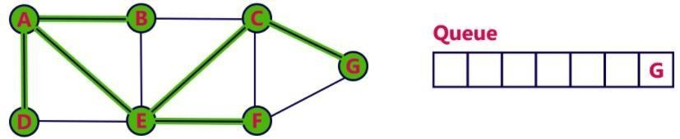
Step 6: Visit all the adjacent vertices of C which are not visited (G) and insert newly visited vertices into the queue and delete C from queue.
Step 7: Visit all the adjacent vertices of F which are not visited (no vertices) and delete F from queue.

Slide 33
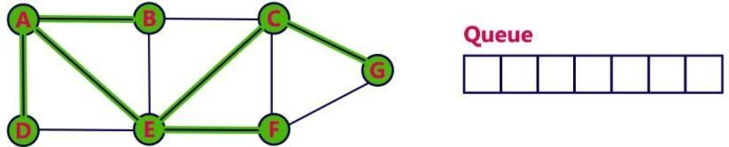
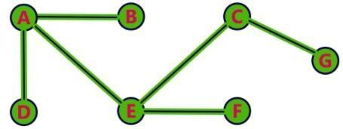
Step 8: Visit all the adjacent vertices of G which are not visited (no vertices) and delete G
from queue.
Now the queue is empty. So, we stop the traversal here. Remove the unnecessary edges from the resulted graph and we can get a final spanning tree.
The resulted visited vertices are: A,D,E,B,C,F,G

Slide 34
DFS (Depth First Search)
DFS traversal of a graph produces a spanning tree as final result. Spanning Tree is a graph
without loops.
We use Stack data structure with maximum size of total number of vertices in the graph to implement DFS traversal.
Algorithm for DFS Step 1: Start
Step 2: Define a Stack of size total number of vertices in the graph.
Step 3: Select any vertex as starting point for traversal. Visit that vertex and push it on to the Stack.
Step 4: Visit any one of the non-visited adjacent vertices of a vertex which is at the top of stack and push it on to the stack.

Slide 35
Step 5: Repeat step 4 until there is no new vertex to be visited from the vertex which is at the top of the stack.
Step 6: When there is no new vertex to visit then use back tracking and pop one vertex from the stack.
Step 7: Repeat steps 4,5 and 6 until stack becomes Empty.
Step 8: When stack becomes Empty, then produce final spanning tree by removing unused edges from the graph
Step 9: Stop

Slide 36
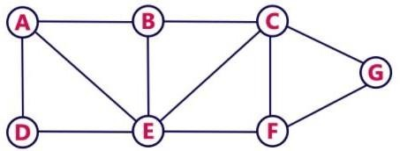
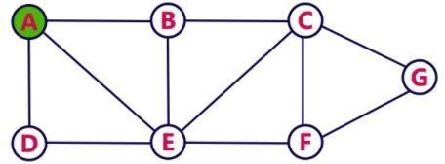

Example: Visit and display all the value of following graph using DFS traversal.
Solution:
Step 1: Select vertex A as starting vertex, visit A and insert into the stack.

Slide 37
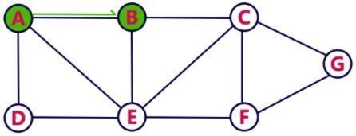

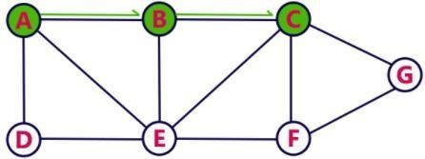

Step 2: Visit any one adjacent vertex of A which is not visited (B), push newly visited
vertex B into the stack.
Step 3: Visit any one adjacent vertex of B which is not visited (C), push newly visited vertex C
into the stack.

Slide 38
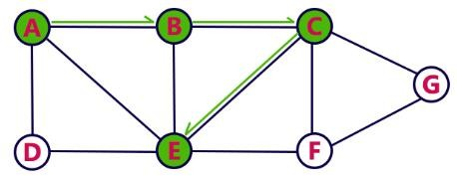

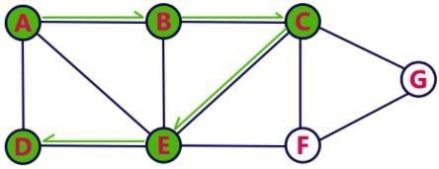

Step 4: Visit any one adjacent vertex of C which is not visited (E), push newly visited vertex E into the stack.
Step 5: Visit any one adjacent vertex of E which is not visited (D), push newly visited vertex
D into the stack.

Slide 39
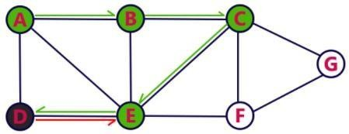

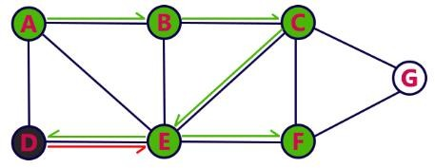

Step 6: Visit any one adjacent vertex of D which is not visited (no vertex). So, use back tracking and pop D from the stack.
Step 7: Visit any one adjacent vertex of E which is not visited (F), push newly visited vertex F
into the stack.

Slide 40
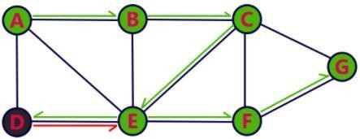

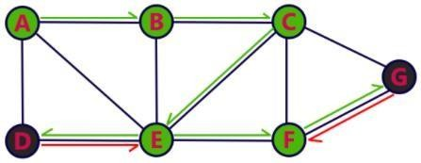

Step 8: Visit any one adjacent vertex of F which is not visited (G), push newly visited vertex G into the stack.
Step 9: Visit any one adjacent vertex of G which is not visited (no vertex). So, use back
tracking and pop G from the stack.

Slide 41
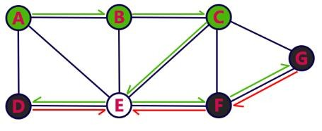

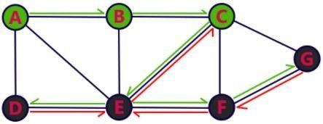

Step 10: Visit any one adjacent vertex of F which is not visited (no vertex). So, use back tracking and pop F from the stack.
Step 11: Visit any one adjacent vertex of E which is not visited (no vertex). So, use back tracking and pop E from the stack.

Slide 42
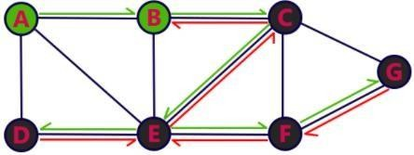

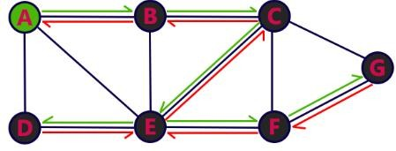

Step 12: Visit any one adjacent vertex of C which is not visited (no vertex). So, use back tracking and pop C from the stack.
Step 13: Visit any one adjacent vertex of B which is not visited (no vertex). So, use back tracking and pop B from the stack.

Slide 43
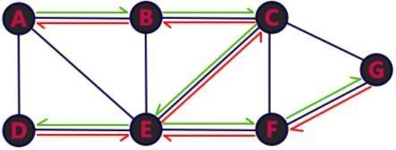

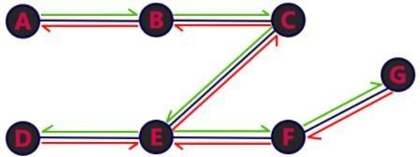
Step 14: Visit any one adjacent vertex of A which is not visited (no vertex). So, use back tracking and pop A from the stack.
Here the stack is empty. So, we stop traversal here. Remove all the unnecessary edges from the final graph and get final spanning tree.
The final visited vertices are: A,B,C,E,D,F,G

Slide 44
Minimum Spanning Trees(MST)
Spanning forest is a forest that spans all of the vertices, meaning only that each vertex of the
graph is a vertex in the forest. For this definition, even a connected graph may have a
disconnected spanning forest, such as the forest in which each vertex forms a single- vertex tree.
A subgraph that spans (reaches out to) all vertices of a graph is called a spanning subgraph.
A subgraph that is a tree and that spans (reaches out to) all vertices of the original graph is called a spanning tree.
Among all the spanning trees of a weighted and connected graph, the one (possibly more)
with the least total weight is called a minimum spanning tree (MST).
Minimum Spanning Tree is a Spanning Tree which has minimum total cost. If we have a
linked undirected graph with a weight (or cost) combine with each edge. Then the cost of
spanning tree would be the sum of the cost of its edges.

Slide 45

Minimum Spanning Trees(MST)
A Minimum Spanning Tree (MST) is a subset of edges in a connected, weighted graph that:
Spans all vertices (i.e., connects all nodes).
Has no cycles (forms a tree).
Has the minimum possible total edge weight among all spanning trees.

Slide 46

Spanning tree
A spanning tree is a subset of Graph G, which has all the vertices covered with minimum possible number of edges. Hence, a spanning tree does not have cycles and it cannot be disconnected.
By this definition, we can draw a conclusion that every connected and undirected Graph G has at least one spanning tree. A disconnected graph does not have any spanning tree, as it cannot be spanned to all its vertices.

Slide 47
We found three spanning trees off one complete graph. A complete undirected graph can have maximum n^{n-2} number of spanning trees, where n is the number of nodes. In the above example, n is 3, hence 3³⁻² = 3 spanning trees are possible.
General Properties of Spanning Tree: We now understand that one graph can have more than one
spanning tree. Following are a few properties of the spanning tree connected to graph G
A connected graph G can have more than one spanning tree.
All possible spanning trees of graph G, have the same number of edges and vertices.
The spanning tree does not have any cycle (loops).
Removing one edge from the spanning tree will make the graph disconnected, i.e. the spanning tree is
minimally connected.
Adding one edge to the spanning tree will create a circuit or loop, i.e. the spanning tree is maximally
acyclic.

Slide 48



Slide 49

Generic MST Algorithm
A greedy algorithm is an approach where we make the best possible choice at each step, hoping to find the global optimum. It does not always guarantee the optimal solution for every problem, but it works well for problems like Minimum Spanning Tree (MST).
The greedy algorithm has only one chance to compute the optimal solution and thus, cannot
go back and look at other alternate solutions.
Example

Slide 50
To find the path with largest sum.
Following steps are followed to find the solution:
Step 1: Initialize sum = 0
Step 2: Select the root node, so sum = 0+8 = 8
Step 3: The algorithm compares nodes at next level, selects the largest node which is 12, so, sum 8+12=
20.
Step 4: The algorithm compares nodes at the next level, selects the largest node which is 10, making
the sum = 30.
Thus, using the greedy algorithm, we get 8-12-10 as the path. But this is not the optimal solution, since the path 8-2-89 has the largest sum i,e. 99.
This happens because the algorithm makes decision based on the information available at each step without considering the overall problem.

Slide 51
Most networking algorithms use the greedy approach. Here is a list of few of them −
Travelling Salesman Problem
Prim's Minimal Spanning Tree Algorithm
Kruskal's Minimal Spanning Tree Algorithm
Dijkstra's Minimal Spanning Tree Algorithm
Graph - Map Coloring
Graph - Vertex Cover
Knapsack Problem
Job Scheduling Problem

Slide 52
Applications of MST:
Minimum spanning trees are used for network designs (i.e. telephone or cable
networks).
They are also used to find approximate solutions for complex mathematical problems like the Traveling Salesman Problem. Other, diverse applications include:
Cluster Analysis.
Real-time face tracking and verification (i.e. locating human faces in a video stream).
Protocols in computer science to avoid network cycles.
Entropy based image registration.
Max bottleneck paths.
Dithering (adding white noise to a digital recording in order to reduce distortion)

Slide 53
Spanning Tree Algorithms
Kruskal's algorithm
Prim's Algorithm
Round Robin Algorithm
Kruskal's algorithm :
Prim’s and Kruskal’s Algorithm are the famous greedy algorithms.
Kruskal's algorithm is a minimum-spanning-tree algorithm which finds an edge of the least possible weight that connects any two trees in the forest.
It is a greedy algorithm in graph theory as it finds a minimum spanning tree for a connected weighted graph adding increasing cost arcs at each step.
ordering the edges by cost and representing the blue trees so that we can test whether two vertices are in the same blue tree.

Slide 54
Step to Kruskal’s algorithm
Sort the graph edges with respect to their weights.
Start adding edges to the minimum spanning tree from the edge with the smallest weight
until the edge of the largest weight.
Only add edges which don’t form a cycle—edges which connect only disconnected components.
Or as a simpler explanation,
Remove all loops and parallel edges
Arrange all the edges in ascending order of cost
Add edges with least weight

Slide 55
Pseudocode
KRUSKAL(G):
A = ∅
For each vertex v ∈ G.V:
MAKE-SET(v)
For each edge (u, v) ∈ G.E ordered by
increasing order by weight(u, v):
if FIND-SET(u) ≠ FIND-SET(v):
A = A 𝖴 {(u, v)}
UNION (u, v)
return A
Kruskal’s Algorithm is preferred when-
The graph is sparse.
There are less number of edges in the graph like E = O(V)
The edges are already sorted or can be
sorted in linear time.

Slide 56


Slide 57
Prim’s Algorithm:
It is used for finding the Minimum Spanning Tree (MST) of a given graph.
To apply Prim’s algorithm, the given graph must be weighted, connected and undirected. The implementation of Prim’s Algorithm is explained in the following steps-
Step-1:
Randomly choose any vertex.
The vertex connecting to the edge having least weight is usually selected.
Step-2:
Find all the edges that connect the tree to new vertices.
Find the least weight edge among those edges and include it in the existing tree.
If including that edge creates a cycle, then reject that edge and look for the next least weight edge.

Slide 58
Step-3:
Keep repeating step-02 until all the vertices are included and Minimum Spanning Tree (MST) is obtained.
Prim’s Algorithm is preferred when-
The graph is dense.
There are large number of edges in the graph like E = O(V²).
Worst case time complexity of Prim’s Algorithm is-
O(ElogV) using binary heap
O(E + VlogV) using Fibonacci heap

Slide 59


Q. Construct the minimum spanning tree (MST) for the given graph using Prim’s Algorithm.
Solution-
Step-01:

Slide 60




Step-2:
Step-4:
Step-3:
Step-5:

Slide 61

Step-6:
Since all the vertices have been included in the
MST, so we stop.
Now, Cost of Minimum Spanning Tree
= Sum of all edge weights
= 10 + 25 + 22 + 12 + 16 + 14
= 99 units

Slide 62


Slide 63
Round Robin Algorithm
The round robin algorithm for the minimum spanning tree problem can be viewed as another special case of the general greedy method.
It builds a collection of blue trees, by repeatedly merging trees using the following rule, until there is just one tree left. Coloring Rule.
Select a blue tree and minimum cost edge incident to it. Color the edge blue
An edge is incident to a tree if one of its endpoints is in the tree and the other is not.
To carry out a coloring step, we remove the first tree, say T1, from the front of the queue and perform a findmin on its heap. We color blue the edge, say e, returned by the findmin. We remove from the queue the other tree, say T2, incident to e. We update the vertex sets and edge heaps to reflect the combining of T1 and T2 and add the new blue tree to the rear of the queue. O(n).

Slide 64

Fig: Execution of the round-robin algorithm, (a) Input graph. The queue contains the vertex sets of the blue trees,
(b) After the initial pass through the queue. Edges {a, c}, {b, d}, {e, g}, and {c, f} become blue, (c) After another
pass. Edges {c, d}and {d, e} become blue.

Slide 65
set function minspantree (set vertices),
set blue;
map h; list queue;
vertex v, w; blue={};
queue = [ ]
for v ⊂ vertices —> makeset (v); h[v) - makeheap (edges (v)); queue = queue & [v] rof;
do | queue | > 1 —>
{v, w)=findmin h(queue (1))); blue= blue 𝖴 (v, w ,};- Queue= queue – {find (v), find (w)};
h{link (find (v), find (w))) = meld (h(find (v)), h(find (w)));
queue= queue & [find (v)]
od;
return blue
end minspantree;
predicate deleted (edge {v, ›w}); return find (v) =find (w)
end deleted;
real function key (edge e); return cost (e)
end key;

Slide 66
Shortest Path Algorithms
The shortest path problem is about finding a path between vertices in a graph such that the
total sum of the edges weights is minimum.
The most important algorithms for solving this problem are: Dijkstra's algorithm solves the single-source shortest path problem with non-negative edge weight. Bellman– Ford algorithm solves the single-source problem if edge weights may be negative.
Dijkstra's Algorithm
Dijkstra's Algorithm finds the shortest path between a given node (which is called the "source node") and all other nodes in a graph.
This algorithm uses the weights of the edges to find the path that minimizes the total distance (weight) between the source node and all other nodes.

Slide 67
Algorithm
Step 1: Remove all the loops.
Step 2: Remove parallel edges between two vertices which have higherweight/cost.
Step 3: Create weight matrix table
Set 0 to the source vertex and infinite to the remaining vertex.
Mark the smallest unmarked value and write that vertex in marked column.
Find those vertices which are directly connected to marked vertex and update all. If d[u] + c[u,v] < d[v] Then, d[v] = d[u] + c[u,v] OR,
New destination = Min(Old dest, Marked Value + Edge Weight)
Repeat stem b and c until final destination vertex is marked.

Slide 68
Step 4: Now, find the shortest path graph using backward tracking method.
Point to the final destination vertex and take it as an initial path.
Move pointer to the position where vertex value is change in samevertex.
Update pointer to that row where the smallest marked value of that row (which is other
vertex value).
Repeat stem b and c until source vertex is reached.
Finally reverse the order of vertex.

Slide 69

Example: Using Dijkstra’s algorithm find the shortest path from A to F for the following
graph.
Solution:
Step 1: Remove all the loops. (Edges that start and end at the same vertex is called loop) In the above graph there are two loops. One is in the vertex C and another one is in the Vertex F (starting and ending vertex are same), thus we remove this two edge.

Slide 70

Step 2: Remove all parallel edges between two vertices except the one with leastweight.
In the above graph there are two edges from A vertex to B vertex, and there cost/weight are 4 and 2.This two edges are called parallel edges. We remove that edge which one has greater value (4>2) i.e. 4. So we remove that edge of cost 4.
Similarly, there is another parallel edge from E to F, and as per the rules we remove that edge which one has greater value (6>3) i.e. 6. So we remove that edge of cost 6.

Slide 71


Step 3: create the weight matrix table.
(i) Set 0 to the source vertex and infinite to the remaining vertices.
Weight Matrix table:

Slide 72

For all vertices, repeat (ii) and (iii)
Find the smallest unmarked value and mark that vertex.
Find those vertices which are directly connected with marked vertex andupdate all.
So, smallest value in the first row is 0. So we marked 0 and put A as Marked.
Now, Find those vertices which are directly connected with A vertex. i.e. B, D andE.
Now, update B, D and E.

Slide 73

Update value formula:
New Destination value = minimum (Old Destination value, Marked value+Edge Weight)
New Value of B = minimum (∞, 0+2) = minimum(∞, 2)= 2 New Value of D = minimum (∞, 0+3)= minimum(∞, 3)= 3 New Value of E = minimum (∞, 0+2)= minimum(∞, 2)= 2 Value of all other vertices remains same. Now the table is:

Slide 74

Now, repeat:
Smallest value in the second row is 2. If there are multiple smallest value we can mark any one of them. We marked first 2 and put B as Marked.
Now, Find those vertices which are directly connected with B vertex. i.e. A, D and C. But A is already Marked, so we will not chose A.
Now, update D and C.

Slide 75

Update value formula:
New Destination value = minimum (Old Destination value, Marked value+ Edge Weight)
New Value of D = minimum (3, 2+4)= minimum(3, 6)= 3 New Value of C = minimum (∞, 2+2)= minimum(∞, 4)= 4 Value of all other vertices remains same. Now the table is:

Slide 76

Now, repeat:
Smallest value in the 3rd row is 2. So, we marked first 2 and put E as Marked.
Now, Find those vertices which are directly connected with E vertex. i.e. A, and F. But A is already
Marked, so we will not chose A. Now, update F.

Slide 77

Update value formula:
New Destination value = minimum (Old Destination value, Marked value+Edge Weight)
New Value of F = minimum (∞, 2+3)= minimum(∞, 5)= 5 Value of all other vertices remains same.
Now the table is:

Slide 78

Now repeat:
Smallest value in the 4th row is 3. So, we marked first 3 and put D as Marked.

Slide 79
Now, Find those vertices which are directly connected with D vertex. i.e. A, B, C, and F. But A
and B are already Marked, so we will not chose A and B.
Now, update C and F.
Update value formula:
New Destination value = minimum (Old Destination value, Marked value+ Edge Weight)
New Value of C = minimum (4, 3+2) = minimum (4, 5) = 4
New Value of F = minimum (5, 4+3) = minimum (5, 7) = 5 Value of all other vertices remains same.
Now the table is:

Slide 80


Now repeat:
Smallest value in the 5th row is 4. So, we marked first 4 and put C as Marked.

Slide 81

Now, Find those vertices which are directly connected with C vertex. i.e. B, D, and
F. But B and D are already Marked, so we will not chose B and D.Now, update F.
Update value formula:
New Destination value = minimum (Old Destination value, Marked value+ Weight)
New Value of F = minimum (5, 4+2)= minimum(5, 6)= 5
Value of all other vertices remains same. Now the table is:
Edge

Slide 82

As we see there is only one unmarked vertex remaining i.e. F. So marked 5 and putF as Marked.
So we cover all vertices. Step 3 is over.

Slide 83
Now,
Step 4: Find the shortest path from source to destination using backtracking.
Put destination vertex in ‘shortest path’
Set pointer to the last marked value and put that vertex to the ‘shortest path’ list.
Move the pointer up until marked value is change.
If the last marked value has been changed then move the pointer to the marked value in that row and put that vertex to the ‘shortest path’ list.
Repeat (ii) to (iii) until the pointer will move to source vertex. The last marked value is 5 so put F to the ‘shortest path’ list.

Slide 84
Shortest path : F
Now, Move the pointer up, the value is same. So again move the pointer up again, the value is same. So again move the pointer, the value has changed(infinity). So now, move the pointer to the marked value in that row which is 2 and put thevertex E to the ‘shortest path’ list.
Shortest path : F -> E
Now again, Move the pointer up, the value is same. So again move the pointer up again, the value has changed(infinity). So now, move the pointer to the marked value in that row which is 0 and put the vertex A to the ‘shortest path’ list.
Shortest path : F -> E -> A
So minimum cost from A to F is: 2 + 3 = 5

Slide 85
Bellman Ford Algorithm
Given a graph and a source vertex src in graph, find shortest paths from src to all vertices in the given graph. The graph may contain negative weight edges. Dijkstra doesn’t work for Graphs with negative weight cycle, Bellman-Ford works for such graphs. Bellman-Ford is also simpler than Dijkstra and suites well for distributed systems.
If there is a negative weight cycle (a cycle of graph whose sum value is negative), then shortest distances are not calculated, negative weight cycle is reported, this is the drawback of this algorithm.

Slide 86
Algorithm
Step 1: This step initializes distances from source to all vertices as infinite and distance to source itself as 0.
Step 2: This step calculates shortest distances.Do following for each edge u-v If d[u] + c[u,v] < d[v]
Then, d[v] = d[u] + c[u,v]
Repeat this step up to (n-1) iteration.
Step 3: Find the complete graph with weight of each vertices.
Note: If we repeat step 2 one more than (n-1) times and get a shorter path for any vertex, then there is a negative weight cycle.

Slide 87

Example: Find the possible routes from vertex A to F using Distance vectoralgorithm.
Solution:
Routes: (AB) (AC) (AD) (BE) (CB) (CE) (DC) (DF) (EF)

Slide 88



