Slide 1

Sampling Distribution
Santosh chhatkuli

Slide 2
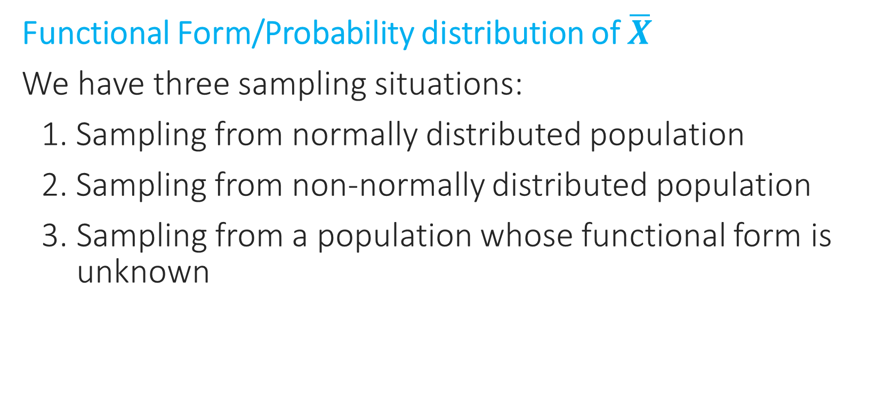

Sampling distribution of sample mean ($\overline{X})$
Functional Form/Probability distribution of $\overline{X}$
We have three sampling situations:
1. Sampling from normally distributed population
2. Sampling from non-normally distributed population
3. Sampling from a population whose functional form is unknown

Slide 3
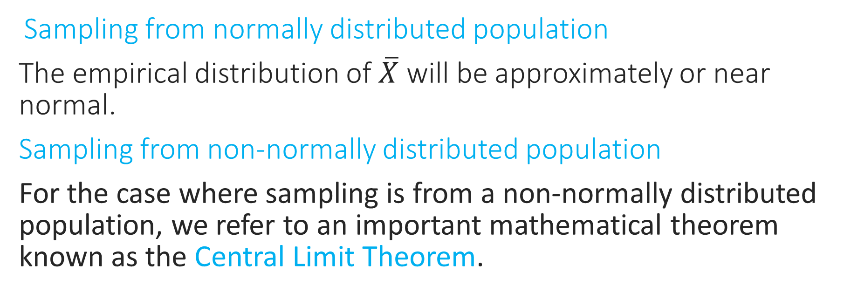

Probability distribution of $\overline{X}$
Sampling from normally distributed population
The empirical distribution of $\overline{X}$ will be approximately or near normal.
Sampling from non-normally distributed population
For the case where sampling is from a non-normally distributed population, we refer to an important mathematical theorem known as the Central Limit Theorem.

Slide 4
Central Limit Theorem
The Central Limit Theorem (CLT) is a statistical concept that states that the sample mean distribution of a random variable will assume a near-normal or normal distribution if the sample size is large enough. In simple terms, the theorem states that the sampling distribution of the mean approaches a normal distribution as the size of the sample increases, regardless of the shape of the original population distribution.
Key things of CLT:
CLT states that the distribution of sample means approximates a normal distribution as the sample size gets larger.
Sample sizes equal to or greater than 30 are considered sufficient for the CLT to hold.
A key aspect of CLT is that the average of the sample means and standard deviations will equal the population mean and standard deviation.
A sufficiently large sample size can predict the characteristics of a population accurately.

Slide 5
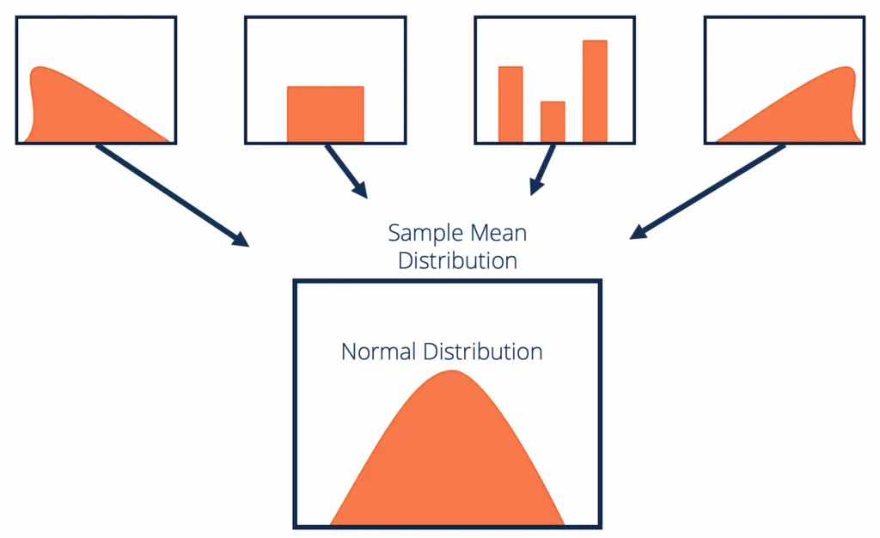
Population Distribution

Slide 6
What sample size is large enough for normal approximation of sampling distribution of mean?
1. For most population distribution, regardless of shape, the sampling distribution of the mean is approximately normally distributed if samples of at least 30 observations are selected.
n ≥ 30 large sample, n < 30 small sample.
2. If the population distribution is fairly symmetrical, the sampling distribution of the mean is approximately normal if samples of at least 15 observations are selected.
3. If the population is normally distributed, the sampling distribution of mean is normally distributed regardless of the sample size.

Slide 7
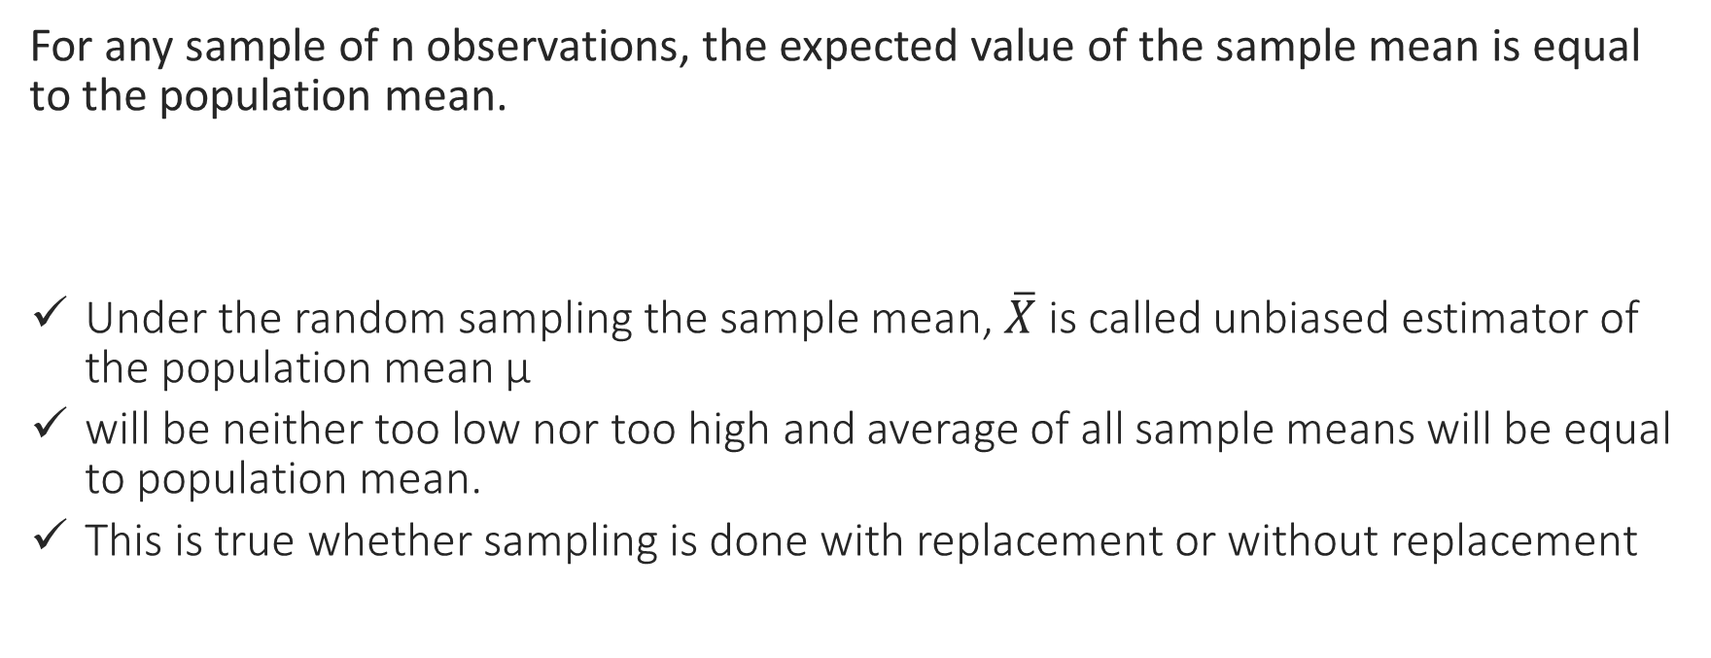
Expected value
For any sample of n observations, the expected value of the sample mean is equal to the population mean.
Under the random sampling the sample mean, $\overline{X}$ is called unbiased estimator of the population mean µ
will be neither too low nor too high and average of all sample means will be equal to population mean.
This is true whether sampling is done with replacement or without replacement

Slide 8
Standard Error
A measure of variability in the statistic from sample to sample is called standard error.
Standard error of mean is the standard deviation of sample means and it measures the fluctuation of mean form sample to sample. A distribution of sample means that is less spread out is a better estimator of the population mean and has a smaller standard error.

Slide 9
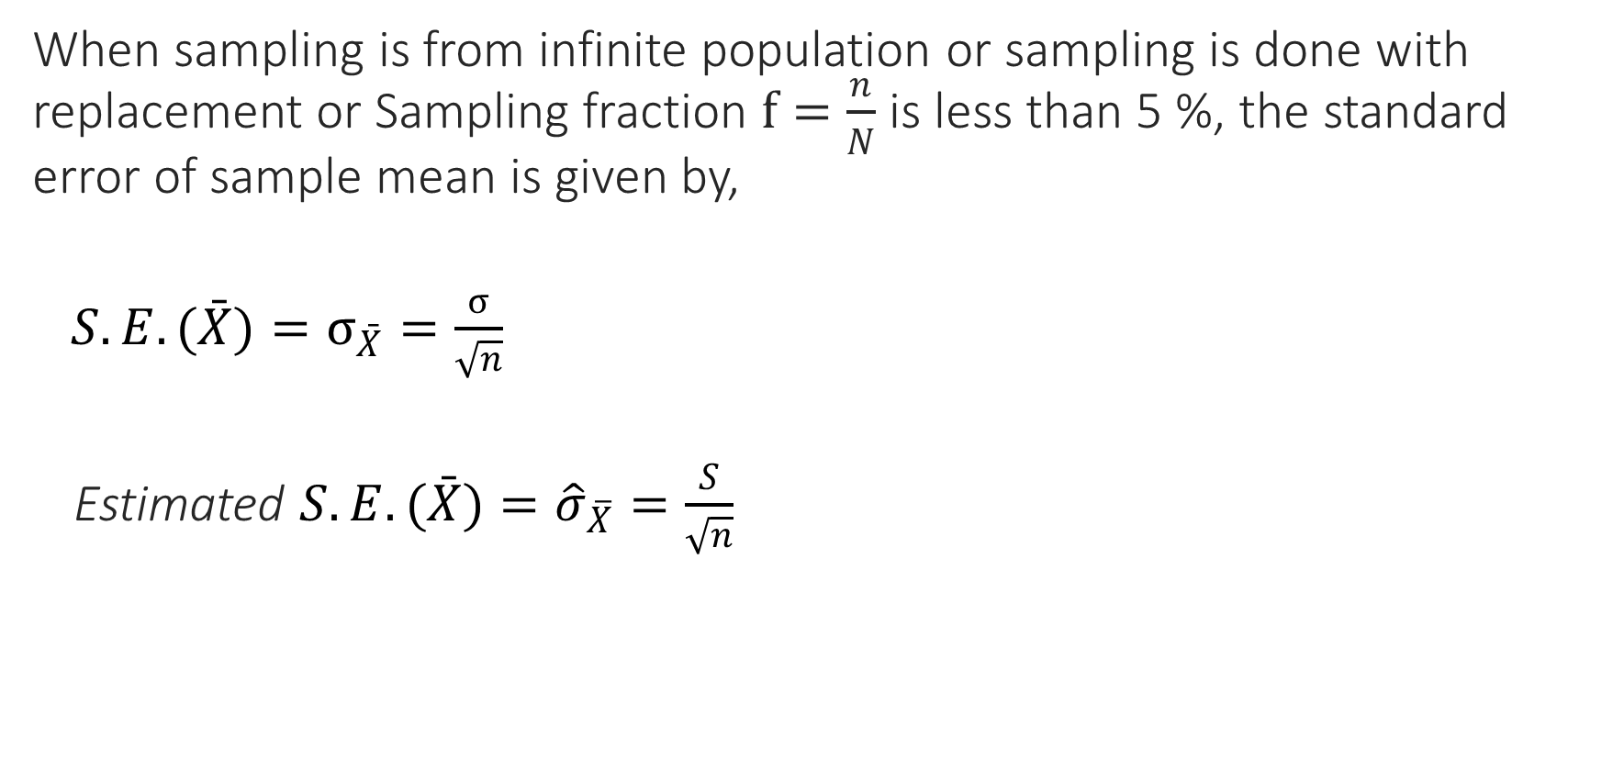
Standard error mean (SRSWR)
When sampling is from infinite population or sampling is done with replacement or Sampling fraction $f=\frac{n}{N}$ is less than 5 %, the standard error of sample mean is given by,
$S.E.(\bar{X})=σ_{\bar{X}}=\frac{σ}{\sqrt{n}}$
Estimated $S.E.(\bar{X})={\hat{σ}}_{\overline{X}}=\frac{S}{\sqrt{n}}$

Slide 10
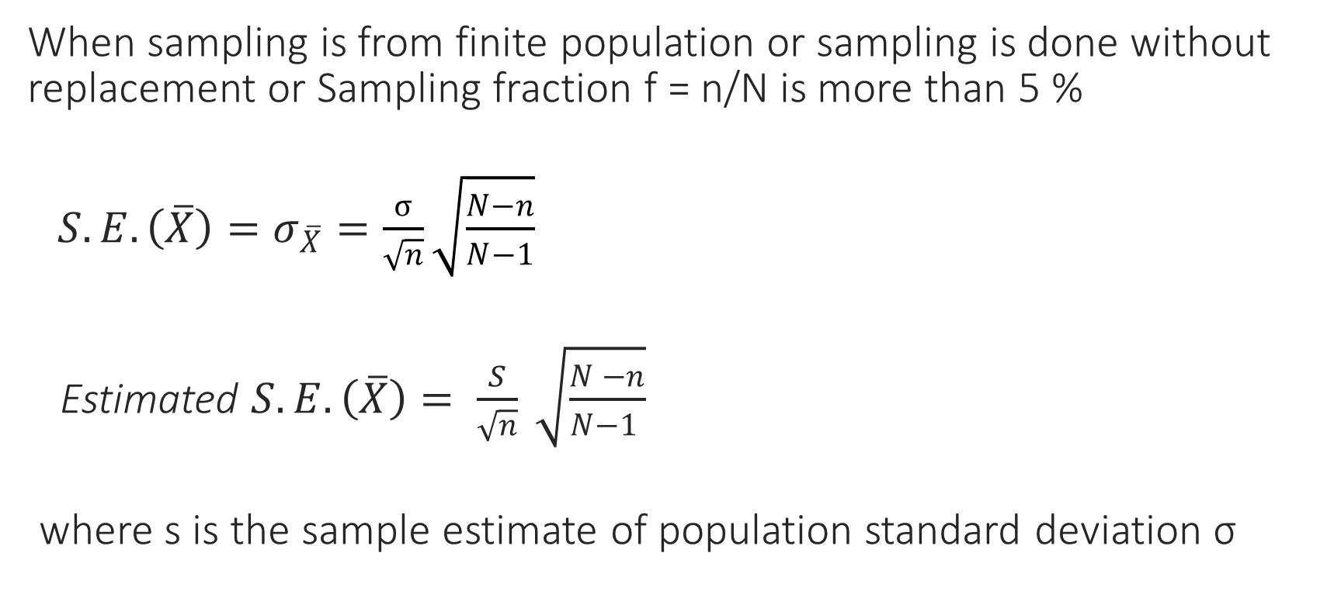
Standard error of mean (SRSWOR)
When sampling is from finite population or sampling is done without replacement or Sampling fraction f = n/N is more than 5 %
$S.E.\left(\overline{X}\right)=σ_{\overline{X}}=\frac{σ}{\sqrt{n}}\sqrt{\frac{N−n}{N−1}}$
Estimated $S.E. \left(\overline{X}\right)= \frac{S}{\sqrt{n}} \sqrt{\frac{N −n}{N−1 }}$
where s is the sample estimate of population standard deviation σ

Slide 11
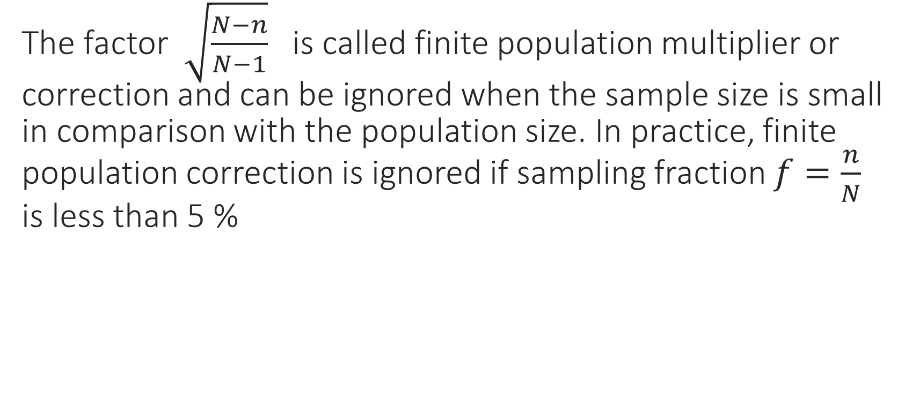
Finite Population Correction
The factor $\sqrt{\frac{N−n}{N−1}}$ is called finite population multiplier or correction and can be ignored when the sample size is small in comparison with the population size. In practice, finite population correction is ignored if sampling fraction $f=\frac{n}{N}$ is less than 5 %

Slide 12
Factor affecting the standard error of sample mean
The factors are:
Sample size ‘n’
The standard error of sample mean decreases with increased sample size. Large the sample size, lesser is fluctuation between sample means
Population standard deviation ‘σ’
If population data is highly variable, then the standard error of sample mean is large.
So, we can control standard error of mean by taking large sample but we have no direct control over it because of the natural variability of population observations or data.

Slide 13

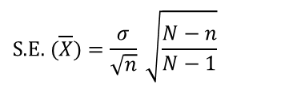
Example: The no. of days absent per year in the population of six health post employees of a certain vdc are 8, 3, 1, 11, 4 and 7
Consider all possible samples of size two i.e. n = 2 which can be drawn with simple random sampling with replacement and without replacement.
Draw histogram of distribution of population values and sampling distribution of means. Comment on the functional form of sampling distribution of means.
Find the mean of the population and means of these samples and verify that population mean is equals to mean of the sample means.
Find population standard deviation and verify following results.
(a)
for sampling without replacement f
(b)
for sampling with replacement.
$$\text{S}\text{.}\text{E}\text{. }(\overline{X})=\frac{σ}{\sqrt{n}} \sqrt{\frac{N−n}{N−1}}$$
$$\text{S}\text{.}E. (\overline{X})=\frac{σ}{\sqrt{n}}$$

Slide 14
In sampling without replacement the total number of possible samples = 6C2 = 15
Serial No. | Sample | Sample Mean | Sample S.D.
1 | (8 , 3) | 5.5 | 3.54
2 | (8 , 1) | 4.5 | 4.95
3 | (8 , 11) | 9.5 | 2.12
4 | (8 , 4) | 6.0 | 2.83
5 | (8 , 7) | 7.5 | 0.71
6 | (3 , 1) | 2.0 | 1.41
7 | (3 , 11) | 7.0 | 5.66
8 | (3 , 4) | 3.5 | 0.71
9 | (3 , 7) | 5.0 | 2.83
10 | (1 , 11) | 6.0 | 7.07
11 | (1 , 4) | 2.5 | 2.12
12 | (1 , 7) | 4.0 | 4.24
13 | (11 , 4) | 7.5 | 4.95
14 | (11 , 7) | 9.0 | 2.83
15 | (4 , 7) | 5.5 | 2.12

Slide 15
Frequency distribution of sample means
Sample means | Frequency
2.0 – 3.5 | 2
3.5 – 5.0 | 3
5.0 – 6.5 | 5
6.5 – 8.0 | 3
8.0 – 9.5 | 1
9.5 – 11.0 | 1
Total | 15

Slide 16
In sampling with replacement the total number of possible samples = $6^{2}$ = 36
S.N. | Sample | Sample Mean | Sample SD | S.N. | Sample | Sample Mean | Sample SD
1 | 8, 8 | 8.0 | 0 | 19 | 11, 8 | 9.5 | 2.12
2 | 8, 3 | 5.5 | 3.54 | 20 | 11, 3 | 7.0 | 5.66
3 | 8, 1 | 4.5 | 4.95 | 21 | 11, 1 | 6.0 | 7.07
4 | 8, 11 | 9.5 | 2.12 | 22 | 11, 11 | 11.0 | 0
5 | 8, 4 | 6.0 | 2.83 | 23 | 11, 4 | 7.5 | 4.95
6 | 8, 7 | 7.5 | 0.71 | 24 | 11, 7 | 9.0 | 2.83
7 | 3, 8 | 5.5 | 3.54 | 25 | 4, 8 | 6.0 | 2.83
8 | 3, 3 | 3.0 | 0 | 26 | 4, 3 | 3.5 | 0.71
9 | 3, 1 | 2.0 | 1.41 | 27 | 4, 1 | 2.5 | 2.12
10 | 3, 11 | 7.0 | 5.66 | 28 | 4, 11 | 7.5 | 4.95
11 | 3, 4 | 3.5 | 0.71 | 29 | 4, 4 | 4.0 | 0
12 | 3, 7 | 5.0 | 2.83 | 30 | 4, 7 | 5.5 | 2.12
13 | 1, 8 | 4.5 | 4.95 | 31 | 7, 8 | 7.5 | 0.71
14 | 1, 3 | 2.0 | 1.41 | 32 | 7, 3 | 5 | 2.83
15 | 1, 1 | 1.0 | 0 | 33 | 7, 1 | 4 | 4.24
16 | 1, 11 | 6.0 | 7.07 | 34 | 7, 11 | 9 | 2.83
17 | 1, 4 | 2.5 | 2.12 | 35 | 7, 4 | 5.5 | 2.12
18 | 1, 7 | 4.0 | 4.24 | 36 | 7, 7 | 7 | 0

Slide 17
Frequency distribution of sample means (SRSWOR)
Sample Mean | Frequency
1.0 – 2.5 | 3
2.5 – 4.0 | 5
4.0 – 5.5 | 7
5.5 – 7.0 | 8
7.0 – 8.5 | 8
8.5 – 10.0 | 4
10.0 – 11.5 | 1
Total | 36

Slide 18
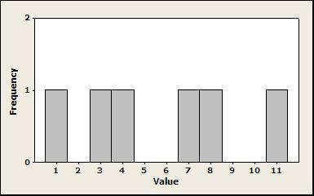
Distribution of population value

Slide 19
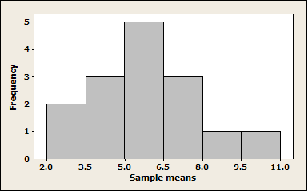
Sampling distribution of means sampling without replacement (n=2)

Slide 20
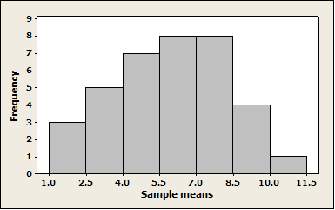
Sampling distributions of means sampling with replacement (n=2)

Slide 21
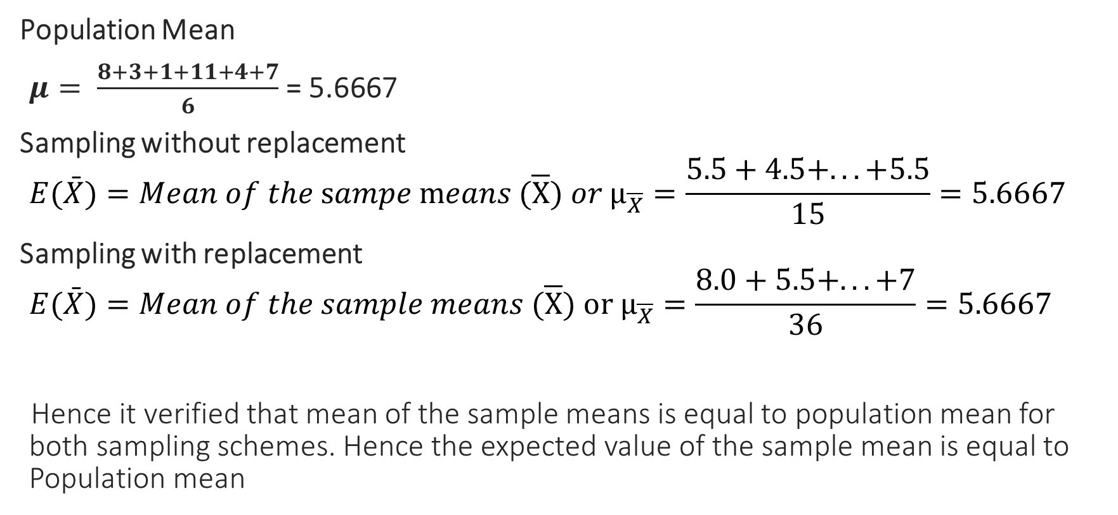

To show $E\left(\overline{X}\right)= μ$
Population Mean
$μ= \frac{8+3+1+11+4+7}{6}$ = 5.6667
Sampling without replacement
$$E(\bar{X})=Mean of the \text{s}ampe \text{m}eans (\overline{X}) or μ_{\overline{X}}=\frac{5.5+4.5+...+5.5}{15}=5.6667$$
Sampling with replacement
$$E(\bar{X})=Mean of the sample means (\overline{X}) \text{or} μ_{\overline{X}}=\frac{8.0+5.5+...+7}{36}=5.6667$$
Hence it verified that mean of the sample means is equal to population mean for both sampling schemes. Hence the expected value of the sample mean is equal to Population mean

Slide 22
Population Standard Deviation (σ )
Direct Formula:
Short-cut Formula:

Slide 23

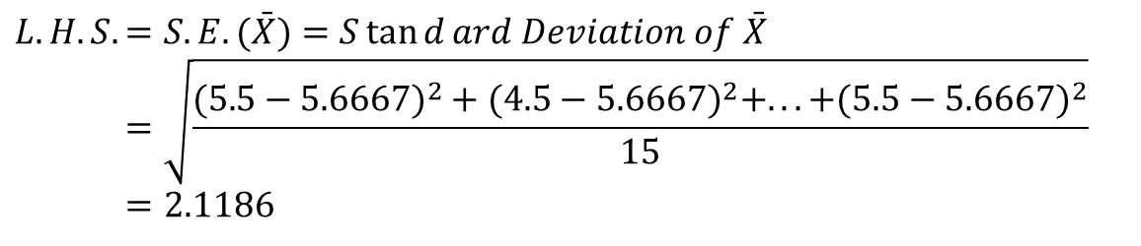

To show for SRSWOR
$$S.E.(\bar{X})=\frac{σ}{\sqrt{n}}\sqrt{\frac{N−n}{N−1}}$$
$$L.H.S.=S.E. (\bar{X})=S\tan{d}ard Deviation of \bar{X} \\ =\sqrt{\frac{(5.5−5.6667)^{2}+(4.5−5.6667)^{2}+...+(5.5−5.6667)^{2}}{15}} \\ =2.1186$$
$$R.H.S=\frac{σ}{\sqrt{n}}\sqrt{\frac{N−n}{N−1}} \\ =\frac{3.35}{\sqrt{2}}\sqrt{\frac{6−2}{6−1}}=2.1186$$
Hence Verified

Slide 24
To show for SRSWR
Hence it is verified.

