Slide 1

Sampling Distribution of proportion
Santosh Chhatkuli

Slide 2
Sampling distribution of proportion
Consider sampling from a population which is divided into two mutually exclusive classes.
One class possessing particular attribute
Other class not possessing that attribute
The presence of an attribute in sampled unit may be termed as success
and its absence as failure (coded as 1 for success and 0 as failure)

Slide 3
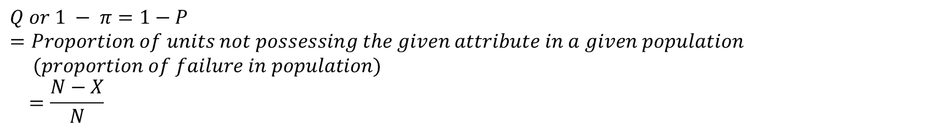
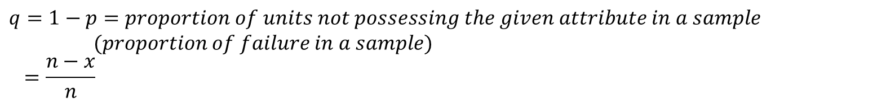
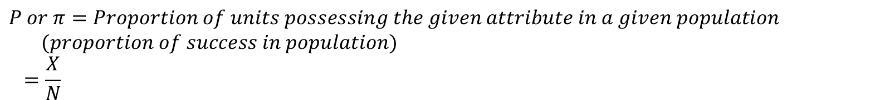
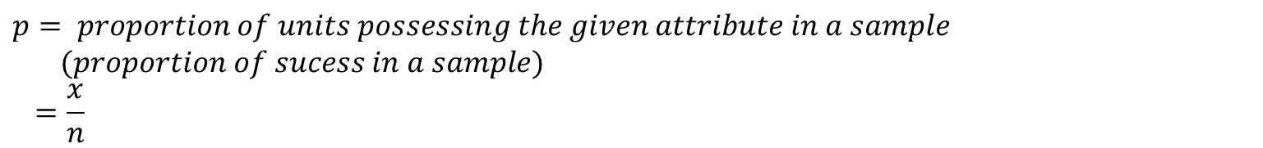
Terminology
$$P or π=Proportion of units possessing the given attribute in a given population \\ (proportion of success in population) \\ =\frac{X}{N}$$
$$Q or 1 − π=1−P=Proportion of units not possessing the given attribute in a given population \\ (proportion of failure in population) \\ =\frac{N−X}{N}$$
$$p= proportion of units possessing the given attribute in a sample \\ (proportion of sucess in a sample) \\ =\frac{x}{n}$$
$$q=1−p=proportion of units not possessing the given attribute in a sample \\ (proportion of failure in a sample) \\ =\frac{n−x}{n}$$
$$where, n=Sample size, x=Number of successes in a sample$$

Slide 4
Functional Form
When the sample size (n) is large, the distribution of sample
proportions is approximately normally distributed by virtue of the
Central Limit Theorem (CLT).
How large does the sample size have to be for the use of the normal
approximation to be valid?
Take a large sample
A widely used criterion for normal approximation is that both nP and n (1 - P) must be greater than 5

Slide 5
Expected value
The expected value of the sample proportion is equal to the population proportion.
Under the random sampling, sample proportion ‘p’ is an unbiased estimator of the population proportion ‘P’ for both SRSWOR and SRSWR sampling plan. The average of all the possible sample proportions will be equal to the true population proportion.

Slide 6
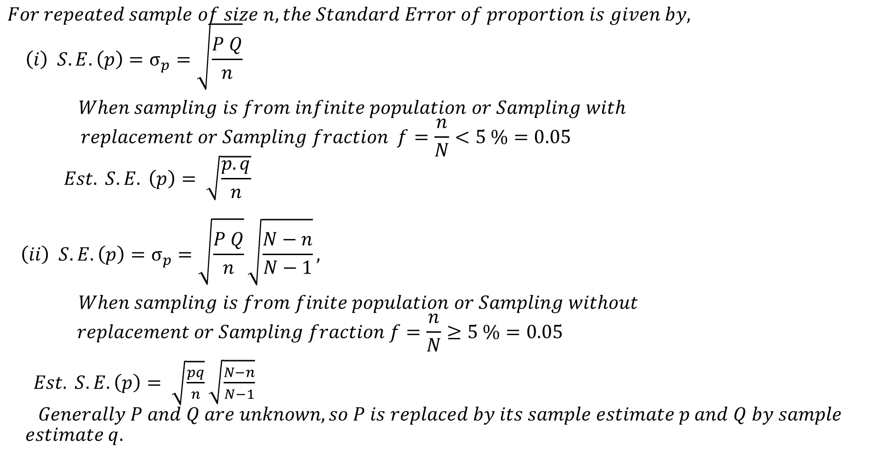
Standard Error of sample proportion p
$$For repeated sample of size n, the Standard Error of proportion is given by, \\ \left(i\right) S.E. \left(p\right)=σ_{p}=\sqrt{\frac{P Q}{n}}$$
$When sampling is from infinite population or Sampling with$ $$replacement or Sampling fraction f=\frac{n}{N}<5 \%=0.05 \\ Est. S.E. \left(p\right)= \sqrt{\frac{p.q}{n}}$$ $$\left(ii\right) S.E. \left(p\right)=σ_{p}=\sqrt{\frac{P Q}{n}}\sqrt{\frac{N−n}{N−1}},$$
$When sampling is from finite population or Sampling without$ $$replacement or Sampling fraction f=\frac{n}{N}≥5 \%=0.05$$
$Est. S.E.\left(p\right)= \sqrt{\frac{pq}{n}}$ $\sqrt{\frac{N−n}{N−1}}$ $$Generally P and Q are unknown, so P is replaced by its sample estimate p and Q by sample$$
$$estimate q.$$

