Slide 1
Sample Size Calculation one sample case

Slide 2
Objective of sample size determination
Determining the appropriate sample size for the study is the most common problem among researchers.
Small sample size means less cost, less administrative burden but high standard error.
Hence size of sample must be optimum ensuring efficiency, representativeness and reliability.
The objective in the sample size determination is to find the minimum number of observations that will guarantee at a particular confidence probability that the parameter of interest will falls within a prescribed confidence interval.

Slide 3
FACTORS AFFECTING SAMPLE SIZE
Expected Population Standard Deviation: Variability of characteristic being measured (direct)
Size of the population (direct)
Margin of error (indirect)
Confidence level (direct)
Sampling design
Nature of analysis
No. of classes or categories

Slide 4
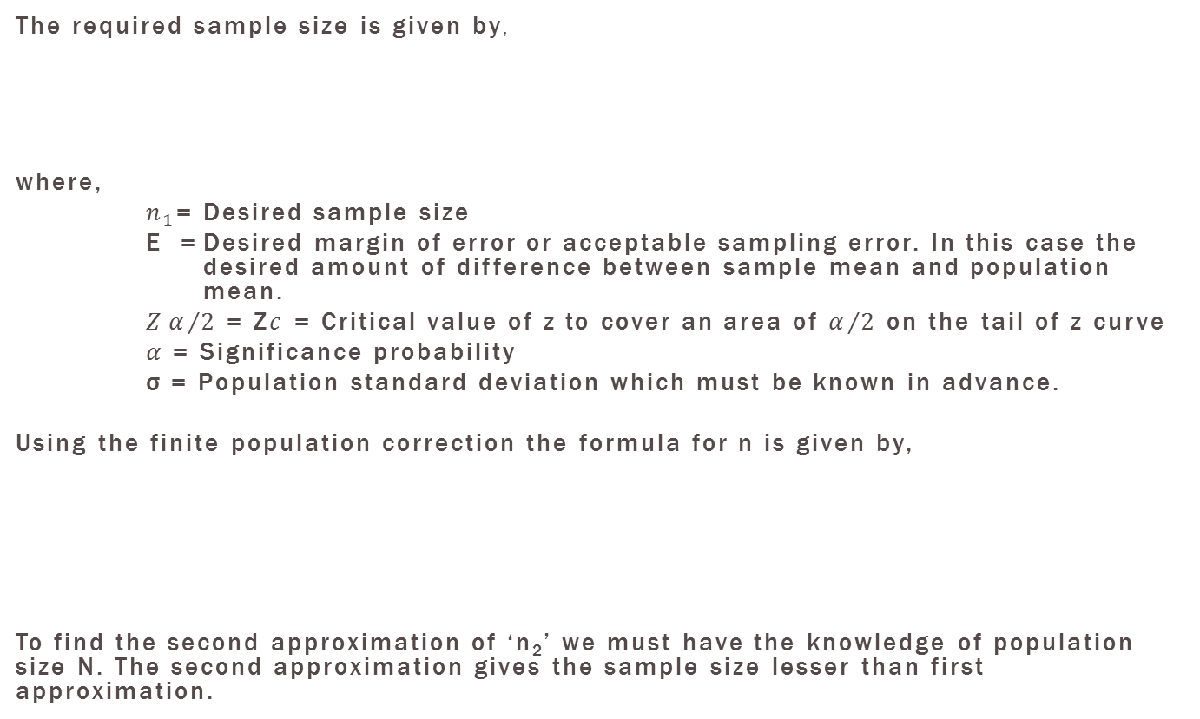
Sample size calculation for population mean when population standard deviation is known

Slide 5
Estimating population standard deviation
The most frequently used sources of estimating for σ are the following:
Conducting a pilot study i.e. taking preliminary sample from the population and computing standard deviation which can be used as an estimate for σ.
Using estimates of σ from previous or similar studies.
If we know that the population from which the sample is to be drawn is approximately normally distributed, we may use the ratio Range/6 as the estimate for σ. This method requires some knowledge of the smallest and largest value of the variable of interest in the population.

Slide 6
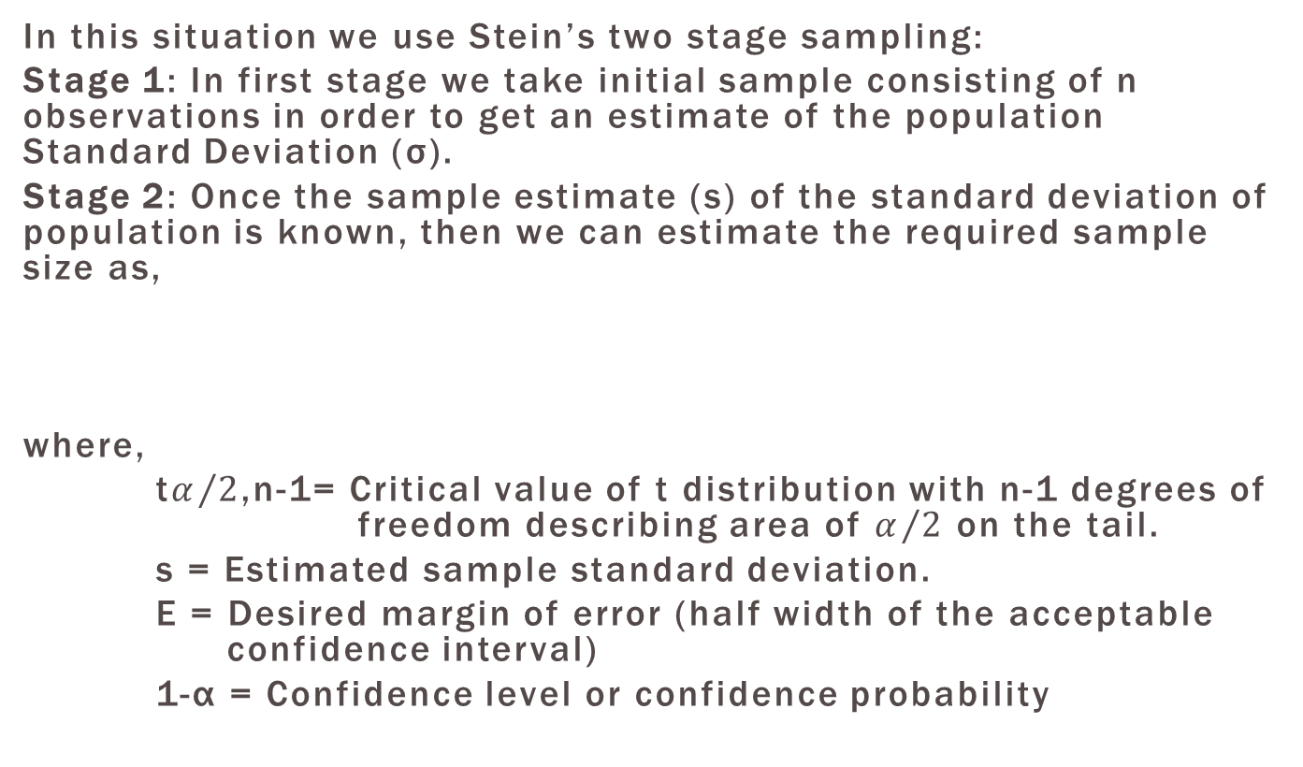
Sample size calculation for population mean when population standard deviation is unknown

Slide 7
Numerical Example
1. An efficiency expert in a large assembly plant for laptop computers is interested to determine the average time it takes a worker to assemble a laptop computer with all available parts. How large a sample will be needed to be 95 % certain that this ample mean will not differ from the true mean by more than 10 minutes. Similar studies conducted before have established a standard deviation of 40 minutes.
2. A health officer wishes to estimate the mean hemoglobin level in a defined community. Preliminary information is that this mean is about 150 mg/l with a standard deviation of 32 mg/l. If a sampling error of up to 5 mg/l in the estimate is to be tolerated, how many subjects should be included in the study with 95% confidence level? If the community to be sample has 1000 people, what is the required minimum sample size.

Slide 8
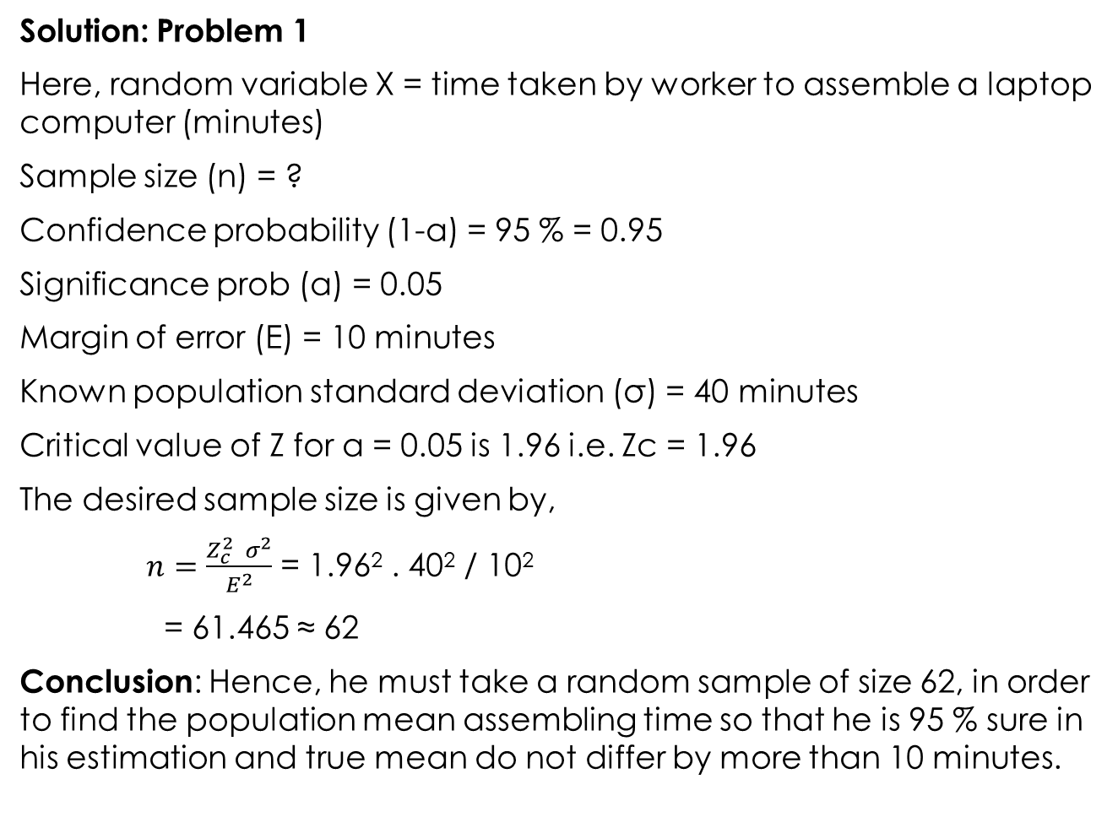
Solution: Problem 1
Here, random variable X = time taken by worker to assemble a laptop computer (minutes)
Sample size (n) = ?
Confidence probability (1-α) = 95 % = 0.95
Significance prob (α) = 0.05
Margin of error (E) = 10 minutes
Known population standard deviation (σ) = 40 minutes
Critical value of Z for α = 0.05 is 1.96 i.e. Zc = 1.96
The desired sample size is given by,
$n=\frac{Z_{c}^{2} σ^{2}}{E^{2}}$ = 1.96² . 40² / 10²
= 61.465 ≈ 62
Conclusion: Hence, he must take a random sample of size 62, in order to find the population mean assembling time so that he is 95 % sure in his estimation and true mean do not differ by more than 10 minutes.

Slide 9
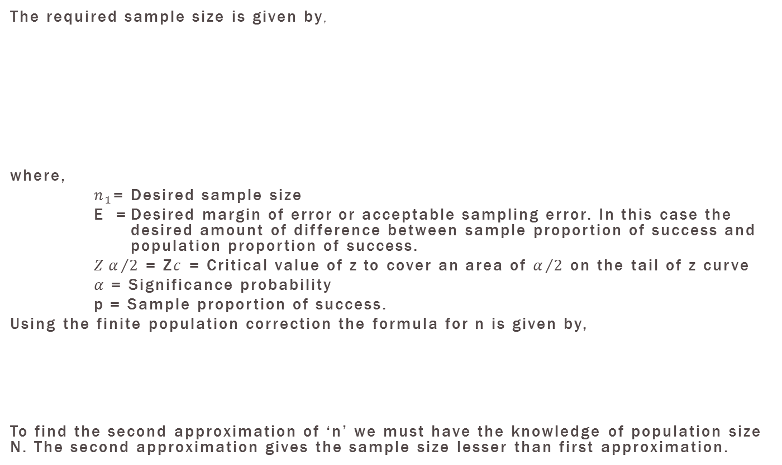
Sample size calculation for population proportion

Slide 10
Estimating Population Proportion
The most frequently used sources of estimating for P are the following:
Conducting a pilot study i.e. taking preliminary sample from the population and computing sample proportion of success(p) which can be used as an estimate for P.
Using estimates of P from previous or similar studies.
If it is impossible to come up with a better estimate, one may set P = 0.5 and solve for n. Since P =0.5 in the formula yields the maximum value of n, this procedure will give a large enough sample for the desired reliability and interval width.

Slide 11
Problem
A survey is planned to study customers satisfaction concerning after-sale support and service of a product. A pilot study was conducted (with a small sample size) and found out that an initial estimate of the percentage of customer not satisfying with the after-sale support and service is 38%. What sample size is needed to conduct new study for proportion of customers satisfied and to obtain a margin of error of 4% and at 95% confidence level?

Slide 12
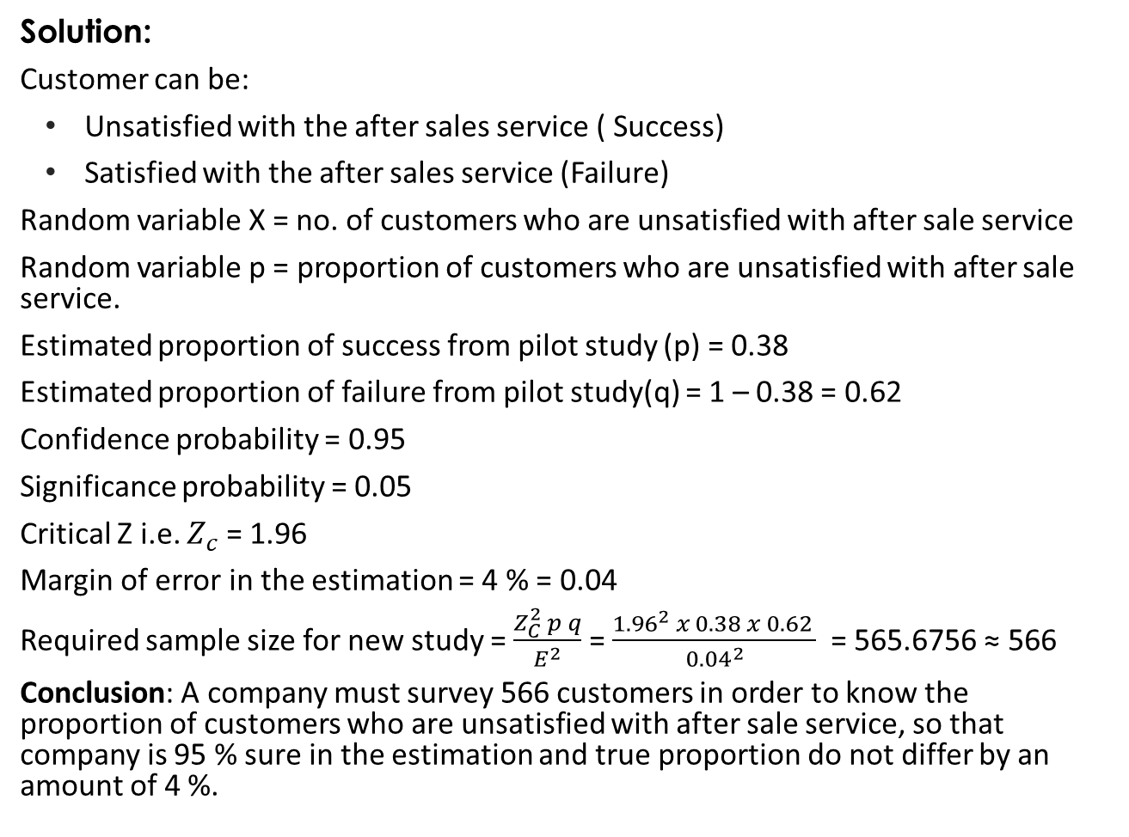
Solution:
Customer can be:
Unsatisfied with the after sales service ( Success)
Satisfied with the after sales service (Failure)
Random variable X = no. of customers who are unsatisfied with after sale service
Random variable p = proportion of customers who are unsatisfied with after sale service.
Estimated proportion of success from pilot study (p) = 0.38
Estimated proportion of failure from pilot study(q) = 1 – 0.38 = 0.62
Confidence probability = 0.95
Significance probability = 0.05
Critical Z i.e. $Z_{c}$ = 1.96
Margin of error in the estimation = 4 % = 0.04
Required sample size for new study = $\frac{Z_{C}^{2} p q}{E^{2}}$ = $\frac{{1.96}^{2} x 0.38 x 0.62 }{{0.04}^{2}}$ = 565.6756 ≈ 566
Conclusion: A company must survey 566 customers in order to know the proportion of customers who are unsatisfied with after sale service, so that company is 95 % sure in the estimation and true proportion do not differ by an amount of 4 %.

Slide 13
Numerical
It is desired to estimate the proportion of children watching TV on Saturday mornings, in order to develop a promotional strategy for electronic games. We want to be 99 % confident that our estimate will be within ± 5 % of the true population proportion. What would the sample size be, if no such previous survey had been taken?
An investigator wants to estimate the proportion of freshmen at NCCS who currently smoke cigarettes (i.e., the prevalence of smoking). How many freshmen should be involved in the study to ensure that a 95% confidence interval estimate of the proportion of freshmen who smoke is within 5% of the true proportion?

