Slide 1

Z test for population mean (μ), population SD (σ) is known
Santosh chhatkuli

Slide 2
Function of the test
The function of the test is to determine whether a sample draw from the population have a specific mean, provided that its population standard deviation σ is known.

Slide 3
Test Assumptions
Characteristic of interest is normally distributed in the population
Sample is drawn randomly from the population
Measurement scale is at least interval, but ratio scale data is preferred
Population standard deviation σ is known

Slide 4
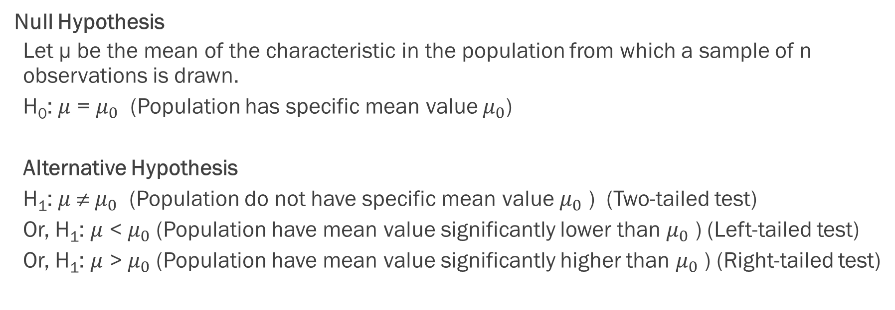
Hypothesis
Null Hypothesis
Let µ be the mean of the characteristic in the population from which a sample of n observations is drawn.
H₀: $μ$ = $μ_{0}$ (Population has specific mean value $μ_{0}$)
Alternative Hypothesis
H₁: $μ$ ≠ $μ_{0}$ (Population do not have specific mean value $μ_{0}$ ) (Two-tailed test)
Or, H₁: $μ$ < $μ_{0}$(Population have mean value significantly lower than $μ_{0}$ ) (Left-tailed test)
Or, H₁: $μ$ > $μ_{0}$(Population have mean value significantly higher than $μ_{0}$ ) (Right-tailed test)

Slide 5
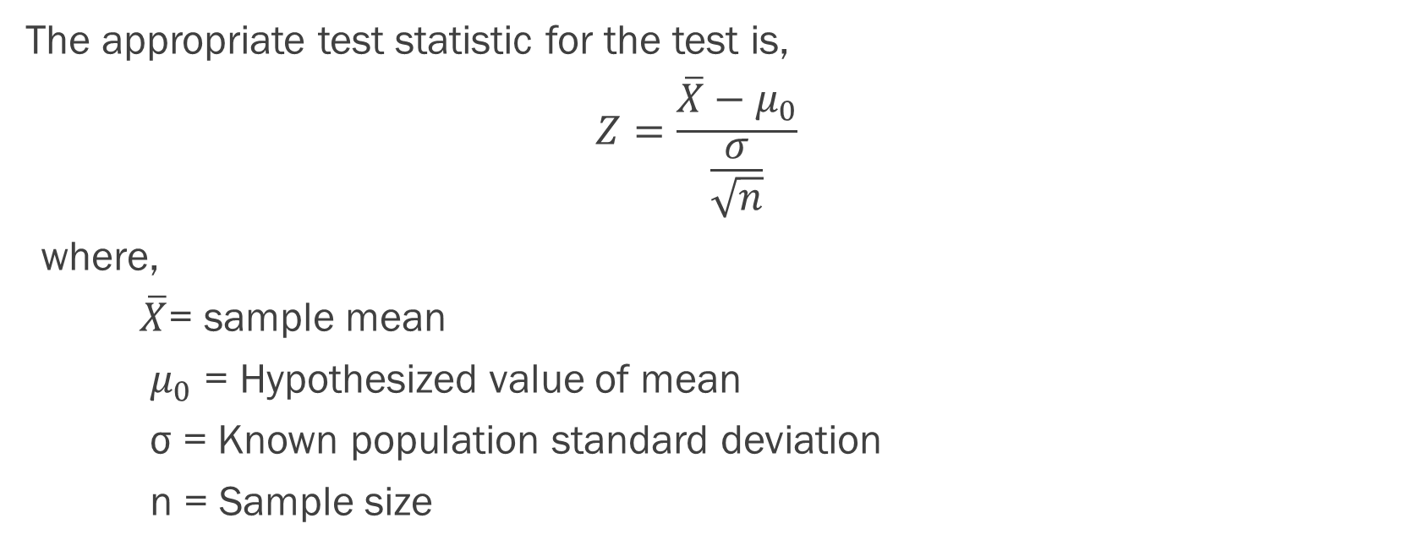
Test statistics
The appropriate test statistic for the test is,
$$Z=\frac{\overline{X}−μ_{0}}{\frac{σ}{\sqrt{n}}}$$
where,
$\overline{X}$= sample mean
$μ_{0}$ = Hypothesized value of mean
σ = Known population standard deviation
n = Sample size

Slide 6
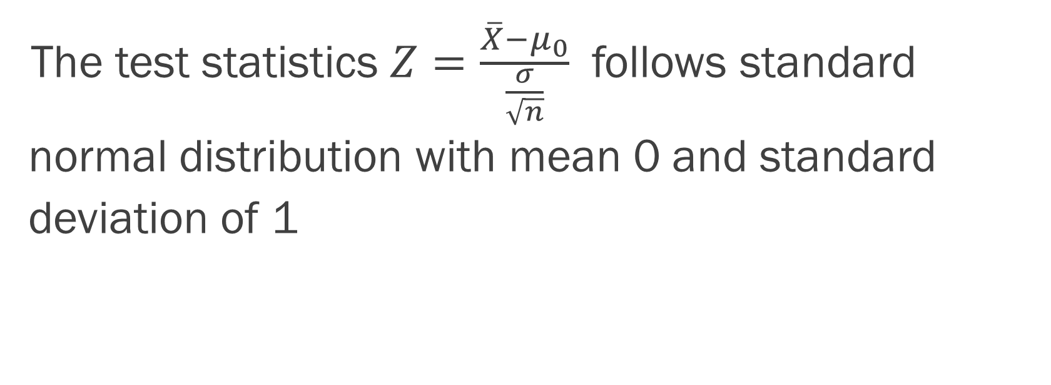
Distribution of test statistics
The test statistics $Z=\frac{\overline{X}−μ_{0}}{\frac{σ}{\sqrt{n}}}$ follows standard normal distribution with mean 0 and standard deviation of 1

Slide 7
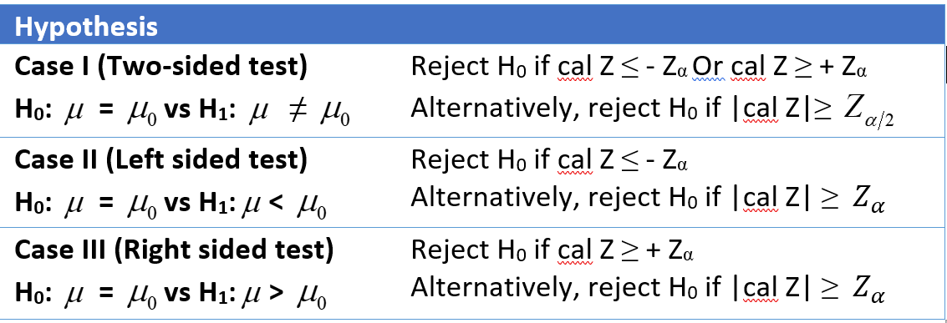
Decision Rule
We adopt following decision rule

Slide 8
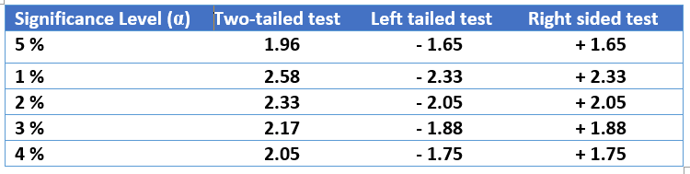
Critical value of Z

Slide 9
Calculating p-value
Two-tailed test: p-value = 2 x P (Z > cal Z)
Left-tailed test: p-vale = P (Z < cal Z)
Right-tailed test: p-value = P (Z > cal Z)

