Slide 1
Chi-square test of goodness of fit
Santosh Chhatkuli

Slide 2
Function of the test
The chi-square test of goodness of fit determines whether observed frequency distribution follows some theoretical or specified distribution. So, this test is used when researcher want to test whether the observed frequency distribution of a single categorical variable matches an expected distribution.

Slide 3
Test Assumptions
The test is designed for categorical data where observations are divided into distinct groups or categories.
The data should be obtained through random sampling from the population to ensure representativeness.
The observations must be independent of each other. This means that the occurrence of one observation does not influence the probability of another.
The sample size should be large enough to provide meaningful results. In particular the expected frequency for each category/class must be at least 5. If some expected frequencies are less than 5, it may affect the accuracy of the test and could require combining categories so that this condition can be met
The total number of observations (n) should be fixed before the test is conducted.

Slide 4
Hypothesis to test
H_{O}: the observed frequencies are according to the distribution specified
H₁: the observed frequencies are not according to the distribution specified

Slide 5
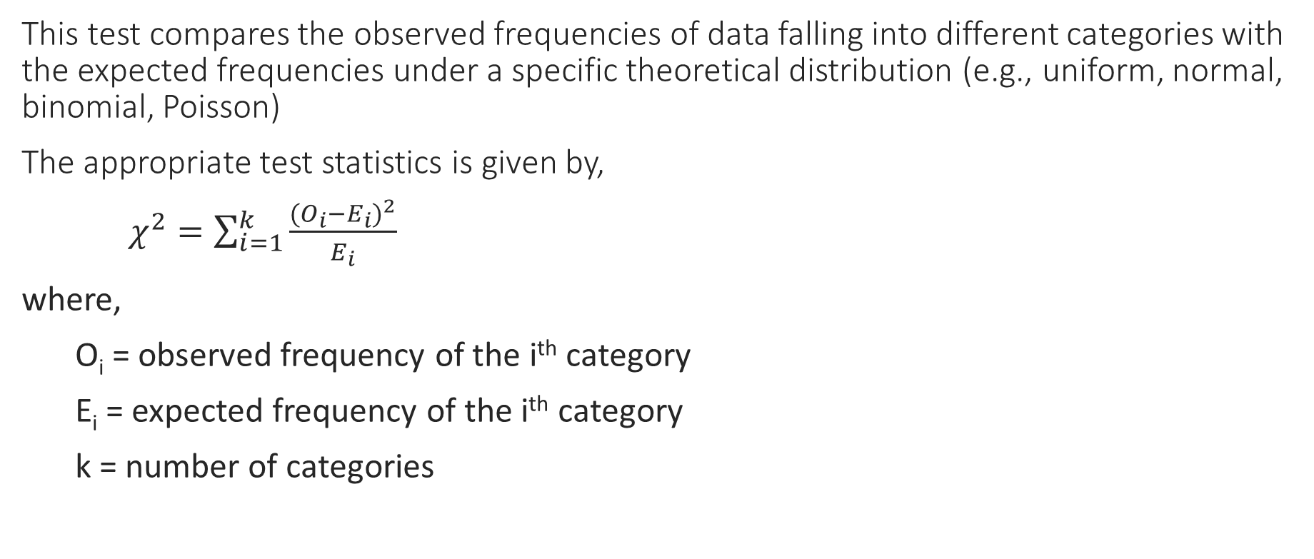
Test Statistics
This test compares the observed frequencies of data falling into different categories with the expected frequencies under a specific theoretical distribution (e.g., uniform, normal, binomial, Poisson)
The appropriate test statistics is given by,
$χ^{2}=\sum_{i=1}^{k}{\frac{(O_{i}−E_{i})^{2}}{E_{i}}}$
where,
O_{i} = observed frequency of the i^{th} category
E_{i} = expected frequency of the i^{th} category
k = number of categories

Slide 6
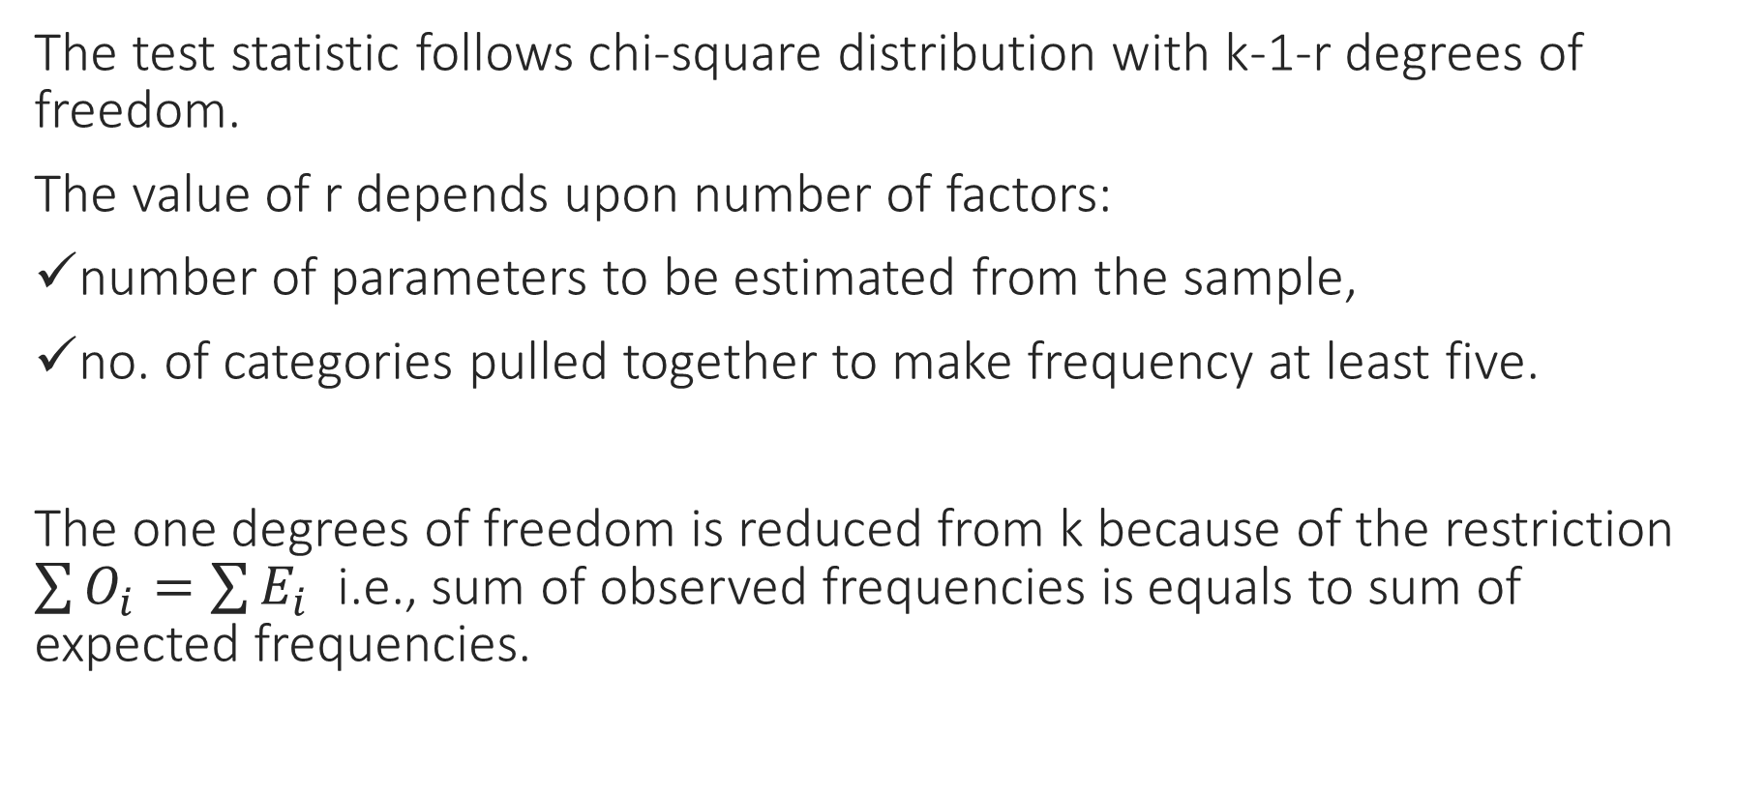
Distribution of test statistics
The test statistic follows chi-square distribution with k-1-r degrees of freedom.
The value of r depends upon number of factors:
number of parameters to be estimated from the sample,
no. of categories pulled together to make frequency at least five.
The one degrees of freedom is reduced from k because of the restriction $\sum{O_{i}}=\sum{E_{i}}$ i.e., sum of observed frequencies is equals to sum of expected frequencies.

Slide 7
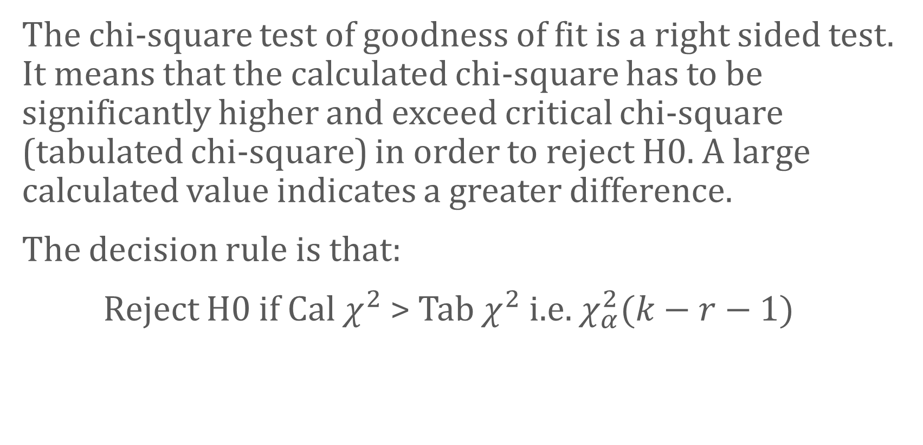
Decision Rule
The chi-square test of goodness of fit is a right sided test. It means that the calculated chi-square has to be significantly higher and exceed critical chi-square (tabulated chi-square) in order to reject H0. A large calculated value indicates a greater difference.
The decision rule is that:
Reject H0 if Cal $χ^{2}$ > Tab $χ^{2}$ i.e. $χ_{α}^{2}(k−r−1)$

