Slide 1
Completely Randomized Design (CRD)
Santosh Chhatkuli

Slide 2
Introduction
In completely randomized design we study the effect of one primary factor only. The experiment compares the values of a response variable based on the different levels of that primary factor. In this design the different levels of primary factor are assigned completely at random so that each experimental unit has the same chance of receiving any one of the treatment level of the factor.

Slide 3
Principle used in CRD
Completely randomization design involves only two principles. They are:
Randomization
Replication
- equal replication
- unequal replication
There is no blocking element in CRD.

Slide 4
Randomization in Crd
The randomization can be done by using one of the following tools:
1. Computer software:
Example: Design expert (Stat-Ease)
URL: https://www.statease.com/software/design-expert
2. Random number table
3. Physical mechanisms
- Drawing cards
- Drawing the slips of papers

Slide 5
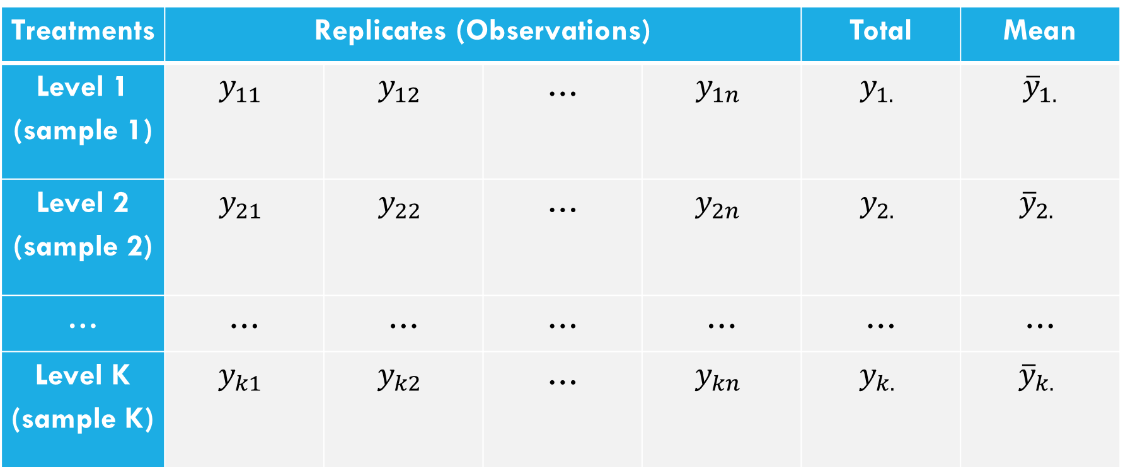
One-way layout
Suppose, we have k different levels or treatments of a single factor that we wish to compare. The observed response from each of the treatment is a random variable.
The following table shows the typical data for a single-factor experiment having equal replication.
Treatments | Replicates (Observations) |  |  |  | Total | Mean
Level 1 (sample 1) | $$y_{11}$$ | $$y_{12}$$ | … | $$y_{1n}$$ | $$y_{1.}$$ | $${\overline{y}}_{1.}$$
Level 2 (sample 2) | $$y_{21}$$ | $$y_{22}$$ | … | $$y_{2n}$$ | $$y_{2.}$$ | $${\overline{y}}_{2.}$$
… | … | … | … | … | … | …
Level K (sample K) | $$y_{k1}$$ | $$y_{k2}$$ | … | $$y_{kn}$$ | $$y_{k.}$$ | $${\overline{y}}_{k.}$$

Slide 6
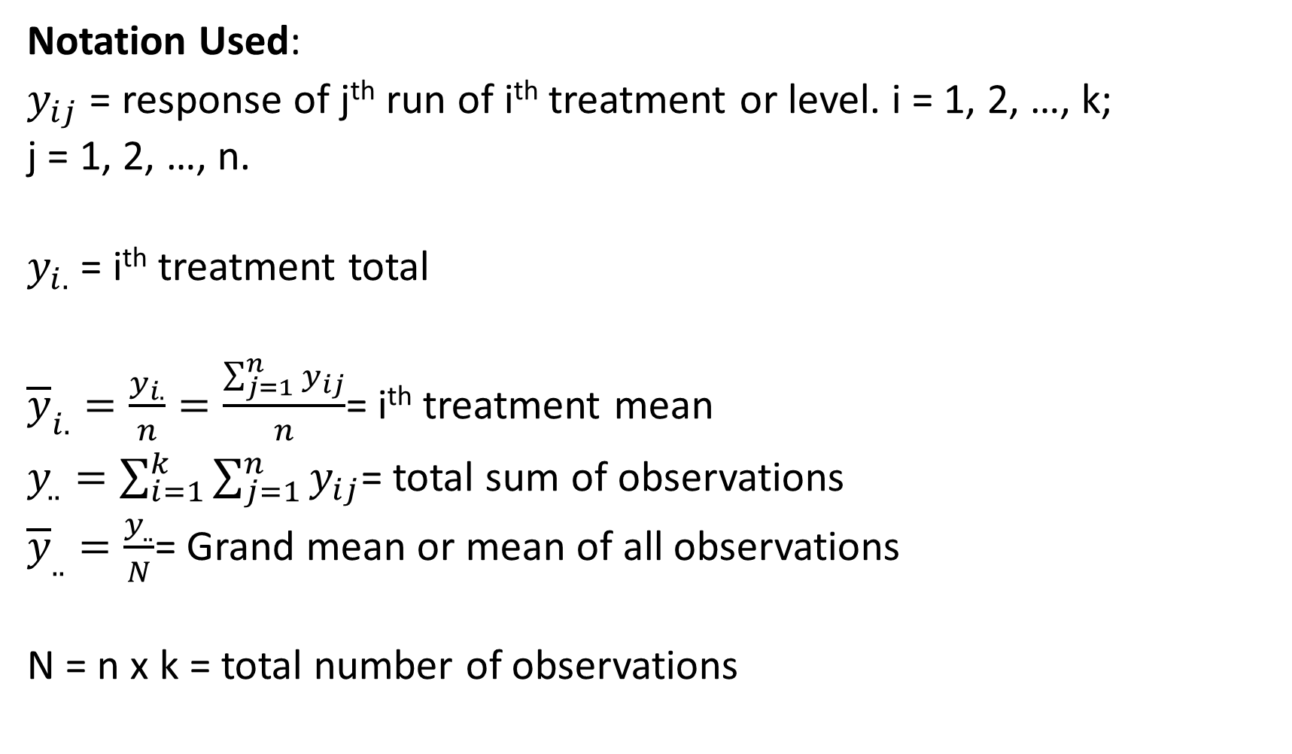
Notation Used:
$y_{ij}$ = response of j^{th} run of i^{th} treatment or level. i = 1, 2, …, k;
j = 1, 2, …, n.
$y_{i.}$ = i^{th} treatment total
${\overline{y}}_{i.}=\frac{y_{i.}}{n}=\frac{\sum_{j=1}^{n}{y_{ij}}}{n}$= i^{th} treatment mean
$y_{..}=\sum_{i=1}^{k}{\sum_{j=1}^{n}{y_{ij}}}$= total sum of observations
${\overline{y}}_{..}=\frac{y_{..}}{N}$= Grand mean or mean of all observations
N = n x k = total number of observations

Slide 7
Hypothesis to test
We have to test equality of k treatment means i.e. homogeneity of k different levels of factor A. Let μ₁, μ₂, …, μ_{k} be the mean response produced by 1st, 2nd , and k^{th} level of factor A respectively.
Null Hypothesis
H₀: μ₁ = μ₂ = … = μ_{k} (all k population means are equal)
Alternative Hypothesis
H_{A}: At least two of the means are not equal (at least one mean is different from at least one other mean)

Slide 8
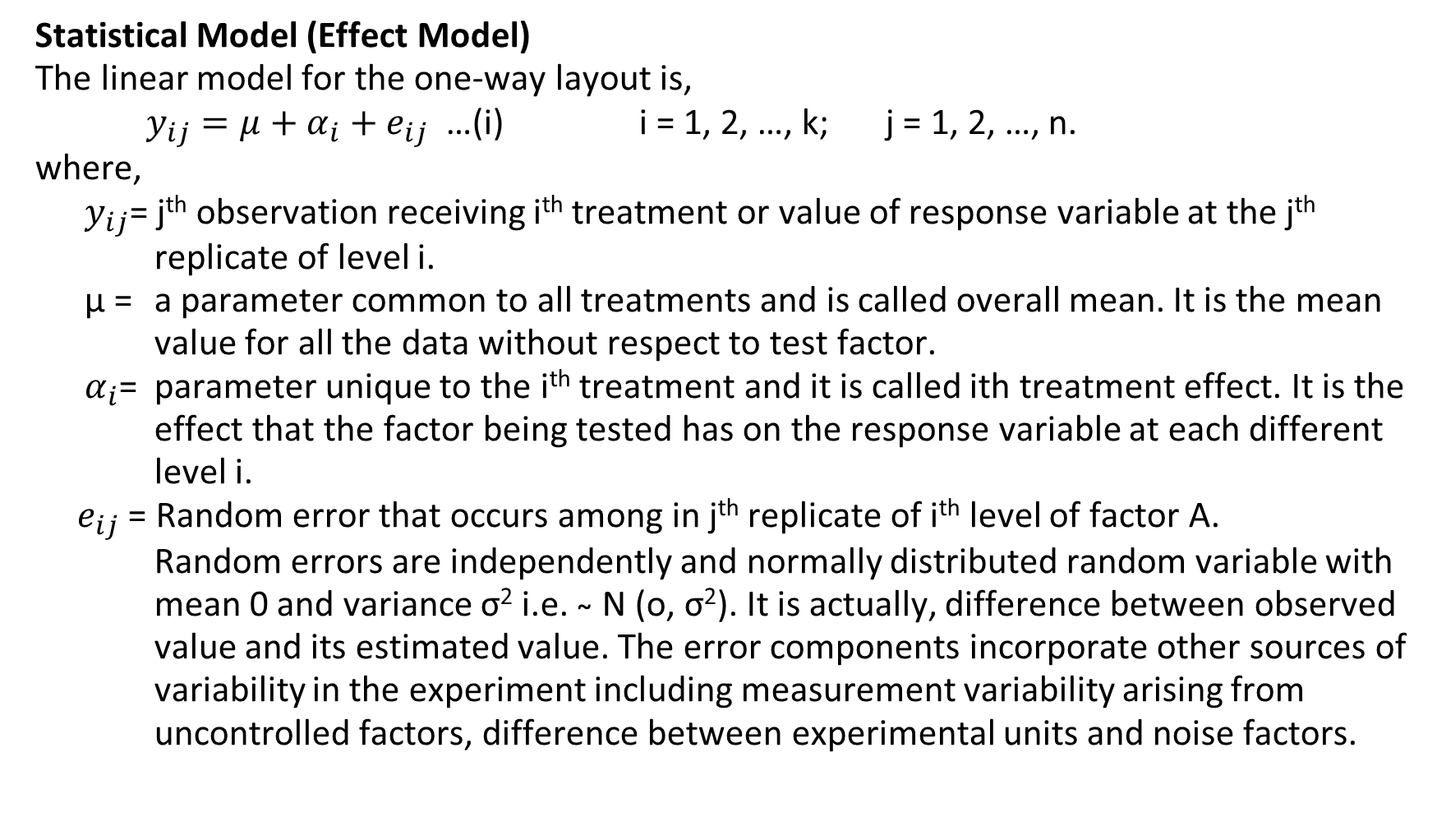
Statistical Model (Effect Model)
The linear model for the one-way layout is,
$y_{ij}=μ+α_{i}+e_{ij}$ …(i) i = 1, 2, …, k; j = 1, 2, …, n.
where,
$y_{ij}$= j^{th} observation receiving i^{th} treatment or value of response variable at the j^{th} replicate of level i.
μ = a parameter common to all treatments and is called overall mean. It is the mean value for all the data without respect to test factor.
$α_{i}$= parameter unique to the i^{th} treatment and it is called ith treatment effect. It is the effect that the factor being tested has on the response variable at each different level i.
$e_{ij}$ = Random error that occurs among in j^{th} replicate of i^{th} level of factor A.
Random errors are independently and normally distributed random variable with mean 0 and variance σ² i.e. ̴ N (o, σ²). It is actually, difference between observed value and its estimated value. The error components incorporate other sources of variability in the experiment including measurement variability arising from uncontrolled factors, difference between experimental units and noise factors.

Slide 9
Statistical analysis of Crd
The main idea of CRD is to compare treatment levels of a primary factor A. One-way ANOVA tool is used to test the hypothesis that treatment means are not significantly different from one another.
There are two sources of variations among N observations obtained from a CRD. They are:
Treatment variation
Random variation (Experimental error)
We compare the variation between treatments with variation among treatments. The relative size of the two is used to indicated whether the observed difference between treatments means is real or different.

Slide 10
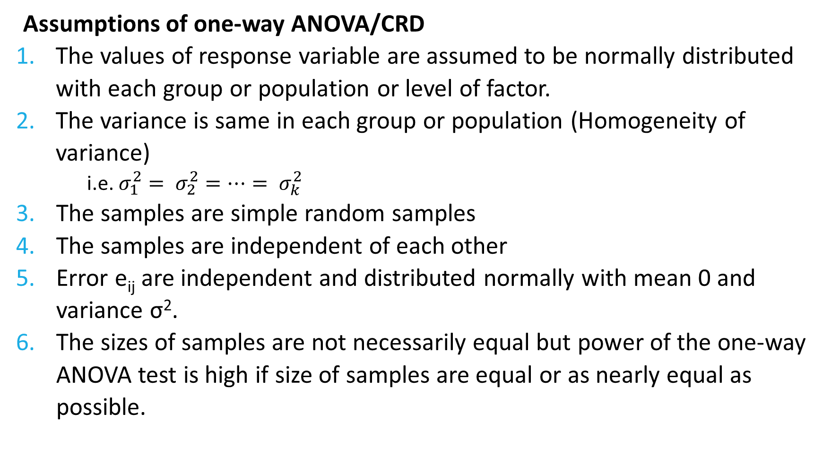
Assumptions of one-way ANOVA/CRD
The values of response variable are assumed to be normally distributed with each group or population or level of factor.
The variance is same in each group or population (Homogeneity of variance)
i.e. $σ_{1}^{2}= σ_{2}^{2}=…= σ_{k}^{2}$
The samples are simple random samples
The samples are independent of each other
Error e_{ij} are independent and distributed normally with mean 0 and variance σ².
The sizes of samples are not necessarily equal but power of the one-way ANOVA test is high if size of samples are equal or as nearly equal as possible.

Slide 11
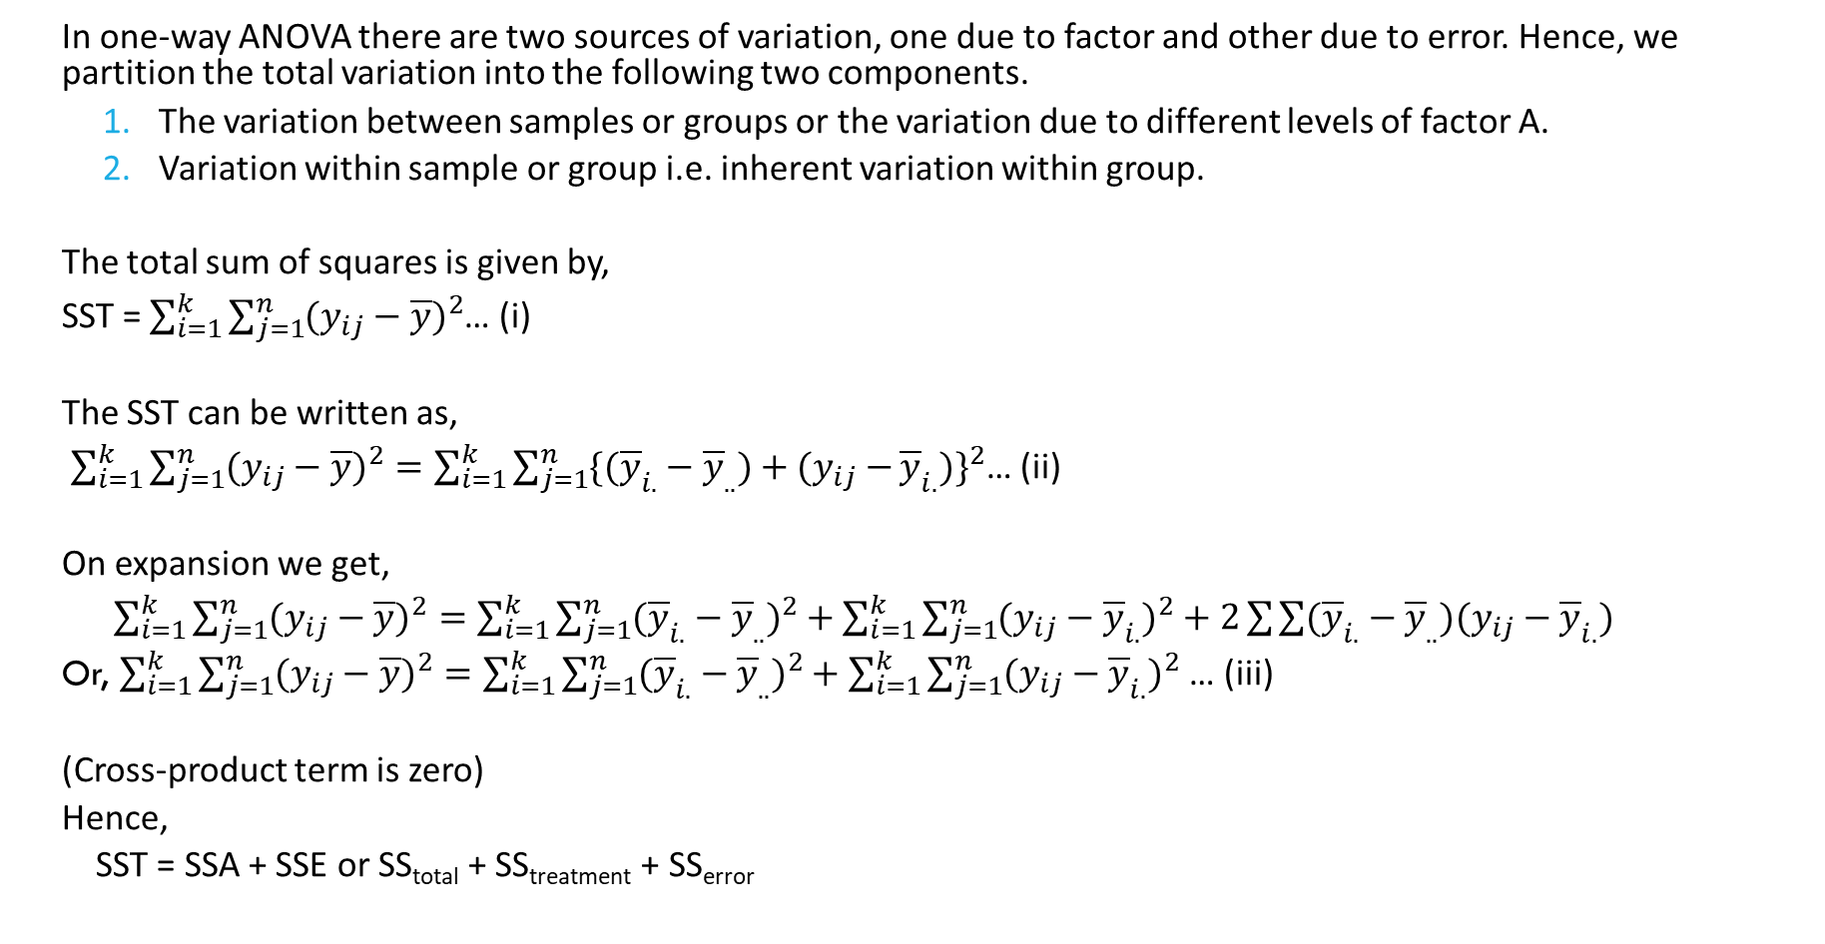
Splitting of total sum of square (SST)
In one-way ANOVA there are two sources of variation, one due to factor and other due to error. Hence, we partition the total variation into the following two components.
The variation between samples or groups or the variation due to different levels of factor A.
Variation within sample or group i.e. inherent variation within group.
The total sum of squares is given by,
SST = $\sum_{i=1}^{k}{\sum_{j=1}^{n}{(y_{ij}−\overline{y}})^{2}}$… (i)
The SST can be written as,
$\sum_{i=1}^{k}{\sum_{j=1}^{n}{(y_{ij}−\overline{y})^{2}=\sum_{i=1}^{k}{\sum_{j=1}^{n}{\{({\overline{y}}_{i.}−{\overline{y}}_{..})+(y_{ij}−}}}}{\overline{y}}_{i.})\}^{2}$… (ii)
On expansion we get,
$\sum_{i=1}^{k}{\sum_{j=1}^{n}{(y_{ij}−\overline{y})^{2}=\sum_{i=1}^{k}{\sum_{j=1}^{n}{({\overline{y}}_{i.}−{\overline{y}}_{..})^{2}+\sum_{i=1}^{k}{\sum_{j=1}^{n}{(y_{ij}−{\overline{y}}_{i.})^{2}}}+2}}}}\sum{\sum{({\overline{y}}_{i.}−{\overline{y}}_{..})(y_{ij}−{\overline{y}}_{i.})}}$
Or, $\sum_{i=1}^{k}{\sum_{j=1}^{n}{(y_{ij}−\overline{y})^{2}=\sum_{i=1}^{k}{\sum_{j=1}^{n}{({\overline{y}}_{i.}−{\overline{y}}_{..})^{2}+\sum_{i=1}^{k}{\sum_{j=1}^{n}{(y_{ij}−{\overline{y}}_{i.})^{2}}}}}}}$ … (iii)
(Cross-product term is zero)
Hence,
SST = SSA + SSE or SS_{total} + SS_{treatment} + SS_{error}

Slide 12
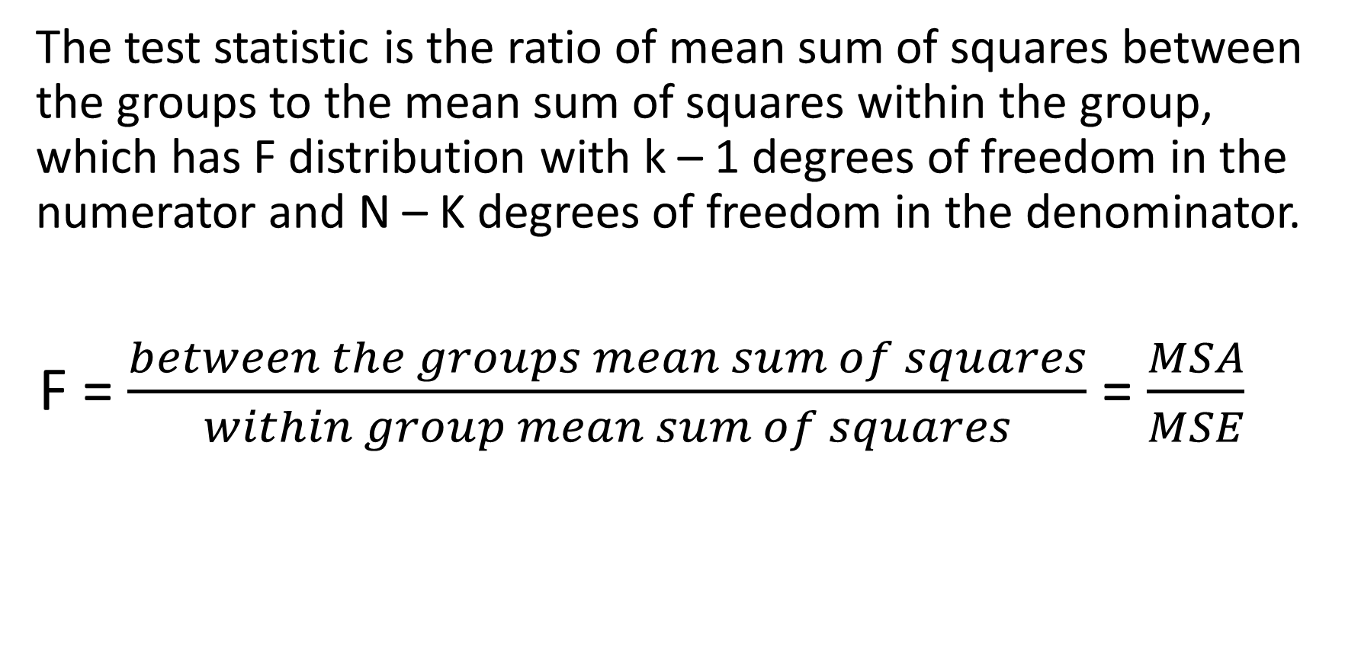
Test Statistics
The test statistic is the ratio of mean sum of squares between the groups to the mean sum of squares within the group, which has F distribution with k – 1 degrees of freedom in the numerator and N – K degrees of freedom in the denominator.
F = $\frac{between the groups mean sum of squares}{within group mean sum of squares}$ = $\frac{MSA}{MSE}$

Slide 13
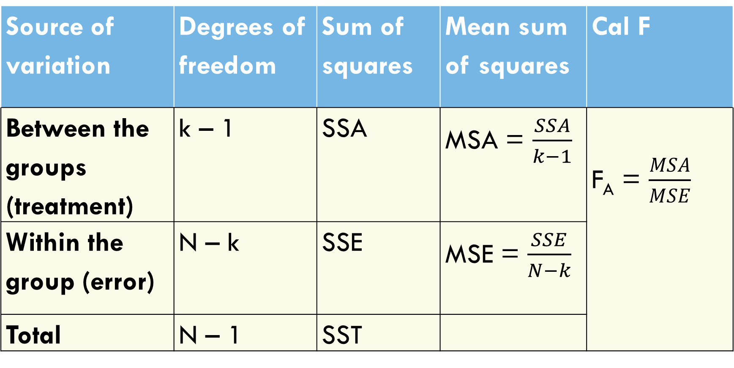
One-way anova table
Source of variation | Degrees of freedom | Sum of squares | Mean sum of squares | Cal F
Between the groups (treatment) | k – 1 | SSA | MSA = $\frac{SSA}{k−1}$ | F_{A} = $\frac{MSA}{MSE}$
Within the group (error) | N – k | SSE | MSE = $\frac{SSE}{N−k}$
Total | N – 1 | SST

Slide 14
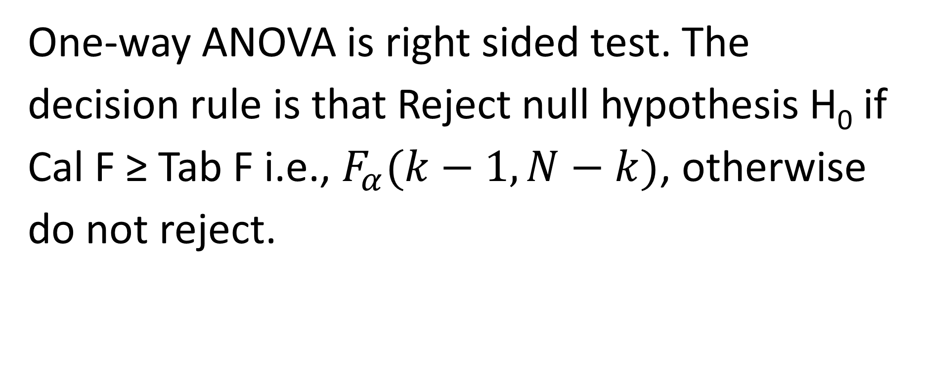
Decision Rule
One-way ANOVA is right sided test. The decision rule is that Reject null hypothesis H₀ if Cal F ≥ Tab F i.e., $F_{α}(k−1, N−k)$, otherwise do not reject.

Slide 15
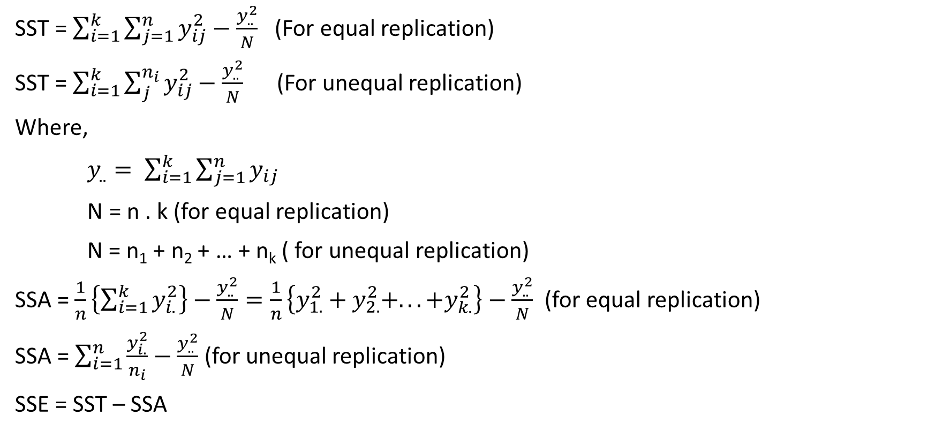
Short-cut formula for computing ss
SST =$\sum_{i=1}^{k}{\sum_{j=1}^{n}{y_{ij}^{2}}}−\frac{y_{..}^{2}}{N}$ (For equal replication)
SST =$\sum_{i=1}^{k}{\sum_{j}^{n_{i}}{y_{ij}^{2}}}−\frac{y_{..}^{2}}{N}$ (For unequal replication)
Where,
$y_{..}= \sum_{i=1}^{k}{\sum_{j=1}^{n}{y_{ij}}}$
N = n . k (for equal replication)
N = n₁ + n₂ + … + n_{k} ( for unequal replication)
SSA = $\frac{1}{n}\left\{\sum_{i=1}^{k}{y_{i.}^{2}}\right\}−\frac{y_{..}^{2}}{N}=\frac{1}{n}\left\{y_{1.}^{2}+y_{2.}^{2}+...+y_{k.}^{2}\right\}−\frac{y_{..}^{2}}{N}$ (for equal replication)
SSA = $\sum_{i=1}^{n}{\frac{y_{i.}^{2}}{n_{i}}−\frac{y_{..}^{2}}{N}}$ (for unequal replication)
SSE = SST – SSA

Slide 16
Advantages of crd
Simplicity: CRD is straightforward to implement and analyzed, making it suitable for simple experiments setups. Researchers randomly assign treatments to experimental units without any restrictions, which simplifies the experimental process.
Flexibility: The design if very flexible. Any number of treatments can be used and treatments can be replicated unequal no. of times. Further, CRD allows for easy addition or removal of treatment, making it adaptable to changes in experimental conditions or research objectives.
Degrees of freedom: It provides maximum degrees of freedom for the estimation of error variance.
Ease of analysis: Statistical analysis is relatively simple.
Missing observation: Loss of information due to missing data is smaller compared to other design.

Slide 17
Disadvantages of Crd
Lack of control: CRD does not account for potential sources of variation or confounding variables that may influence the outcome variable. This can lead to reduced precision and increased variability in the estimates of treatment effects.
Inefficiency: In situations where there are known sources of variability that could be controlled for, CRD may be less efficient than other experimental designs such as RBD and LSD.
Low statistical power: CRD does not allow for the blocking of nuisance variables or known sources of variation, which can lead to increased variability and reduced power to detect treatment effects.

Slide 18
Numerical example
An electronics engineer is interested in the effect on tube conductivity of five different types of coating for cathode ray tubes used in a telecommunications system display device. The following conductivity data are obtained.
Coating Type Conductivity
1 143 141 150 146
2 152 149 137 143
3 134 133 132 127
4 129 127 132 129
5 147 148 144 142
(a) Is there any difference in conductivity due to coating type? Use α = 0.05
(b) Estimate the overall mean and the treatment effects

